Slide 1
National Geodetic Survey’s
National Height Modernization
Program Overview
Austin, Texas
October 22-24, 2009
Renee Shields
Height Modernization Manager

Slide 2
Overview
NGS Mission and Height Modernization Overview
Needs and Benefits of Accurate Heights
NGS Roles and Responsibilities

Slide 3
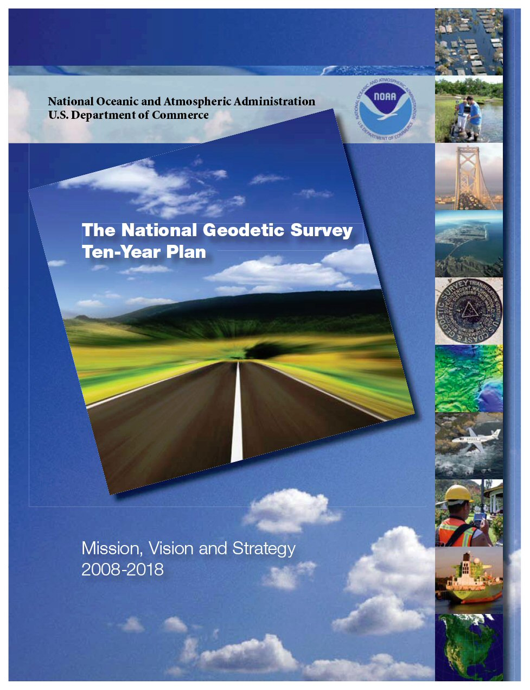
The National Geodetic Survey 10 year plan -- Mission, Vision and Strategy 2008-2018
To define, maintain and provide access to the National Spatial Reference System to meet our nation’s economic, social, and environmental needs
2018 Targets:
  NAD 83 and NAVD 88 replaced
  Modernize the Geopotential (Vertical) Datum
http://www.ngs.noaa.gov/INFO/NGS10yearplan.pdf
Notes:
Specific points to be made are that a simultaneous redefinition of both NAD 83 and NAVD 88 will be made and that GNSS and the geoid model will be the tools to access them.

Slide 4
From the NGS 10-Year Plan
Define the NSRS
  “The NSRS must be more accurate than all activities which build upon it, while still being practicably achievable.”
Maintain the NSRS
  “NGS must track all of the temporal changes to the defining points of the NSRS in such a way as to always maintain the accuracy in the NSRS definition.”
Provide Access to the NSRS
  “NGS must develop and maintain guidelines for users to access the NSRS at a variety of accuracies.”
  “NGS will publish all coordinates of defining points of the NSRS with an epoch tag and will furthermore publish velocities relative to that epoch-tagged set of coordinates”
http://geodesy.noaa.gov/INFO/ngs_tenyearplan.pdf

Slide 5
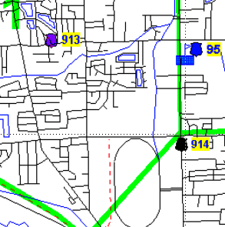
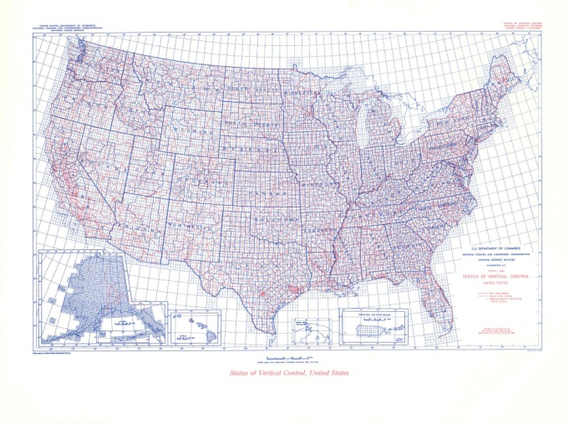
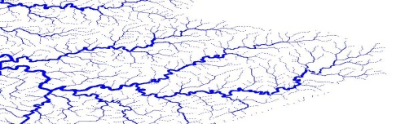
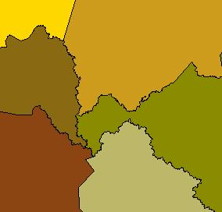
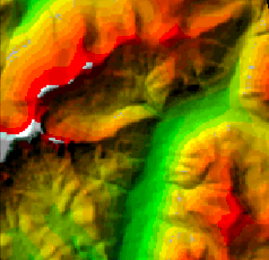
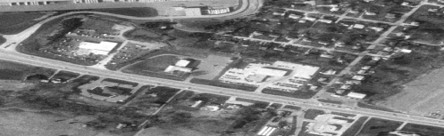
Height Modernization Objective
NSRS
NSRS
NAVD88
GEODETIC CONTROL
Reliable
Accurate
Cost-effective
Standardized
Legally Established
Notes:
Information about where an object or feature is or where an event takes place is known as spatial data. We use spatial data all the time.
National Spatial Reference System – a consistent coordinate system that defines latitude, longitude, height, scale, gravity, and orientation throughout the United States and how these values change with time. Comprised of an accurate, up-to-date national shoreline, a network of CORS (Continuously Operating Reference Stations), a network of ground monuments, and a set of accurate models that describe processes affecting spatial measurements.
Spatial data is crucial to economy, resource management, the environment and emergency response.
Transportation - Surface waters - Boundaries - Geodetic control - Elevation - Aerial imagery
National Spatial Data Infrastructure – Formalized effort of the federal, state and local government, private groups to develop and use a consistent, reliable means to share spatial data.
Geodetic control is NGS’ responsibility.

Slide 6
Height Modernization is …
…the establishment of accurate, reliable heights using GNSS technology in conjunction with traditional leveling, gravity, and modern remote sensing information….

Slide 7
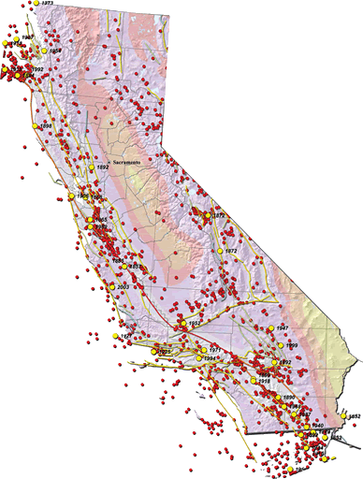
The Roots of Height Modernization
In 1994 - First meeting held in Sacramento, CA
  Some heights in CA in error by more than a meter
  GPS could be immediately used to meet some of California’s requirements
  Necessary for the implementation of NAVD 88
In 1998, $1.0 M was added to NGS budget to perform Height Modernization Study
Notes:
History
California first state to draw attention to deficit in NAVD 88. Hard to pin down movement in CA. A lot of the state did not get adjusted in NAVD 88. Especially southern California because the leveling was so old. Grassroots effort to begin Height Modernization.
Earthquakes shown as red are > or = to 4.0 and occurred between 1852-2001
Earthquakes shown in yellow are > or = 6.5 and occurred between 1852-2003
In 1997, Height Modernization was mentioned in our appropriation language for the first time. No money allocated, but NGS encouraged to investigate the concept of height modernization.
In 1998, $1.0 M was added to NGS budget to perform Height Modernization Study.
In 1999, Height Modernization not mentioned.

Slide 8
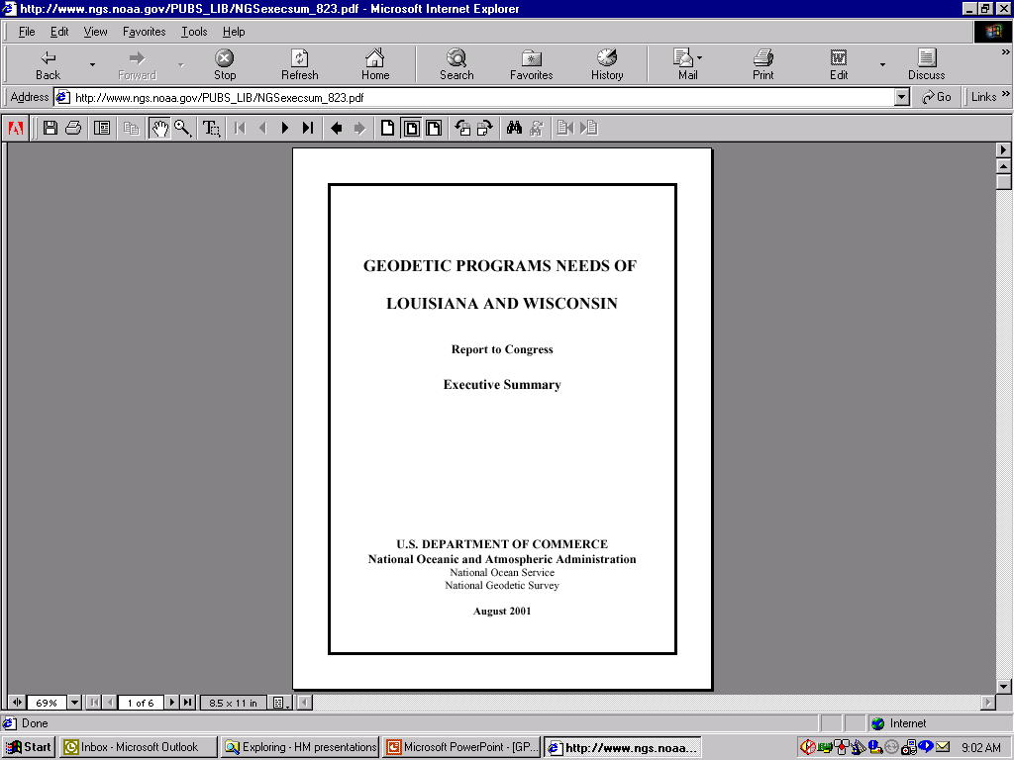
The Roots of Height Modernization
In 2000, $500K added to NGS’ budget for Height Modernization planning
In 2001, $2.25M added to NGS budget
  to implement Height Modernization in NC
  to support the California Spatial Reference Center (CSRC)
  to support NGS related Height Modernization activities
Also in 2001, NOAA is directed to work with LA and WI to assess their requirements for Height Modernization
Notes:
In 1999, Height Modernization not mentioned.
In 2000, $500K added to NGS budget to perform Height Modernization planning
In 2001, $2.25 M added to NGS budget to perform Height Modernization in North Carolina, to support the California Spatial Reference Center (CSRC), and to support NGS related Height Modernization activities.
Also In June 2001, NGS was directed to report to Congress about the Height Mod needs of Louisiana and Wisconsin. Louisiana had similar issues with data not being adjusted into NAVD 88. (Due to subsidence). Wisconsin had a very active Height Mod program by the DOT. Very active in GIS. Problems with obsolete geodetic control and rapid land loss thru subsidence and erosion.

Slide 9
Height Modernization Program Timeline
2002-2006 – Program expanded to 11 states through Congressionally directed earmarks
2007 – Program funded at previous year’s levels but without Congressional Direction
2008 – Appropriations includes Height Modernization line plus earmarks, but total funding is decreased
Notes:
History
In 2002-2006, steady increase in funds and states, still through earmark process; Earmarks have to be applied for through a grant award process, but the funding is not competed. The amount and recipient are pre-designated.
In 2007, turnover in parties on the Hill, very late in fiscal year passing appropriations, chose to fund at same level as in 2006, but with no designated recipients; earmark was becoming a dirty word. Through NOAA guidance we advertised a funding opportunity in the federal grant program through Grants.gov. Since the time frame was very short, only states previously funded got applications in on time. We were able to fund ALL previously funded states, though not at levels requested.
In 2008, Appropriations included both height mod “line” plus earmarks, but total funding was cut significantly
In 2009, see next slide, but essentially the same cuts. The lion’s share of funding went to a small group of states through earmarks, but the line was still down, and we had many more states applying for funding. We also thought we’d get some funding through the American Recovery and Reinvestment Act (ARRA, aka stimulus), but all funding that came to National Ocean Service went to the Office of Coast Survey for hydrographic charting)

Slide 10
Height Modernization Appropriations
(FY01-FY09)
Fiscal Year | Appropriations | States
FY 2001 | 2.25 M | CA, NC
FY 2002 | 3.75 M | CA, NC, LA, WI
FY 2003 | 3.75 M | CA, NC, LA, WI, MS
FY 2004 | 9.0 M | CA, NC, LA, WI, MS, AL, WA, SC
FY 2005 | 9.6 M | CA, NC, LA, WI, MS, AL, WA, TX, KY
FY 2006 | 9.9 M | CA, NC, WI, MS, AL, SC, TX, KY, AZ
FY 2007 | 9.9 M | “without direction”
FY 2008 | 4.995 M + 1.152 M | Line + AL, KY, IL
FY2009 | $2.54 M + 9.06 M | Line + earmarks (AL, MS, LA, IL, WI) + stimulus?
Notes:
FY 2001: CA 1.0M, NC 1.0M, NGS 0.25M
FY 2002: CA 1.0M, NC 1.0M, LA 1.0M, WI 0.5M
FY 2003: CA 1.0M, NC 1.0M, LA 0.5M, WI 0.5M, MS 0.5M
FY 2004: CA 1.0M, NC 1.0M, LA 0.5M, WI 3.0M, MS 0.5M, AL 2.0M, SC 0.5M, WA 0.5M
FY 2005: CA 0.5M, NC 1.0M, LA 0.5M, WI 3.0M, MS 0.6M, AL 2.0M, WA 0.5M, KY 0.5M, TX 0.75, NGS 0.25M
FY 2006: CA 0.93M, NC 0.93M, WI 3.0M, MS 0.6M, AL 1.97M, SC 0.467M, KY 0.5M, TX 1.6M, AZ 0.5M, NGS 0.233M
Note: GRAV-D is yet unfunded, so what support it does get comes in some measure from height mod funds.

Slide 11
FY08 Height Modernization - Recipients
Academic Institutions
  Scripps Oceanographic Institute
  North Carolina A&T University
  Louisiana State University
  University of Southern Mississippi
  Texas A&M Corpus Christi
  Morehead State University
  University of Illinois
  New Mexico State University
State and Local Governments
  North Carolina Geodetic Survey
  South Carolina Geodetic Survey
  State Departments of Transportation: Wisconsin, Michigan, Minnesota, Colorado
  Alabama Department of Revenue
  Washington State Department of Natural Resources
  Arizona State Land Development

Slide 12
Participating and Interested States
X
X
X
States engaged in HM without federal funding assistance
Spatial Reference Centers
Regional Leaders
Other funded partners
Current Funded Partners
Notes:
“X” marks the states 9ID, KS, NJ) that sent in applications in 2009, but with decreased funding we were unable to give them awards.

Slide 13
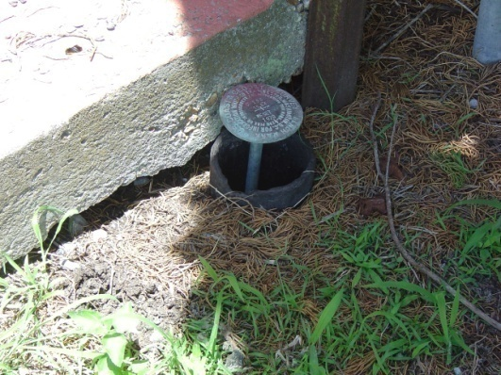
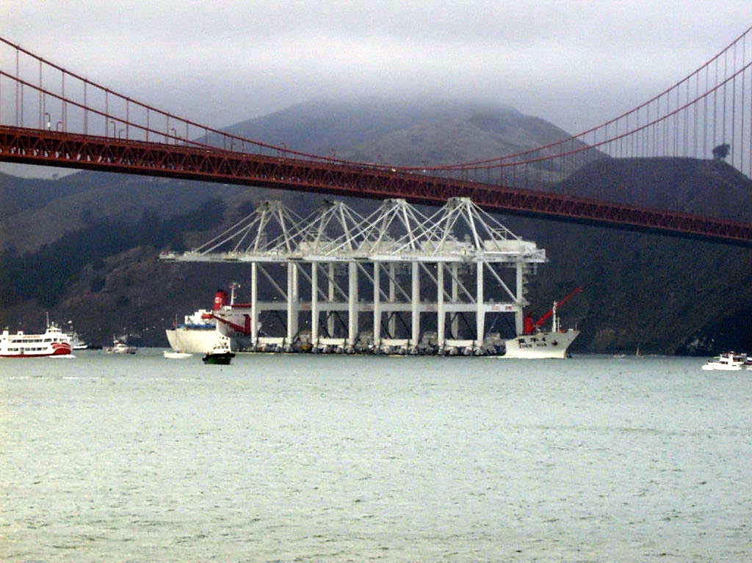
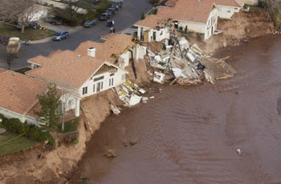
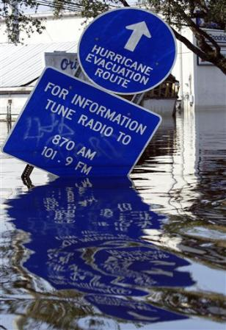
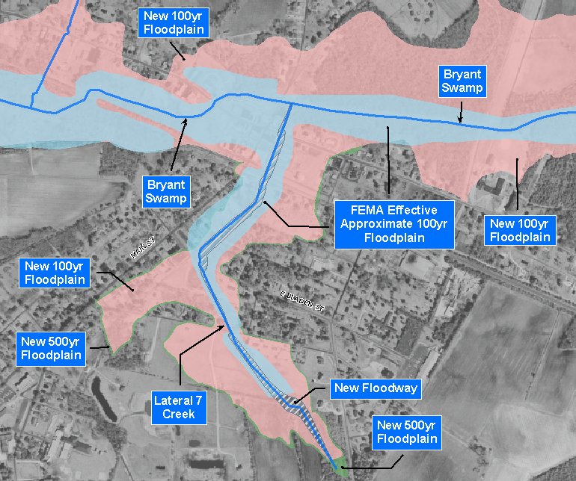
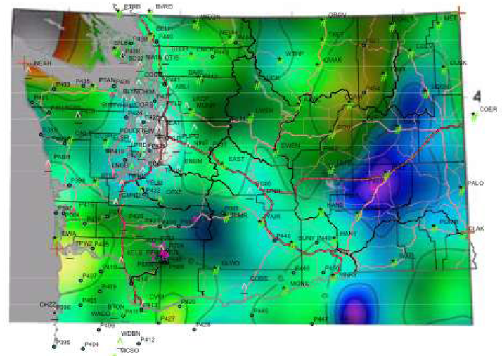
Height Matters
Image credit:: AP Photo/Rick Bowmer
Notes:
Talk about needs and benefits. In groups of surveyors this is preaching to the choir, but many of these examples show the importance of accurate heights to the non-technical users.

Slide 14
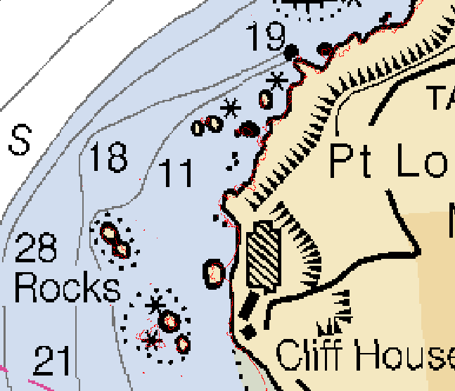
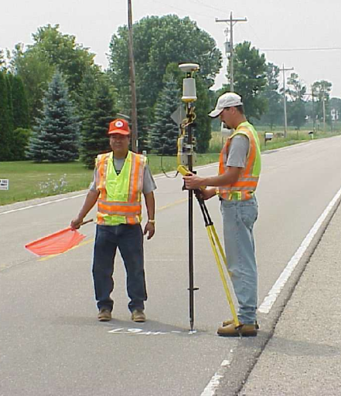
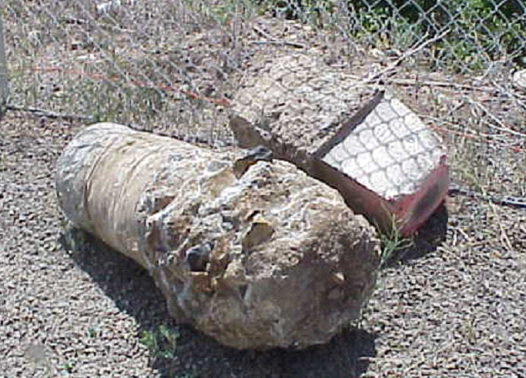
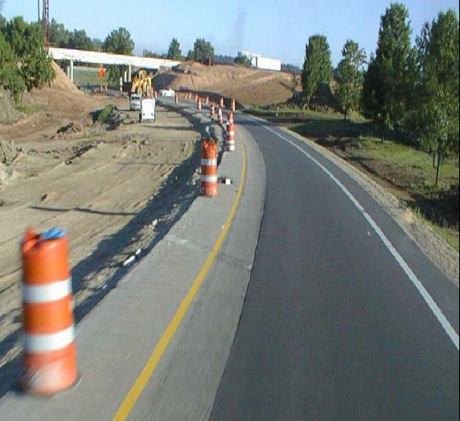
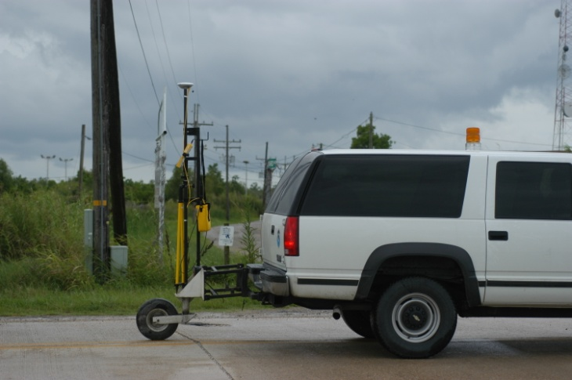
Transportation
Mapping and Charting
Construction, Engineering
Recover decimated control networks
Notes:
CSRC
The Network - 50 Km CORS, 7 Km Corridors
The System - 4 Dimensional, Geodetic Models, Height Datum, Data Distribution, Education & Outreach,
Information Management
Researching procedures leads to development of new specs.
LSRC
View of Plaquemines Parish at Empire and River
Y 195 RESET
Evacuation Route Surveys

Slide 15
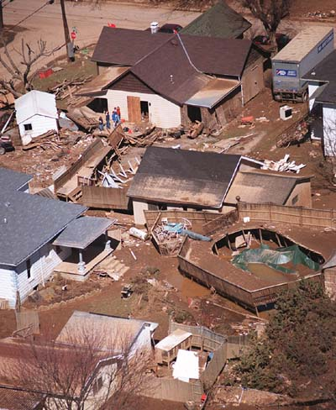
Flooding: river overflow, coastal, storm surge, flash flood
FEMA Map Modernization Program
  Flood Insurance Rate Maps
  Elevation Certificates
  FEMA Cooperative Technical States, e.g. NC
Determining High Water Marks
Evacuation Route Surveys
Damage Mitigation
Notes:
Height Modernization control for floodplain maps and LIDAR surveys
OPUS for floodplain certificates and LIDAR surveys
Subsidence rates, maps, and tools for floodplain managers
Guidelines for use of GPS and LIDAR for floodplain mapping
Height Modernization improves the “foundation” for the determination of floodplain maps for FEMA’s Map Modernization program.
Digitizing maps that are based on outdated, inaccurate heights is not worthwhile – ensuring that the heights used for the floodplain and flood insurance rate map are updated and accurate is critical.
Areas shown in pink delineate the “New 100 yr floodplain” (with HeightMod) – areas in light blue the previous “FEMA Effective Approximate 100yr floodplain” (old survey control)
Builders, owners and planners in “pink” areas now aware that they are in the 100yr floodplain and will be able to insure their property as needed. Future building and zoning will done with better knowledge of elevations and flood risks.
Benefits to FEMA:
Three dimensional geodetic control network to support map modernization
Establish bench marks in remote areas (2 centimeters)
Global Positioning System (GPS) base station network to support collect of elevation (LIDAR and photogrammetry) and imagery
Compared to traditional leveling, GPS heights can be established at a reduced cost
Quickly establish bench marks in declared disaster areas to support recovery and mitigation
Support the development of flood warning systems
Provide elevation data to support dam breach analysis
Potential Products and Tools for Map Modernization
Height Modernization control for floodplain maps and LIDAR surveys
OPUS for floodplain certificates and LIDAR surveys
Subsidence rates, maps, and tools for floodplain managers
Guidelines for use of GPS and LIDAR for floodplain mapping

Slide 16
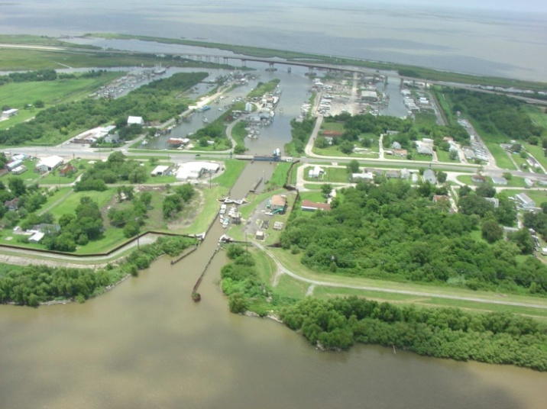
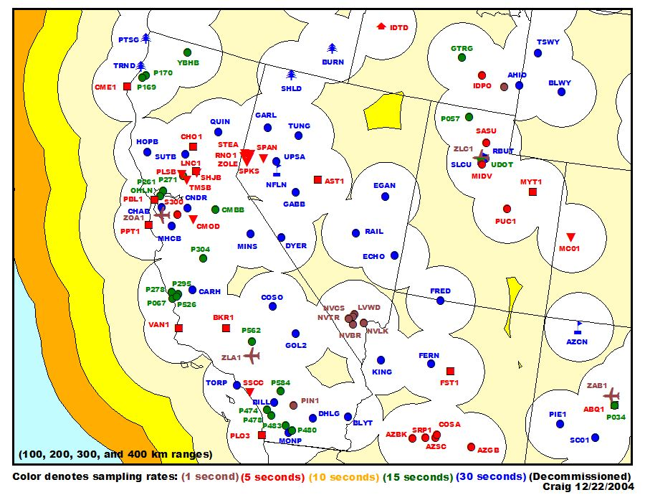
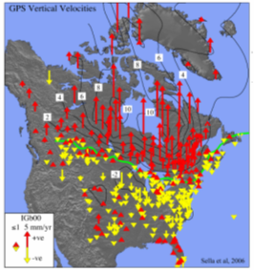
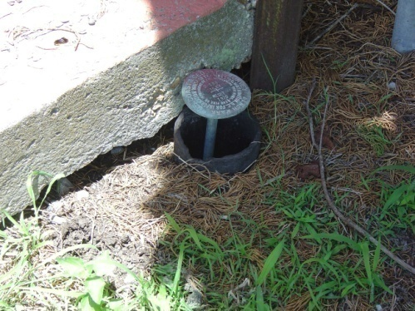
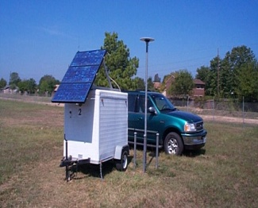
Measure, Monitor, Model - Crustal Motion/ Subsidence/Isostatic Rebound /Seasonal changes
13
MONTGOMERY
17
12
11
7
8
2
9
18
LKHU
19
1
HARRIS
6
3
5
NE
ADKS
HOUSTON
28
15
4
TMC
24
FORT BEND
27
10
16
00
20
14
21
GALVESTON
22
23
26
Notes:
California CORS map is out of date.
Harris Galveston Coastal Subsidence District – have been measuring subsidence from ground water and oil extraction for more than 20 years using semi-portable GPS stations.
Northern part of the country has issues with isostatic readjustment.

Slide 17

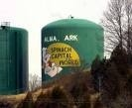
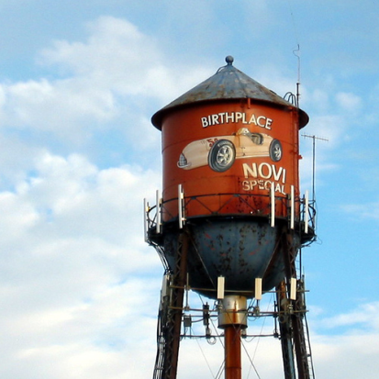
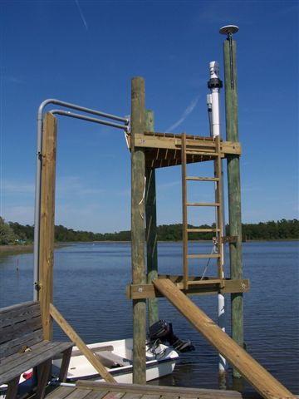

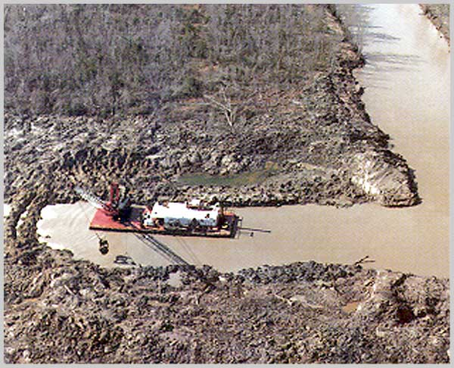
Water Resource Management
Dam Safety
Water resources
Relating tidal and geodetic datums
  Ship transport: underwater/overhead clearance
Folsom dam
Novi Special WT, MI
Notes:
Tying geodetic control to tide gages – connect geodetic and tidal datums, enable distinction between measuring changes in sea level and changes on land.
Other marine navigation issues includes knowing when, where, how much to dredge, and understanding relationships of tidal and geodetic height values to allow safe under keel overhead clearance while maximizing shipping loads.

Slide 18
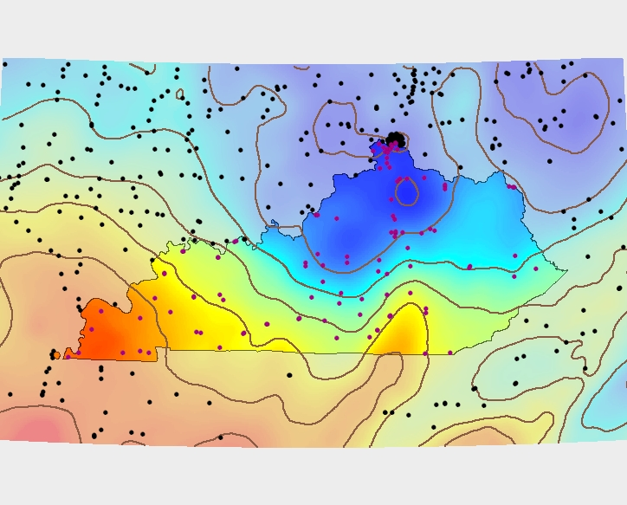
DEMs, Geoid modeling

Slide 19
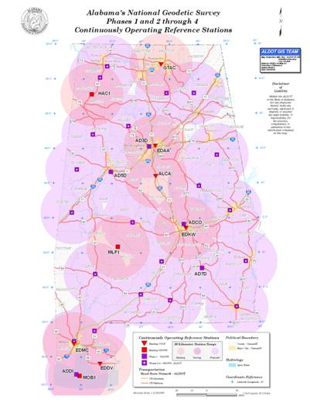
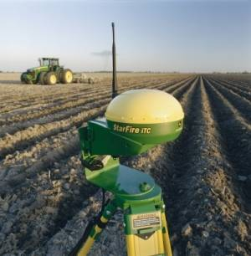
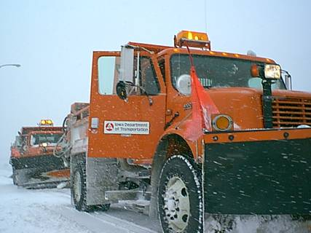
New and Non-traditional Applications:
Geographic Information Systems (GIS)
Precision Farming
Fleet Management
Notes:
New Users – many states implementing statewide GIS; precision agriculture allows for more efficient use of fertilizer and pesticides, and of irrigation, to save farmer time and money, and to be environmentally groovey.

Slide 20
Benefits
Reduce design and construction costs for engineering projects
Accurate geospatial foundation for GIS
Emergency response
Coastal resilience, habitat restoration
Water management, delivery – dams, levees
Water levels – relative sea level change
Storm surge, inundation modeling
Accurate determination of floodplains – maximize insurance cost/benefit
Improve agricultural yields
Ensure safe low-visibility aircraft landings
Ensure safe overhead and under-keel clearance on waterways
Notes:
Other benefits…

Slide 21
Goal of NHMP
Access to accurate, reliable heights nationally
Standards that are consistent across the nation
Data, technology, and tools that yield consistent results regardless of terrain and circumstances
A system/process that will stand the text of time – “Maintain-able”
Notes:
This theme defines the direction height mod is working towards.
Accurate: best field and computation practices, best control as base. E.g. CORS give us accurate e.h.; with best geoid model this can be converted to an ortho height.
Consistency – many kinds of users now with varying accuracy requirements. We need to provide the infrastructure, tools, and guidelines that enable users to get what they need, whether in mountains or on the coast, on open plains or forested areas.
Maintainable – this is key. This leads to the discussion of the new vertical datum being the best way to maintain a vertical datum in a dynamic area with the least cost and difficulty. Leveling is time consuming, costly, can’t relevel everytime we need new heights. If we could reobserve with GPS and get the accuracy we need that would be more efficient. That means a new approach to a geoid model.

Slide 22
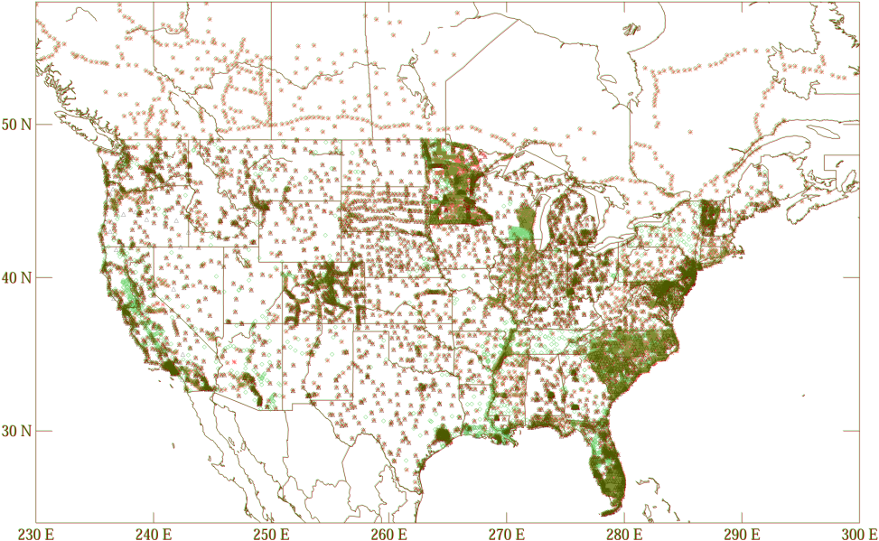
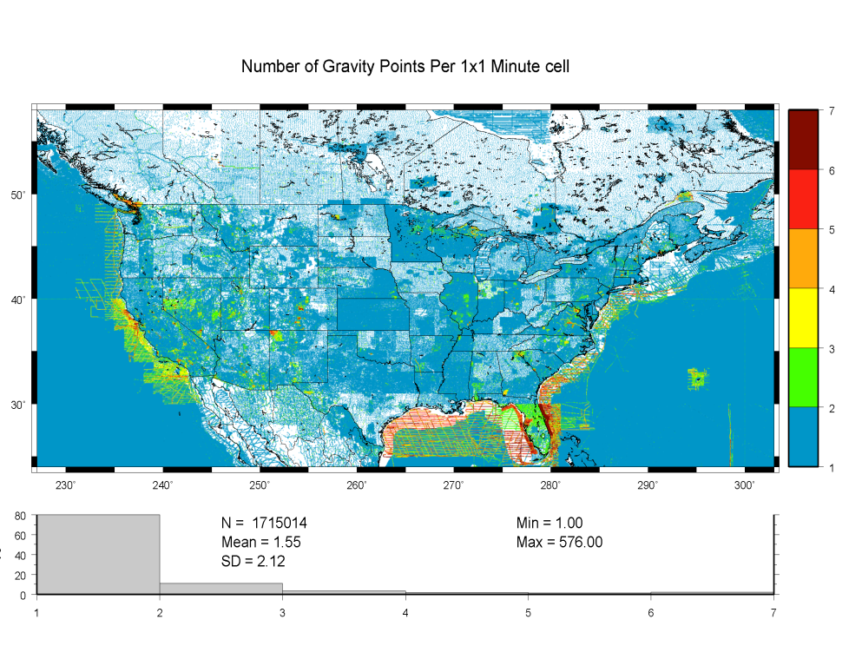
Consistency?
Notes:
This shows why the current approach or status is not consistent:
Getting funding and implementing state by state will not yield consistent results – every state wants something different.
Using GPS on bench marks is OK but you can see by the distribution that some states have the geoid model tied down and other have very little data. Often when we get more GPS on bench marks between models, it is in the same states where we already have a lot.
Gravity holdings are not consistent. Inconsistency in the absolute and relative on land, shipboard gravity off shore, and very little aero gravity.
None of these show promise of consistency nation-wide.

Slide 23
A National Program
Through Regional Expansion
Support NGS Mission for NSRS
Needs don’t stop at state boundaries
More efficient use of funds, people
Encourages partnerships
Commitment by users and larger voice might result in increased Congressional support
Difficult for state and local agencies to work outside of their mandates
Notes:
Discussion of one approach NGS will use to expand to a National – pros and cons

Slide 24
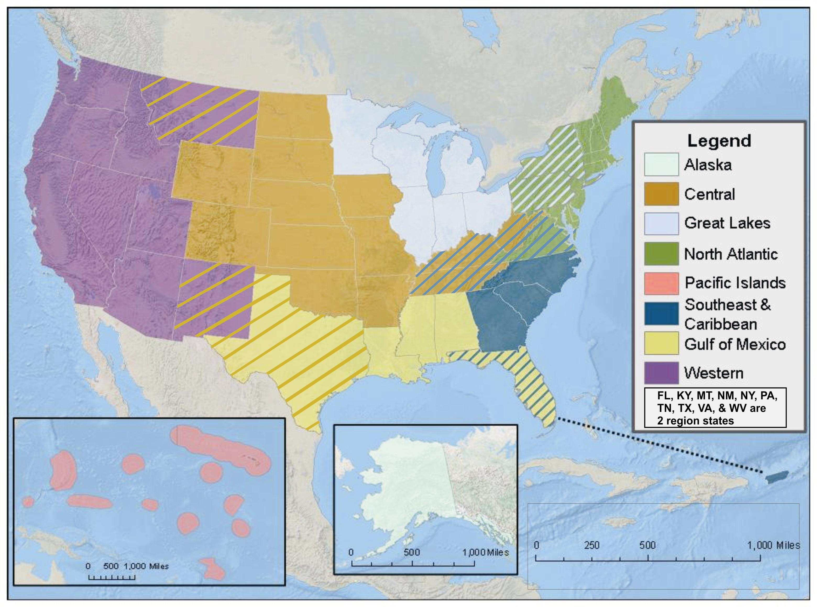
Height Modernization Regions
Notes:
NOAA has developed a plan to improve collaboration within NOAA based on regions it has defined. Height mod has adopted the definition of regions with the addition of making more states “multi-regional”. Gulf Coast and Great Lakes are particularly active as regions, both because of the existence of state advisors in many of the states, and that many states are funded height mod states. Great Lakes has been very active, holding teleconferences every other month and height mod forums and workshops every 6 months, holding the event in a different state each time. This in spite of the fact that many of the funded organizations are state agencies. Also assisting NGS with developing regional pages on the NGS height mod web site. (still under construction).

Slide 25

Differential Leveling – NAVD88: Accurate? Maintainable?
Notes:
Leveling network – cross country error; can only trust it over time by releveling, relies on passive control. Too costly to maintain.

Slide 26
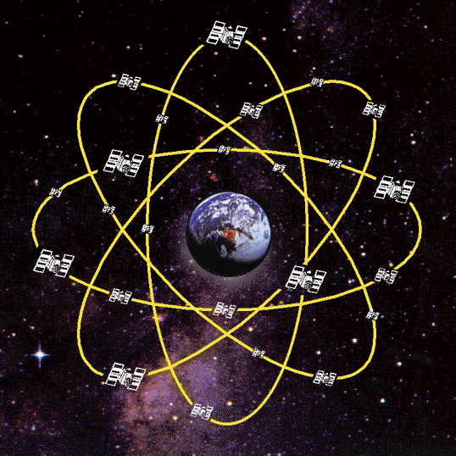
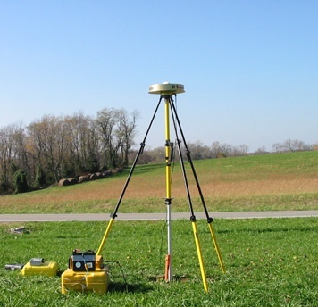
enter GNSS…
Can we get accurate heights with GNSS?

Slide 27
Ellipsoid, Geoid, and Orthometric Heights
H = Orthometric Height (leveling)
H = h - N
h = Ellipsoidal Height (GPS)
N = Geoid Height (model)
h (NAD83)
TOPOGRAPHIC SURFACE
(NAVD88) H
N
Geoid Height
(GEOID03/09)
Ellipsoid
Geoid
With 2 known heights we can calculate the 3rd
Notes:
Orthometric height is the height on the surface above the geoid. But we can’t measure from the geoid so we use leveling. The NAVD88 is defined from the control point in Quebec. Because the ortho ht is computed from leveling observations, where error is modeled or estimated, it probably isn’t right at the geoid, right at “sea level”.
Our vertical datum, NAVD88, is defined. We need a geoid that we can use that is relative to the NAVD88.
In the continental United States, the geoid is actually below the ellipsoid, so the value of the geoid height is negative.
Note that good ortho heights and the good ellipsoid heights from NGS58 will improve our geoid model. But if you don’t have good ortho heights you still have to bring them in by leveling. The new vertical datum will not require leveled heights. The geoid model will be from the gravity.

Slide 28
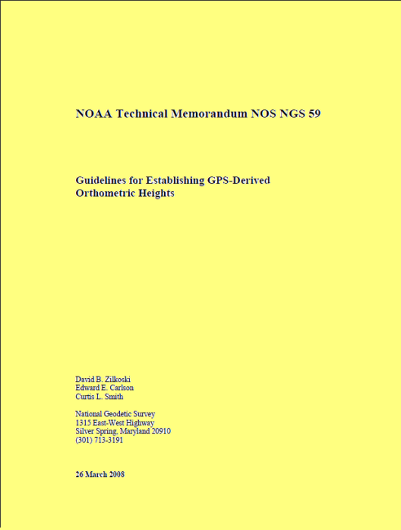
Guidelines to obtain accurate heights through GNSS
Equipment requirements
Field Procedures/Data Collection Parameters
Basic Control Requirements
Processing/Analysis Procedures
Notes:
Guidelines - will eventually become routine; not so much explanation of why its done but provides background information. Repeat baselines, station spacing, fixed height antenna setups, identify and control all error sources, tie local networks together, etc..
NOS NGS-58 GPS-Derived Ellipsoid Heights Guidelines will lay the foundation for NGS 59, GPS-Derived Orthometric Heights Guidelines. Produce 2 cm ellipsoid heights to be able to obtain 2 cm orthometric heights.
There are more detailed slides to cover these.

Slide 29
How accurate is a
GPS-derived Orthometric Height?
Relative (local) accuracy in ellipsoid heights between adjacent points will be better than 2 cm, at 95% confidence level
Network accuracy (relative to NSRS) in ellipsoid and orthometric heights will be better than 5 cm, at 95% confidence level
Accuracy of orthometric height is dependent on accuracy of the geoid model – Currently NGS is improving the geoid model with more data, i.e. Gravity and GPS observations on leveled bench marks from Height Mod projects

Slide 30
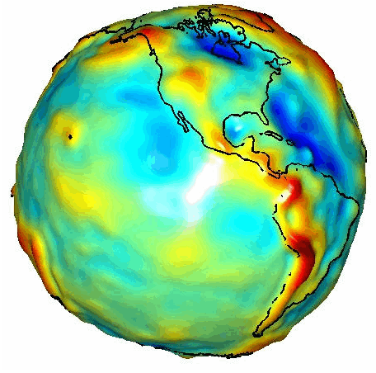
To use GNSS you need a good geoid model
NGS makes 2 geoid models
Gravitational model:
  is good for scientific applications
  uses gravity data collected from a variety of sources
“Hybrid” model:
  starts with gravitational model
  uses GPS on bench marks to enable a fit to NAVD88
GRACE Satellite Gravity
Notes:
Geoid heights are the distance between the (a) geoid (there can be infinite geoids – we decide which one we use) and the ellipsoid. The gravitational model is based on a worldwide DEM, satellited gravity from GRACE and GOCE, and other gravity data. This model does not give you a relationship to NAVD88 which is a different surface altogether.
Once we have a good gravitational model we can tweak the model with GPS on bench mark data so we have the version of the geoid that will convert ellipsoid heights to ortho heights specifically on NAVD88.
The new vertical datum in 2018 will skip this step, and we will use GPS and the gravitational geoid to determine orthometric heights.

Slide 31

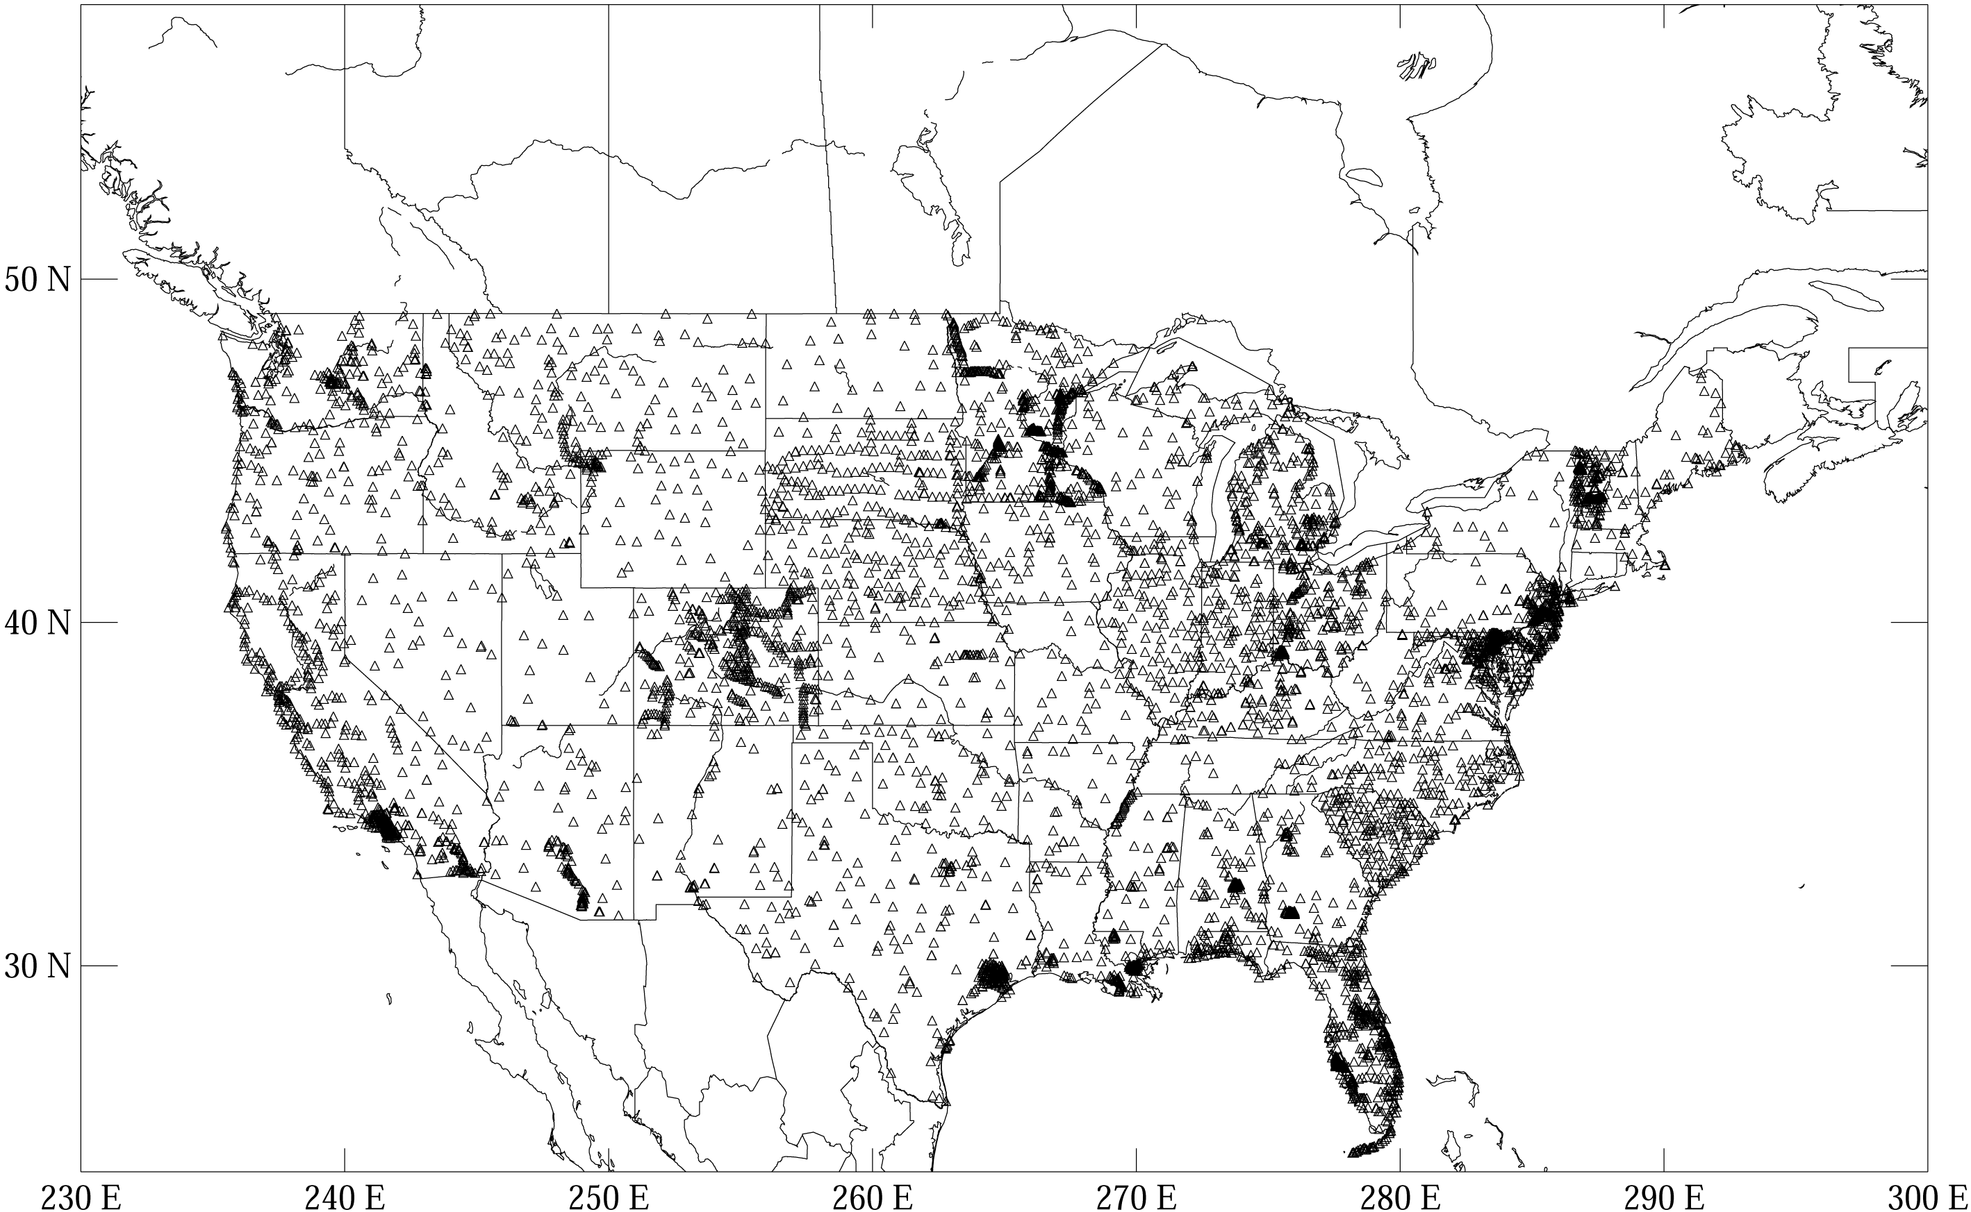
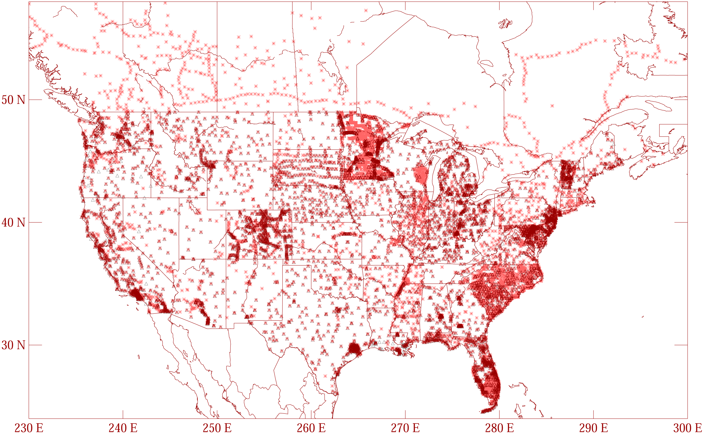
GGPSBM1999: 6,169 total 0 Canada STDEV 9.2 cm (2σ)
GGPSBM2003: 14,185 total 579 Canada STDEV 4.8 cm (2σ)
Notes:
These are the control data used to make xGEOID06a, GEOID03 and GEOID99 (GPS on bench marks: GPSBM’s).
Improvements in Distribution are primarily due to obtaining data in Canada.
The bulk of the increase comes in one state: Minnesota (603 => 4161).
Note the inequitable distribution.
You could practically grid the GPSBM’s in South Carolina or Minnesota and get a good result.
Other places are not so fortunate…
Also note that this shows distribution but not quality of the points.
Some regions (e.g., Texas) have systematic quality problems (due to subsidence) that impact the GPSBM’s and the derived hybrid geoids.
Current techniques rely on creating models of the systematic effects at multiple wavelengths. If the spatial density doesn’t support the shorter wavelength models, then the quality of predictions will commensurately be reduced.
Note that a hyper-dense survey isn’t necessary to achieve optimal results. Later discussion on Minnesota will emphasize this.
I have not yet added GEOID09 GPS on bench marks.

Slide 32
That was then….
In the early years of Height Mod NGS felt the Gravimetric geoid was adequate as the base for the Hybrid geoid
What’s changed?
Better accuracy from GNSS-derived heights – can use GNSS to monitor changes in heights
Better understanding of poor condition of vertical network
Gravity holdings at NGS evaluated
Notes:
Using GPS on bench marks to get that geoid model has been the focus of height mod up till this point. Technology, circumstances, users change. We now know both that the data for the gravitational model needs to be better, and the vertical network is such that much leveling would be needed to get a good set of GPS on bench marks nationwide.

Slide 33
NGS Gravity Holdings
Most of the historical NGS data is terrestrial
Multiple observers, multiple processors over the past 60 years
Numerous corrections and datums over time
Metadata maintained in paper records
Very limited aerogravity
Deficit in near-shore gravity data
Notes:
Early on in the height mod program when we would ask the geoid model team if more gravity was needed, they would say no. Except for a few specific problem areas, they had all they needed. As they cleaned/evaluated the data in the gravity data base they revised their opinion.

Slide 34
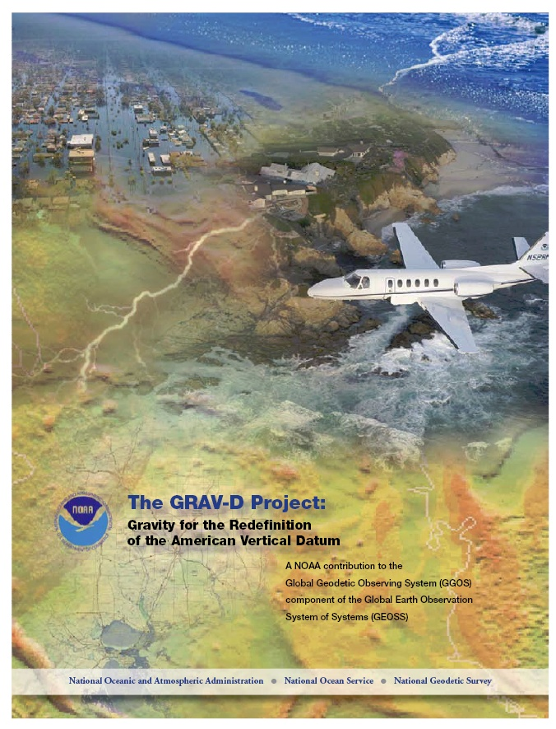
Transition to the Future – GRAV-D
Gravity for the Redefinition of the American Vertical Datum
Official NGS policy as of Nov 14, 2007
  $38.5M over 10 years
Airborne Gravity Snapshot
Absolute Gravity Tracking
Re-define the Vertical Datum of the USA by 2018
http:/www.ngs.noaa.gov/GRAV-D/
Notes:
Plan is available online

Slide 35
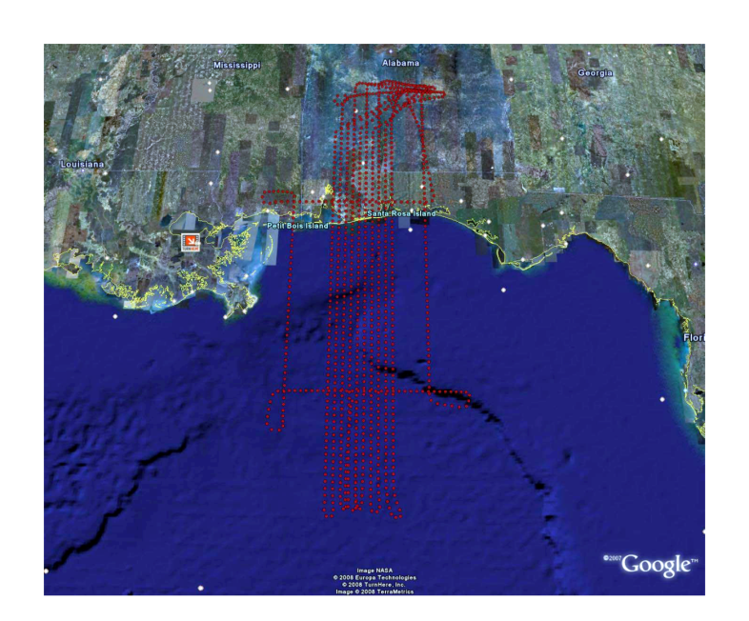
GRAV-D Survey Plan
Aerogravity – 1 time
  Gulf Coast - Test varieties of flight heights/speeds/spacings
  Fly surveys of AK coast, southern AK, CONUS coast and Great Lakes, Pacific islands, CONUS, northern AK
  Surveys of Opportunity
Absolute/relative gravity
Monitor with Satellite gravity projects (GOCE, GRACE) and episodic repeat absolute/relative gravity
Notes:
There is a precise order of field work laid out in the plan based on need. This is:
Tests in Gulf Coast, prof of concept in PR/VI
AK Coast and Southern half of interior AK
CONUS coast, including Great Lakes
Pacific Islands, Aleutians
CONUS interior
Northern interior AK
This has been changed by surveys of opportunity. Project has been unfunded, so when a partner wants to help through support for aero gravity data collection, we deviate from the plan, then return to it. Currently the entire Gulf Coast has been completed through a partnership in TX with USACE.

Slide 36
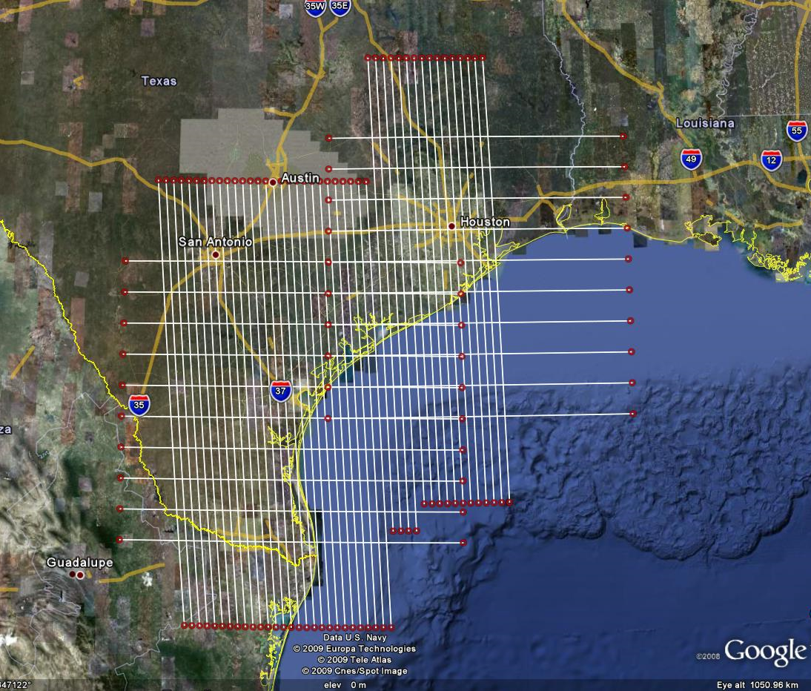
GRAV-D Survey Plan
AL/MS test flights complete
AK – July 2008
LA/MS border coast - Nov 2008
PR/VI - Jan 2009
Texas –summer 2009; completes coverage from the AL/GA state line to the Mexican border
AK – August, 2009
Notes:
When it is all done, locations will be chosen for Gravity stations that will be re-observed regularly to monitor change in the gravity field. Locations will be chosen at some spacing not yet determined, and also in areas with known problems or that are suspect of rapid changes.

Slide 37
National Height Modernization Program
 | Height Mod | National Height Mod
Funding Source | State earmarks | Line item
Funding Recipients | Grant Recipients | NGS + Grant Recipients
Primary Driver | 1998 Report to Congress | NGS 10 year plan + GRAV-D project plan
Geography | 17 states | All states and territories
Cost | > $60 M | $5(?)M / year, 10 years (split internal/external)
Dominant Activities | Leveling, GPS, SRC’s, Outreach | Similar, plus airborne and terrestrial gravity, LIDAR, IFSAR
Notes:
The distinction between “Height Mod” and “National Height Mod” is multi-faceted:
To avoid the volatility of earmarks, a specified funding source or “line item” in the NGS budget is proposed, for “National Height Modernization”
Within that line item, half the funds would remain internal to NGS, half would go out in competitive grants
The activities defining accepted grants should be taken from the NGS 10 year plan and GRAV-D, not from the 1998 report to Congress (which, amongst other things, specified 10 km spacing of Benchmarks nationwide)
National Height Mod will allow for greater equitability in geographic coverage
Cost of Height Mod thus far has been over $60M to taxpayers, which is more than enough to have done GRAV-D. During the next 10 years, part of the money spent (both in grants and inside of NGS) should go toward supporting NAVD 88 and GRAV-D (with larger percentage going toward the new vertical datum as we get closer to 2018)
Activities of National Height Mod will be similar to now, only with a broader view of activities, particularly in airborne platforms

Slide 38
NGS Business Plan: 3 Areas of Focus
  Infrastructure
  Models and Tools
  Outside Capacity Building
Notes:
The NGS operating plan has 3 main components. As NGS gets smaller, we will focus less resources on infrastructure and more on building capacity outside NGS to do things we used to do. Partnerships will be crucial.

Slide 39
Infrastructure
“Define, maintain, provide access to NSRS”
  Active control network – CORS
  Passive control network as needed
  Guidelines and standards for geodetic field and processing practices
  Quality check data that is incorporated in the NGS database – update coordinates in dynamic areas
  Enable positioning consistent with NSRS
Notes:
More of the responsibility for maintaining a passive control network will rest on the local community.
Tools are being developed to improve the way users can submit data for the NGS database. We now have OPUS DB, in which users can agree to share their results, which are loaded into a special database, along with nominal description and contact information. Another OPUS version being developed, OPUS Projects, will accept multiple GPS sessions at multiple stations and process them using a least squares adjustment. It is hoped these tools will provide the means for users to submit data to NGS, have it quality checked, and provide data NGS can use for it’s models.

Slide 40
Models and Tools
Modeling – atmospheric, 1-cm geoid
Development of software, tools
    Software, Online Tool Kit –e.g. datum transformations
    OPUS “Variety Pack”
    Field tools – PGM, Digital Level Tool
    VDatum
Guidelines for use of new technologies and processes like remote sensing, real time
Notes:
New tool, LOCUS – Leveling Online Calculation User Service – “OPUS for Leveling”. User can submit leveling data to this application and will receive an email with an orthometric height result. Similar to a field elevation, which is generally quite accurate for most purposes.

Slide 41
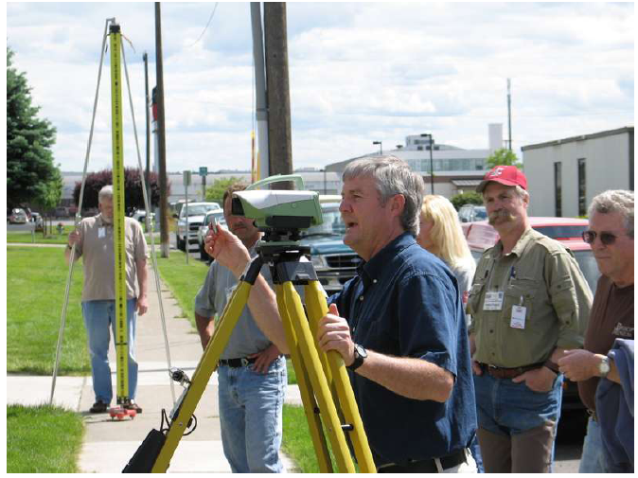
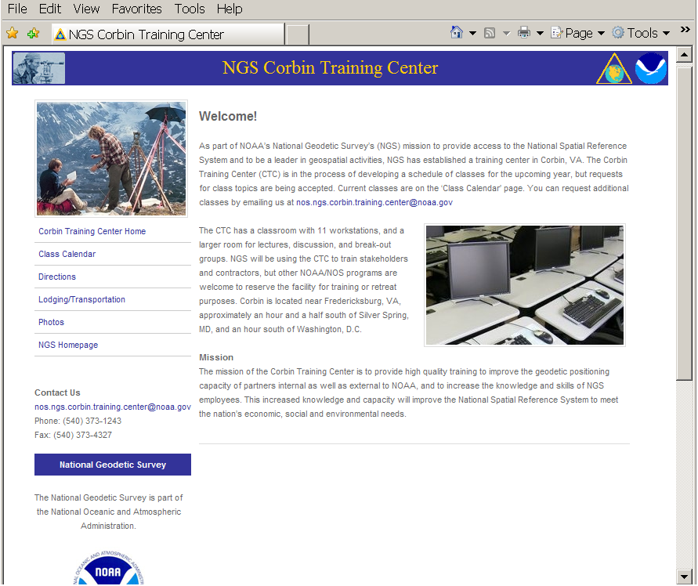
Outside Capacity Building
Leveling – Spokane, 2006
State Geodetic Advisor Program
Forums, workshops
Conferences
Training, capacity building
www.ngs.noaa.gov/corbin/index.shtml
Notes:
Corbin Training center. Facility in Fredericksburg, VA where our antenna calibration is done. Portions of the original machine shop where instruments and equipment were built have been turned into a computer lab and meeting room. The grounds serve as a field survey training site. Many classes are being developed for presentation in a webinar format, enabling people to attend without the expense of traveling to VA. For those who do want to attend in person, the class is free of charge so the only cost is for your travel.

Slide 42
Height Modernization Partners
Funded Partners
  Academic Institutions
  State and Local Governments
  Spatial Reference Centers
Offices within NOAA
  National Weather Service
  National Hurricane Center
  Ocean and Atmosphere Research
  National Ocean Service
Other federal agencies
  Department of Homeland Security/FEMA
  US Army Corps of Engineers – e.g. levees, dams
  US Geological Survey – e.g. stream gages
Notes:
SRCs are mini-NGS’ in several states (CA, TX, WA, MS, LA, AZ). Each is different.
Also partner with other users within NOAA and other federal agencies

Slide 43
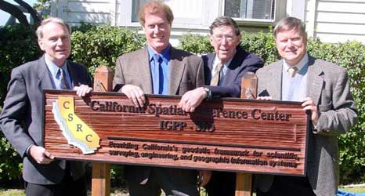
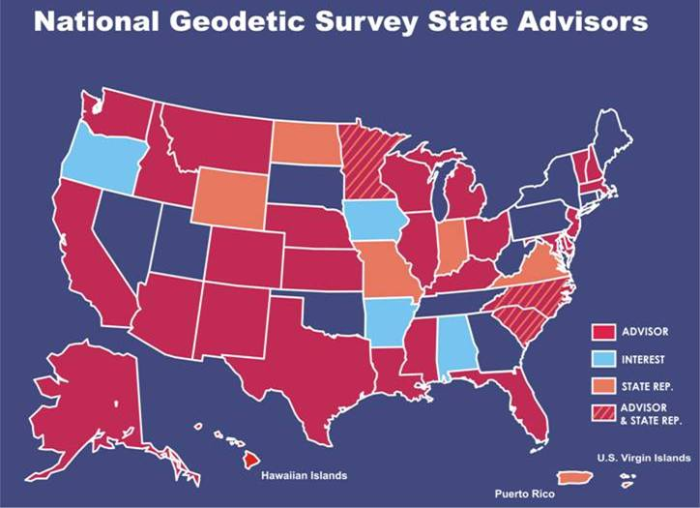
HM in Practice – What are states doing?
Infrastructure – establish, densify, maintain
  CORS
  Passive control - leveling
  Co-locate CORS and tide stations; level to tide stations
  Remote sensing
Models, tools
  Pilot projects, test guidelines
  Data collection, distribution - Gravity? – contribute to models
  Build state GIS
  Develop software – PGM, “THM level tool”
Outreach, education
  Create Spatial Reference Centers
  Workshops, forums, technology transfer
  Websites, data access
  NGS/State Geodetic Advisor Program
Notes:
States are engaged in many of the same kinds of activities we do.

Slide 44
  Role of NGS: Program Management
    Congressional briefings
    Budget, grants management
    Coordination – Partners, SRCs
  Role of NGS: Project Leadership
    Support program growth - develop long range plan
    Support advance of science
    Support NOAA’s Mission – shoreline, weather, climate change
Notes:
Congressional briefings by invitation, to respond to technical questions regarding the program.

Slide 45

From NGS’ 10-Year Plan
  NGS Mission: “Modernize the Geopotential (“Vertical”) Datum”
  “The gravimetric geoid, long used as the foundation for hybrid geoid models, becomes the most critical model produced by NGS.”

Slide 46


Slide 47

Winnie, Texas - September 14, 2008, Hurricane Ike (AP Photo/Pool, Smile N. Pool)

Slide 48

Questions
Contact information
Renee Shields
Height Modernization Manager
N/NGS1, SSMC3, Room 9357
1315 East-West Highway
Silver Spring, MD 20910
301-713-3231, x116
Renee.Shields@noaa.gov

