Slide 1
NAVD 88 No More:
A Modernized Vertical Datum for the Future
2018 ASFPM Conference
June 20, 2018
Christine Gallagher
Communications Branch Chief, NGS

Slide 2
Poll
How aware are you that NGS is replacing NAD 83 and NAVD 88?
Very
Somewhat
Not at all
Unsure
Notes:
POLL QUESTION: How aware are you that NGS is replacing NAD 83 and NAVD 88?
Very
Somewhat
Not at all
Unsure

Slide 3
Outline
Getting started…
Who is NGS and what is NAVD 88?
What is replacing NAVD 88?
NAPGD 2022, part of larger NSRS Modernization
What do I use today?
Data, tools and metadata
What’s next?
Coordination, education and preparation!
Notes:
I’ll start by telling you why NGS and NAVD 88 matter to floodplain management community along with reviewing some terminology.
Then, I’ll talk about the title of the talk itself - the replacement of NAVD 88.
After that, I want to highlight a lot of tools you can use today, which will be incredibly important when we replace NAVD 88.
Finally, I want to focus on how coordination, education and preparation will help make the transition away from NAVD 88 as smooth as possible.

Slide 4
Getting started…
Who is NGS and what is NAVD 88?
What is replacing NAVD 88?
NAPGD 2022, part of larger NSRS Modernization
What do I use today?
Data, tools and metadata
What’s next?
Coordination, education and preparation!

Slide 5
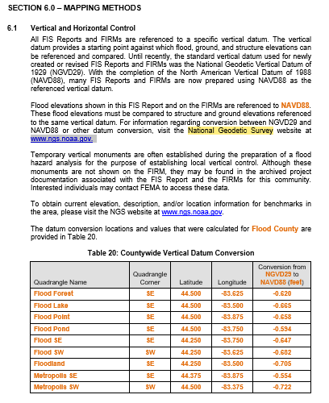
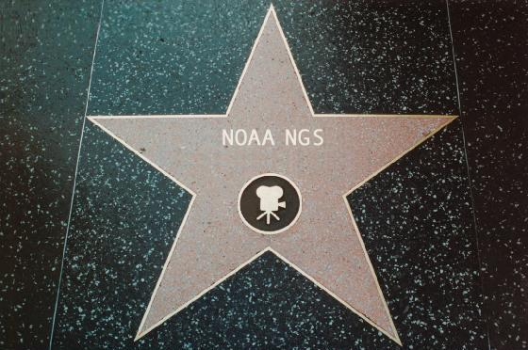
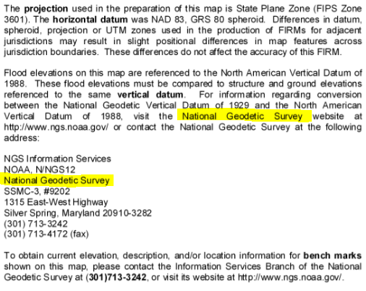
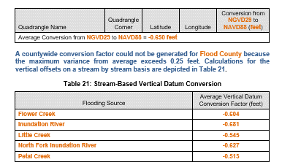
National Geodetic Survey
Notes:
Let’s start with some documents you are likely all familiar with.
First, we have Section 6.1 For the Template Flood Insurance Study Report. You will see references to both the National Geodetic Survey and the illustrious NAVD 88.
Next, we have the “Note to Users” section of your favorite Flood Insurance Rate Map. In this case, we see mention of the National Geodetic Survey along with our website and phone number.
I’m sharing these documents up to illustrate the point that the National Geodetic Survey and vertical datums are the sometimes unseen and unrecognized star of floodplain mapping!

Slide 6
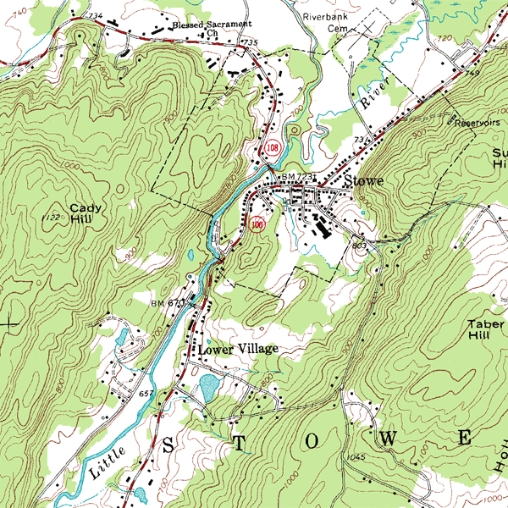
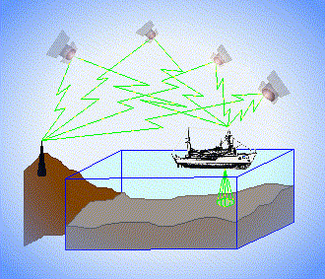
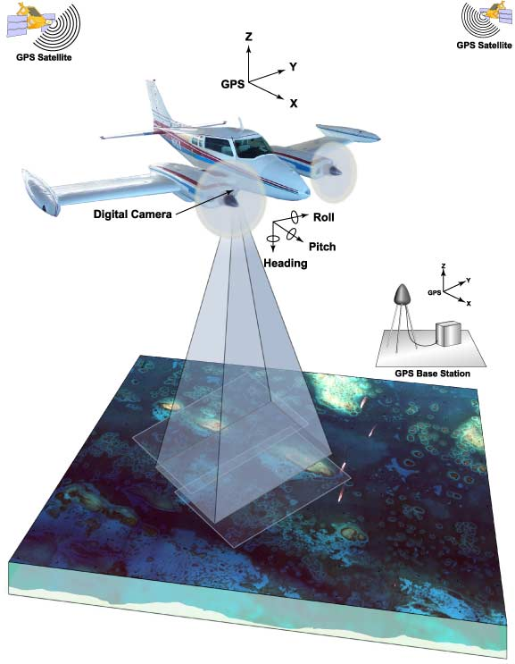
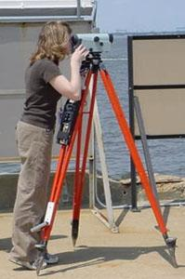
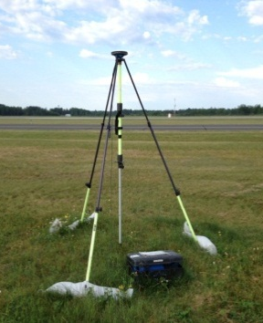
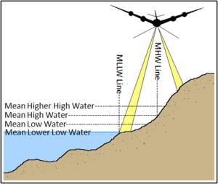
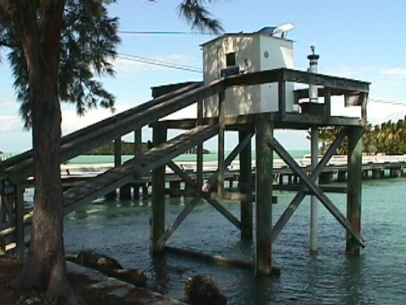
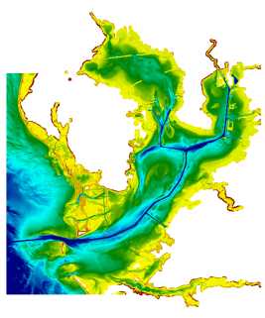
3 Categories of Vertical Datums
Orthometric
Ellipsoidal
Raw Hydrographic Surveys vertically referenced with RTK-GPS
USGS
Topography
FEMA Flood Insurance Rate Maps
Engineering and Development Site Surveys
Native GPS measurements
Raw Lidar
Tidal
NOAA Bathymetry (MLLW)
Shoreline Mapping (MHW) and Regulatory Boundaries at the Coast
Daily and Extreme Water Levels
Notes:
Vertical Datum overview
A vertical datum is a reference surface that can be used to measure heights in a uniform way.
First, we have ellipsoidal datums. Examples include WGS84 or the North American Datum of 1983. You will encounter these datums frequently in hydrographic surveys that are vertically referenced with RTK-GPS; any native GPS measurements; and even raw lidar datasets.
Next, we have orthometric datums. These datums are very important because height differences referenced to orthometric datums will allow us to know the direction water will flow. The North American Vertical Datum of 1988 (or NAVD 88) is an orthometric datum, which you will see on USGS topographic maps, engineering and development site surveys, and FEMA Flood Insurance Rate Maps.
Finally, we have Tidal Datums, which are derived from water level measurements. They have extremely important applications including daily and extreme water levels; NOAA nautical charts, and shoreline mapping or boundaries along the coast.

Slide 7
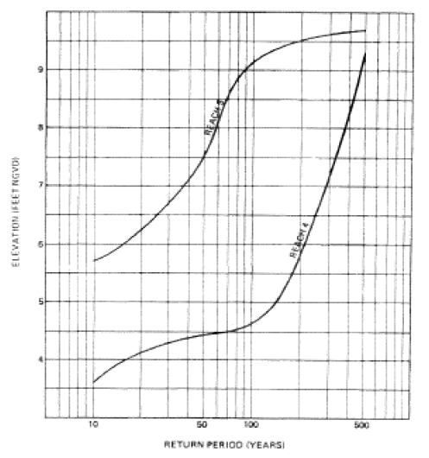
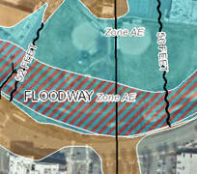
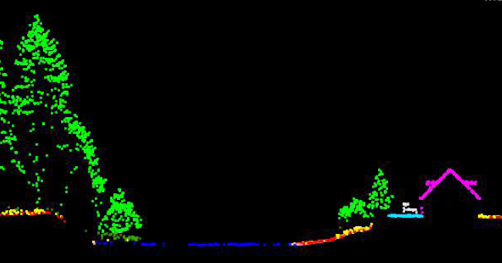
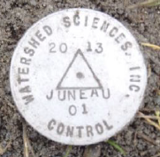
The National Spatial Reference System (NSRS)
A common and consistent geospatial framework to meet the economic, social, and environmental positioning needs of our Nation.
Foundational elements include:
Latitude • Longitude • Elevation • Gravity • Shoreline Position
+ changes over time
+
+
=
Reliable FIRMs require data from disparate sources and dates be consistently aligned
Notes:
This consistent framework - as defined by NGS - is the National Spatial Reference System or NSRS.
Definition
It is common to all Federal agencies and other users.
It supports informed decision-making for mapping and charting, navigation, flood risk determination, transportation, land -use and more.
Elements of the NSRS include - but are not limited to - latitude, longitude, elevation, gravity, shoreline position, and changes over time.
Example:
The images on the bottom of the slide follow an example work-flow of why we need consistent coordinates.
First, we might collect airborne or mobile lidar data; next we’d generate a stream hydrograph. A surveyor would complete a elevation certificate and the final product is a flood insurance rate map.
As you can see - just in the making of a single FIRM, data is collected at different points in time using different methods, and must be reliably aligned and combined with historical data (in both horizontal and vertical), all to produce a final product in which all of this information is available in one place to assist the planner in appropriate flood mitigation.

Slide 8
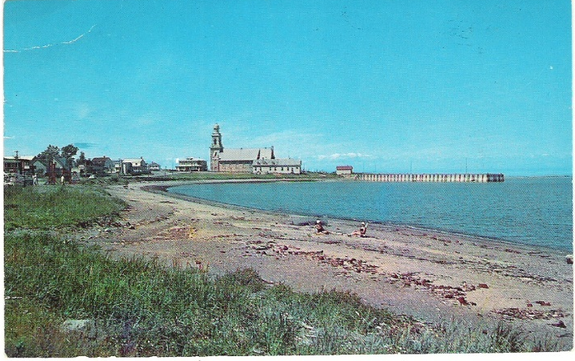
The NSRS of Today (simplified)
Primary elements:
Horizontal North American Datum of 1983 - NAD 83(2011) coordinates
Vertical North American Vertical Datum of 1988 - NAVD88 orthometric heights
These elements are geodetic datums that define the shape and size of the earth to enable precise positioning
System based on connections to published passive control
Notes:
For practical purposes, we can simplify the NSRS down to its primary elements:
The horizontal component is the North American Datum of 1983 - NAD 83(2011).
The vertical component is the North American Vertical Datum of 1988, from which we get NAVD88 orthometric heights.
This system was defined on and based on connections to published passive control or physical survey markers you can find in the ground.

Slide 9
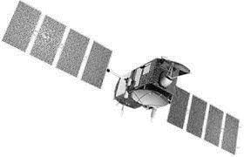
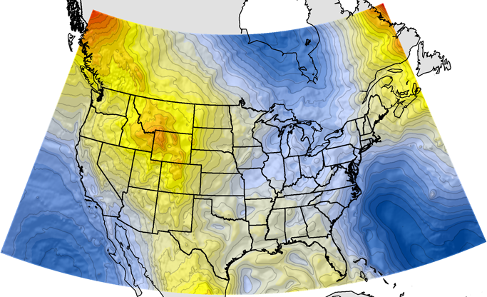
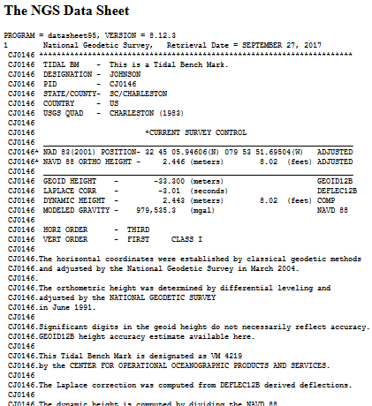
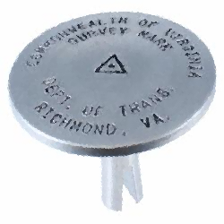
NGS Supports Access to NAVD88 Heights
GEOID12B
official path
Notes:
Accessing NSRS today - Over time, and with advances in technology, there are now two paths to access NSRS or NAVD 88 heights.
Path (1) - Since the NSRS is presently defined by a network of passive control, NGS provides primary access to the NSRS at published passive control (in IDB), at present this remains the ‘official’ gateway to NSRS position.
Path (2) - In recognition of increasing use of GPS/GNSS technology for precise positioning activities, NGS also supports GPS/GNSS-enabled access to the NSRS (via OPUS). In an ideal (static) world, these two pathways lead you to the same coordinates.
For GPS/GNSS-enabled access to NSRS heights, NGS maintains geoid models.
***Geoid models are necessary to convert GPS measurements (ellipsoid-based) into real-world elevations (orthometric heights)***
The current geoid model (GEOID12B) that is used to access NSRS orthometric heights (NAVD88) is a hybrid geoid, a gravimetric geoid (USGG2012) that has been warped to align with published values on passive control.

Slide 10
Getting started…
Who is NGS and what is NAVD 88?
What is replacing NAVD 88?
NAPGD 2022, part of larger NSRS Modernization
What do I use today?
Data, tools and metadata
What’s next?
Coordination, education and preparation!
Notes:
What is replacing NAVD 88? (NAPGD 2022)

Slide 11
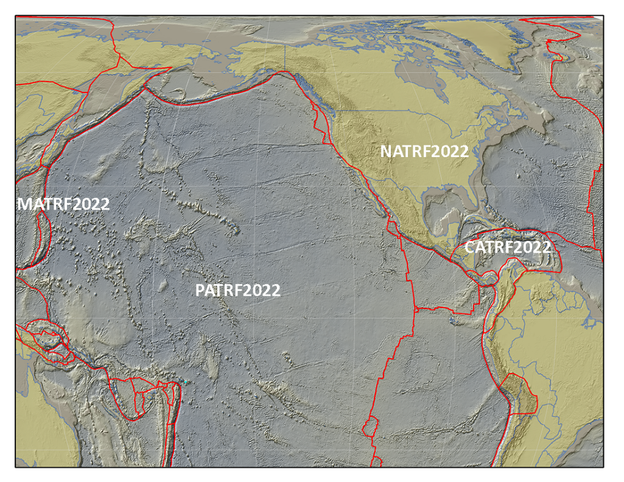
New Reference Frames
Blueprint for 2022, Part 1: Geometric Coordinates
The North American Terrestrial Reference Frame of 2022 (NATRF2022) to replace NAD 83 (2011)
The Caribbean Terrestrial Reference Frame of 2022
(CATRF2022) to replace NAD 83 (2011)
The Pacific Terrestrial Reference Frame of 2022 (PATRF2022) to replace NAD 83 (PA11)
The Mariana Terrestrial Reference Frame of 2022 (MATRF2022) to replace NAD 83 (MA11)
Notes:
What is replacing NAVD 88? (NAPGD 2022)
NSRS Modernization - While the focus today is on NAVD 88, I’m going to talk about the effort to replace both NAD 83 and NAVD 88 because in many ways they are inextricably connected.
First, we are replacing the horizontal datum - NAD 83 - with four new reference frames:
North American Terrestrial Reference Frame of 2022 (NATRF2022);
Caribbean Terrestrial Reference Frame of 2022 (CATRF2022);
Pacific Terrestrial Reference Frame of 2022 (PATRF2022); and
Mariana Terrestrial Reference Frame of 2022 (MATRF2022)
To get more technical details: there is a technical publication called Blueprint 1 and an accompanying recorded webinar.

Slide 12
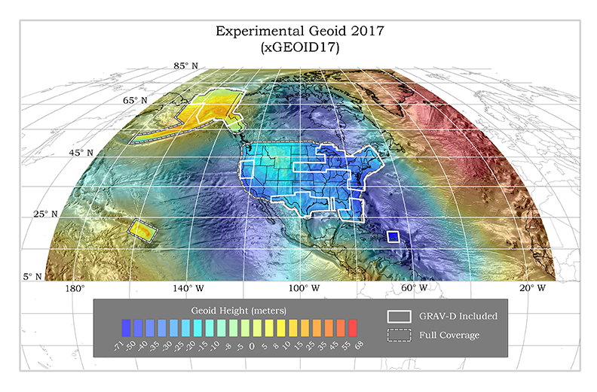
New Geopotential Datum
Blueprint for 2022, Part 2: Geopotential Coordinates
The North American-Pacific Geopotential Datum of 2022 (NAPGD2022) will include GEOID2022
Notes:
NSRS Modernization - Second, we are replacing the vertical datum - NAVD 88 - with a new geopotential datum.
It will be called the North American-Pacific Geopotential Datum of 2022 or NAPGD2022.
It will include a new geoid model - GEOID2022 along with a few other products.
Again, to get more technical details: there is a technical publication called Blueprint 2 and an accompanying recorded webinar.

Slide 13
The NSRS of Tomorrow (2022)
Primary elements:
The geometric North American Terrestrial Reference Frame of 2022 (NATRF2022) plus the Caribbean, Pacific, and Mariana plates
The North American-Pacific Geopotential Datum of 2022 (NAPGD2022)
New reference system is:
Geocentric and defined by relationships to a global/international ideal frame;
Time-dependent; and
Primarily accessed via GPS technology and a newly refined semi-dynamic geoid model
Notes:
In addition to its new names and new primary elements, the modernized NSRS has other significant changes.
It is geocentric and defined by relationships to a global/international ideal frame;
This direct relationship to ITRF/IGS will improve the spatial framework for GNSS-based technology, such as UAS/UAVs
It is time-dependent, meaning coordinates in the new system will reflect where that position is at a specific epoch in time.
This change is potentially challenging because we - as a society - have adopted an expectation that our spatial reference system is defined in a manner that provides some level of CONSTANCY. In other words, that objects considered to be stationary have fixed coordinates and/or heights.
This introduction of time-dependency provides better ways to assess to mark stability and use the NSRS to monitor gradual change such as subsidence or uplift.
Primarily accessed via GPS technology and a newly refined semi-dynamic geoid model
Accessing the datums via GPS will take advantage of advances in technology and increase convenience of access to NSRS while simultaneously reducing our dependence on physical marks in the ground that were deteriorating over time.
Again, the semi-dynamic geoid model will allow us to account for gradual change in the earth’s surface caused by things like subsidence or uplift.

Slide 14
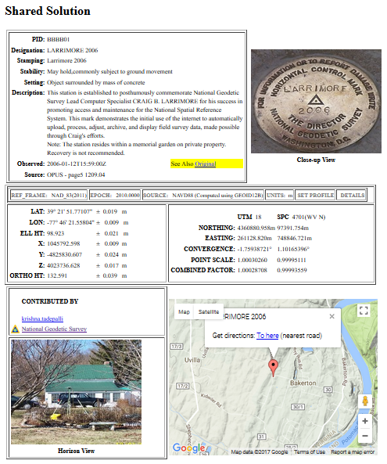
NGS Will Support Access to NAPGD 2022 Heights
GEOID 2022
official path
Notes:
In 2022, we’ll be on Path 2 - active control
Active geodetic control (CORS) will replace passive geodetic control (bench marks)
GPS/GNSS will be the official gateway to the NSRS
And this transition to path 2 is made possible by the GRAV-D project for a refined gravimetric geoid for the US that will enable access to orthometric heights w/in 2 cm accuracy using GPS/GNSS (no warp to published heights)
Transition: While the prevalence of active control will reduce our reliance of passive control, it will still have its place.
Path 1 - passive control - will continue to play important roles in precise positioning as:
Calibration sites for GNSS technology, Real Time Network validation, and verification of datum transformation tool results,
Sites for monitoring motion to enhance Intra-Frame Velocity Model (via repeat/campaign GNSS occupations),
Convenience: passive control will continue to provide rapid access to NSRS positions in areas with limited GNSS coverage (e.g. cities, forests) or in the event of GNSS failure (e.g. geomagnetic storms).

Slide 15
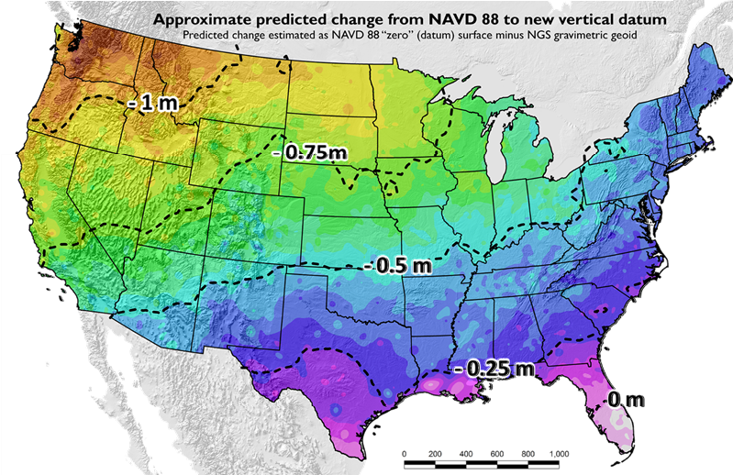
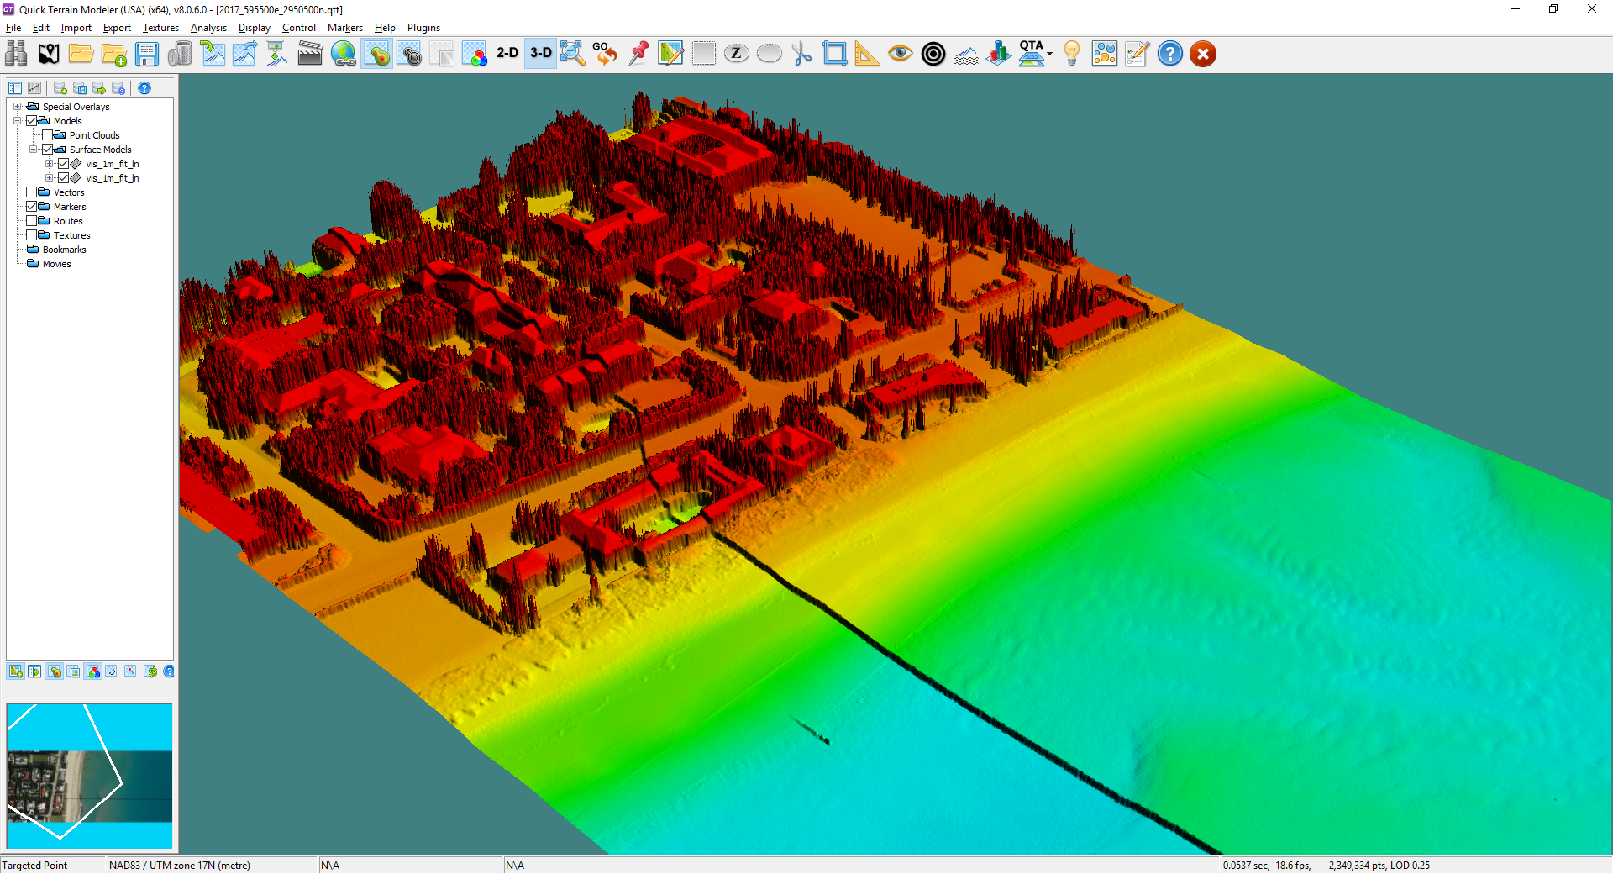
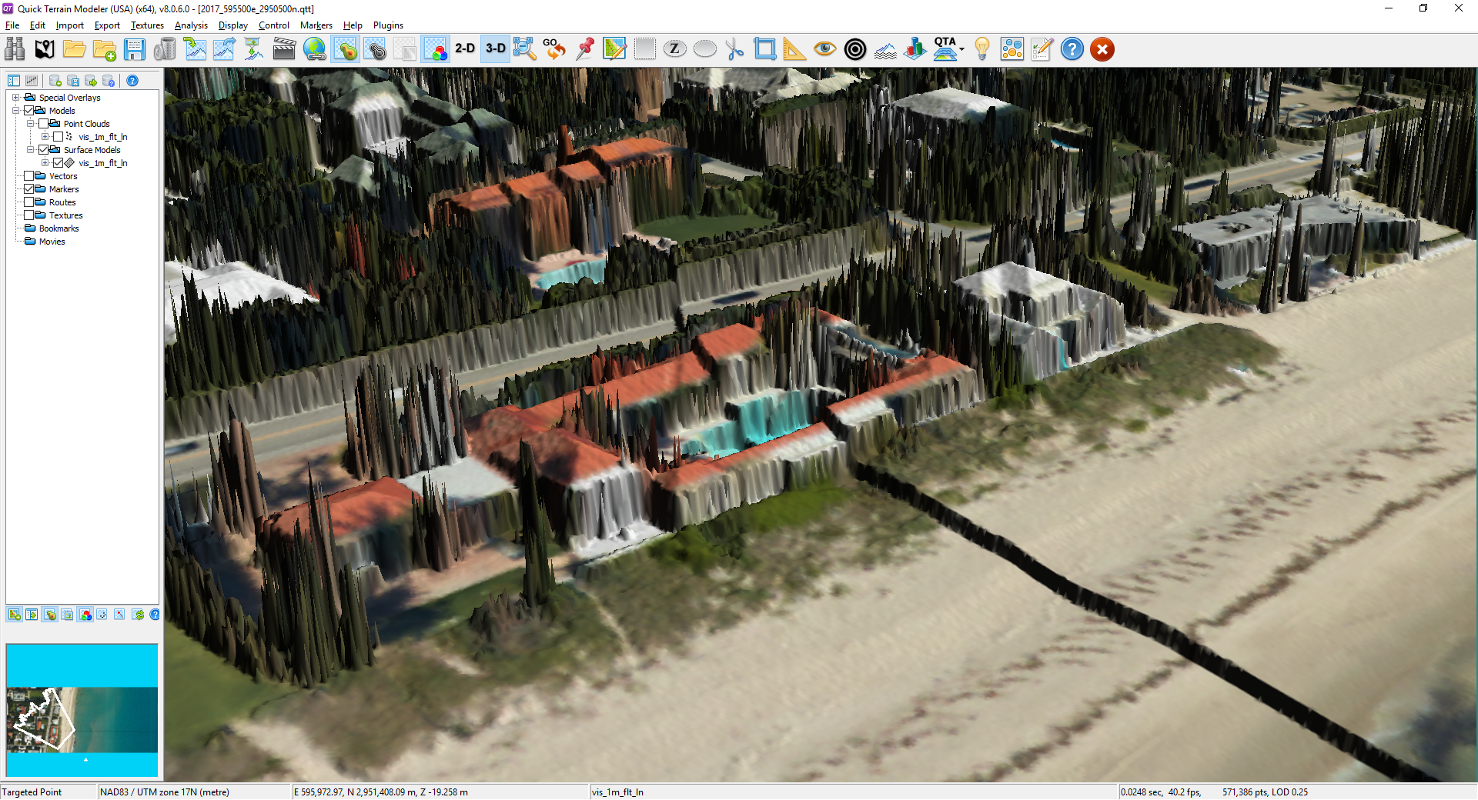
Vertical Change (Offset)
GEOID12B (NAVD88)
Updates available online from the New Datums website and Modernization News
xGEOID17
Vertical offset of more than 1 meter
https://geodesy.noaa.gov/datums/newdatums/index.shtml
Notes:
Coordinates will change
There will be a 0 to 1.5 meter shift in your vertical coordinates depending on where you are in the country.
This offset could have huge implications if you try and mix data from sources in the old and new vertical datums
See the offset with the DEM
See the offset in the orthophotography
Do you want to see what the offset is for your area?
Maps and materials are online
You can also use our experimental geoid tool. Every year, we come out with our latest experimental geoid that incorporates new gravity data that is improving our geoid model from the one we use today.

Slide 16
Getting started…
Who is NGS and what is NAVD 88?
What is replacing NAVD 88?
NAPGD 2022, part of larger NSRS Modernization
What do I use today?
Data, tools and metadata
What’s next?
Coordination, education and preparation!
Notes:
What do I use today? (Data, tools and metadata)

Slide 17
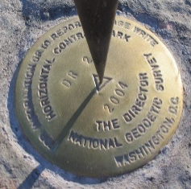
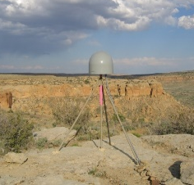
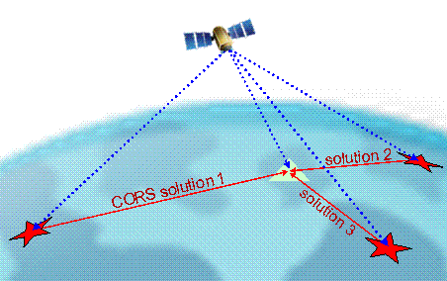
Tools to Access the NSRS
Online Positioning User Service
(OPUS) Tool Suite
Continuously Operating Reference Stations (CORS)
Integrated Database (IDB) of Published & OPUS Shared Control
(NGS Data Explorer)
Notes:
Tools to access the NSRS - I’ve talked about accessing the NSRS and how it will change.
OPUS will be the critical tool to access the NSRS because by submitting your GPS or GNSS data - whether through your own receiver or real time network - that is how you will get an NSRS coordinate.
Next, I should mention our CORS network. OPUS relies on CORS to compute its position, and these CORS stations are what we are referring to as active control. Because they are collecting data all the time, we can use that data to monitor velocities, motion and ultimately update coordinates in areas of uplift and subsidence.
Finally, I want to emphasize that you can still access information about our passive control. This is needed today, and will have its more limited uses in the future. A user friendly tool we have is called the NGS Data Explorer, and it lets you search for information about passive marks from both our integrated database and any marks that users have chose to share their OPUS solutions publically.

Slide 18
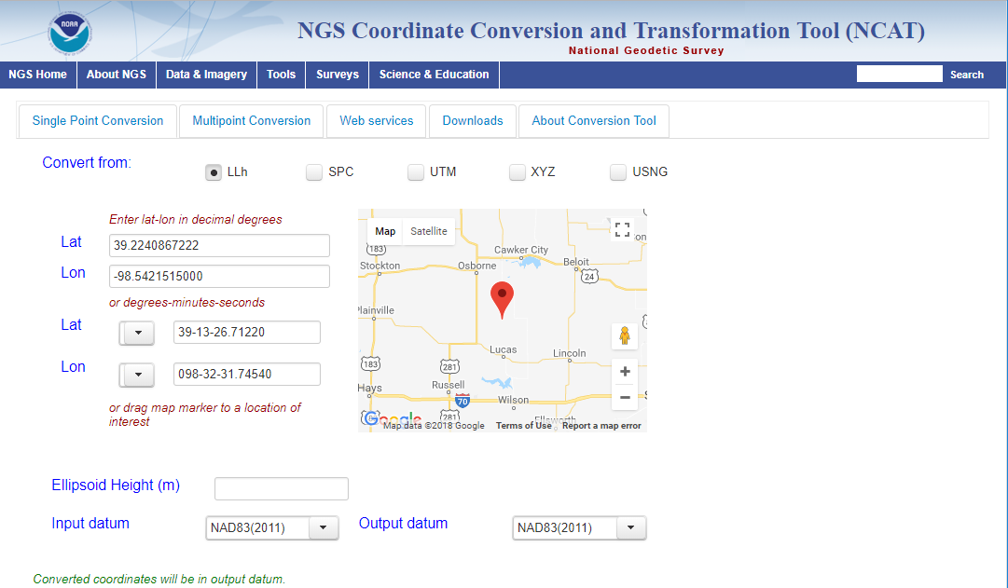
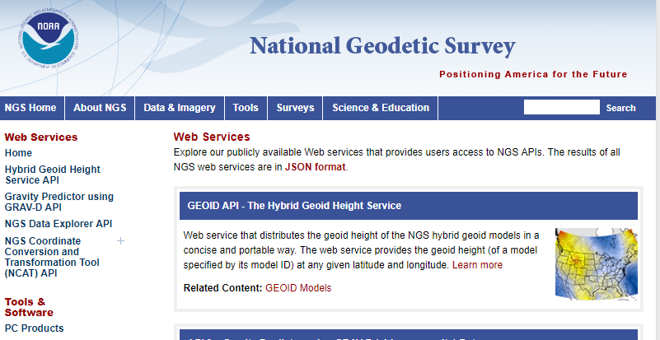
Transformation Tools
NGS Coordinate Conversion and Transformation Tool (NCAT)*
Vertical Datum Transformation (VDatum)*
Web Services*
Transformation Tool Notes
NCAT and VDatum will draw from same source code for identical transformations.
VDatum includes tidal datums and HTDP.
NCAT has a web service; VDatum will have one soon.
Make sure to note version numbers when using tools.
Notes:
Transformation tools are critical because as we discussed earlier, sometimes you’ll need to pull together data from different sources, collected in different ways, and collected at different times. And when we replace NAVD 88, the transformation tool at that time will be critical to transform existing datasets.
NCAT - NGS is combining various transformation tools into a single user interface, called NCAT. Right now, it helps transform across horizontal datums and projected coordinates. However, it will have some vertical transformations added to it soon (VERTCON, which transforms from NGVD 29 to NAVD 88).
VDATUM - Another NOAA tool already has a series of vertical datum transformations built into it. You can transform your coordinates using appropriate Geoid Models, and you can even transform from orthometric and ellipsoidal to tidal datums.
Web services - Looking ahead, we recognize that other software developers want to use these transformations, so we are providing web services. NCAT is available already, and work on VDATUM has started.
Caution - Do be careful when you use transformations because they will degrade the accuracy of your original position information. And you should keep track for the version of the software you are using.

Slide 19
Document Datums (Metadata)
NAD83(2011) epoch 2010.00
H. Datum
Realization/Adjustment
Reference Epoch
NAVD88 (GRS80, Geoid12B)
V. Datum
Reference Ellipsoid
Geoid Model
Notes:
METADATA - you must document the datum you are referencing, but the datum itself is not enough.
Example: I have a horizontal and vertical example on this slide.
Note: exact content and format may vary; these general recommendations are specific to projects with a vertical emphasis.
Start now: Also keep a record of source/date of survey whenever possible, even before 2022.

Slide 20
Getting started…
Who is NGS and what is NAVD 88?
What is replacing NAVD 88?
NAPGD 2022, part of larger NSRS Modernization
What do I use today?
Data, tools and metadata
What’s next?
Coordination, education and preparation!
Notes:
What’s next? (Coordination, education and preparation!)

Slide 21
NOAA/Federal Coordination
2017 Geospatial Summit
Feedback on the New Datums
Preparations to-date
Advantages and challenges
Necessary transition tools, products, and services
FEMA Feedback
Kimberly Pettit, FEMA GIS Coordinator
Prepared with Paul Rooney
watch online
Notes:
Coordination
We are coordinating with other Federal Agencies - since Federal mapping agencies must use the NSRS, we’ve made a particular effort to engage federal agencies
Our director chairs the Federal Geodetic Control subcommittee (FGCS), and they will adopt the new datums in 2022
We hosted Geospatial summits in 2010, 2015 and most recently in 2017.
We asked federal agencies to share their requirements and concerns.
Check out what FEMA share by visiting our website.

Slide 22
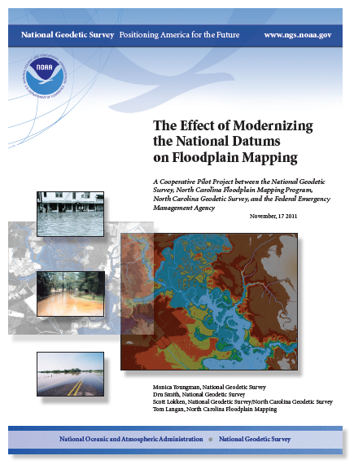
NOAA/FEMA Coordination
Cooperative Pilot Study (2011):
NGS and FEMA;
North Carolina Floodplain Mapping Program, and
North Carolina Geodetic Survey.
Key Outcomes:
Recommendation of FEMA implementation plan to account for coordinate and height shifts.
Improved relative positional accuracies and greater understanding of height uncertainties will enhance quality of flood mapping.
Notes:
NOAA/FEMA - Getting FEMA to implement the new datums is incredibly important to use.
We commissioned an socio-economic benefit study that found improved floodplain maps have tremendous value. This study was a huge driver in getting funding from our GRAVD project.
We completed a pilot study in 2010 in North Carolina
Made recommendation that FEMA create an implementation plan to account for coordinate and height shifts.
Found that improved relative positional accuracies and greater understanding of height uncertainties will enhance quality of flood mapping.
We recognize there will be challenges, but we really are looking to work with FEMA and this group to make the transition work as well as possible.

Slide 23
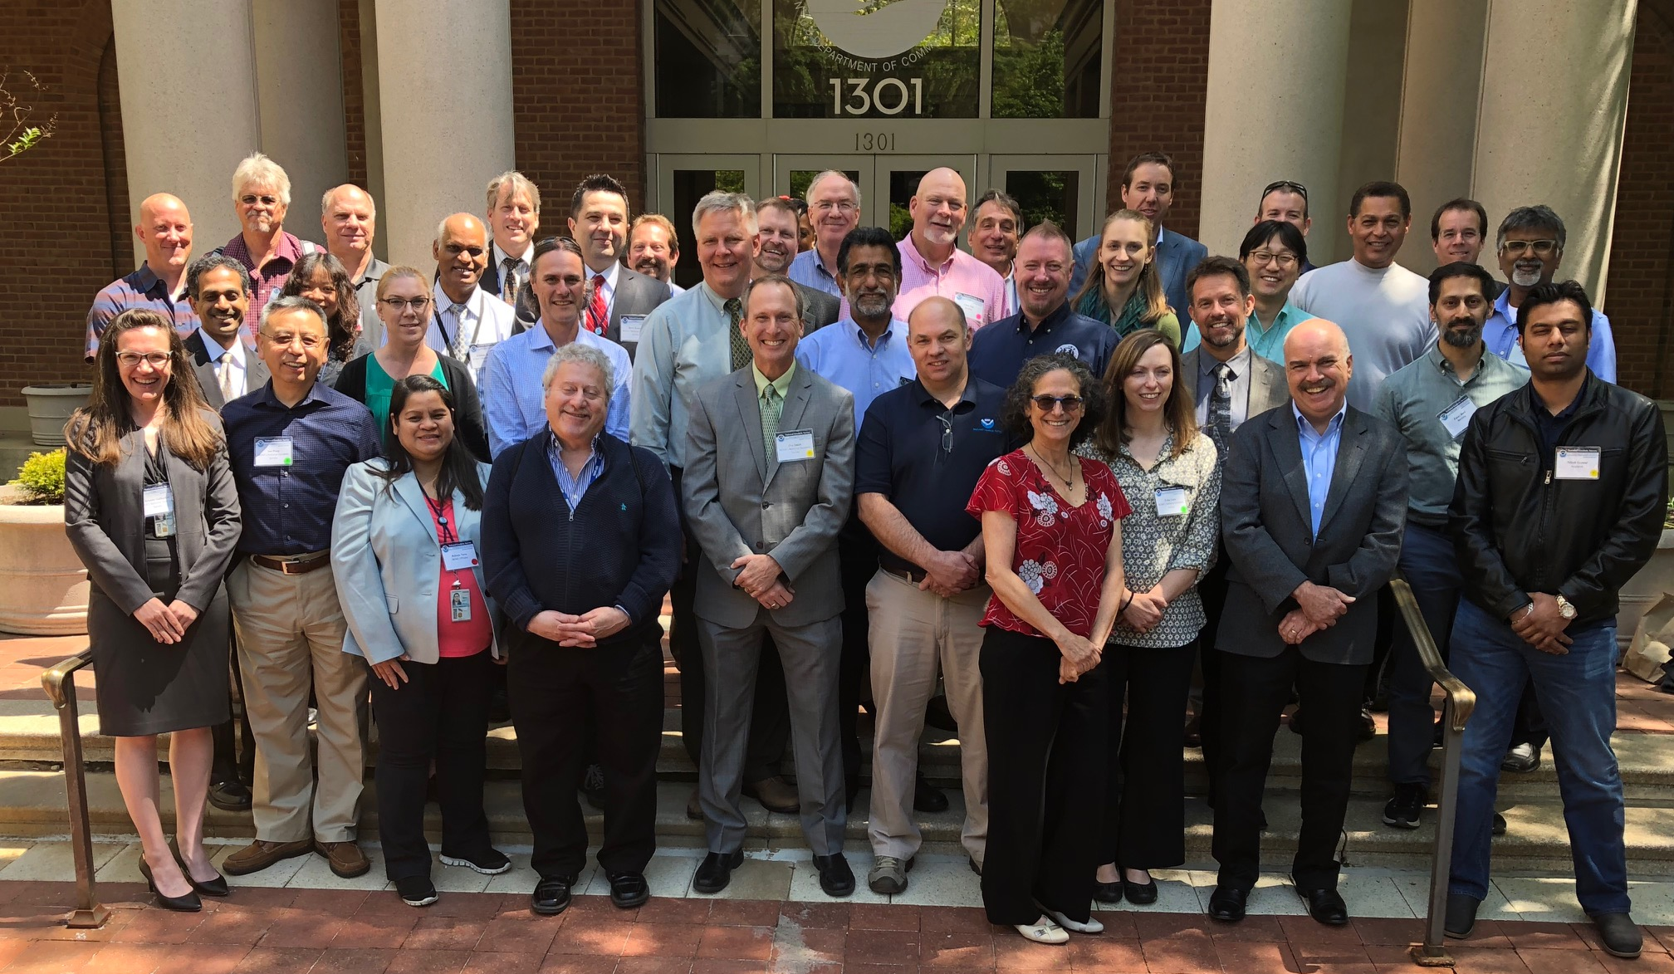
NOAA/Industry Coordination
Vendor software and tools let users access NSRS.
Workshop held to discuss industry requirements and concerns.
Software developers (surveying and GIS) met with NGS subject matter experts.
Outcomes include anticipated alpha/beta products and more standardized formats / documentation.
2018 NSRS Modernization Industry Workshop Attendees (Silver Spring, MD).
Notes:
Our coordination with industry has been a recent priority.
At geospatial summits, we were reminded that end-users access NSRS through vendor software, so they asked us to engage industry.
We had a successful workshop in May with software developers from Surveying Equipment and GIS firms. You can watch a recorded webinar from June to hear a longer summary of the event.
We expect to work closely with them, particularly with respect to alpha/beta products and more standardized formats / documentation.

Slide 24
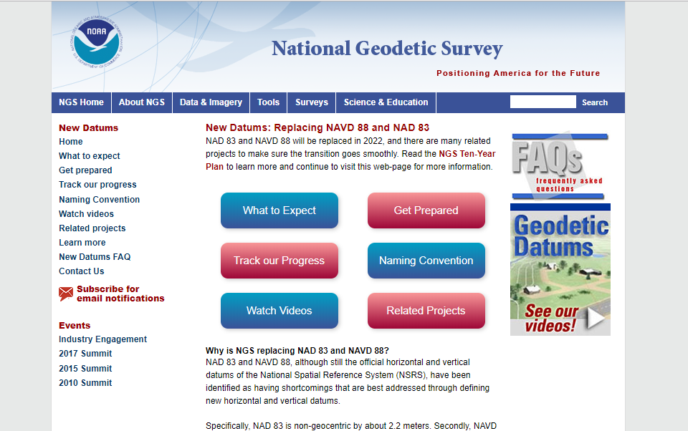
Resources from geodesy.noaa.gov
Click icon on home-page
Notes:
Education –
We have a lot of resources online at our website
Please spread the word, and
make an effort to keep yourself and your colleagues informed.
Tell us what content is missing or how we can make it better!
Transition – I’ll highlight a handful of online resources, beginning with our new datums web site.
New Datums site –
Visit our site. It has information today, and we’ll continue to update it.

Slide 25
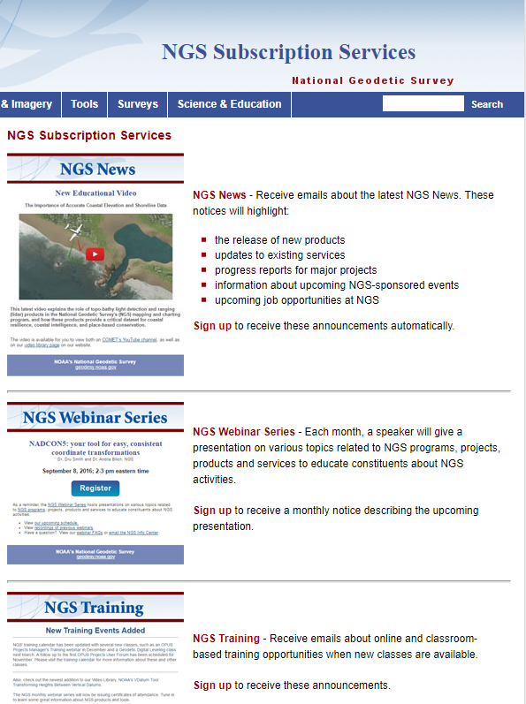
Email Subscriptions
Stay informed!
NGS News
Includes quarterly NSRS Modernization newsletter
NGS Webinar
NGS Training
Only 1-2 messages / month
Click icon
on home-page
Notes:
Email Subscription –
Sign up for notifications about News, webinars, and training opportunities with NGS.
We use our News subscription list to send out our quarterly NSRS Modernization Newsletter, too.

Slide 26
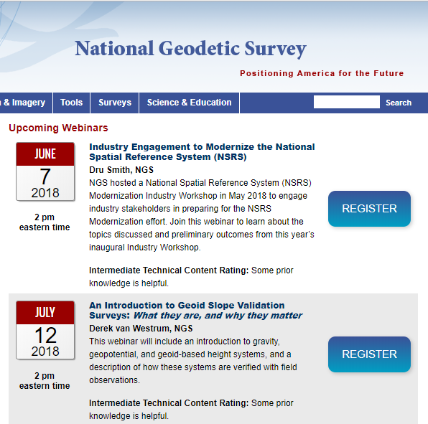
NGS Monthly
Webinar Series
Learn about NGS products and services
Technical rating published in advance
Live questions / answers
All webinars are recorded / posted online
Join us: second Thursday of each month / 2 pm eastern
Save the Date &
Spread the Word
Webinar on Oct. 11th at 2 pm eastern
Case Studies on Limitations of Static Vertical Datums
Notes:
Monthly Webinar –
Save the date for a floodplain focused webinar in October.
We recognize much of our content is intermediate / focused at surveyors and some engineers, but we want to expand our user base.

Slide 27
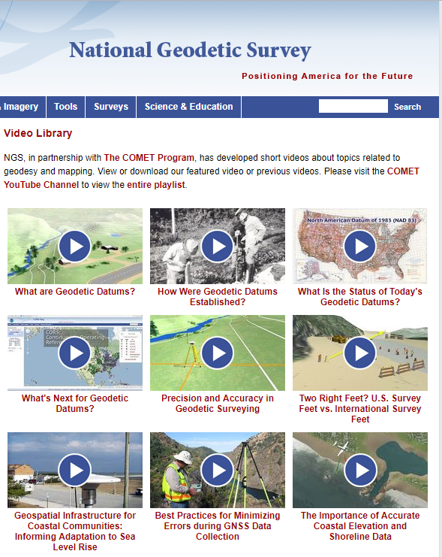
Educational Videos & Online Tutorials
Videos are ~3-5 minutes
Vertical Datums Tutorial is ~1 hour
Notes:
Educational videos and online tutorials –
Our library of lessons and videos are great resources, and will reinforce a lot of information we covered today.
The videos are just 3-5 minutes long, and
the lesson is a deeper dive but still only takes an hour.

Slide 28
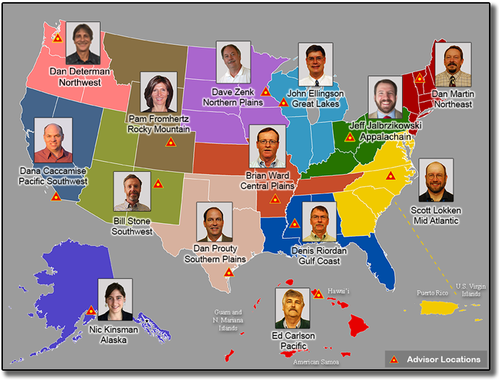
NGS Regional Advisor Program
Notes:
Regional geodetic advisors are located around the country for questions / support.

Slide 29
Get Prepared
EVERYONE
Spread the word…
More active NSRS users
Metadata, metadata, metadata..
Use current datums / realizations
Keep original (“raw”) GNSS observation files
Notes:
Everyone = Spread the word!
More active NSRS users
Metadata, metadata, metadata..
Require/provide complete metadata for all mapping contracts.
How did they get the positions/heights? Document it!
Lead by example and use best metadata practices
Use current datums / realizations.
NAD 83(2011) epoch 2010.00
USGG12 (gravimetric geoid) / GEOID12B(hybrid geoid)
NAVD 88 (get off of NGVD 29)
Keep original (“raw”) GNSS observation files. This will improve quality of future transformations.

Slide 30
Poll
How do you feel about NSRS Modernization?
Excited
Neutral
Concerned
Excited and concerned
Unsure
Notes:
As promised, I’d like to end with a poll.
POLL QUESTION: How do you feel about NSRS Modernization?
Excited
Neutral
Concerned
Excited and concerned
Unsure

Slide 31
Recap
NGS and NAVD 88 are critical to floodplain mapping.
NAVD 88 is going to be replaced in 2022.
The tools to access NSRS and transform/convert data that you used today will be expanded for 2022.
Spread the word to help coordinate, educate and prepare!
DON’T FORGET!
Notes:
Recap
NGS and NAVD 88 are both critical to floodplain mapping
Ellipsoidal, orthometric, and tidal vertical datums each have a role…
NAVD 88 is going to be replaced in 2022
By NAPGD 2022, part of larger NSRS Modernization effort (2022).
Replacement is in 2022, but the time to prepare is now.
The tools you use today will be expanded for 2022
Tools for accessing NSRS (OPUS, CORS, Data Explorer)
Tools for transformations (NCAT and VDATUM), and
they all require good metadata (lead by example!)
What’s next? Spread the word to help coordinate, educate and prepare!

Slide 32
Thank you!
Christine.Gallagher@noaa.gov
Special thanks to:
Nicole.Kinsman@noaa.gov
Notes:
Thanks!
Thanks for the opportunity to speak with you.
Thanks to Nic Kinsman, who as a coastal manager and now NGS Alaska Region Geodetic advisor has helped focus what’s relevant to this group (in addition to creating a lot of the slides herself)
Happy to answer any questions.

