Slide 1
PA Basemap 2030
What will the “bottom layer” look like?
NW PA GIS Conference
October 2022
Jeff Jalbrzikowski, P.S., GISP, CFS
Appalachian Regional Geodetic Advisor
jeff.jalbrzikowski@noaa.gov
240-988-5486
Notes:
-hi my name’s Jeff!
-so who am I?
-I’m a surveyor, NGS calls me a geodesist, and my background is in all types of surveying both land and hydrographic. I’ve been with NGS for about 2 years, came here from the USACE (Pittsburgh District), and have also worked for the Bureau of Land Management and various State & local government. Spent almost my entire career with government, and got my start surveying in the military. It’s taken me around the world, but originally I’m from SE Ohio, I’m a university of Akron graduate, and I have an older sister who lives just north up in Flint.

Slide 2
Organizational Structure
-Department of Commerce (DoC)
(~47,000 employees)
-National Oceanic and Atmospheric Administration (NOAA)
-National Ocean Service (NOS)
-National Geodetic Survey (NGS)
(~170 employees)
Notes:
-We are the Federal Government’s oldest scientific agency.
-part of the Executive Branch
-I know it can seem kind of strange that NGS is part of the NOS, but the origins of NGS lie with the C&GS.
-we are a “Program Office” of the NOS
Survey of the Coast – 1807
Coast Survey – 1836
Coast and Geodetic Survey – 1878
NGS since 1970

Slide 3
Organizational Structure
We’re not USGS, we’re NGS
-Department of Commerce (DoC)
(~47,000 employees)
-National Oceanic and Atmospheric Administration (NOAA)
-National Ocean Service (NOS)
-National Geodetic Survey (NGS)
(~175 employees)
≠
Notes:
-as you can read my slide, I like to point that out because over my 2 years at NGS I’ve seen and heard this misunderstanding quite a bit
-don’t worry! it doesn’t offend us! and we do work closely with USGS, but we are separate agencies within totally different departments of the federal government

Slide 4
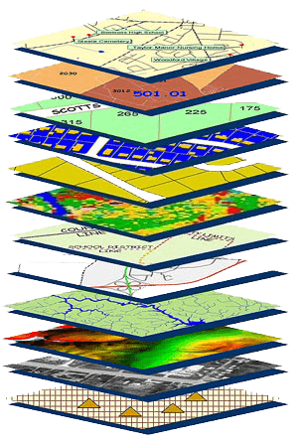
NGS Mission
To define, maintain and provide access to the National Spatial Reference System (NSRS) to meet our Nation’s economic, social, and environmental needs.
NSRS
Notes:
NGS develops and maintains the National Spatial Reference System, a national coordinate system that provides the foundation for transportation, navigation, land record systems, mapping and charting efforts, and a multitude of scientific and engineering applications
CLICK
You’ve all seen this or some similar graphic I’m sure. That bottom layer… that’s our baby, the NSRS.

Slide 5
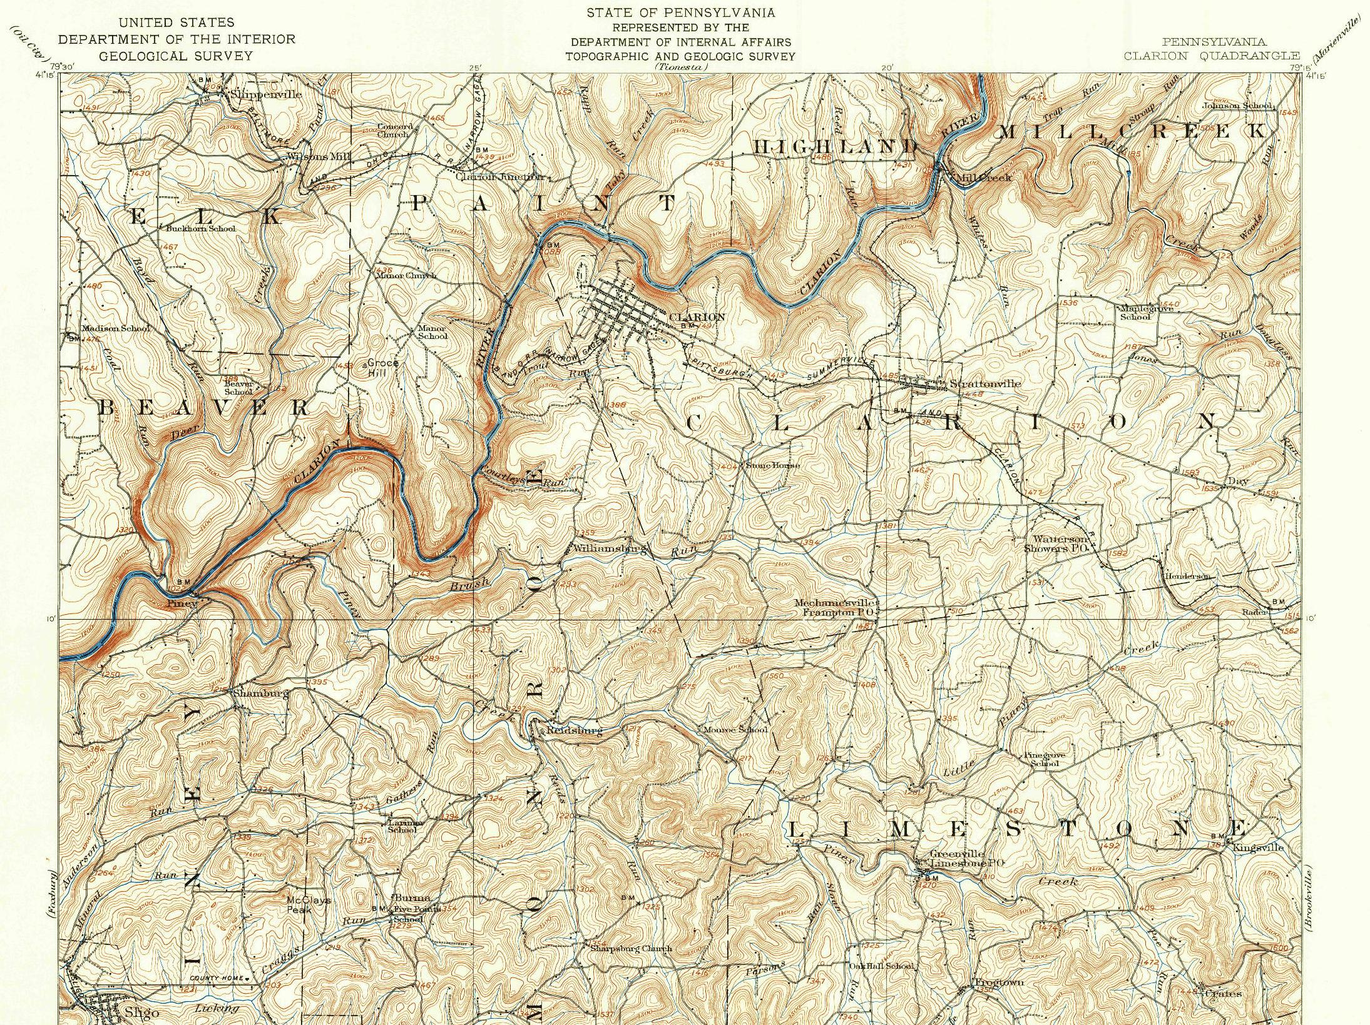
Vintage USGS Quads Geodetic Control shown
Horizontal/Trig
Vertical/Benchmarks
Notes:
Here’s the old 1907 USGS quad of this area.
CLICK
Check that out, there’s some horizontal control shown on a hilltop, there’s some benchmarks, 3 I’ve highlighted here.
But really there’s plenty more if you peruse the map.

Slide 6
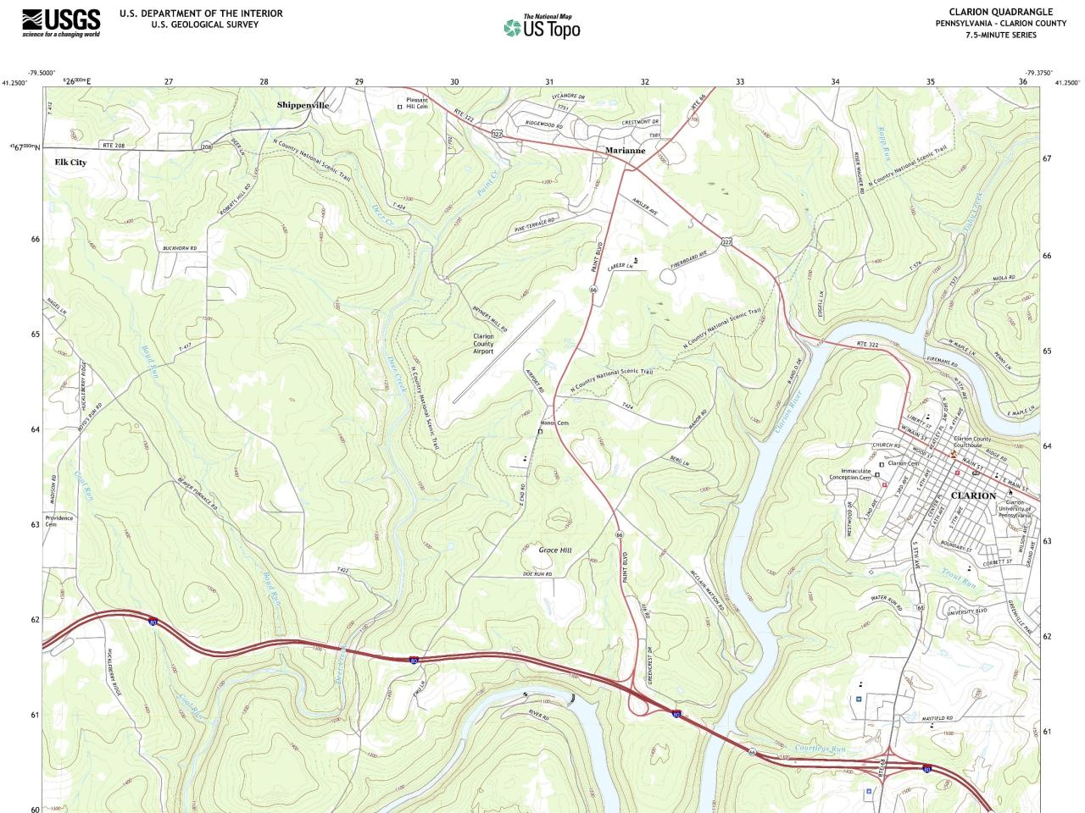
Current US Topo Geodetic Control absent
It’s still there as the framework!
Notes:
Now here’s the current 2019 quadrangle, the US Topo product line from USGS
And with regards to geodetic control… we see nothing!

Slide 7
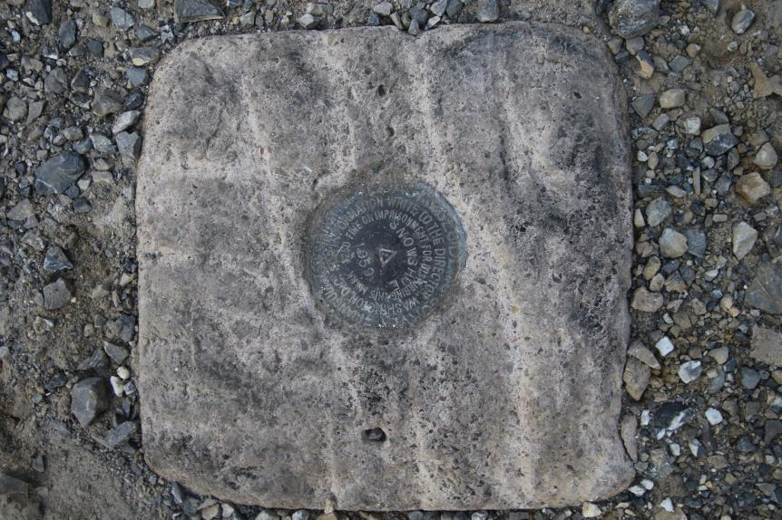
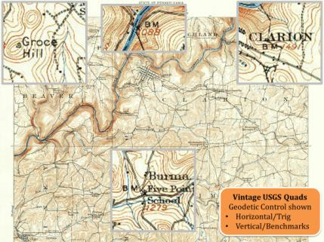
Passive Control
Terminology – Geodetic Control
All marks are passive—they sit there and hold a point
Notes:
All marks are passive!—in that they sit there doing nothing in and of themselves besides holding a point
-This is the only way to tie your data to NGVD29 is to find one of these marks and start a survey from it.
-Primary way to to tie your data toi NAVD88, but GNSS ties are popular
Calibration sites for GNSS technology, Real Time Network validation, and verification of datum transformation tool results.
Monitoring Sites for to enhance velocity models (via repeat/campaign GNSS occupations)
Convenience for local project control, in areas with limited GNSS coverage (e.g. cities, forests), or in the event of GNSS failure (e.g. geomagnetic storms)

Slide 8
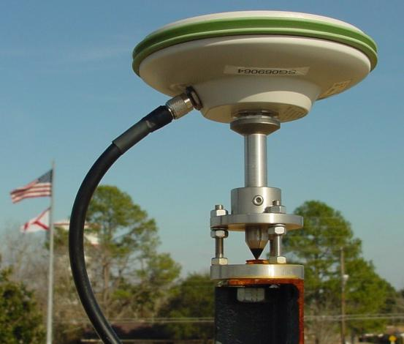
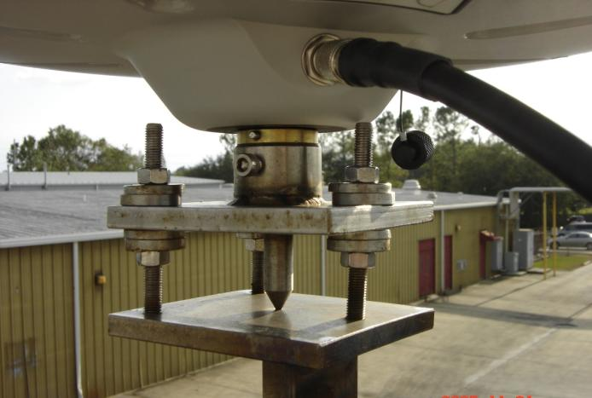
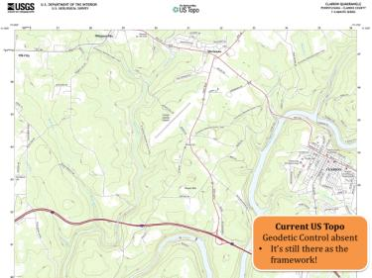
Active Control
Terminology – Geodetic Control
Some marks have permanently installed antennas that enable continuously logged observations
(they still sit there and hold a point)
Notes:
All marks are passive!—in that they sit there doing nothing in and of themselves besides holding a point
This includes the fixed antenna mount that is a part of a CORS.
But, some marks have permanently installed equipment that enable nearly continuous observation and these are called “active” stations.
Access to NAPGD2022 and NATRF2022 for anyone with a GNSS receiver.
More Efficient than conventional leveling for determining orthometric heights.
Convenience in that no need to recover passive control, rather set one’s own and collect GNSS data on it.
So, GPS/GNSS technologies simplify and improve access to, and the accuracy of, our spatial reference system.
→ By adding a 4th dimension to all coordinates (time), marks can serve as more faithful access points.

Slide 9
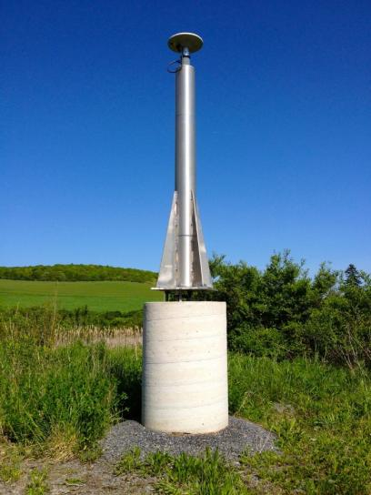
CORS
Terminology – Geodetic Control
Continuously Operating Reference Station
GNSS ANTENNA
RECEIVER
POWER
DATA STORAGE
COMMUNICATIONS
WVTA in Terra Alta, WV
Notes:
Note that the whole pillar could be considered a type of “mark”, being a passive do-nothing structure that holds a “point”, the GRP of this CORS.
But the point, given coordinates computed from all the data collected by that antenna, is probably in here somewhere, as a part of this huge pillar which is effectively one big mark, passive as can be….

Slide 10
National Spatial Reference System
A common and consistent geospatial framework to meet the economic, social, and environmental positioning needs of our Nation.
Foundational elements include:
Latitude
Longitude
Height
Gravity
Shoreline Position
…but also how these change over time
Horizontal Datums | Vertical Datums
Horizontal Datums | Vertical Datums
NAD83 | NAVD88
NAD27 | NGVD29
Elevation
Orientation
Great Lakes Datums | Geoid Models
Great Lakes Datums | Geoid Models
IGLD85 | GEOID18
IGLD55 | GEOID12B
Notes:
The primary mission of NGS is, “to define, maintain, and provide access to the NSRS to meet our nations economic, social, and environmental needs”.
NSRS is a consistent geospatial framework, common to all Federal agencies and other users
NSRS supports informed decision-making for mapping and charting, navigation, flood risk determination, transportation, land management, and more
Elements of NSRS include (but are not limited to): latitude, longitude, elevation, gravity, shoreline position + their changes over time …other elements include scale, earth orientation parameters and others
The vertical component of the NSRS currently utilizes the North American Vertical Datum of 1988 (NAVD88)

Slide 11
Positional Components of
the NSRS
Geometric
aka “Horizontal”
Latitude, Longitude, Ellipsoid Height
Geopotential
aka Orthometric Height
aka “Elevation”
NAD83
NAVD88
Notes:
-geometric component is latitude, longitude, and ellipsoid height
-geopotential component is combined with the geometric components to calculate an ortho height or capital H

Slide 12
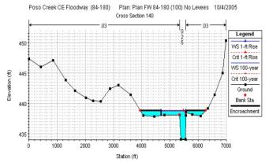
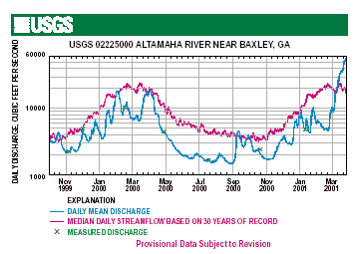
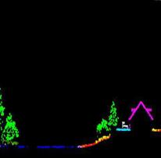
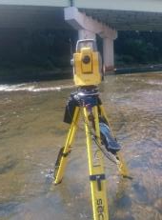
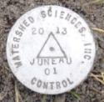
Why does the NSRS matter to me?
Ellipsoidal Datum
Orthometric Datum
Water Level Datum
(and Flow Rates)
+
+
Aerial LiDAR/Mapping
Historic Water Levels and Flow Rates
Terrestrial Survey/Cross-Sections
Notes:
Example of why we need consistent coordinates (illustrated):
Just in the making of a single FIRM, data collected at different points in time using different methods:
-aerial lidar
-x-section and structure data via survey
-streamflow data/hydrographs
All of these must be reliably aligned and combined with historical data, in both the horizontal and vertical components, to produce a final product in which all of this information is available in one place, to assist professionals like yourselves in appropriate flood mitigation.
→Therefore, Reliable Flood Rate Insurance products rely on the NSRS
In a perfect world…
datums would be parallel and smooth
Surface of Earth would not move

Slide 13
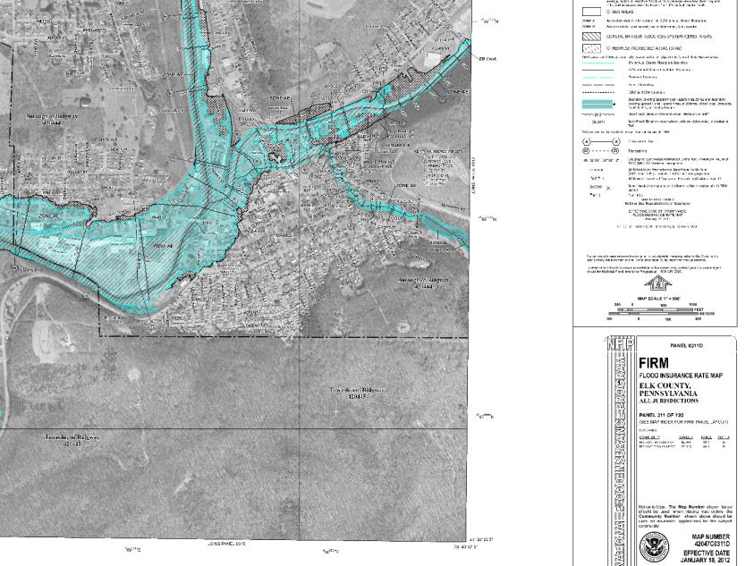
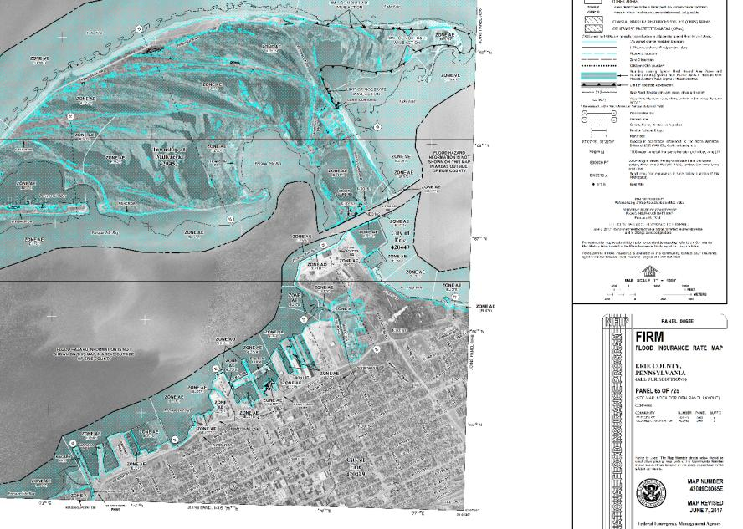
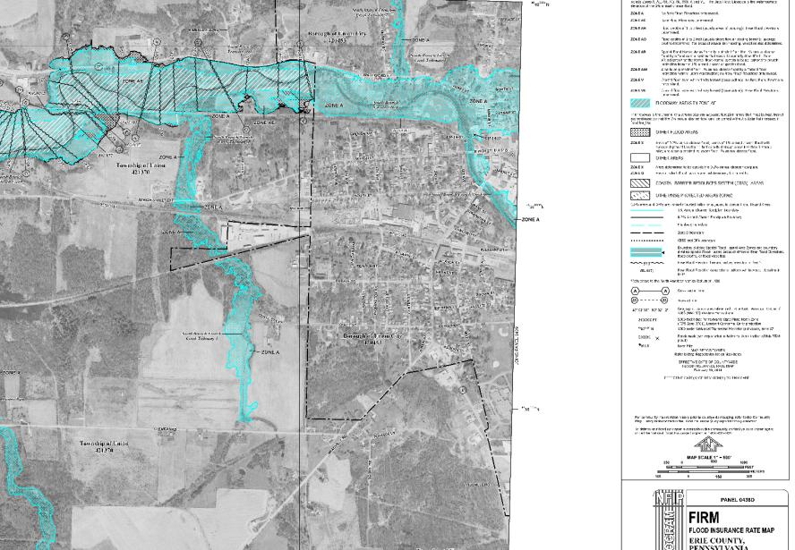
Why does the NSRS matter to me?
=
FIRMs require data from disconnected sources.
Datums must be consistently aligned.
Notes:
All of these must be reliably aligned and combined with historical data, in both the horizontal and vertical components, to produce a final product in which all of this information is available in one place, to assist professionals like yourselves in appropriate risk mitigation.
→Therefore, Reliable Flood Rate Insurance products rely on the NSRS
In a perfect world…
datums would be parallel and smooth
Surface of Earth would not move

Slide 14
Yes, we are delayed.
NSRS Modernization
Notes:
So remember, today’s presentation is not JUST about new datums, it is about modernizing the NSRS as a whole.
You don’t know what the NSRS is? Stay tuned, we’ll get there as we go along.

Slide 15
Delayed Release of the Modernized NSRS
How long will the delay be?
Our website or newsletter is best source of projected timeframe, current estimate is middle of 2025.
Will the names stay the same?
Yes, terms containing “2022” such as “NATRF2022” and “NAPGD2022” will remain the same.
Will all previously proposed products be released along with the new datums?
No, they will not. Check out our June 2022 webinar.
hyperlink to the Track Our Progress homepage
June 2022 webinar
hyperlink to the full FAQ

Slide 16
Delayed Release → Re-prioritization
We recently decided to release all of the modernized NSRS data before we have fully completed all support tools
If we do not take this approach, we are not likely to see the modernized NSRS defined and released until 2030

Slide 17
What’s going to stay the same?
NSRS Modernization
What’s going to be different?
Notes:
-so you’ve probably seen that phrase that I have front and center here, NSRS Modernization
-that’s the blanket term we use to refer to not just the new datums but other updates

Slide 18
North American Datum
of 1983
NAD83
will be replaced by

Slide 19
North American Terrestrial Reference Frame of 2022
NATRF2022
(pronounced: nat-ref)

Slide 20
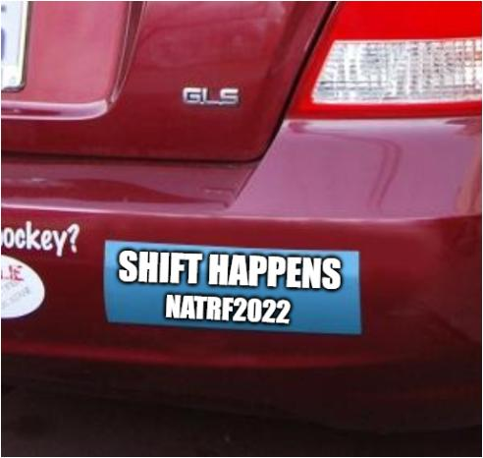

Slide 21
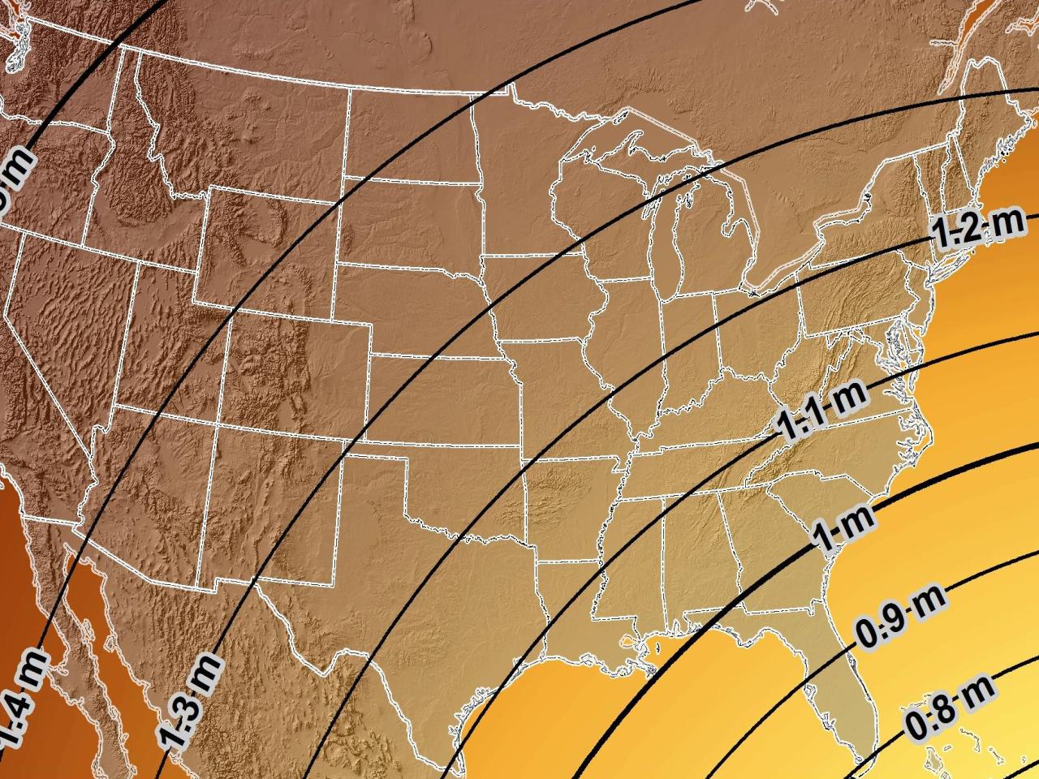
Estimated Geometric Change – Latitude & Longitude
NAD83 (2011) → NATRF2022
Direction of Shift
4.3 ft
3.9 ft
3.6 ft
Notes:
What’s the magnitude of the horizontal datum shift across Pennsylvania?
Minimum Shift ~3.75 feet
Maximum Shift ~3.97
Remember this is just an estimation, don’t hold me to the numbers please

Slide 22
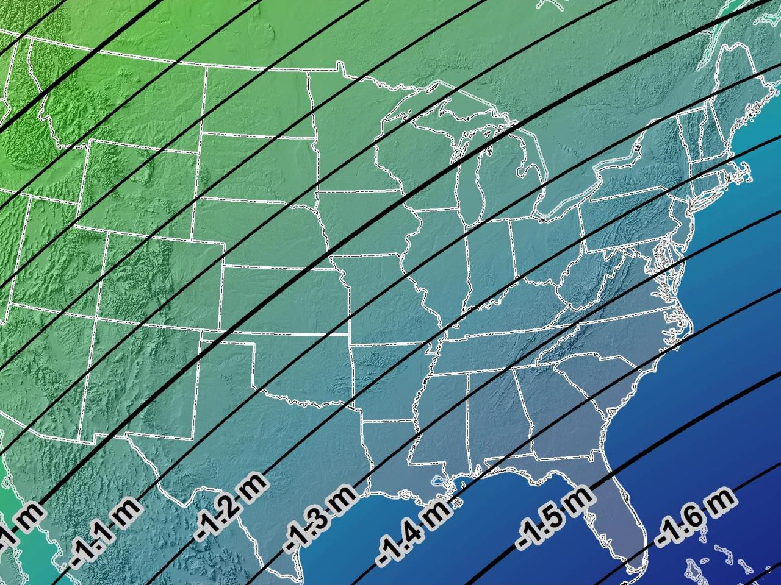
Estimated Geometric Change – Ellipsoid Height
NAD83 (2011) → NATRF2022
-3.6 ft
-3.9 ft
-4.3 ft

Slide 23
Terrestrial Reference Frame?
Existing, accepted terminology
International TRF
first realization of the ITRF was 1992
NATRF2022 will be based on ITRF2020
“Horizontal Datum” - misnomer for NAD83
Really is a Geometric Reference Frame
Notes:
-Where do you see an Epoch right now in NGS data?
CLICK
Datasheets! there you see the epoch of 2010.0
and of course OPUS Solution Reports!
note that in blue over there on the right you’ll see another epoch, in the ITRF, which I will explain later on

Slide 24
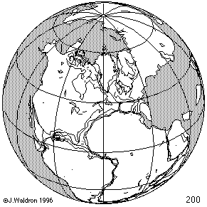
ITRF concept
Watch the grid!
Epoch:
Notes:
Ok, now ITRF mentioned a couple slides ago.
Most simplistic way to explain ITRF is to watch this animation.
This is a very loose representation/visualization of what the ITRF is, a characterization only.

Slide 25
ITRF
Frame = constant
NA Plate = rotating
NATRF
Frame = rotating
NA Plate = constant
Notes:
We say “NATRF2022” is “fixed” to the N.A. Plate, making it a “plate fixed” frame
-the frame is constant to itself, but rotating within ITRF, and moving in a different direction than the other 3 frames

Slide 26
ITRF
Frame = constant
NA Plate = rotating
NATRF
Frame = rotating
(relative to ITRF)
NA Plate = constant
(relative to NATRF)
Notes:
We say “NATRF2022” is “fixed” to the N.A. Plate, making it a “plate fixed” frame
-the frame is constant to itself, but rotating within ITRF, and moving in a different direction than the other 3 frames

Slide 27
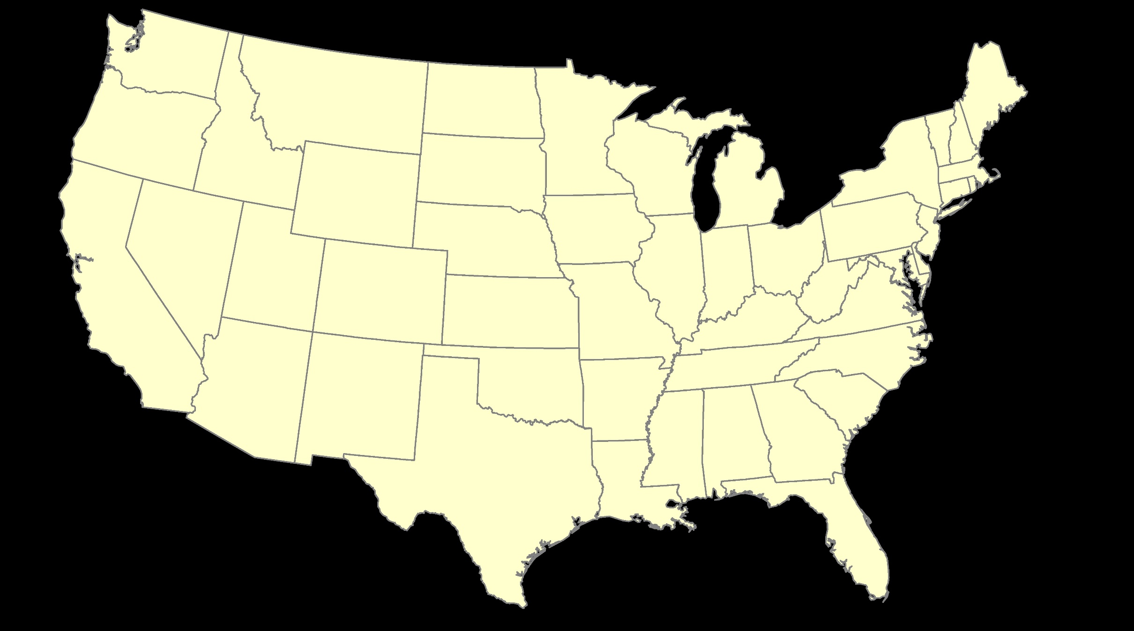
ITRF – constant frame, rotating plate

Slide 28
“Plate-Fixed”
NATRF – rotating frame, constant with plate

Slide 29
ITRF or NATRF – your choice, we’ll provide both

Slide 30
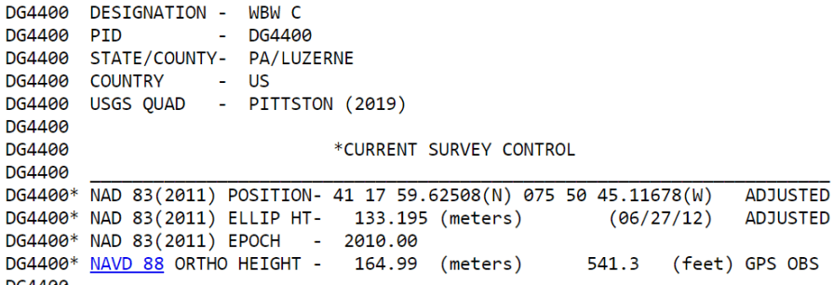
Terminology – Time/4D
Epoch
eh-puck? ee-pock? … to-may-to, to-mah-to
an instant of time
astronomy & geodesy use a decimal date
e.g. 2021.0276 or 2020.0000 or 2022.8205
doesn’t have to be
incorporating epochs is important, not format
others may use day-of-year = 2021:131
calendar date is sufficient
Notes:
-Where do you see an Epoch right now in NGS data?
CLICK
Datasheets! there you see the epoch of 2010.0
and of course OPUS Solution Reports!
note that in blue over there on the right you’ll see another epoch, in the ITRF, which I will explain later on

Slide 31
4D alignment – Epochs
One epoch where ITRF2020 coordinates will be equivalent to NATRF2022
January 01, 2020
ITRF2020 (epoch 2020.0) = NATRF2022 (epoch 2020.0)
Notes:
After that, they diverge and continue to do so, we’ll visualize that soon

Slide 32
NCAT
How will you do that?
Epochs/Time/4D
Notes:
-so you’ve probably seen that phrase that I have front and center here, NSRS Modernization
-that’s the blanket term we use to refer to not just the new datums but other updates

Slide 33
NGS Coordinate Conversion And Transformation Tool (NCAT)
Notes:
NCAT includes the functionality of previous NGS tools:
NADCON 5.0
XYZWIN 2.0
UTMS 2.1
SPC83 2.1
USNG 2.3
Includes error estimate of transformation per point.
Available as the single-point graphic seen here, multi-point upload/download, as a downloadable executable fie to run from the DOS prompt, and as web services for inclusion in your own
It’s a great tool. Anyone using

Slide 34
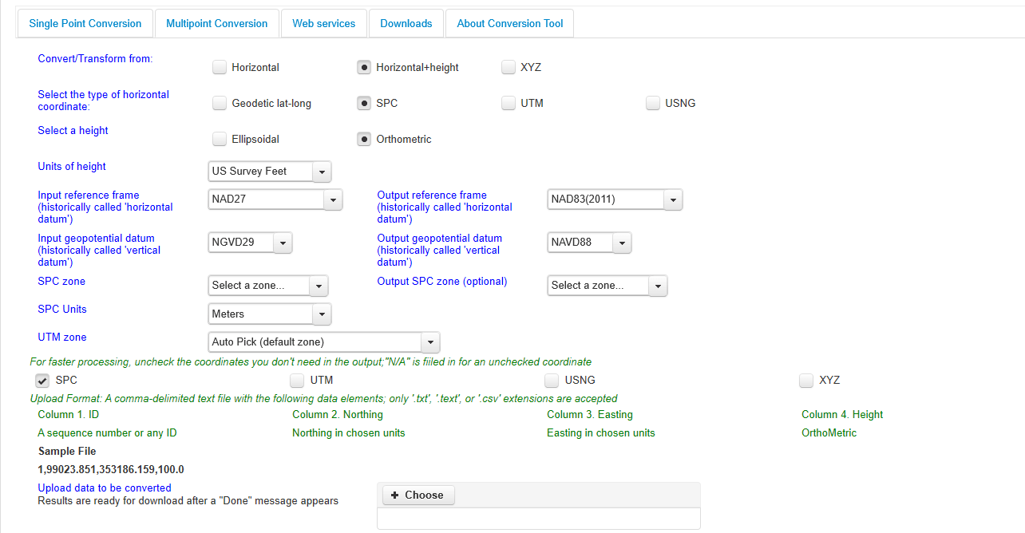
NGS Coordinate Conversion And Transformation Tool (NCAT)
Notes:
NCAT includes the functionality of previous NGS tools:
NADCON 5.0
XYZWIN 2.0
UTMS 2.1
SPC83 2.1
USNG 2.3
Includes error estimate of transformation per point.
Available as the single-point graphic seen here, multi-point upload/download, as a downloadable executable fie to run from the DOS prompt, and as web services for inclusion in your own
It’s a great tool. Anyone using

Slide 35
NCAT is available via web services

Slide 36
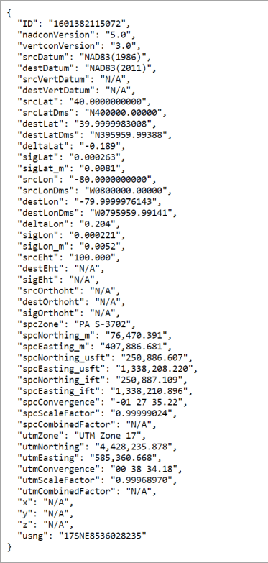
NCAT is available via web services
Note that each operation is a separate service
Struggling?
Contact us.
We can help!

Slide 37
NGS Coordinate Conversion And Transformation Tool (NCAT)
Notes:
NCAT includes the functionality of previous NGS tools:
NADCON 5.0
XYZWIN 2.0
UTMS 2.1
SPC83 2.1
USNG 2.3
Includes error estimate of transformation per point.
Available as the single-point graphic seen here, multi-point upload/download, as a downloadable executable fie to run from the DOS prompt, and as web services for inclusion in your own
It’s a great tool. Anyone using

Slide 38
NGS Coordinate Conversion And Transformation Tool (NCAT)
Notes:
NCAT includes the functionality of previous NGS tools:
NADCON 5.0
XYZWIN 2.0
UTMS 2.1
SPC83 2.1
USNG 2.3
Includes error estimate of transformation per point.
Available as the single-point graphic seen here, multi-point upload/download, as a downloadable executable fie to run from the DOS prompt, and as web services for inclusion in your own
It’s a great tool. Anyone using

Slide 39
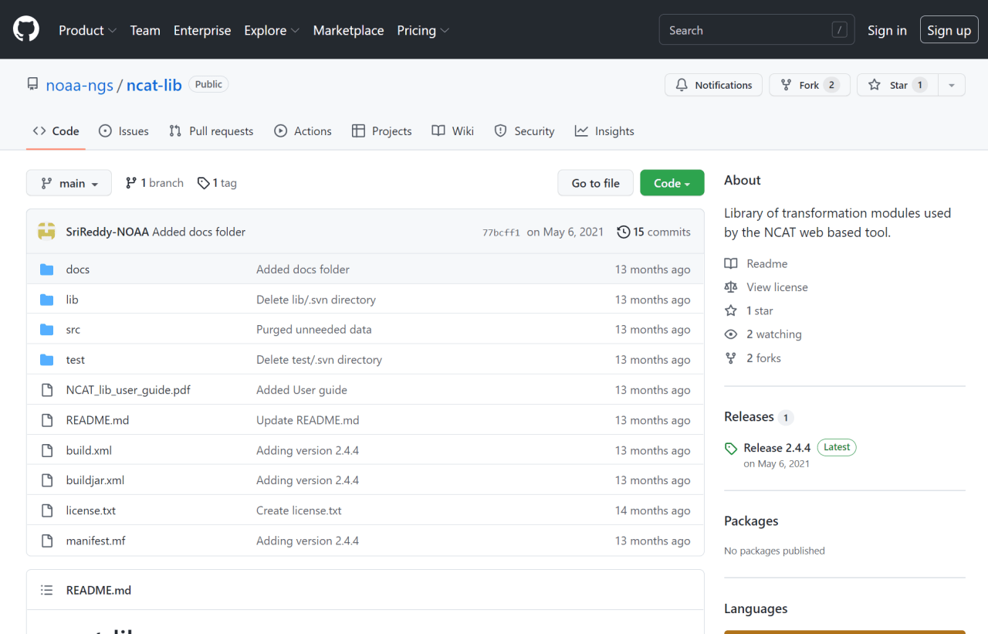
NCAT source code is on GitHub

Slide 40
NGS Coordinate Conversion and Transformation Tool (NCAT)
NGVD29
Please… don’t continue to use old NGS VERTCON or USACE CorpsCon
transformation
transformation
NAVD88
NAPGD2022
transformation
NCAT is a container for newest version of VERTCON
It will be upgraded to include NAPGD2022
Notes:
NCAT incorporates the functionality of the old software VERTCON to transform NSRS heights.
NCAT is a container for newest version of VERTCON (v3.0)
It will be upgraded, after the release of the new datums, to include NAPGD2022

Slide 41
How does NCAT do that?
CORS data
Continuous → 24/7/365
Notes:
-so you’ve probably seen that phrase that I have front and center here, NSRS Modernization
-that’s the blanket term we use to refer to not just the new datums but other updates

Slide 42
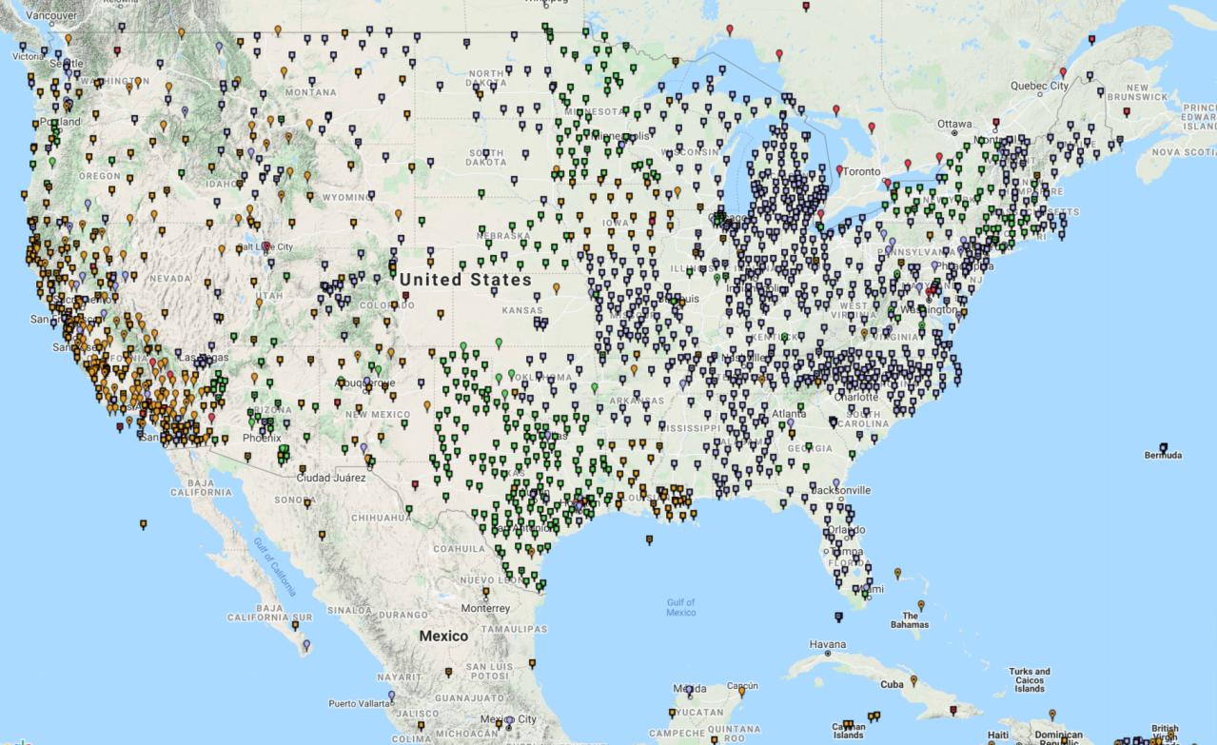
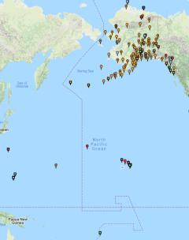
Continuously Operating Reference Stations (CORS)
2000+ sites
200+ organizations
Notes:
-I would like to point out we have a new, official name for the network you see represented on this map,
-The NOAA CORS Network, or NCN
CLICK
-this is neat little graphic with some stats on teh NCN you can find on our website
-below the gaphic youll find a search bar with more information

Slide 43
NOAA CORS Network (NCN)
2000+ sites
200+ organizations
Notes:
-I would like to point out we have a new, official name for the network you see represented on this map,
-The NOAA CORS Network, or NCN
CLICK
-this is neat little graphic with some stats on teh NCN you can find on our website
-below the gaphic youll find a search bar with more information

Slide 44
NOAA CORS Network (NCN)
We manage the public access to NCN data
July marked our billionth download
The vast majority of stations are not “ours”
NOAA has had as many as 50 or so in-house
Nowadays, NOAA maintains 13 stations
CO-OPS stations along the coasts
We provide guidance on installation, operations, best practices, etc.
“CORS” became vernacular, need distinction
NCN Station… or non-NCN Station
Notes:
-I would like to point out we have a new, official name for the network you see represented on this map,
-The NOAA CORS Network, or NCN
CLICK
-this is neat little graphic with some stats on teh NCN you can find on our website
-below the gaphic youll find a search bar with more information

Slide 45
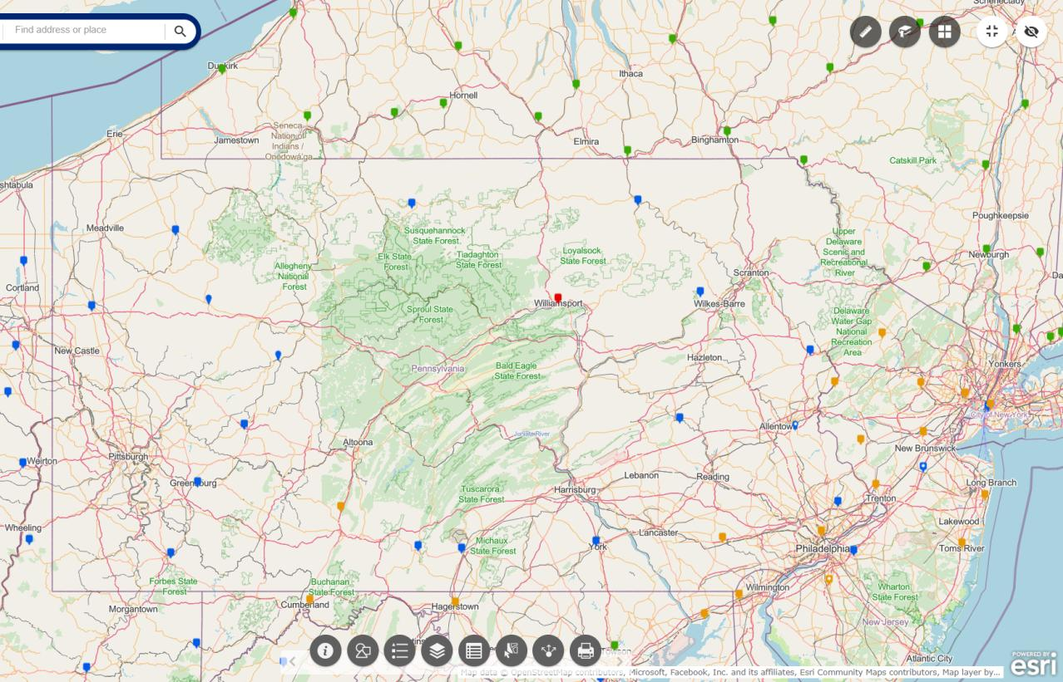
NOAA CORS Network (NCN)
Notes:
where else but the federal government are you going to see two acronyms within one acronym?

Slide 46
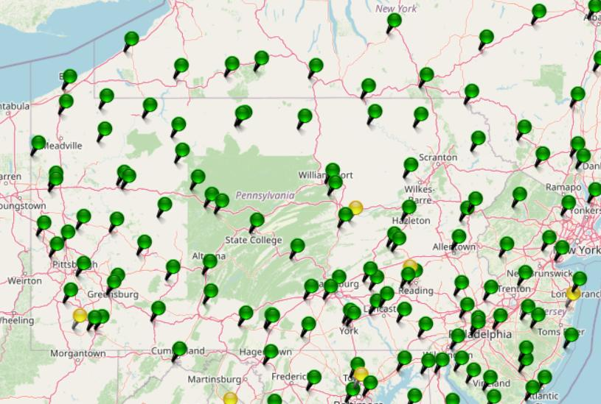
KeyNetGPS CORS Network
Notes:
where else but the federal government are you going to see two acronyms within one acronym?

Slide 47
Terminology – Time/4D
Epoch
eh-puck? ee-pock? … to-may-to, to-mah-to
an instant of time
astronomy & geodesy use a decimal date
2021.4762 = 23 June 2021 (@ ~7:15pm)
doesn’t have to be!
using epochs is important, not format
It doesn’t have to be in decimal years… just start assigning dates to your data
Notes:
-Where do you see an Epoch right now in NGS data?
CLICK
Datasheets! there you see the epoch of 2010.0
and of course OPUS Solution Reports!
note that in blue over there on the right you’ll see another epoch, in the ITRF, which I will explain later on

Slide 48
Terminology - Changing Coordinates
Conversion
change the type of coordinate
e.g. NAD83(2011) latitude & longitude → NAD83(2011) SPCS
Transformation
change the datum of coordinate
e.g. NGVD29 height in feet → NAVD88 height in feet
e.g. NAD 27 latitude & longitude → NAD 83(2011) latitude & longitude
Propagation
change the epoch of coordinate
e.g. NAPGD2022 epoch 2020.00 to NAPGD2022 epoch 2087.2570
e.g. NATRF2022 epoch 2020.00 to NATRF2022 epoch 2023.243
Notes:
Historically NGS has been inconsistent with these top two words.
Going forward, we will use them as:
Conversion: Meaning to change the type of coordinate without changing the datum or frame
e.g. change NAD 83(1986) latitude and longitude to NAD 83(1986) State Plane Coordinates
Transformation: Meaning to change the datum or frame, without changing the type of coordinate
e.g. changing an NAD 27 latitude & longitude to an NAD 83(1986) latitude & longitude
So, “NADCON” which transforms coordinates between datums could have been called “NADTRAN.” C’est la vie.

Slide 49
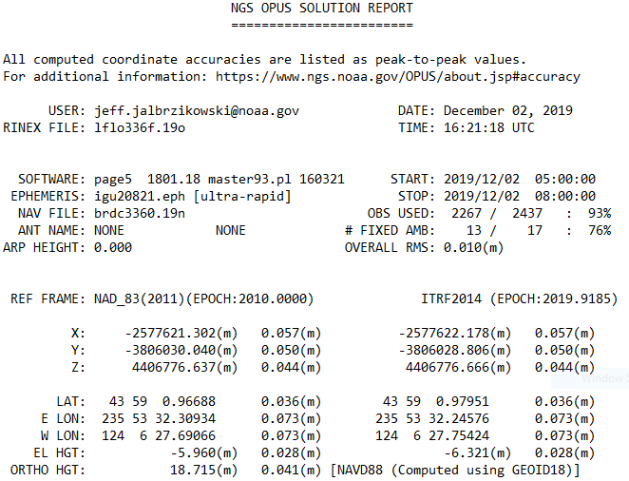
Reference Epoch
Survey Epoch

Slide 50
Reference Epoch
Survey Epoch
Here above we’re looking at a
Transformation and Propagation
Notes:
Revisiting this slide,
CLICK
here above we’re looking at a Transformation from ITRF to NAD83(2011)…
and a Propagation from the Survey Epoch of 2019.9185 to the Reference Epoch of 2010.0

Slide 51
I’ll be selling these bumper stickers at the next NW PA GIS conference ☺
SPCS2022
MAKING EARTH FLAT AGAIN
…ONE ZONE AT A TIME

Slide 52
State Plane Coordinate System of 1983
SPCS83
North and South Zones as they exist now
Notes:
We start with the SPCS83 zones as a frame of reference
NOTE that the color shading of these zones is matched to that of the Preliminary SPCS2022 Zones that follow

Slide 53
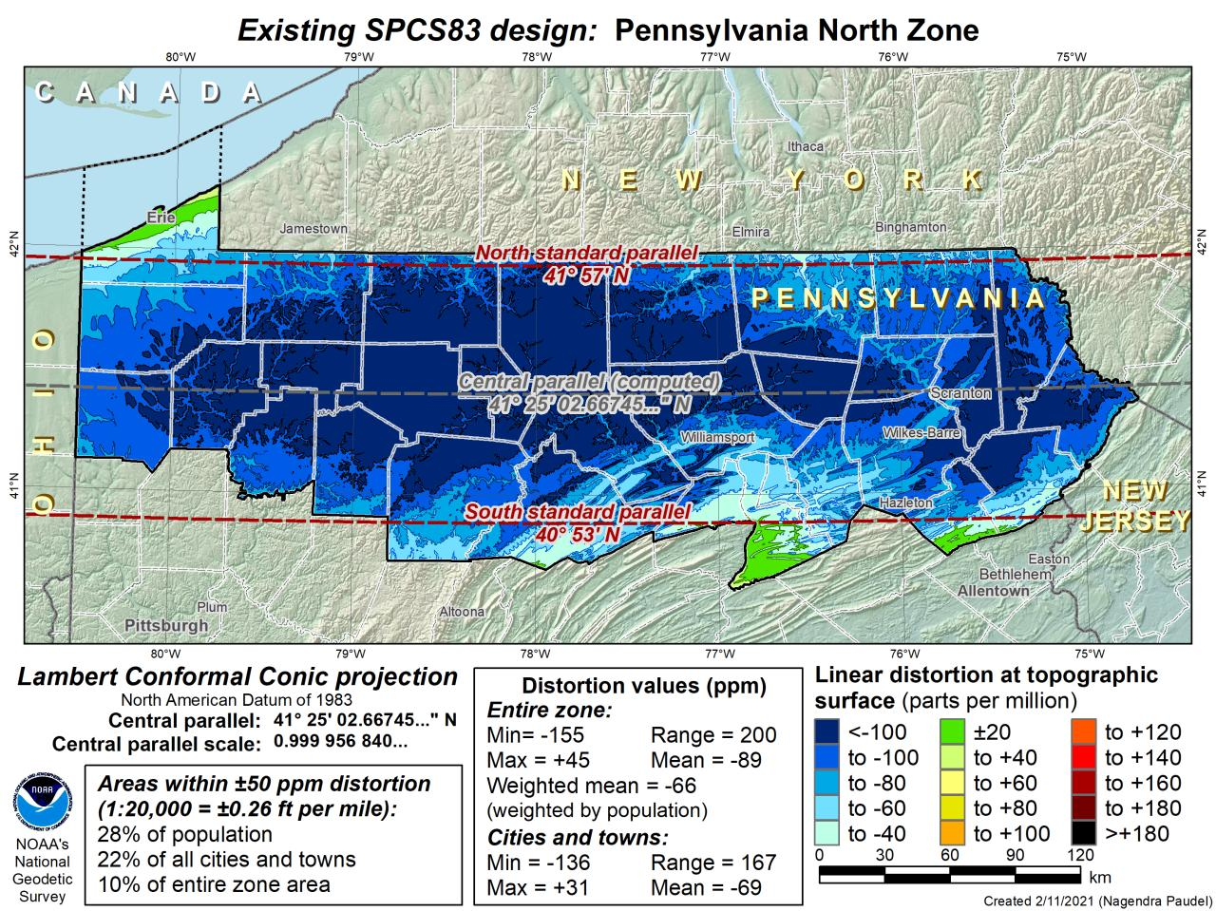
DRAFT

Slide 54
DRAFT

Slide 55
State Plane Coordinate System of 2022
SPCS2022
PA stakeholder group requested a 4-5 zone design, the following are Preliminary maps
Notes:
The following section illustrates the preliminary SPCS2022 zones
There are 4 zones in the NGS design, per request that we design “4-5 zones required to meet the minimum distortion acceptable” set by our design criteria of 50ppm
NOTE the request also included wording: “It is also requested that PennDOT districts be divded into no more than two zones”

Slide 56
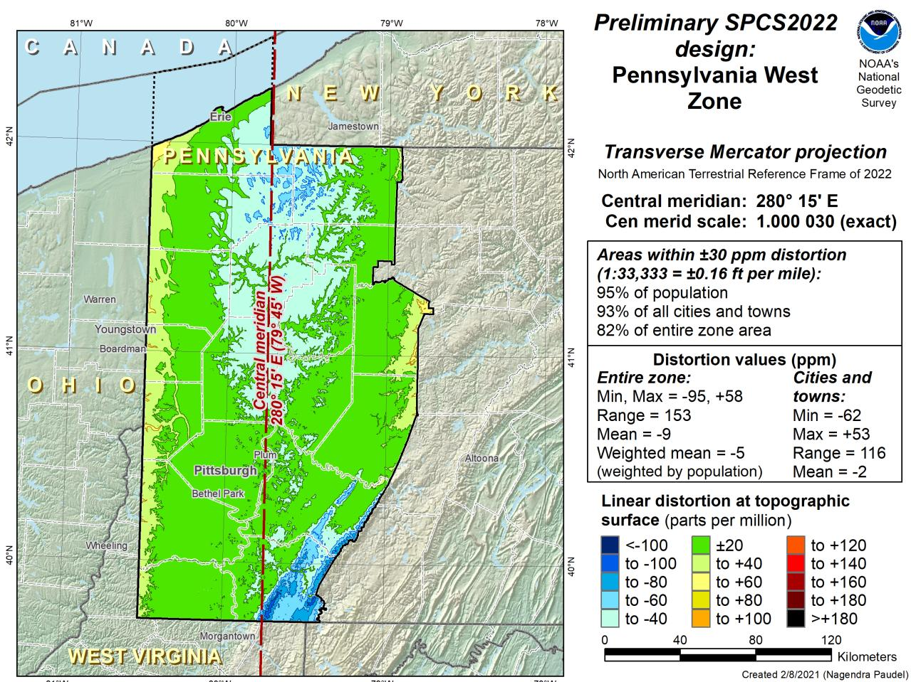
Notes:
NOTE that the West Zone far surpasses the NGS design criteria of 50ppm

Slide 57
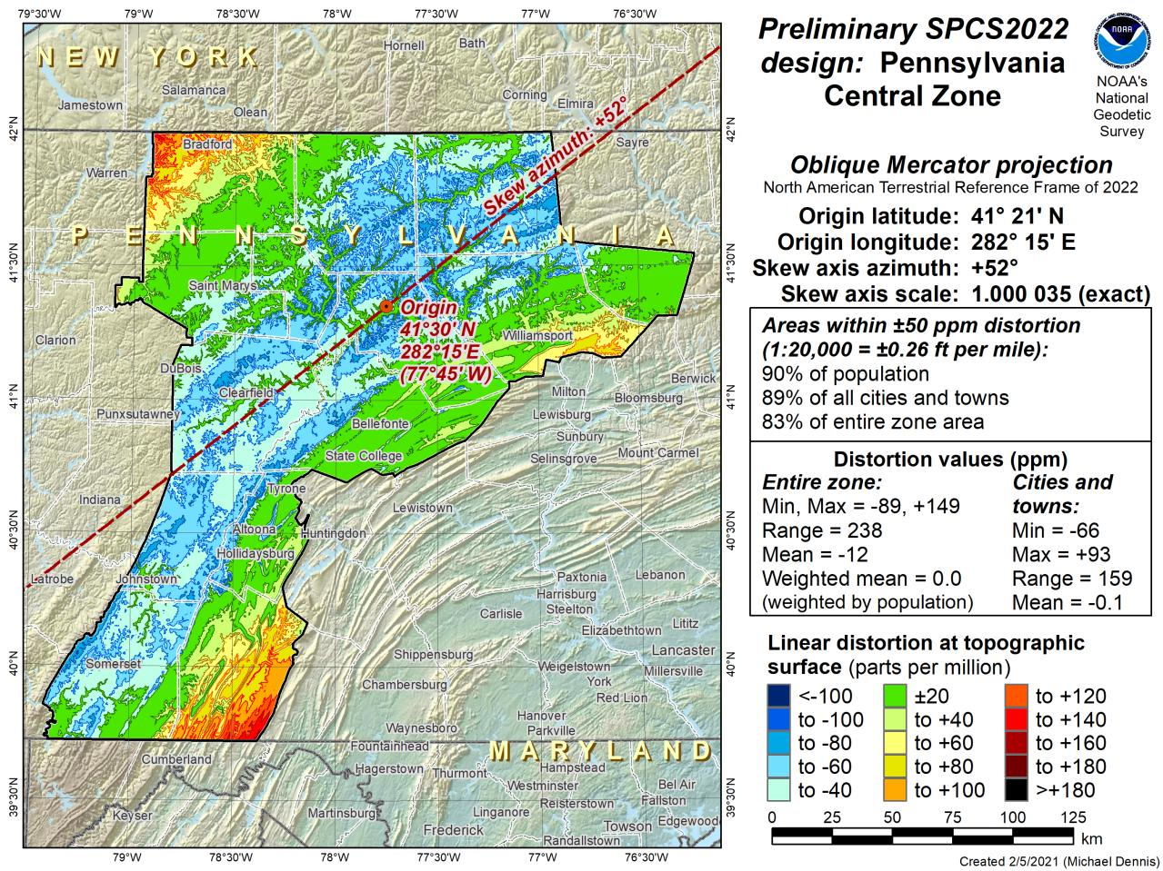
Notes:
This is the first, and likely final, draft of an Oblique Mercator projection for the Preliminary Central Zone
NOTE that even with the

Slide 58
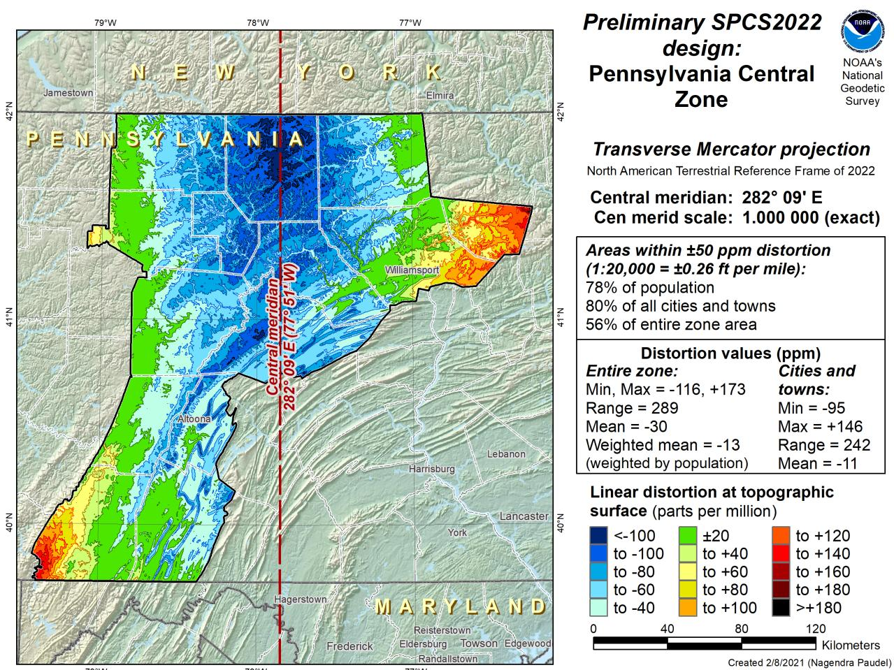
Notes:
This is the first draft of a Preliminary Central Zone
NOTE that this area as Transverse Mercator projection does not meet the 50ppm design criteria
The requirement is that 90% of zone population (per census data) falls within the 50ppm, and the stats here show only 78% do
This is the reason for drafting up this Preliminary Zone also as an Oblique Mercator projection

Slide 59
Notes:
So… there we are back at the Oblique Mercator Projection which will serve as the Central Zone for PA
NOTE that Eastings and Northings are still based on a true north grid

Slide 60
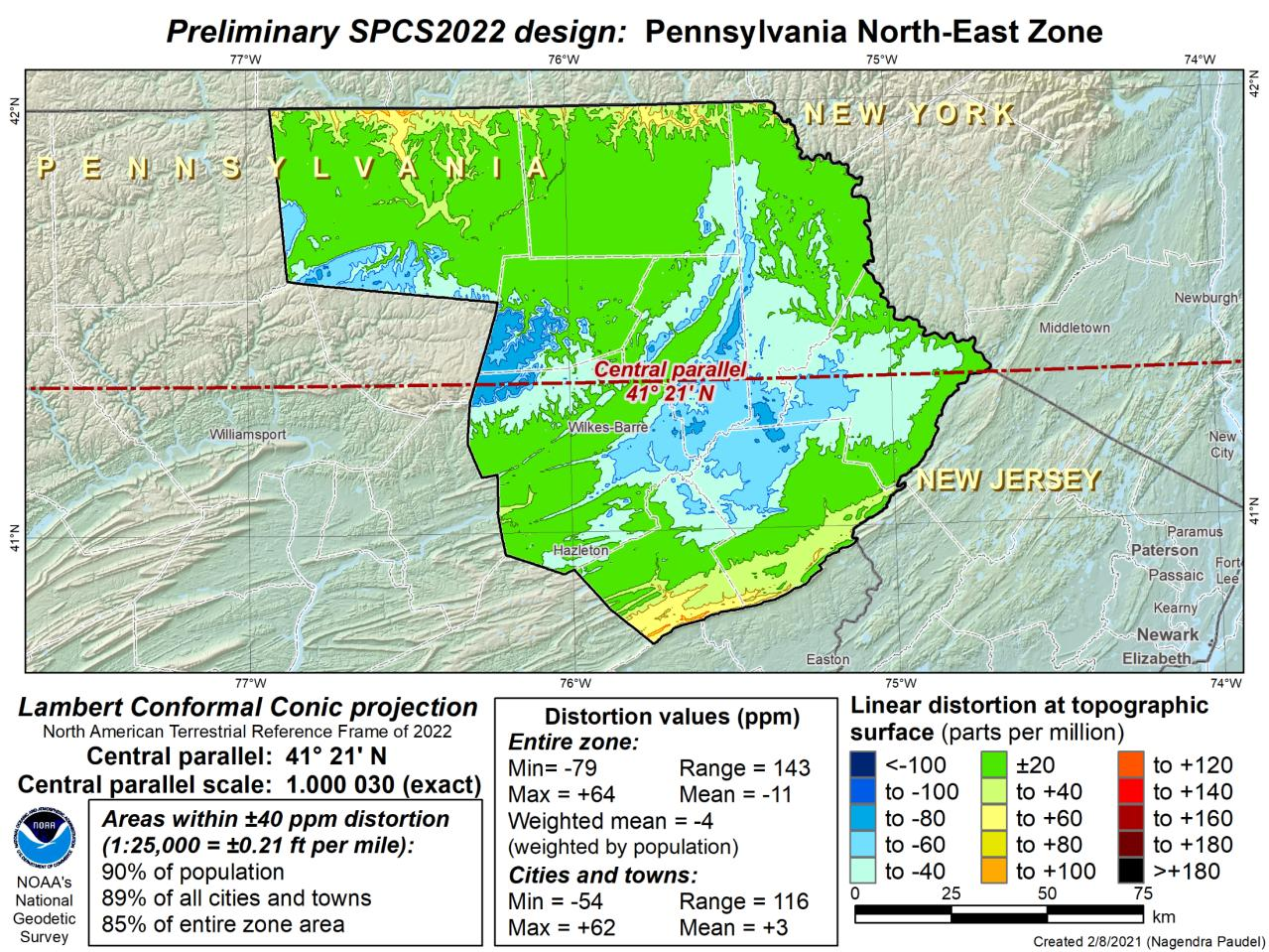
First Draft
Notes:
This is the first draft of a Preliminary North East Zone
NOTE this excludes Columbia and Montour Counties (they would fall in SE Zone)

Slide 61
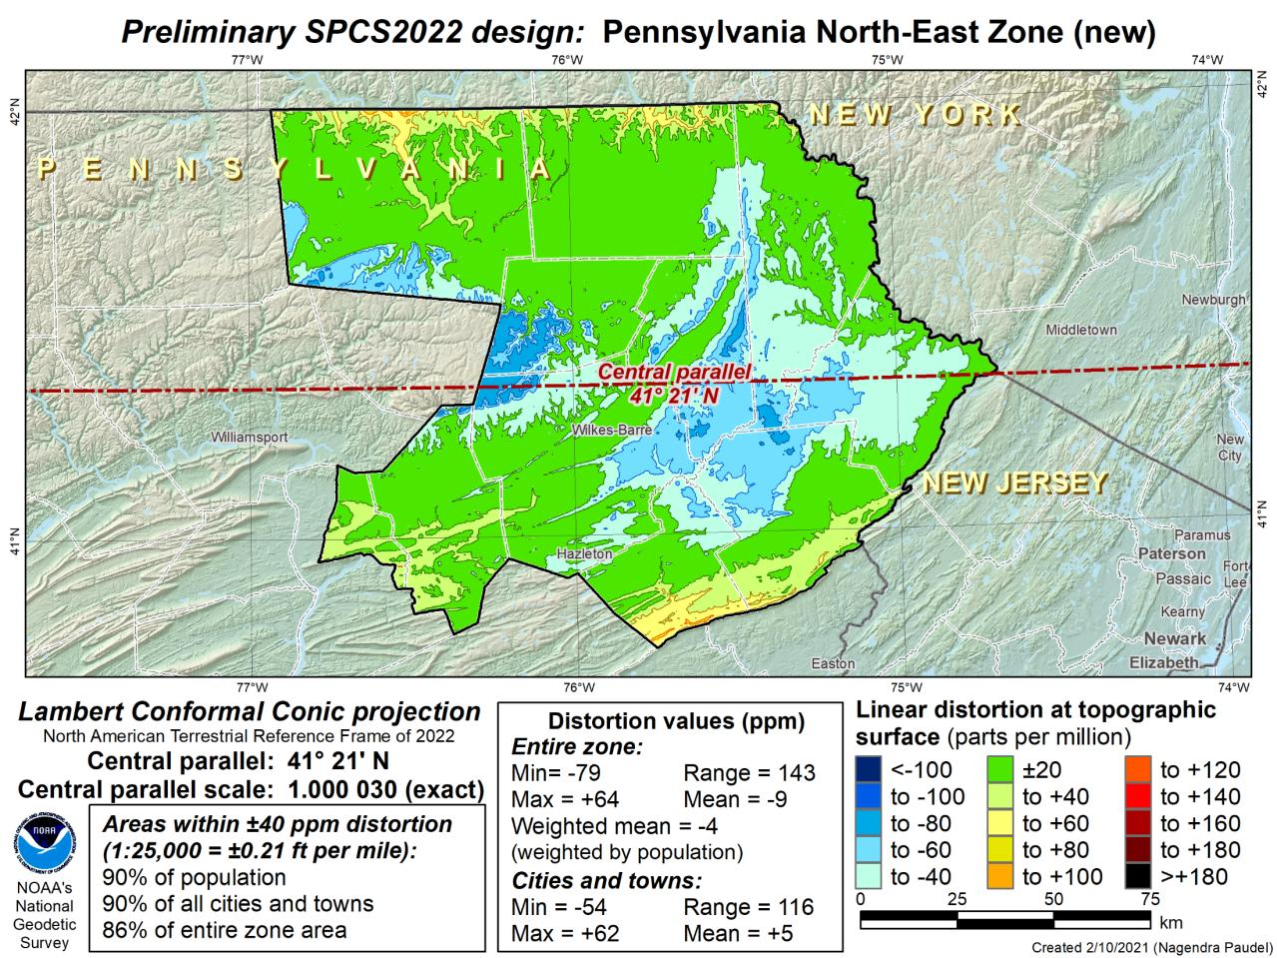
Notes:
This is the second draft of a Preliminary North East Zone
NOTE this includes Columbia and Montour Counties, and the animation highlights the comparison between having these counties in the SE or NE Zone

Slide 62
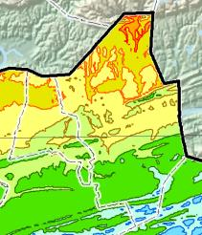
SE Zone
Notes:
This is the second draft of a Preliminary North East Zone
NOTE this includes Columbia and Montour Counties, and the animation highlights the comparison between having these counties in the SE or NE Zone

Slide 63
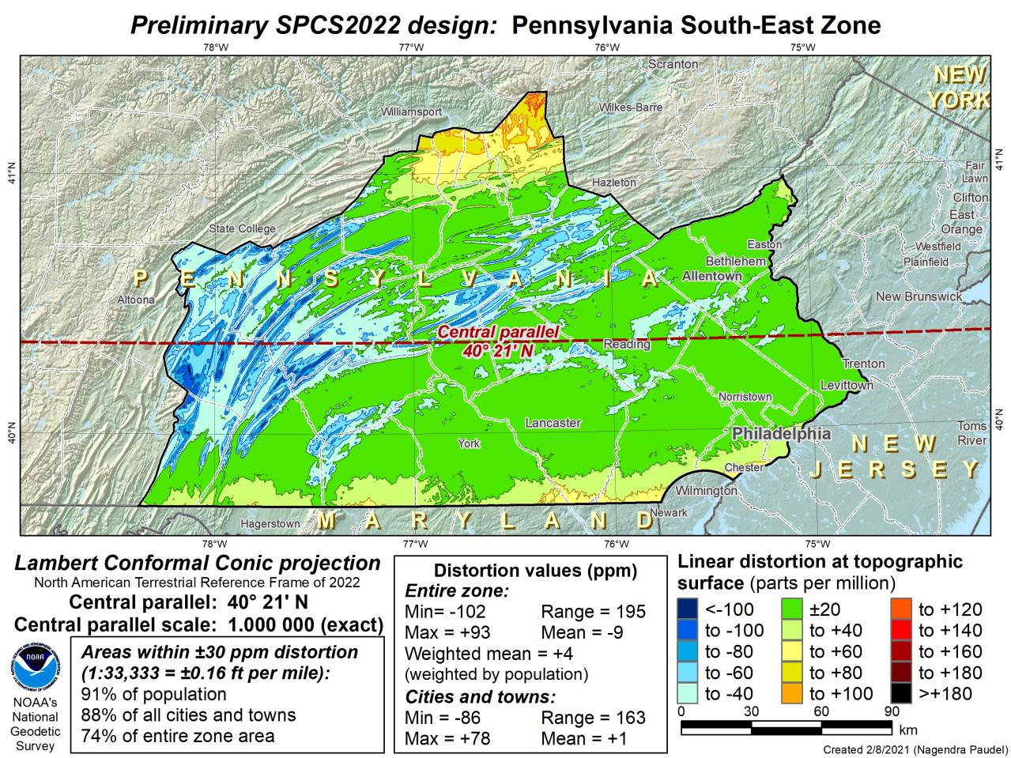
First Draft
Notes:
This is the first draft of a Preliminary South East Zone
NOTE this includes Columbia and Montour Counties

Slide 64
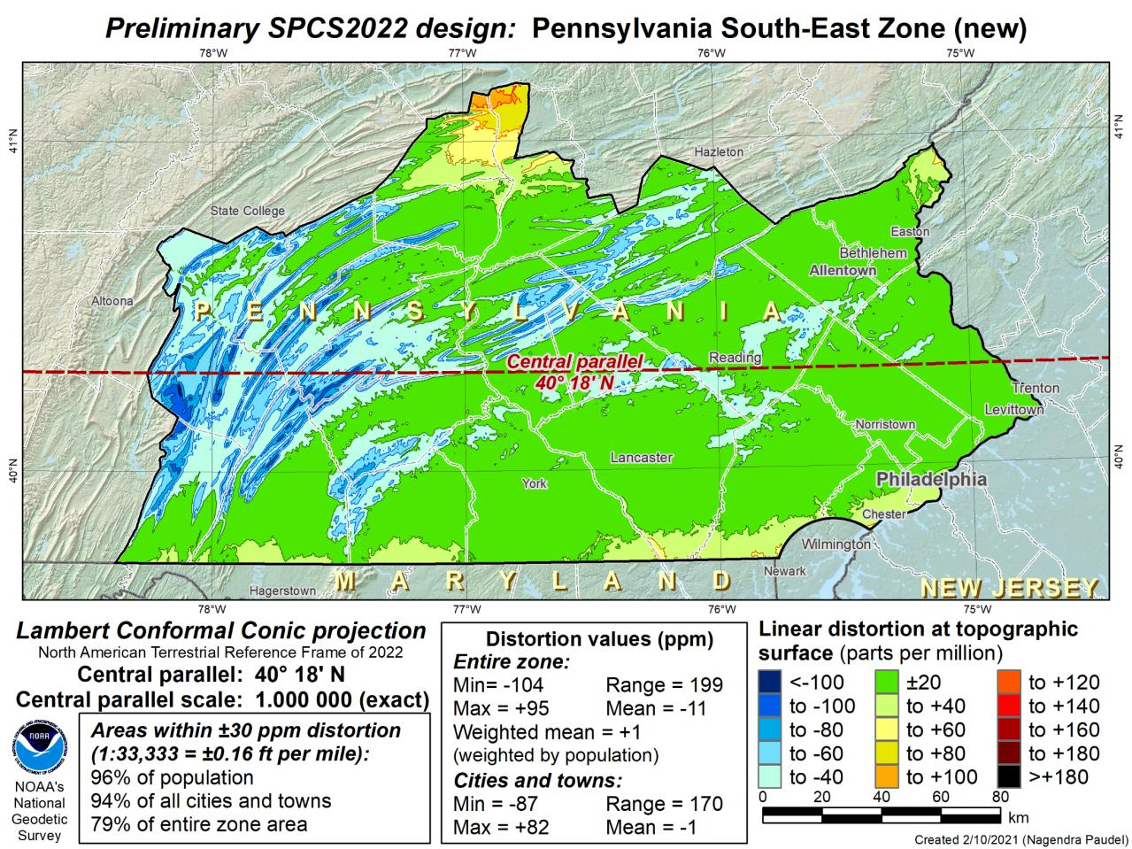
Notes:
This is the second draft of a Preliminary South East Zone
NOTE this excludes Columbia and Montour Counties (they would fall in SE Zone)

Slide 65
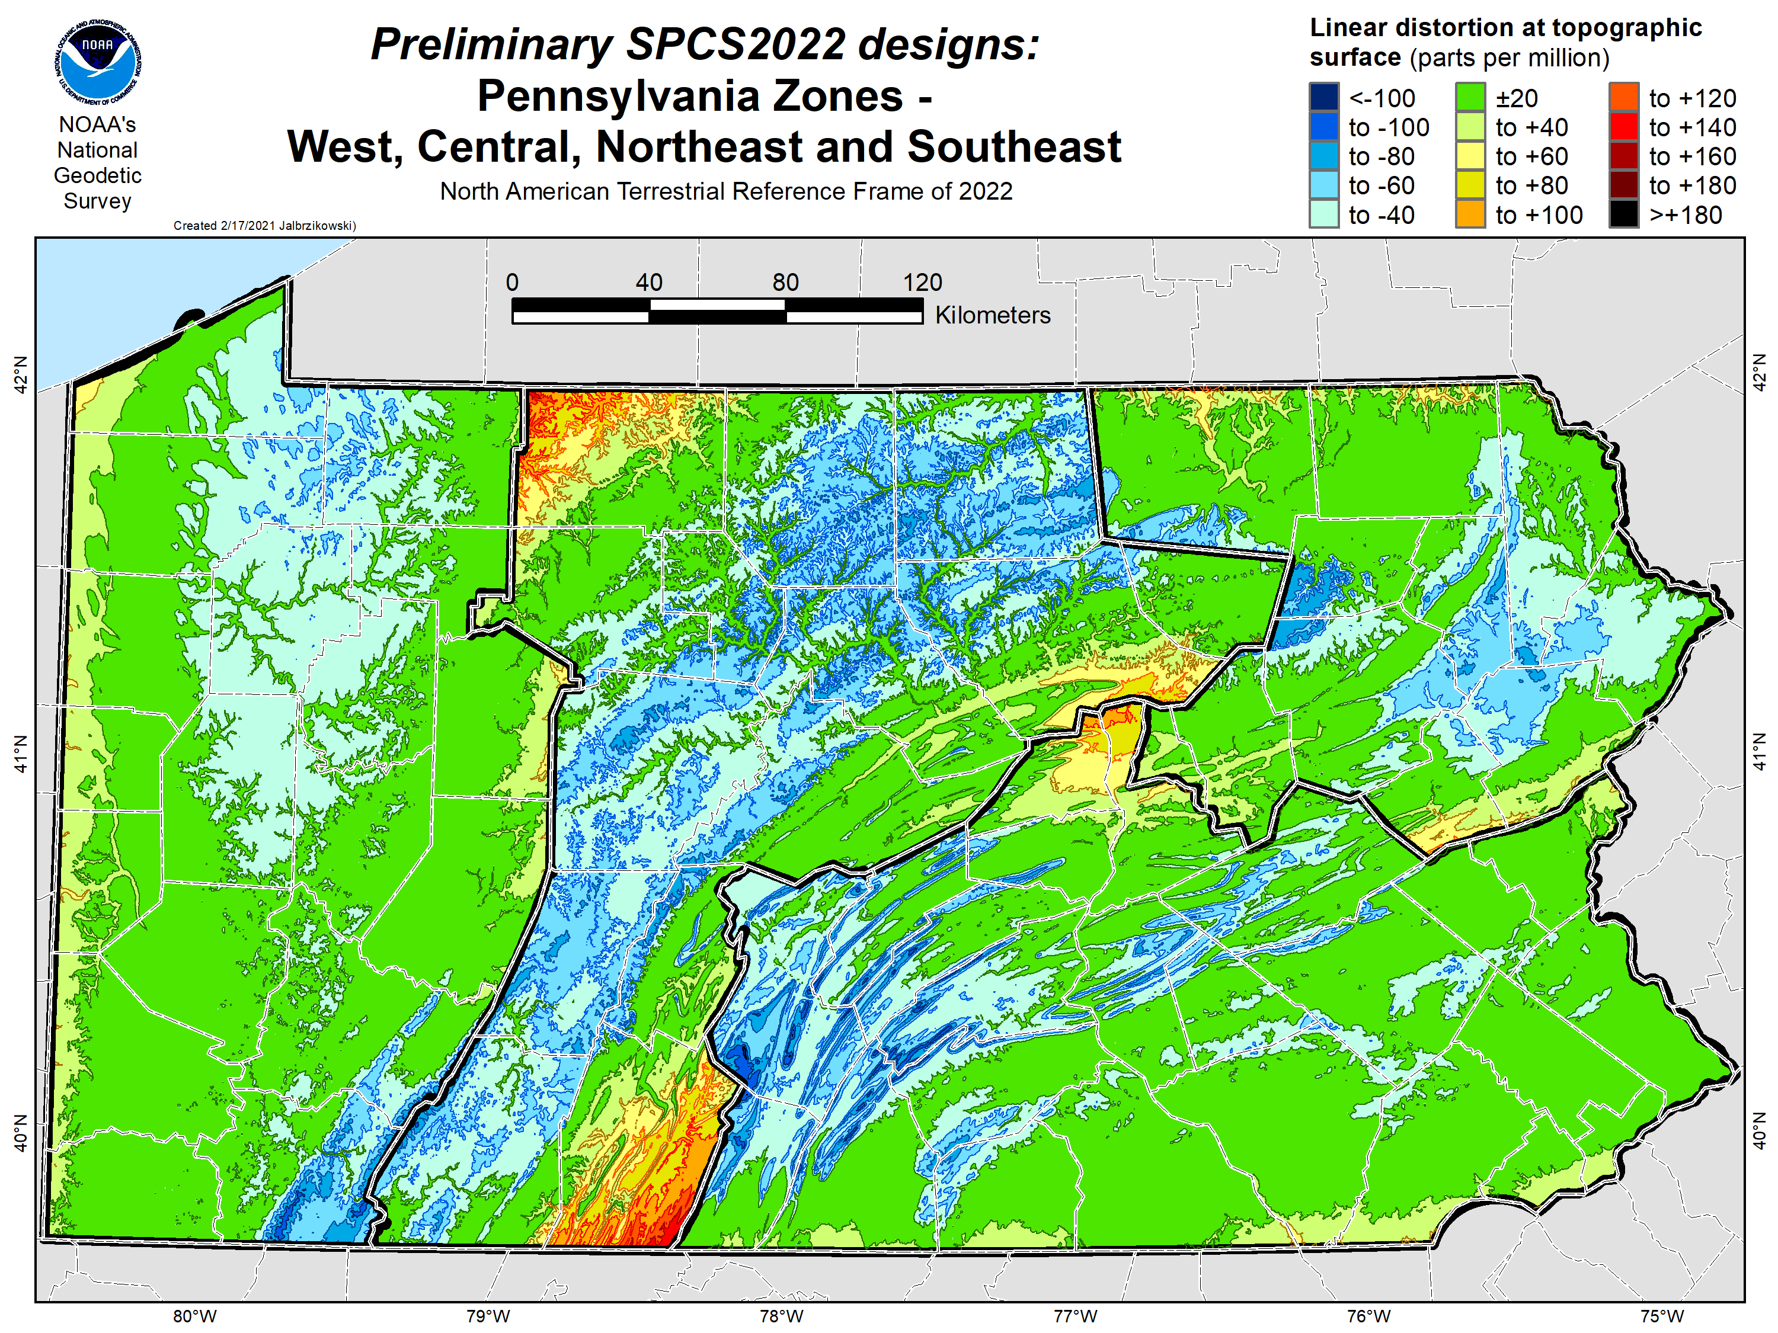

Slide 66
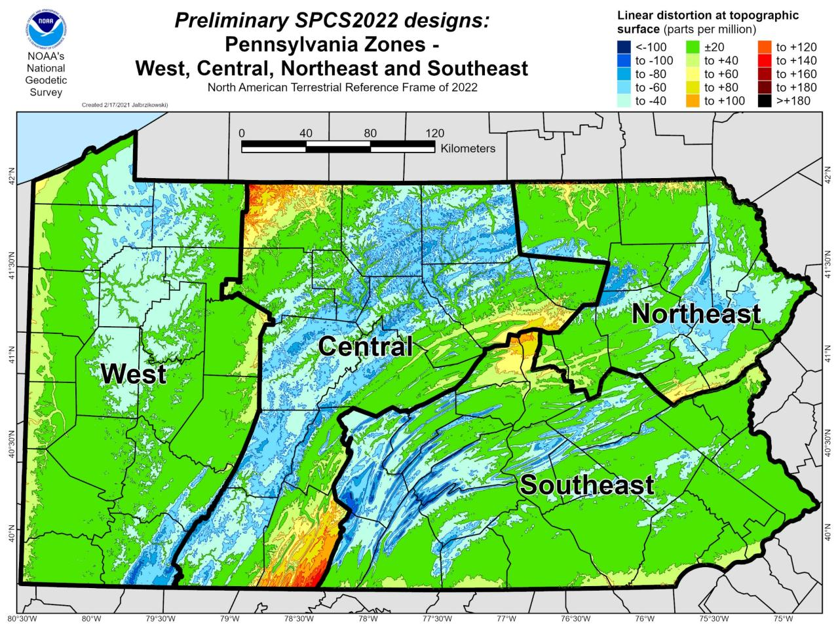

Slide 67
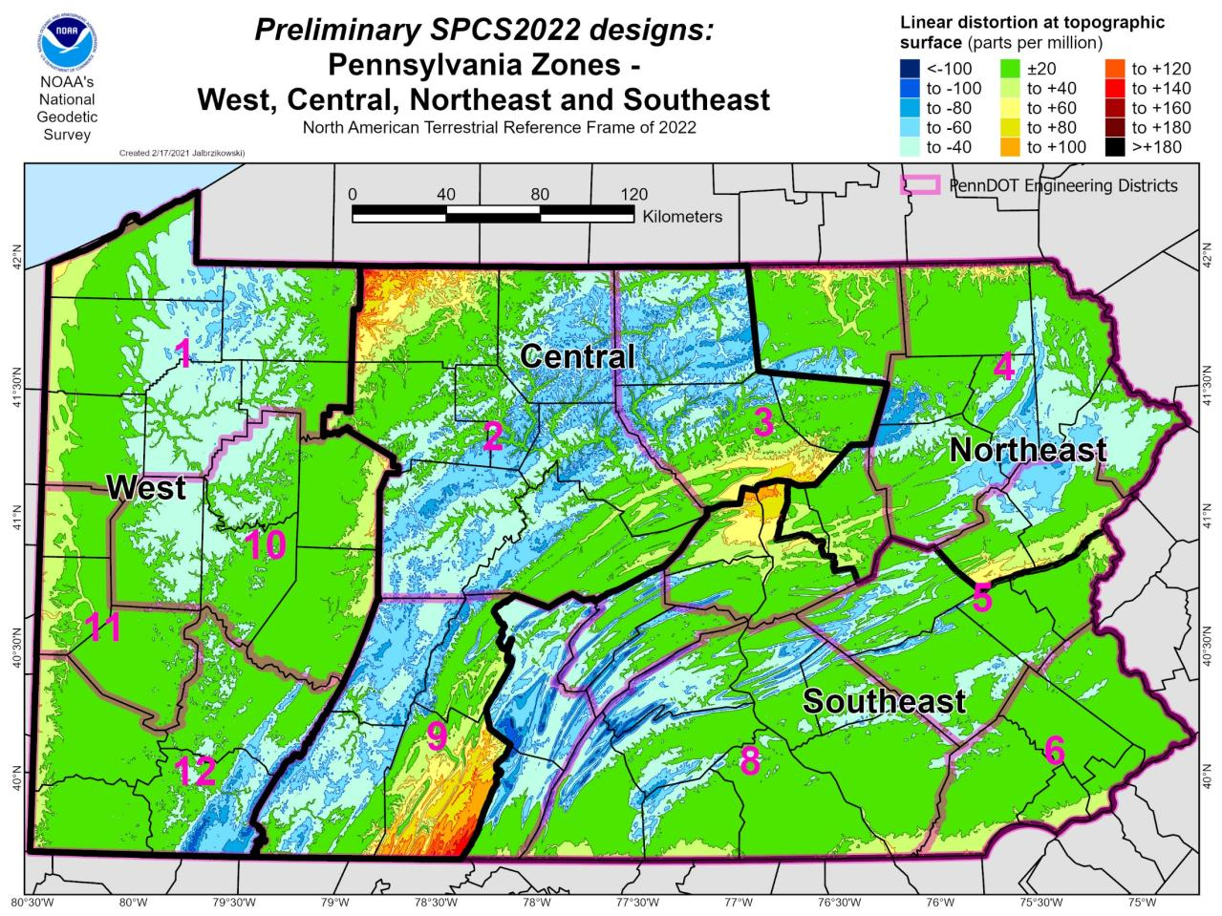

Slide 68
State Plane Coordinate System of 2022
SPCS2022
NGS will create a Single Statewide Zone for every State, the following is a Preliminary map

Slide 69
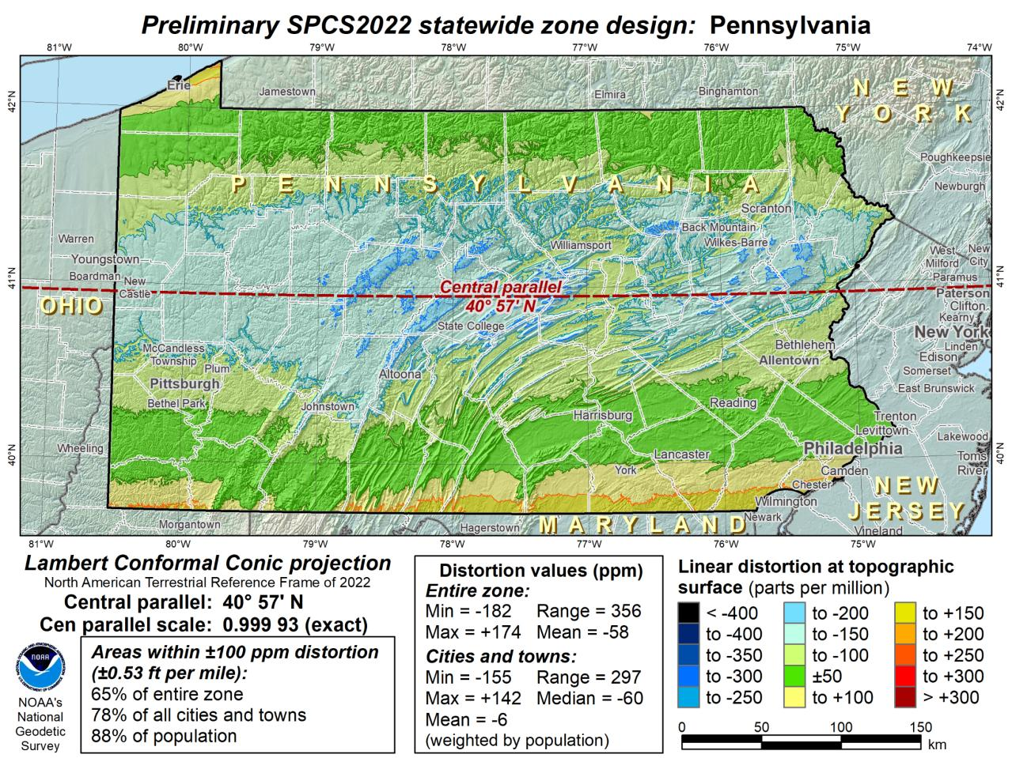
Notes:
This Single Statewide Zone designed by NGS is color shaded to match the following section of slides that show UTM Zones linear distortion values
It is known that some user communities with large areas of responsibility choose to maintain geospatial data and work in UTM
This graphic as compared to the UTM serves to highlight in SPCS2022, users will see better performance (lower linear distortion) if they choose to work in the SPCS2022 Single Statewide Zone rather than one of the UTM Zones that fall within Pennsylvania

Slide 70
UTM (NAD83) Zones as
UTM
The following are maps using existing UTM zones as a Single Statewide Zone
(included to highlight the lower performance as compared to Preliminary NGS Zone)

Slide 71
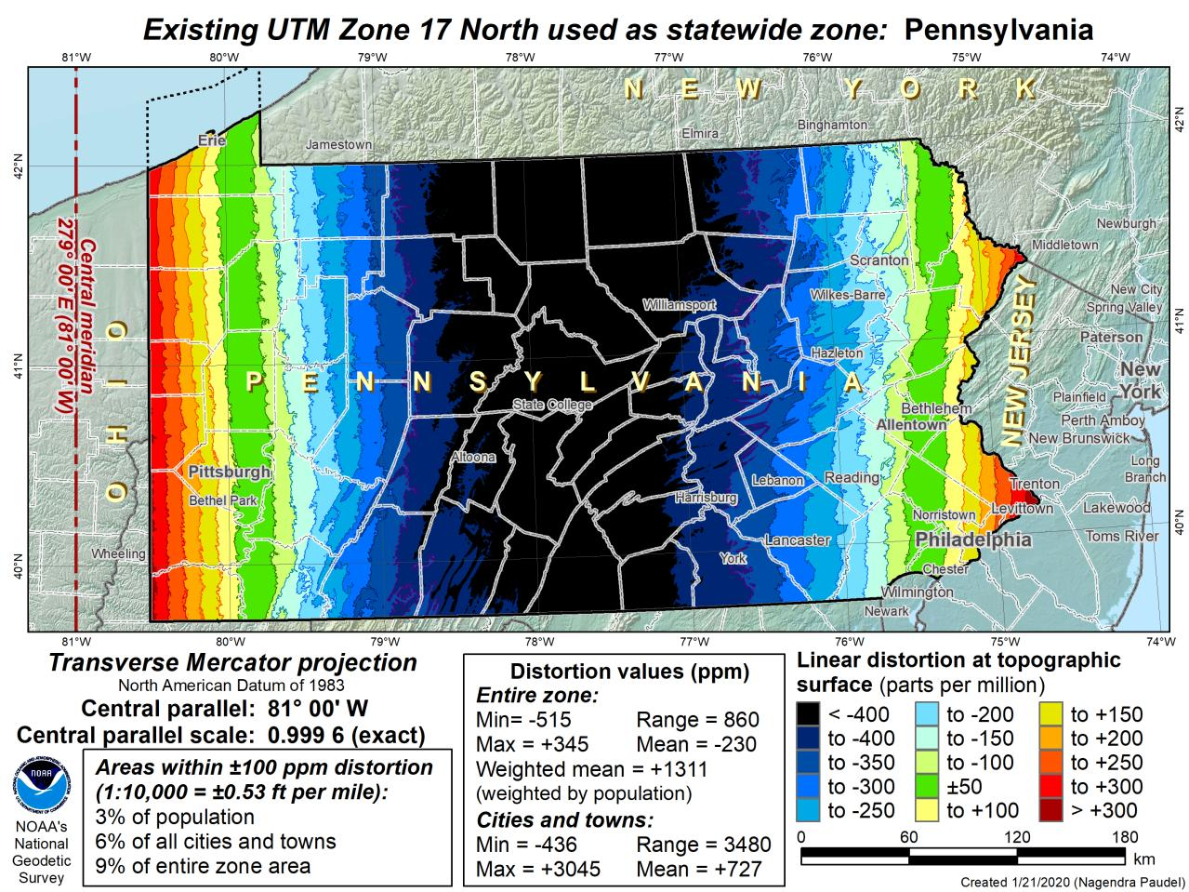

Slide 72
Notes:
The NGS designed preliminary single statewide zone is included again here at the end for easier visual comparisons.

Slide 73
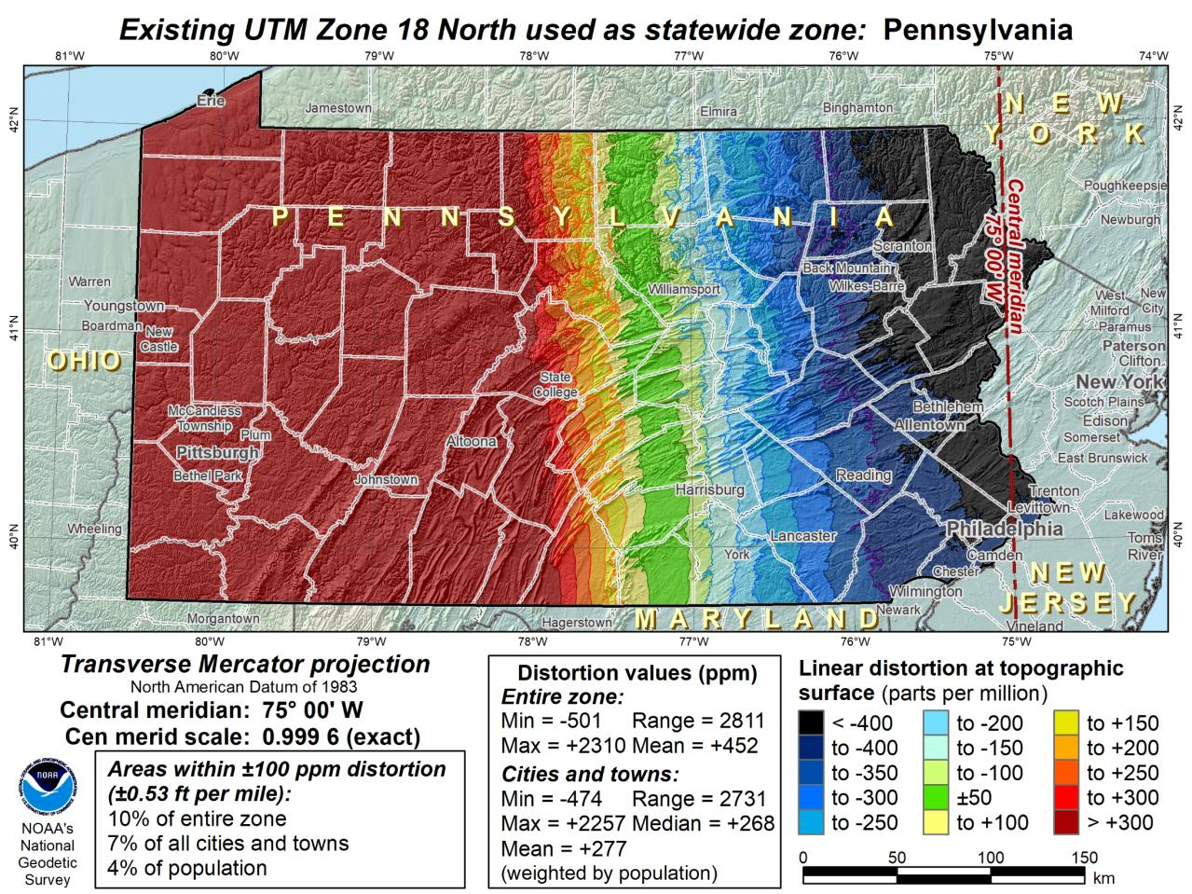

Slide 74
What do we do with the existing tiling scheme in NATRF2022?
Leave it alone? → Uneven coordinates at corners?
Something different?
Notes:
The NGS designed preliminary single statewide zone is included again here at the end for easier visual comparisons.

Slide 75
US Survey Foot
and
International Foot
RIP
Paul Barrere
…or Feets Don’t Fail Me Now

Slide 76
The Issue at Hand…
Two versions of same unit in current use
“New” international foot and “old” U.S. survey foot
Intl. shorter than US by 2 ppm (0.01 ft per mile)
What’s in a name?
“U.S. survey” versus “international”
Who is using U.S. survey feet?
Surveyors exclusively… also the users of their data.
Derivative products
So… this impacts everyone here.
Notes:
It’s likely everyone watching this webinar knows about the problem: there are two nearly identical versions of the foot in current use in the U.S.;
They differ by 2 parts per million (ppm), or only 0.01 ft per mile, or slightly more than a tenth of an inch in a mile.
Despite (or actually because of) the very small difference, it has become a REAL problem with REAL costs.
What’s in a name? That which we call a “foot” by any other word would smell as… sweet? Maybe that’s not he best analogy for the foot…
“U.S. survey foot” sounds patriotic, is surveyor-centric…
“International foot” sounds like a New World Order, UN sanctioned sort of thing, with perhaps a whiff of socialism…
Is the name really part of the problem? I hope not, but emotion does play a role. We are not entirely rational creatures after all (myself included).
Surveyors are really the only users of the U.S. survey foot (sft). They are also among the very few who even know of its existence. In schools and colleges they only teach students about the official international foot (ift). However, because people use the products created by surveyors, they end up using the sft without even knowing it.
Want to have a conversation about this, get all of us on the same page. So I will present facts to facilitate informed discussion (sprinkled with some opinions…)

Slide 77
What’s impacted?
When does this matter?
Not typically in lengths/distances
Published planar coordinate systems
Why? → large false eastings and northings
Like what?
SPCS and UTM are very popular
both fall victim to mix-ups
due to… the large false E/N in their zones
Notes:
It’s likely everyone watching this webinar knows about the problem: there are two nearly identical versions of the foot in current use in the U.S.;
They differ by 2 parts per million (ppm), or only 0.01 ft per mile, or slightly more than a tenth of an inch in a mile.
Despite (or actually because of) the very small difference, it has become a REAL problem with REAL costs.
What’s in a name? That which we call a “foot” by any other word would smell as… sweet? Maybe that’s not he best analogy for the foot…
“U.S. survey foot” sounds patriotic, is surveyor-centric…
“International foot” sounds like a New World Order, UN sanctioned sort of thing, with perhaps a whiff of socialism…
Is the name really part of the problem? I hope not, but emotion does play a role. We are not entirely rational creatures after all (myself included).
Surveyors are really the only users of the U.S. survey foot (sft). They are also among the very few who even know of its existence. In schools and colleges they only teach students about the official international foot (ift). However, because people use the products created by surveyors, they end up using the sft without even knowing it.
Want to have a conversation about this, get all of us on the same page. So I will present facts to facilitate informed discussion (sprinkled with some opinions…)

Slide 78
2 parts per million (ppm)?
1,000,000.00 sft = 999,998.00 ift
10,000,000.00 sft = 9,999,980.00 ift
1,000.00 sft = 999.998 ift (can you measure that?)
International → 1 ft = .3048 m
US → 1 ft = .30480061 m (approx.)
Notes:
It’s likely everyone watching this webinar knows about the problem: there are two nearly identical versions of the foot in current use in the U.S.;
They differ by 2 parts per million (ppm), or only 0.01 ft per mile, or slightly more than a tenth of an inch in a mile.
Despite (or actually because of) the very small difference, it has become a REAL problem with REAL costs.
What’s in a name? That which we call a “foot” by any other word would smell as… sweet? Maybe that’s not he best analogy for the foot…
“U.S. survey foot” sounds patriotic, is surveyor-centric…
“International foot” sounds like a New World Order, UN sanctioned sort of thing, with perhaps a whiff of socialism…
Is the name really part of the problem? I hope not, but emotion does play a role. We are not entirely rational creatures after all (myself included).
Surveyors are really the only users of the U.S. survey foot (sft). They are also among the very few who even know of its existence. In schools and colleges they only teach students about the official international foot (ift). However, because people use the products created by surveyors, they end up using the sft without even knowing it.
Want to have a conversation about this, get all of us on the same page. So I will present facts to facilitate informed discussion (sprinkled with some opinions…)

Slide 79
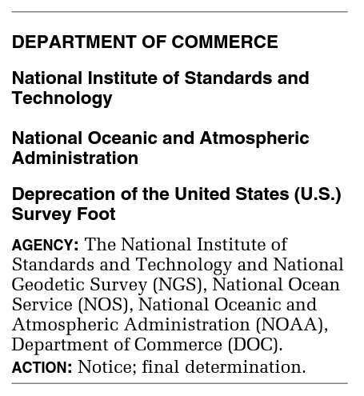
What’s happening to US Survey Foot?
Deprecation/Retirement
Effective 31 December 2022
Which begs the question
What happens next year?
Notes:
The date of December 31, 2022, was selected to accompany the modernization of the NSRS by NGS.

Slide 80
What happens on 01 January 2023?
Per FRN October 2020
The date of December 31, 2022, was selected to accompany the modernization of the NSRS by NOAA’s National Geodetic Survey.
Nothing changes until new datums.

Slide 81
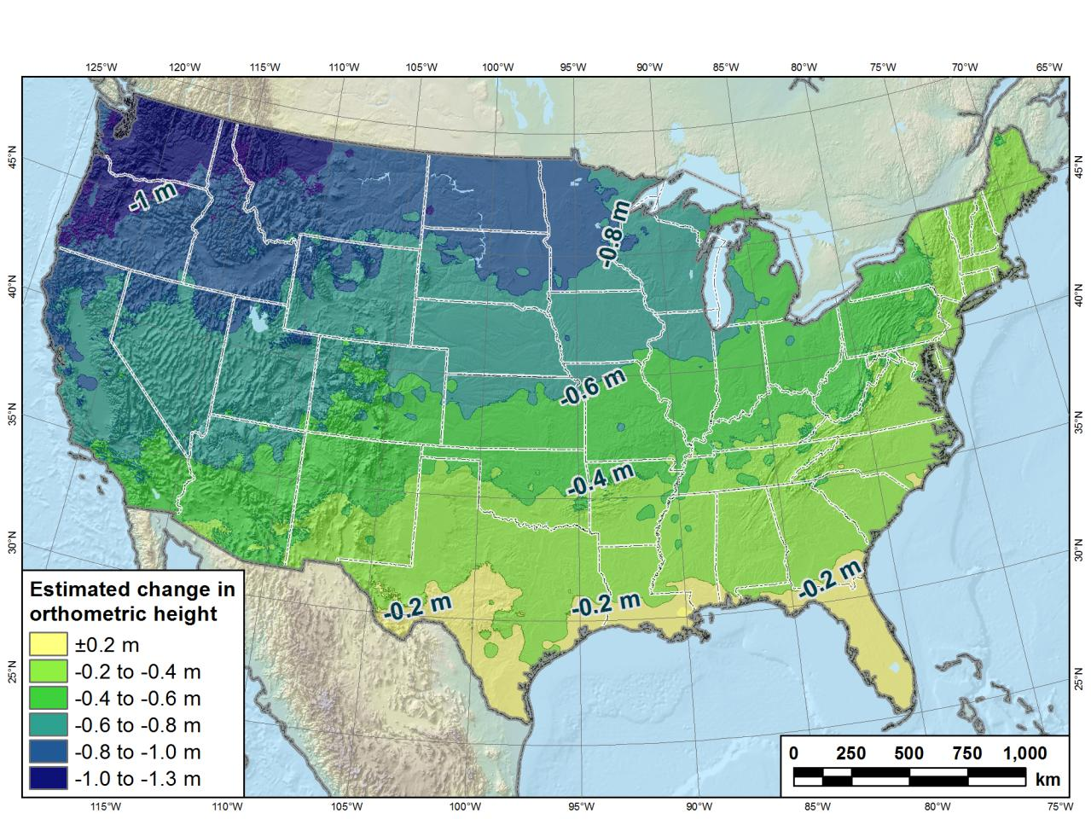
Estimated change in orthometric heights from NAVD88 to NAPGD2022
Change in Pennsylvania:
At least -0.6 feet
At most -2.0 feet
(NAPGD2022 approximated using xGEOID16B)

Slide 82
Remember…
What’s the goal of NATRF2022?
Give you the stability in positions that you expect
That’s the point of Reference Epochs (REs)
Akin to the different realizations of NAD83
REs will be published every 5 or 10 years
you choose when you update
in a perfect world, everyone would stay current
aka versions
Notes:
What’s the goal of the way NATRF2022 was designed, by including EPP2022 and IFVM2022
Does a database of manholes in PA need cm-level coordinate updates on an annual basis? Probably not.

Slide 83
Preparing for NATRF2022
Two factors will dictate your frequency of coordinate updates
Your accuracy needs
The region you work in → tectonic motion
Do manholes need cm-level updates annually?
We accommodate that… you choose
Just because we’re chasing the millimeter… it doesn’t mean you need to.
Notes:
What’s the goal of the way NATRF2022 was designed, by including EPP2022 and IFVM2022
For a database of features in PA
Does a database of manholes in PA need cm-level coordinate updates on an annual basis? Probably not.

Slide 84
Preparing
Know the epoch of your data/datasets
consider how you will track this
full to-the-second timestamp on every feature?
labeling a year for each dataset?
something in-between that works for your needs?

Slide 85
Preparing
Reprocessing your data
in a perfect world, everyone would reprocess
What does this really mean?
consider a hydro-enforced DEM
start over with the raw flight data (GNSS/IMU)
generate new point clouds
recreate all the drainage features in new datum
unrealistic! … and unnecessary for majority users
Notes:
Reprocessing your data
in a perfect world, everyone would reprocess data
consider a final product like you use everyday - a hydro-enforced DEM
starting fresh with the raw GNSS/IMU processing
generate new ellipsoid height point clouds
recreate all the drainage features in new datum
this is totally unrealistic → both from a financial and programmatic perspective

Slide 86
Preparing
Transforming your data
NCAT - NGS Coordinate Conversion and Transformation Tool
ASCII up/download, Web Services, Download, GitHub
ask your software provider(s) about integration
we envision COTS integrations as most popular method of access
Industry Workshops - May 2021 and August 2022
Esri, Trimble, Blue Marble, etc… all the well known names attended
Geospatial Software Developers’ Summit – Nov/Dec
International & Virtual → US NGS and NRCan CGS
Notes:
Transforming your data
NCAT - NGS Coordinate Conversion and Transformation Tool
available now: ASCII upload and Web Services
ask your software providers about integration
we envision this as most popular method of access
Industry Workshop held this year – esri, trimble, bluemarble, all the major well known names were represented
labeling a year for each dataset?
something in-between that works for your needs

Slide 87
additional Resources
Notes:
This presentation is intended to raise awareness about the upcoming changes and what they mean for floodplain mapping, but you probably have lots of remaining questions and we have a lot of resources online at our website
Please spread the word, and
make an effort to keep yourself and your colleagues informed.
Tell us what content is missing or how we can make it better!

Slide 88
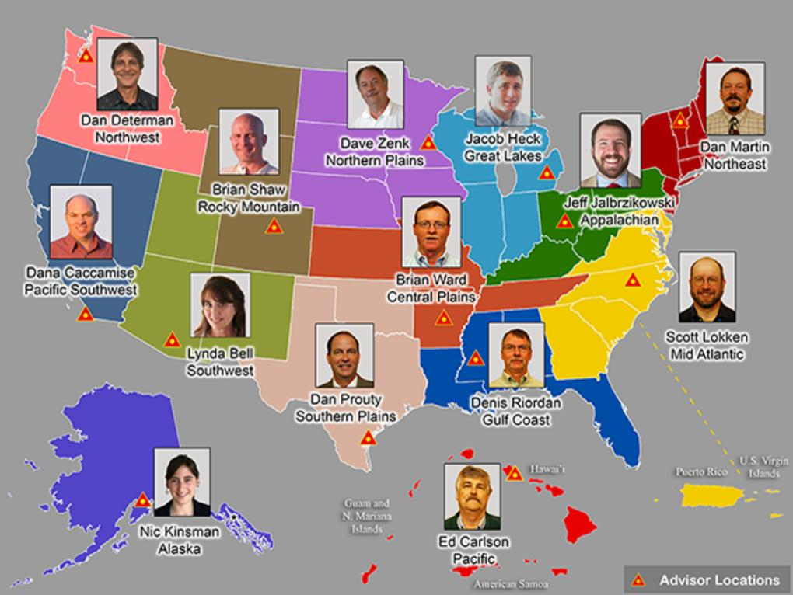
https://www.ngs.noaa.gov/ADVISORS/
RETIRES TOMORROW
Notes:
-14 Regional Advisors, we’ve transitioned from a State-based to a Regional Program
-our advisors homepage up there at the top, also easy to find us by querying any major search engine for “ngs advisors”
-if you know Ross Mackay, he is our Chief Advisor, I report to him…
**ya know, I don’t know why they don’t make him put his photo up here
-we do have one vacant advisor position, that was recently advertised and John up there in Wisconsin is officially retired in oh… 18 days

Slide 89
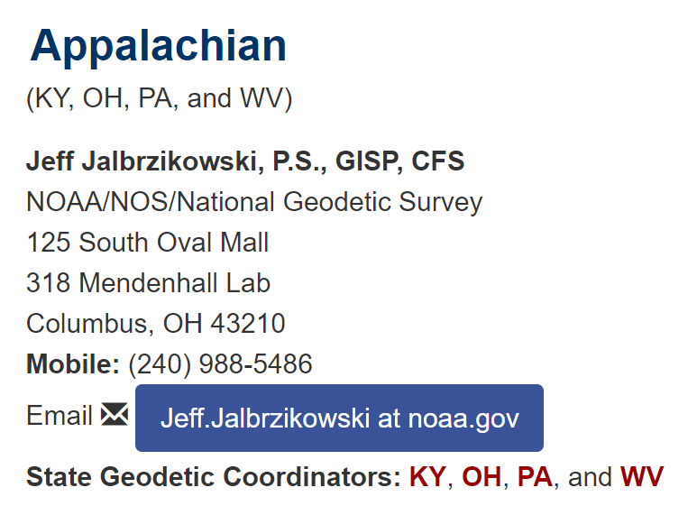
Regional Geodetic Advisor Program
geodesy.noaa.gov/ADVISORS/
query any major search engine: “ngs advisors”
Notes:
Transitioned from a State to a Regional program in 2016. States no longer provide funding if they desire to have an Advisor, but NGS reorganized the personnel to support regions rather than single States.
Kentucky has appointed a State Geodetic Coordinator

Slide 90
State Geodetic Coordinators
Not an NGS employee, rather:
State/Commonwealth government
RTN manager
DOT survey lead
Geospatial Information Officer
Academia
Professor or Program Director
Professional society representative
Serves as a liaison between the State’s geospatial community and the NGS
Notes:
-The State Geodetic Coordinator is not employed by NGS and is typically assigned by a state government agency or university.
-West Virginia has not requested a State Geodetic Coordinator

Slide 91
State Geodetic Coordinators
Not an NGS employee
Serves as a liaison between the State’s geospatial community and the NGS
Stepehn at PennDOT and Brian at PSU

Slide 92
Resources at geodesy.noaa.gov
Educational Videos
<5 minutes
Online Lesson
(via MetEd/COMET)
~1 hour
Notes:
Educational videos and online tutorials –
Our library of lessons and videos are great resources, and will reinforce a lot of information we covered today.
The videos are just 3-5 minutes long.
the lesson is a deeper dive but still only takes an hour.

Slide 93
Email Subscriptions
*Only 1-2 messages per month*
NGS News
Includes quarterly NSRS Modernization newsletter
Webinar Series
Training
Primarily surveyor focused
GPS on Benchmarks
Click this icon on homepage
Notes:
Stay abreast of any new information coming from us via Email Subscription –
Sign up for notifications about News, webinars, and training opportunities with NGS.
We also use our News subscription list to send out our quarterly NSRS Modernization Newsletter.

Slide 94
https://www.ngs.noaa.gov/ADVISORS/
-use any major search engine: “NGS advisors”
Jeff Jalbrzikowski, P.S., GISP, CFS
Appalachian Regional Geodetic Advisor
jeff.jalbrzikowski@noaa.gov
240-988-5486

