Slide 1
NSRS Modernization Preparing for New Datums
PSLS Annual Conference
January 2024
Jeff Jalbrzikowski, P.S., GISP, CFS
Appalachian Regional Geodetic Advisor
jeff.jalbrzikowski@noaa.gov
240-988-5486

Slide 2
Any references to any commercially available hardware or software do not constitute an endorsement or a disapproval of any manufacturers, developers, dealers, or suppliers.
Thanks.

Slide 3
Organizational Structure
-Department of Commerce (DoC)
(~47,000 employees)
-National Oceanic and Atmospheric Administration (NOAA)
-National Ocean Service (NOS)
-National Geodetic Survey (NGS)
(~175 employees)
Notes:
-We are the Federal Government’s oldest scientific agency.
-part of the Executive Branch
-I know it can seem kind of strange that NGS is part of the NOS, but the origins of NGS lie with the C&GS.
-we are a “Program Office” of the NOS
Survey of the Coast – 1807
Coast Survey – 1836 → in 1871 the agency was tasked by Congress with responsibility to carry geodetic control inland (>150 years)
Coast and Geodetic Survey – 1878
NGS since 1970

Slide 4
Organizational Structure
We’re not USGS, we’re NGS
-Department of Commerce (DoC)
(~47,000 employees)
-National Oceanic and Atmospheric Administration (NOAA)
-National Ocean Service (NOS)
-National Geodetic Survey (NGS)
(~175 employees)
≠
Notes:
-as you can read my slide, I like to point that out because over my years at NGS I’ve seen and heard this misunderstanding quite a bit
-don’t worry! it doesn’t offend us! and we do work closely with USGS, but we are separate agencies within totally different departments of the federal government

Slide 5
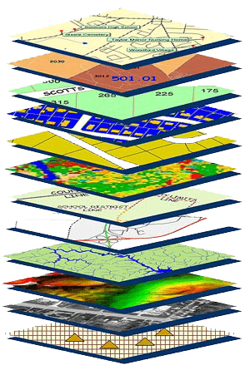
NGS Mission
To define, maintain and provide access to the National Spatial Reference System (NSRS) to meet our Nation’s economic, social, and environmental needs.
NSRS
Notes:
NGS develops and maintains the National Spatial Reference System, a national coordinate system that provides the foundation for transportation, navigation, land record systems, mapping and charting efforts, and a multitude of scientific and engineering applications
CLICK
You’ve all seen this or some similar graphic I’m sure. That bottom layer… that’s our baby, the NSRS.

Slide 6
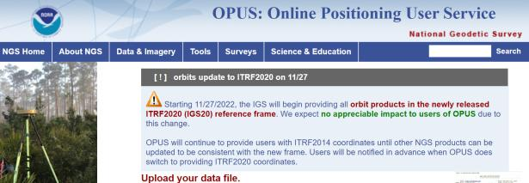
NGS Mission
To define, maintain and provide access to the National Spatial Reference System (NSRS) to meet our Nation’s economic, social, and environmental needs.
access… ? = traditionally → marks/disks/objects
= modern and future → NOAA CORS Network (NCN)
via OPUS
Notes:
Follow up thought
-like it or not, we know that the vast majority of our users are obtaining NSRS coordinates via OPUS
-while that is our plan for the future of primary access, modernized NSRS, as of now the official form of access (specifically to NAVD88) truly is to “touch brass” as they say → meaning occupy a benchmark

Slide 7
NCN - NOAA CORS Network
1695 sites
241 organizations
Notes:
What does that mean?
Please don’t think of this as us here at NGS being some pointy-haired semantics. We need to make distinctions about CORS when talking about all this. If you haven’t already realized this, you’ll start to catch on today.

Slide 8
CORS Networks
Global: International GNSS Service (IGS) Network
NSRS: NOAA CORS Network (NCN)
Regional: State/Municipal or Private CORS Networks
They’re all semi-coupled, not 100% overlap.
Notes:
Global: International GNSS Service (IGS) Network
The international standard since mid-1990s
Supported by IGS Analysis Centers (ACs) → NGS is one AC of seven total
Overall system sponsored by NASA
NSRS: NOAA CORS Network (NCN)
NGS processes/distributes data, but few are NGS-operated
Subset of NGS-operated CORS comprise the under construction NOAA Foundation CORS Network (NFCN)
Regional/State/Commonwealth/Local Networks
Real-Time Networks (RTN… aka “VRS”)
Currently semi-coupled to the NCN
NGS sees the future as a close coupling of other networks with the NCN so users can seamlessly and confidently work in the NSRS using their favorite regional/local CORS network

Slide 9
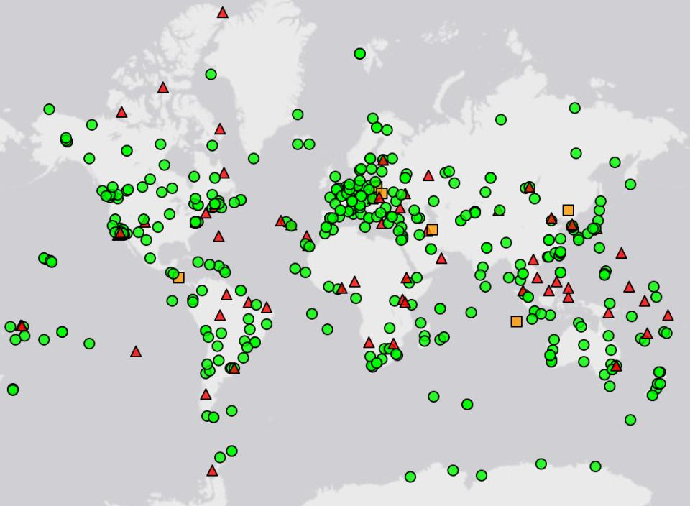
IGS CORS Network
Source: https://www.igs.org/maps/#station-map
Notes:
There are several CORS Networks.
The Global Standard is the IGS Network
IGS = International GNSS Service
The NOAA CORS Network (NCN) which consists of:
The NOAA Foundation CORS Network (NFCN), a sub-network being installed, owned, and operated by NGS
and 2,000+ stations managed, but rarely owned by NGS
Other Regional/Local Networks (RTNs, etc.)
Currently semi-coupled to the NCN
NGS sees the future as a close coupling of these other networks with the NCN so users can seamlessly and confidently work in the NSRS using their favorite regional/local CORS network.

Slide 10
NOAA CORS Network (NCN)
Notes:
-I would like to point out we have a new, official name for the network you see represented on this map,
-The NOAA CORS Network, or NCN
CLICK
-this is neat little graphic with some stats on teh NCN you can find on our website
-below the gaphic youll find a search bar with more information

Slide 11
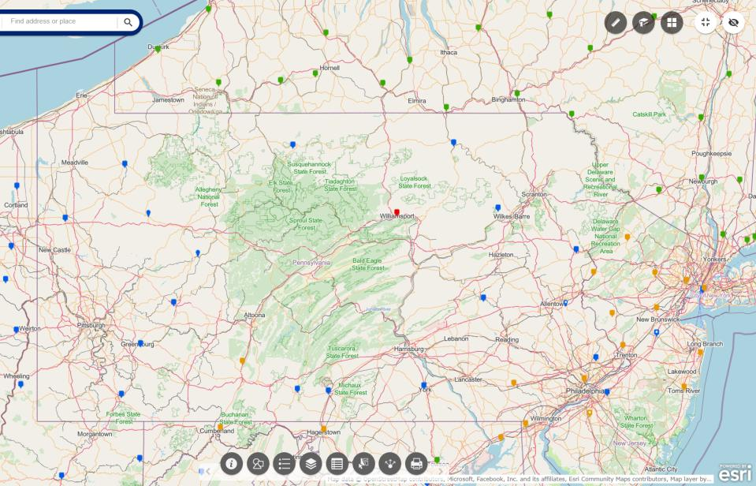
NOAA CORS Network (NCN) in PA
Notes:
where else but the federal government are you going to see two acronyms within one acronym?

Slide 12
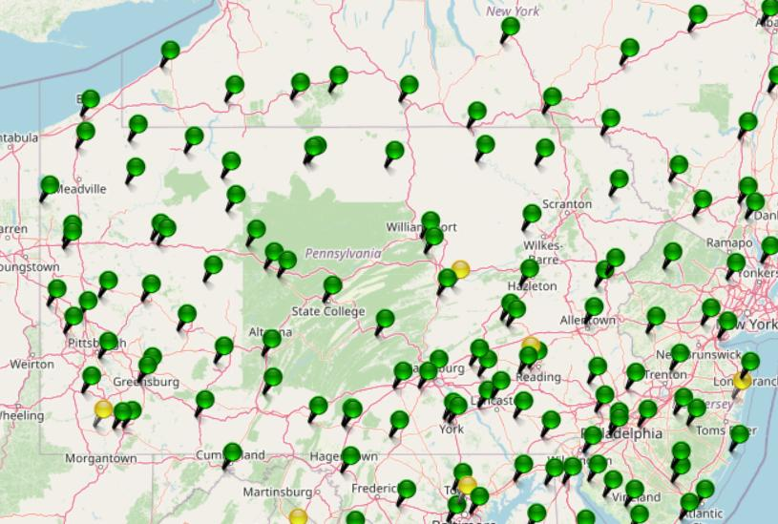
KeyNetGPS CORS Network

Slide 13
NOAA CORS Network (NCN) in PA

Slide 14
KeyNetGPS CORS Network
non-NCN CORS

Slide 15
Online Positioning User Service
dual frequency receiver
static observations (via RINEX → ABCD123x.24o)
30 seconds epoch/logging rate aka recording interval
OPUS Rapid Static (OPUS-RS)
15 minutes to 2 hours of GPS data
OPUS Static (OPUS-S) → also Beta OPUS!
same requirements as above
2 to 48 hours of GPS data
OPUS Projects (OP)
adds session processing and network adjustment
training by NGS currently required (~12 hours)
Notes:
Currently 4 types of OPUS.
*OPUS only supports GPS constellation data, last I talked to the OPUS developer the plan for incorporation of other constellations is Jan 2021.
Rapid Static – files uploaded that are 15 minutes to 2 hours in duration are processed using an NGS software called “RSGPS”
Static - files that are 2 to 48 hours in duration are processed using an NGS software called PAGES Your coordinates are the average of three independent, single-baseline solutions,
OP and Beta OP - these are not a different processing software, just a way to tie multiple OPUS-Static solutions together and use least squares methods to adjust them all as a coherent network
**the Beta serves as a testing bed for the developers to roll out new features or improvements and get feedback from users

Slide 16
NGS Products and Services
Not just OPUS
All exist in three environments:
Development (DEV) - internal testing and development
same as when you hear a company talk about an “Alpha” product
Beta - continued internal testing, open for public testing
key features have already been vetted/tested
Production - final product, open to public use
this is what you see first when navigating our website
Notes:
I’ll be talking about OPUS today, but I need to clarify one of our processes for this to all be clear. I will also mention that this is a new-ish workflow for NGS, began in the past 8 or so years.
So all NGS Products & Services go thru this process as they are created, tested internally, open for testing by you our constituents, and then rolled out as final products.
CLICK
There’s three environments that products will exist in, listed here in the order they occur
First, a tool will be created on the “DEV” servers for internal NGS-only development, testing, and otherwise “working the bugs out”
→this is the same phase as when you hear a software company or video game maker talk about their alpha products
CLICK
Next, after some level of confidence in the product is gained, it will be migrated to the Beta servers, thereby open to the public for their own testing
→it’s important to note that when a product is available via our Beta page, when you use it you are indeed now a “beta tester”
key features will have already been tested in the Development environment, but it is still a beta, so as a beta tester please let us know if you have issues/complications/struggles or the like
CLICK
At some point, when all I’s are dotted and T’s crossed, the thing will be moved to the Production environment.
→ by then, the tool is integrated into others, has been vetted with 2 testing phases and functions as expected, but may still continue to receive version updates by repeating this process

Slide 17
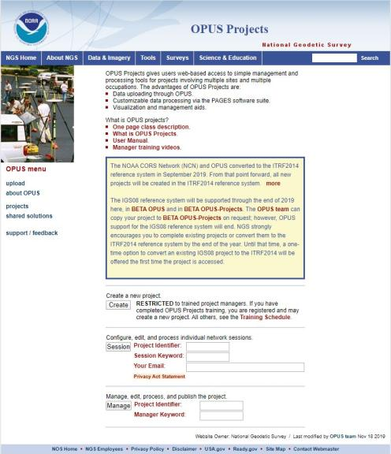
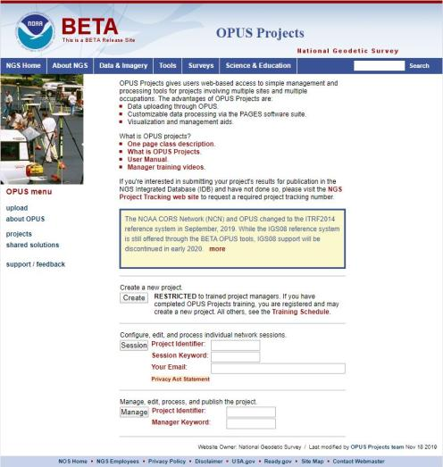
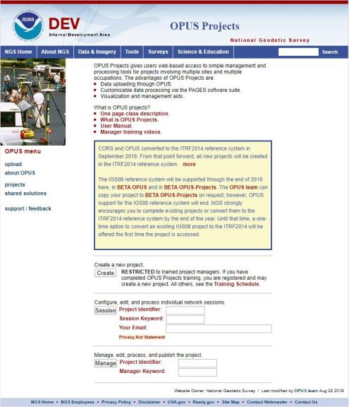
www.ngs.noaa.gov
beta.ngs.noaa.gov
Remember, you won’t see the DEV environment…
Notes:
So here we have 3 screenshots, first here showing the Production OPUS Projects gateway page
CLICK
Second is the Beta page, with the text here showing the URL for our Beta homepage
-How do you find that beta page? substitute “beta” for “www”
-or most tools that have a beta will have a link to that beta platform
CLICK
Last is the Development or DEV example, which again you will not see unless via a demo from NGS personnel

Slide 18
Wait… how do I get to the NGS Beta site?

Slide 19
www.ngs.noaa.gov
beta.ngs.noaa.gov

Slide 20
OPUS only processes every 30s
You can upload 5s interval data
But OPUS will trim/decimate to 30s interval
And this may result in delays or error messages
You can even upload 1s interval data
But only shorter files, or OPUS kicks it back
Even if you’re running RTK…
You can setup your base to only log @ 30s rate
Know your equipment
For static, 30s yields good results
If using your commercial software, 15s can be advantageous

Slide 21
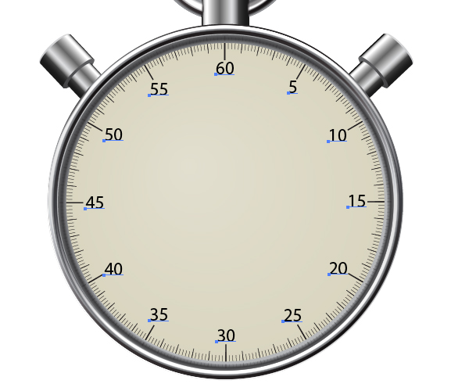
OPUS processes every 30s
20s decimates to 60s

Slide 22
OPUS Rapid Static (OPUS-RS)
15 min to 2 hours
Computes atmospheric delay at up to 9 NCN CORS within 250km
Interpolates that delay to your position
Reports corrected position with standard deviation stats
5001
CORS
OPUS Solution
Notes:
-OPUS Static takes the best 3 of 5 baselines, sequentially processed, and provides you their peak-to-peak average
sidenote
-we delivered over 1.2 million solutions in 2021, compared to in 2011 when we first broke the 200,000 solutions milestone

Slide 23
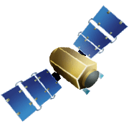
OPUS Rapid Static (OPUS-RS)
15 min to 2 hours
1st creates an atmospheric delay model
2nd position calculated via a DGPS static solution
Notes:
OPUS-RS or Rapid Static performs two calculations.
1st - creates an atmospheric delay model from surrounding CORS data (white circle)
2nd - Your position is determined via a differential GPS static solution

Slide 24
OPUS Static (OPUS-S)
2 to 48 hours
Best 3 of 5 baselines
Sequentially processed
Reports your peak-to-peak (P2P) average position
5001
5002
CORS
OPUS Solution
Notes:
-OPUS Static takes the best 3 of 5 baselines, sequentially processed, and provides you their peak-to-peak average
-we delivered over 1.2 million solutions in 2021, compared to in 2011 when we first broke the 200,000 solutions milestone
-sidenote that we’ve already broken the 1.5 million mark for 2022

Slide 25
OPUS Static (OPUS-S)
No correlation between your observed marks
Low Relative Accuracy
Even if … collected simultaneously
… and submitted to OPUS simultaneously
OPUS-S = independent solutions
5001
5002
CORS
OPUS Solution

Slide 26
OPUS Projects (OP)
Simultaneous processing of your observed marks
Improved Relative Accuracy
Requires more field prep and office processing effort
OP = true network solutions
And of course, least squares adjustment
Distant CORS
~400-800 km
5001
5002
5003
5004
CORS
OPUS Solution

Slide 27
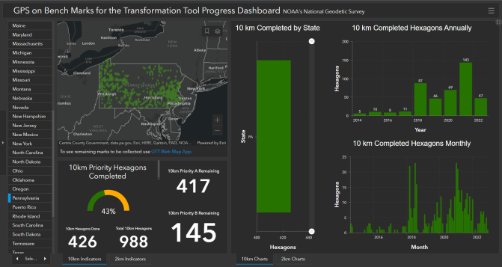
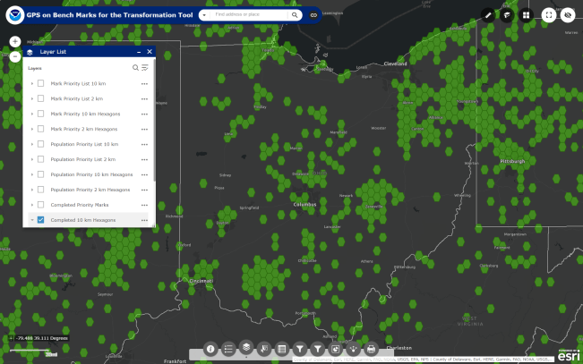
What’s the deal with GPSonBM?
GPS on Bench Marks
Web Map Application
Deadline = 30 September 2023
OPUS Shared Solutions
2 OPUS-Static, ≥4 hours each
2 photos of each setup
Brief Description w/Ties
Progress Dashboard
The struggle is real.
“too much field time”
“we don’t do static”
“poor site, if only we had multi-GNSS”
Notes:
Note here that the Dashboard map is separate from the Web Map Application.
CLICK They are linked, but different tools.
If you got mixed up about this at some point, no worries, you were not the only one.
If we have had this process to submit GPSonBM for years now… why are we now putting out this option for OPUS Projects via GVX?
CLICK

Slide 29
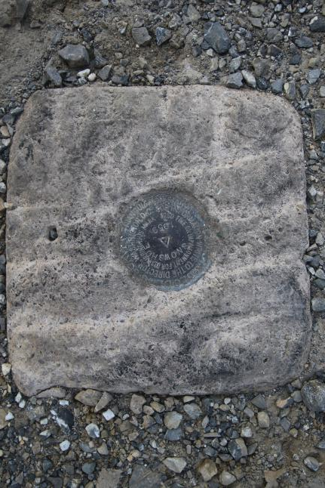
Passive Control
Geodetic Control – Terminology
All marks are passive—they sit there and hold a point
Notes:
All marks are passive!—in that they sit there doing nothing in and of themselves besides holding a point
This includes the fixed antenna mount that is a part of a CORS.
But, some marks have permanently installed equipment that enable nearly continuous observations and these are called “active” stations.

Slide 30
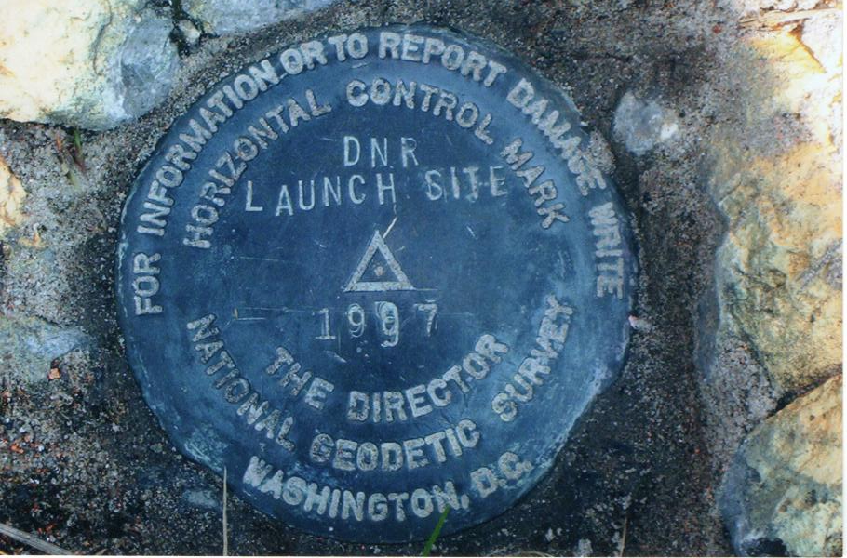
Passive Control

Slide 31
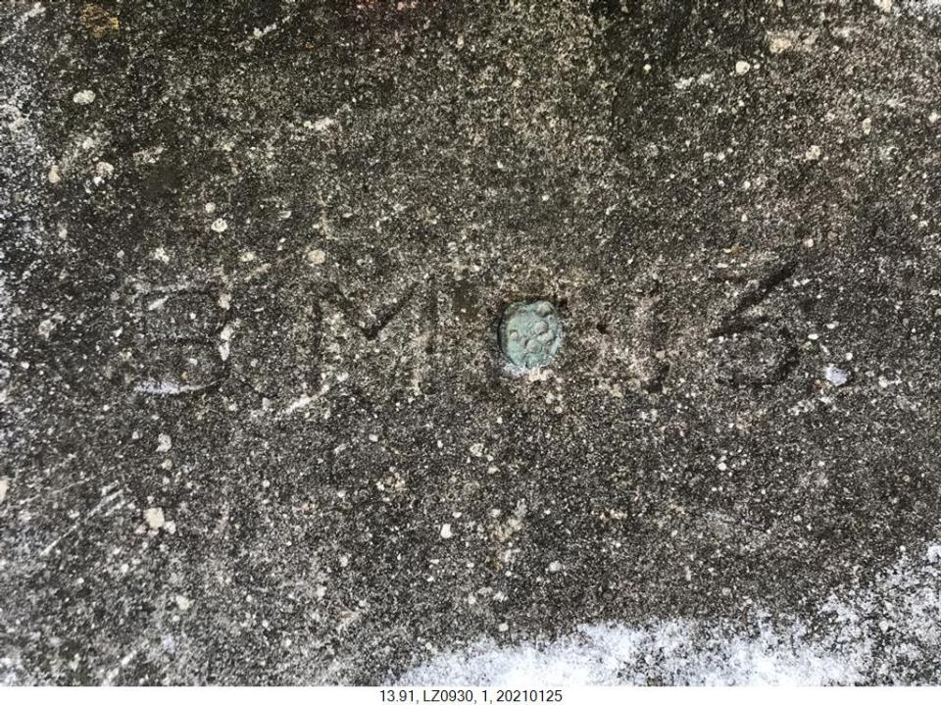
Terminology - Passive Control
Notes:
LZ0930
Lycoming County → PRR copper plug in bridge abutment
--that’s a photo from PennDOT, not sure what District Lycoming County is

Slide 32
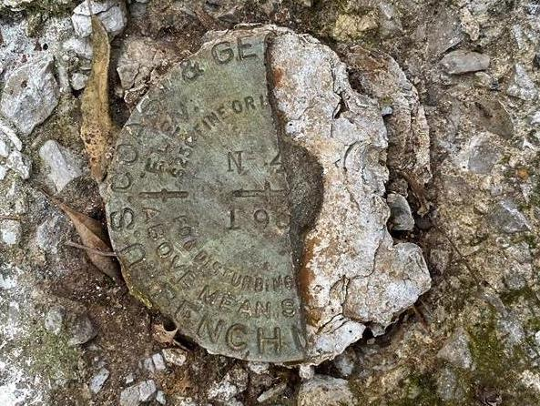
Terminology - Passive Control
Notes:
KW0392 –
https://www.ngs.noaa.gov/cgi-bin/ds_mark.prl?PidBox=KW0392
COLUMBIA COUNTY, PA, NEAR READING COMPANY REAILROAD STATION

Slide 33
Notes:
KR1724 - https://www.ngs.noaa.gov/cgi-bin/ds_mark.prl?PidBox=kr1724
Set 1946 → Washoe County, NV, about 4 miles southwest of Reno
Recovery 1958 → THE STATION MARK WILL BE PRESERVED BY MR. GARCIA, AND WILL BE IN THE CENTER OF HIS LIVING ROOM. - -> BUILT AS A BROKEN WAGON WHEEL WITH THE TRIANGULATION STATION THE HUB THERE-OF.
A STANDARD DISK STAMPED WHEELER 1946, 1958 IS BEING PROVIDED MR. GARCIA, TO PLACE IN THE FLOOR.

Slide 34
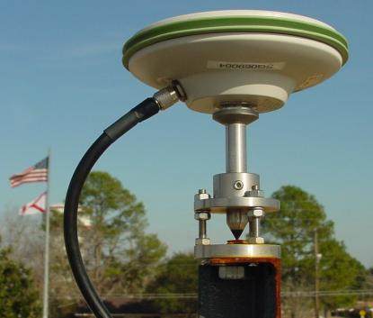
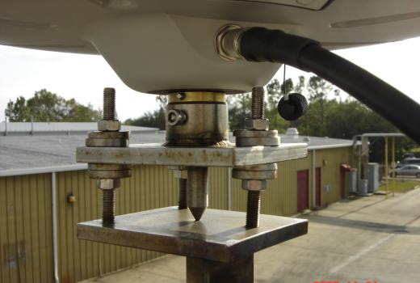
Active Control
Geodetic Control – Terminology
Some marks have permanently installed equipment that enables nearly continuous observations
(they still sit there and hold a point)
Notes:
All marks are passive!—in that they sit there doing nothing in and of themselves besides holding a point
This includes the fixed antenna mount that is a part of a CORS.
But, some marks have permanently installed equipment that enable nearly continuous observations and these are called “active” stations.

Slide 35
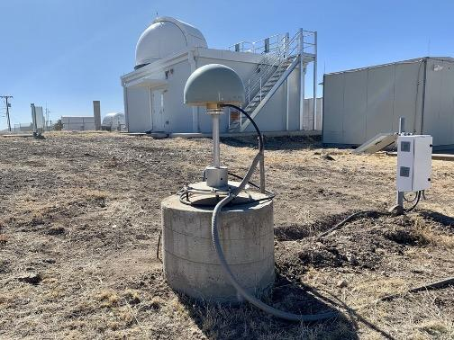
Active Control

Slide 36
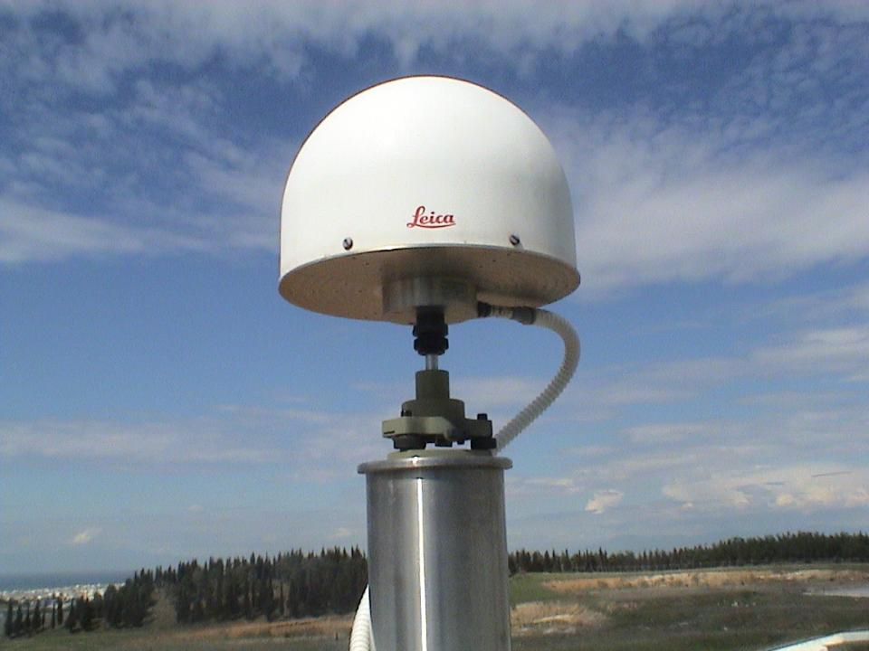
Active Control

Slide 37
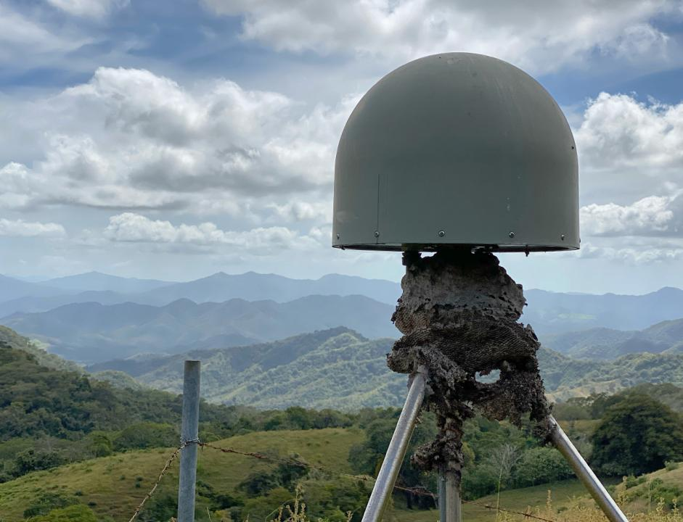
Active Control
Active Control

Slide 38
Active vs. Passive Control
Geodetic Control – Terminology
Passive – setting up your RTK Base on existing geodetic control (e.g. Datasheet) while collecting with RTK Rover
Active – setting up your RTK Base to log data while collecting with RTK Rover then processing Base data via OPUS; or collecting with RTN Rover
My point: surveying is still surveying
Notes:
Often the term active geodetic control has been used to mean some equipment is continuously or at least frequently collecting observations at or near a point
Yet those observations are often used to compute coordinates (often time-dependent) at a point on a mark, which, by its nature is passive

Slide 39
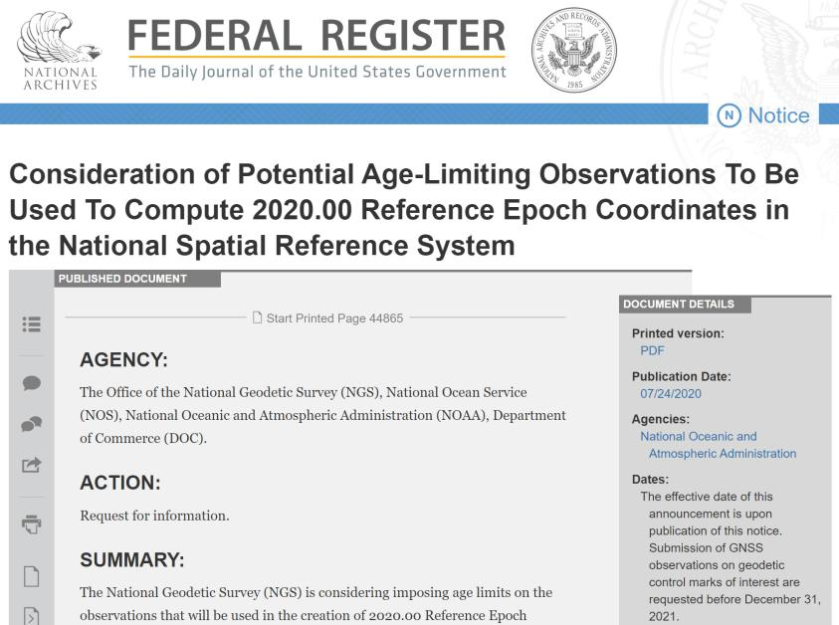
Why OPUS Projects?
Reference Epoch Coordinates (RECs)
You’ll get coordinates in NATRF2022 and NAPGD2022 on “day one”
Only “recent” GPS data in the IDB will get RECs
Federal Register Notice – July 2020
GPS on Benchmarks (GPSonBM)
3 occupations @ 5 minutes each vs. 2 occupations @ 4 hours each
Multi-constellation aka “GNSSonBM”

Slide 40
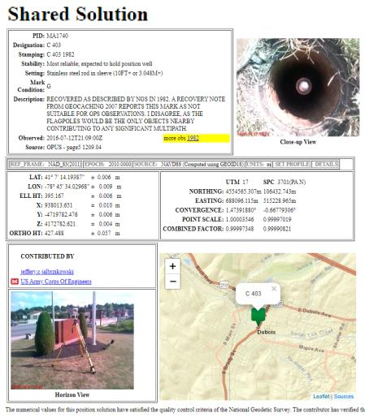
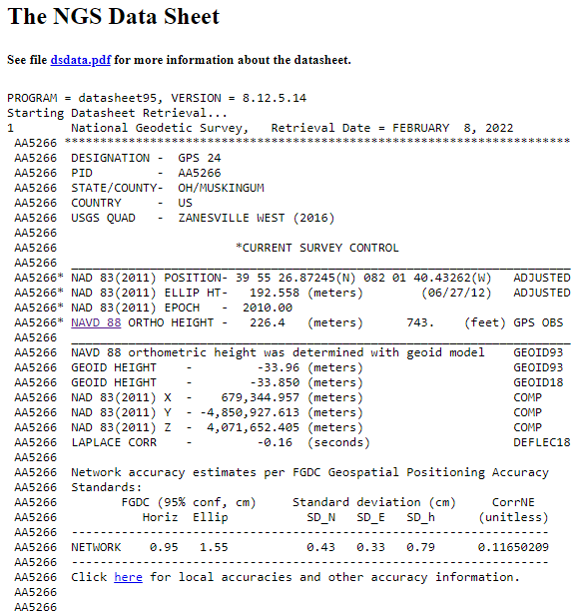
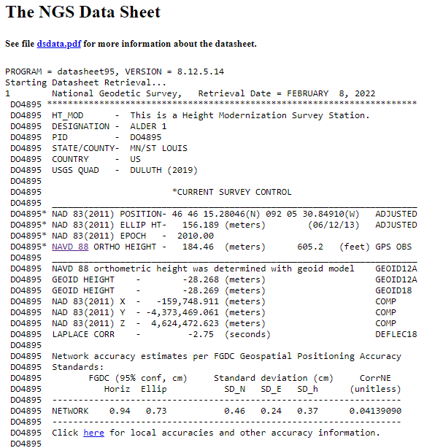
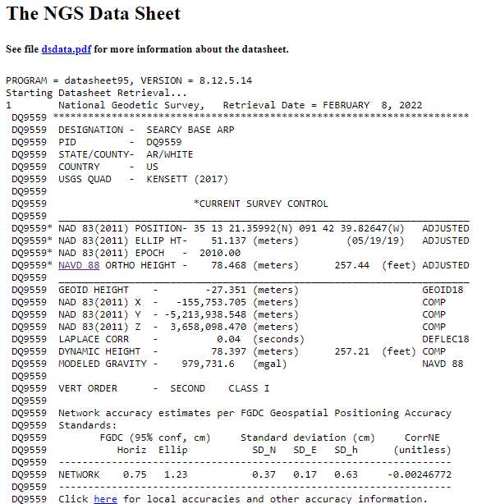
OPUS Shared vs. OPUS Projects
 | OPUS Shared | OPUS Projects (RINEX) | OPUS Projects (GVX)
Minimum Occupations | 4 hours At least 1, maybe 2* | 2 hours At least 2 | 5 minutes At least 3
Processing | OPUS-S (sequential) | PAGES (simultaneous) | Real Time (RTN/NRTK)
Adjustment | None | Least Squares Network | Least Squares Network
Metadata | 2 photos Brief Description | 3 photos, WinDesc files, Logs, & Report | 3 photos, WinDesc files, Logs, & Report
*Need 2 or more GPS datasets in our database, existing data holdings count toward that.

Slide 41
Terminology – Time/4D
Epoch
eh-puck? ee-pock? … to-may-to, to-mah-to
an instant of time; a moment in time
astronomy & geodesy use a decimal date
2021.4762 = 23 June 2021 @ 19:16:00
using epochs is important, not your format
start preparing to assign epochs to your data
Notes:
-Where do you see an Epoch right now in NGS data?
CLICK
Datasheets! there you see the epoch of 2010.0
and of course OPUS Solution Reports!
note that in blue over there on the right you’ll see another epoch, in the ITRF, which I will explain later on

Slide 42
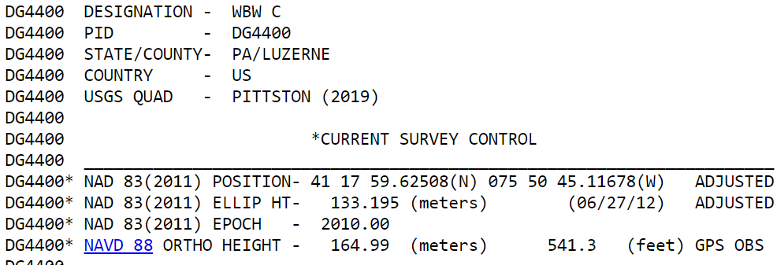
Notes:
-Where do you see an Epoch right now in NGS data?
Datasheets! there you see the epoch of 2010.0
and of course OPUS Solution Reports!
note that in blue over there on the right you’ll see another epoch, in the ITRF, which I will explain later on

Slide 43
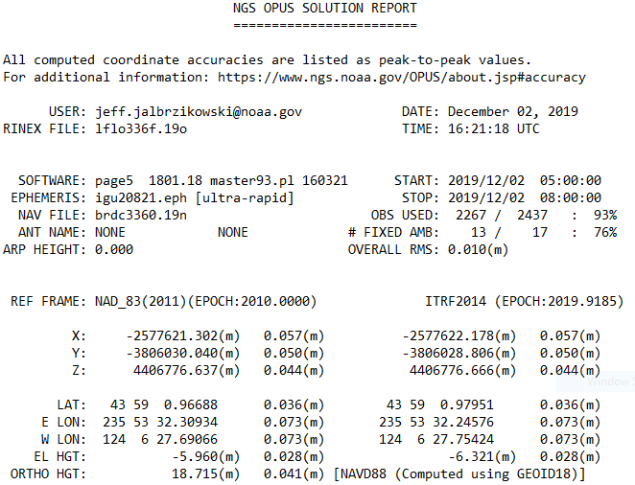
Reference Epoch
Survey Epoch
Notes:
-Where do you see an Epoch right now in NGS data?
and of course OPUS Solution Reports!
note that in blue over there on the right you’ll see another epoch, in the ITRF, which I will explain later on

Slide 44
Epochs in Modernized NSRS
Survey Epoch (SE)
Reference Epoch (RE)
Position at the moment of survey data collection
Used in ITRF
SEC = SE Coordinate
Ground movement will be illustrated
Position after propagated back in time from SE to RE
Used in NAD 83
REC = RE Coordinate
Ground movement will be hidden

Slide 45
Yes, we are delayed.
NSRS Modernization
Notes:
So remember, today’s presentation is not JUST about new datums, it is about modernizing the NSRS as a whole.
You don’t know what the NSRS is? Stay tuned, we’ll get there as we go along.

Slide 46
Delayed Release of the Modernized NSRS
How long will the delay be?
Our website or newsletter is best source of projected timeframe, current estimate is middle of 2025.
Will the names stay the same?
Yes, terms containing “2022” such as “NATRF2022” and “NAPGD2022” will remain the same.
Will all previously proposed products be released along with the new datums?
No, they will not. Check out our June 2022 webinar.
hyperlink to the Track Our Progress homepage
June 2022 webinar
hyperlink to the full FAQ

Slide 47
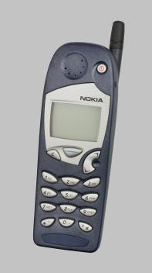
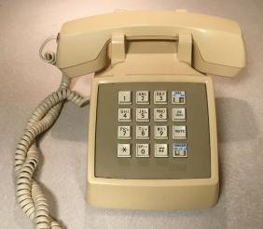
Evolution of the NSRS
NAD27
NAD83 (1986)
NAD83 (2011)
Notes:
NAD27
-like the dial of a rotary phone, you were out there spinning a theodolite around, running resections and solar shots to get a position… am I right?
-and you’d get a position, but it might not be that great, and if you set a mark then everybody wanted your data, like sharing the old party lines
NAD83(1986)
-we brought in a more accurate network, it was easier to access
-you were using an early total station and data collector, just like pushing the buttons on a touchtone phone
NAD83(2007/2011)
-the network was maturing with more CORS just like the cell towers
-just as cell phones were becoming ubiquitous, so too was the use of OPUS

Slide 48
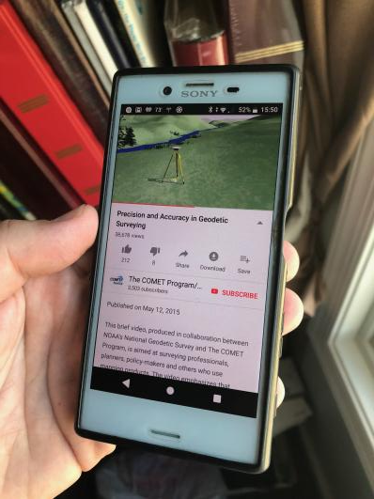
Modernized NSRS is our “smartphone”
You resisted it for a while…
It was a little cumbersome to get used to…
But soon you were hooked!
Notes:
-so if you think about the NSRS that way, then NATRF2022 is our smartphone, in more ways than one, right?
-some folks were excited to get a smartphone, but some (show of hands?) were reluctant to embrace the idea… kind of like this whole NSRS Modernization deal huh?
-some of us are excited for this development and some folks, well some are ready to retire as soon as NGS rolls this out, am I right?

Slide 49
Modernizing the NSRS
Updating all NSRS coordinates
Replace existing datums with new datums
Replacing existing SPCS83 with new SPCS2022
Accounting for coordinates changing with time
Improving NGS products and services
Simplifying customer contributions
Making the NSRS:
More accurate
More accessible
More efficient
Rollout in
2025

Slide 50
Positional Components of
the NSRS
Geometric
aka “Horizontal”
Latitude, Longitude, Ellipsoid Height
Geopotential
aka Orthometric Height
aka “Elevation”
NAD83
NAVD88
Notes:
-geometric component is latitude, longitude, and ellipsoid height
-geopotential component is combined with the geometric components to calculate an ortho height or capital H

Slide 51
NATRF2022
North American Terrestrial Reference Frame of 2022
will replace
NAD83
North American Datum of 1983
Technically, not just NATRF2022 but also its 3 sister TRFs…

Slide 53
Four TRFs for Modernized NSRS
North American Terrestrial Reference Frame of 2022
(NATRF2022)
Pacific Terrestrial Reference Frame of 2022
(PATRF2022)
Caribbean Terrestrial Reference Frame of 2022
(CATRF2022)
Mariana Terrestrial Reference Frame of 2022
(MATRF2022)

Slide 54
Terrestrial Reference Frame?
Existing, accepted terminology
International TRF
first realization of the ITRF was 1992
NATRF2022 will be based on ITRF2020
“Horizontal Datum” - misnomer for NAD83
Really is a Geometric Reference Frame

Slide 55
International Terrestrial Reference Frame
(ITRF)
Is native coordinate system for NCN.
Is what OPUS uses.
Is what most of world uses.
Is what NGA aligns WGS-84 to.
Notes:
So what is that acronym, ITRF?
-it is a global reference frame, the most widely adopted one, or the “gold standard” or the “Cadillac” or what-have-you
-ITRF is the internationally recognized standard
-who realizes the ITRF? well, NGS contributes to the realization but
CLICK
-The IERS is in responsible charge of defining, realizing and promoting the ITRF
-and the ITRF was formally adopted by the…yes, more acronyms
CLICK
IUGG some years ago

Slide 56
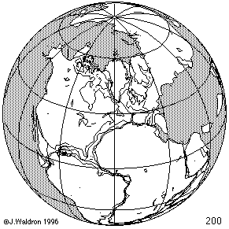
ITRF concept
Watch the grid!
Epoch:
Notes:
Ok, now ITRF mentioned a couple slides ago.
Most simplistic way to explain ITRF is to watch this animation.
This is a very loose representation/visualization of what the ITRF is, a characterization only.

Slide 57
Four TRFs for Modernized NSRS
North American Terrestrial Reference Frame of 2022
(NATRF2022)
Pacific Terrestrial Reference Frame of 2022
(PATRF2022)
Caribbean Terrestrial Reference Frame of 2022
(CATRF2022)
Mariana Terrestrial Reference Frame of 2022
(MATRF2022)

Slide 58
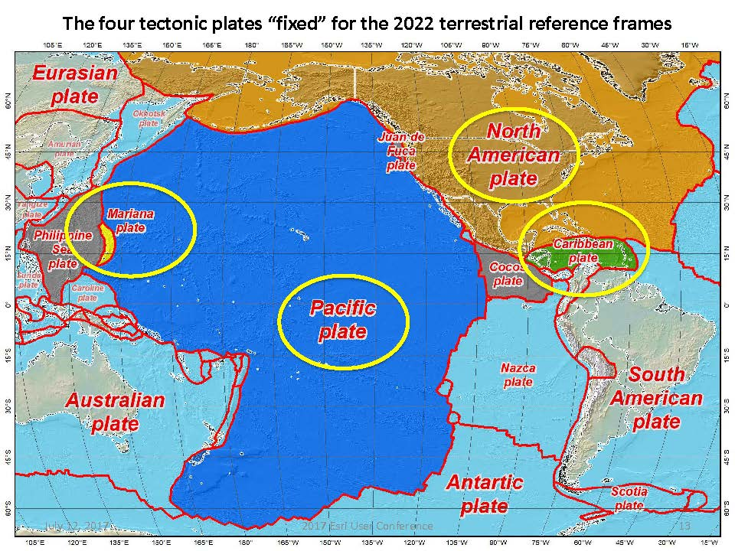
Plate Rotation visualized
Drift…

Slide 59
Plate-Fixed NSRS TRFs
ITRF
Frame = constant
NA Plate = rotating
NATRF
Frame = rotating
(relative to ITRF)
NA Plate = constant
(relative to NATRF2022)
Notes:
We say “NATRF2022” is “fixed” to the N.A. Plate, making it a “plate fixed” frame
-the frame is constant to itself, but rotating within ITRF, and moving in a different direction than the other 3 frames

Slide 60
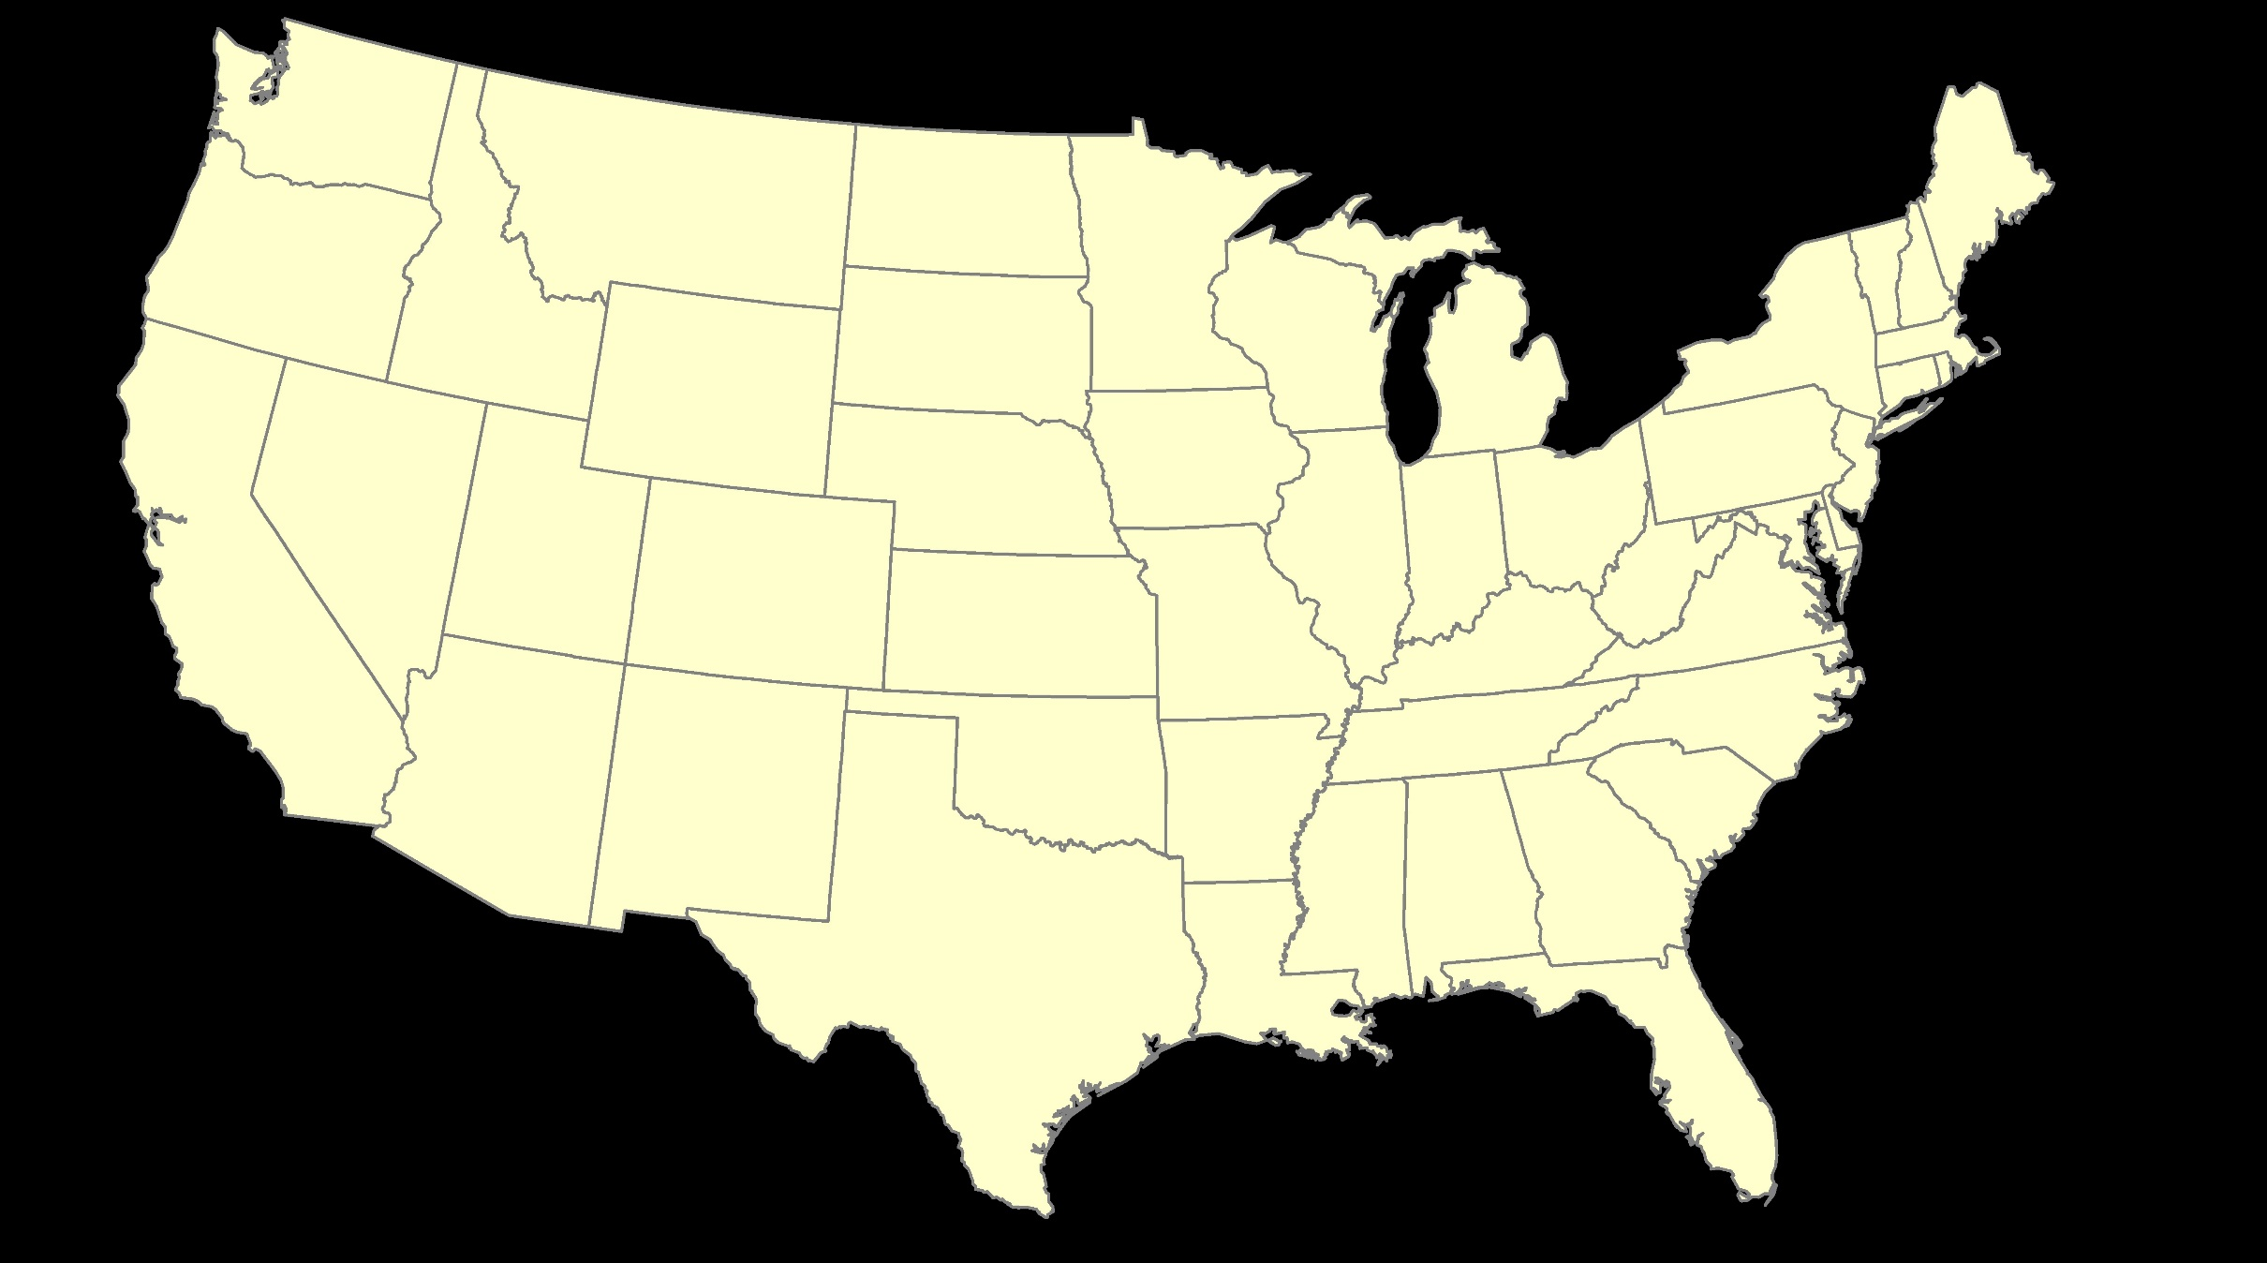
ITRF – constant frame, rotating plate

Slide 61
Plate-Fixed
NATRF – rotating frame, constant with plate

Slide 62
if you know epoch
ITRF or NATRF – your choice if you know epoch

Slide 63
Decades of continuously logged GPS data from the NOAA CORS Network (NCN).
But how?

Slide 64
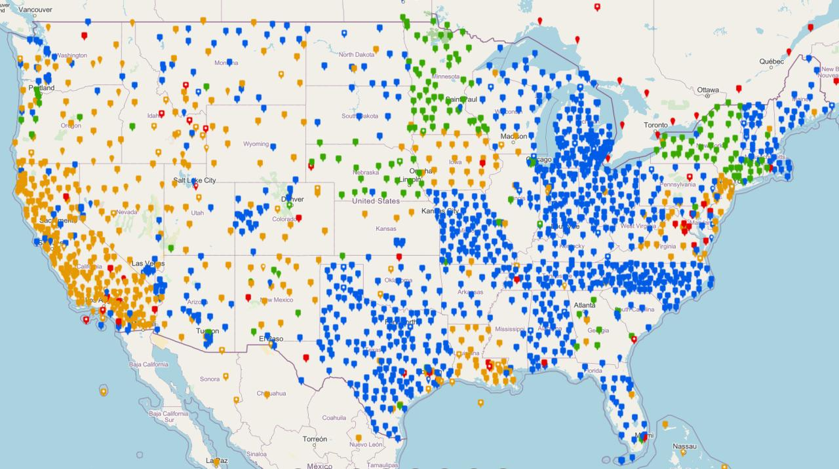
NOAA CORS Network (NCN)

Slide 65
Plate-Fixed
NATRF – rotating frame, constant with plate
= CORS

Slide 66
Plate-Fixed
ITRF or NATRF
= CORS
Notes:
ITRF is independent of any plates, tied to the layer below,
-”plate-agnostic” if we want to sound all silicon valley ish
-the plates go down about 200 km (125 mi) deep below our feet right now, as we’re on a continental plate
--(oceanic plates are roughly half the thickness, like 100 km)
-→ but thickness of the tectonic plates varies greatly, from down to 15 km up over the 200 km I mentioned earlier

Slide 67
4D alignment – Epochs
One epoch where ITRF2020 coordinates will be equivalent to NATRF2022
at 00:00 on January 01, 2020
ITRF2020 (epoch 2020.0) = NATRF2022 (epoch 2020.0)
Notes:
After that, they diverge and continue to do so, we’ll visualize that soon

Slide 68
Terminology - Changing Coordinates
Conversion
change the type of coordinate
NAD83(2011) latitude & longitude → NAD83(2011) SPCS
Transformation
change the datum of coordinate
NGVD29 height → NAVD88 height
NAD 27 latitude & longitude → NAD 83(2011) latitude & longitude
Propagation
change the epoch of coordinate
NATRF2022 epoch 2020.00 to NATRF2022 epoch 2023.243
Notes:
Historically NGS has been inconsistent with these top two words.
Going forward, we will use them as:
Conversion: Meaning to change the type of coordinate without changing the datum or frame
Transformation: Meaning to change the datum or frame, without changing the type of coordinate

Slide 69
NCAT
How will you do that?
NGS Coordinate Conversion And Transformation Tool (NCAT)
Epochs/Time/4D

Slide 70
NGS Coordinate Conversion And Transformation Tool (NCAT)
Notes:
NCAT includes the functionality of previous NGS tools:
NADCON 5.0
XYZWIN 2.0
UTMS 2.1
SPC83 2.1
USNG 2.3
Includes error estimate of transformation per point.
Available as the single-point graphic seen here, multi-point upload/download, as a downloadable executable fie to run from the DOS prompt, and as web services for inclusion in your own
It’s a great tool. Anyone using

Slide 71
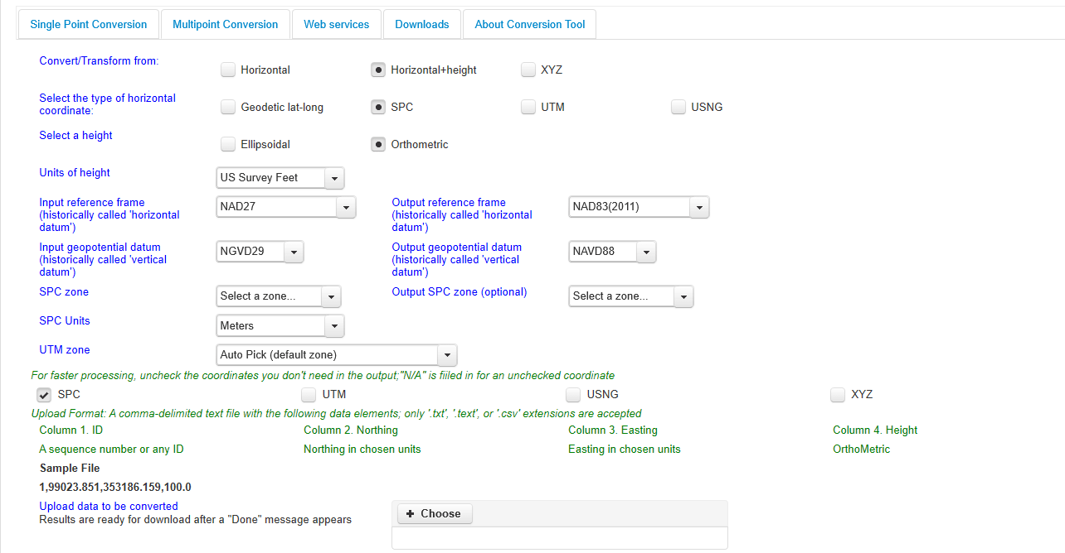
NGS Coordinate Conversion And Transformation Tool (NCAT)
Notes:
NCAT includes the functionality of previous NGS tools:
NADCON 5.0
XYZWIN 2.0
UTMS 2.1
SPC83 2.1
USNG 2.3
Includes error estimate of transformation per point.
Available as the single-point graphic seen here, multi-point upload/download, as a downloadable executable fie to run from the DOS prompt, and as web services for inclusion in your own
It’s a great tool. Anyone using

Slide 72
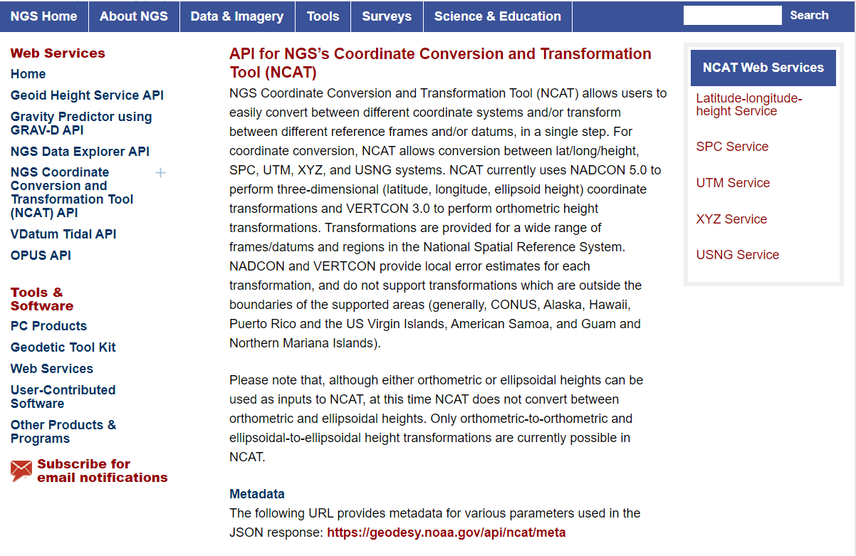
NCAT is available via web services

Slide 73
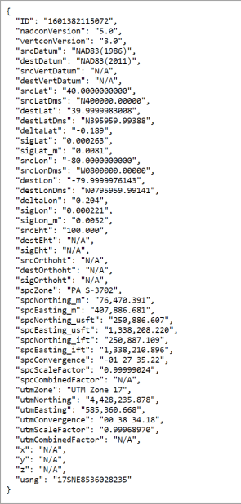
NCAT is available via web services
Note that each operation is a separate service
Struggling?
Contact us.
We can help!

Slide 74
NGS Coordinate Conversion And Transformation Tool (NCAT)
Notes:
NCAT includes the functionality of previous NGS tools:
NADCON 5.0
XYZWIN 2.0
UTMS 2.1
SPC83 2.1
USNG 2.3
Includes error estimate of transformation per point.
Available as the single-point graphic seen here, multi-point upload/download, as a downloadable executable fie to run from the DOS prompt, and as web services for inclusion in your own
It’s a great tool. Anyone using

Slide 75
NGS Coordinate Conversion And Transformation Tool (NCAT)
Notes:
NCAT includes the functionality of previous NGS tools:
NADCON 5.0
XYZWIN 2.0
UTMS 2.1
SPC83 2.1
USNG 2.3
Includes error estimate of transformation per point.
Available as the single-point graphic seen here, multi-point upload/download, as a downloadable executable fie to run from the DOS prompt, and as web services for inclusion in your own
It’s a great tool. Anyone using

Slide 76
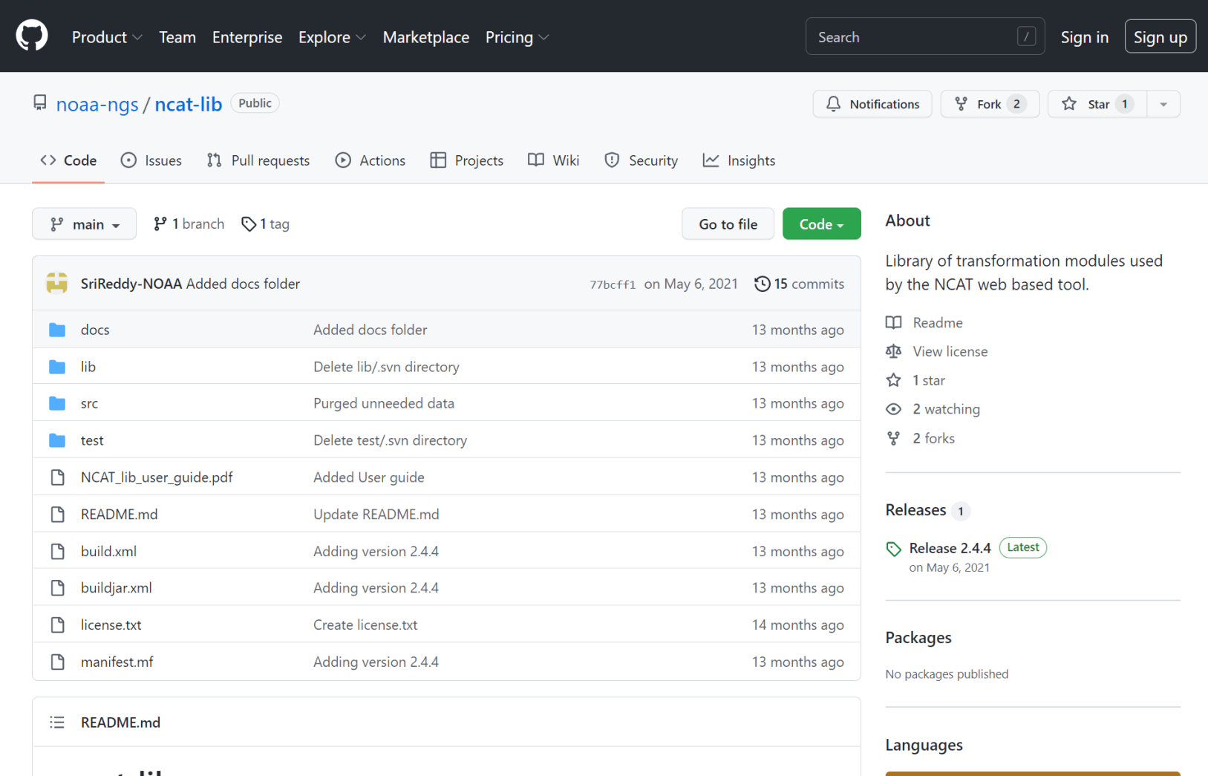
NCAT source code is on GitHub

Slide 77
What’s the difference?
NCAT
VDatum
NSRS Datums
NAD 27
NAD 83
NGVD 29
NAVD 88
PRVD 02
ASVD 02
NMVD 03
GUVD 04
VIVD 09
NSRS Datums
Geoid Models
Add/Subtract from Ellipsoid
Tidal Datums
MHW, MLLW, MTL
Great Lakes Datum
IGLD85
ITRF#### ≈ WGS84
Local Tidal (LT)

Slide 78
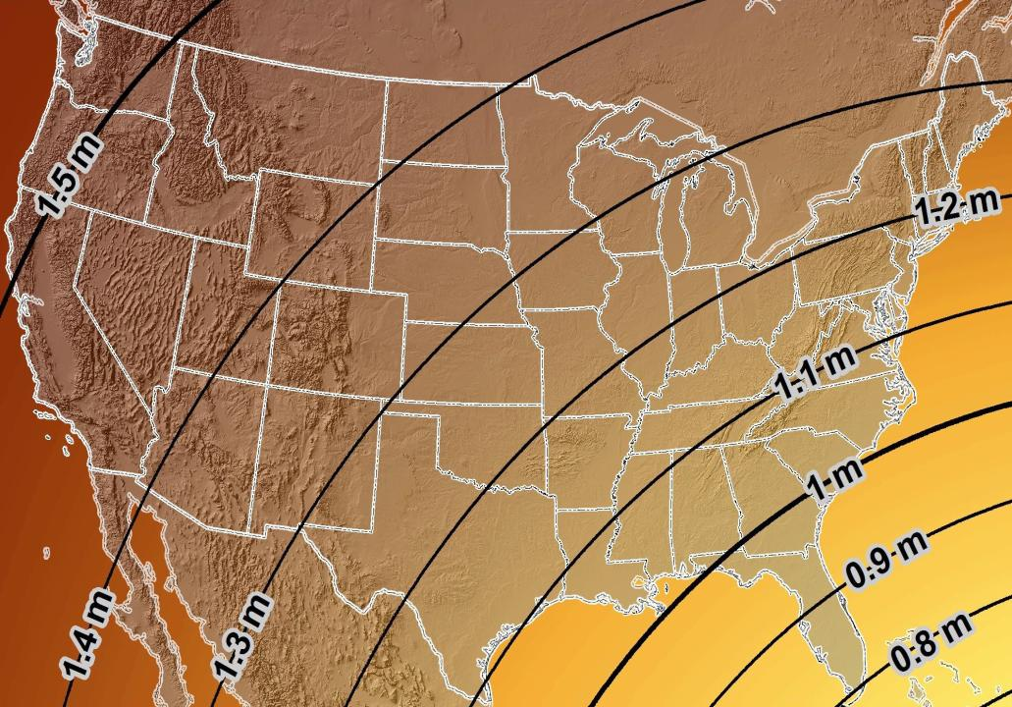
Estimated Geometric Change - Horizontal
NAD83 (2011) → NATRF2022
4.6 ft
Direction of Shift
4.3 ft
3.9 ft
3.6 ft
3.0 ft
Notes:
What’s the magnitude of the horizontal datum shift across Pennsylvania?
Minimum Shift ~3.75 feet
Maximum Shift ~3.97
Remember this is just an estimation, don’t hold me to the numbers please

Slide 79
New Lat/Long = New XY
With a new horizontal datum…
There comes a new set of SPCS zones

Slide 80
State Plane Coordinate System of 1983
SPCS83
North and South Zones as they exist now
Notes:
We start with the SPCS83 zones as a frame of reference
NOTE that the color shading of these zones is matched to that of the Preliminary SPCS2022 Zones that follow

Slide 81
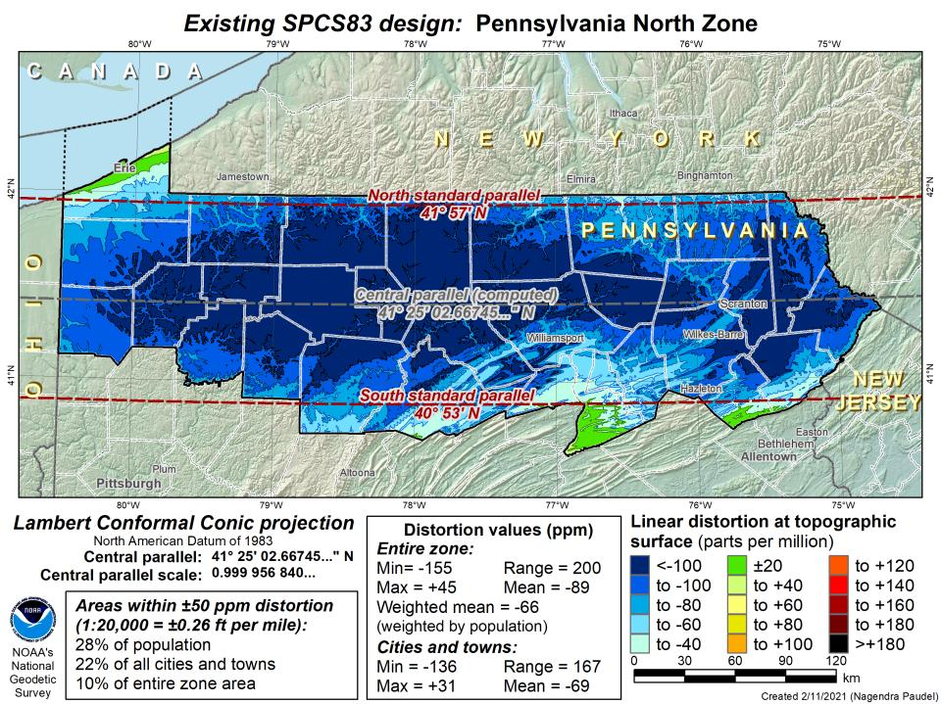
DRAFT

Slide 82
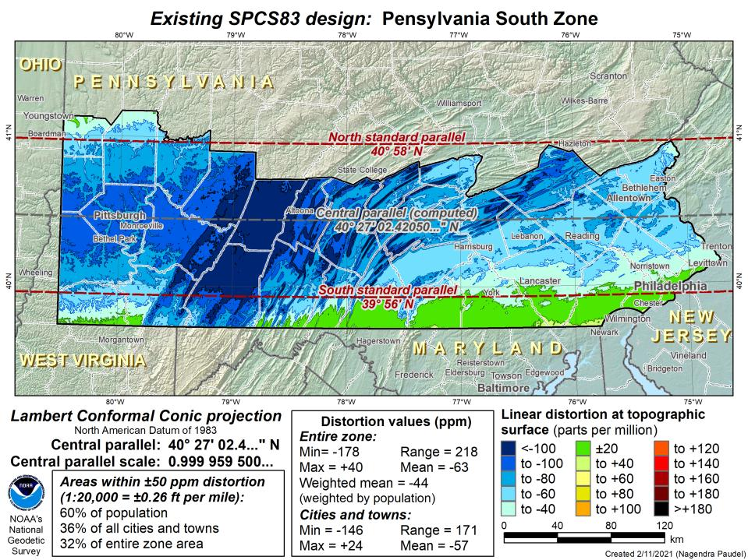
DRAFT

Slide 83
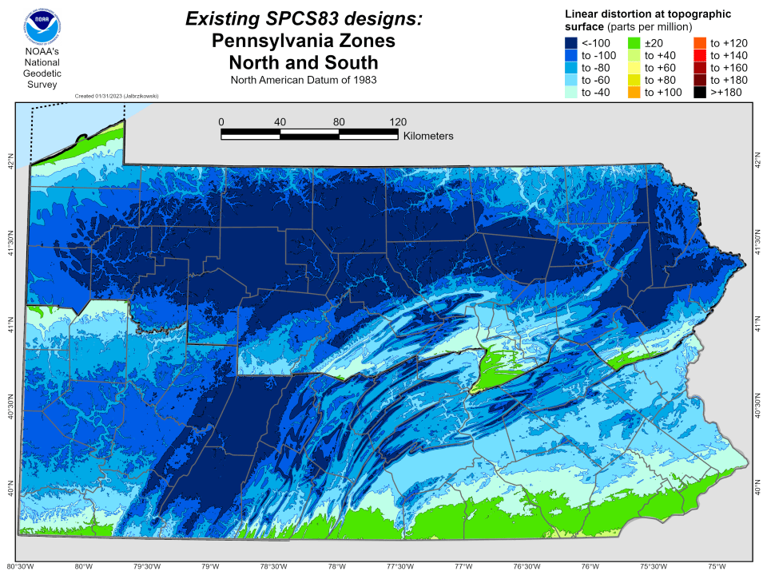

Slide 84
State Plane Coordinate System of 2022
SPCS2022
PA stakeholders requested 4-5 zones, which NGS designed, the following are preliminary maps
Notes:
The following section illustrates the preliminary SPCS2022 zones
There are 4 zones in the NGS design, per request that we design “4-5 zones required to meet the minimum distortion acceptable” set by our design criteria of 50ppm
NOTE the request also included wording: “It is also requested that PennDOT districts be divded into no more than two zones”

Slide 85
Stakeholders Involved in PA SPCS2022
PennDOT
PTC
PSLS
PSPE
PA Geospatial Coordinating Board (GeoBoard)
Geodetic Working Group
County GIS Professionals Association of PA
PA-MAGIC (now Keystone GIS)
PA-MAPPS
Notes:
A major component of SPCS2022 are stakeholders
Stakeholders have a role in helping define (and maintain) SPCS2022
Pennsylvania Department of Transportation
Pennsylvania Turnpike Commission
PSLS of course
PSPE – Society of Professional Engineers
The GeoBoard
County GIS Professionals Association of Pennsylkvania
PA Mapping & Geographic Information Consortium
Your State chapter of the Management Association for Private Photogrammetric Surveyors

Slide 86
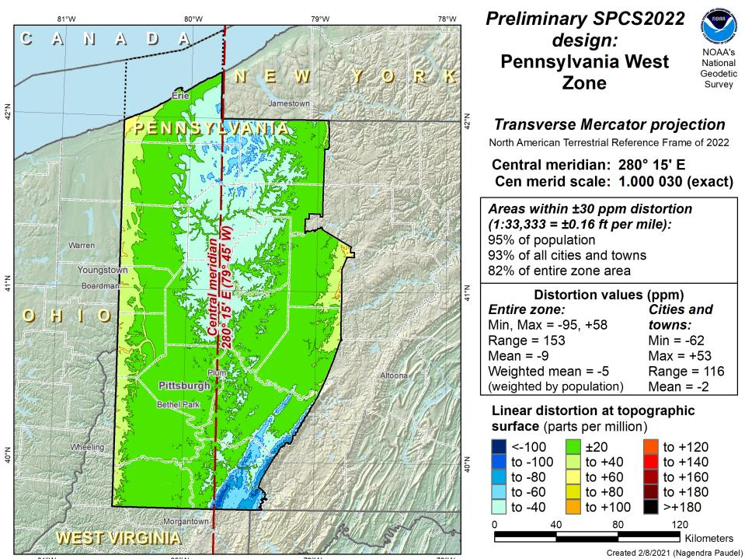
Notes:
NOTE that the West Zone far surpasses the NGS design criteria of 50ppm

Slide 87
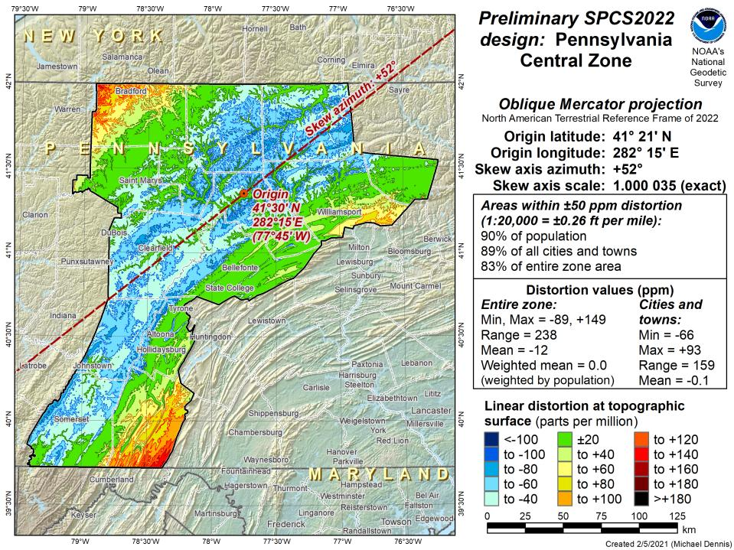
Notes:
This is the first, and likely final, draft of an Oblique Mercator projection for the Preliminary Central Zone
NOTE that even with the

Slide 88
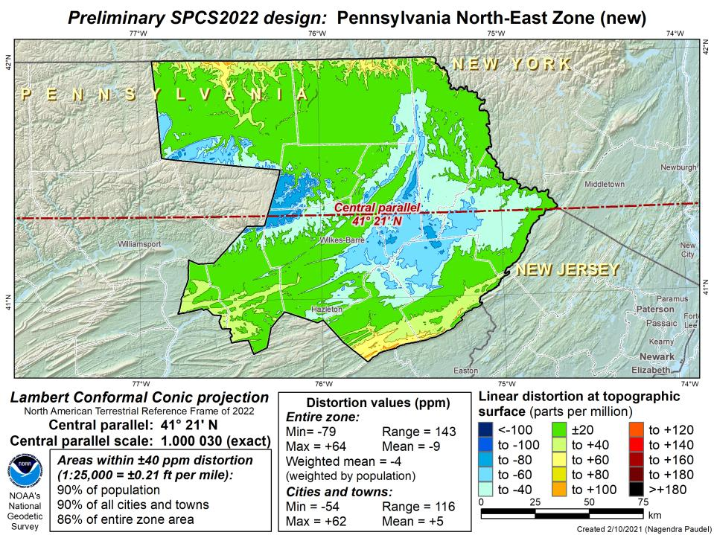
Notes:
This is the second draft of a Preliminary North East Zone

Slide 89
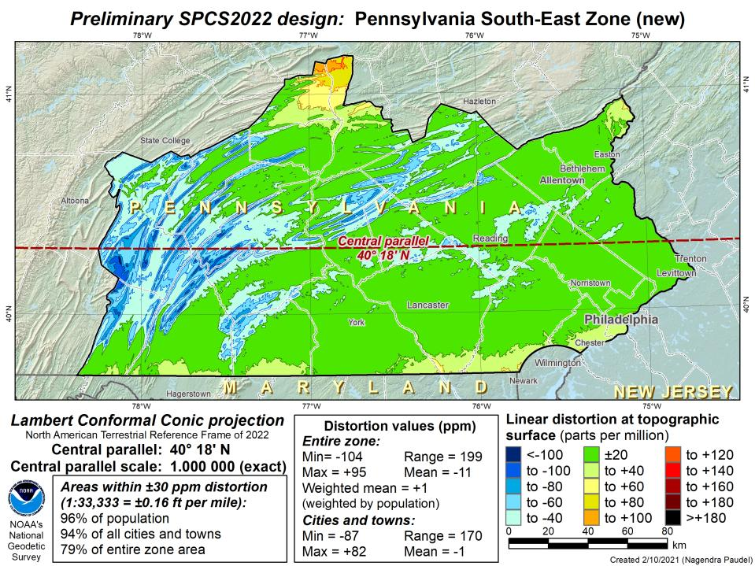
Notes:
This is the second draft of a Preliminary South East Zone

Slide 90
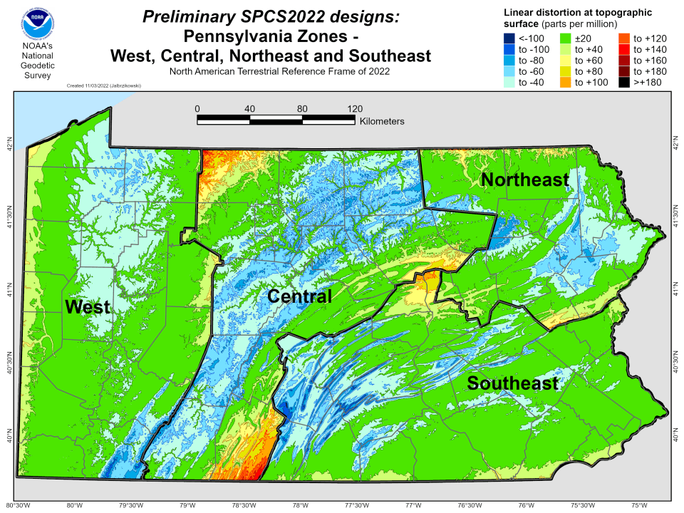

Slide 93
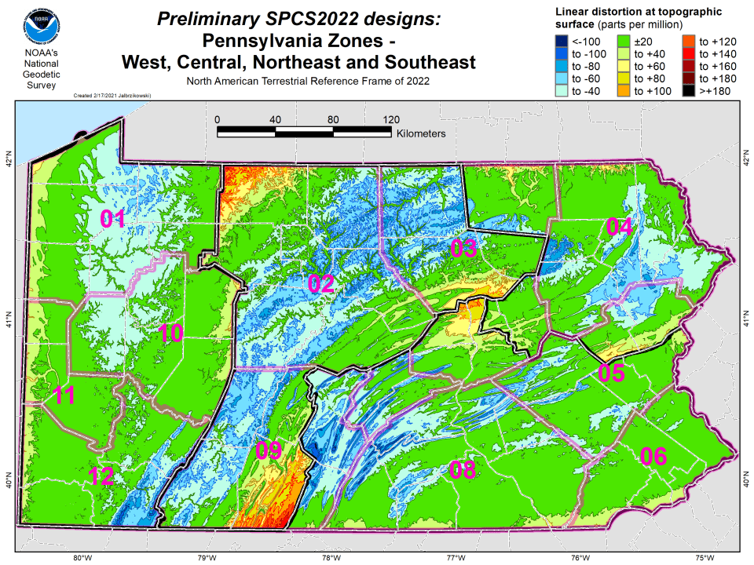

Slide 94
State Plane Coordinate System of 2022
SPCS2022
NGS will create a Single Statewide Zone for every State, the following is a Preliminary map

Slide 95
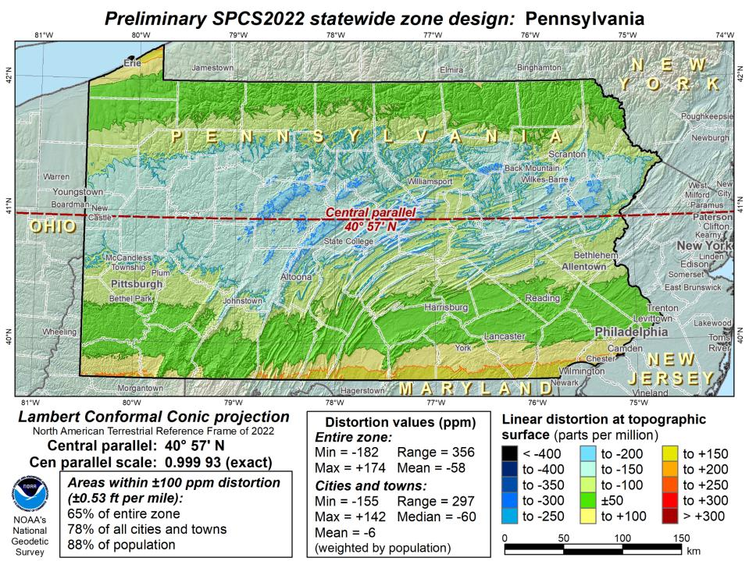
Notes:
This Single Statewide Zone designed by NGS is color shaded to match the following section of slides that show UTM Zones linear distortion values
It is known that some user communities with large areas of responsibility choose to maintain geospatial data and work in UTM
This graphic as compared to the UTM serves to highlight in SPCS2022, users will see better performance (lower linear distortion) if they choose to work in the SPCS2022 Single Statewide Zone rather than one of the UTM Zones that fall within Pennsylvania

Slide 96
UTM (NAD83) Zones as
UTM
The following are maps using existing UTM zones as a Single Statewide Zone
(included to highlight the lower performance as compared to Preliminary NGS Zone)

Slide 99
Notes:
The NGS designed preliminary single statewide zone is included again here at the end for easier visual comparisons.

Slide 100
Notes:
Reminder that you don’t have to cutoff data at any SPCS zone extent
→ just need to understand that they’re designed with certain extents in mind

Slide 101
SPCS2022 Zone Layers in PA
Both Single Statewide and Multi-Zone Layers will coexist
Think about your data, your goals, your customers
Remember that geographic coordinates are your friend!
Smaller zones not “the best” … it all depends on usage & goals

Slide 102
Which is best?
Single Statewide Zone Layer
Multi-Zone Layer
Each has strengths and each has weaknesses.

Slide 103
SPCS2022 Zone Layers and LDPs
Each state may have max of 3 zone “layers”
One layer must be statewide zone
Pennsylvania Single Statewide
Other layers have two or more zones
Pennsylvania Multi-Zone
A third layer can exist, but must be discontinuous coverage
Left open for possibilities in Pennsylvania
Low Distortion Projections (LDPs) for specific areas?

Slide 104
Pennsylvania Coordinate System Law
Act of Dec. 16, 1992, P.L. 1224, No. 161
Problems
Designates specific zones
Parameters of projections included
Restricts datum usage to 1983 or 1927
Unit of measure designated as Survey Foot
Anyone familiar with the requirement that SPCS coordinates in recorded land records must be certified by the surveyor?

Slide 105
State Plane Coordinate System of 2022
SPCS2022
Not just Pennsylvania

Slide 106
Number of SPCS2022 zones (preliminary)
CONUS, Alaska, and Hawaii
Three island zones not shown:
Puerto Rico and U.S. Virgins Islands
American Samoa
Guam and the Commonwealth of the Northern Mariana Islands

Slide 107
SPCS2022 linear distortion (prelim)
846 zones (CONUS)
Percent within distortion (ppm):
Distor | Pop | Cities | Area
±20 | 76% | 71% | 58%
±50 | 92% | 89% | 76%
±100 | 98% | 97% | 89%
±400 | 100% | 100% | 99.9%
City and area statistics (ppm):
 | Min | -407 | -1438
 | Max | +486 | +2624
 | Range | 893 | 4062
 | Mean | -6 | -23
Mean weighted by pop = -4

Slide 108
The Survey Foot is dead!
Long live the Survey Foot!
US Survey Foot was deprecated 31 December 2022… now what?!?

Slide 109
What happened to the US Survey Foot?
Deprecated 31 December 2022
Which begs the question
What should you be doing now?

Slide 110
What should you be doing now?
Ask the right questions
Does state law specify US Foot for SPCS83?
40 states do that we know of
Does it specify US Foot for boundary surveys? (Does that matter?)
We’re not tracking that, it’s not NSRS-related
Prepare for this along with new datums
GeoBoard Geodetic Working Group
Anyone always welcome to any meeting/discussion
Update Monday evening is that it will likely be un-opposed

Slide 111
What should you be doing now?
Prepare for this along with new datums
Understand the difference between sft and ift
2 parts per million
Understand this is not enforced
Neither NIST or NGS are a regulatory agency
We support education/outreach of course
But OPUS, NCAT, etc. will not have US Survey Foot options for output in SPCS2022 zones

Slide 112
2 parts per million (ppm)?
1,000,000.00 sft = 999,998.00 ift
10,000,000.00 sft = 9,999,980.00 ift
1,000.00 sft = 999.998 ift (can you measure that?)
International → 1 ft = .3048 m
US → 1 ft = .30480061 m (approx.)

Slide 114
The Survey Foot is dead!
Long live the Survey Foot!
US Survey Foot was deprecated 31 December 2022…
But it will always be available in NGS tools for NAD83 and NAD27 coordinates

Slide 115
National Geodetic Vertical Datum
of 1929
NGVD29
was replaced by

Slide 116
North American Vertical Datum
of 1988
NAVD88
will be replaced by

Slide 117
North American-Pacific Geopotential Datum of 2022
NAPGD2022
(pronounced: nap-jee-dee)

Slide 118
NAPGD2022
Geopotential
gravity based
no leveling used to define it (none!)
GNSS is your access
collect data & submit it to OPUS
no leveling necessary
Global Mean Sea Level (GMSL) based
geoid change when sea level threshold crossed

Slide 119
NAVD88 geoids
versus
NAPGD2022 geoids

Slide 120
Two types of geoid models
Gravimetric
Hybrid
Notes:
-believe it or not there’s more than 2 types, but the 2 types you’ll see NGS publish are…

Slide 121
Gravimetric → Hybrid
Gravimetric geoid is created from “scratch” with various types of gravity data
USGG2003, USGG2009, USGG2012, xGEOID19
Hybrid geoid is simply a gravimetric geoid then best fit some vertical datum… like NAVD88
GEOID03, GEOID09, GEOID12B, GEOID18
Notes:
So… all the geoids you’re using to get elevations from your GNSS data

Slide 122
Gravimetric → Hybrid
USGG2003, USGG2009, USGG2012, xGEOID19
GEOID03, GEOID09, GEOID12B, GEOID18
best fit to NAVD88
best fit to NAVD88
best fit to NAVD88
best fit to NAVD88
Notes:
So… all the geoids you’re using to get elevations from your GNSS data

Slide 123
Gravimetric vs. Hybrid Geoid
topographic surface
gravimetric geoid
hybrid
geoid
datum zero
surface
Concept

Slide 124
NAVD88 uses a Hybrid Geoid
topographic surface
gravimetric geoid
hybrid
geoid
datum zero
surface
Concept

Slide 125
NAPGD2022 uses a Gravimetric Geoid
topographic surface
gravimetric geoid
datum zero
surface
Datum zero surface aligned to Global Mean Sea Level (GMSL)
Concept
Notes:
-importantly, the height chosen was to minimize 29→88 differences on USGS topo maps in the eastern U.S. … thus, the “zero height surface” of NAVD 88 was NOT chosen for its closeness to the geoid (but it was close…few decimeters)

Slide 126
Why leveling is not part of NAPGD2022
…but will still be important for you.
ground surface
equipotential surfaces
(equal gravity)
Geoid at Site Scale

Slide 127
Why leveling is not part of NAPGD2022
…but will still be important for you.
ground surface
equipotential surfaces
(equal gravity)
Geoid at Continental Scale

Slide 128
Why leveling is not part of NAPGD2022
We are determining height differences across the whole continent
Large Area
Gravity varies due to: geology, water, etc.
You are determining height differences across your area/site
Small Area (as compared to CONUS)
Gravity does not change that much locally

Slide 129
Why leveling is not part of NAPGD2022
…but will still be important for you.
When you’re working on a site, you need high accuracy relative height differences
Geoid model is not able to provide that
So don’t toss out your level come 2025!
What about if submitting data to NGS?
Yes, we will accept leveling, but…
GNSS ties will be required

Slide 130
Sea Level Change and the Geoid
Threshold Level is published as 20 cm
Process is repeated as GMSL changes
H_{2020.000}
H_{2085.000}
Threshold Level
Geoid
GMSL
Notes:
The illustrated strategy will be adopted at NGS. An animated characterization of this approach
What this means is that NGS will decouple the geoid from GMSL, until they have diverged by some threshold amount, currently defined as 20cm.
When that threshold is reached a new geoid will be defined and held fixed until reaching next threshold. In this way, the impact of the change of GMSL is accounted for in the heights of the NSRS, while the appearance of stability is maintained for “decades at a time” (BP2 Section 14).
If we calculate how long that might be based on existing rates of sea level rise of 3ish mm/yr then we’re talking ~60 years

Slide 131
Estimated change in orthometric heights from NAVD88 to NAPGD2022
Change in PA:
At least -0.6 feet
At most -2.0 feet
(NAPGD2022 approximated using xGEOID16B)
Notes:
In Ohio, from just under a foot to almost 2 feet
Quite a bit of variation, but average of 1.5 foot shift down
Change in Pennsylvania:
At least -0.6 feet
At most -2.0 feet

Slide 132
Estimated change in orthometric heights from NAVD88 to NAPGD2022
OPUS Extended Solution Report

Slide 133
Estimated change in orthometric heights from NAVD88 to NAPGD2022
OPUS Extended Solution Report
Scroll all the way to the bottom…

Slide 134
Preparing for NAPGD2022
Inventory heights in your data/datasets
Have you mix & matched geoid models?
Are you tracking levees or other flood control?
Are you managing subsurface utilities?
Access covers, junction boxes, cleanouts, etc.
Maybe geoid differences aren’t even significant?
VADOT story…
Know your goals, know your data.

Slide 135
Preparing for New Datums
Know the epoch of your data/datasets
consider how you will track this
full to-the-second timestamp on every feature?
Modern survey equipment makes this possible
labeling a year for each dataset?
Easy to add to workflows, datasets/databases, folders
something in-between that works for your needs?
2023.1957
2023:27
20230127
Epoch nomenclature is your choice

Slide 136
Preparing for New Datums
Reprocessing your data
perfect world = everyone reprocesses everything
what does this mean?
consider an ALTA w/topo
start over with the onsite GNSS-based control
reorient all your shots/ties (hopefully linked)
recreate all the drainage features in new datum
unrealistic! … and unnecessary for majority users
Notes:
Reprocessing your data
in a perfect world, everyone would reprocess data
consider a final product like you use everyday - a hydro-enforced DEM
starting fresh with the raw GNSS/IMU processing
generate new ellipsoid height point clouds
recreate all the drainage features in new datum
this is totally unrealistic → both from a financial and programmatic perspective

Slide 137
Preparing for New Datums
Transforming your data
NCAT - NGS Coordinate Conversion and Transformation Tool
available now: ASCII upload, Web Services, GitHub
ask your software provider(s) about integration
we envision this as most popular method of access
Industry Workshops held in 2021 and 2022
All the well known commercial names attended
Plus some open-source advocates
Notes:
Transforming your data
NCAT - NGS Coordinate Conversion and Transformation Tool
available now: ASCII upload and Web Services
ask your software providers about integration
we envision this as most popular method of access
Industry Workshop held this year – esri, trimble, bluemarble, all the major well known names were represented
labeling a year for each dataset?
something in-between that works for your needs

Slide 138
Preparing for New Datums
What can you do to ensure your control will get coordinates in the new datums on rollout?
Re-observe and submit the data to NGS
must be submitted by 30 September 2023
Options to submit your data:
OPUS Share → 4+ hrs static data; 2 photos; mark ties
rinse & repeat … as we need redundancy
OPUS Projects → 2+ hrs static GPS data
→ 5+ minutes RTN-GNSS data, 3x per mark
Also: photos, field logs, descriptions, survey report
Notes:
-OPUS Share requires 4+ hrs static data; 2 photos; and a brief description of reference ties (not a full IDB “from the post office”)
→ NOTE THAT OPUS SHARE OPTION REQUIRES 2 OBSERVATIONS
→ WHY? WE REQUIRE REDUNDANCY FOR ANY OBS THAT GO INTO OUR DATABASE
-OPUS Projects → 2+ hrs data; photos; full IDB style descriptions via WinDesc (*MUST USE WINDESC*)

Slide 140
Additional Resources

Slide 141
Regional Geodetic Advisor Program
geodesy.noaa.gov/ADVISORS/
14 RGAs across country
We are here to support:
You
Your constituents
Our Federal Partners
Questions about
NSRS Modernization?
Reach out now
Be prepared
Notes:
-14 Regional Advisors across the country and Territories
-our advisors homepage up there at the top, also easy to find us by querying any major search engine for “ngs advisors”

Slide 142
Educational Videos
<5 minutes
Online Lesson
(via MetEd/COMET)
~1 hour
NGS homepage: geodesy.noaa.gov
Notes:
Educational videos and online tutorials –
Our library of lessons and videos are great resources, and will reinforce a lot of information we covered today.
The videos are just 3-5 minutes long.
the lesson is a deeper dive but still only takes an hour.

Slide 143
Email Subscriptions
*Only 1-2 messages per month*
NGS News
Includes quarterly NSRS Modernization newsletter
Webinar Series
Training
GPS on Benchmarks
Click this icon on homepage

Slide 144
https://geodesy.noaa.gov/ADVISORS/
-use any major search engine: “NGS advisors”
Jeff Jalbrzikowski, P.S., GISP, CFS
Appalachian Regional Geodetic Advisor
jeff.jalbrzikowski@noaa.gov
240-988-5486

Slide 145
Scan to save my contact info on your phone

