Slide 1
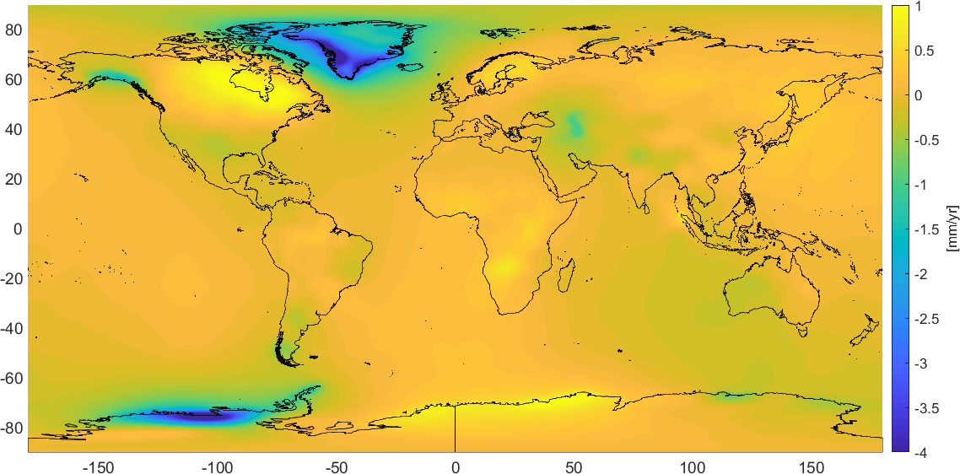
GeMS
Geoid Monitoring Service
NGS Project to estimate time-dependent quantities and incorporate into vertical reference system (NAPGD 2022)
Quantities: $\dot{N},\dot{∆g},\dot{H},\dot{W},\dot{η},\dot{ξ}$
Geoid Time Rate of Change – secular trend from GRACE (NASA GSFC mascon v02.4, Luthcke, et al. 2013))
Notes:
Stress: need to validate how well this changes reflect what is happening on the ground.

Slide 2
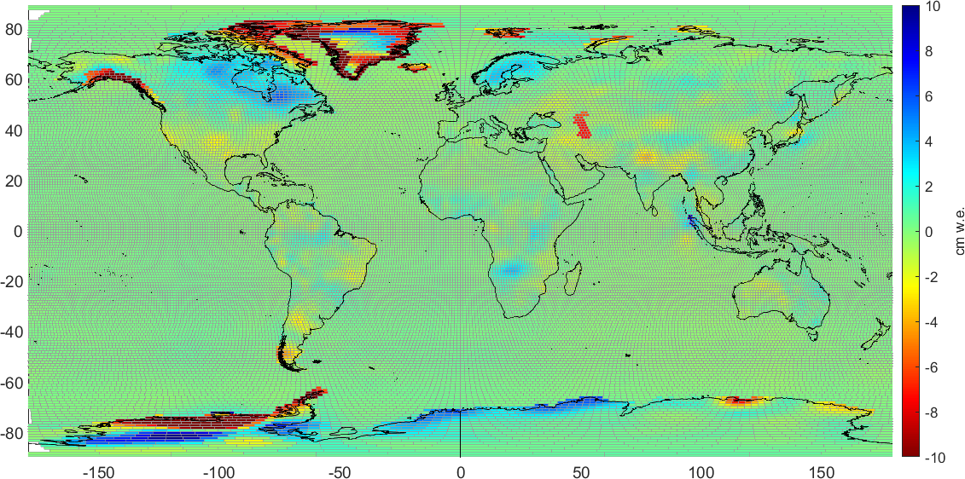
Causes of Geoid Change
Any mass change or redistribution
Glacial isostatic adjustment (GIA)
present day ice-mass changes
changes in hydrology (including ground water storage, snow, etc.)
large earthquakes
volcanic eruptions
Mass Change in cm water equivalent (cm w.e.) – secular trend from GRACE (NASA GSFC mascon v02.4, Luthcke, et al. 2013))
Notes:
Stress: Need a lot of mass change over large areas to get ‘significant’ geoid change

Slide 3
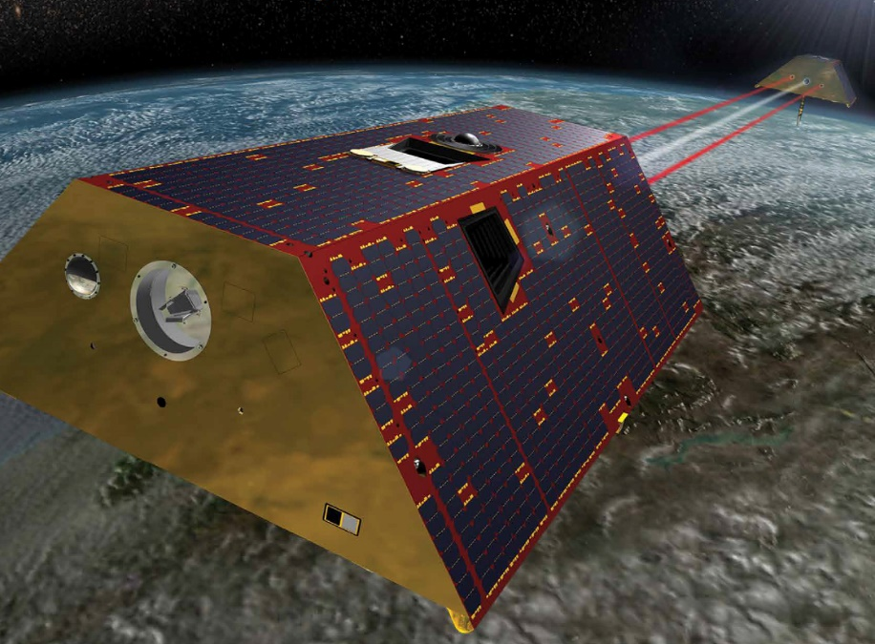
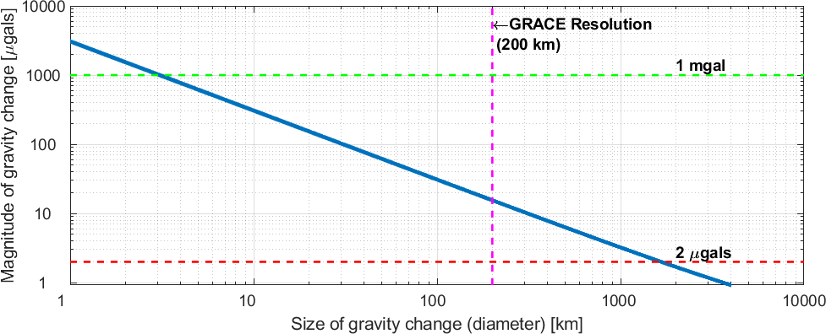
GRACE/GRACE-Follow-on
NASA/GFZ missions to monitor temporal gravity field at 200 km wavelengths
GRACE: 2002 – 2017
GRACE-FO: 2018 –
Foundation for GeMS models. Use monthly gravity fields to estimate a trend and produce $\dot{N}(φ,λ,t)$
GRACE/GRACE-FO – Twin satellites that measure distance between one another at few μm (a tenth of the thickness of a human hair)
Relationship between gravity change, geographic size of change, and geoid change. Combinations to the right of the blue line will cause a 1 cm geoid change.

Slide 4
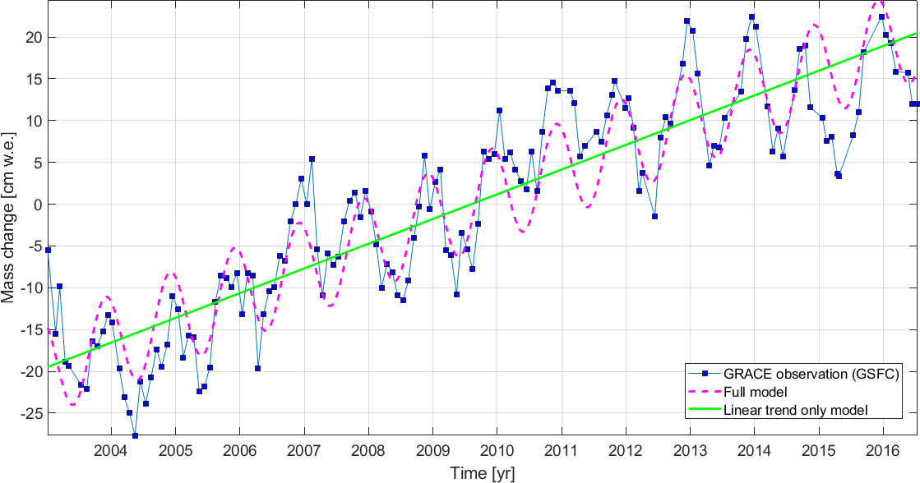
Looking at one of the mascons….
Monthly time series from GRACE/GRACE-FO
Temporal signatures: trend, sinusoids, instantaneous jump, (& residual)

Slide 5
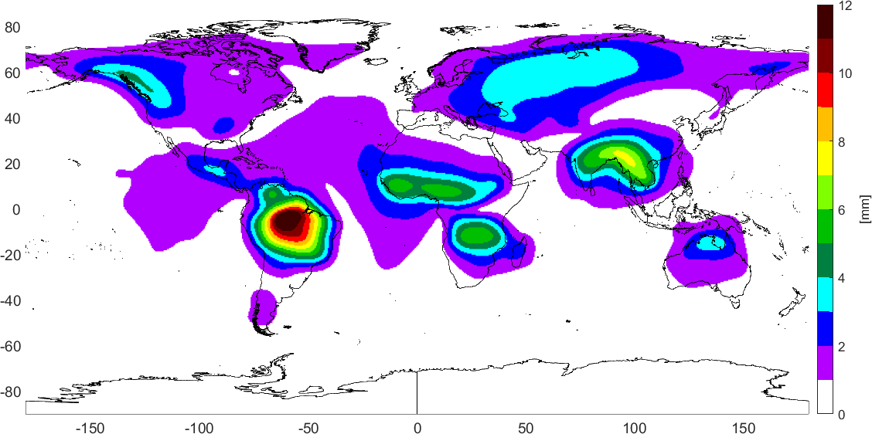
Annual Amplitude
Seasonal geoid model…
Amplitudes are only 4-5 mm in North America
Amazon River basin in South America has 10+ mm
Geoid change annual amplitude (mm) from GRACE
Notes:
Stress: Need a lot of mass change over large areas to get ‘significant’ geoid change

Slide 6
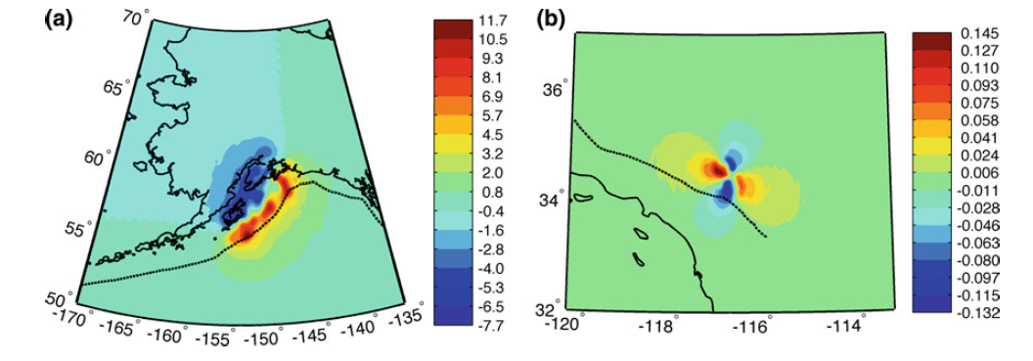
Episodic Events
Earthquakes, Volcanoes, Landslides…
Case by case
Possibly warrant a geodetic response
Very rarely occur at levels of significance
1992 Landers M7.3 Earthquake produced ~0.1 mm
1964 Alaska M9.2 had ~10 mm
Modeled geoid change in mm for (a) the 1964 Alaska earthquake and (b) the 1992 Landers earthquake. (from Jacob, et al., 2012)
Notes:
Stress: Need a lot of mass change over large areas to get ‘significant’ geoid change

Slide 7
GeMS Products:
Relationship to NSRS Modernization
The Old:
NAVD 88
PRVD 02
VIVD09
ASVD02
NMVD03
GUVD04
IGLD 85
IGSN71
GEOID12B
DEFLEC12B
The New:
The North American-Pacific Geopotential Datum of 2022 (NAPGD2022)
- Will include GEOID2022
DEFLEC2022
GRAV2022
DEM2022
IGLD 2020
Orthometric
Heights
Normal
Orthometric
Heights
Static Geoid Model (SGEOID2022)
Dynamic Geoid Model (DGEOID2022)
SDEFLEC2022
DDEFLEC2022
Dynamic
Heights
SGRAV022
DGRAV2022
Gravity
Geoid
Undulations
SDEM2022
DDEM2022
Deflections of
the Vertical
Notes:
Bold elements are provided by GeMS…

Slide 8
Final Takeaway:
xGEOID19 will likely contain DGEOID component from GeMS
kevin.ahlgren@noaa.gov

