Slide 1
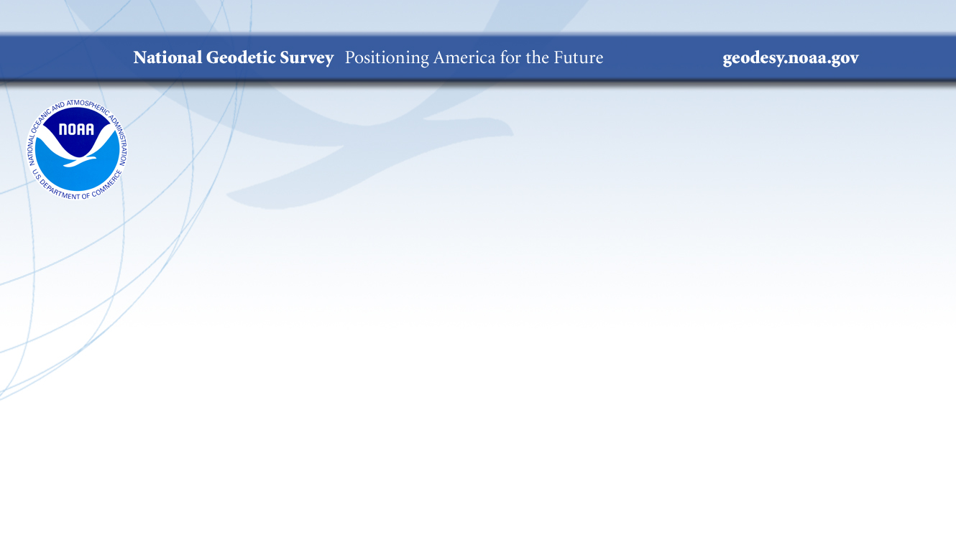
The NOAA Foundation CORS Network
Theresa Damiani, Ph.D.
Chief, Spatial Reference System Division
May 7, 2019 NGS Geospatial Summit

Slide 2

Outline
What are the Foundation CORS?
How are they different from other CORS?
Why do we need them?
(a.k.a. How the new NSRS is made)
What does NGS have underway?

Slide 3
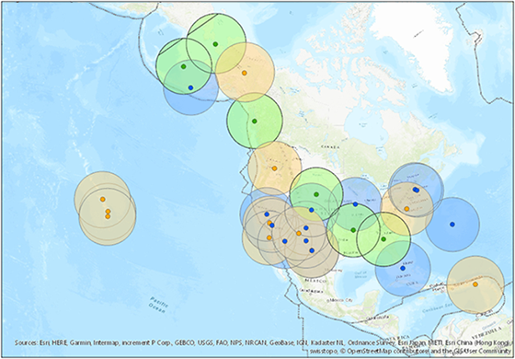
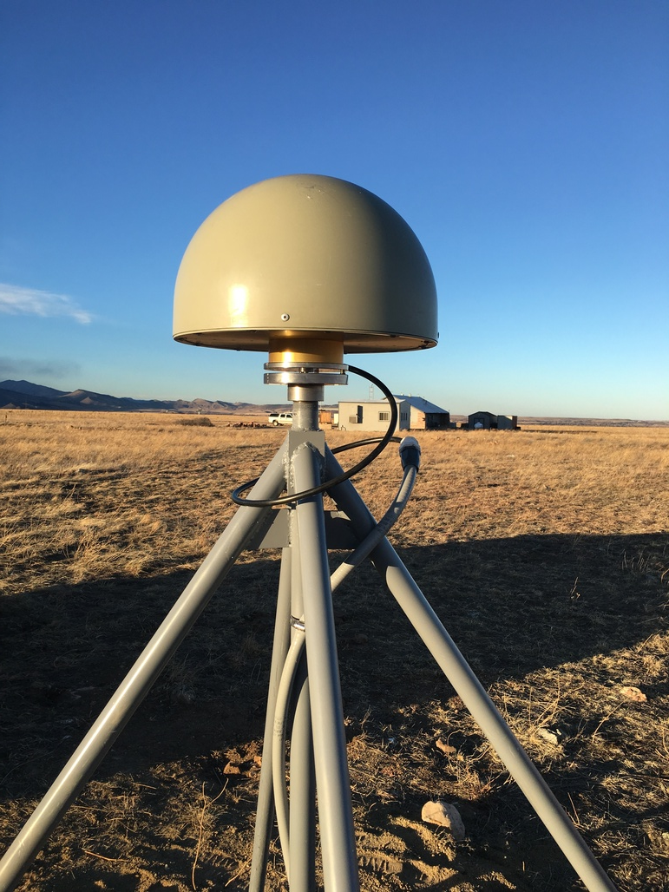
What are the Foundation CORS?
Federal Partners | Site ID | Location
National Science Foundation (NSF) Existing Sites Program: EarthScope Plate Boundary Observatory (PBO) | AB09 | Wales, AK
 | P777 | Dennard, AR
 | P804 | Georgia
 | AB51 | Petersburg, AK
 | ATQK | Atqasuk, AK
 | P043 | Wyoming
National Aeronautics and Space Administration (NASA) Existing Sites Program: Global GNSS Network (GGN), operated by Jet Propulsion Laboratory | CRO1 | Saint Croix, VI*
 | BREW | Brewster, WA*
 | FAIR | Fairbanks, AK
 | GODE | Greenbelt, MD*
 | GOL2? | Goldstone, CA*
 | MDO1 | McDonald Observatory, Texas*
 | MONP | Mount Laguna, CA*
 | PIE1 | Pie Town, NM*
 | GUAM | GUAM
 | KOKB | Kauai, HI*
 | MKEA | Mauna Kea, HI*
 | HAL1 | Haleakala, HI*
NOAA- National Geodetic Survey (NGS) Existing and New Sites Program: Continuously Operating Reference Stations (CORS) | ASPA | American Samoa
 | CNMR | Saipan, TQ
 | GUUG | GUAM*
 | BRSG | Bermuda
 | FLF1 | Richmond, FL*
 | WES2 | Westford, MA*
 | TMG2 | Boulder, CO
 | NEW | Apache Point, NM*
 | NEW | Fort Davis, TX*
 | NEW | Fort Irwin, CA*
 | NEW | Hancock, NH*
 | NEW | Los Alamos, NM*
 | NEW | Kitt Peak, AZ*
 | NEW | Owens Valley, CA*
 | NEW | Cold Bay, AK*
 | NEW | North Liberty, IA*
TBD | TBD | Existing location in Caribbean
 | TBD | Existing location in Caribbean
A set of federally-operated, ultra-high-quality, high-reliability stations with the longevity to guarantee citizens access to official NSRS positions and support international positioning consistency efforts.
26 in North America, 4 in the Pacific, 3 in the Caribbean, and 3 in the Marianas.

Slide 4
How are they different from other CORS?
Federally-owned and operated “backbone”
Chosen for location, longevity, and high quality
Operational Goals:
  Non-operational time minimized for each station
  90% of NOAA Foundation CORS Network available
  at any time (no more than 4 stations non-operational)
All stations are critical to some function of the new NSRS
22 out of 36 stations are (currently or will be) co-located with other space geodetic stations supporting the IGS/ITRF
Local tie surveys (“IERS site survey”) will link together all geodetic instruments/marks at the site every 5 years.

Slide 5
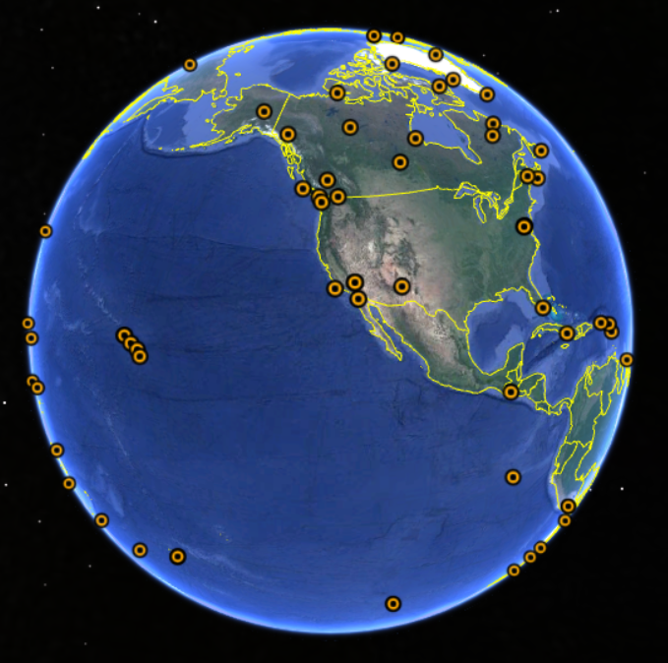
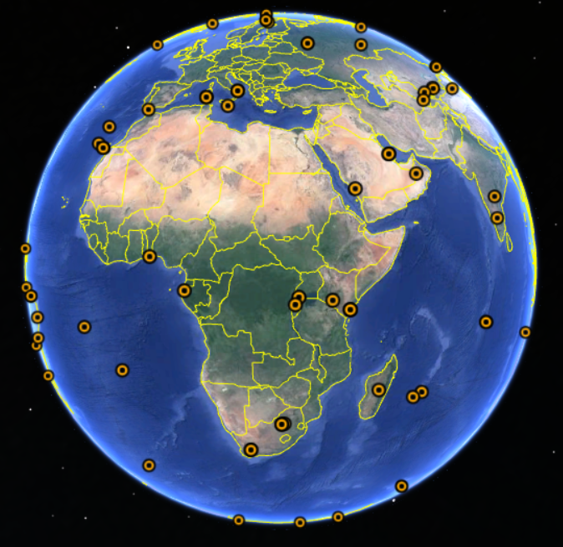

Why do we need them? A.k.a. How will the new NSRS be made?
“The new *TRFs will be plate-fixed and aligned to the IGS densification of the ITRF.”
WHAT DOES THAT MEAN???
A reference frame starts with defining the planet’s size and shape.
This allows exact values of latitude, longitude, and height to be assigned to places.
An international science service does this, relying on data contributed from agencies all over the globe and from several space geodetic instruments, including GNSS.
International GNSS Stations (IGS) included in ITRF 2014

Slide 6
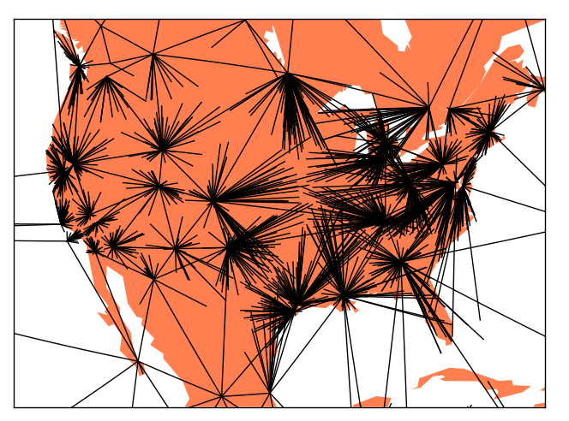
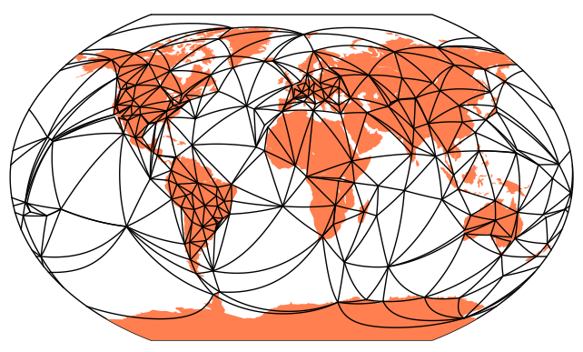
How will the new NSRS be made?
The IGS uses the ITRF stations as “known” locations and calculates/aligns additional IGS stations to those ITRF stations-- a process called “densification”.
NGS uses the IGS stations (some are CORS) as “known” and aligns all the NOAA CORS to them*.
And so on… other federal, state, local, and private GNSS networks align to the NOAA CORS…

Slide 7
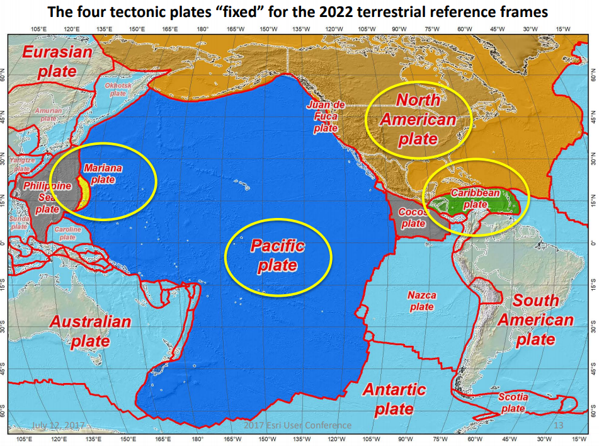
How will the new NSRS be made?
The ITRF is designed to be global and does not account for tectonic plate motions.
The NSRS needs to model and remove those motions to provide locations useful for surveying.
North America and Pacific are well-represented.
Need a minimum of 3 stations per plate, far apart if possible.

Slide 8
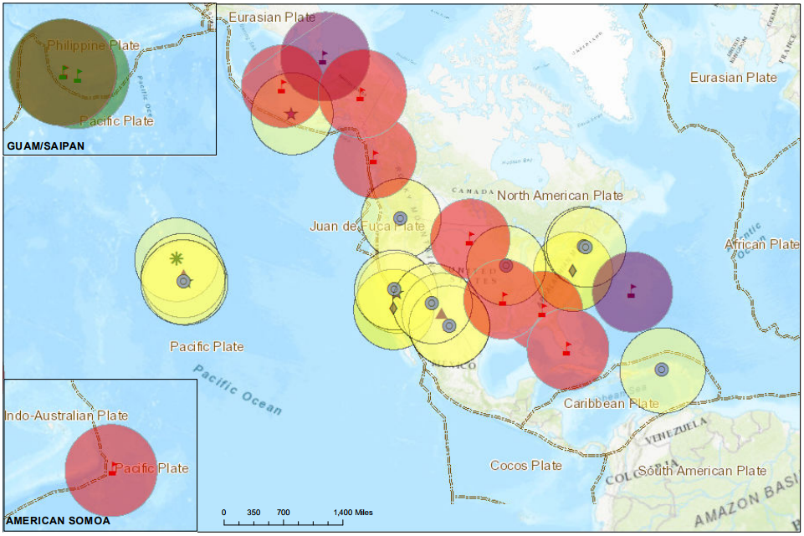
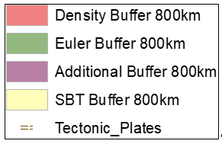
Why do we need Foundation CORS?
The Foundation CORS targeted locations provide:
A geographic distribution no greater than 800 km to provide 1.5 cm accuracy ellipsoidal height results through NGS’ OPUS tools anywhere in the U.S.
Support for the ITRF by co-locating at existing space-based geodetic sites.
Favorable geometry to monitor tectonic plate (Euler Pole) rotation.
Gap Filling in international areas where foundational stations are needed to support the U.S. NSRS, e.g. Caribbean
Notes:
CORS is a method-agnostic term, but common useage applies it to GPS/GNSS stations.

Slide 9
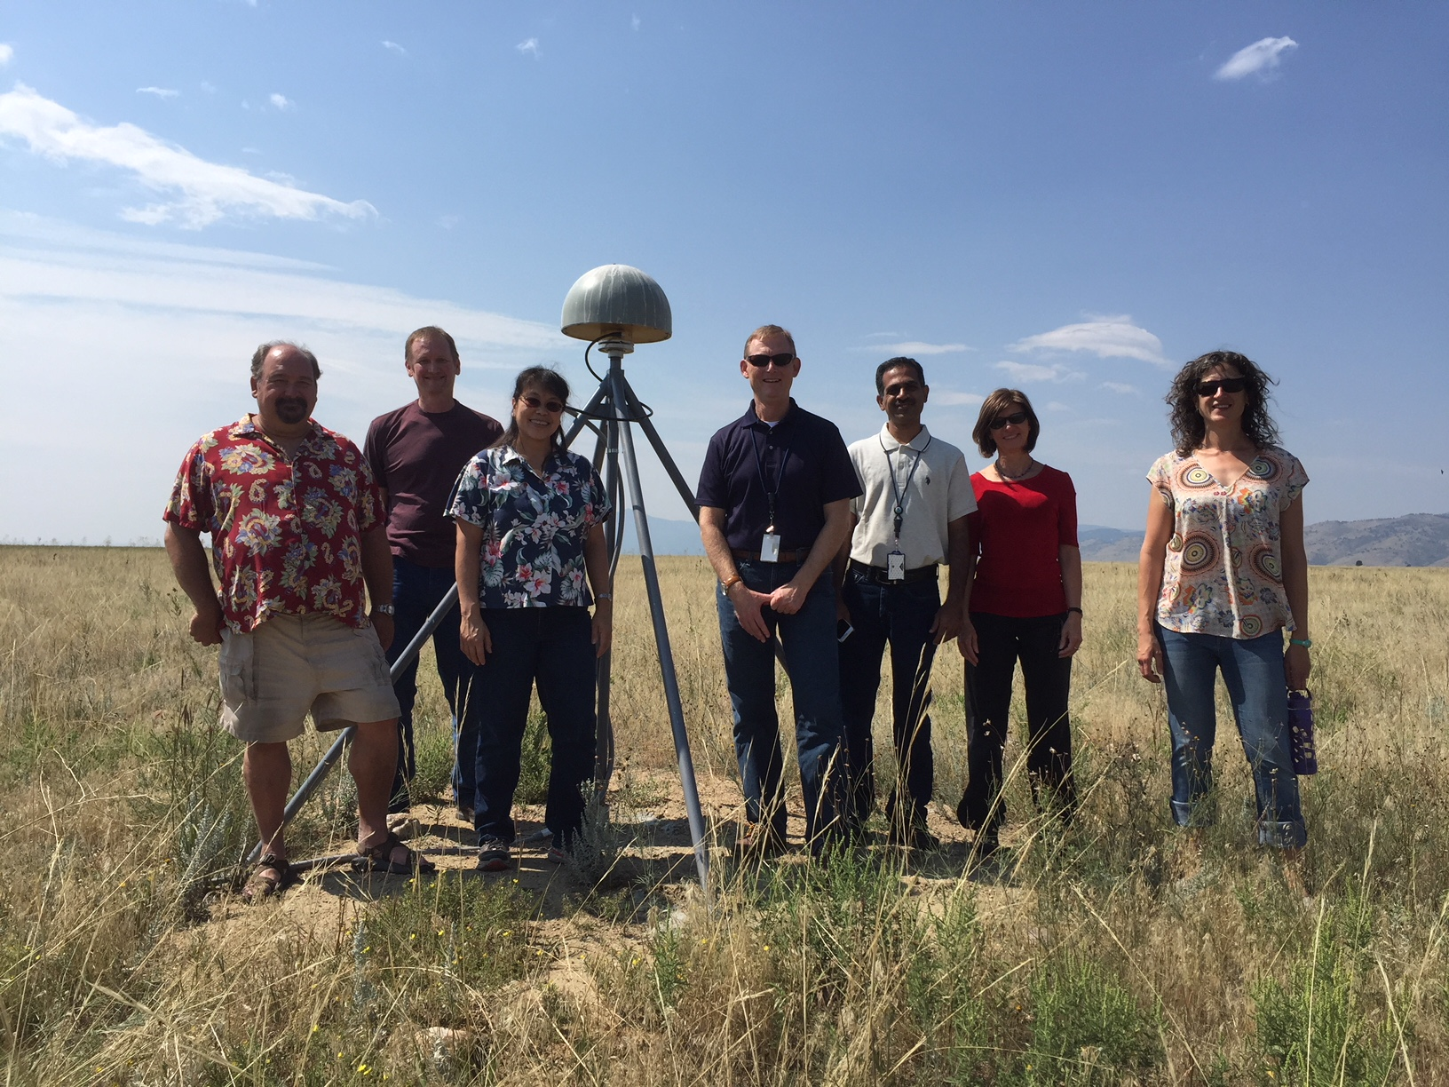
Foundation CORS Development Underway
Phase 1: Incorporate partner stations
Existing NASA, NSF, and Caribbean partner stations brought into the Foundation CORS network.
Phase 2: Upgrade existing NGS CORS
Upgrades include fully-GNSS equipment and submission to IGS to meet Foundation CORS requirements
Phase 3: Construct ~8 new stations
These NGS-owned stations will all be co-located at sites with other existing space geodetic techniques.
Foundation CORS at NGS’ Table Mountain Geophysical Observatory in Boulder, CO (ID: TMG2)
Notes:
CORS is a method-agnostic term, but common useage applies it to GPS/GNSS stations.

