Slide 1
Evaluating Noise in GNSS Time Series
Jordan Krcmaric (jordan.krcmaric@noaa.gov)
NOAA National Geodetic Survey
June 13, 2024

Slide 2
Outline
Background
The importance of evaluating noise in GNSS time series
Types of noise in GNSS time series
Sources of noise
Estimating noise amplitudes
Results from a noise analysis of stations around the Great Lakes
How surface mass loading affects noise properties
Noise in different monument types

Slide 3
Background

Slide 4
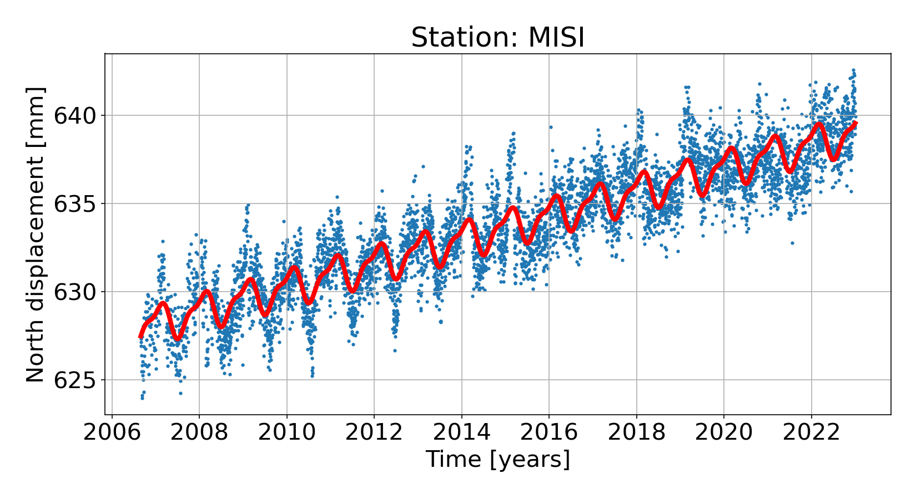
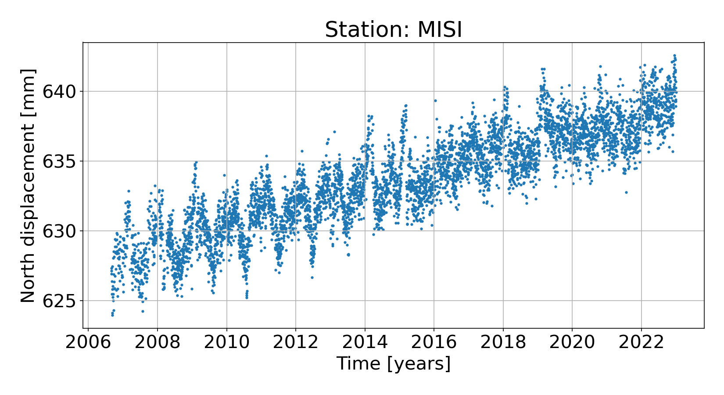
Motivation
Station velocities are used for:
Studying crustal deformation and movement of tectonic plates
Defining stable reference frames
Tracking sea level rise
Now possible to image sub-millimeter velocities
But, we need realistic velocity uncertainties that take into account temporal correlations in the noise

Slide 5
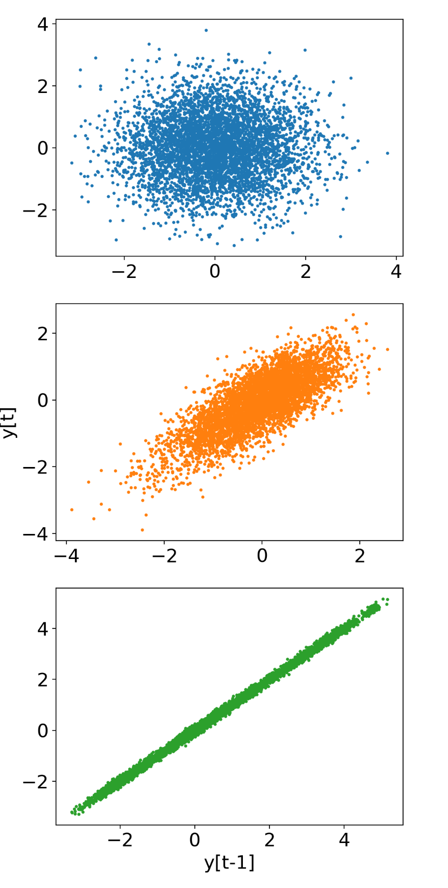
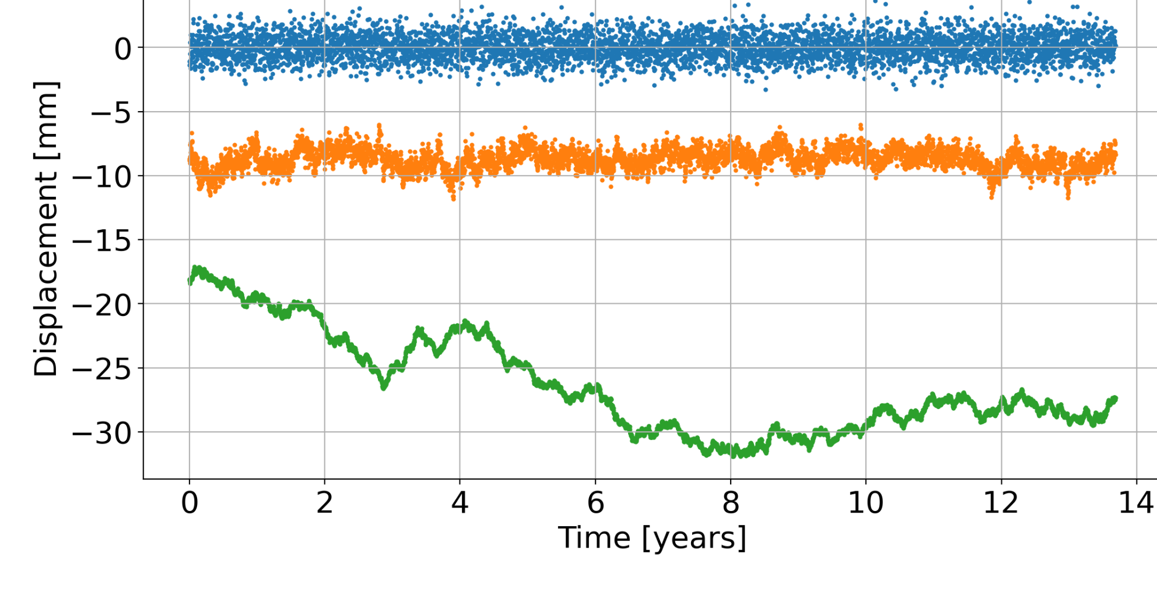
Noise in GNSS time series
Time Correlation
white noise
flicker noise
random walk
*Other common noise processes: Gauss-Markov, bandpass

Slide 6
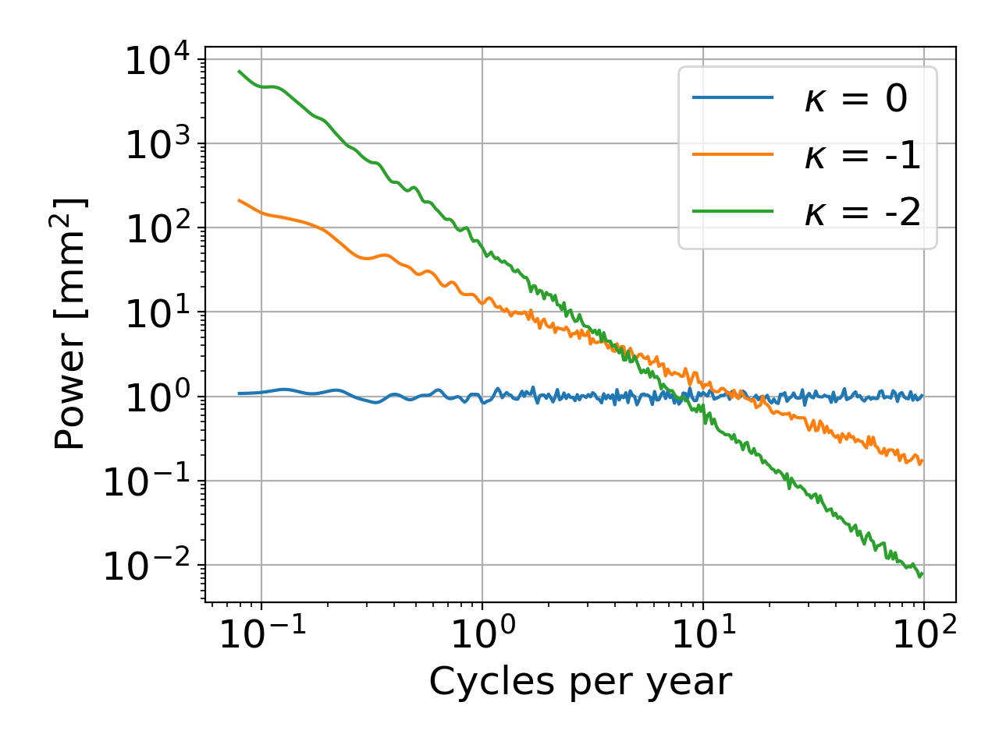
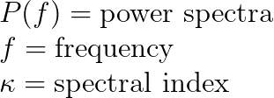
Noise in GNSS time series
Noise in GNSS time series is often modeled as a power-law process that describes its frequency dependence:
White noise, spectral index = 0
Flicker noise, spectral index = -1
Random walk, spectral index = -2

Slide 7
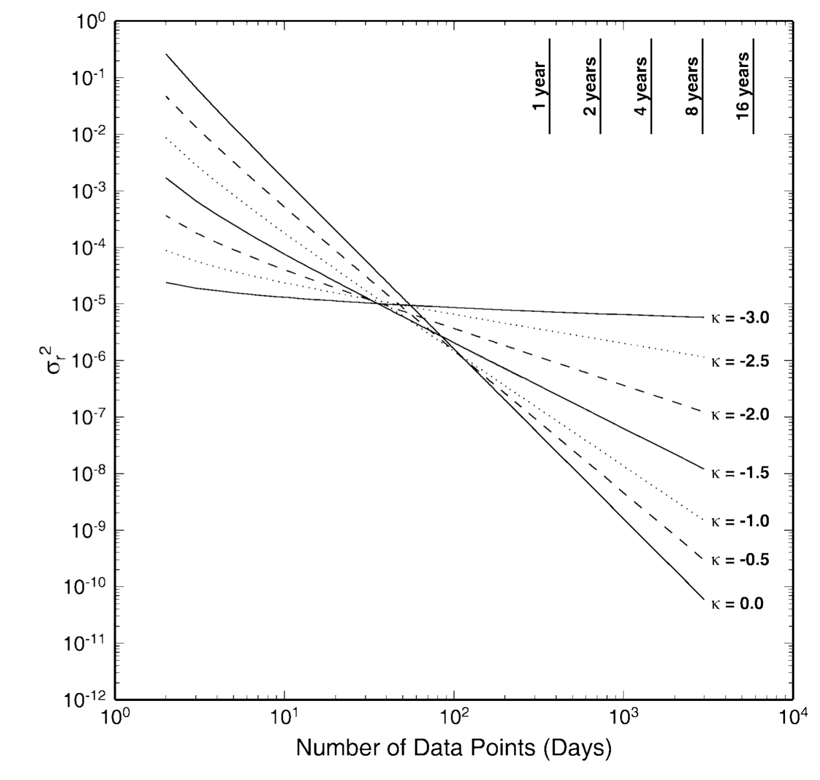
Noise in GNSS time series
White noise has most effect on velocity uncertainty of short time series, but effect decreases rapidly with more observations
Low spectral index noise (e.g. random walk) has a larger effect on velocity uncertainties of long running time series
From Williams, 2003

Slide 8
Sources of noise in GNSS time series
Instrument and processing errors:
Multipath, receiver noise, equipment failures and changes
Orbit models, atmospheric models, clocks, etc.
Surface mass loading:
Atmospheric loading (atmospheric tides, pressure systems)
Ocean loading (tides, storm surges)
Hydrological loading (soil moisture, snowpack, groundwater, lake storage)
Monument instability

Slide 9
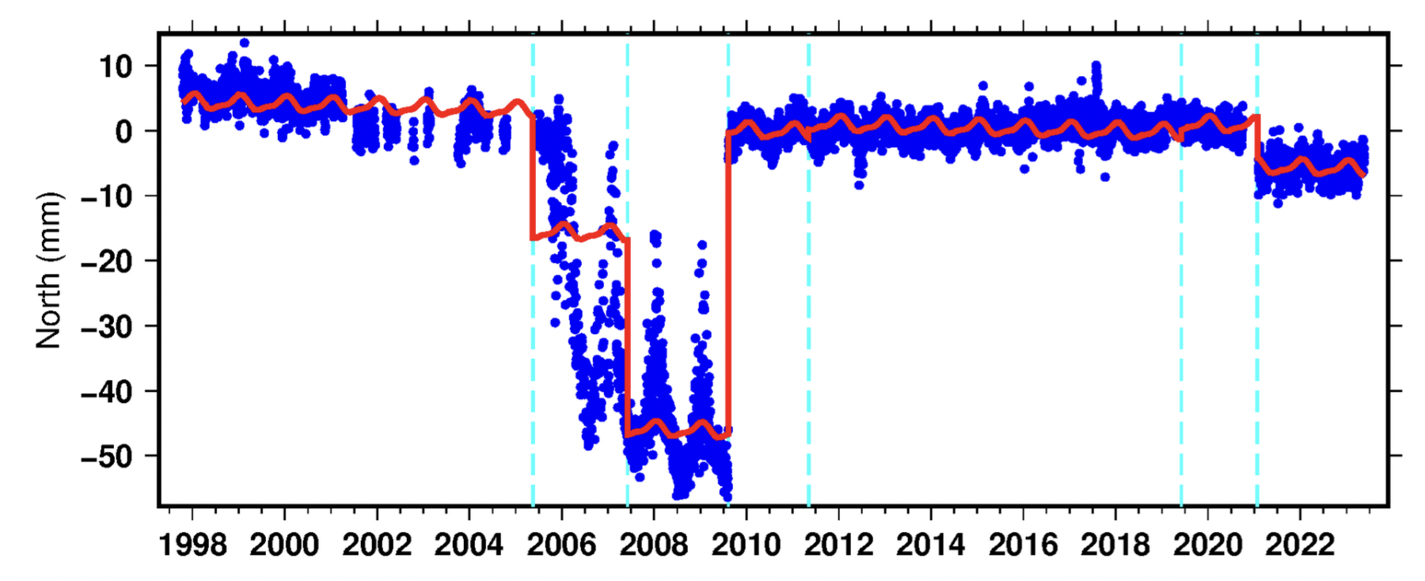
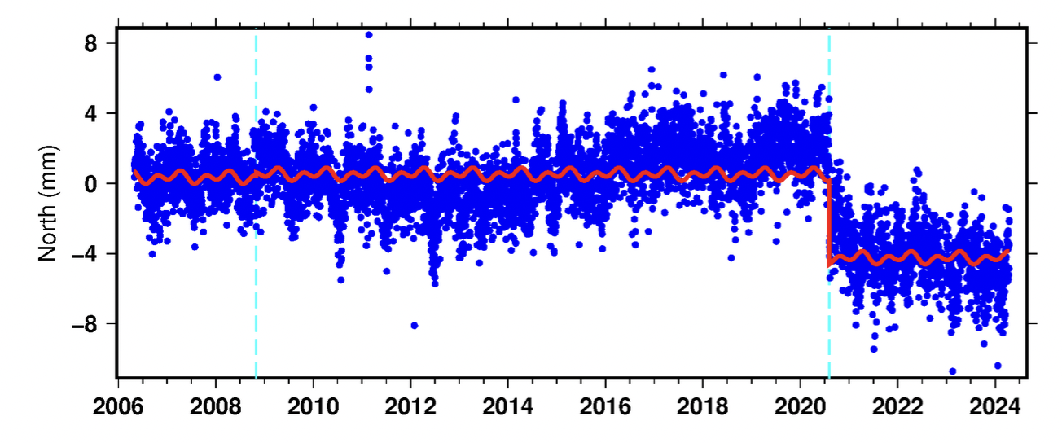
Instrument Errors:
Failing antenna
RLAP
Equipment change
MIPW

Slide 10
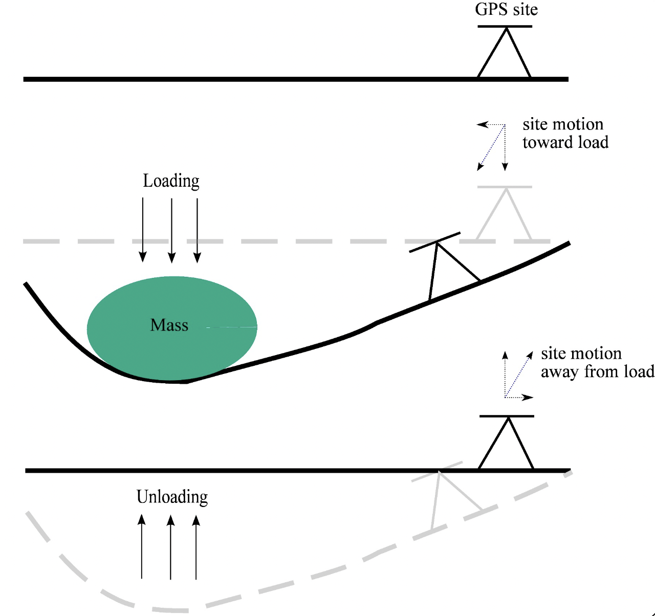
Surface mass loading
Illustration from van Dam, 2017

Slide 11
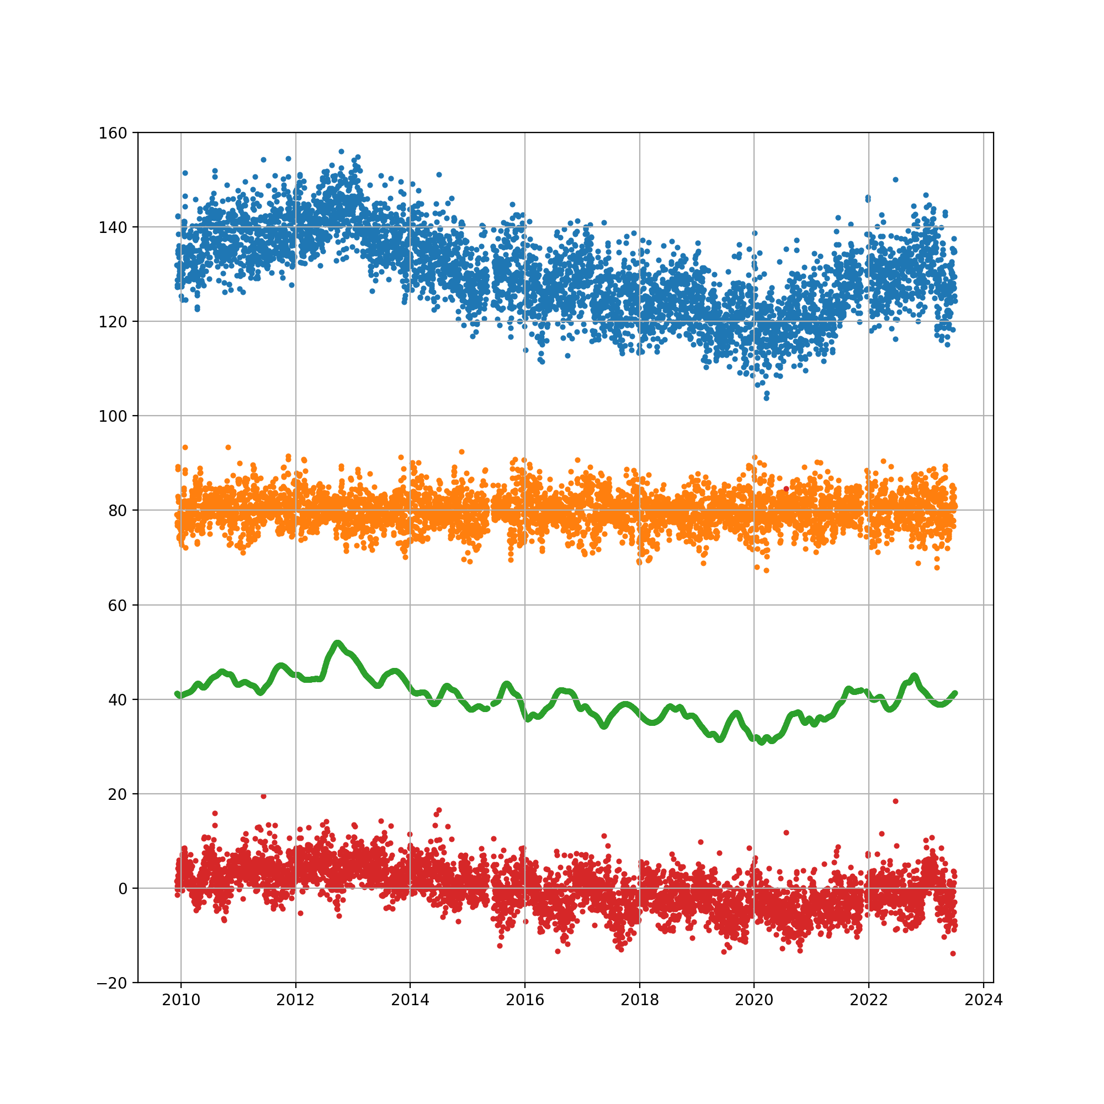
Surface mass loading
MIQE - Vertical Component Time Series
Raw daily time series
Non-tidal atmospheric loading (NTAL)
hydrologic loading (GRACE)
Raw - NTAL - GRACE

Slide 12
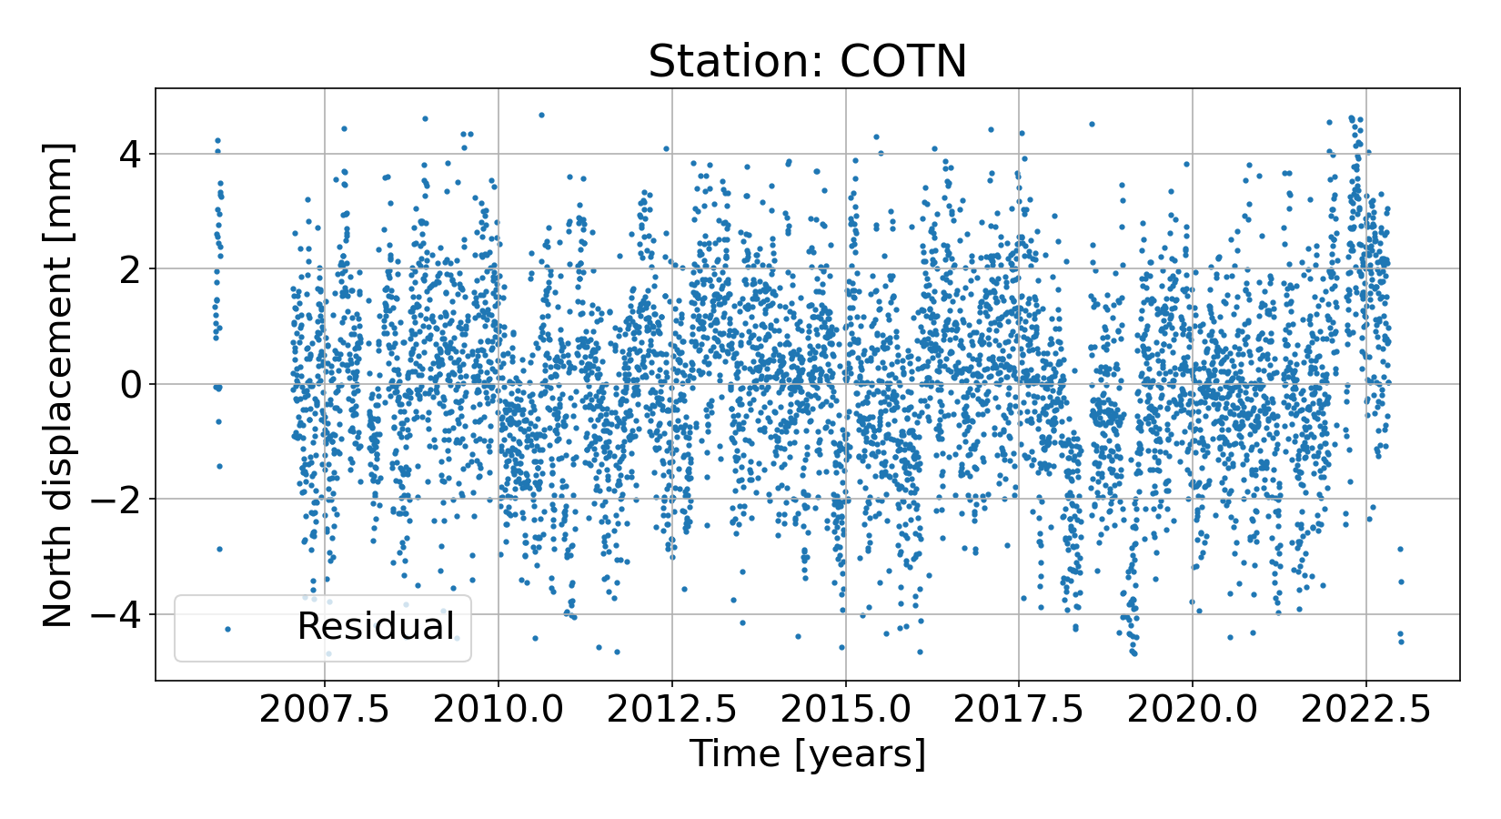
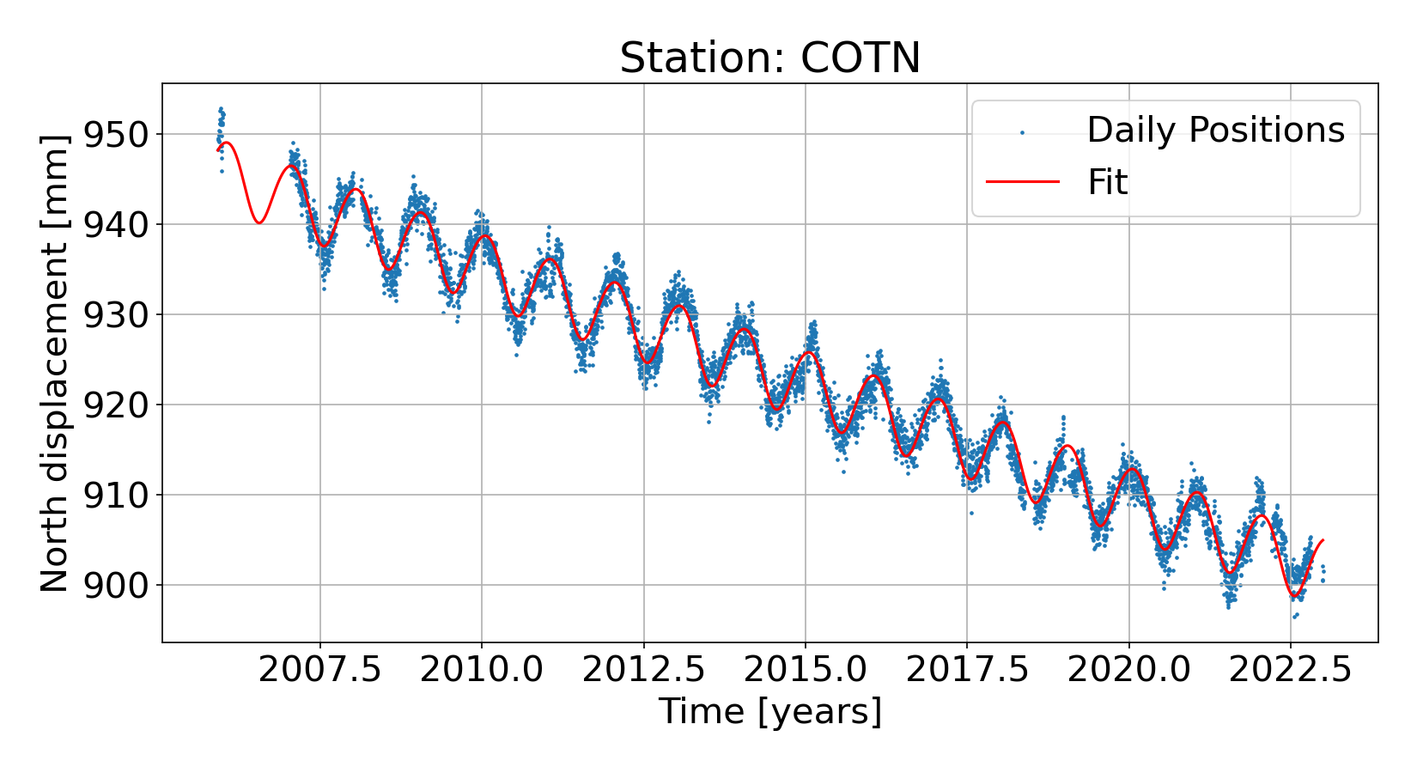
Estimating noise amplitudes
least squares fit

Slide 13
Estimating noise amplitudes
Stochastic model*:
Noise amplitudes can be estimated from the residual time series, many methods for doing this (I use LS-VCE)
*There are other choices for a stochastic model, e.g. WN+PL, Bandpass, WN+GGM etc. Choice of model will influence velocity uncertainty estimation

Slide 14
Results from a noise analysis of stations around the Great Lakes

Slide 15
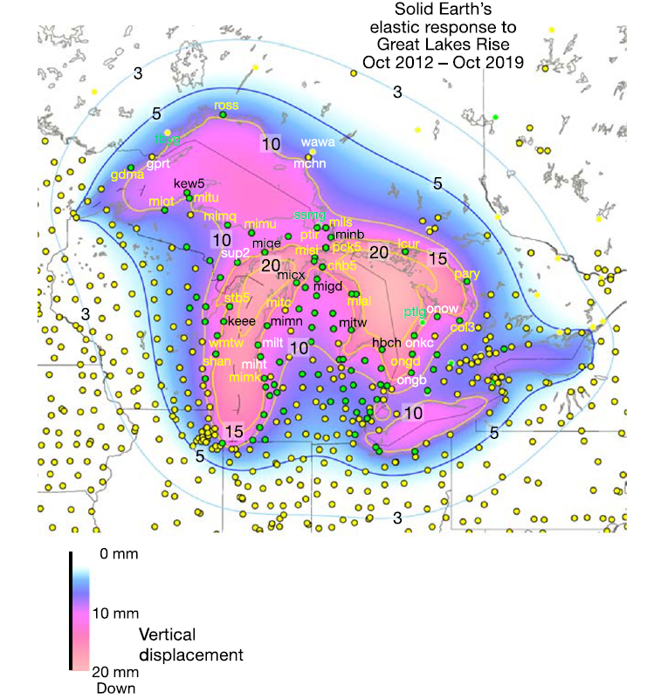
The Great Lakes region
Covered by a dense network of GNSS stations
Oscillations in climate and hydrological cycle drive changes in the water levels
Changes in water storage captured in the displacements of GNSS stations, as much as 20 mm from 2012-2019
From Argus et al., 2020

Slide 16
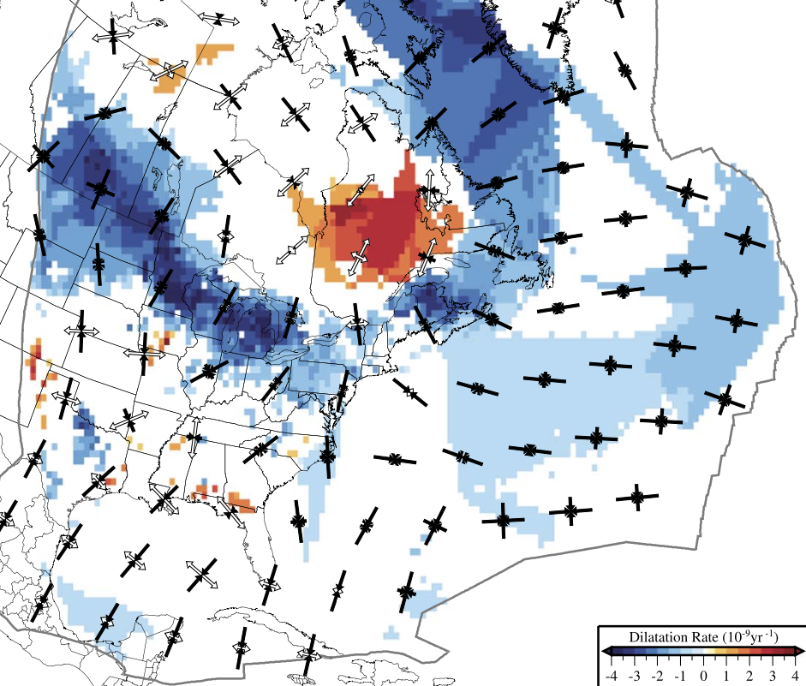
The Great Lakes region
Long term deformation controlled by glacial isostatic adjustment (GIA) from the unloading of Laurentide ice sheet ~ 20,000 years ago
Hydrologic loading from the Great Lakes could obscure GIA related deformation
From Kreemer et al., 2018

Slide 17
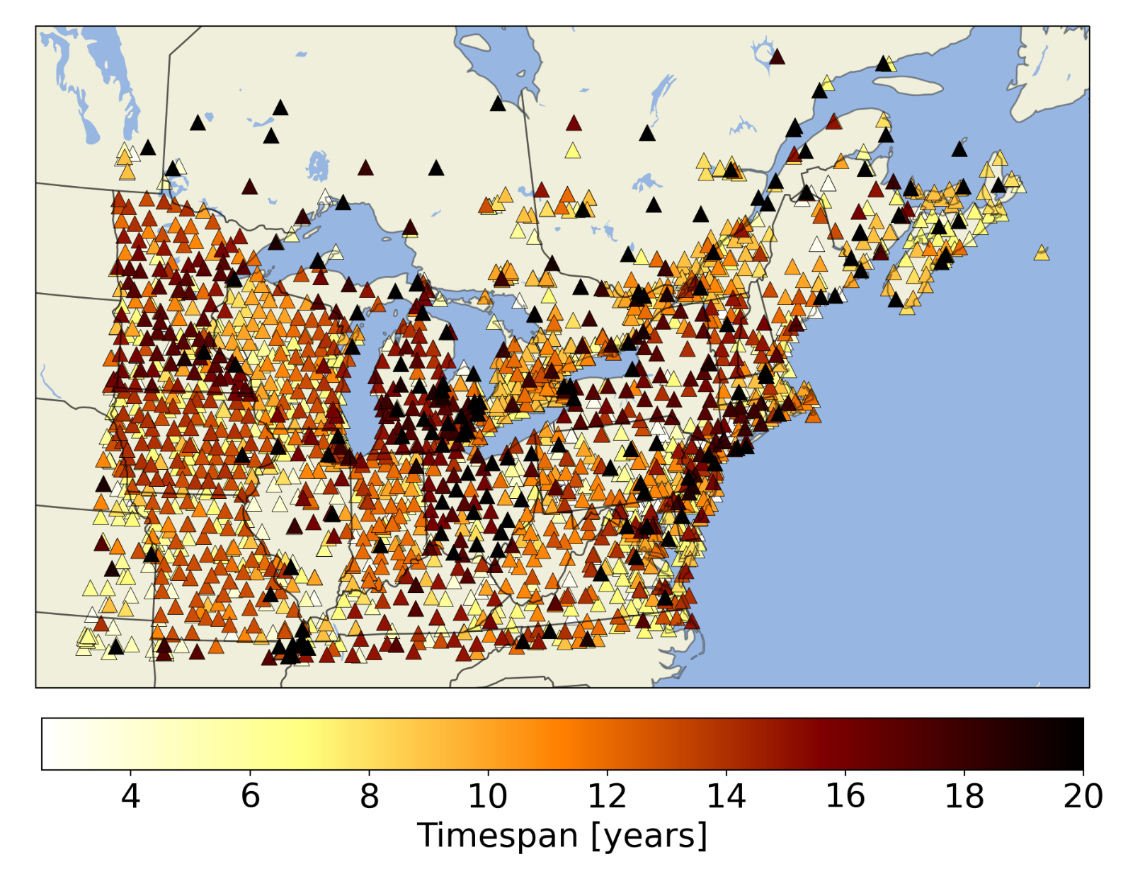
Data
Daily position time series from 2,481 stations processed by the Nevada Geodetic Laboratory (PPP, GPS only)
Time period: 2005 - 2023
Only time series spanning greater than 2.5 years
Median time span is ~9.3 years

Slide 18
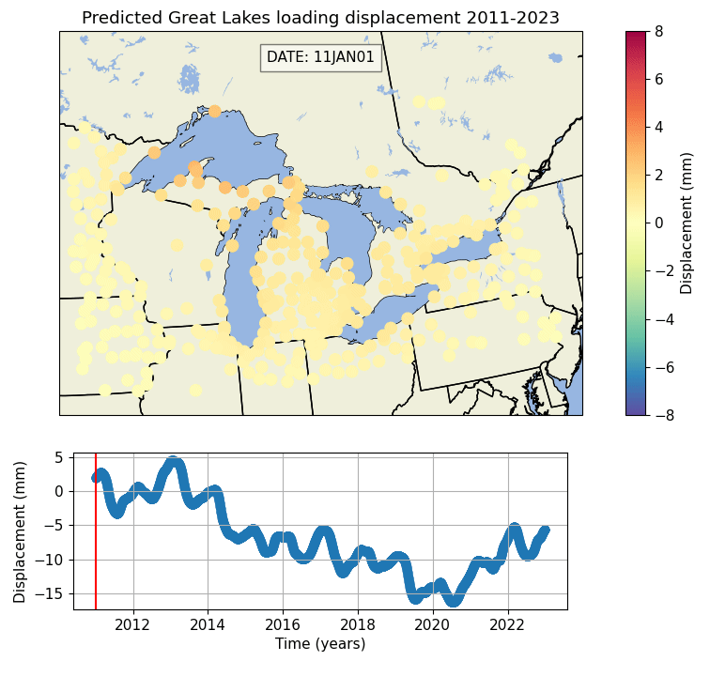
Surface mass loading models
Non-tidal* atmospheric loading (NTAL) and Non-tidal ocean loading (NTOL) from the Earth Systems Modelling Group at GFZ.
Gravity Recovery and Climate Experiment (GRACE) “mascon” based hydrological loading model
Model of elastic deformation from water storage changes in the Great Lakes (LAKE)
*Deformations from ocean, atmosphere and solid earth tides corrected during the GNSS processing step

Slide 19
Questions
What are the primary drivers of variation in GNSS time series around the Great Lakes region?
How do noise amplitudes and velocity uncertainties change when surface mass loading is removed?
How does monument type influence the noise properties of GNSS time series?

Slide 20
What are the primary drivers of variation in GNSS time series around the Great Lakes region?

Slide 21
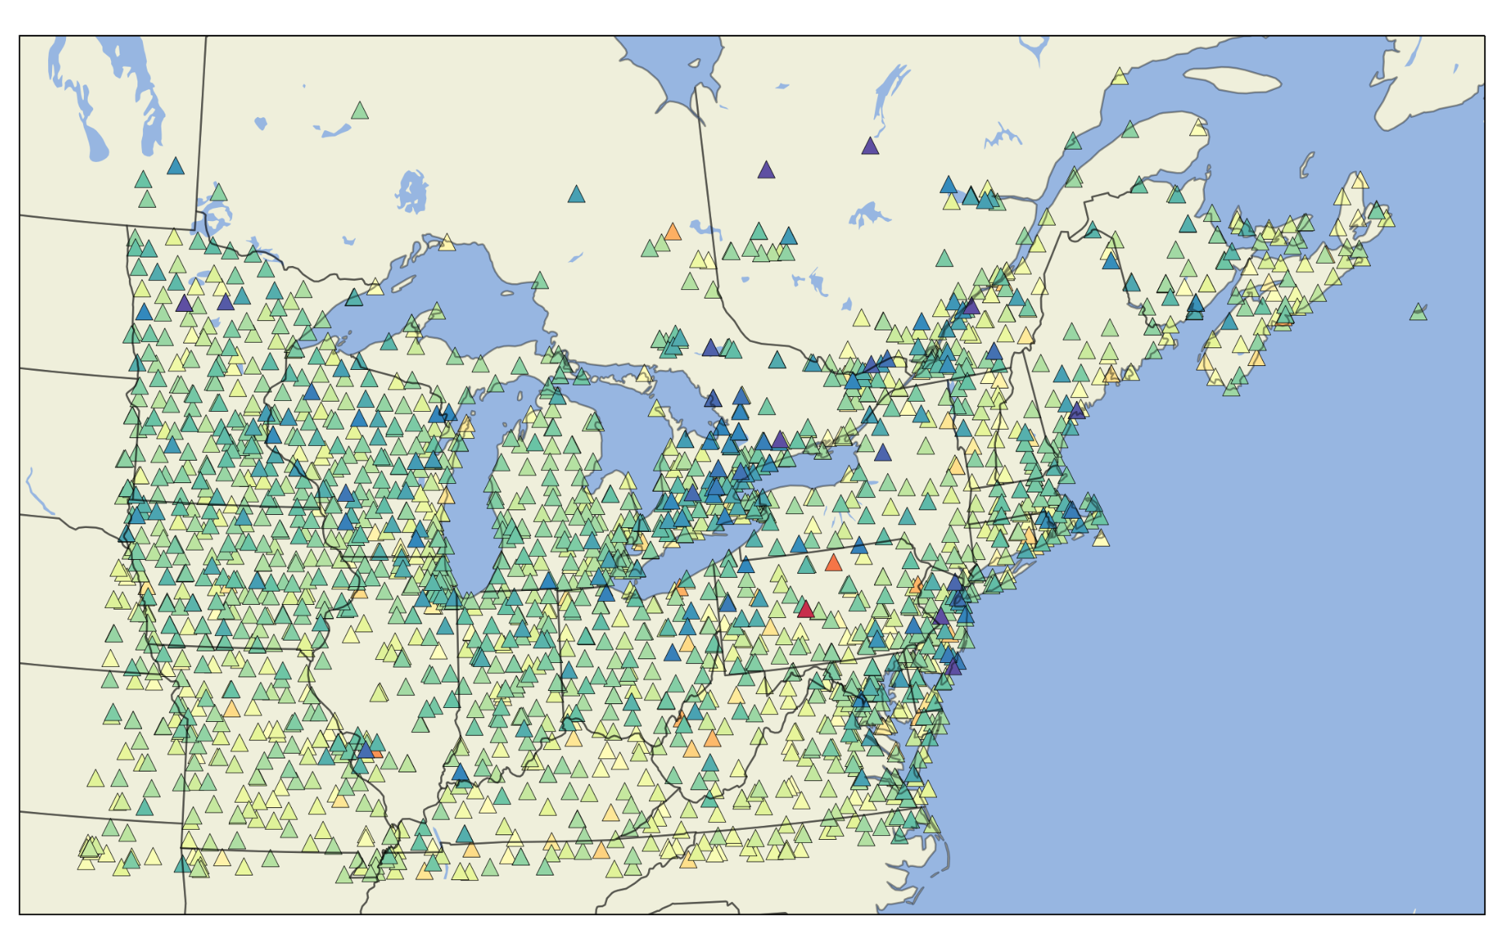
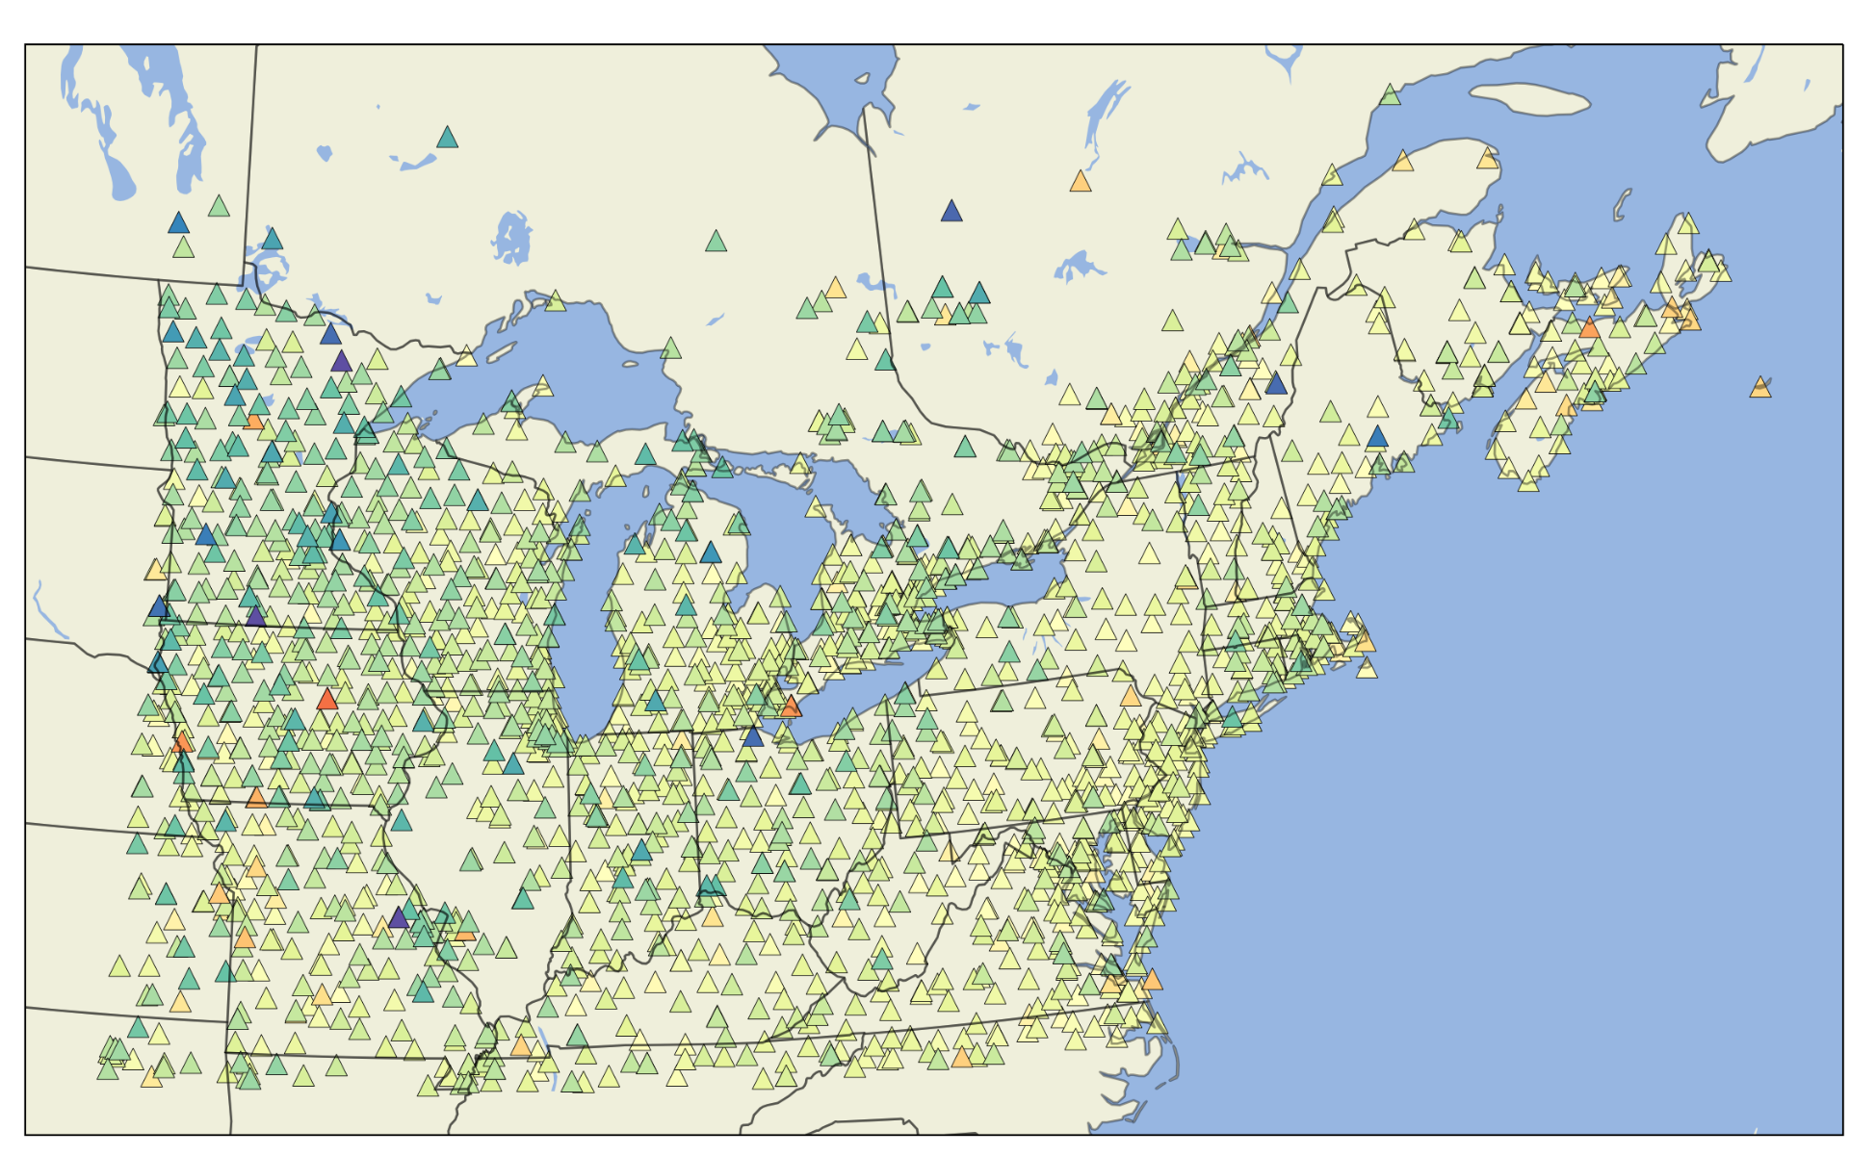
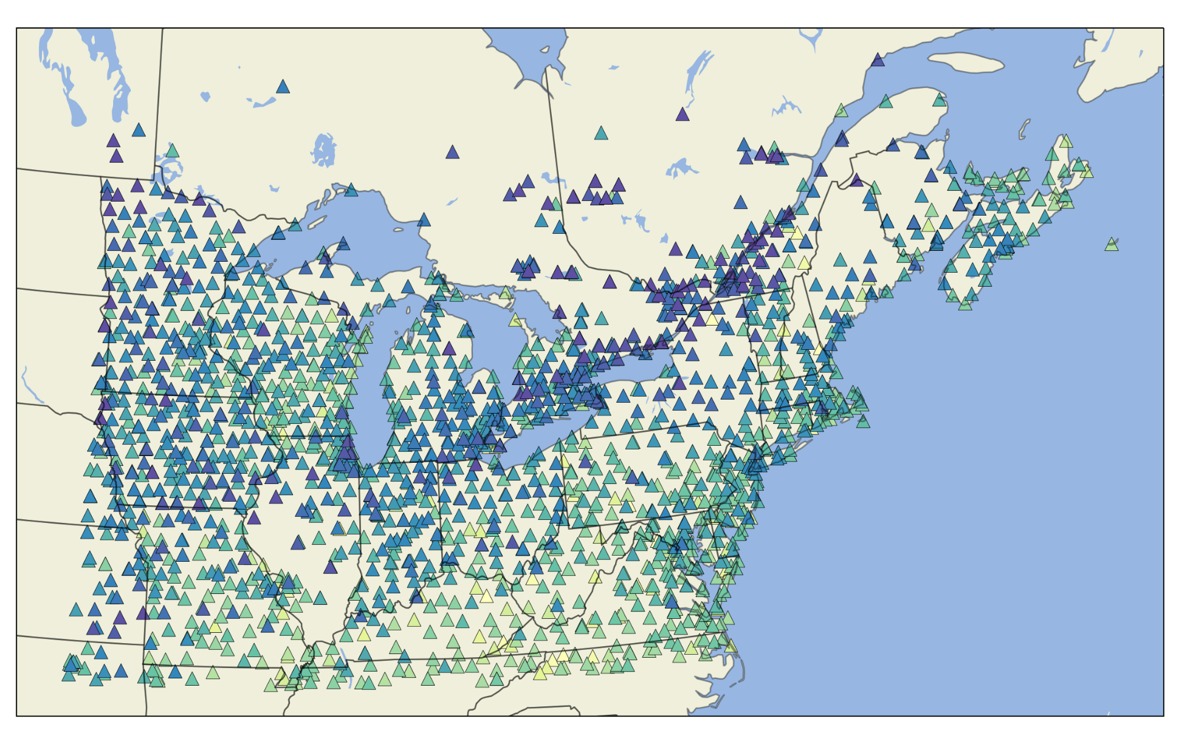
Atmospheric and Ocean Loading
East
North
Up
NTAOL
7.3%
4.6%
33.3%
NTAOL = NTAL + NTOL

Slide 22
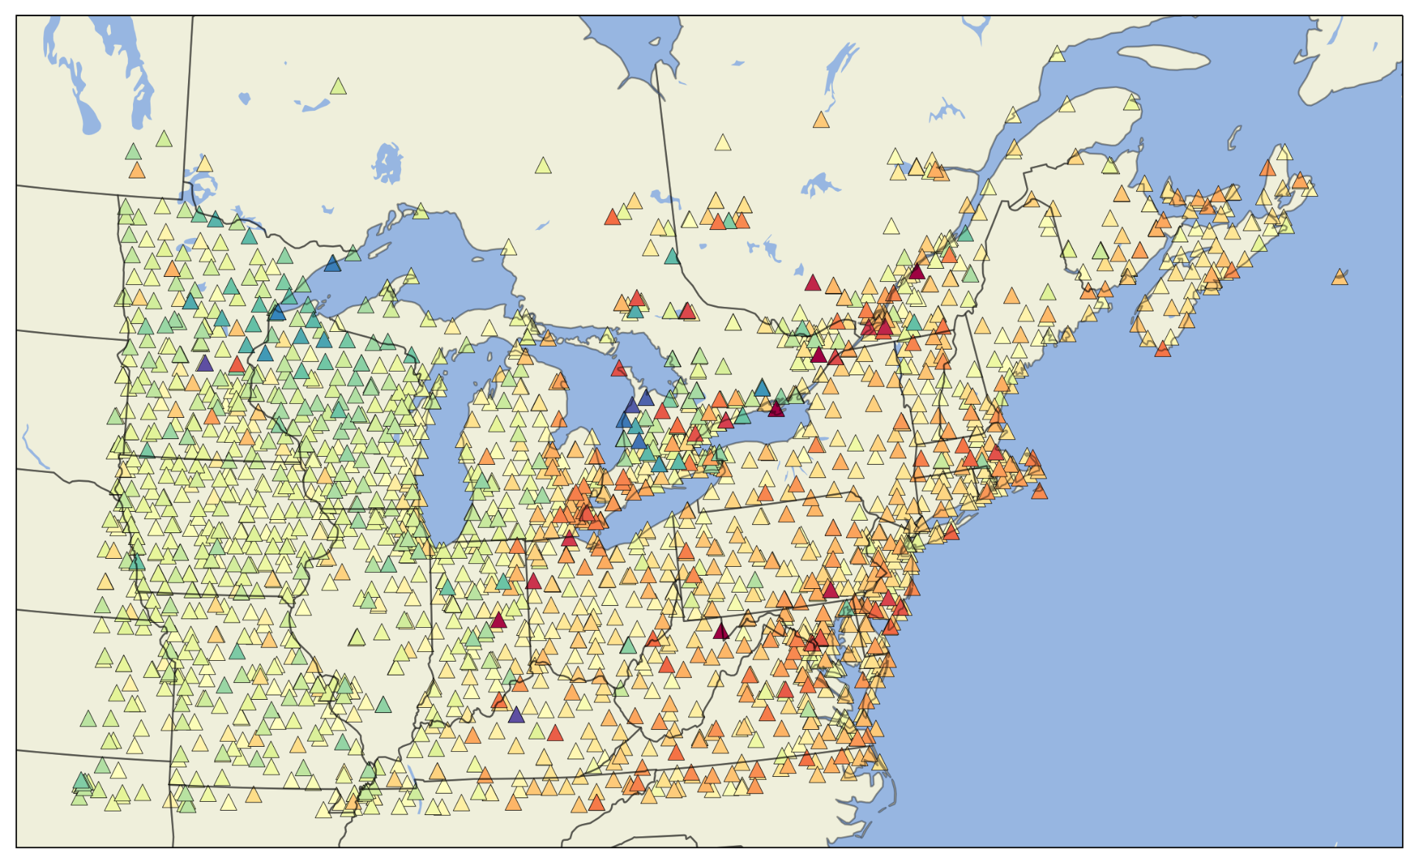
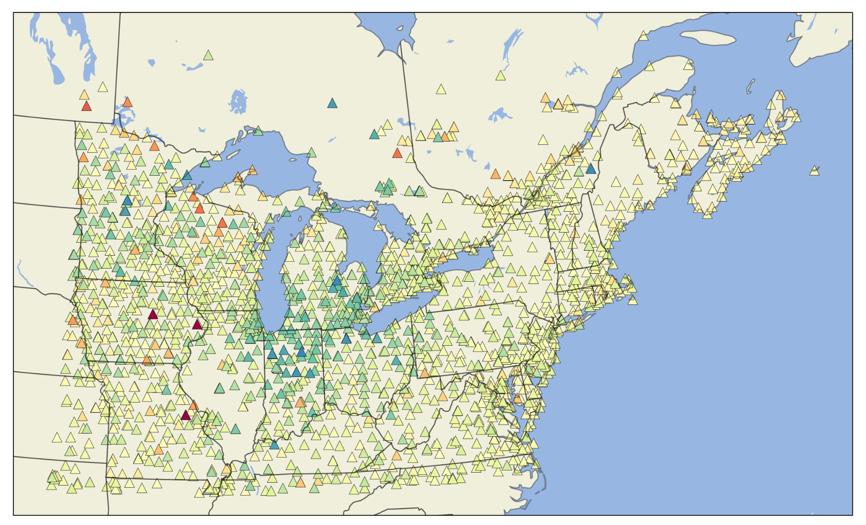
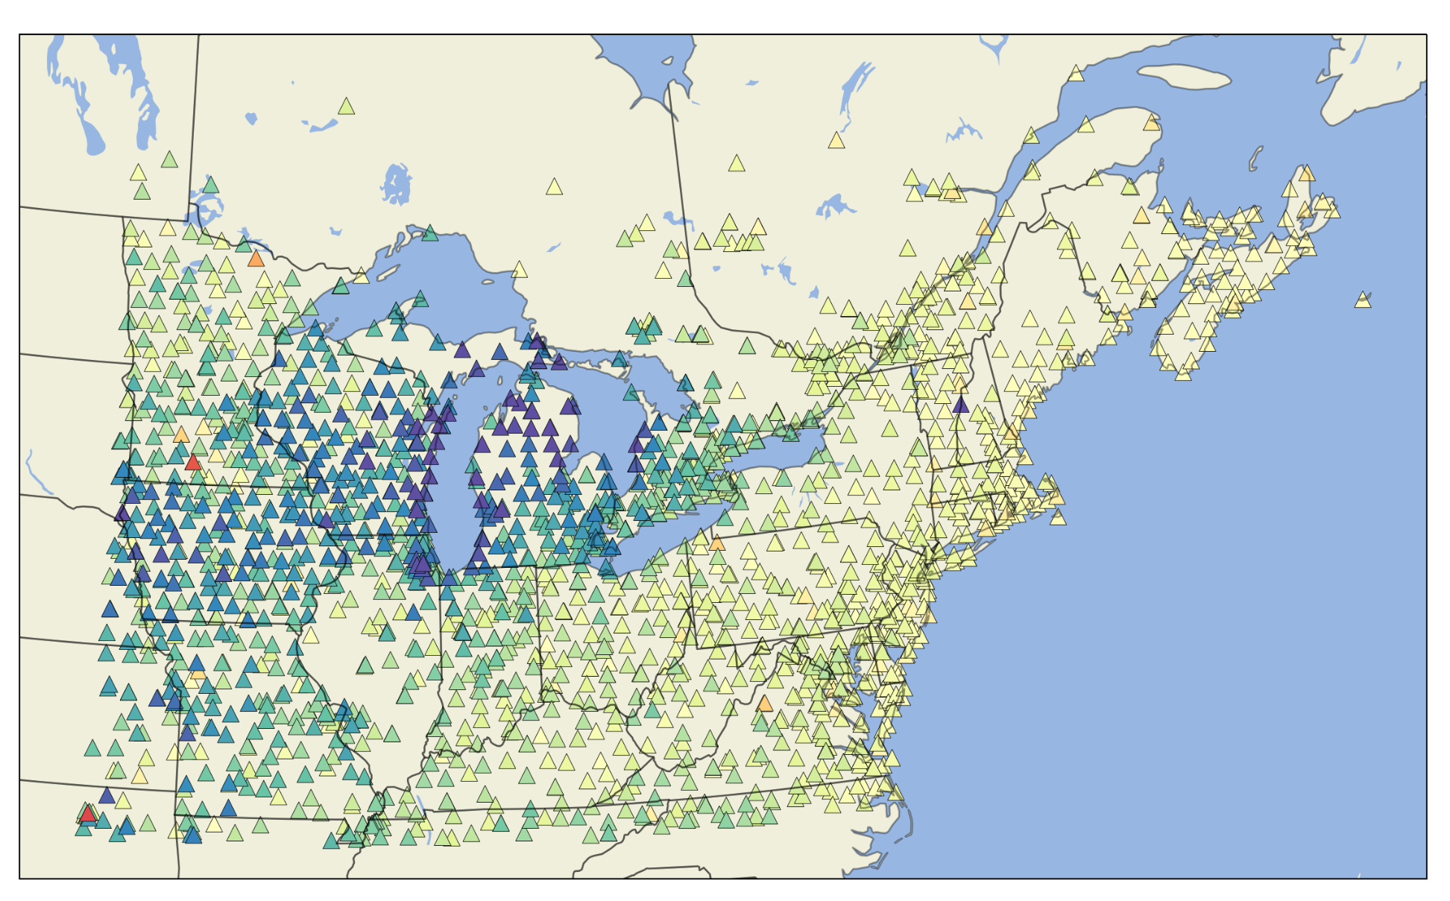
Hydrologic Loading
East
North
Up
GRACE
-0.3%
2.4%
17.2%
LAKE
1.0%
1.4%
8.0%

Slide 23
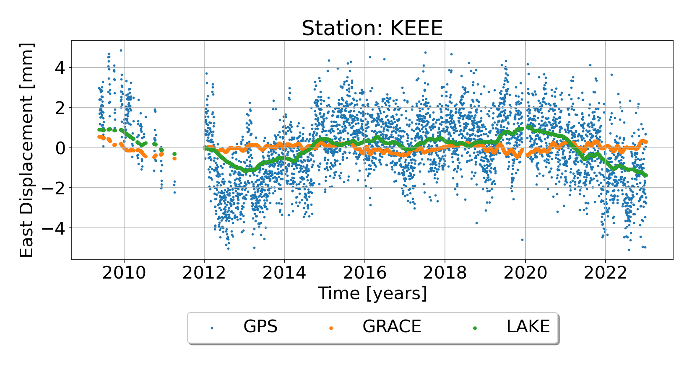
GRACE versus LAKE horizontal displacements

Slide 24
What are the primary drivers of variation in GNSS time series around the Great Lakes region?
A third of the variance in vertical time series can be attributed to NTAOL deformations
Hydrologic loading explains an additional 17.2% of vertical time series variance, with greatest reductions in variance around the Great Lakes and Midwest region (e.g. Iowa, Missouri)
GRACE loading model explains very little variance in the horizontal components of GNSS stations, LAKE does a better job at explaining horizontal variance at some stations close to the Great Lakes

Slide 25
How do noise amplitudes and velocity uncertainties change when surface mass loading is removed?

Slide 26
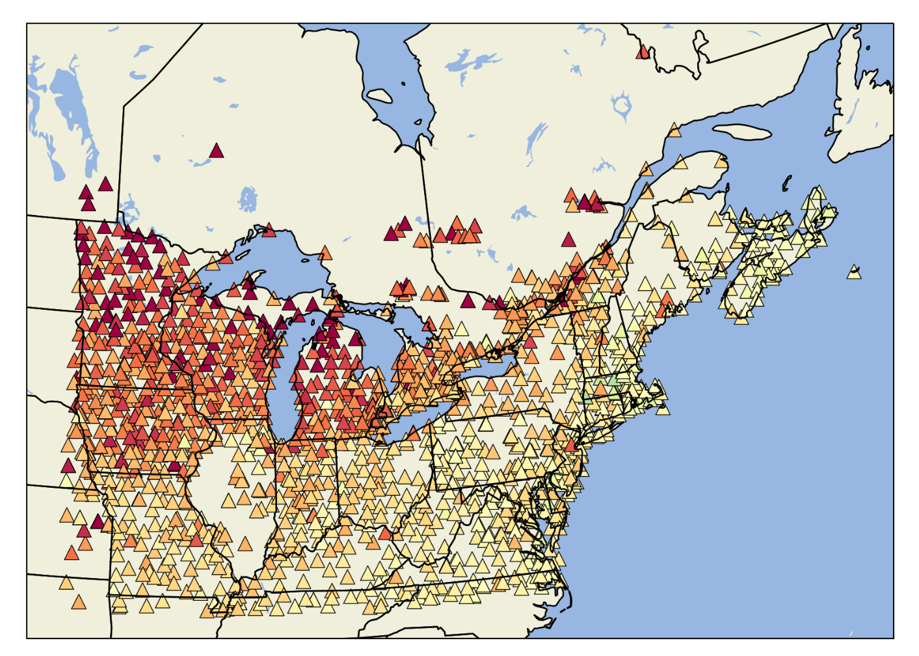
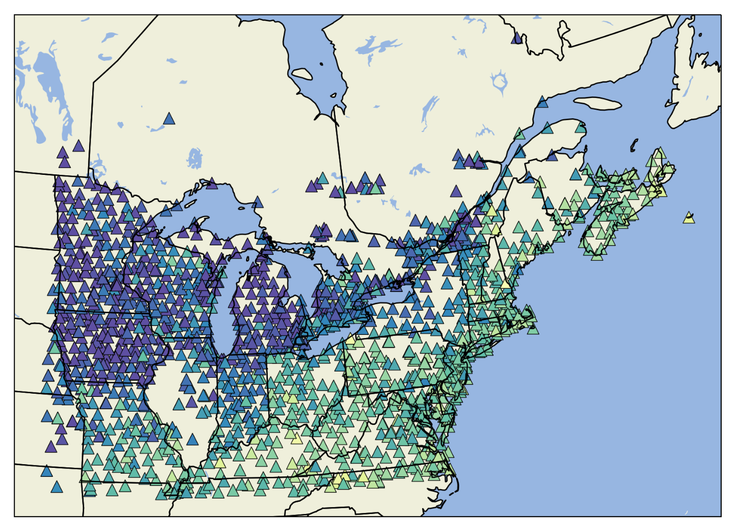
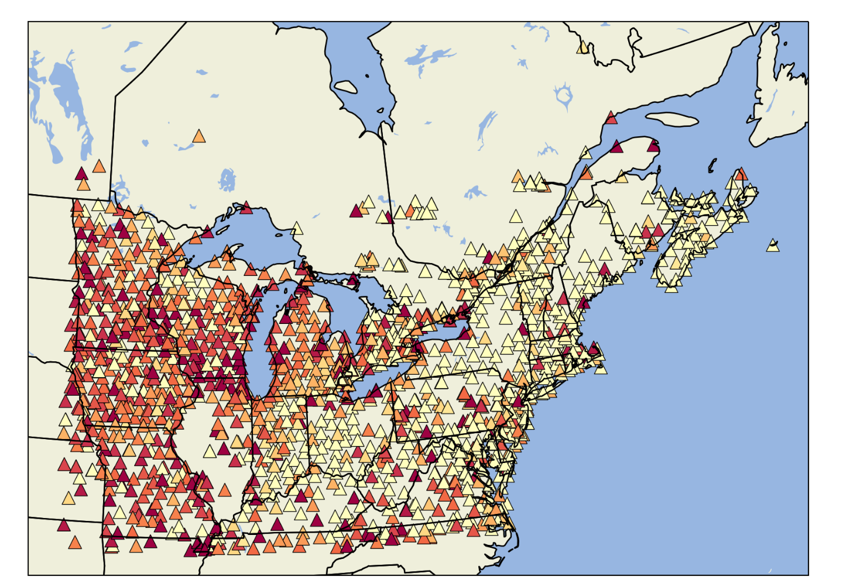
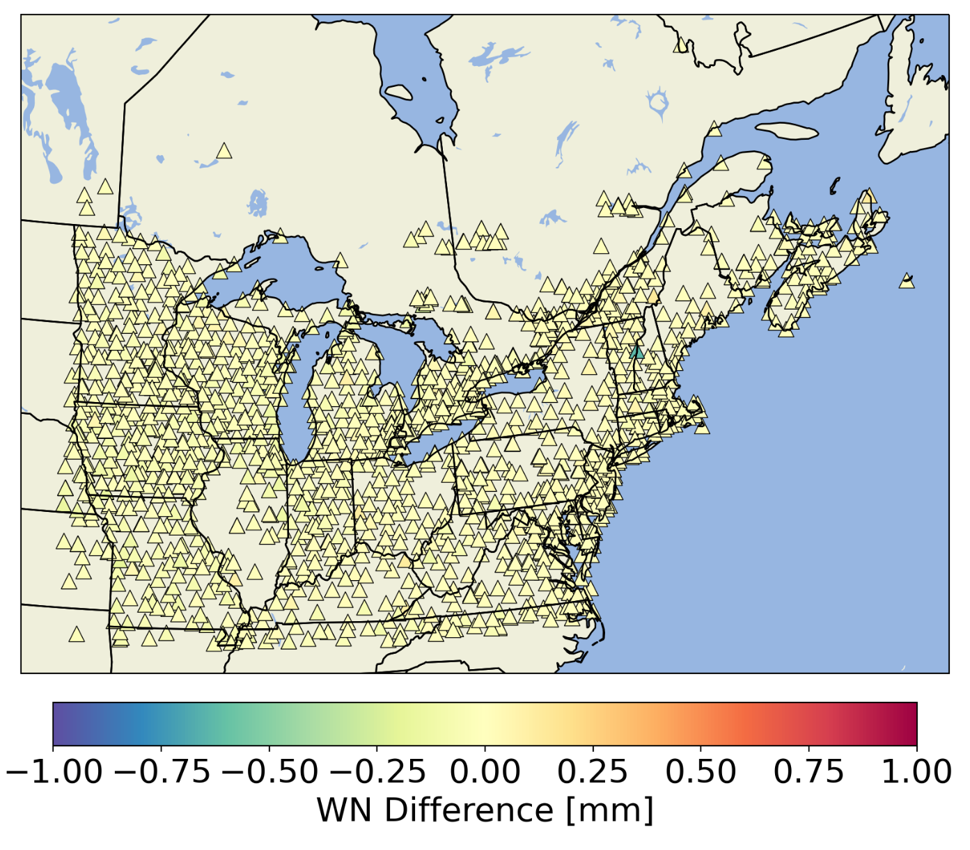
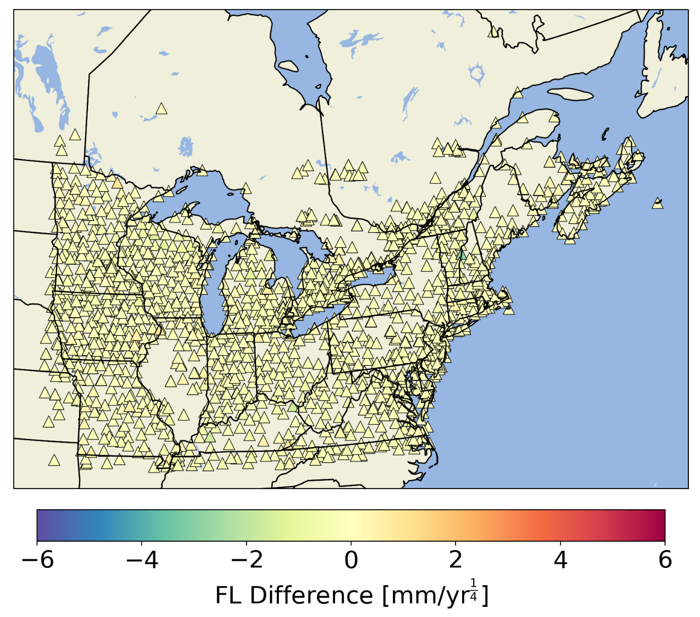
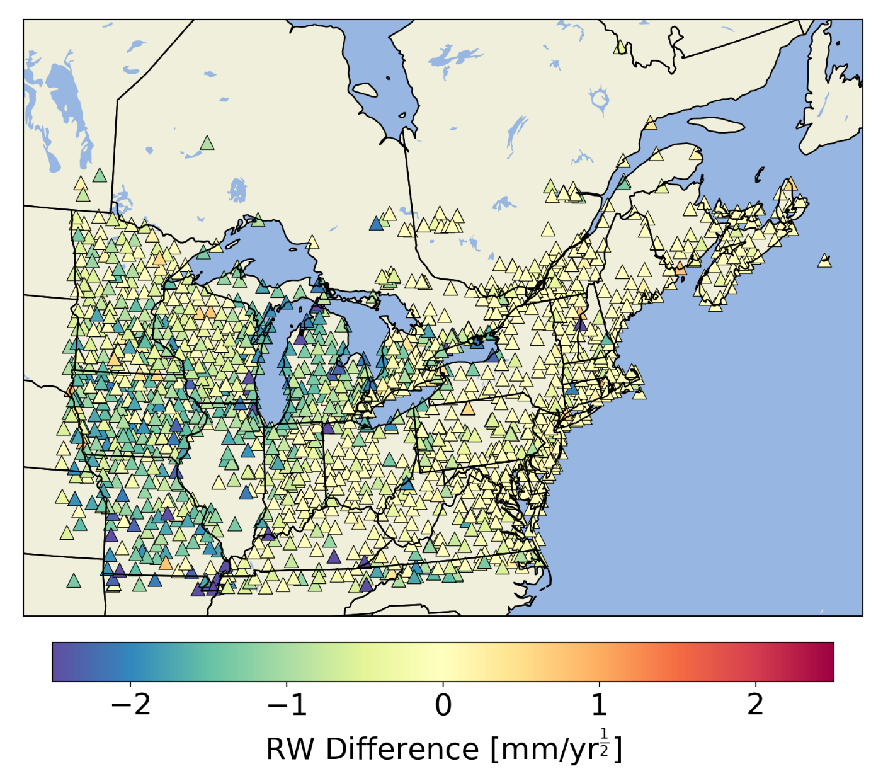
NTAOL removed
Additional differences for GRACE removed

Slide 27
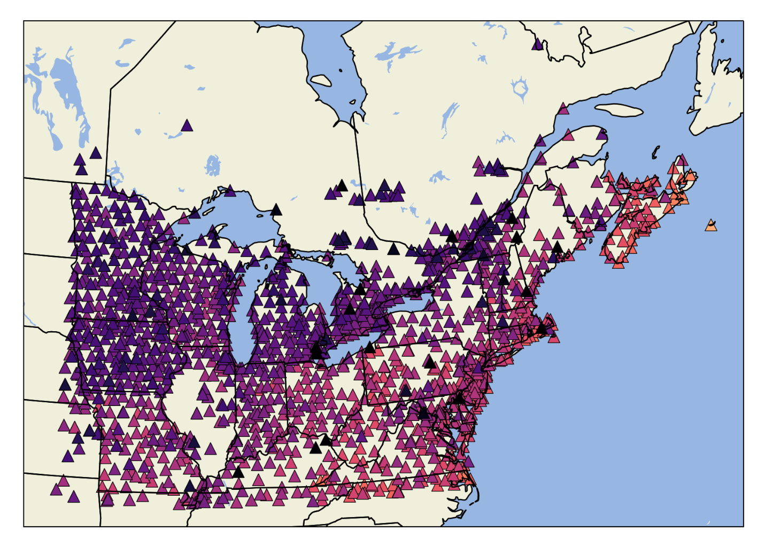
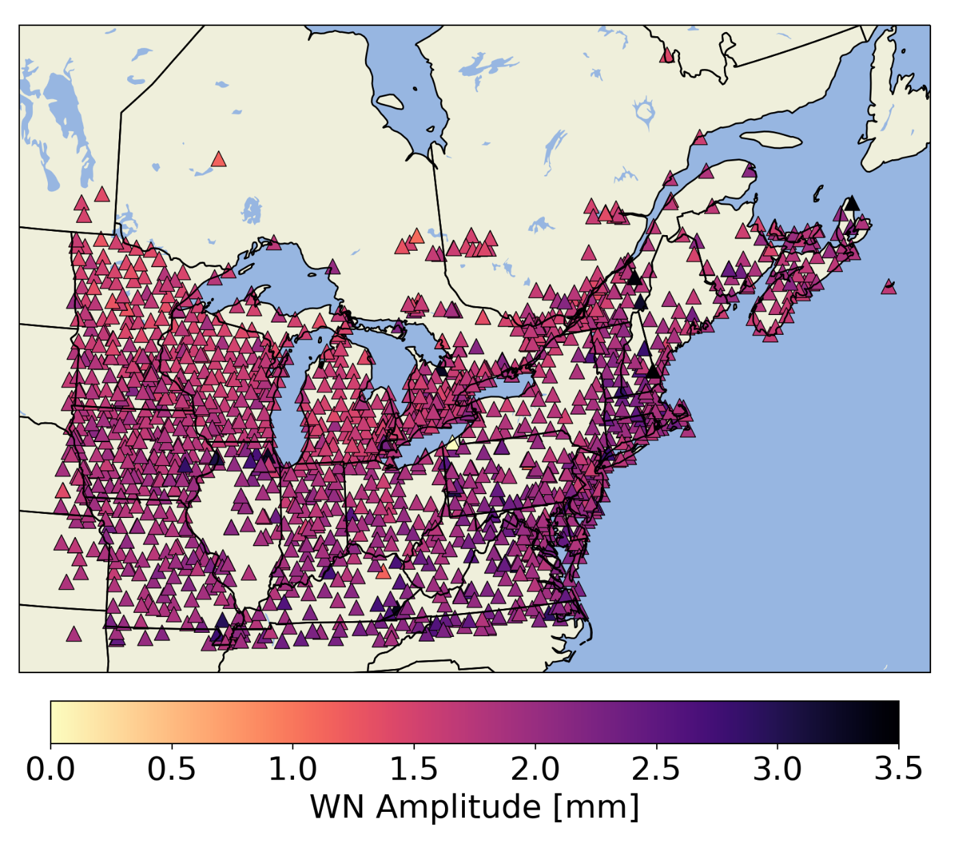
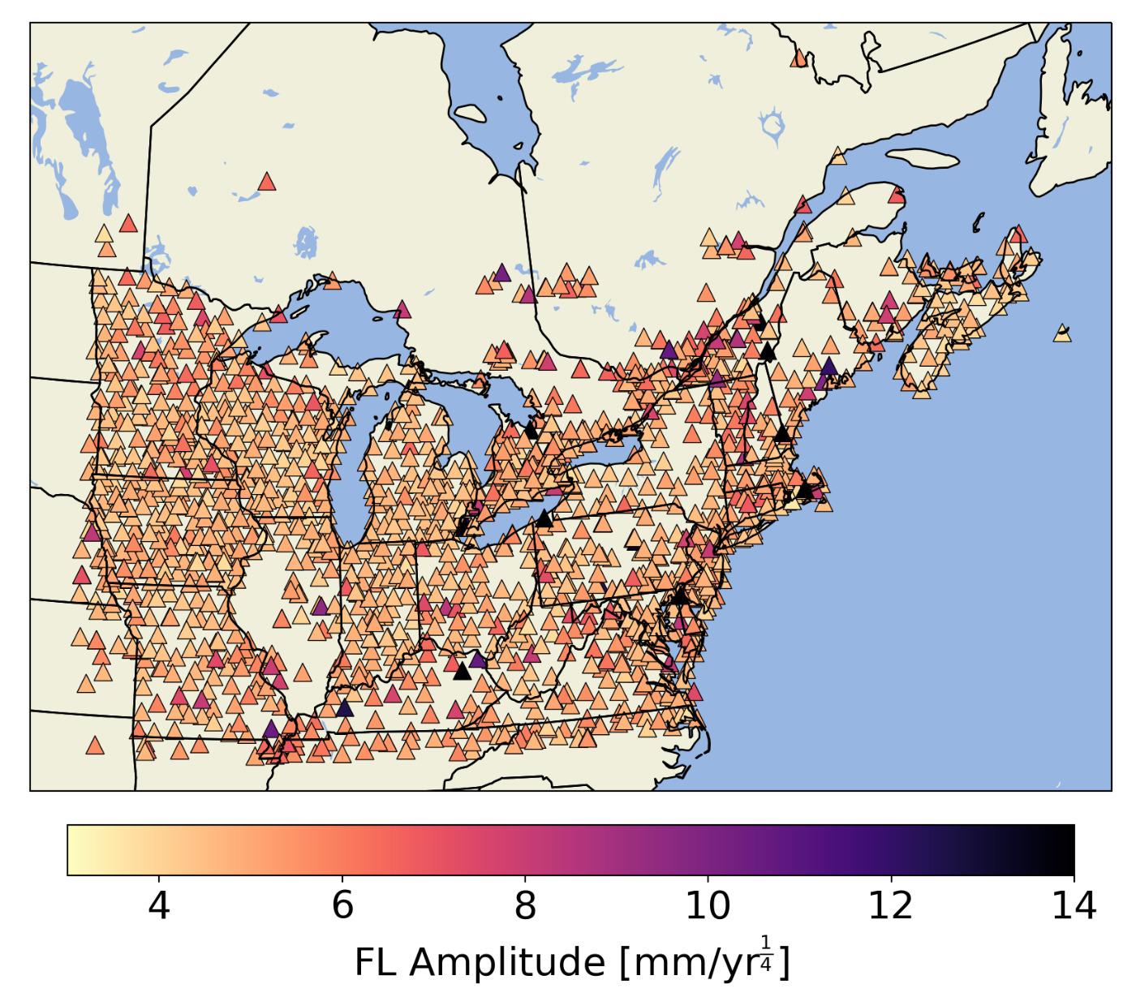
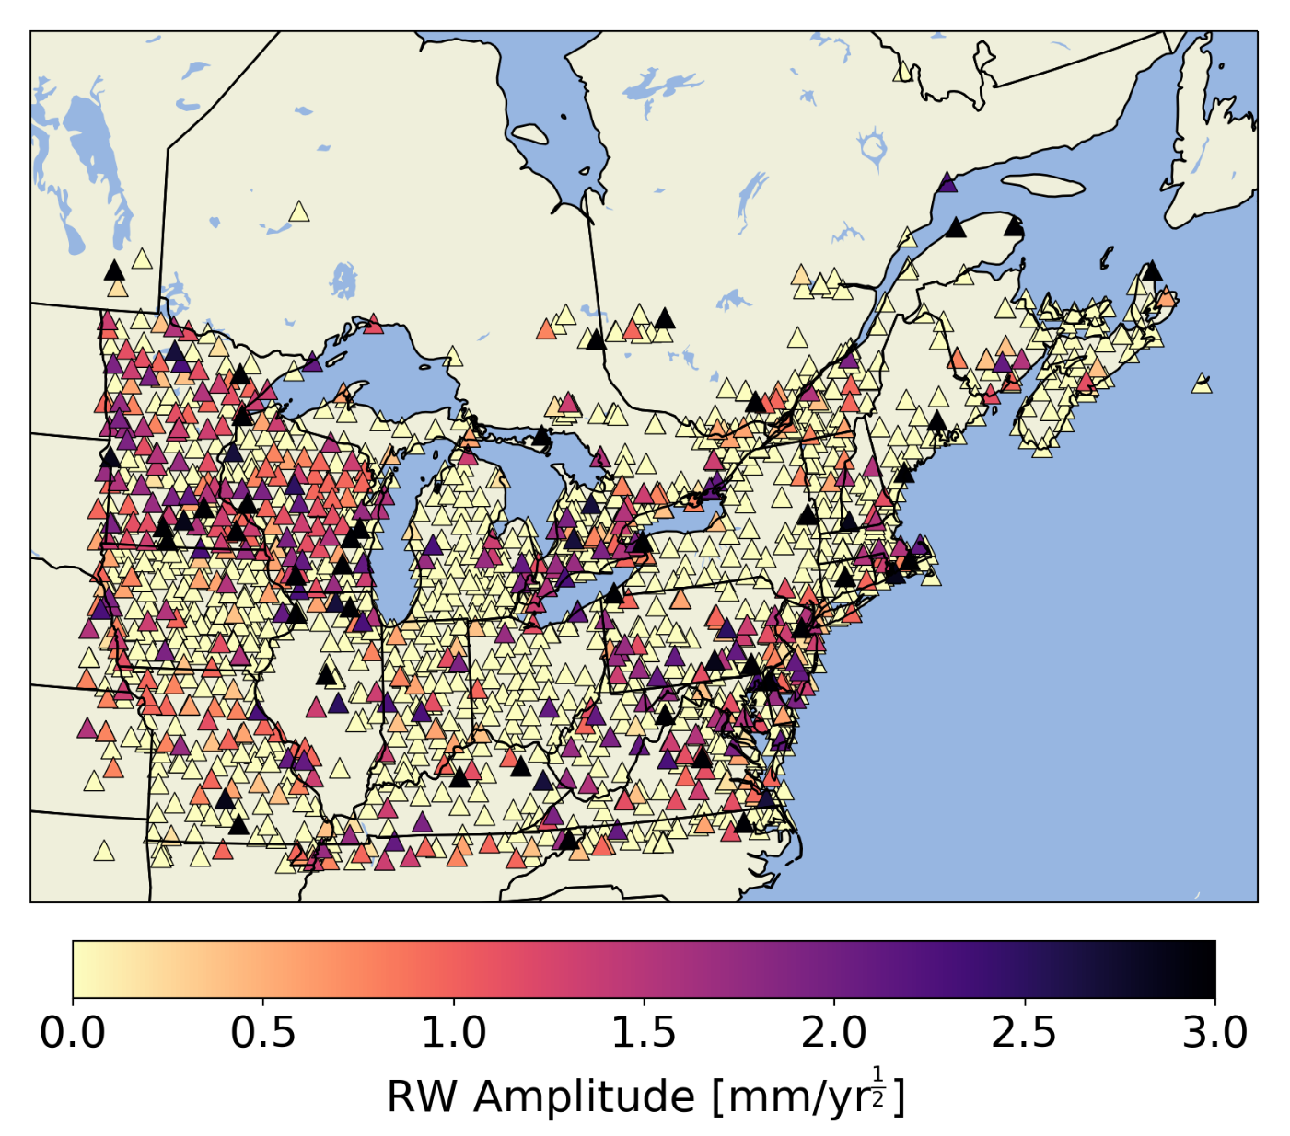
Original time series
NTAOL+GRACE removed

Slide 28
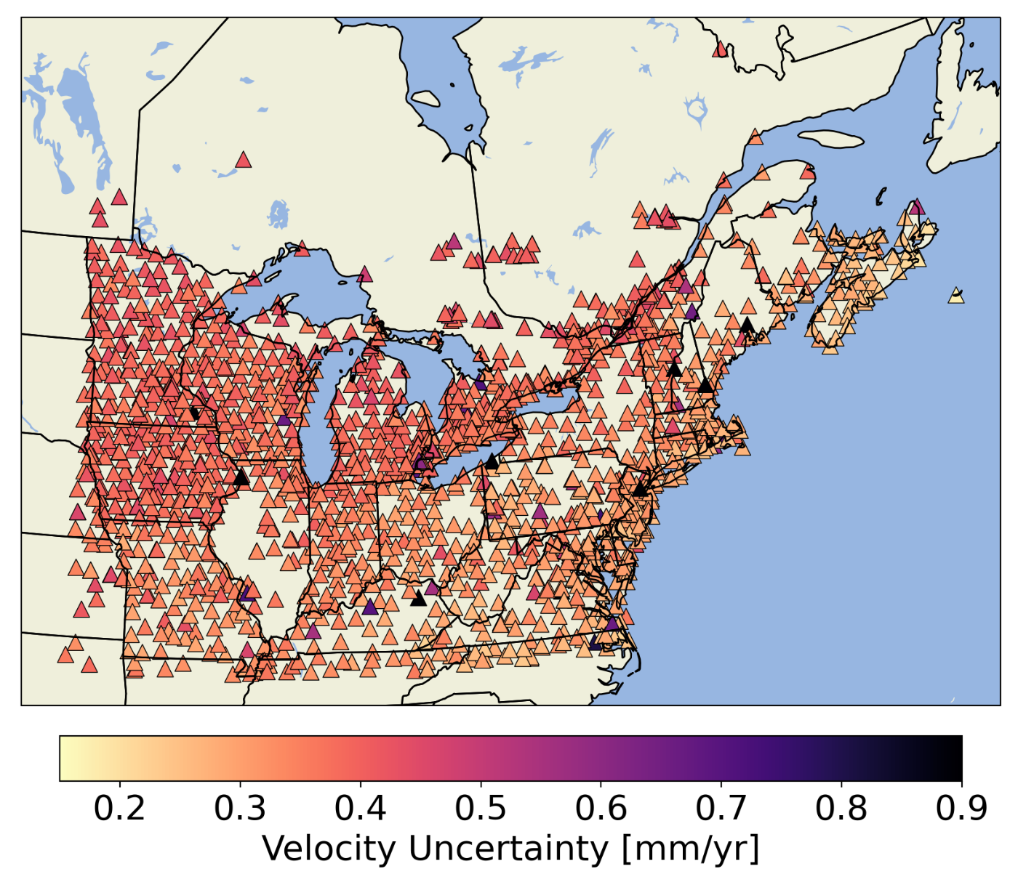
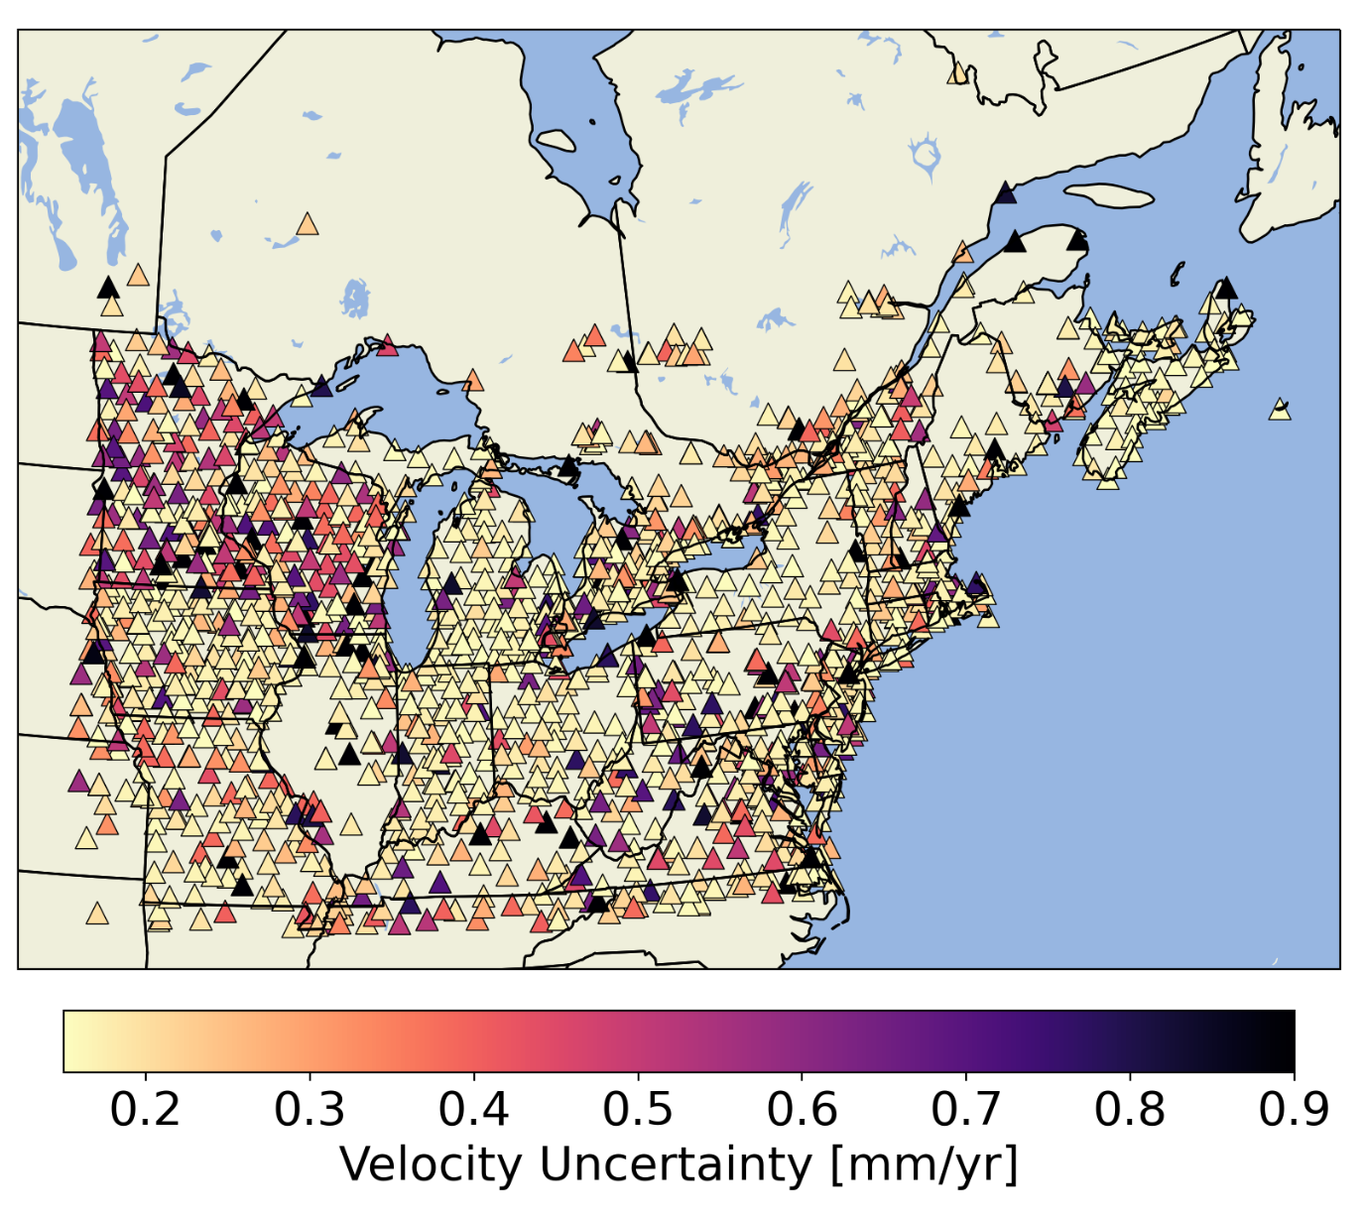
Velocity uncertainties
*Assuming a 8-year time span with no missing observations
Original time series
NTAOL+GRACE removed

Slide 29
Results of removing surface mass loading
*median values

Slide 30
How do noise amplitudes and velocity uncertainties change when surface mass loading is removed?
Removing NTAOL reduces flicker noise amplitudes by about half
NTAOL deformations obscure the presence of random walk and bias white noise amplitude estimates
Hydrological loading primarily influences the random walk amplitudes in GNSS time series
Median velocity uncertainty is reduced from 0.35 mm/yr to 0.18 mm/yr after removing surface mass loading, but uncertainty increases in some station due to an increase in random walk amplitude
Differences between state networks become apparent only after correcting for surface mass loading

Slide 31
How does monument type influence the noise properties of GNSS time series?

Slide 32
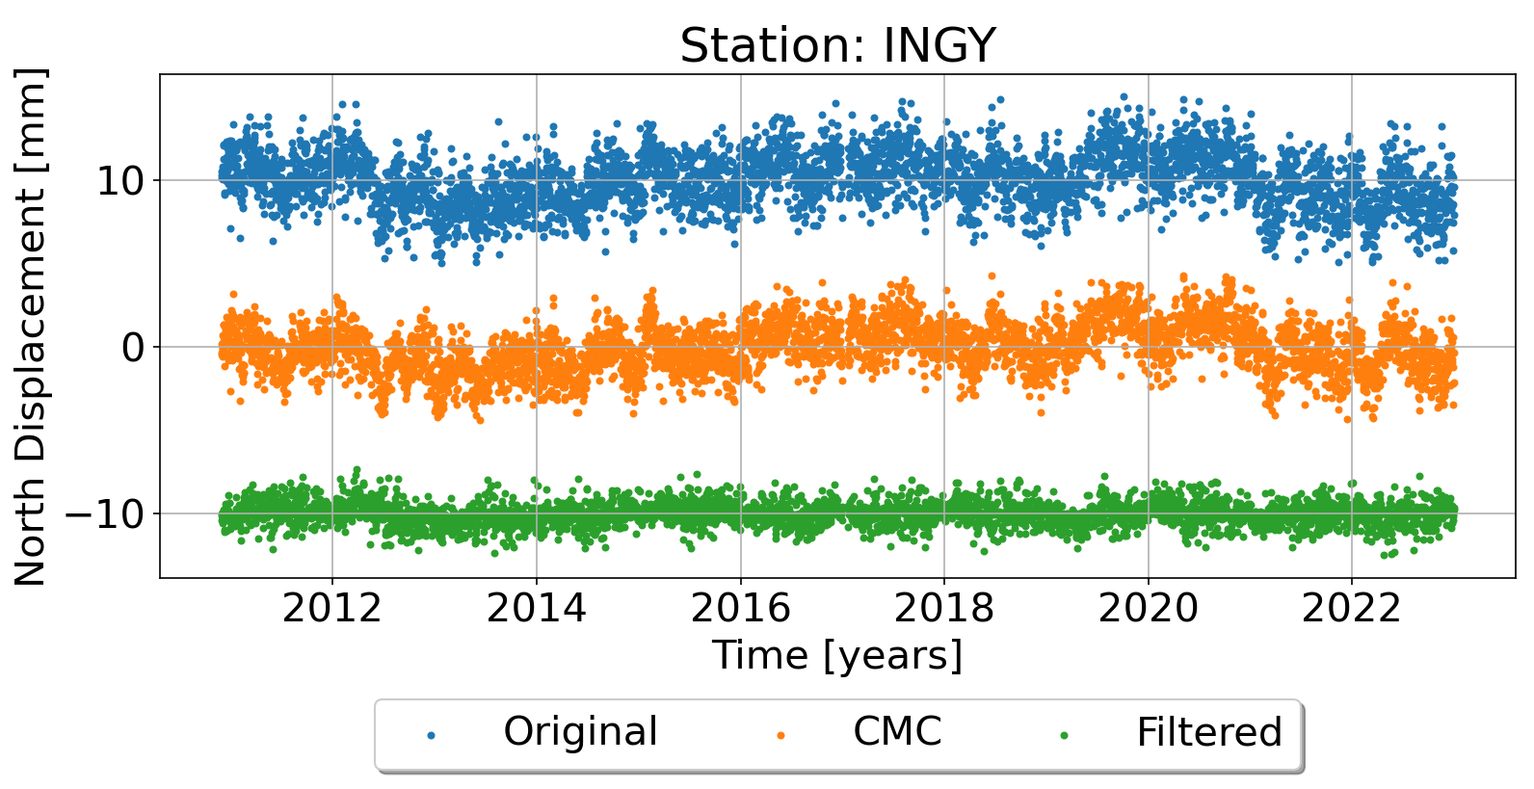
CMC Imaging
The common mode component (CMC) is made up of the spatially correlated noise shared between stations
CMC Imaging (Kreemer and Blewitt, 2021) is a technique that uses the weighted median of the residuals of nearby stations to construct the CMC
The spatial extent of CMC Imaging is defined by distribution of stations and is capable of capturing both large scale and local effects

Slide 33
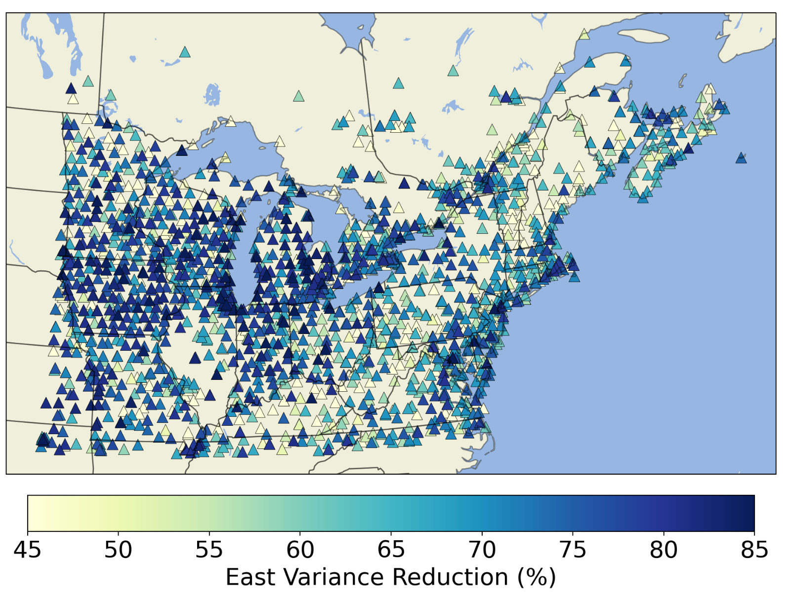
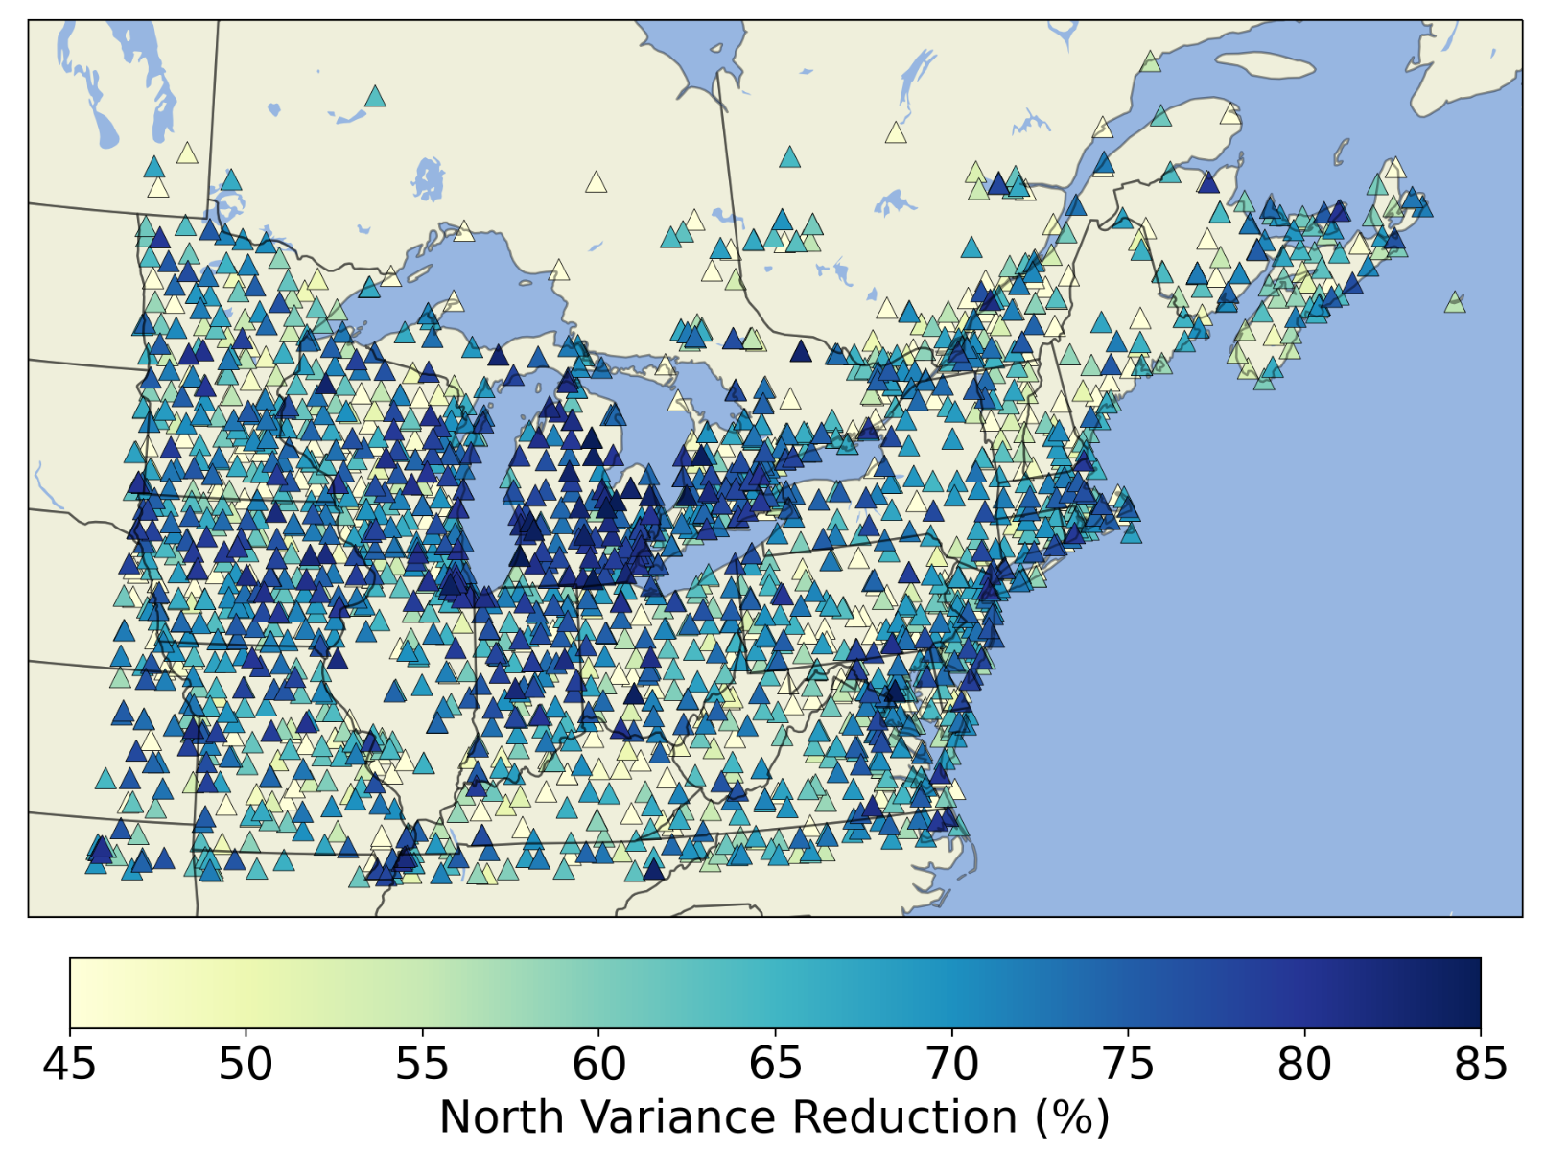
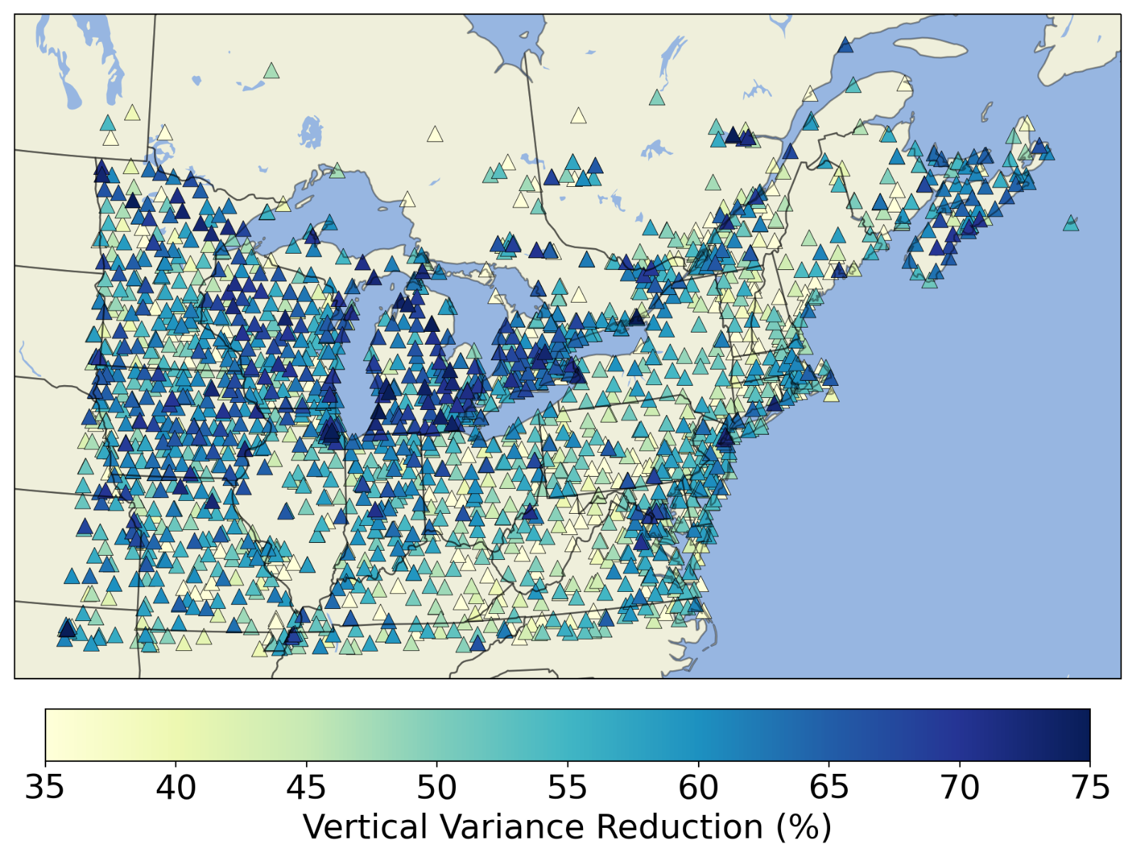
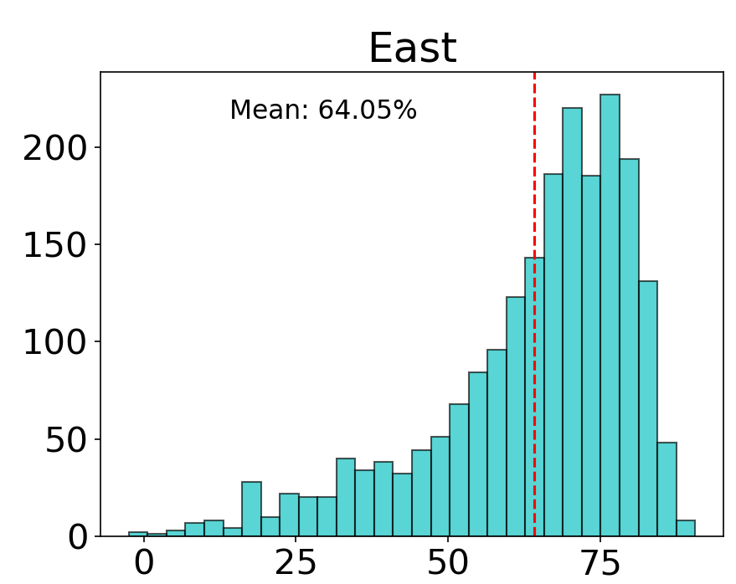
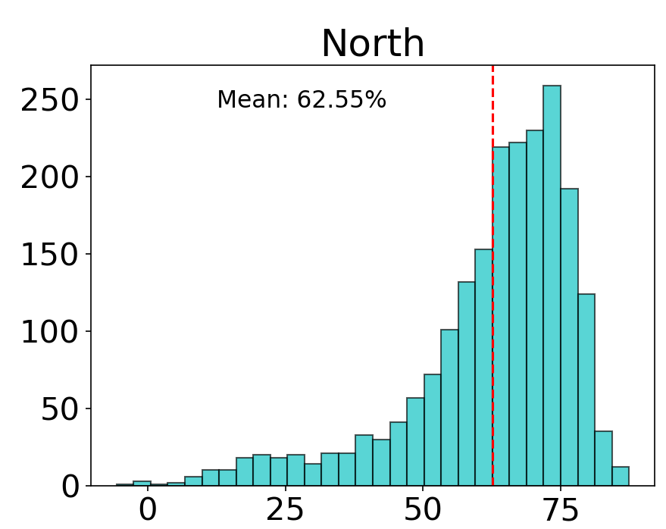
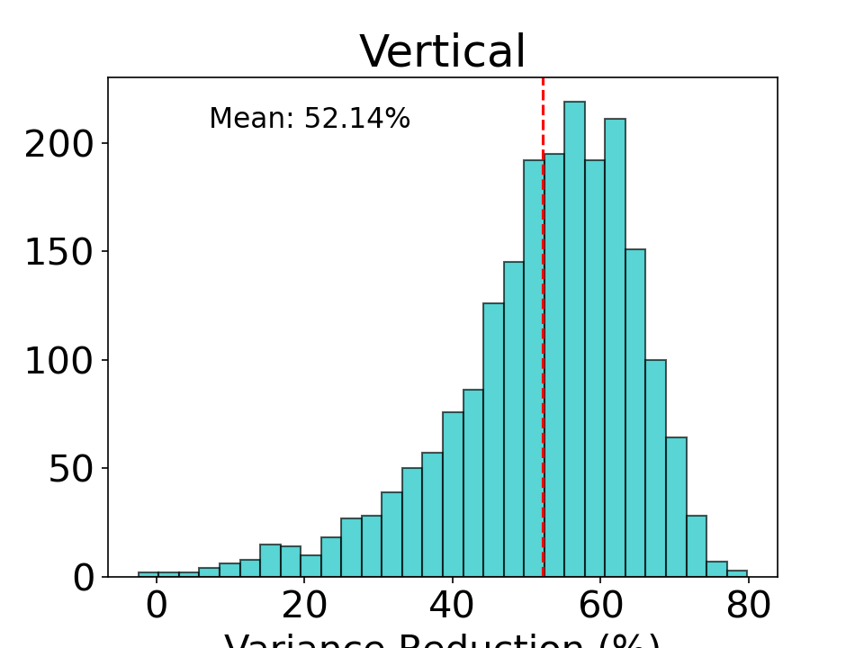
Variance reduction - CMC filtering
*NTAOL+GRACE removed

Slide 34
Results of CMC filtering

Slide 35
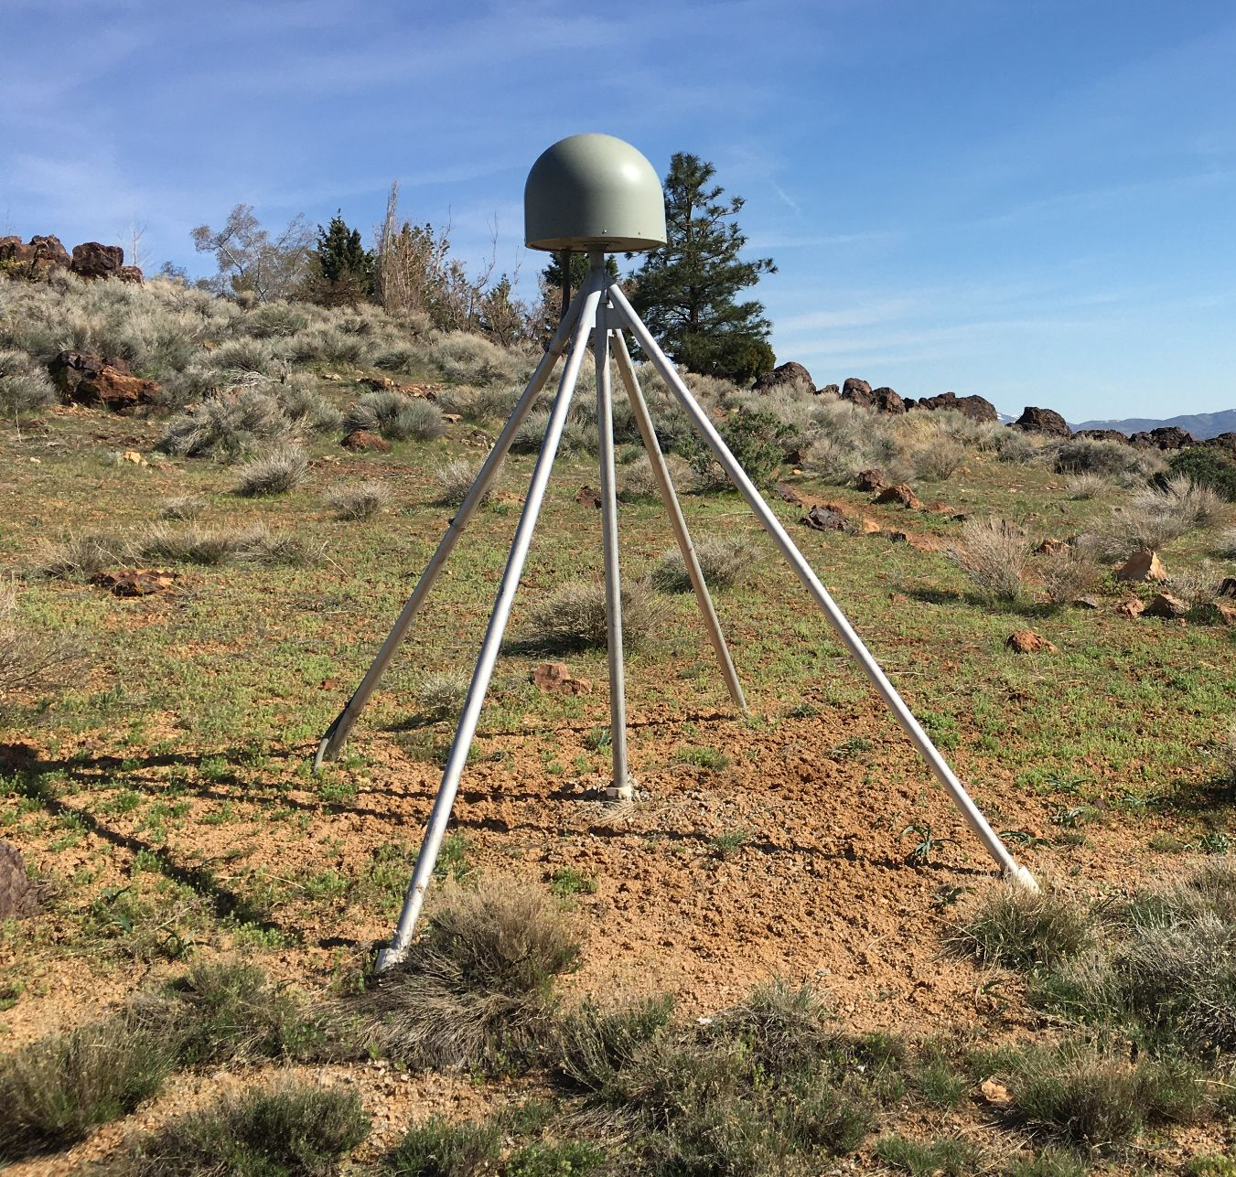
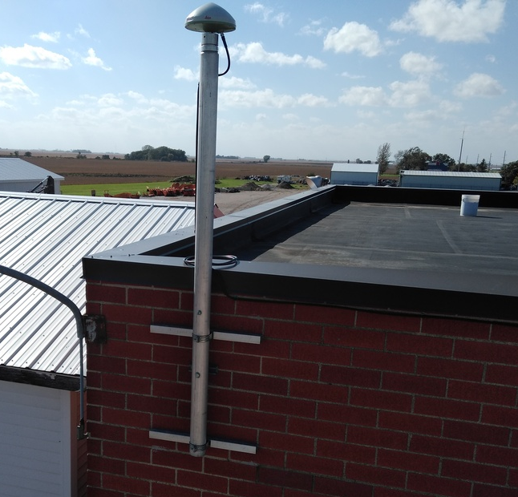
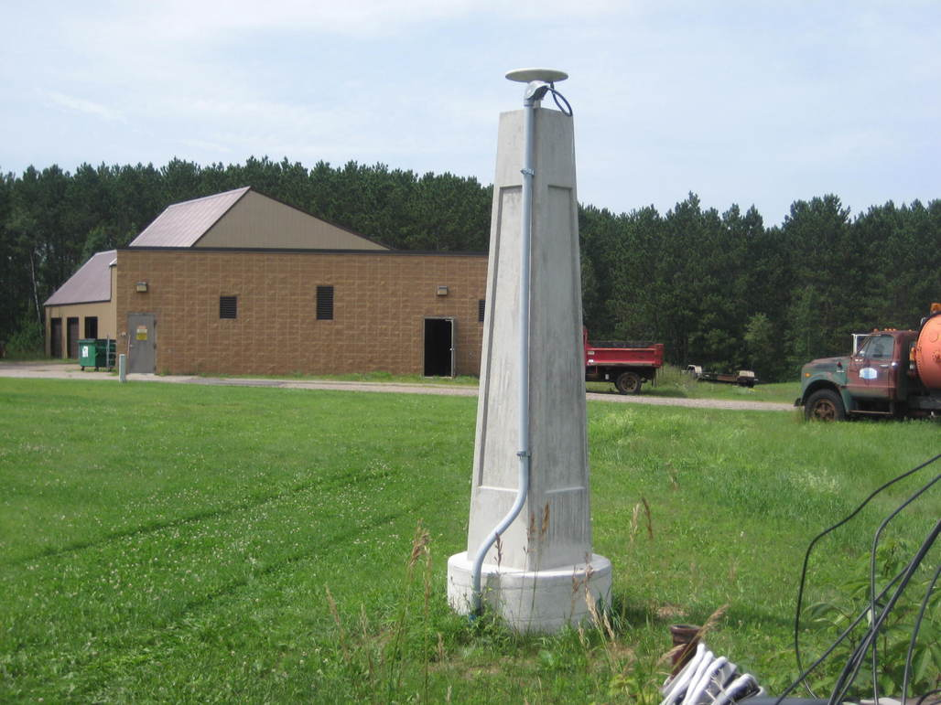
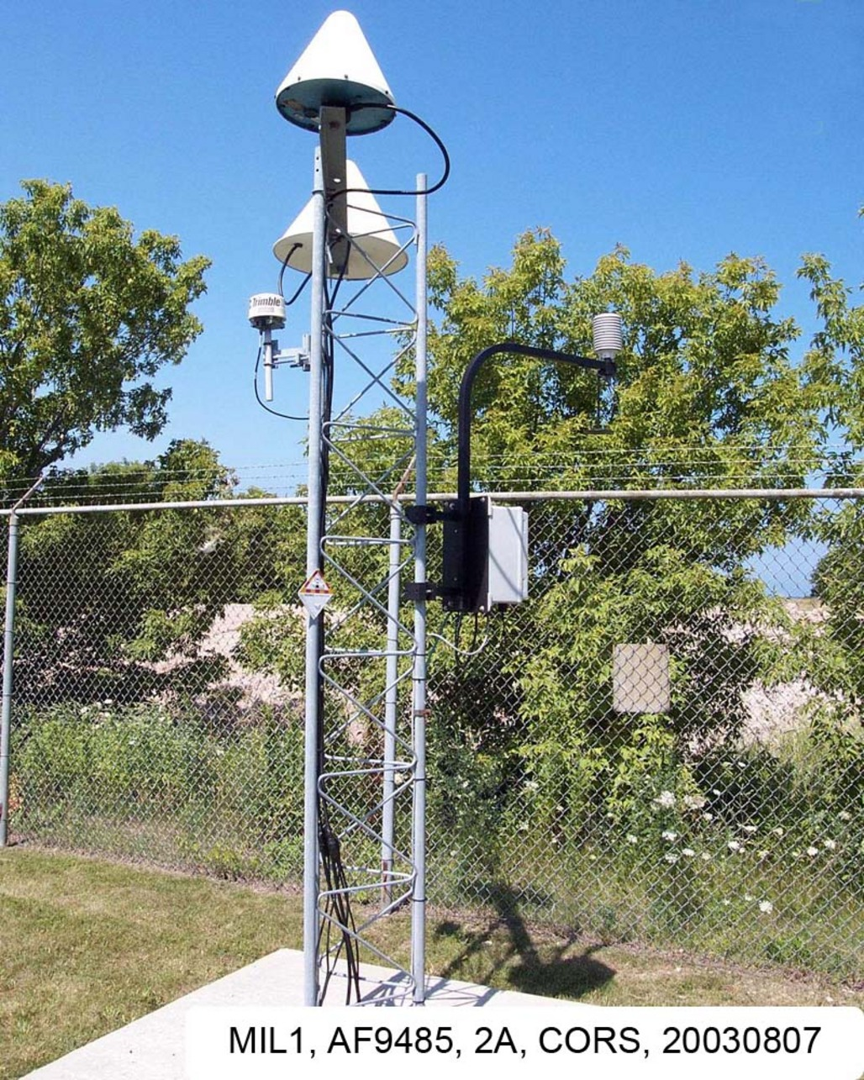
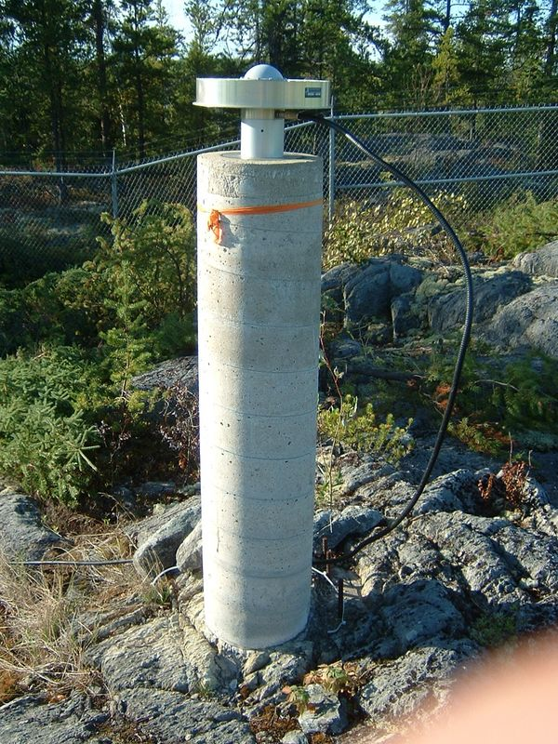
GPS monuments
NGL Monument Table + WISCORS = 831 sites with monument information
Classified into 5 categories:
DDBMs (n=11) Roof mounted (n=461) Concrete pillar (n=314) Steel tower (n=33) Bedrock (n=12)

Slide 36
Monument comparison results
*NTAOL+GRACE Removed and CMC Filtered

Slide 37
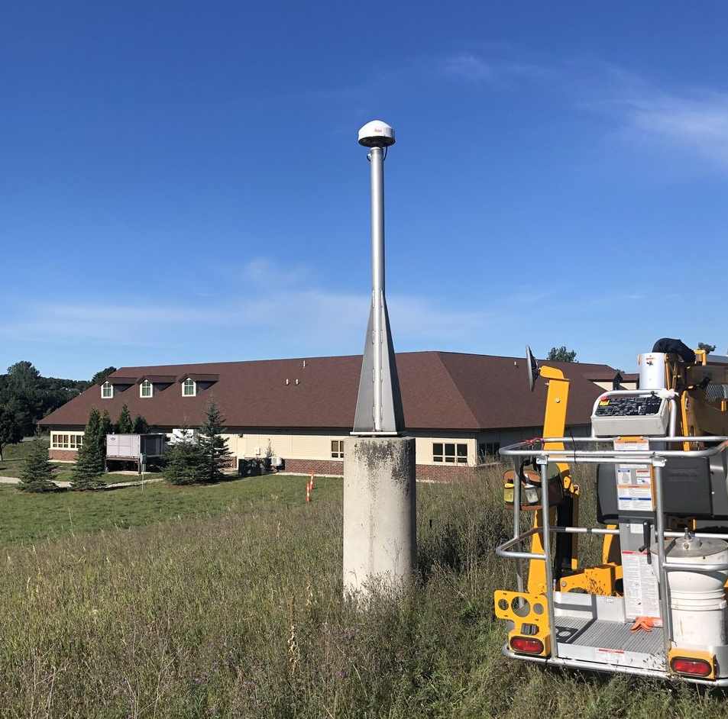
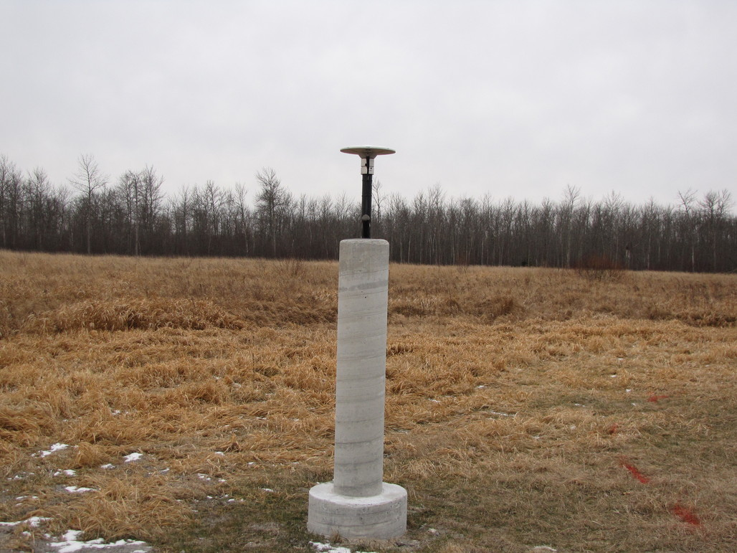
Concrete pillar comparison
MIGD - Michigan
MNWH - Minnesota
MOCE - Missouri
WICR - Wisconsin

Slide 38
How does monument type influence the noise properties of GPS time series?
Concrete pillars and roof mounted make up a majority of the monument types in the study region
Median random walk amplitudes are lower in roof mounted monuments compared to concrete pillar monuments, which leads to lower velocity uncertainties over a 8-year observation period
Design of concrete pillar monuments differ by state network, and some concrete pillar designs have significantly lower velocity uncertainties due to lower random walk amplitudes

Slide 39
Main takeaways
NTAOL deformations explain a third of the variance in vertical time series around the Great Lakes region, while hydrological loading explains a significant proportion close the lakes and in the Midwest
Correcting for surface mass loading reveals higher random walk amplitudes that impacts the velocity uncertainty of long running stations
Differences between state networks is only revealed when surface mass loading is corrected
CMC filtering further reduces white noise and flicker noise amplitudes, but random walk amplitudes increase for some stations
Roof mounted monuments have lower velocity uncertainties compared to concrete pillars during a 8-year time span, but concrete pillar design possibly plays a role on the random walk amplitudes

Slide 40
Questions?
jordan.krcmaric@noaa.gov

Slide 41
Extras

Slide 42
Average Power Spectra

Slide 43
Average Power Spectra

Slide 44
Average Power Spectra

Slide 45
Average Power Spectra

