Slide 1
NSRS Modernization Update
Dru Smith | NSRS Modernization Manager
November 2016

Slide 2
Introduction: About the NSRS

Slide 3
Overview
The NSRS (National Spatial Reference System) is the official coordinate system for all geospatial work done by the non-military federal government
NAD 83 (latitude, longitude, ellipsoid height)
NAVD 88 (orthometric height)
IGLD 85 (dynamic heights: predominantly on the Great Lakes)
These datums are often adopted, even legislated, by states, counties and municipalities

Slide 4
Federal Users of the NSRS

Slide 5
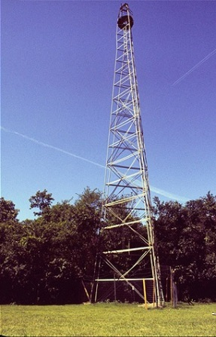
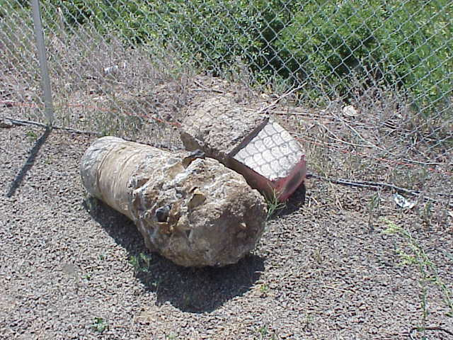
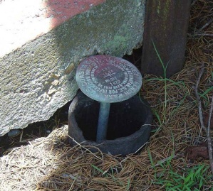
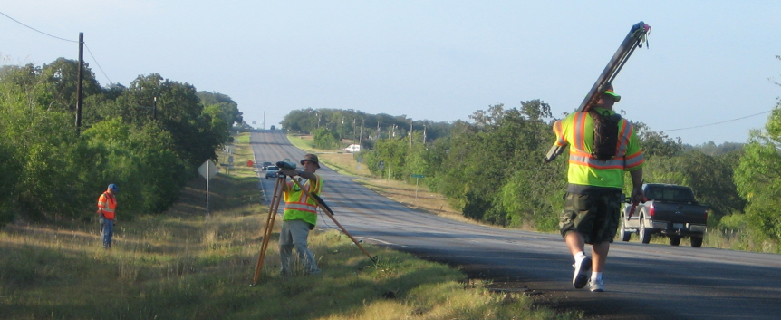
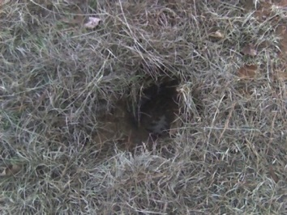
Why modernize?
Older Methodology
Terrestrial, pre-space-geodesy, line-of-sight observations
Easily destroyed, unmonitored passive control marks
PID: EZ0840

Slide 6
Why modernize?
Evidence of systematic errors
Decades of space geodetic observations
All of the datums contain systematic errors (decimeters to meters)
At scales larger than today’s accuracy capabilities (centimeters)
Origin (center of Earth) Offset: 2+ meters
Zero elevation Surface: 0.5 to 2+ meters

Slide 7
What’s Being Replaced
What’s being replaced:
Horizontal Vertical
NAD 83(2011)
NAD 83(PA11)
NAD 83(MA11)
NAVD 88
PRVD 02
VIVD09
ASVD02
NMVD03
GUVD04
IGLD 85
Heights
Latitude
Longitude
Ellipsoid Height
State Plane Coordinates

Slide 8
Details: Ten Year Plan
5 Goals:
Support the users of the National Spatial Reference System.
Modernize and improve the National Spatial Reference System.
Expand the National Spatial Reference System stakeholder base through partnerships, education, and outreach.
Develop and enable a workforce with a supportive environment.
Improve organizational and administrative functionality.

Slide 9
Nomenclature

Slide 10
Nomenclature
A chance to increase accuracy in naming!
“North American”?
Ignores Guam, Hawaii, American Samoa, Northern Mariana Islands
Datum vs Reference Frame?
Plate-specific?
Vertical vs Geopotential?
6/8/2016: NGS and the Canadian Geodetic Survey negotiated a naming proposal
Approved by NGS ESC
Approved by the CGS leadership (with minor reservations)
Awaiting final word from INEGI as of 10/26/2016….

Slide 11
Objective 1 of 5: Replace NAD 83

Slide 12
Replace NAD 83
Simplified Concept of NAD 83 vs. “2022”
Earth’s Surface
h_{”2022”}
h_{NAD83}
φ_{NAD83} – φ_{”2022”}
λ_{NAD83} – λ_{”2022”}
h_{NAD83} – h_{”2022”}
all vary
smoothly by latitude
and longitude
“2022” origin
~2.24 m
NAD 83 origin

Slide 13
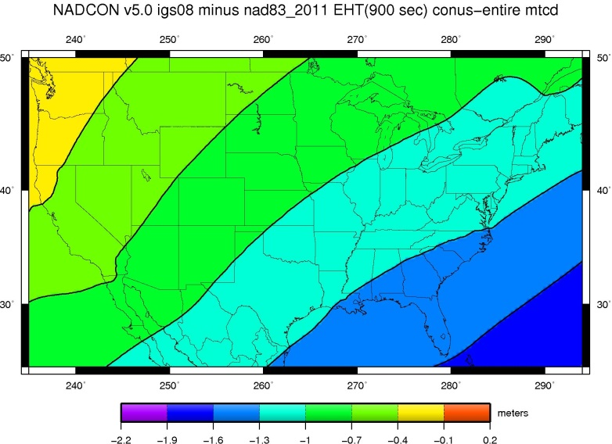
Ellipsoid Height Shifts
Approximate
IGS08(GRS-80) minus NAD 83(2011)

Slide 14
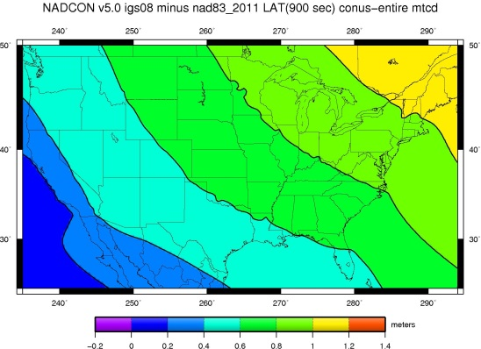
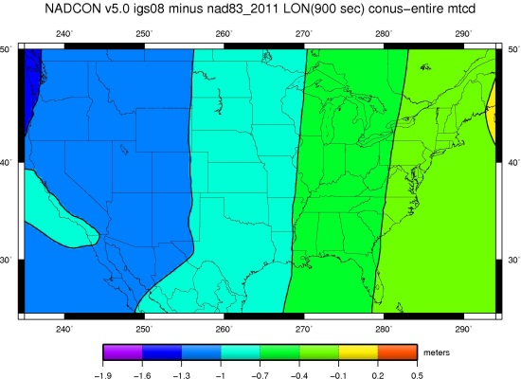
Horizontal Shifts
Approximate
IGS08(GRS-80) minus NAD 83(2011)
Lat:
Lon:

Slide 15
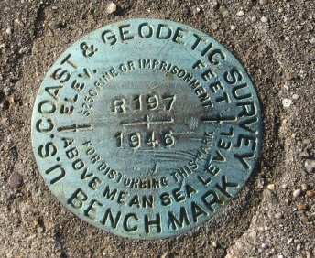
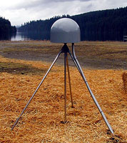
Replace NAD 83
Access and definition
Primary: CORS
Continuous monitoring
OPUS
IGS coordinates
Transformable to any national reference frame chosen for 2022
Static Surveys
RTK/RTN
Validation service
Secondary: Passive
Time-tagged coordinates
Will reflect each occupation of the mark
Will generally not be accepted as “fixed control” in surveys turned in to NGS

Slide 16
Definition of new frames
“Plate fixed +” … announcement coming soon
Plate rotations will tie the new terrestrial reference frames of 2022 to the IGS frame
Deformational velocities will be modeled separately

Slide 17
Time Dependencies
Track cors and always know where you are
Surveying to CORS positions at survey epoch
If we track CORS, we can do this easily
Tectonic rotations
Easily removed for a “good east of the Rockies” solution
Lat/Lon only
Residual deformations
Can be modeled many ways and provided for cross-epoch checking between surveys
3-D

Slide 18
Objective 2 of 5: Replace NAVD 88

Slide 19
Replace NAVD 88
Earth’s
Surface
H (NAVD 88)
H
NAVD 88 reference level
The Geoid
Errors in NAVD 88 : ~50 cm average, 100 cm CONUS tilt,
1-2 meters average in Alaska, NO tracking

Slide 20
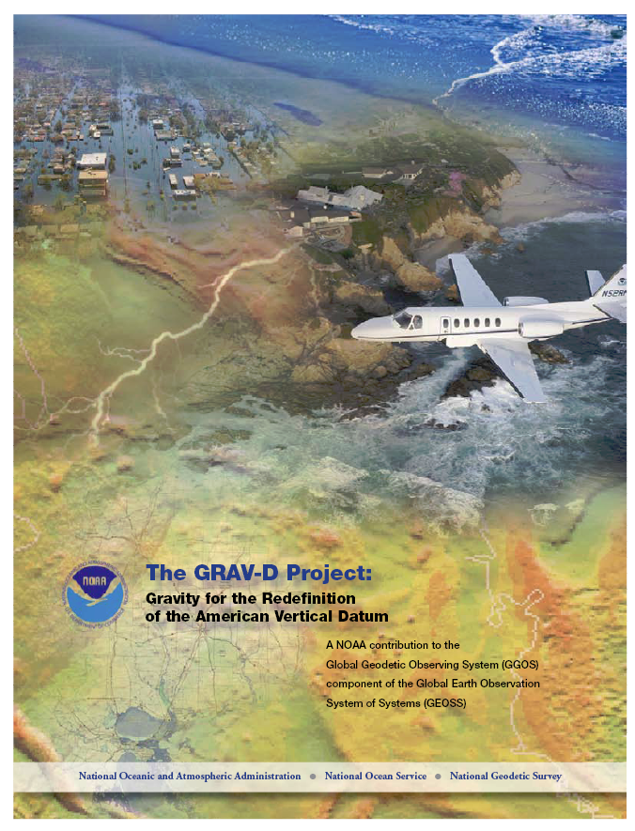
Replace NAVD 88
Changing from a leveling-based to a geoid/GNSS-based vertical datum
Biggest requirement: An updated,
accurate, nationwide gravity survey
Airborne
GRAV-D!
Gravity for the Redefinition of the
American Vertical Datum

Slide 21
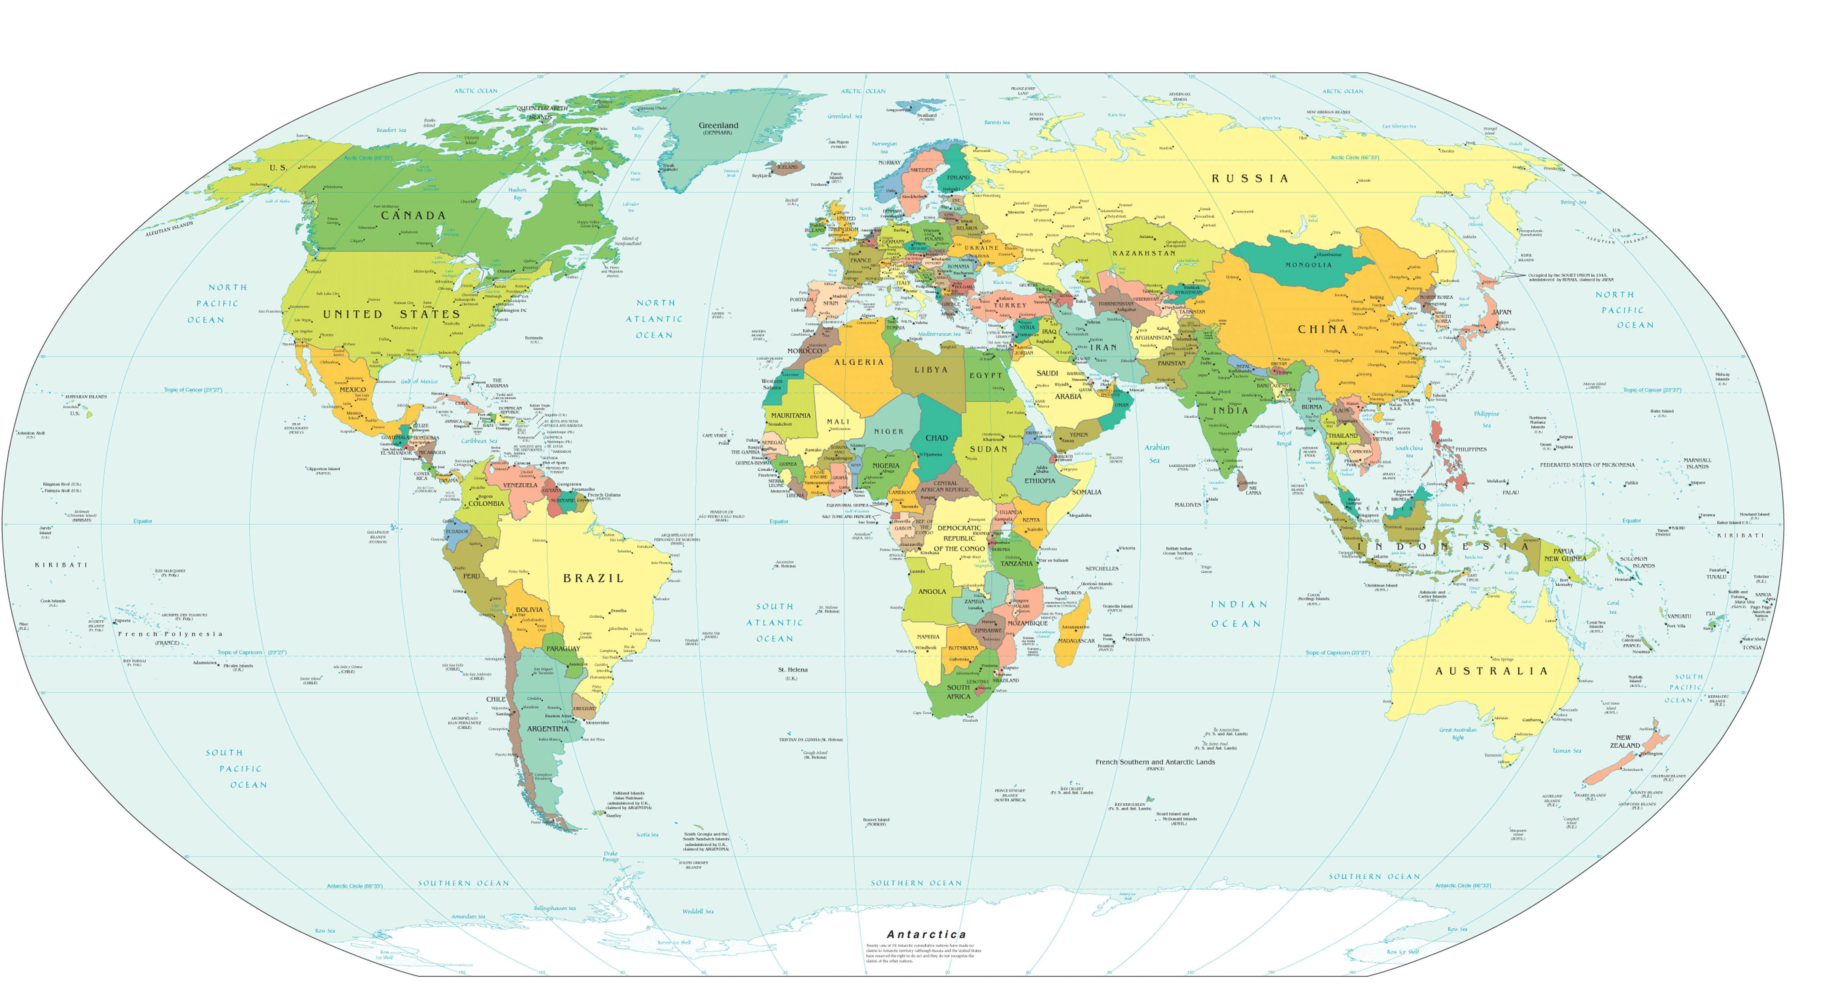
GRAV-D Coverage
Alaska
“CONUS”
Guam / Northern Marianas
Hawaii
Puerto Rico / Virgin Islands
American Samoa

Slide 22
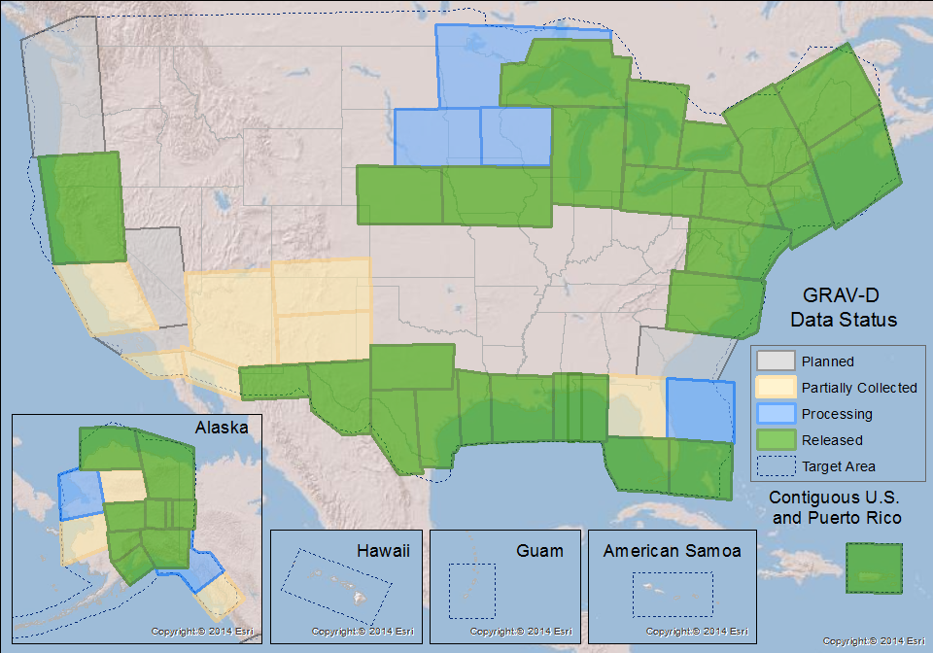
GRAV-D Status
100% by 2022
50% mark hit in FY2016
FY2017 target: 62%
Two planes at a time
Occasionally three
Mix of Government and Private Industry Flights

Slide 23
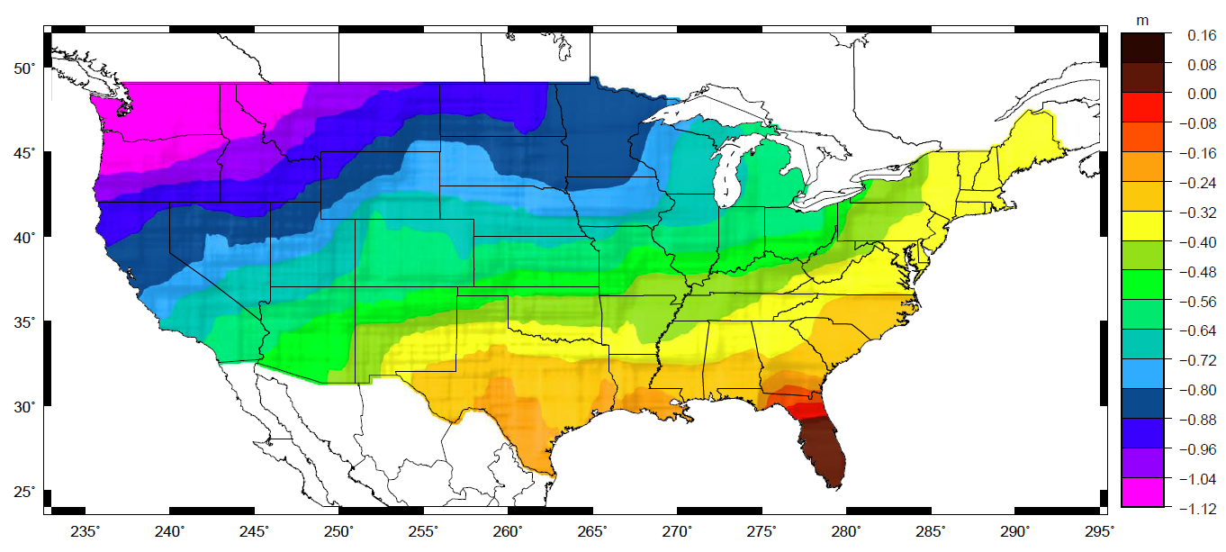
Orthometric Heights
Approximate EXPECTED SHIFTS
Approximate level of geoid mismatch known to exist in the NAVD 88 zero surface:
Does not include local subsidence issues

Slide 24
Time Dependencies
Geoid changes cause height changes
The zero elevation surface will change with time
Heights will be time tagged to respect:
Geoid change
Subsidence

Slide 25
Objective 3 of 5: Re-invent Bluebooking

Slide 26
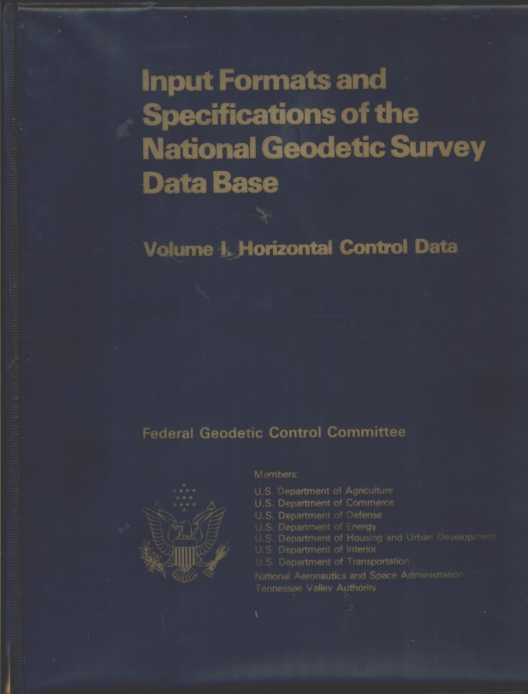
Bluebooking
background
Refers to the blue cover of Input Formats and Specifications of the National Geodetic Survey Data Base
The requirements for turning in a geodetic survey to NGS
Very DOS/FORTRAN heavy
Horizontal (angles, distances) vertical (leveling) and gravity
GPS surveys were force-fitted into the horizontal rules
Reputation: “Cumbersome”
To be fair: All industry standards are cumbersome – it prevents chaos

Slide 27
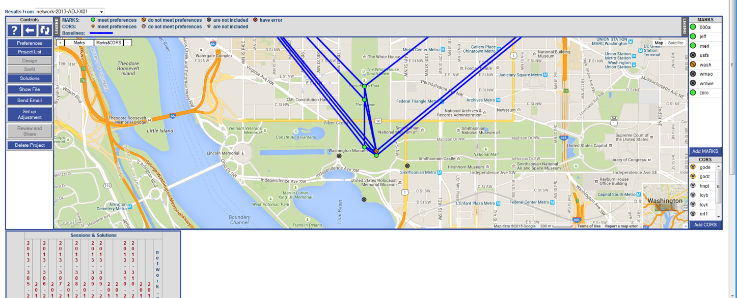
OPUS-Projects
Or “bluebooking for the 21st century”
The 2013 Survey of the
Washington Monument
had GPS, leveling and
traverse components.
An integrated OP might
allow for easier
processing and especially
cross-processing

Slide 28
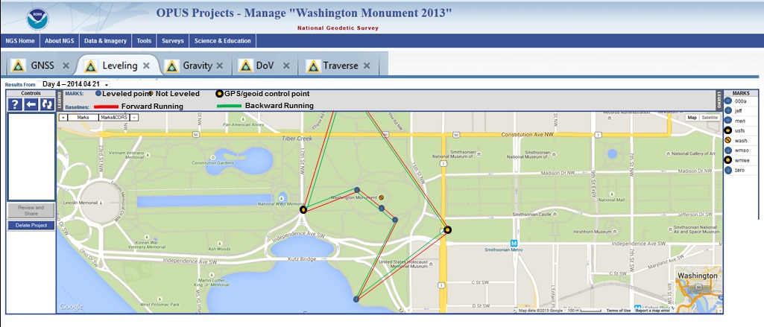
OPUS-Projects
Or “bluebooking for the 21st century”

Slide 29
New Database
Replacing the NGS IDB
NGS IDB (“Integrated Database”)
Current official repository of some (most?) NSRS data
“Integrated”…2 old DBs:
Hor / Ver
Built for
Passive Control
No time dependencies
Line of sight techniques
Points
NSRS DB
Being built (target: 2020)
“Spatial” database
Time tags for everything
Open design for any type of data
Things that couldn’t go into the IDB, but can go in the NSRS DB:
Lines of airborne gravity
LIDAR clouds
CORS
Superconducting Gravimeter data
etc

Slide 30
Objective 4 of 5: Improve the Toolkit

Slide 31
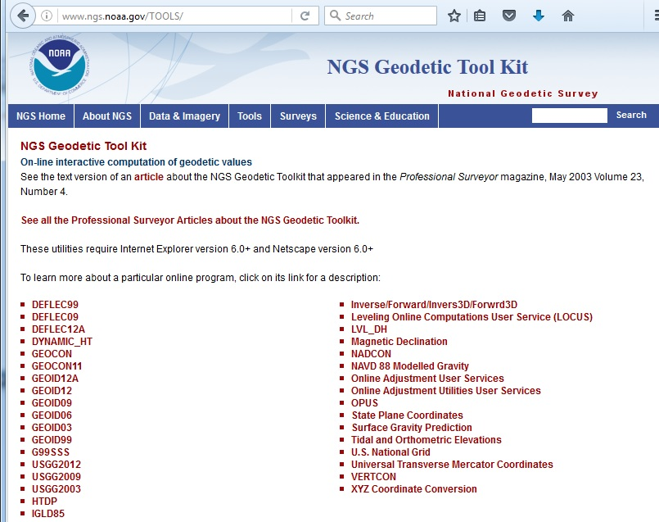
NGS Toolkit
background
A set of (mostly FORTRAN based) geodetic tools
Little integration
Many with no online capability
No web services

Slide 32
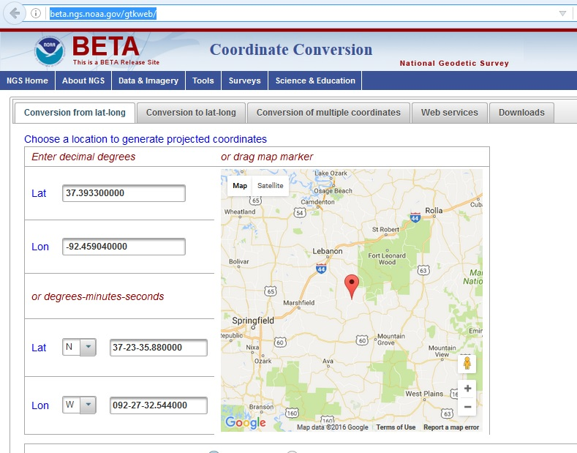
New Toolkit
http://beta.ngs.noaa.gov/gtkweb/
Convert to/from lat & lon
State Plane Coordinates
UTM
US National Grid
Upload file of points
Web Service
Download and run offline

Slide 33
NADCON 5
Expected in beta toolkit In december 2016
Replacing NADCON 4.2 and GEOCON 2.0
Support for nearly all horizontal datums since 1897
Exceptions: Regional Alaska
No “state by state” grids
Fixing all existing bugs
Web Service
Consistent
Documented
Rigorous Location-Dependent Error Estimates
Ready to support 2022

Slide 34
NADCON 5 example
USSD / NAD 27

Slide 35
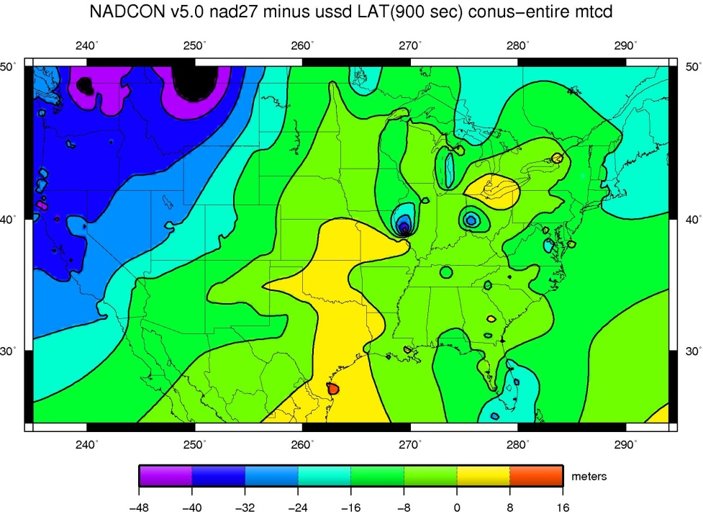
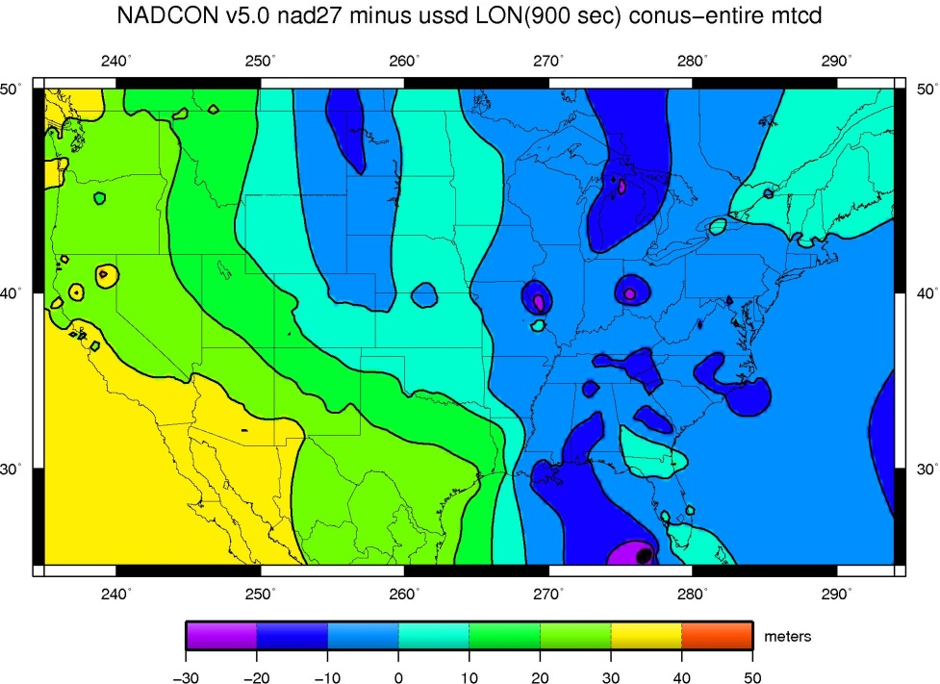
NADCON 5 example
Transformation shown in meters but actually performed in arcseconds

Slide 36
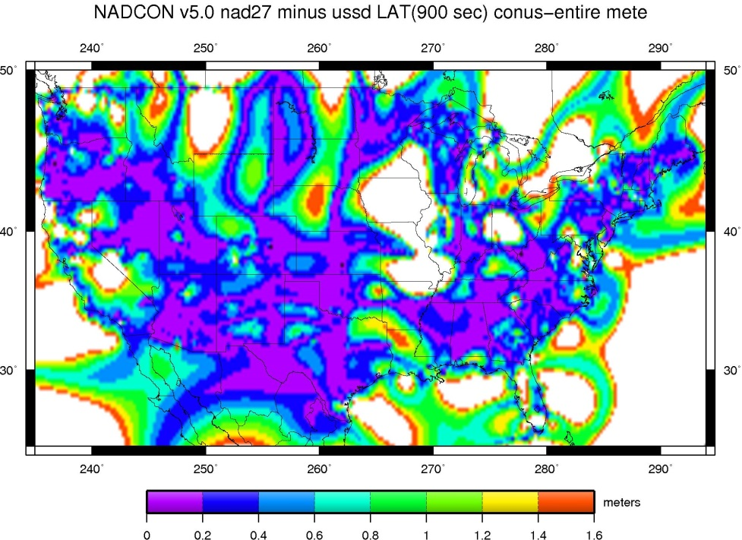
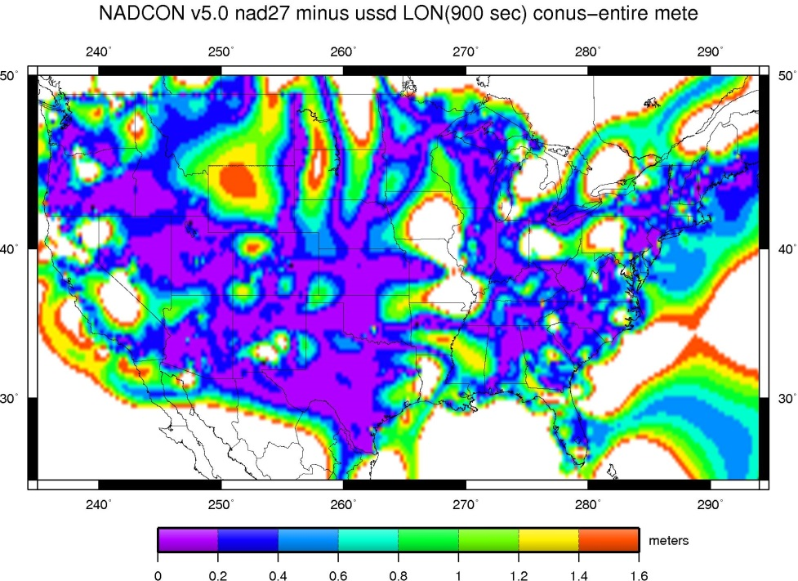
NADCON 5 example
Errors are no longer generalized (e.g. “15 cm in CONUS”)

Slide 37
Toolkit Future
The entire ngs toolkit will be integrated eventually
VERTCON 3.0
HTDP
VDatum
All other tools

Slide 38
Objective 5 of 5: Better Surveying

Slide 39
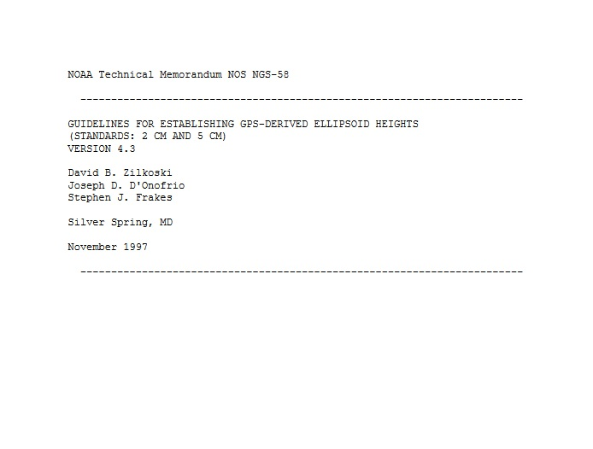
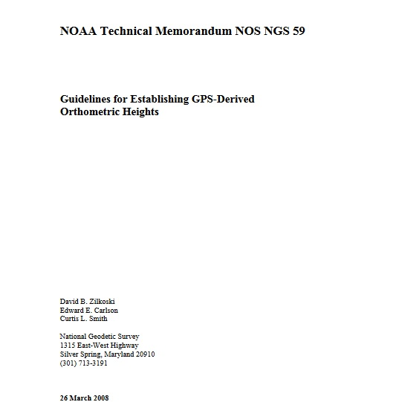
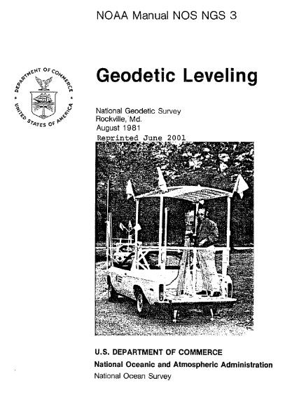
Better Surveying
overview
A focus on updating technology and field procedures
Field research
New Manuals
1997
1981
2008

Slide 40
Better Surveying
Upcoming project
The role of leveling in a vertical datum defined by a gravimetric geoid and accessed by GNSS
Acknowledging that leveling can not yield absolute heights
Combining GPS and leveling observations
New adjustment model
New software (see earlier OPUS-Projects slides!)

Slide 41
Summary

Slide 42
Summary
Nsrs modernization
More than just replacing NAD 83 and NAVD 88
Affects most tools, products and services of NGS
Dozens of interdependent multi-year projects ongoing
Expect rollouts and announcements throughout the next 6 years!

Slide 43
To learn more
New Datums Web Page
geodesy.noaa.gov/datums/newdatums/index.shtml

Slide 44
To learn more
Attend the Geospatial Summit
Silver Spring, MD
April 24-25, 2017
FREE
geodesy.noaa.gov/geospatial-summit/index.shtml

Slide 45
Questions?
THANK YOU!

