Slide 1

Geodesy in the Arctic:
A Focus on Alaska
Lynda Bell, NOAA/NGS Alaska Regional Geodetic Advisor
Arctic Regional Hydrographic Commission Open Science Forum
Anchorage, Alaska USA
September 08, 2025
Notes:
A note

Slide 2
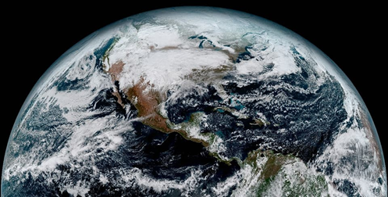
What is Geodesy?
Definition
The science of measuring and representing Earth’s shape, orientation in space, and gravity field
Key Elements
Positioning (latitude, longitude/height)
Gravity
Reference Frames
While we often think of the Earth as a sphere, our planet is actually very bumpy and irregular. Geodesy is the science of accurately measuring and understanding the Earth's geometric shape, orientation in space, and gravity field. This composite color full-disk visible image was captured on January 15, 2017, by GOES-16, the first spacecraft in NOAA’s next-generation of geostationary satellites.
Importance
Navigation
Mapping
Infrastructure

Slide 3
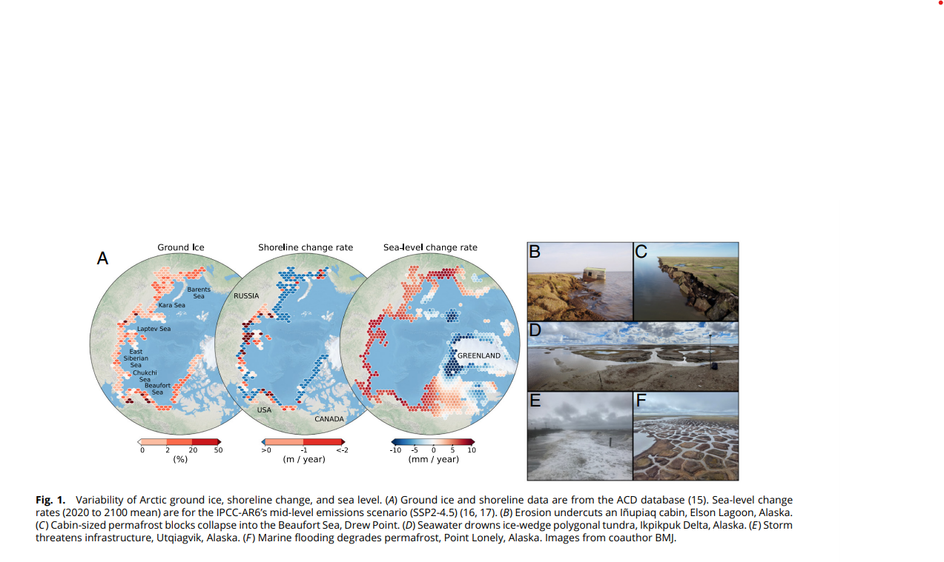
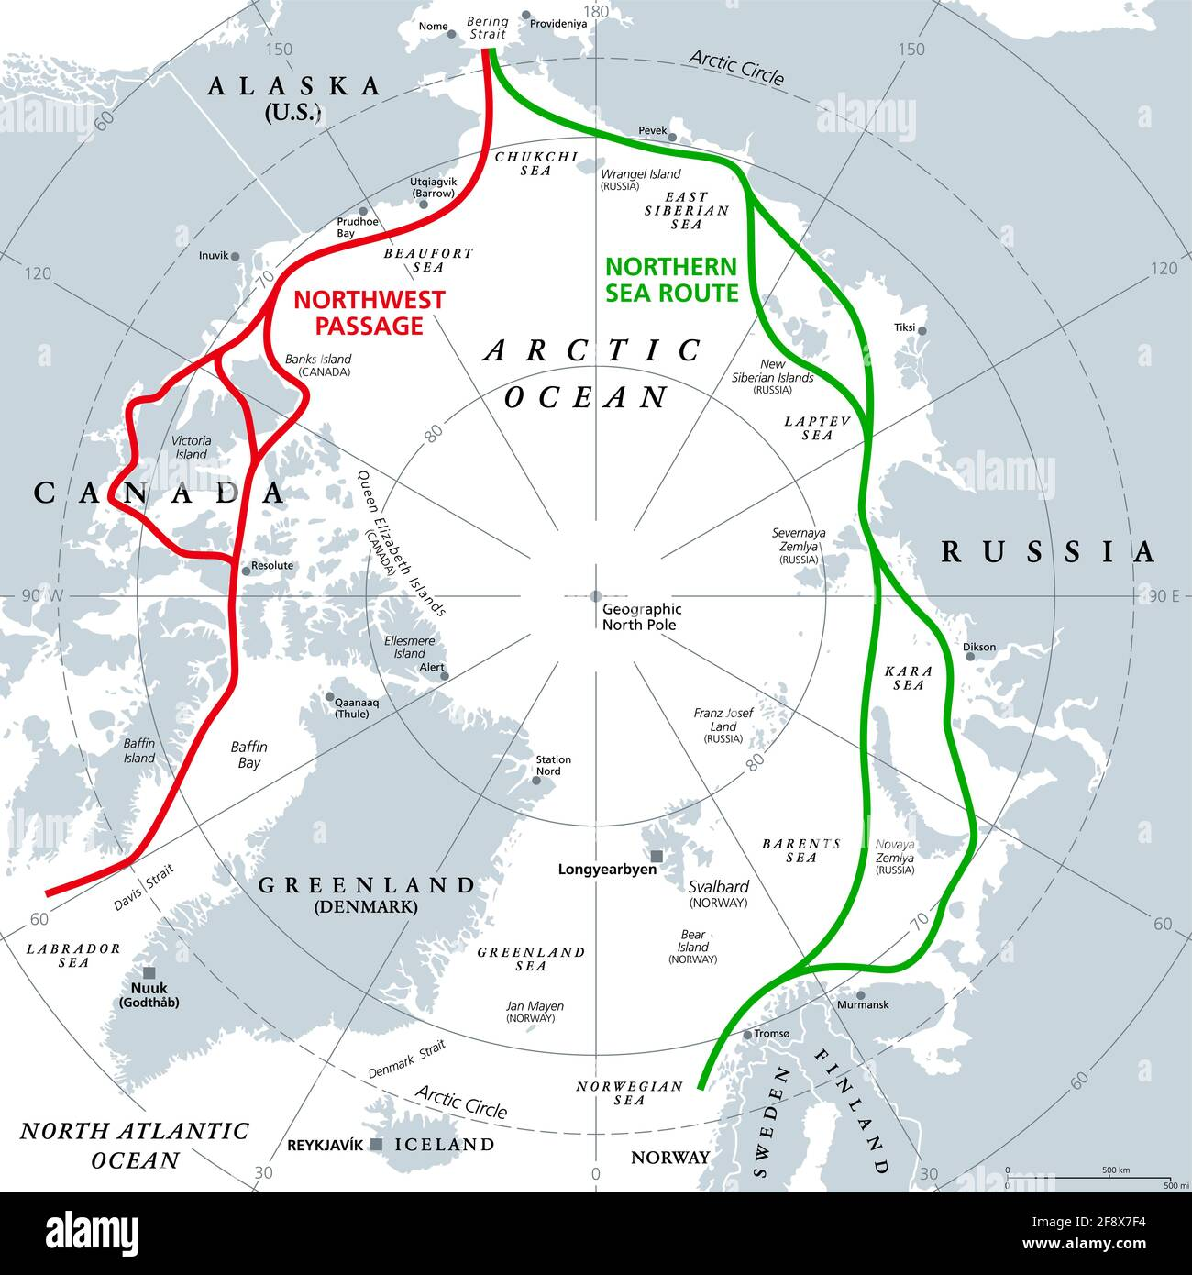
Why the Arctic Matters
Rapid environmental change → melting ice, permafrost thaw, sea-level rise
Strategic importance: shipping routes, natural resources, defense
Sensitive region for geodetic monitoring
Creel et al, PNAS 2024 Vol. 121 No. 50 e2409411121

Slide 4
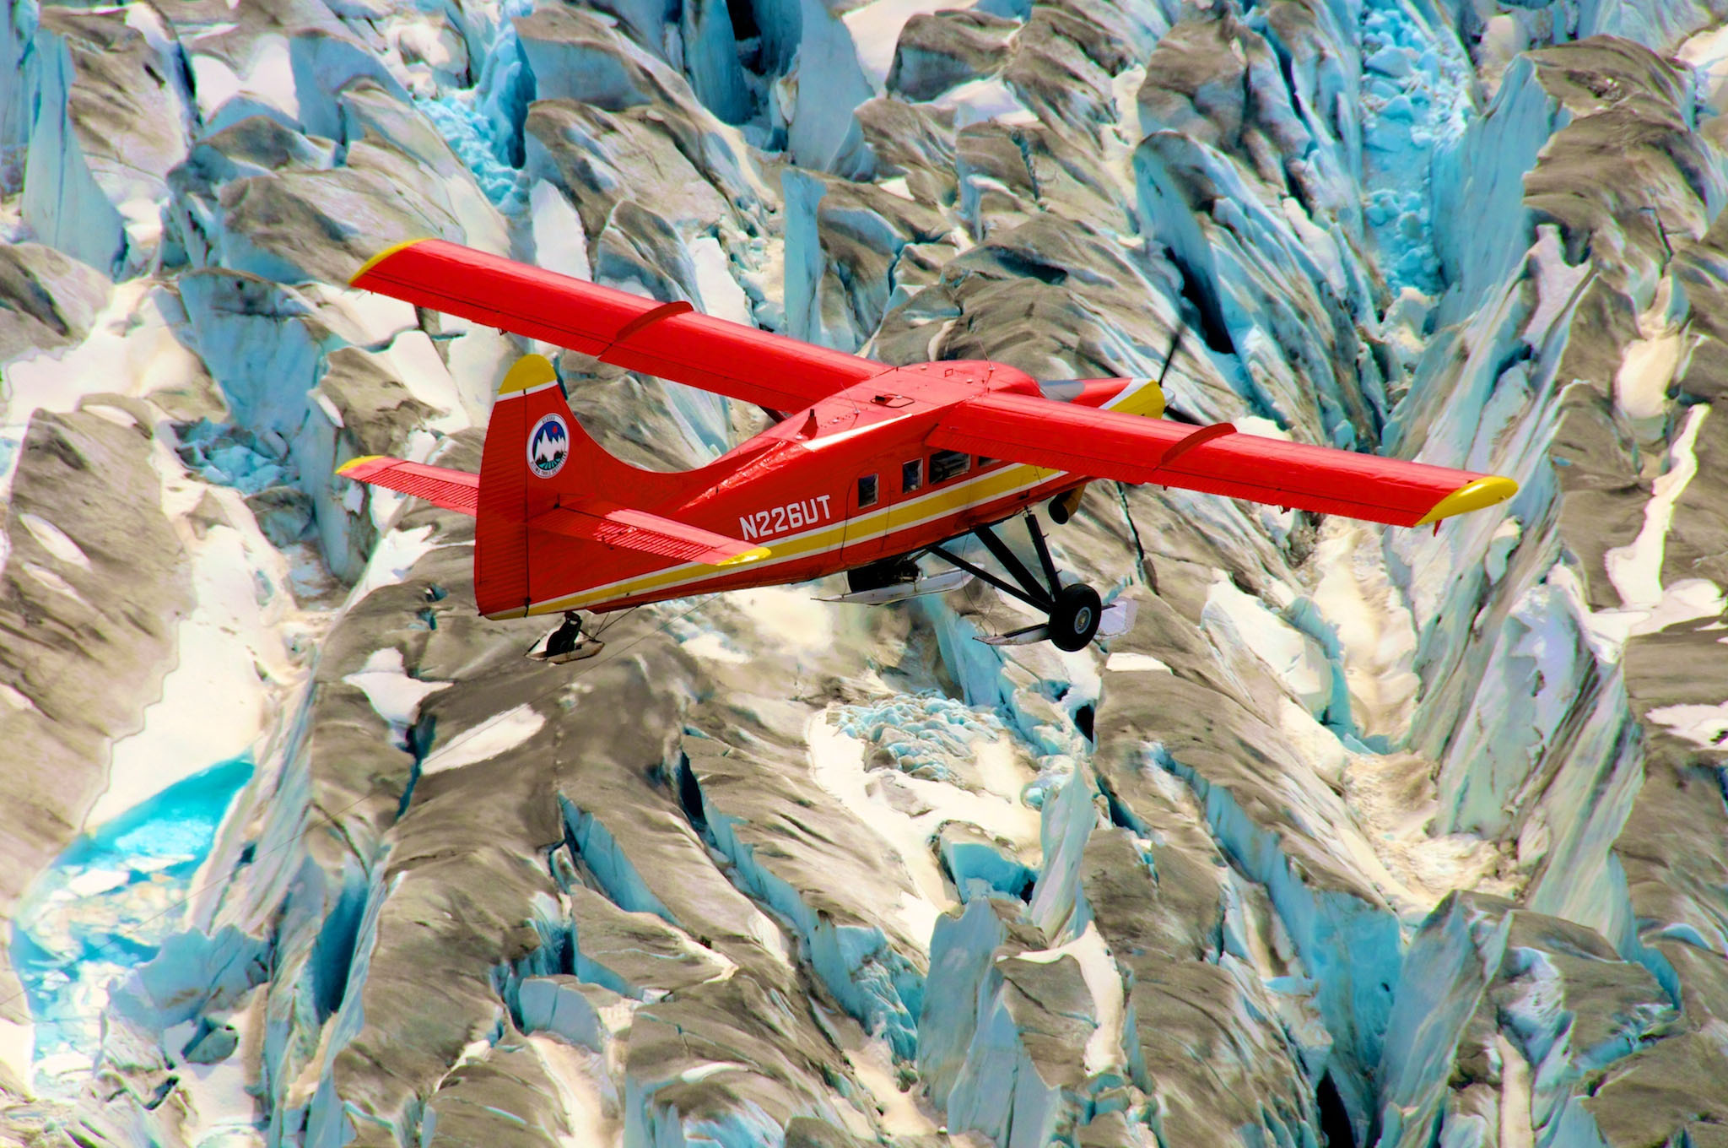
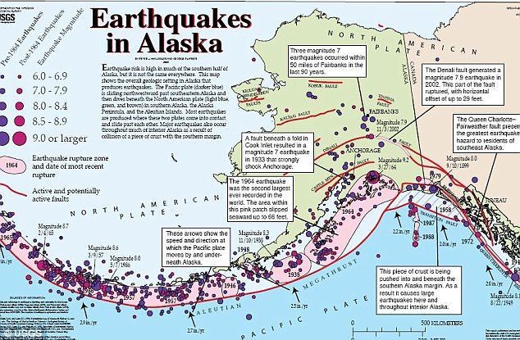
Alaska’s Role : US Arctic Gateway
The Setting: Active Plate Boundary,
Glacial Retreat, Isostatic Rebound
Periodic Strain Release
Unique geophysical setting:
tectonics, glaciers, permafrost,
33,904 miles of coastline
Key site for geodetic observations
and Arctic research

Slide 5
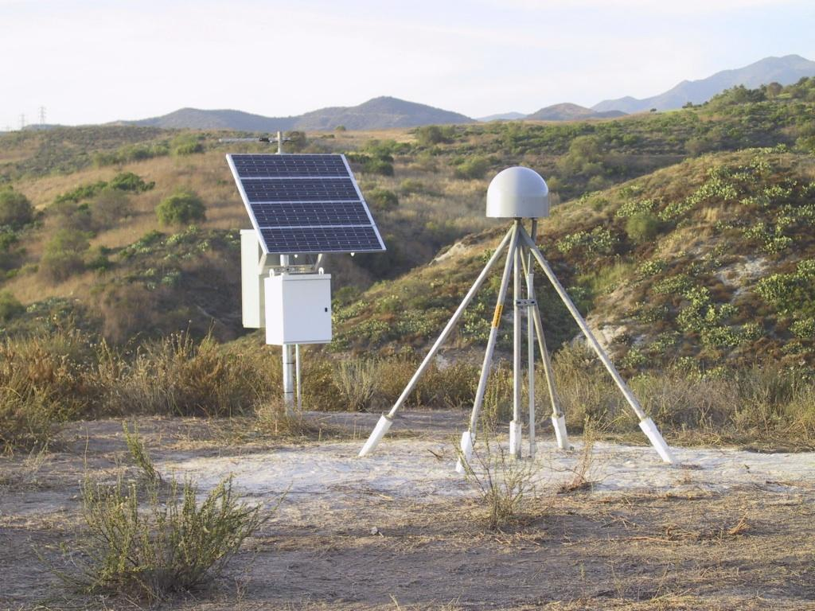
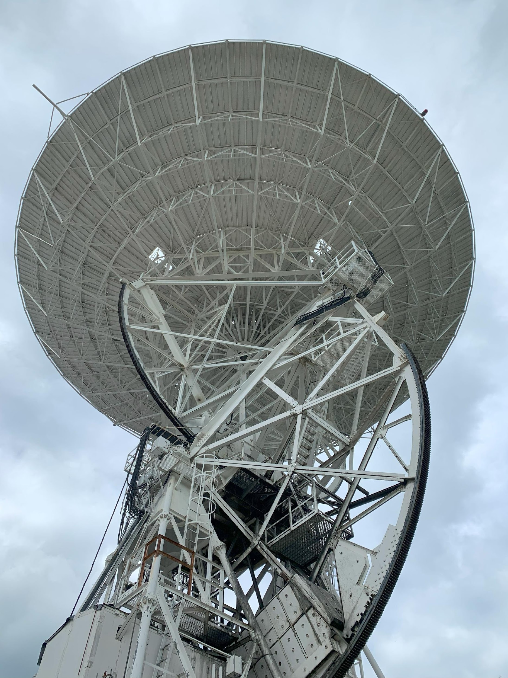
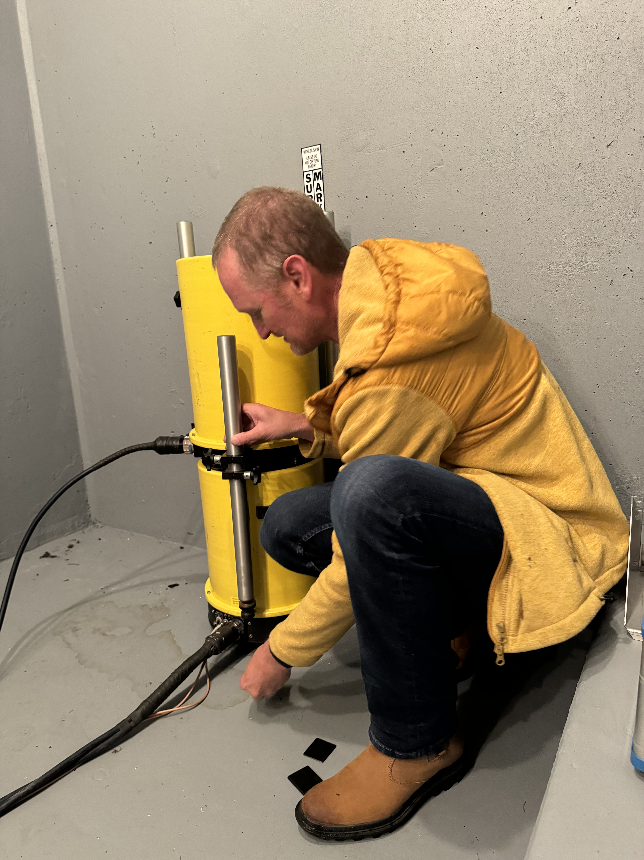
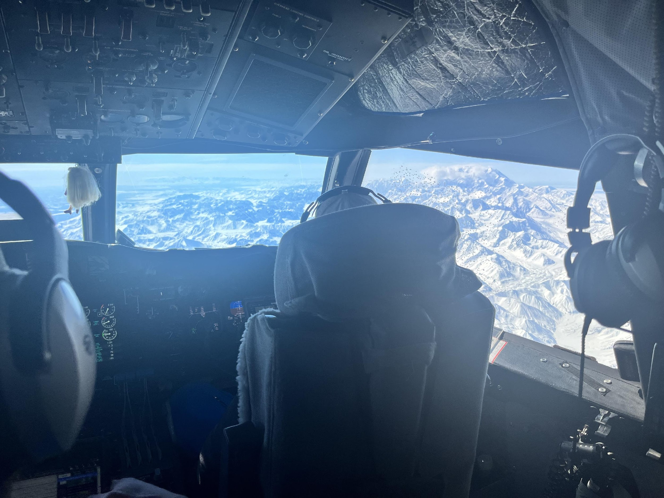
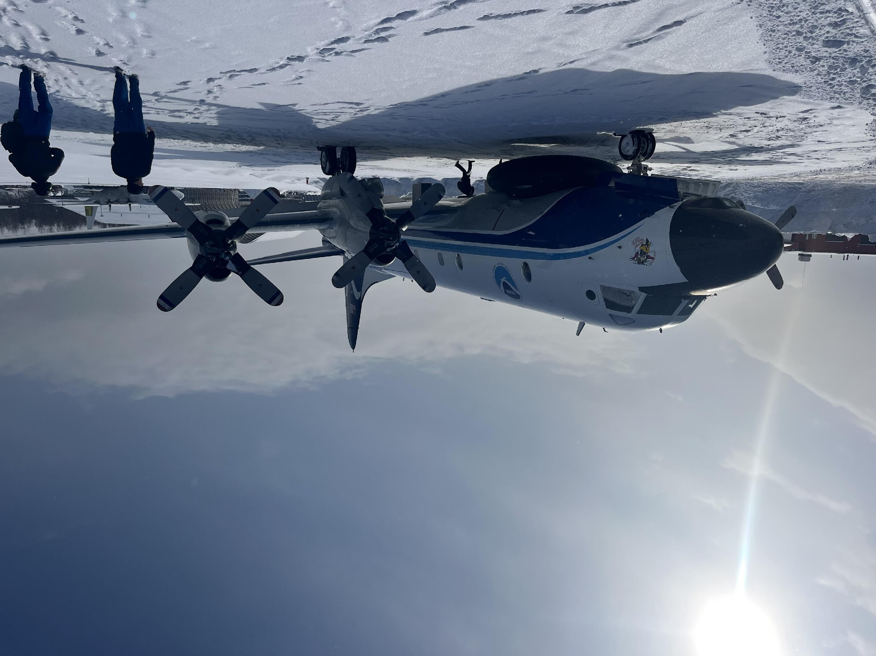
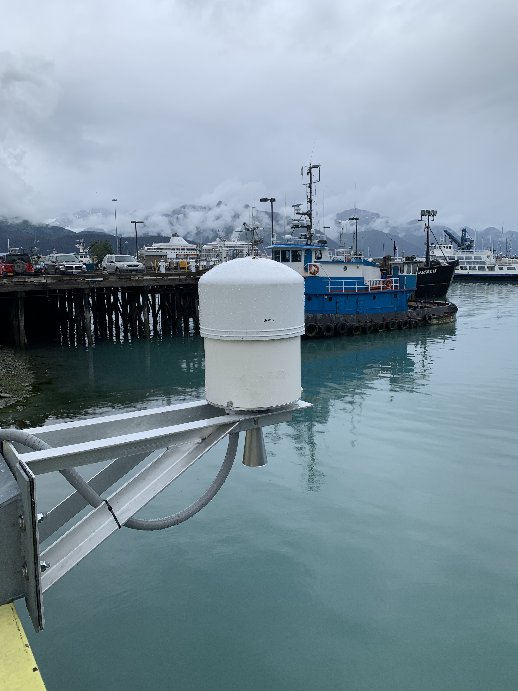
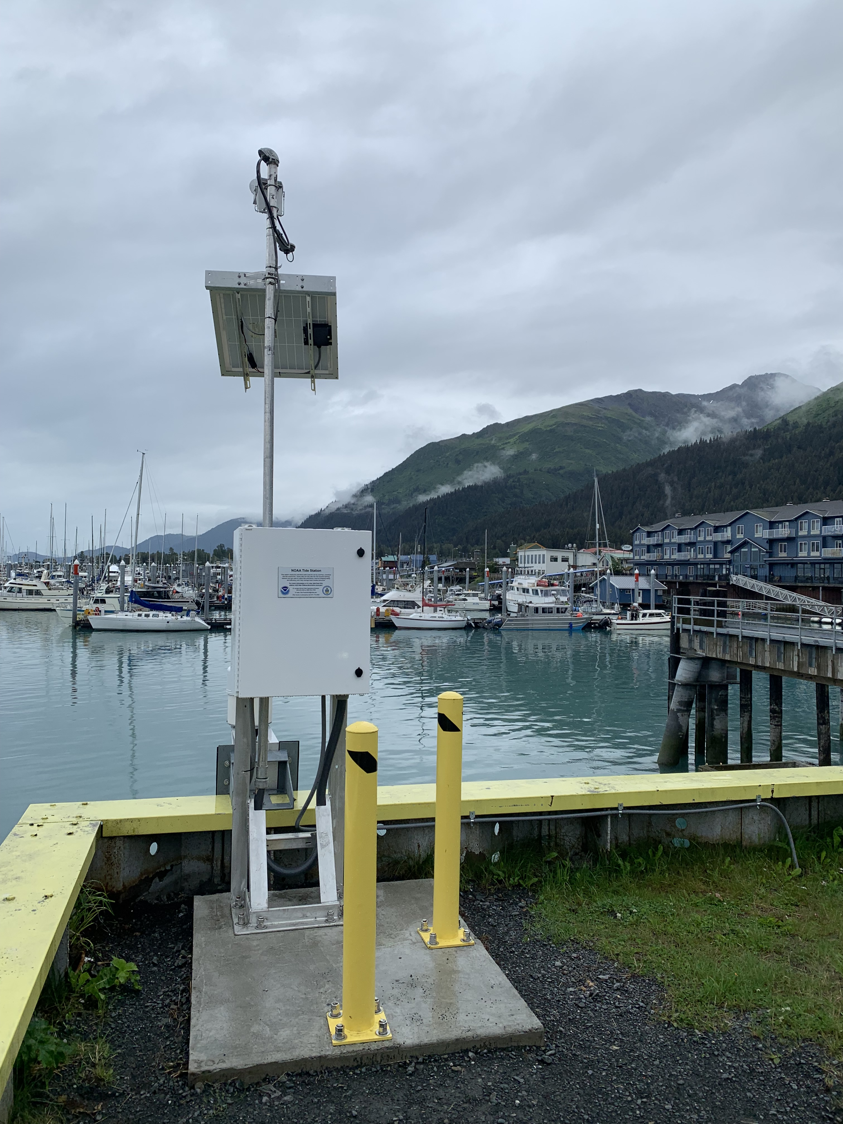
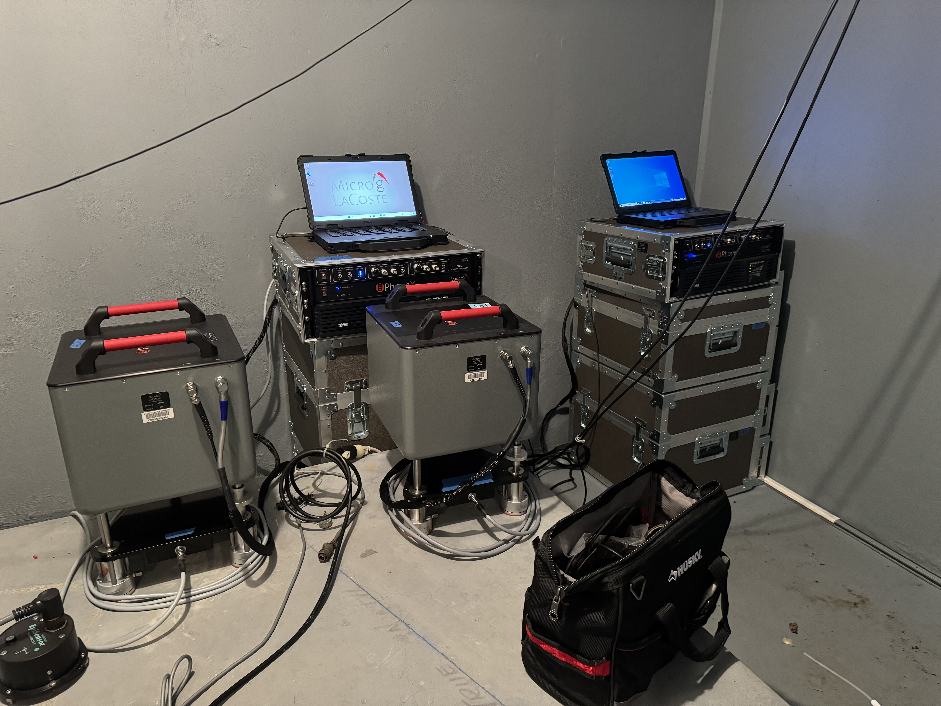
Tools & Techniques in Arctic Geodesy
GNSS (Global Navigation Satellite Systems)
Gravimetry (absolute & relative gravity measurements)
Remote sensing (satellite altimetry, InSAR, LiDAR)
Tide gauges & sea-level monitoring

Slide 6
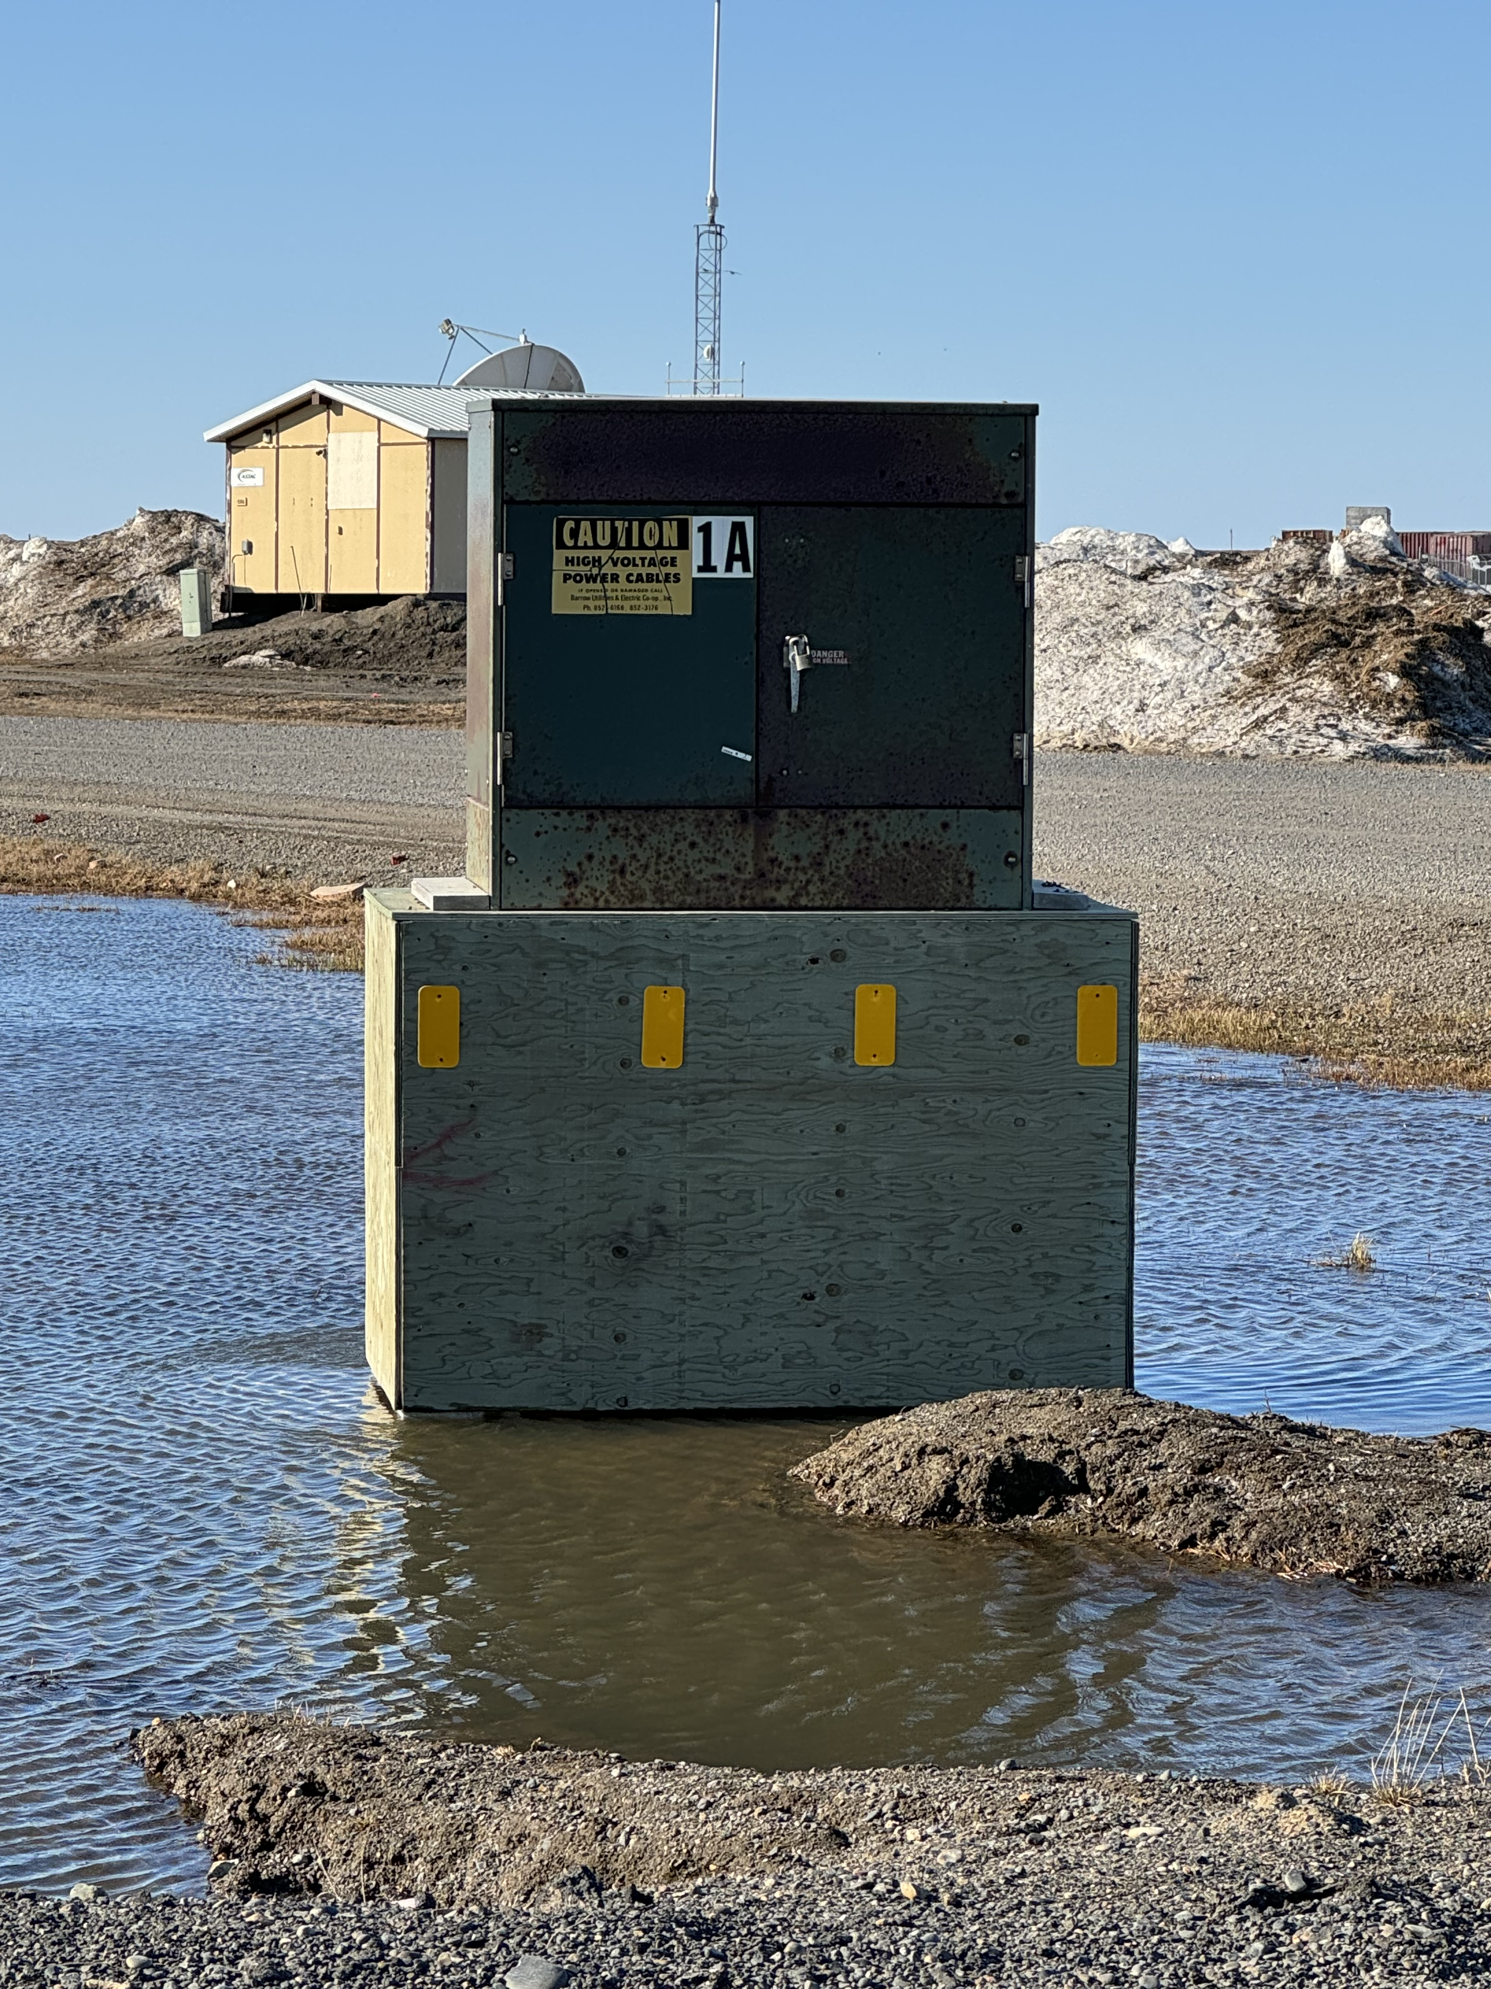
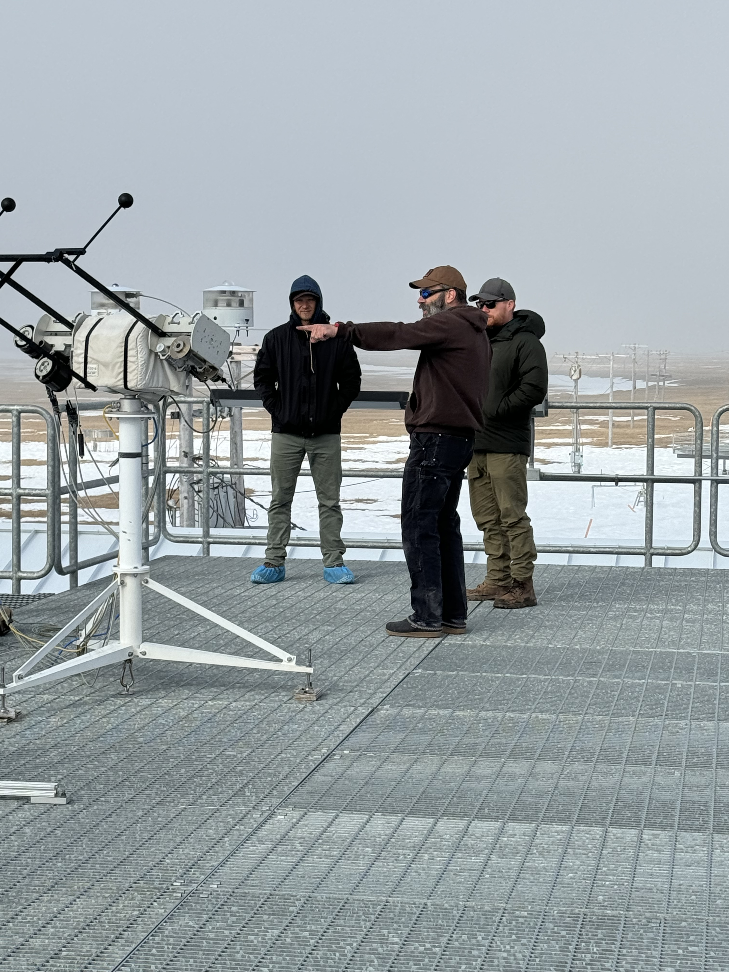
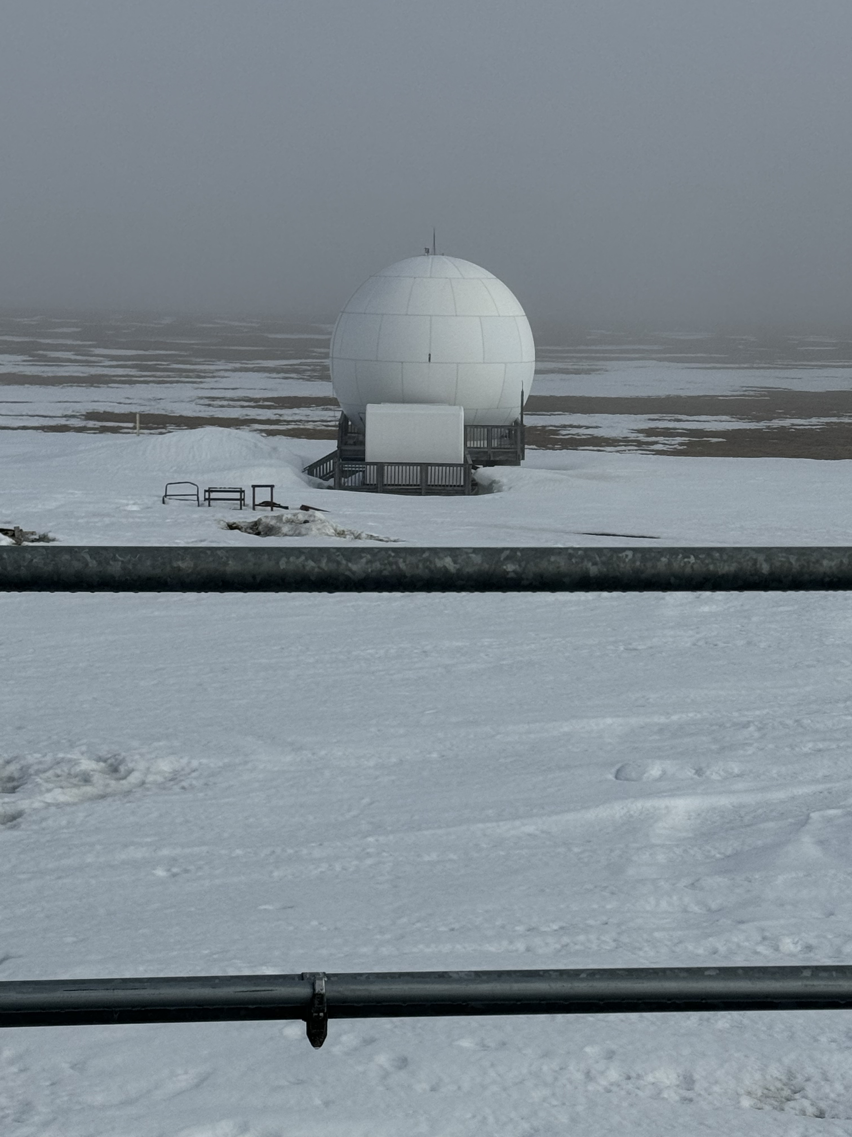
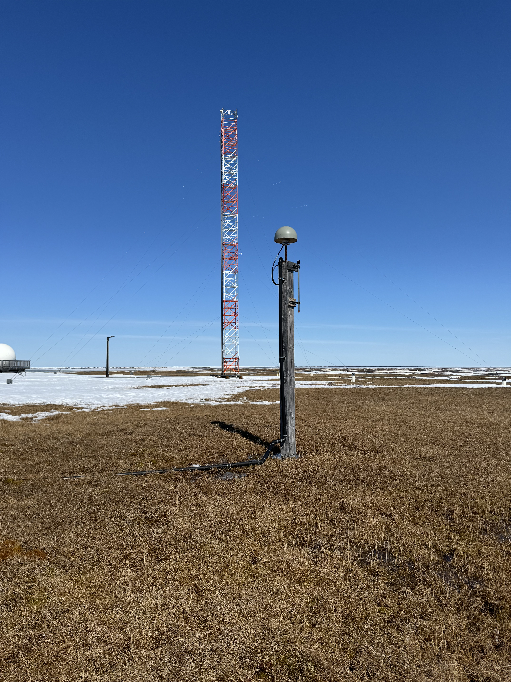
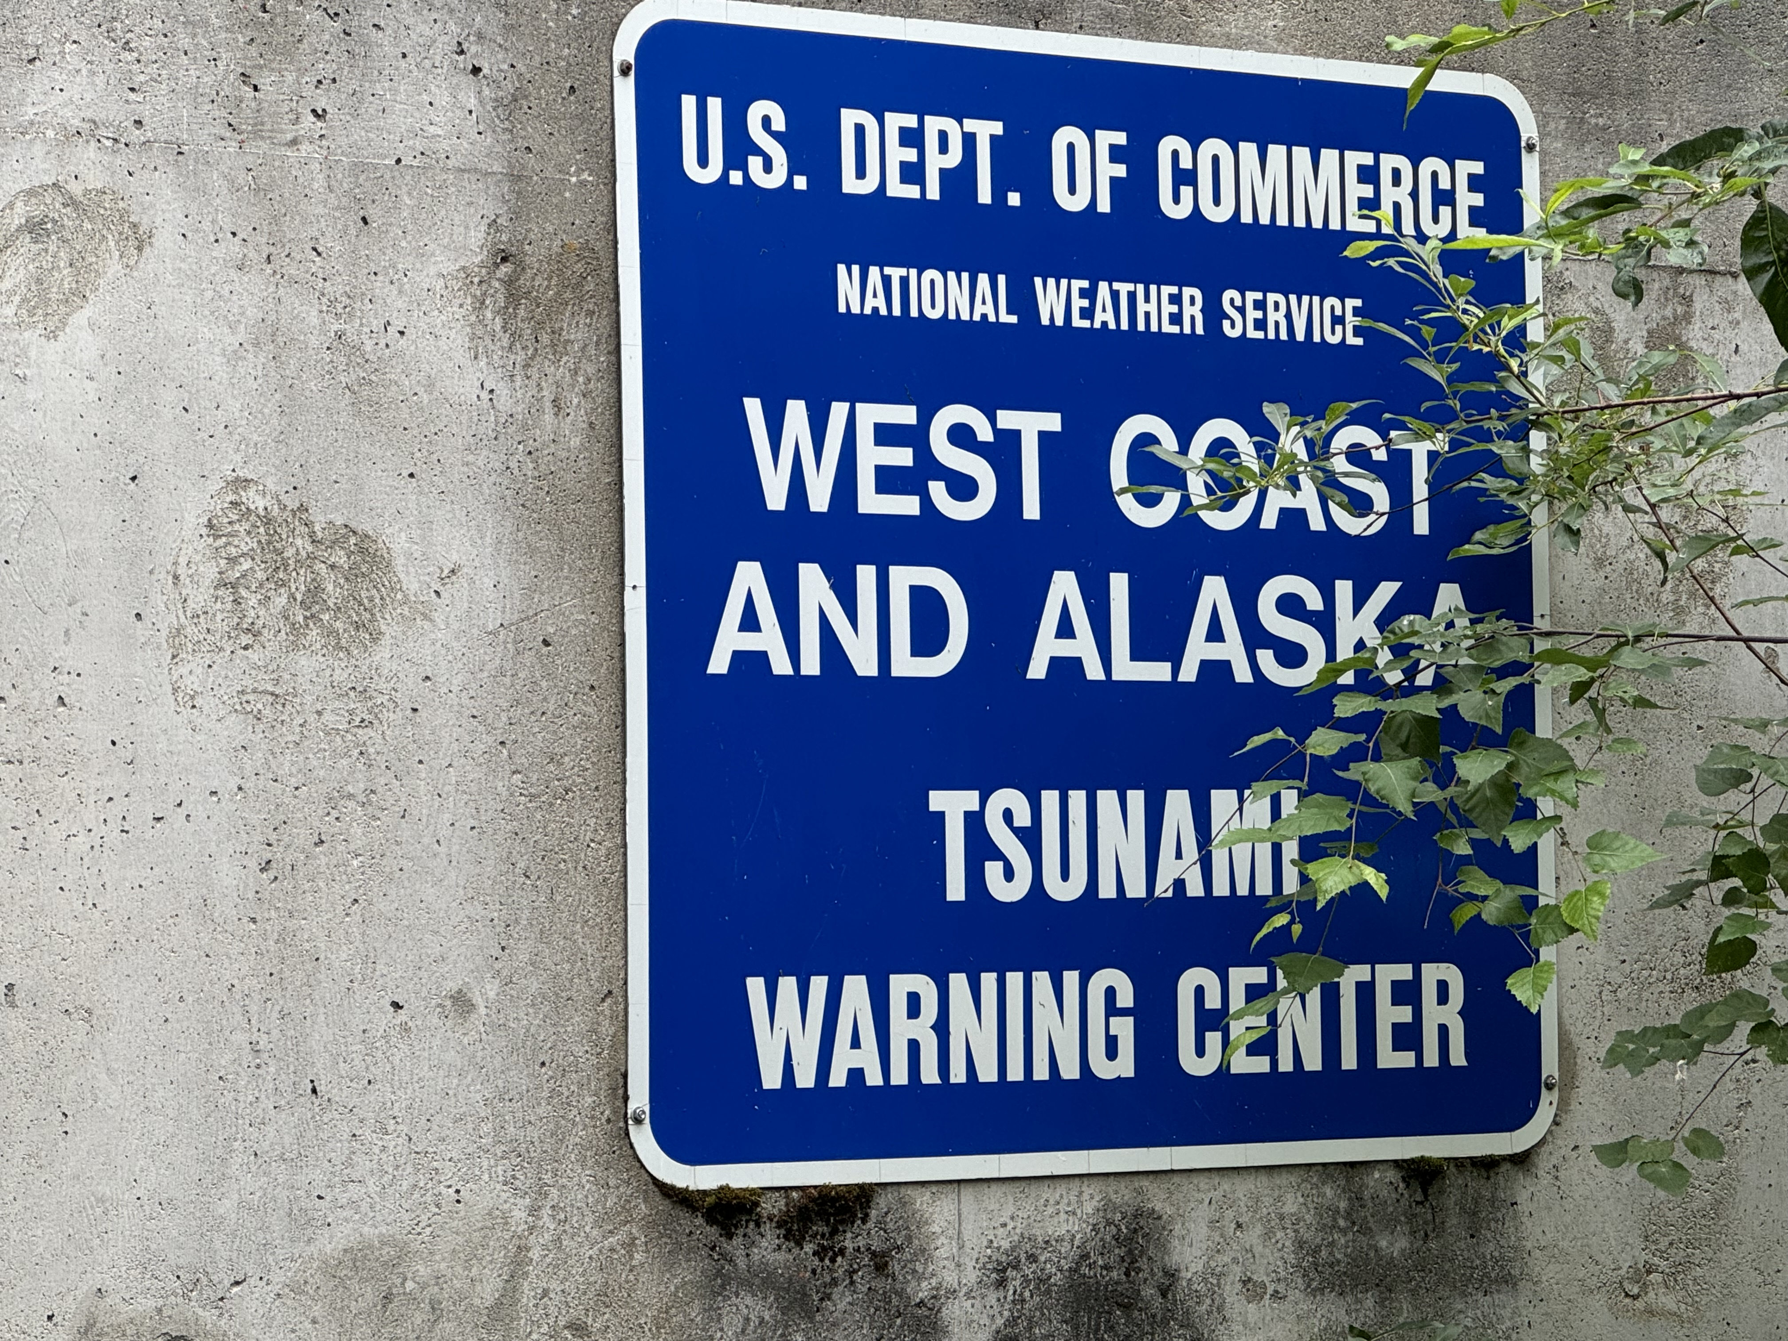
Challenges in Alaska
Harsh weather & remoteness → station maintenance difficulties
Seasonal accessibility
Permafrost impact on geodetic benchmarks
Polar ionospheric effects on GNSS signals

Slide 7
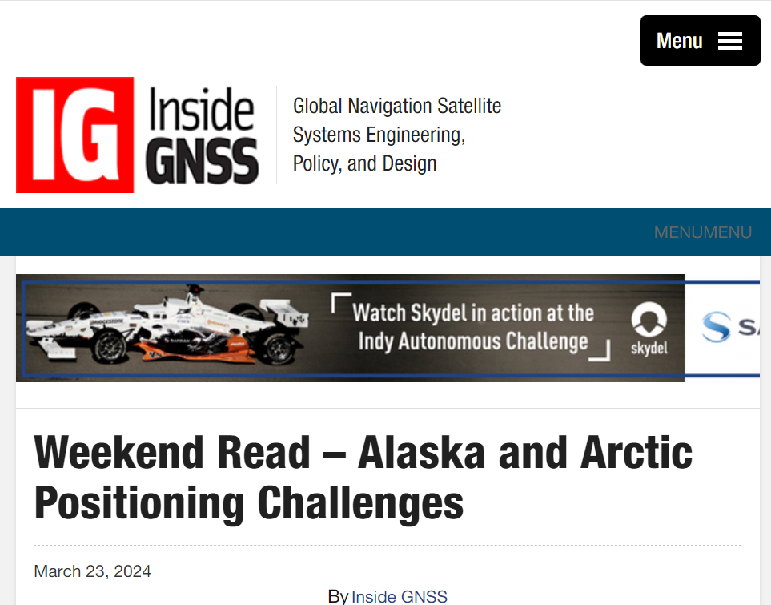
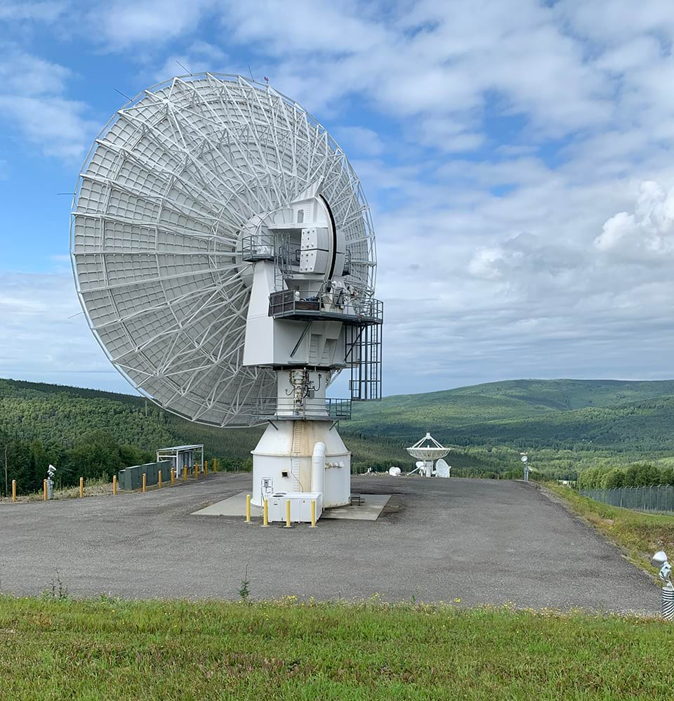
Mapping Challenges in Alaska:
Size, Remoteness, and Data Gaps
https://insidegnss.com/weekend-read-arctic-positioning-challenges/, Published March 23, 2024, Inside GNSS

Slide 8
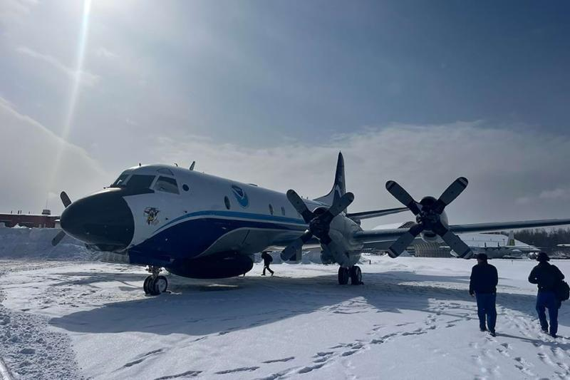
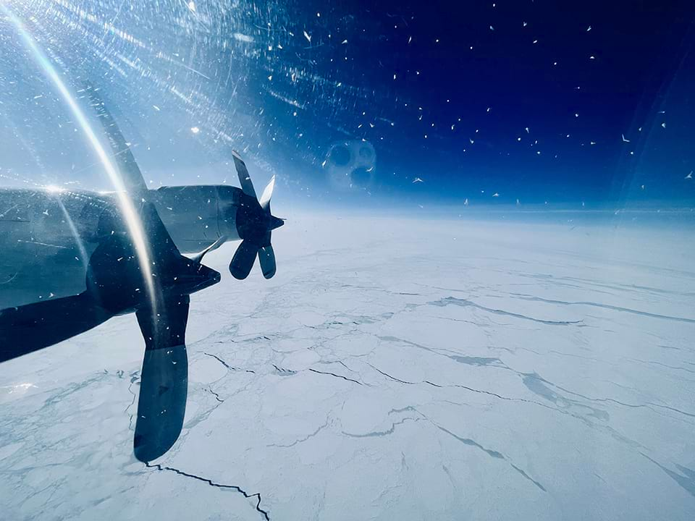
National Ocean Service:The Arctic Oceans & Coasts
Accurate Positioning Data for Alaska and the Arctic
https://oceanservice.noaa.gov/arctic/ngs-arctic.html
Published 2024

Slide 9
Positioning & Modernization Challenges in Alaska: Solutions : Support Regional Preparation
Improving Geodetic Survey Control and Coastal Mapping in Alaska through Federal, State, and Industry Partnerships
Building NOAA Foundation CORS in Alaska and NOAA CORS Network Improvements through Alaska state, federal, and private industry partnerships
NOAA’s NGS GRAV-D Completion 2024! Continue to improve gravity models through GeMs program 2025 and beyond in Alaska
VDATUM moving towards completion in Alaska through State and Industry Partnerships
University Outreach : training the future geodetic workforce

Slide 10
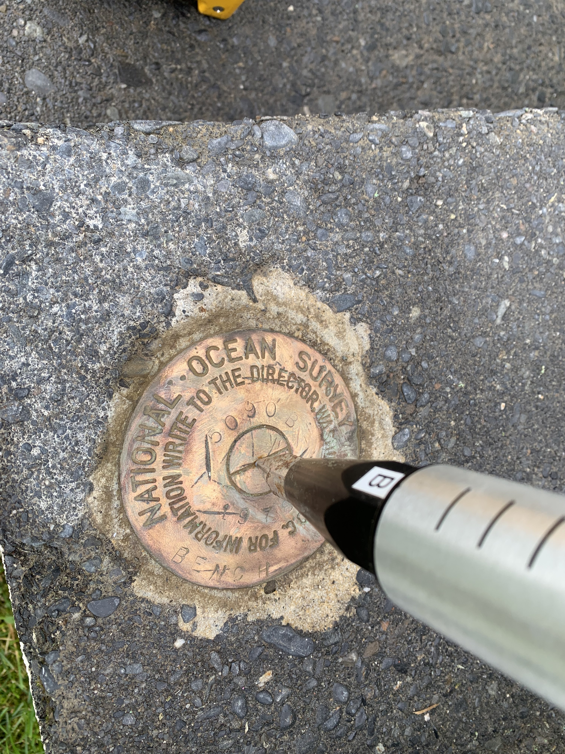
Enhancing and Densification of Geodetic Survey Control Improves:
Positioning – improvements in both
vertical and horizontal positioning
Ground truthing – improve base station
positions for LIDAR,aerial, drone,
photogrammetric, altimetric data
Datum consistency -throughout multiple
data sets used for digital elevation modeling

Slide 11
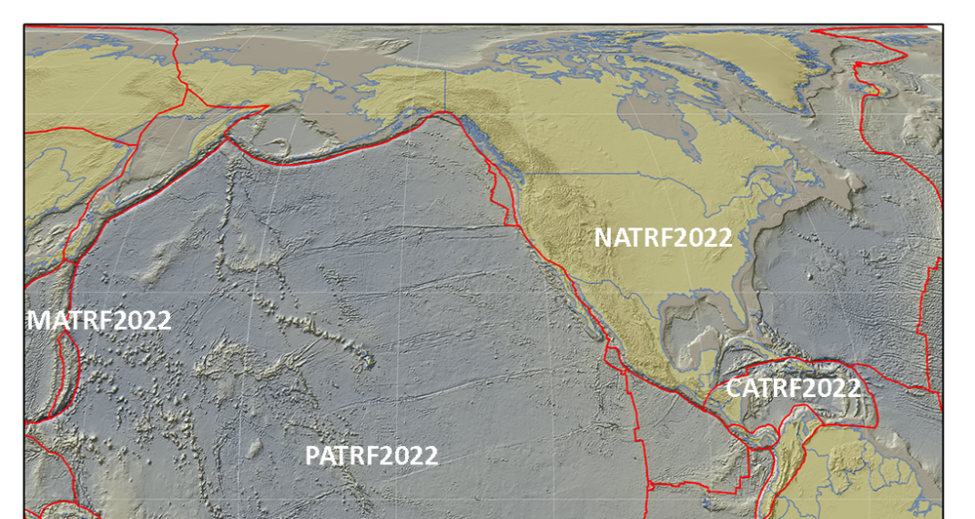
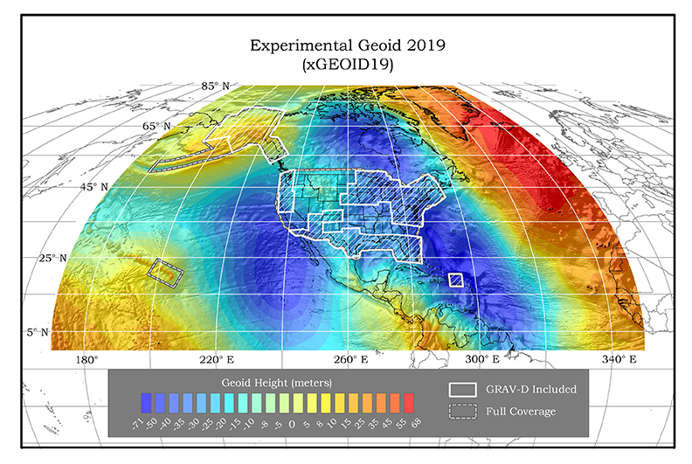
Modernizing the National Datums
NAPGD2022 – replaces NAVD 88
  Geopotential, Geoid Deflection of Vertical,
& Surface Gravity
NATRF, CATRF, PATRF, and MATRF2022
  Replaces NAD 83
  Based on densified ITRF model
  Tectonic-plate fixed
Notes:
ITRF fixed PLATE specific reference frame. 5th frame will be SIRGAS
NSRS Modernization Naming Conventions https://geodesy.noaa.gov/datums/newdatums/naming-convention.shtml
GRAV-D is now 96% completed

Slide 12
NSRS Modernization Timeline
June 2025
Initial release of key data sets (Beta site)
Sep 2025
Second release of tools and services (Beta site)
Early 2026
Finalizing tools and service based on comments provided through the Beta site (Beta site)
Late 2026
FGDC Approval - Moving all data, tools and services into production
Modernized NSRS Deploys!

Slide 13
Foundation CORS (Continuously Operating Reference System)
The Foundation CORS (FCORS) are the “backbone” of the NOAA permanent GPS Network (also known as, NOAA CORS Network, NCN). The purpose of FCORS is to allow NGS to fulfill its core mission: to define, maintain, and provide access to the national coordinate system defined by NOAA, even if every single other station in the network were to cease providing data
2,000
# of stations
Alignment and Definitional CORS
Foundation CORS
0

Slide 14
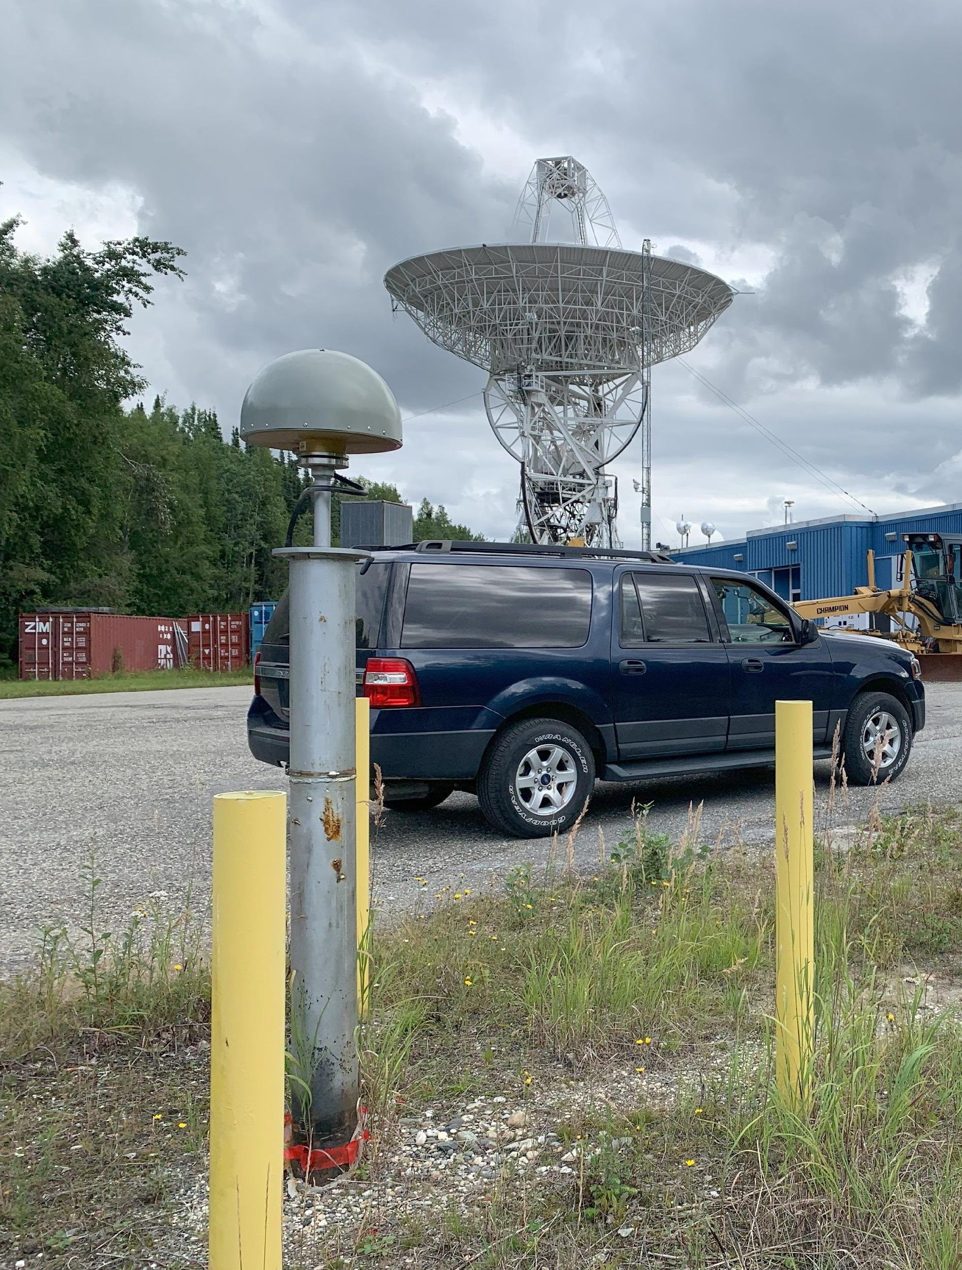
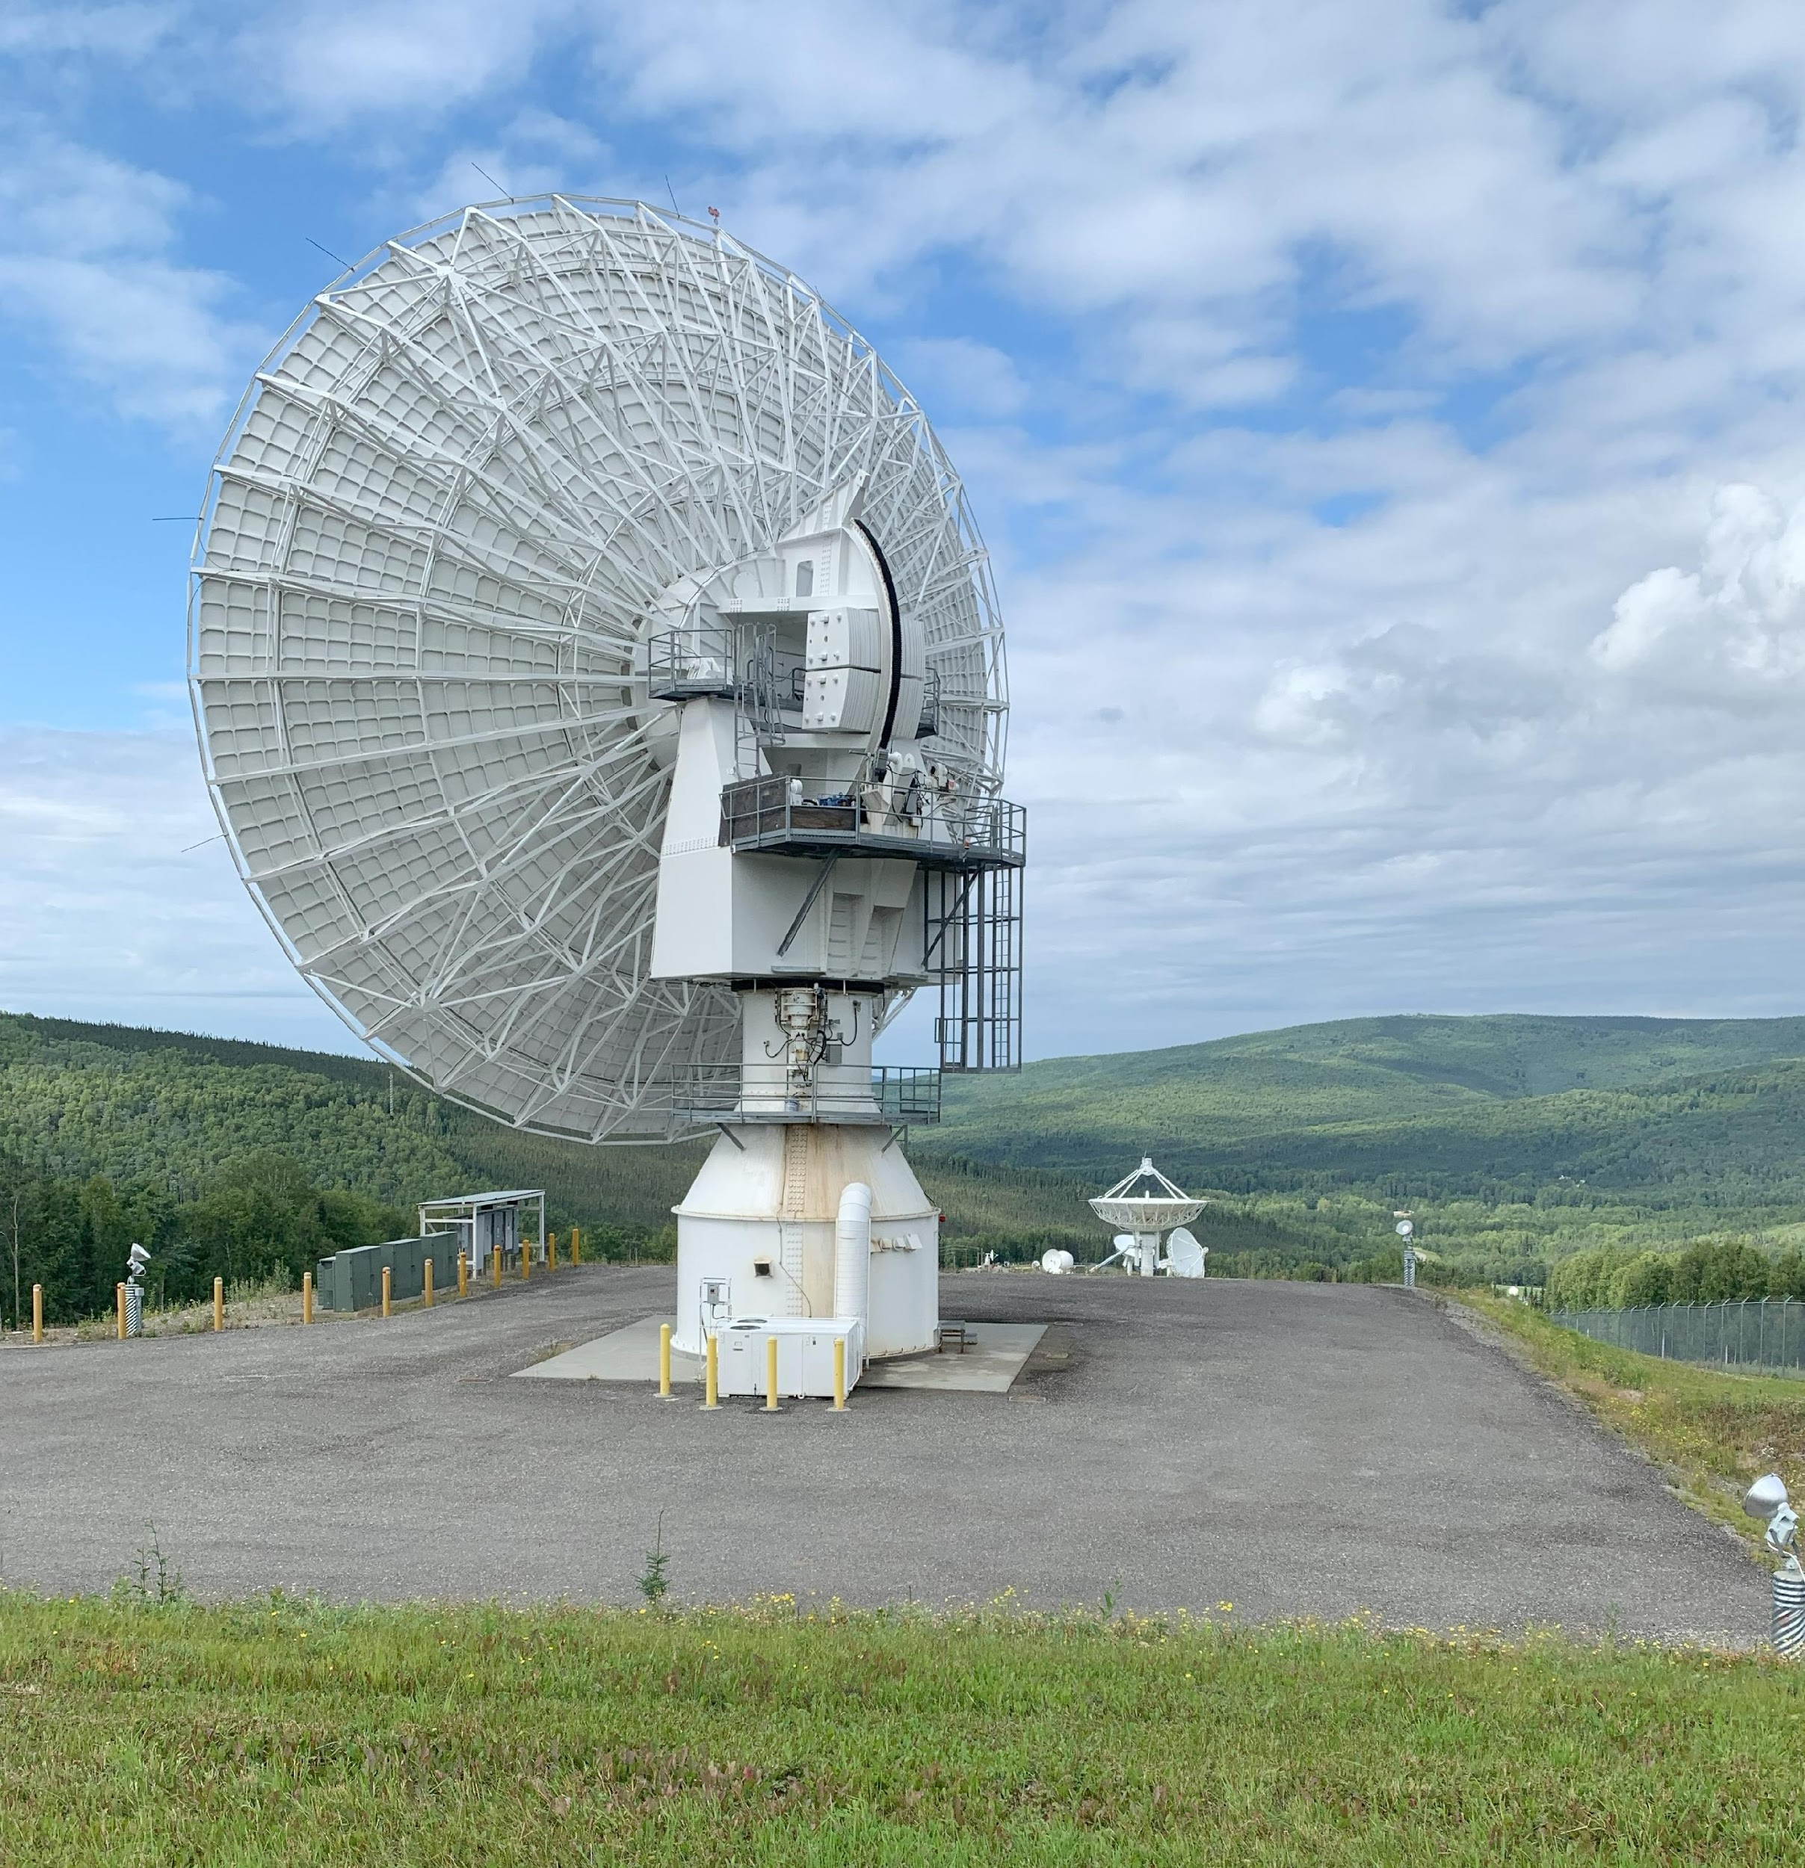
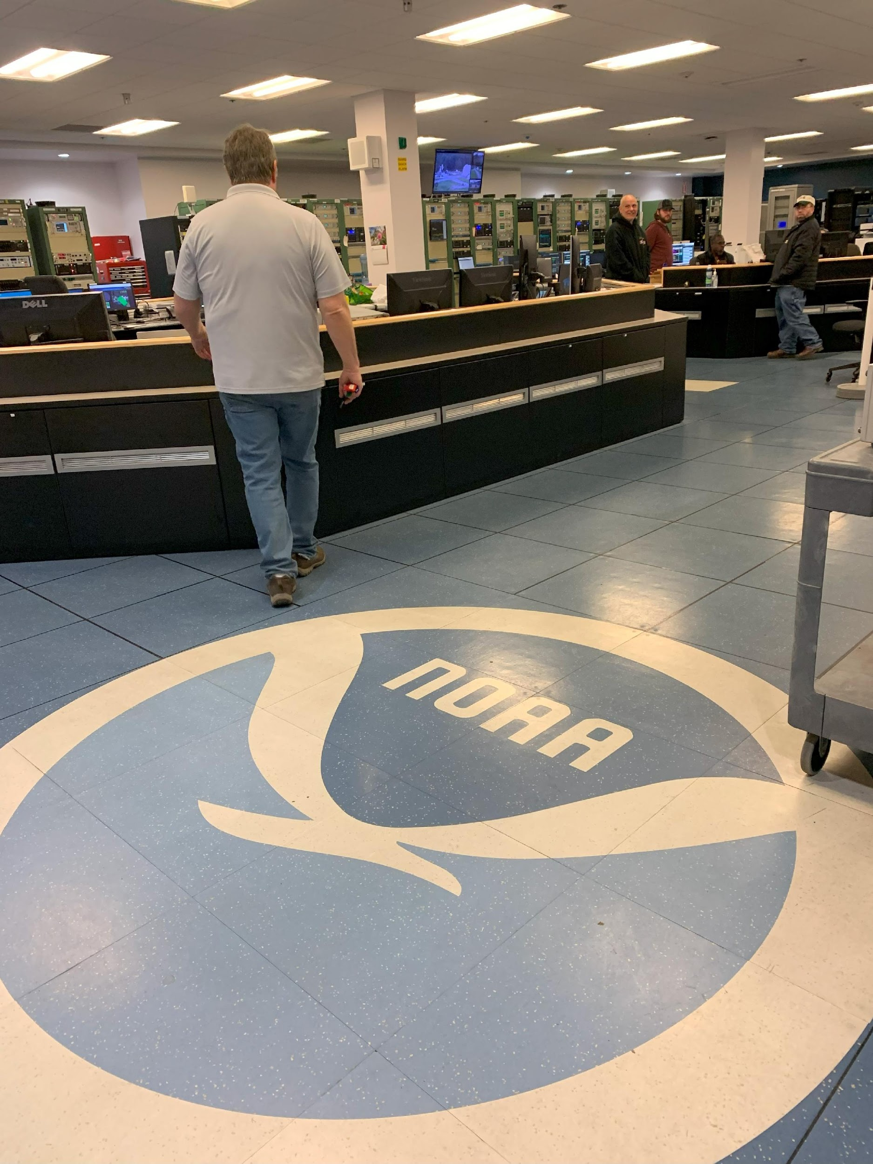
NGS in Alaska: Foundation CORS
A permanent GPS station that provides stable measurements that allows accurate station position and velocity.
Maintain consistency between NSRS and ITRF
Stations at highest standards and federally owned
  Available > 90% of time
  Down time < 14 days
  800-1000 km to support OPUS service

Slide 15
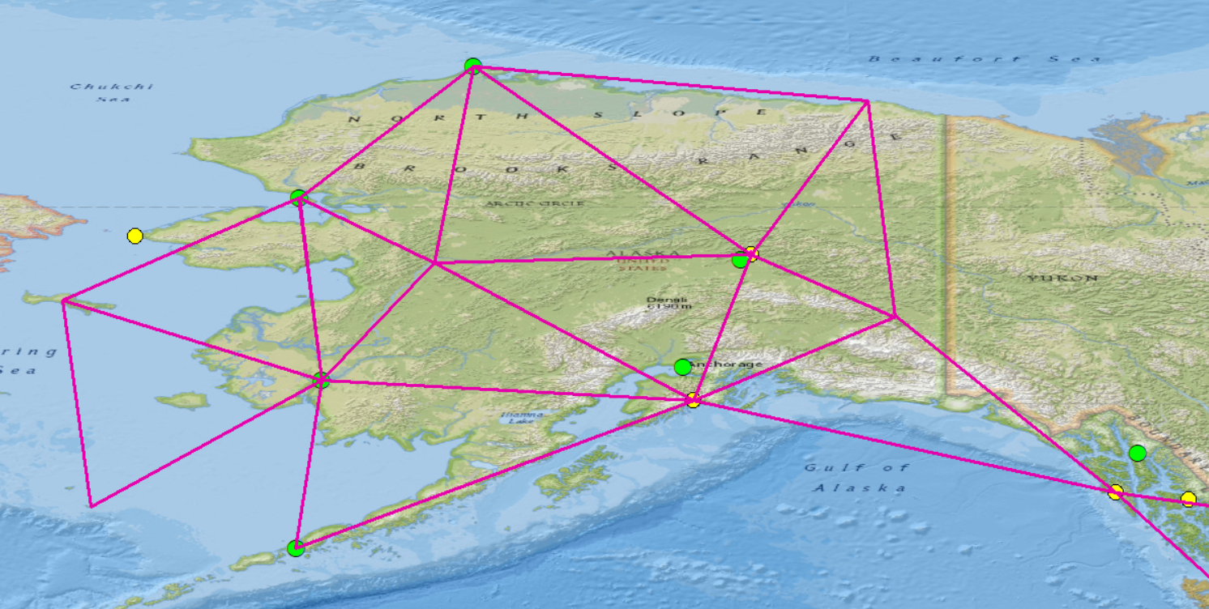
FCORS in Alaska
Legend
FCORS (NGS)
FCORS (NSF)
FCORS (NASA)
WAAS (FAA)
Gap
GCGO (NASA)
AKSE (NASA)
AKSI (NGS)

Slide 16
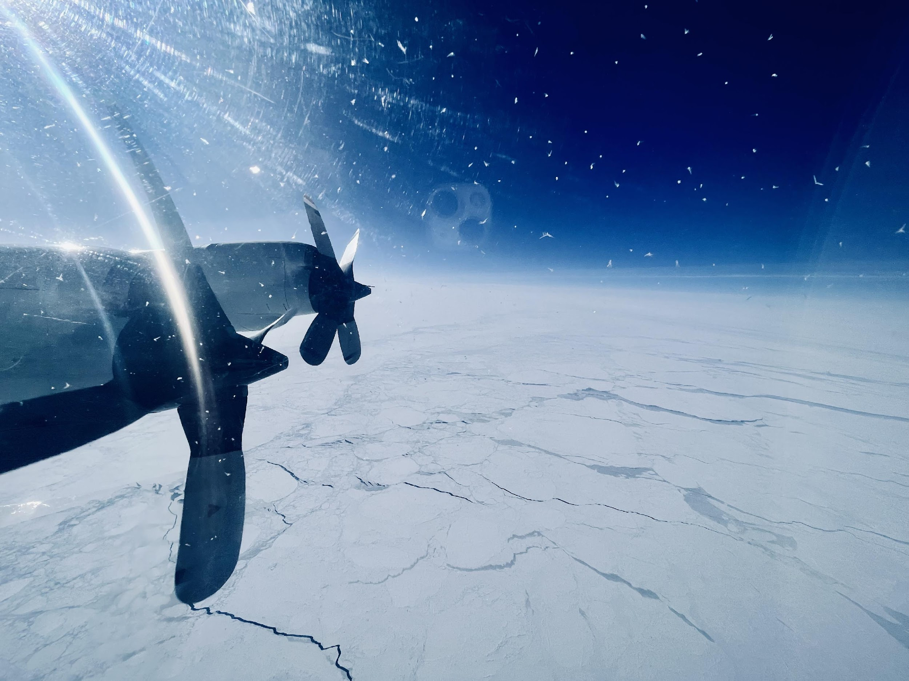
NGS in Alaska: GRAV-D Complete!
The NGS GRAV-D (Gravity for the Redefinition of the American Vertical Datum) aerial surveys were completed in Alaska with the final set of flights flown through the summer of 2023, bringing this 15-year project to successful completion. This data will be a critical component in the development of the North American-Pacific Geopotential Datum of 2022 (NAPGD2022).

Slide 17
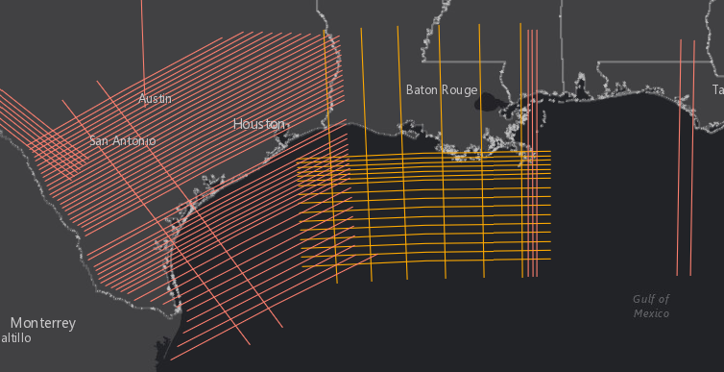
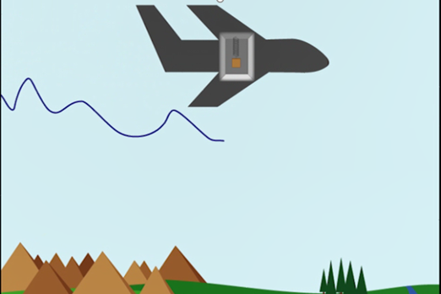
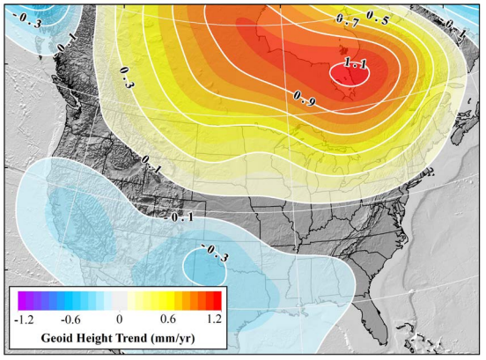
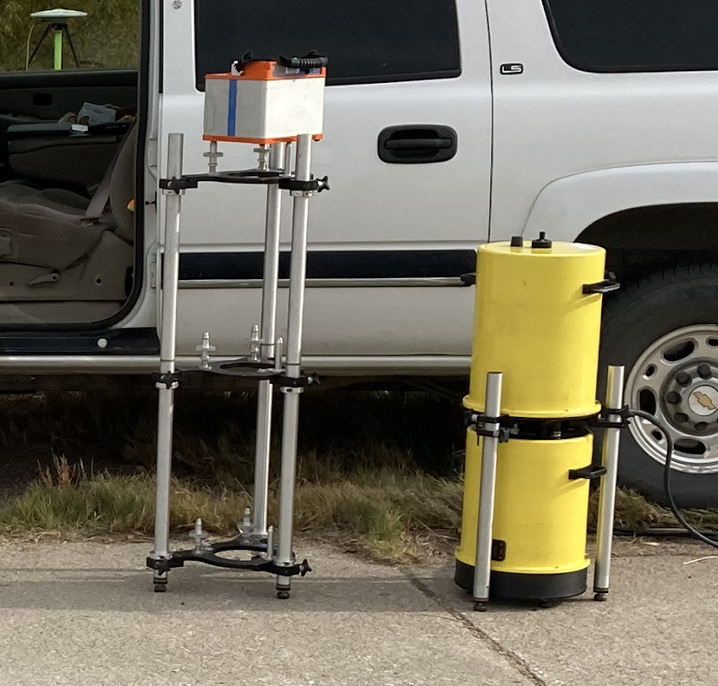
What is GRAV-D?
Gravity for the Redefinition of the American Vertical Datum (GRAV-D):
NOAA initiative to collect airborne gravity data over the entire US and territories started circa 2007, referred to as a “high-resolution snapshot”
A “low-resolution movie” of gravity changes over time: Now a project in its own right as the Geoid Monitoring Service (GeMS)
  GeMS informs the dynamic DGEOID2022 part of NAPGD2022.
Notes:
Note: GRAV-D is an airborne gravity campaign, not the actual vertical datum.

Slide 18
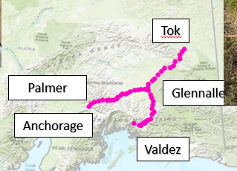
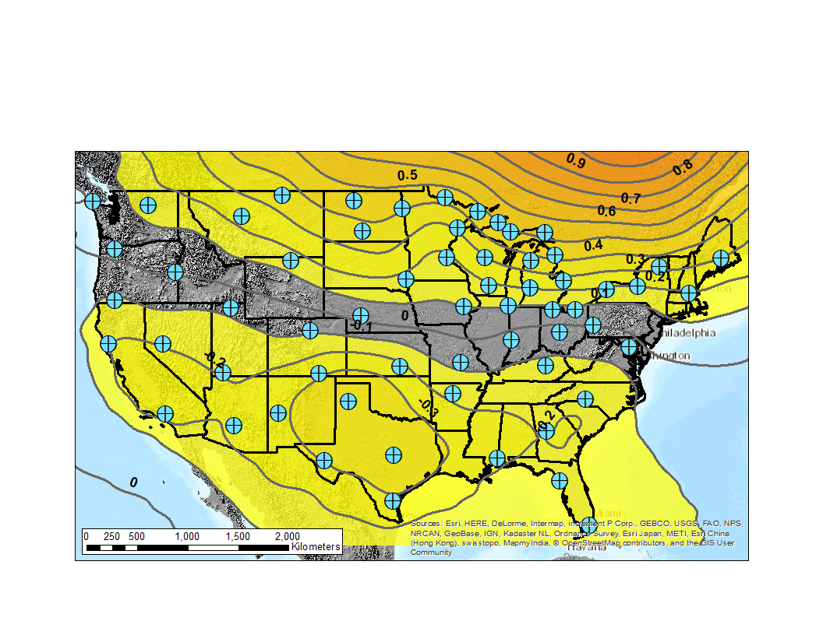
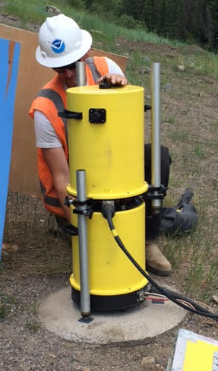
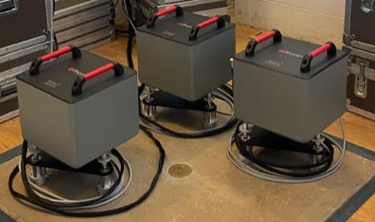
What’s Next? Geoid Monitoring Service: GeMS
Alaska GeMs Validation Survey September 2025
Supports the DGEOID2022 product: How are geoid heights, gravity, orthometric heights, potential, and DoV changing over time? (NOAA Technical Report 69)
Alaska GeMS Validation Survey: 5 year frequency
Continuous relative gravity observations. . Alaska also includes DoV and GNSS observations.
Proposed, preliminary absolute gravity network with geoid rates from GRACE in mm/yr (contour interval = 0.1 mm/yr)
Absolute gravity observations
Notes:
Divided the country into 4 quadrants. We have already done absolute gravity surveys in the NE and SE quadrants. This year, we intend to do work in the NW quadrant and Alaska. Take absolute gravity measurements and then deploy g-phones for continuous observations.

Slide 19
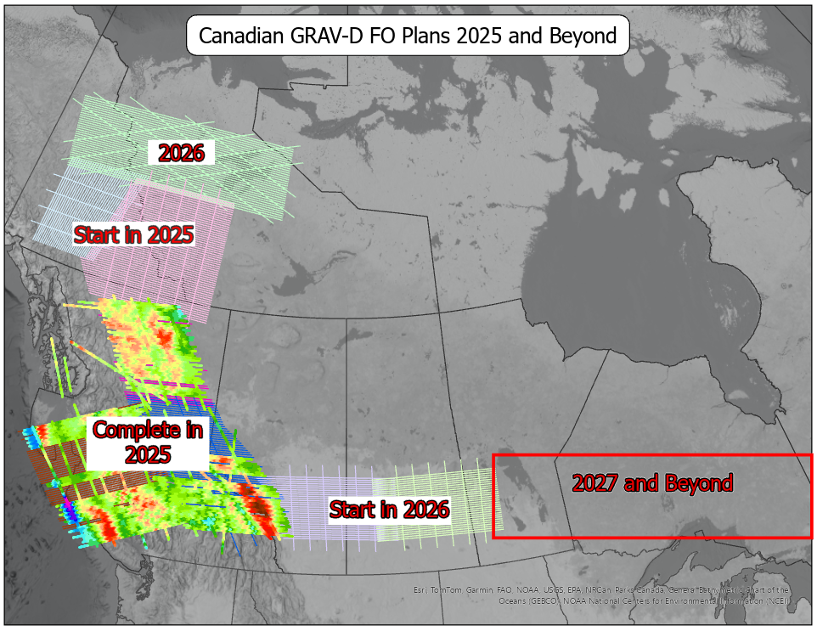
Airborne gravity (Canada) *NGA funded project
Complete blocks over the Canadian Rockies in 2025
Start blocks over Yukon and Northwest Territories in 2025
Complete large block over Yukon and Northwest Territories in 2026 with long range aircraft.
Start central blocks in 2026 (Below 53°N parallel).
2027 and Beyond move through Ontario.

Slide 20
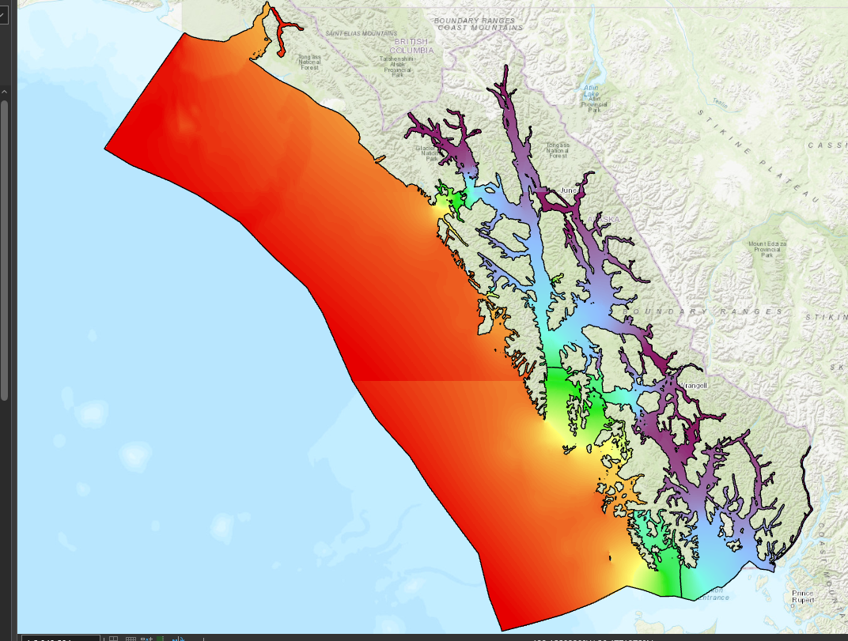
Supporting Completion of NOAA’s VDatum : Vertical Datum Transformation Tool for use in Alaska
VDatum is a free software tool being developed jointly by NOAA’s National Geodetic Survey (NGS), Office of Coast Survey (OCS), and Center for Operational Oceanographic Products and Services (CO-OPS).
Designed to vertically transform geospatial data among a variety of tidal, orthometric, and ellipsoidal vertical datums
Enables fusion of diverse geospatial data in desired reference levels

Slide 21
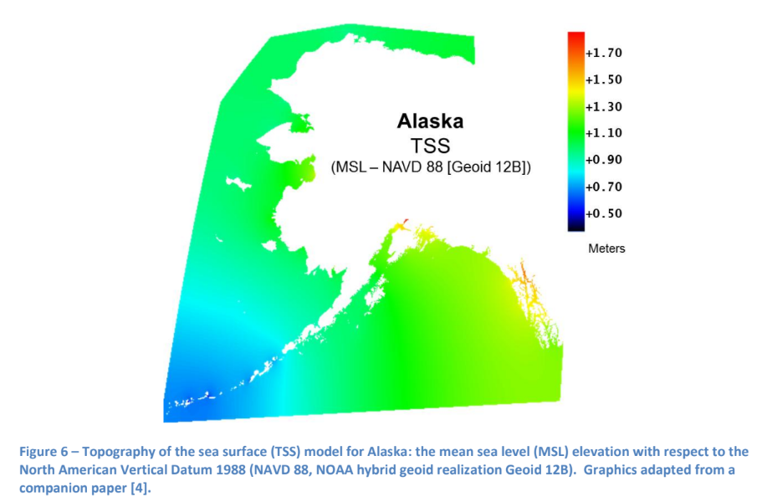
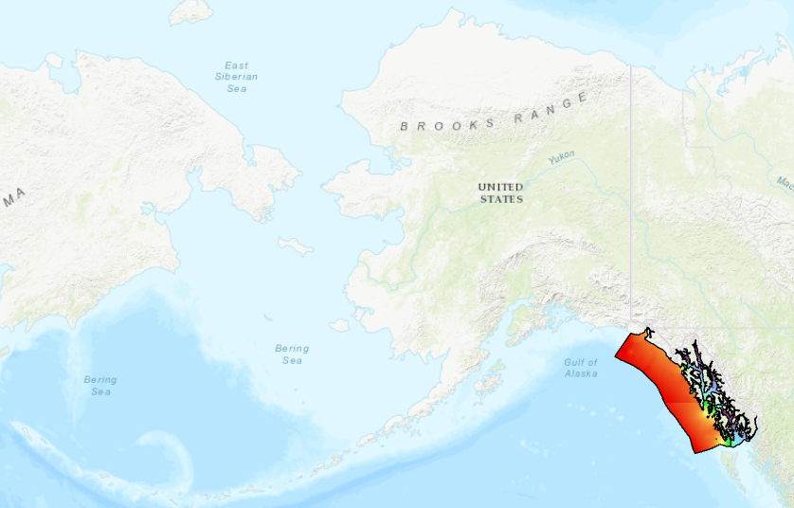

VDatum “Where we are”: Models & Current Transformations
Current VDatum GTX grids: SE AK (Yakutat, Whale, Glacier), GIS-friendly ASCII-based grids, (but big)
Pretty limited VDatum model in AK right now…

Slide 22
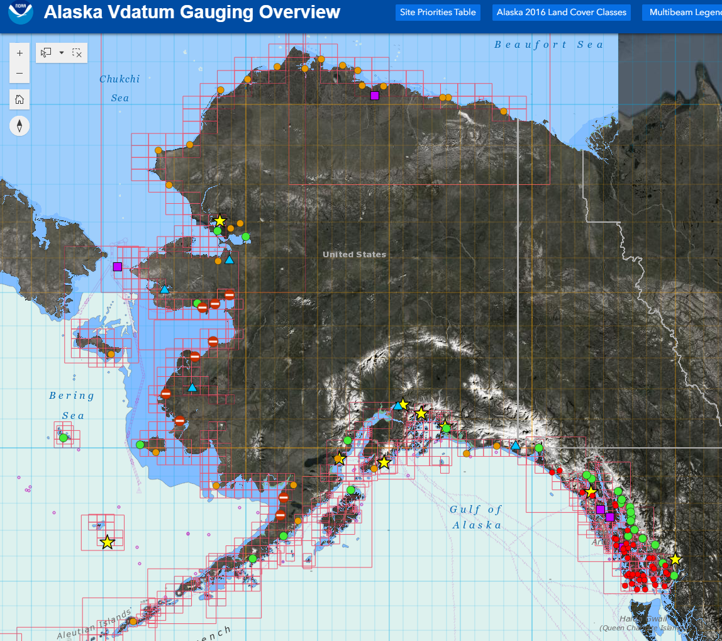
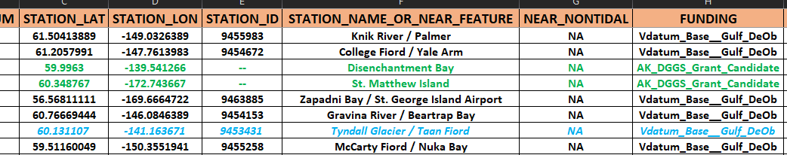
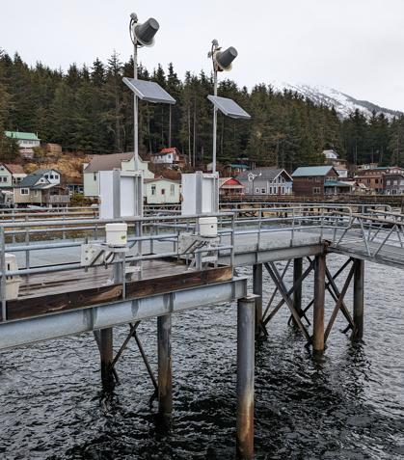
VDatum “Where we are going: Water level gaging (model validation by observations)
A lot of prioritization and assessment, based on stakeholder need (AK State DGGS, AK Water Level Watch, local folks, tribes, etc., etc., etc.)
I
Lots of gaging, around the entire Alaskan coast.
Alaska Gaging Web Application (later), public
Tenekee Springs
(Photo courtesy of JOA Surveys, LLC)

Slide 23
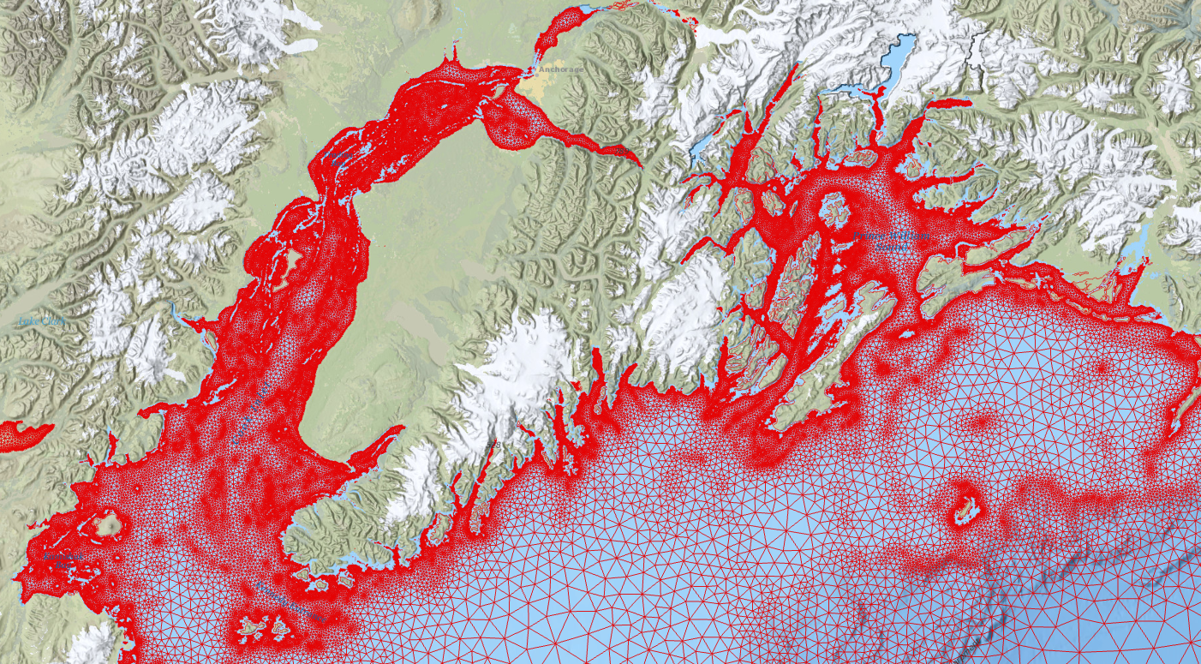
VDatum “Where we are going: New model development
Cook Inlet / Prince William Sound / Gulf of Alaska AOI Mesh
“First version” Alaska State-wide VDatum model due by the end of CY2025); final coverage is ‘TBD’.

Slide 24
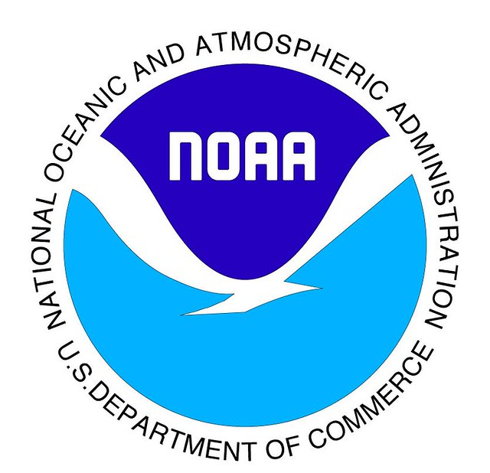
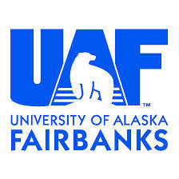

University Outreach
NOAA/NGS Geospatial Modeling Grant Recipients in Alaska, University of Alaska Fairbanks, Anchorage sub awardees
NGS Alaska Regional Advisor University of Alaska Anchorage Geomatics Board Member, Geodesy Curriculum Support
NOAA Fellows in Alaska

Slide 25
Geodesy Community of Practice (CoP)
NGS, NGA, NASA, USGS
Sharing resources, equipment, tech, software, and expertise
Technical working groups formed
  Surveys cooperation
  Reference frames & modeling coordination
  GNSS cooperation
  Geodesy lunar cooperation
Notes:
The National Geodetic Survey and National Geospatial Intelligence Agency 2021 Memorandum of Agreement calls for creation of a Geodesy/Geosciences Community of Practice
This Community of Practice (CoP) will Build our interagency scientific partnerships, participate in joint operations, and coordinate interagency functions and expertise.
Includes, but is not limited to, sharing scientific assets such as equipment, technology, software and expertise, conducting field surveys, equipment calibration and testing studies, and the development of unified products.
This CoP is being established, a roadmap is under development and other federal partners are being invited to this developing federal community.
Outcome: Build our Inter-Agency Scientific Partnership in order to share mission resources to accomplish mutually beneficial outcomes and provide both national and international outreach to advance technical capability and global community presence.

Slide 26
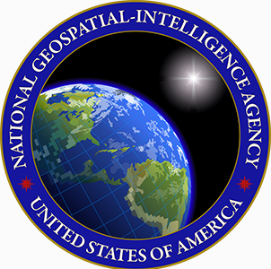
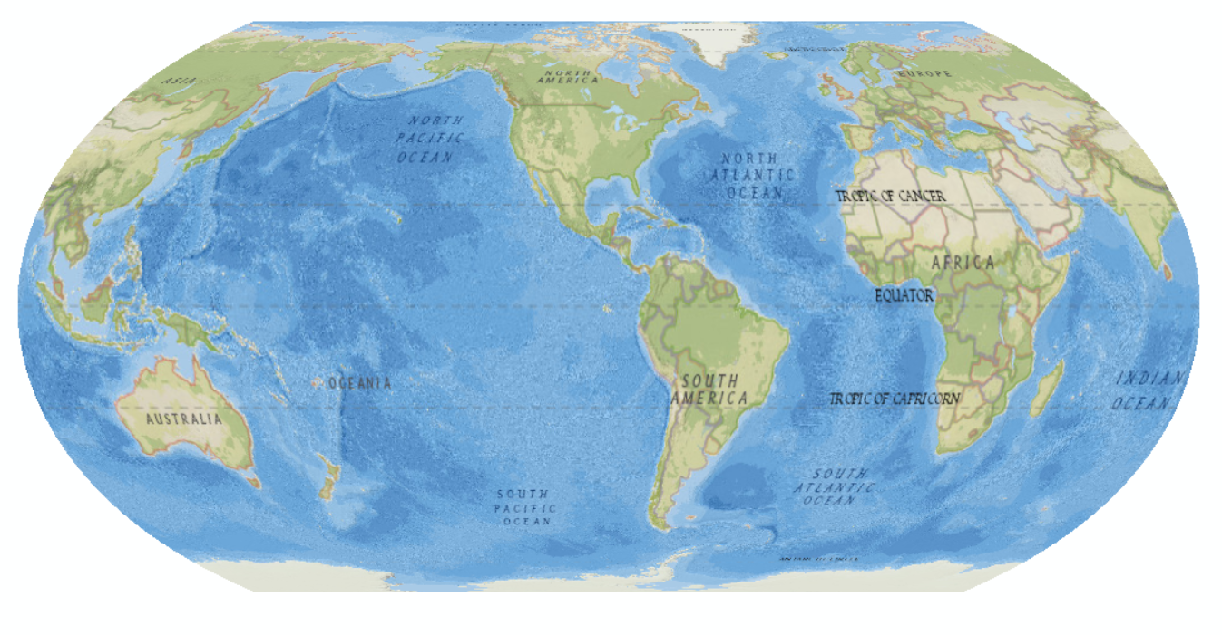








NGS engagement with Federal, State, and local communities
NASA
NGA
USACE
DoT
USAF
USGS
Navy
USCG/FEMA
Notes:
We serve the public, and we engage with data providers and end user at a federal, state and local level.

Slide 27




Applications in Alaska
Monitoring glaciers & ice loss
Sea-level rise & coastal erosion studies
Earthquake & tectonic motion tracking
Infrastructure planning (pipelines, roads, communities)
Navigation for aviation & shipping in the Arctic

Slide 28





Looking Forward
Improved satellite missions (GRACE-FO, SWOT, ICESat-2)
Expanded GNSS networks in Alaska
Integration of Indigenous knowledge with geodetic science
Better models for sea-level rise and infrastructure adaptation
Modernization of the National Spatial Reference System

Slide 29
Geodesy in the Arctic:
Principle Organizations & Projects in Alaska
NOAA’s National Ocean Service’s National Geodetic Survey (NGS), Office of Coast Survey (OCS), Office of Coastal Management (OCM), and NOAA Center for Operational Oceanographic Products and Services (CO-OPS)
NOAA’s National Weather Service Alaska Region National Tsunami Warning Center, Barrow Atmospheric Baseline Observatory Global Monitoring Laboratory
Alaska Water Level Monitoring Network :NOAA CO-OPS (NWLON, PORTS), partnered with the Alaska Ocean Observing System (AOOS), Alaska Water Level Watch
Alaska Mapping Executive Committee (AMEC)
EarthScope Alaska GPS/GNSS Network
Alaska DNR/Alaska Dept. of Transportation Alaska Continuously Operating Real-time Network (ACORN)
Alaska DNR Alaska Geospatial Office
NASA’s Arctic Boreal Vulnerability Experiment (ABoVE), NASA SAR Alaska Satellite Facility at UAF
University of Alaska Fairbanks Poker Flat Research Range NASA AWESOME Mission, Aurora studies
JOA Surveys LLC
U.S. Department of the Interior’s Bureau of Land Management, National Park Service Alaska Region
Federal Aviation Administration
Alaska State Professional Land Surveyors
University of Alaska Fairbanks Geophysical Institute
University of Alaska Anchorage Geomatics Department

Slide 30


















Working with industry

Slide 31


Conclusion
Geodesy is vital to understanding Arctic change
Alaska is a critical location for U.S. Arctic geodesy
Data supports navigation, hazard monitoring,
climate research, and planning

