Slide 1

Modernizing OPUS Projects: How NGS is Improving Tools to Access the NSRS
Jacob Heck
NGS Great Lakes Regional Geodetic Advisor
MSPS 2023 Convention
Notes:
45 minutes
NGS’s Online Positioning User Service (OPUS) provides simplified access to high-accuracy National Spatial Reference System (NSRS) coordinates. OPUS Projects gives users web-based access to simple management and processing tools for projects involving multiple sites and multiple occupations. As NGS modernizes the NSRS, these tools are being updated to better serve the needs of surveyors and other users of the NSRS. I'll discuss these recent updates to these online tools, including how to utilize GNSS vectors derived from real time network observations, as well as future goals to improve the OPUS suite of tools.

Slide 2
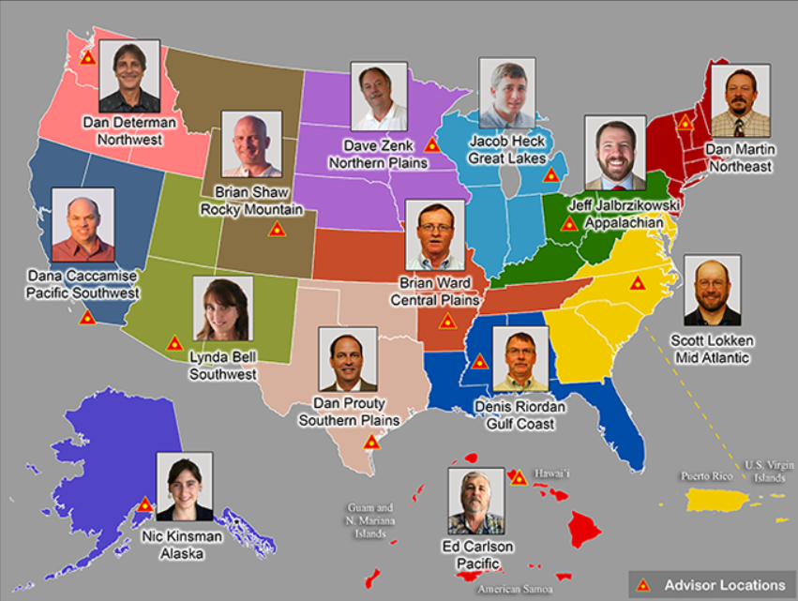
Regional Geodetic Advisor Program
www.ngs.noaa.gov/ADVISORS/
Notes:
This photo is a little out of date

Slide 3
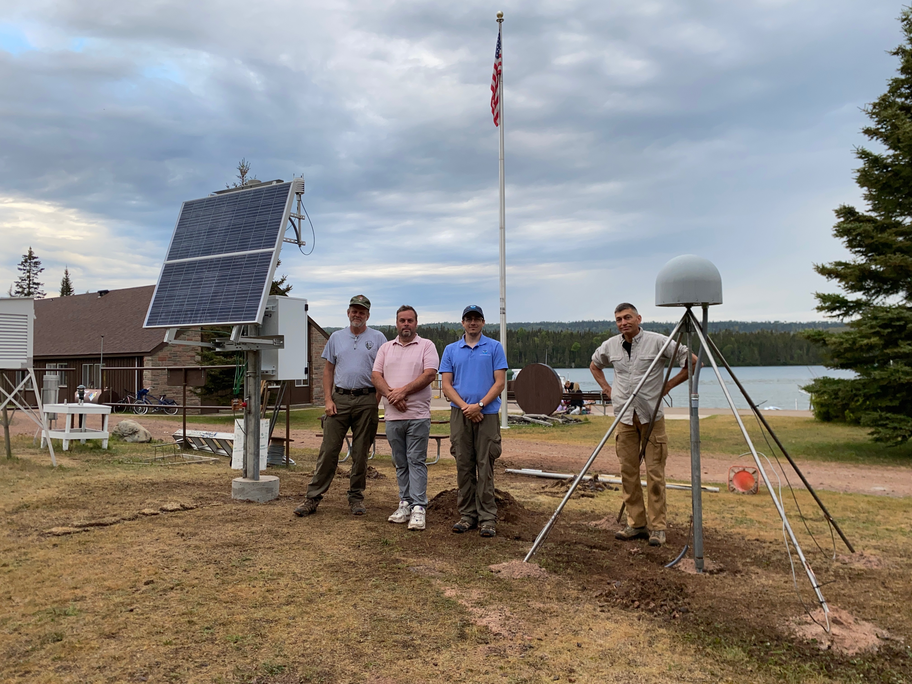
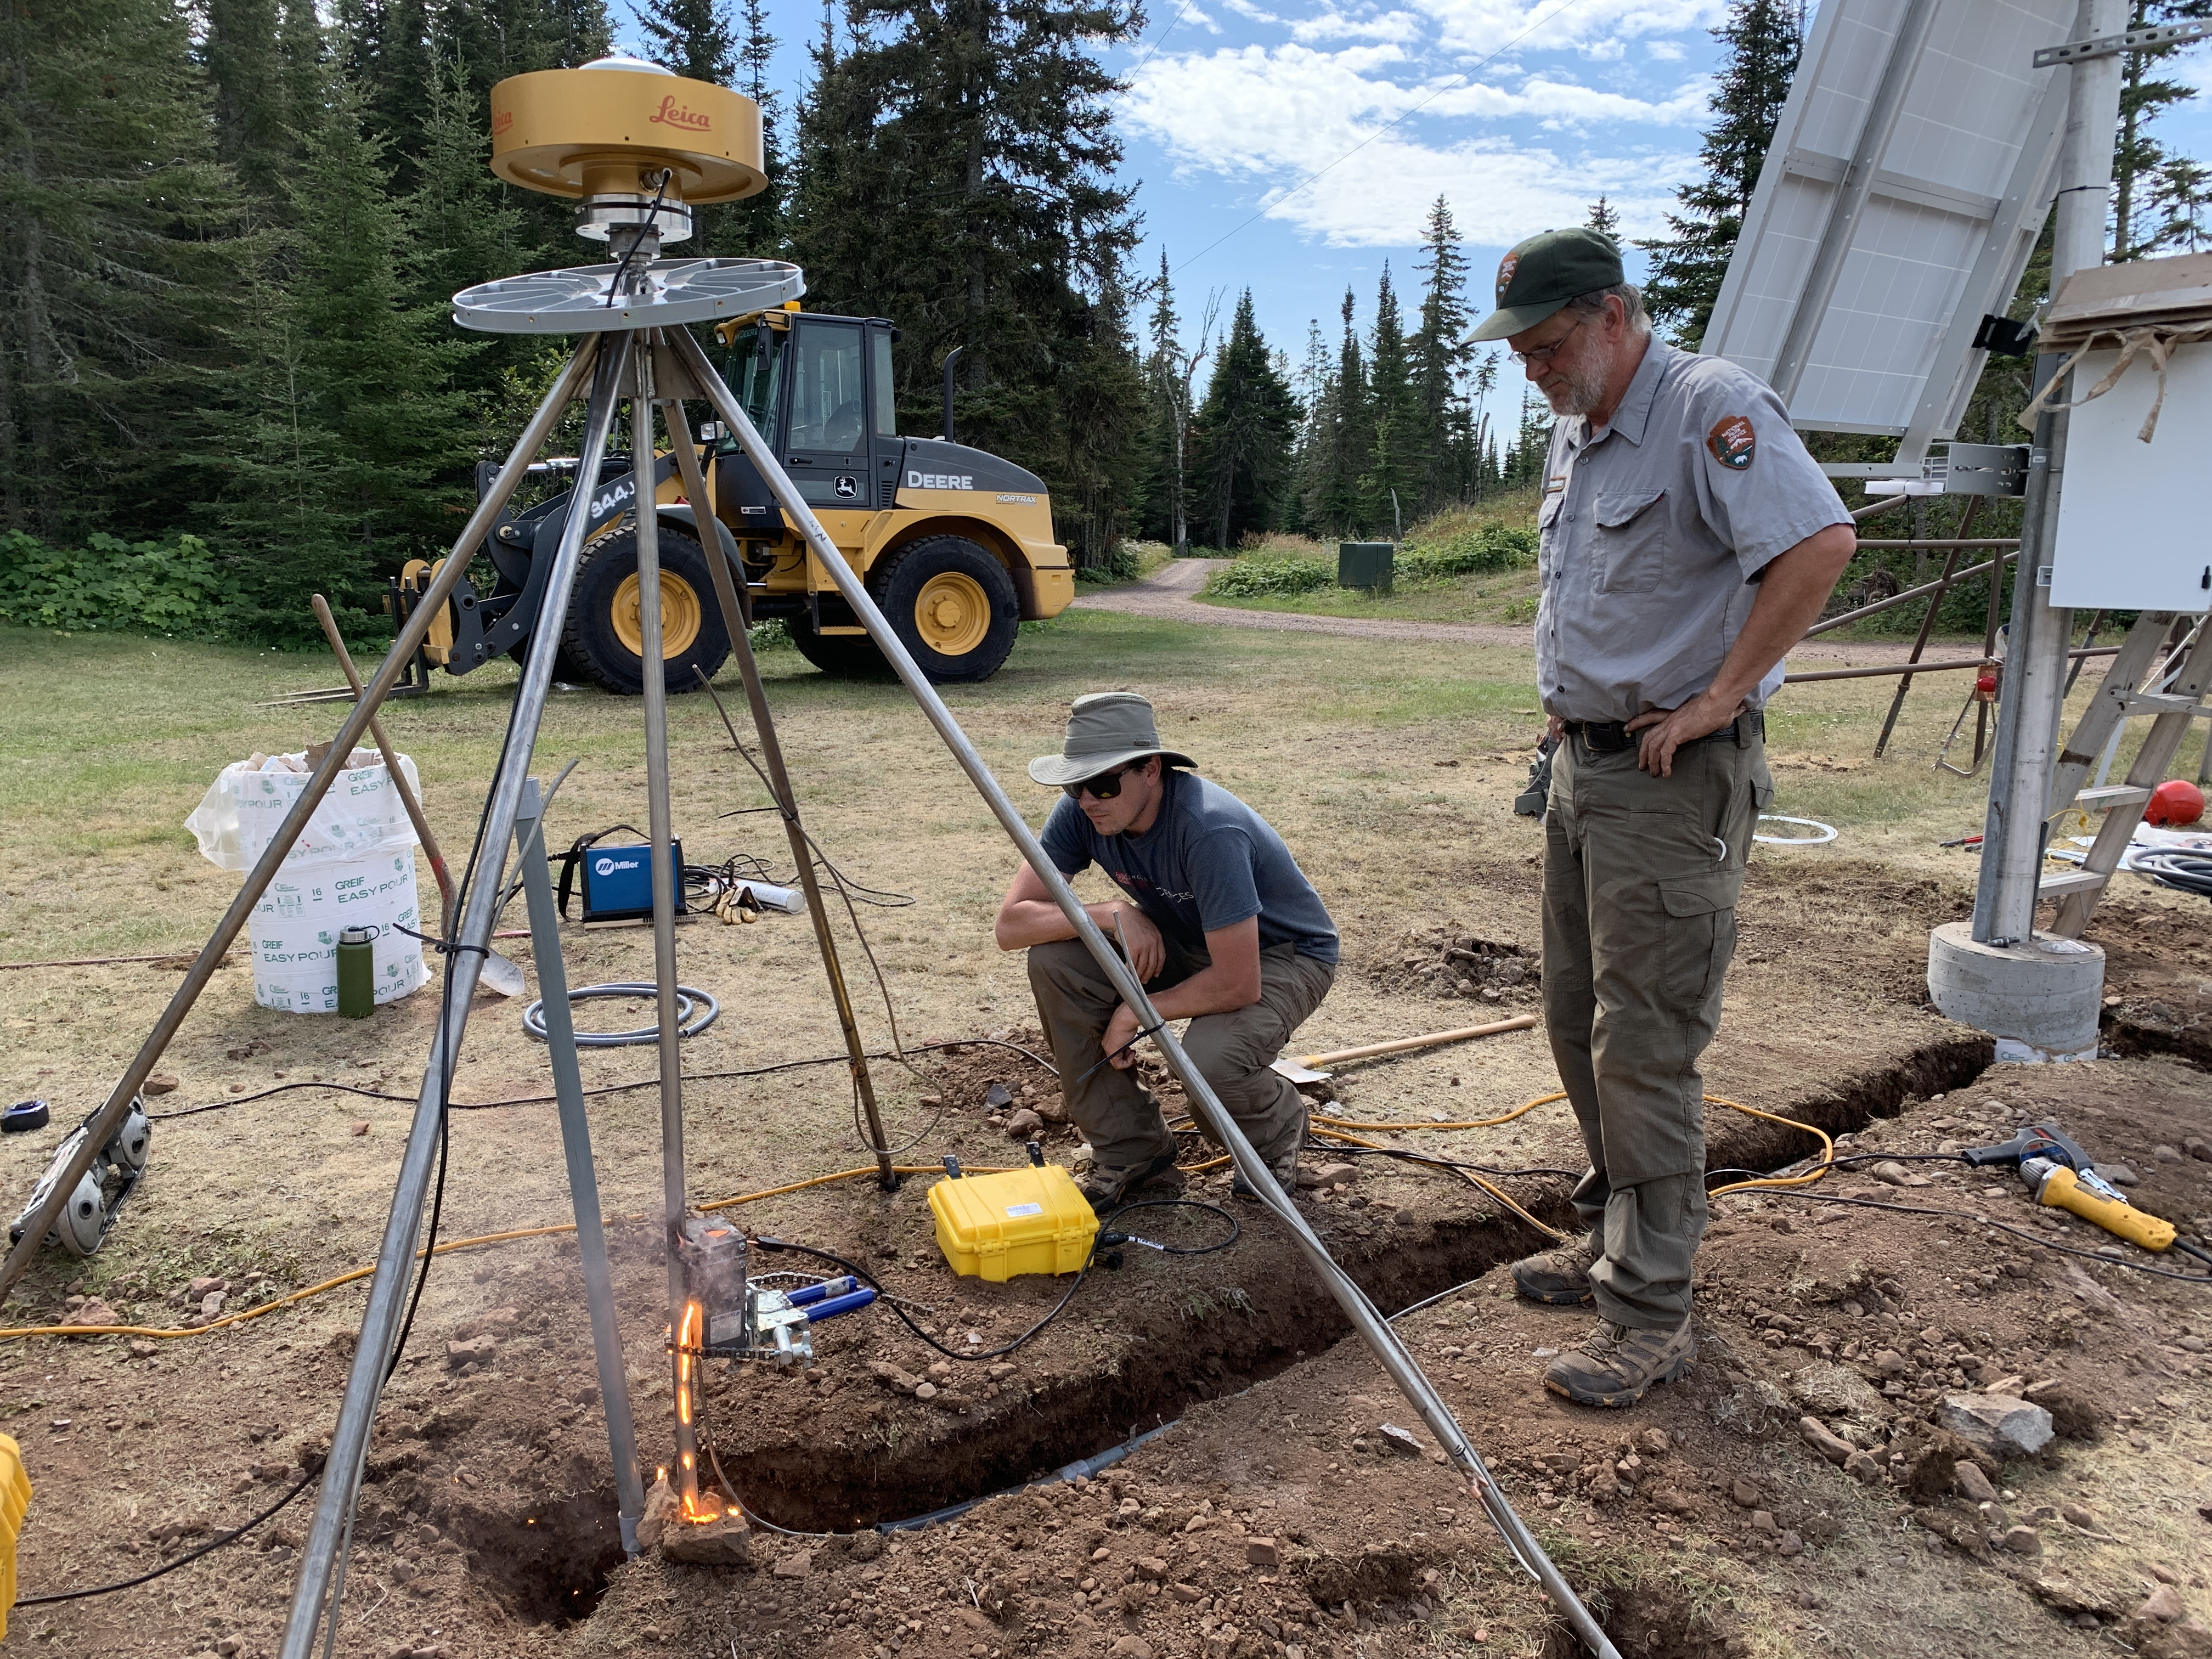
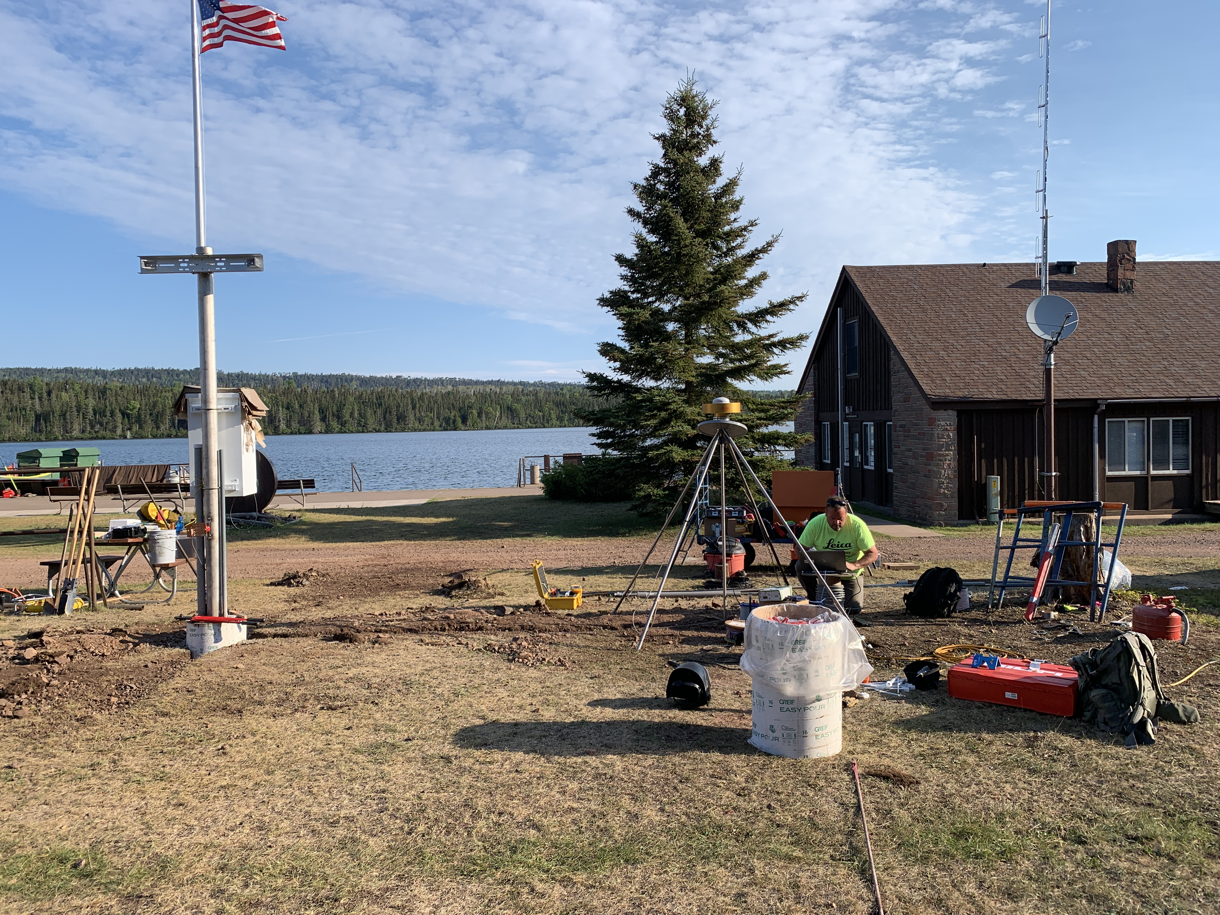
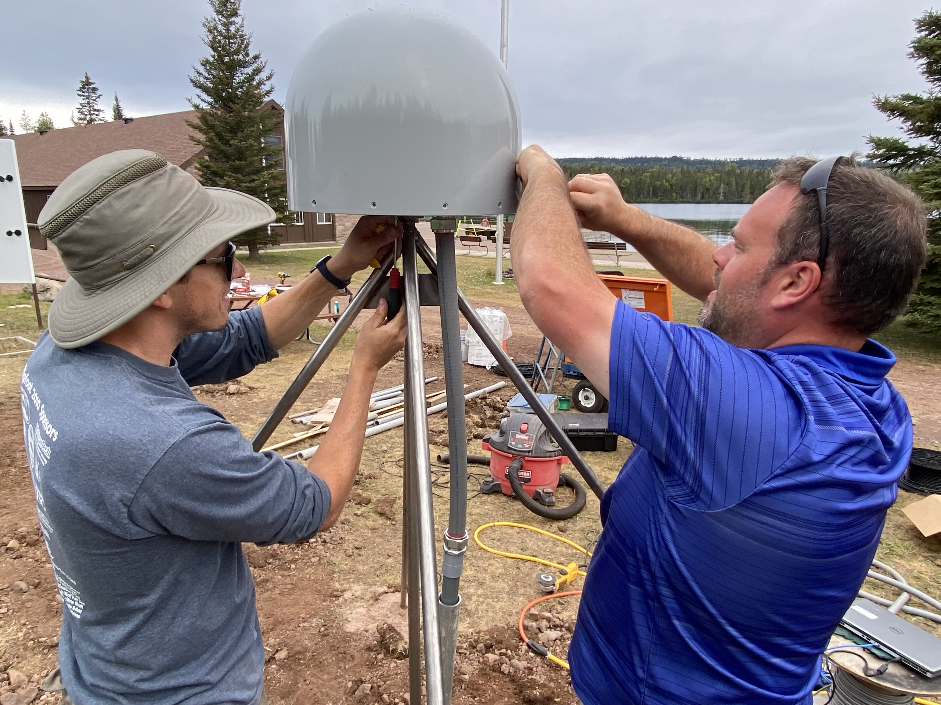
Field Action

Slide 4


Slide 5
National Spatial Reference System (NSRS) Modernization: Delay
Will names change?
    No, “GEOID2022”, “NATRF2022”, etc. will remain the same
NGS anticipates the release of all data, and limited tools, by the middle of 2025.
  Some of this may depend on things outside of NGS control (we have already delayed beyond 2022!)
Work on additional tools will continue in the out-years

Slide 6
Status of International Great Lakes Datum (IGLD) Update
GNSS field campaign took place in 2022 – data processing continues
Seasonal gauging continues
Hydraulic corrector working group is investigating the need for HCs in IGLD (2020)
IGLD (2020) is planned for release about one year after the release of the NAPGD2022 vertical datum (around 2026)

Slide 7
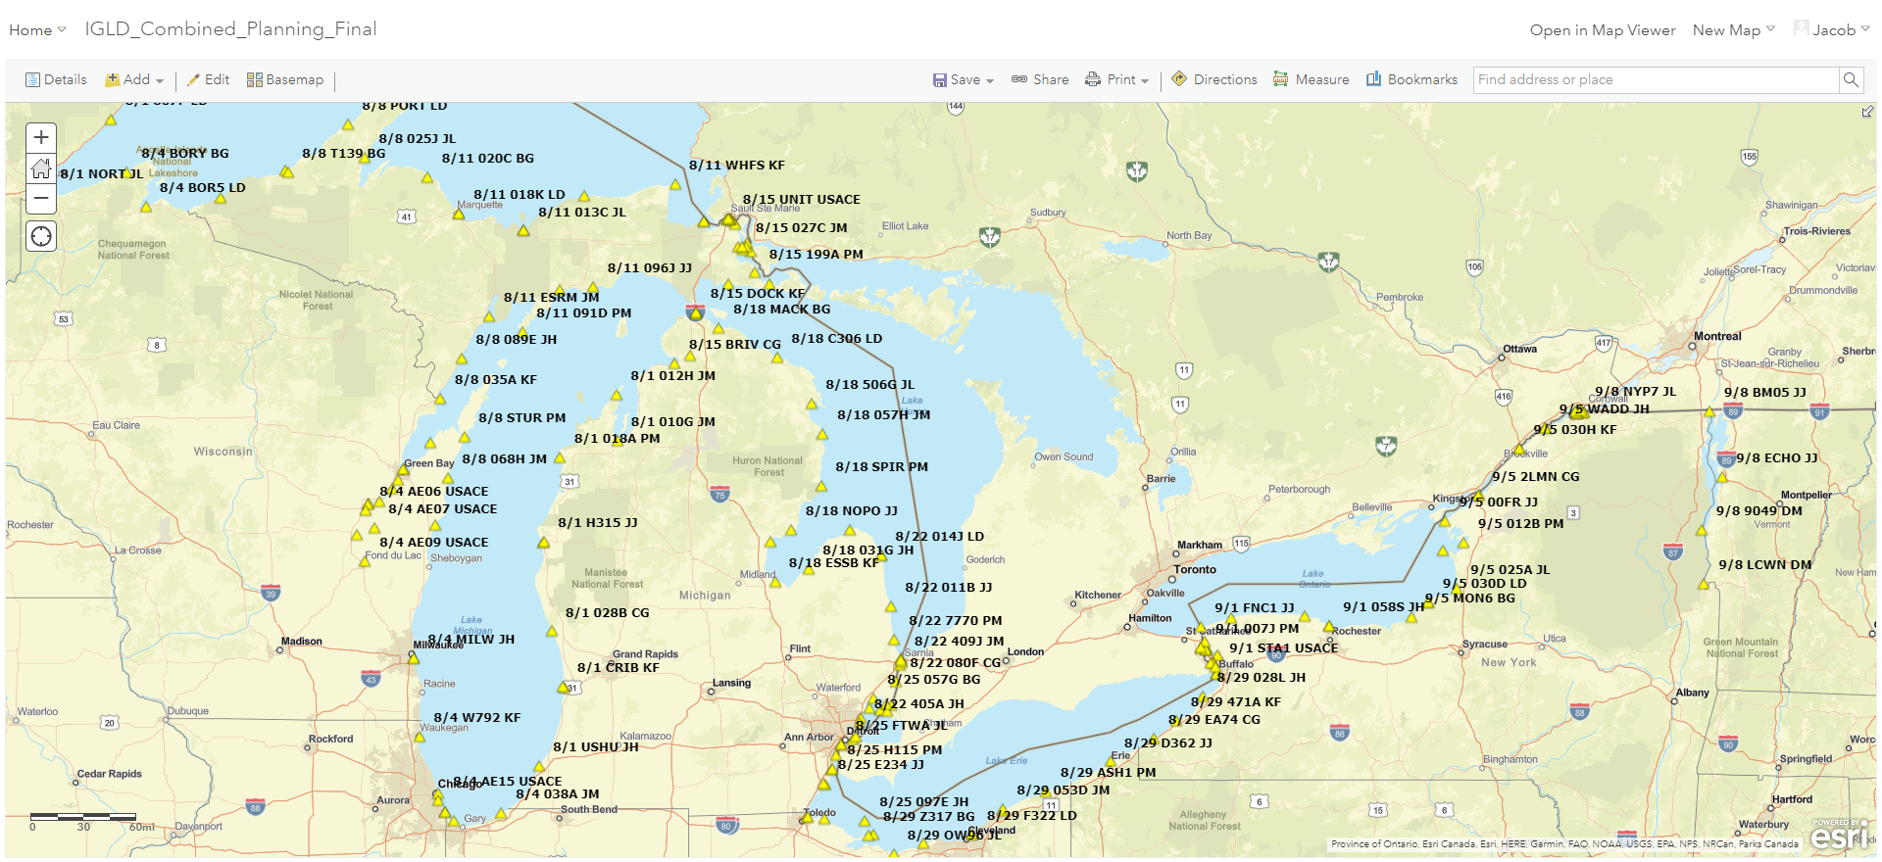
2022 IGLD GNSS Campaign

Slide 8
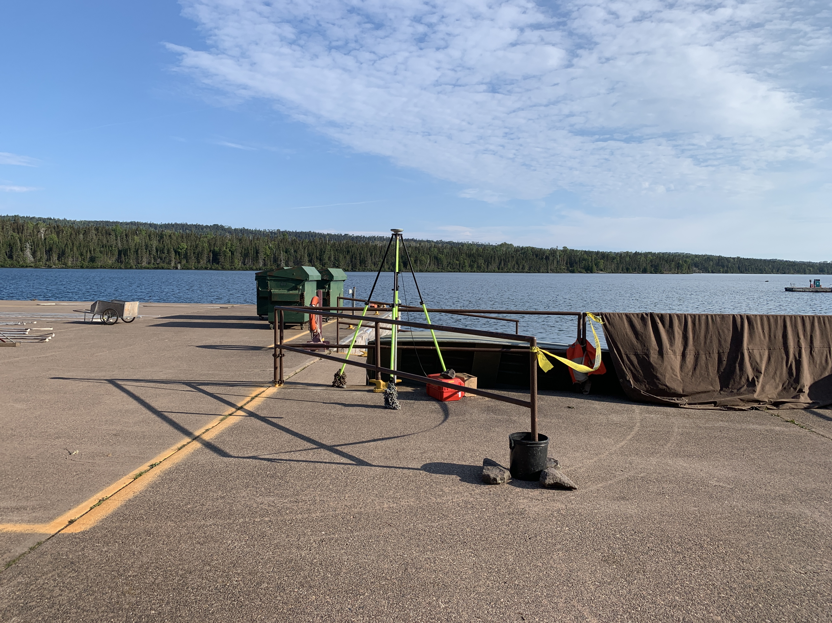
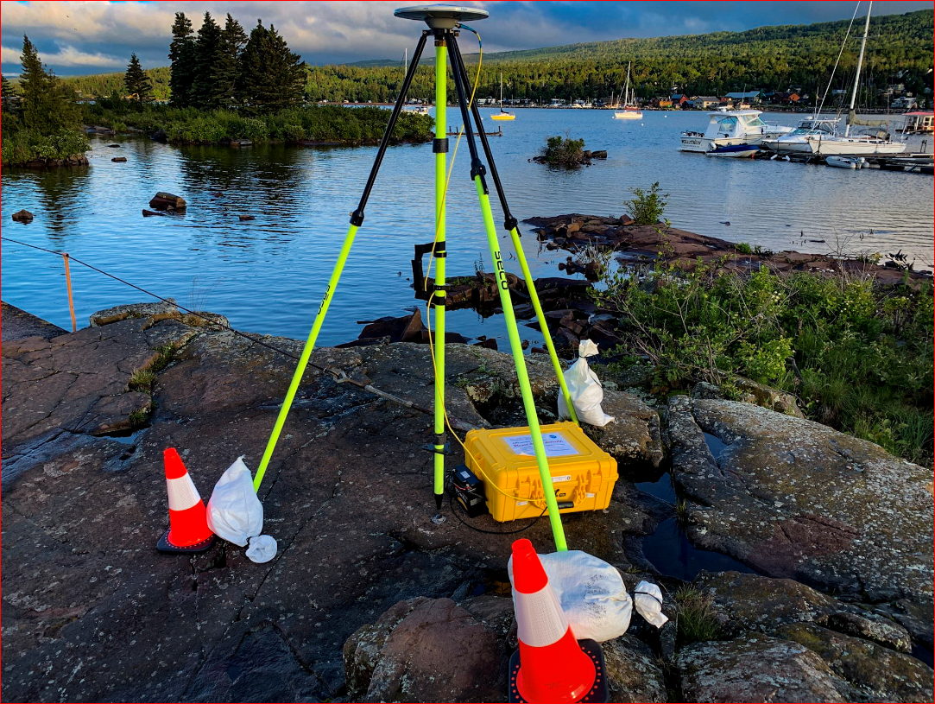
IGLD GNSS Field Work

Slide 9




Save the Date! Water Level Datum Workshop
NOAA, the Canadian Hydrographic Service (CHS), and the Coordinating Committee on Great Lakes Basic Hydraulic and Hydrologic Data would like to invite you to a virtual workshop on Tidal and Water Level Datums. Participants will have the opportunity to learn more about the datums and impacts on the coastal, navigation and shipping communities and industries.
April 5: National Tidal Datum Epoch (NTDE)
April 6: International Great Lakes Datum (IGLD) and the Low Water Datum (LWD)
The workshop will feature presentations and discussions from NOAA’s Center for Operational Oceanographic Products and Services, the National Geodetic Survey, and the Office of Coast Survey, as well as U.S. Army Corps of Engineers, CHS, Natural Resources Canada, Environment and Climate Change Canada, and others.

Slide 10
OPUS-PROJECTS Updates

Slide 11
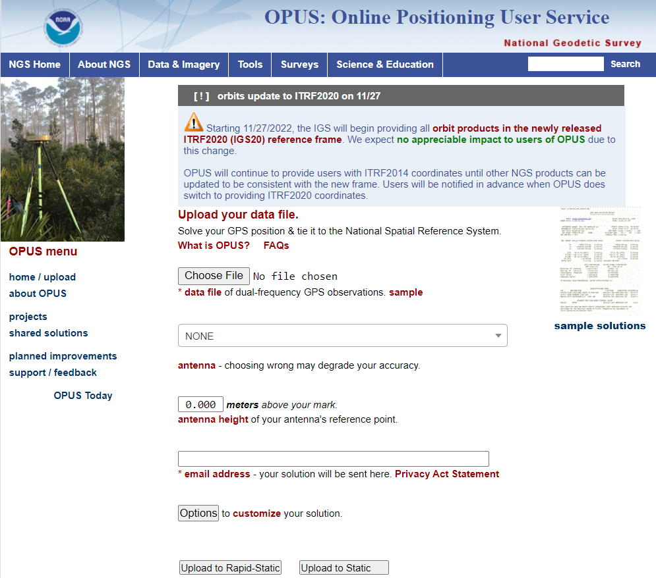
What is OPUS?
OPUS-S (static processing, 2-48 hours)
OPUS-RS (rapid-static, 15 minutes – 2 hours)
Sharing database of solutions
OPUS Projects
  campaign style survey- processing, adjustments, publication

Slide 12
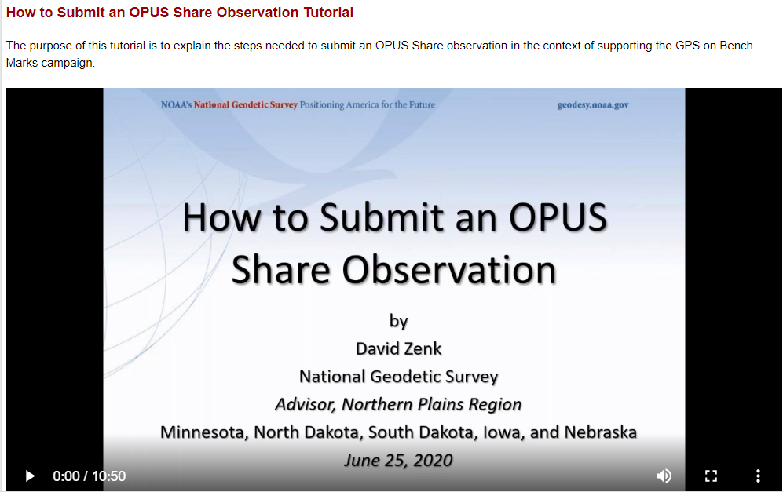
Share GPS observations through OPUS
Upload 4+hour GPS observation file
Provide antenna type, antenna height, and email address
Click “Options” & Select “Yes, Share”
Identify the Mark by PID
Write a “To Reach” description
Attach 2 photos: Close up & Horizon
Respond to confirmation email
geodesy.noaa.gov/corbin/class_description/opus-share-tutorial/

Slide 13
Why use OPUS-Projects?
Supports both static GPS and RTK GNSS surveys
Organizes data for multiple occupations on more than one mark
  Campaign-style surveys for control
Performs least squares adjustments of control survey networks
  Estimate relative accuracy between marks
Constrains NAVD 88 bench marks – check/establish NAVD 88 heights
Ensures survey is tied to the NSRS
  CORS data and published coordinates/heights
  Official models (HTDP, GEOID18)
Submits survey to NGS for review, loading in database, and publication on datasheets
  Establishment of geodetic control
  NGS will use data for making models (e.g., future transformation model for the new datums)

Slide 14
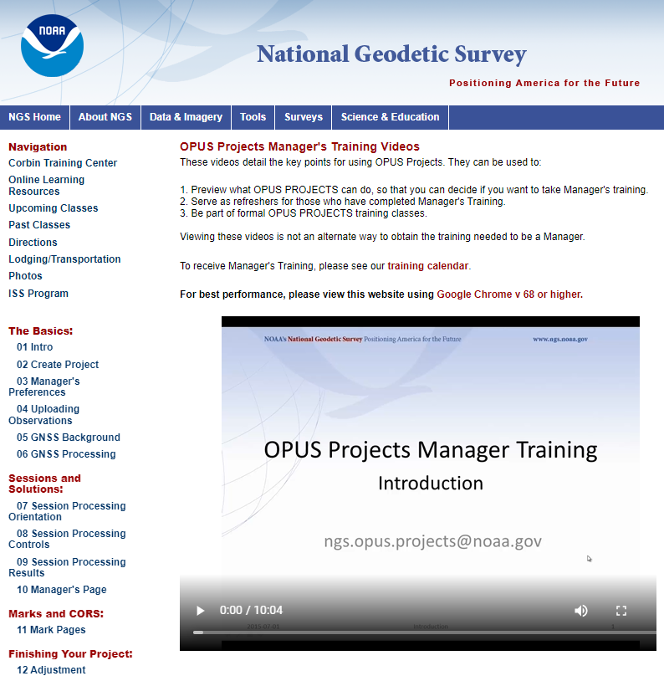
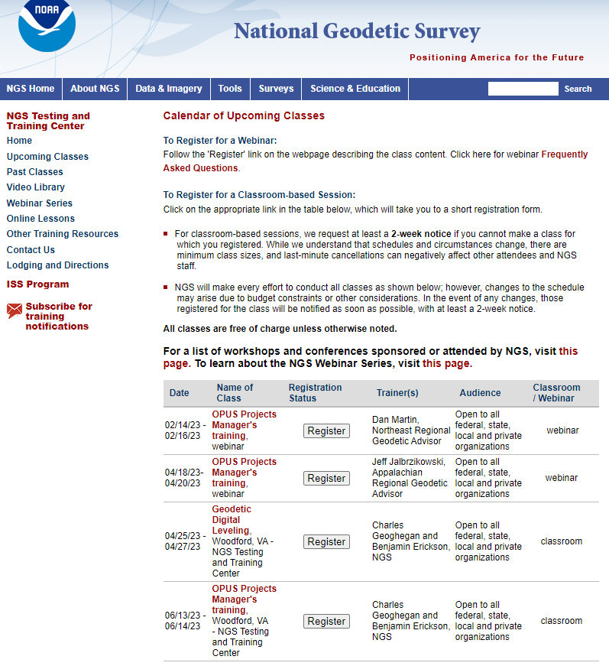
Training Opportunities
https://geodesy.noaa.gov/optrainingvideos/
https://geodesy.noaa.gov/corbin/calendar.shtml

Slide 15
OPUS-Project 4.0
Currently on Production
What does this version add?
  Allows you to submit campaign style GPS survey to NGS for inclusion in the IDB (Integrated DataBase)
    Upload GPS data to OPUS-S
    Upload photos and mark descriptions
    Process simultaneous/overlapping sessions
    Run network adjustment (using GPSCOM and ADJUST)
    Click the “Submit” button to send to NGS!
(must be created using WinDesc)
Notes:
OP 4.0, our recent improvement allows users to submit campaign-style GPS surveys for inclusion into the NGS Integrated Database
→if you haven’t heard the phrase IDB before, that’s the database that holds the coordinates that you get on a Datasheet
So with version 4.0 you can
CLICK
Upload GPS data to OPUS-S
CLICK
Upload mark descriptions and photos … I do want to point out that descriptions and photos must be created/formatted with another tool we provide called WinDesc
CLICK
Process simultaneous/overlapping sessions
CLICK
Run least squares adjustment on the resulting network
CLICK
Then when you’re ready to submit just click the “Submit” button to send to us!
CLICK
For full details see our Webinar Series, recorded on 11 February 2021

Slide 16
OPUS-Projects 5.1
Available on BETA at: https://beta.ngs.noaa.gov/OP-bluebook/OpusProjects.shtml
Continues to support static GPS baseline processing and network adjustments
Continues to prepares all files according to FGCS Bluebook for submission to NGS for loading in the NGS Integrated Database and publication on Datasheets
Supports GVX → uploading of previously processed GNSS vectors
  Single-base RTK vectors
  Network RTK vectors
  Vectors post-processed in other software
Automatically “weights” uploaded vectors in a network least squares adjustment

Slide 17
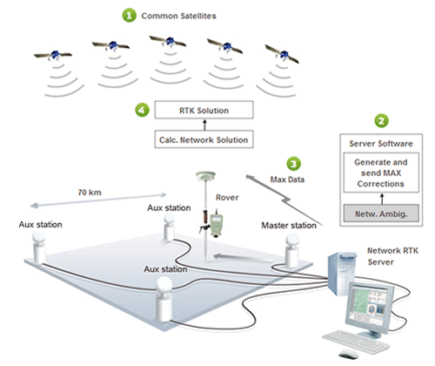
Real-Time Networks
Virtual Reference Stations (VRS)
Master-Auxiliary Concept (MAC)
Vector “tails” referenced to virtual base station
Base station position is variable
Vector “tails” connected to physical base station
Base station position is fixed
RTN Base
RTN Base
VRS
Control
Center
(Landau et al. 2002)
RTN Base
(Leica 2005)
Notes:
VRS
1.) Rover sends approx. position to RTN control center
2.) Control center assigns this position as the location of an imaginary base station and interpolates corrections at this virtual location
3.) These interpolated corrections are used to generate corrected pseudo-observables that are “transmitted” from the virtual base to the rover to be processed using conventional single-base RTK algorithms to solve for precise geodetic coordinates at the rover (Wang et al. 2010)
MAC
1.) The rover transmits an uncorrected point position to the central server, and then the server searches and selects a “cell” of reference stations for generating corrections
2.) The phase ranges from all selected stations are reduced to a common ambiguity level, and dispersive and nondispersive errors for each frequency and satellite-receiver pair are computed relative to the master station
3.) The residual corrections between the auxiliary stations and the master station, as well as the full corrections and published coordinates at the master station are transmitted to the rover. The rover then interpolates the received corrections and network information to derive its precise position (Janssen 2009).

Slide 18
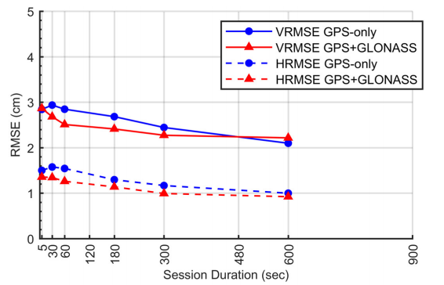
Empirical Evaluation of the Accuracy of RTNs
95% Confidence
± 5.0 cm, vertical
± 2.5 cm, horizontal
Or similar to accuracy of a 2-h OPUS-S solution!
Ellipsoid Height
Horizontal
[Allahyari et al. 2018]

Slide 19
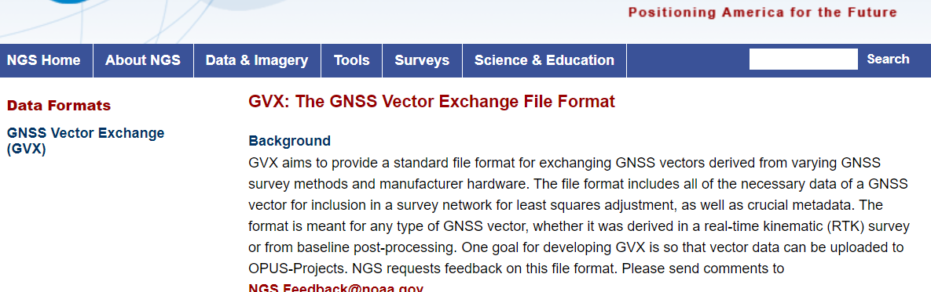
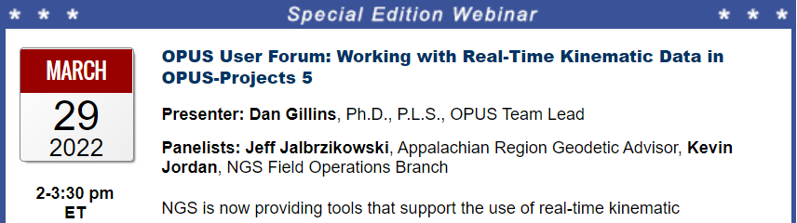
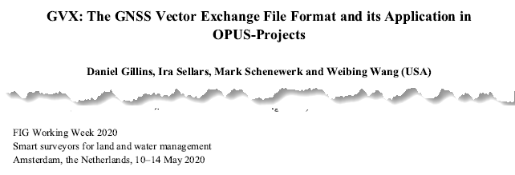
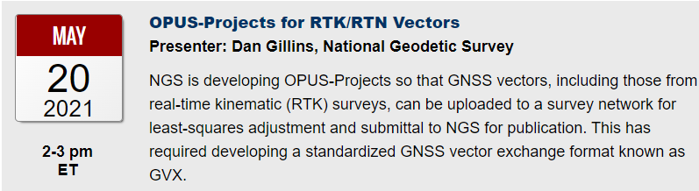
GNSS Vector eXchange (GVX)
Hyperlink to GVX Info Page
Detailed documentation, Schema, and Example File available
Any major search engine: “ngs gvx file format”
Open standard for anyone to use or integrate
GVX is sort of like RINEX for RTK/RTN data

Slide 20
GVX ≈ RINEX for RTK/RTN data
RINEX
GVX
Uncorrected Observations
That’s why we post-process them
Static Observations
One observation per file
Proprietary Format → Open Standard
Export RINEX using your COTS software
Metadata
Antenna, Rx, HI, Point Name, Start Time, SVs at each epoch
Based on ASCII Text File Format
Longtime industry standard
  Way too many to list!
Corrected/Processed Positions
And the Vectors used to create them
RTN, RTK, PP Static, even PPK
Many observations, any mix of above
Proprietary Format → Open Standard
Export GVX using your COTS software
Metadata - same as RINEX, plus…
Project Info, Solution Types, PDOP, Mount Points, Correlation Matrices, QC data
Based on XML File Format
Longtime industry standard
  e.g. LandXML, JXL, MAXML, KML/KMZ

Slide 21
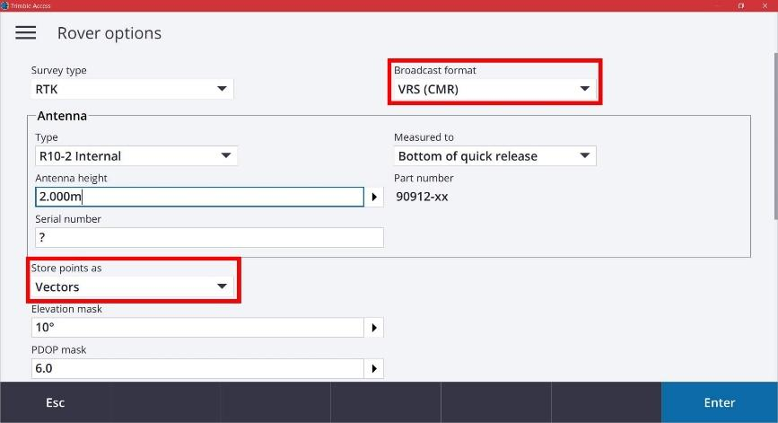
Equipment Setup
When using VRS, store points as vectors

Slide 22







Status of GVX Exporters
…that we know of.
Available Now
Trimble Business Center (TBC) v5.60 - released Nov 2021
Topcon MAGNET Software v7.2 - released Nov 2021
Leica Infinity 4.0.0 - released May 2022
Developers who have expressed interest to us
iGage
Emlid
Available, but not fully functional
JAVAD J-field - onboard Triumph-LS device
Carlson SurvPC 7 - released February 2023
Notes:
-Please note that this information here can only reflect what we know. If you are a developer working on incorporating GVX into your software… reach out to us! We would be happy to assist you, just as we have assisted some of our other commercial partners named here.
-What would make us happiest is if the list got so long we couldn’t fit in on this slide.
-Oh, and hey, you customers out there… express your desire for GVX to your suppliers/dealers or Support team
NGS is still testing/vetting the Carlson exporter

Slide 23
GVX Flow Chart

Slide 24
Steps for Submitting a Survey to NGS
Submit a survey project proposal and obtain a project tracking ID
Create descriptions for marks in WinDesc. Tutorial video available
Upload all static data via Beta OPUS-S
Upload GVX file(s)
Upload description files from WinDesc
Perform session baseline processing
Run all 5 network adjustments
Upload 3 photos per mark (close-up of mark, horizon photo, and downward from eye-level)
Upload observation logs (as a single PDF), and a project report
Submit to NGS (button not enabled on Beta)
All but step 4 is currently explained in the OPUS-Projects User Guide!

Slide 25
Future Directions
Perform Beta Testing and respond to feedback from users
  Provide your feedback! NGS.Feedback@noaa.gov
Finish OPUS-Projects 5 development and enable “submit” button
Update OPUS-Projects User Guide materials to include GVX workflow
Draft new guidelines for surveying with RTK/RTN to replace NGS-58/59

Slide 26
Brief overview:
Re-inventing “Bluebooking” or
The Modernized OPUS
AKA
“OPUS 6”

Slide 27
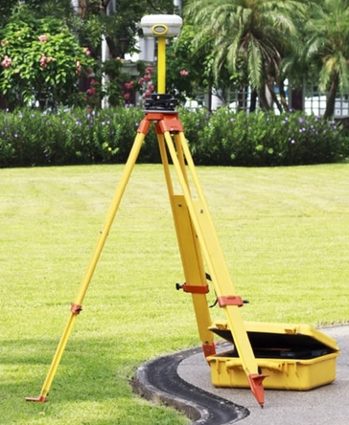
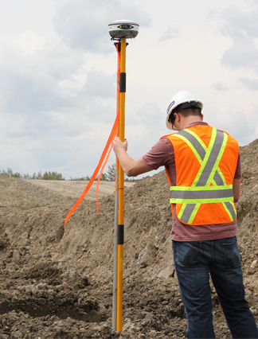
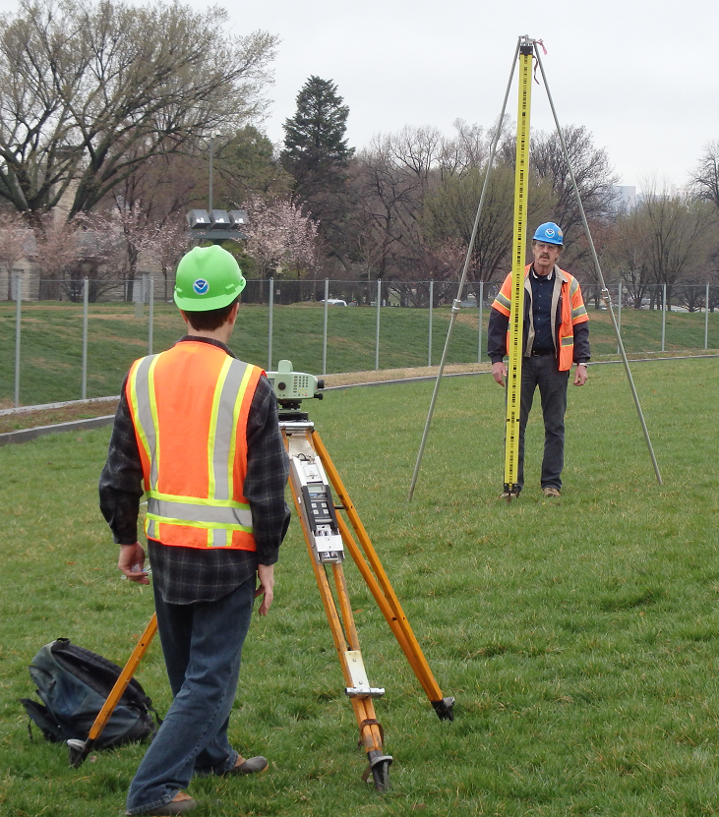
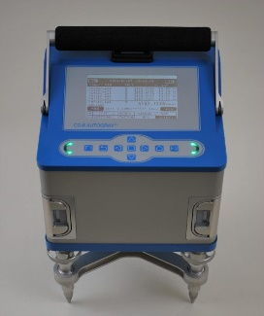
Future of OPUS
Static GNSS
RTK/RTN
Classical
Leveling
Rel. Gravity
RINEX
GVX
CVX
LVX
RGX
RINEX
GVX
CVX
LVX
RGX
RINEX
GVX
CVX
LVX
RGX
RINEX
GVX
CVX
LVX
RGX
Notes:
OPUS 6 will allow you to upload multiple types of data, and multiple files for each type, to a single survey project. You can then process/reduce the data, and adjust it.
The colors imply how finished each format is. RINEX is well established, GVX was released in 2021 but requires an update, likely in 2022 in a joint roll-out with CVX and LVX. RGX has not been substantially fleshed out yet.

Slide 28
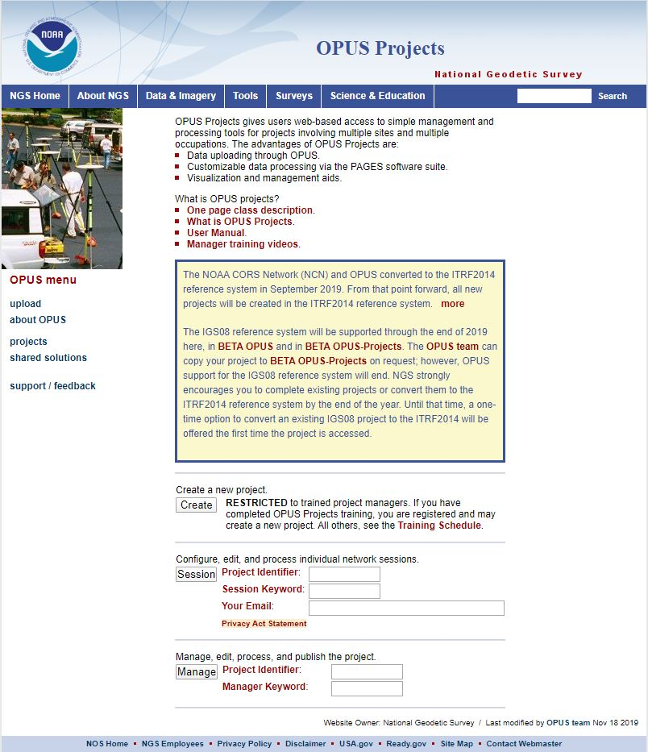
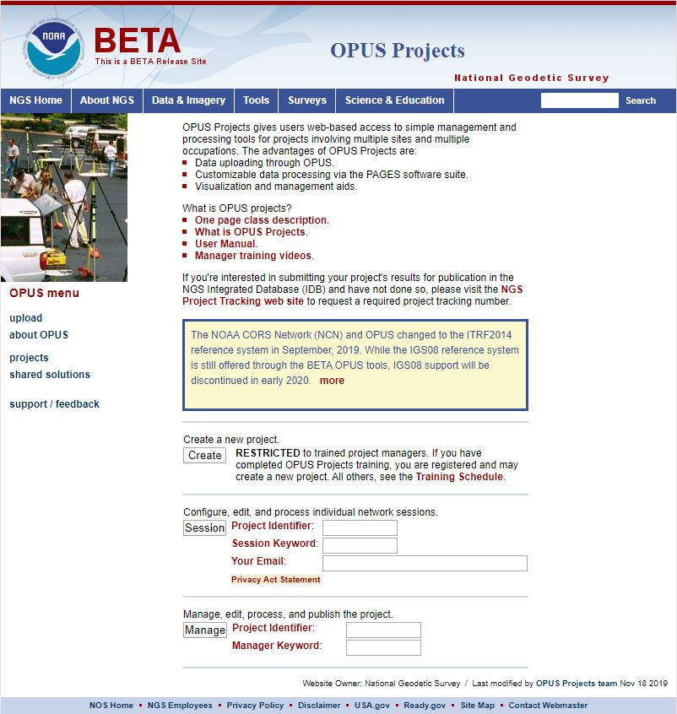
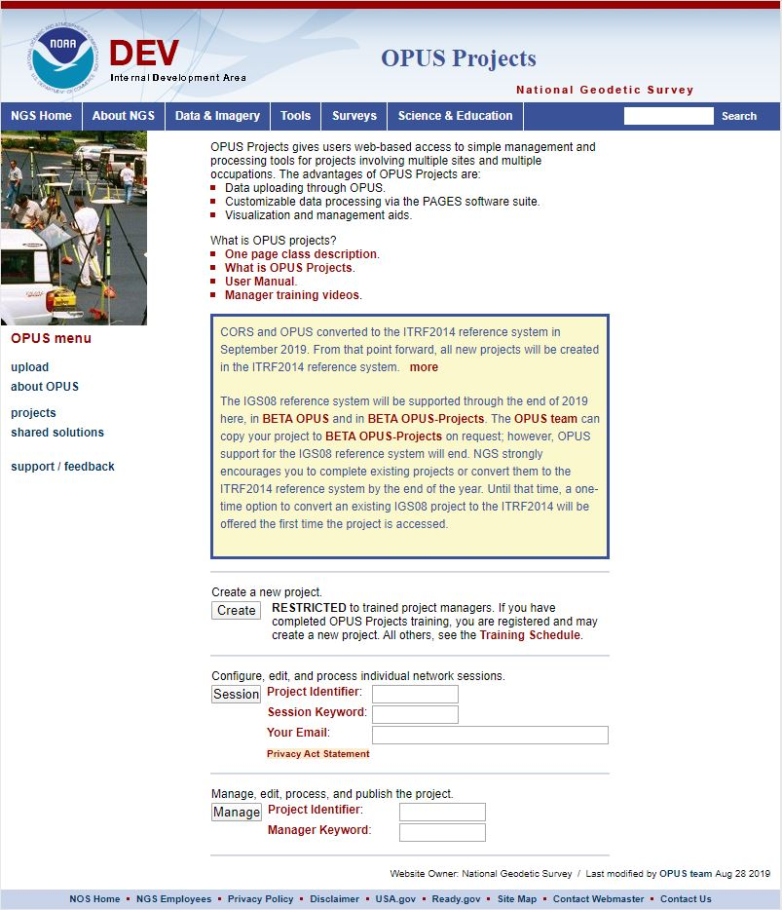
www.ngs.noaa.gov
beta.ngs.noaa.gov
Remember, you won’t see the DEV environment…
Notes:
So here we have 3 screenshots, first here showing the Production OPUS Projects gateway page
CLICK
Second is the Beta page, with the text here showing the URL for our Beta homepage
-How do you find that beta page? substitute “beta” for “www”
-or most tools that have a beta will have a link to that beta platform
CLICK
Last is the Development or DEV example, which again you will not see unless via a demo from NGS personnel

Slide 29
Data Delivery System
The Data Delivery System (DDS) is a system for querying the new NSRS database
  The most common query will be for a new version of datasheets
  But other queries will be part of the DDS
    Mark recovery and mark reporting
    Active control (CORSs)
    Projects, observations, data, etc.

Slide 30
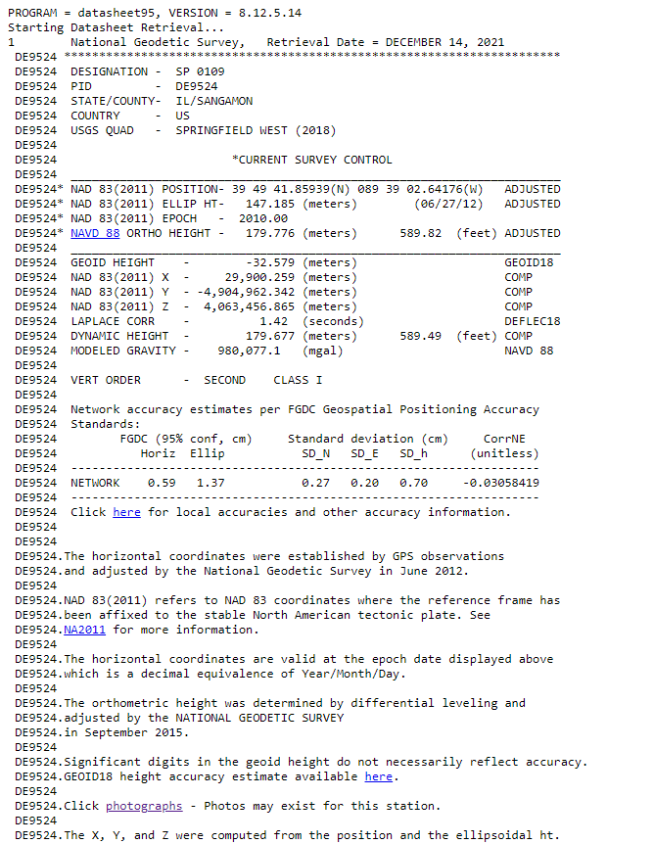
Datasheets
Datasheets are the current way to access the NSRS
Give information about passive marks, including coordinates

Slide 31
The Data in the Datasheet
Starting Datasheet Retrieval...
1 National Geodetic Survey, Retrieval Date = JULY 1, 2022
AC6803 ***********************************************************************
AC6803 HT_MOD - This is a Height Modernization Survey Station.
AC6803 PACS - This is a Primary Airport Control Station.
AC6803 DESIGNATION - AZC A
AC6803 PID - AC6803
AC6803 STATE/COUNTY- AZ/MOHAVE
AC6803 COUNTRY - US
AC6803 USGS QUAD - LOST SPRING MOUNTAIN EAST (2018)
AC6803
…
In ASCII format
{"datasheet":
{
"datasheetHeading":"National Geodetic Survey",
"datasheetRetrievalDate":"JULY 1, 2022",
"htMod":"This is a Height Modernization Survey Station.",
"pacs":"This is a Primary Airport Control Station.",
"determinedProjects":[
{"project":"GPS1154"},{"project":"GPS2300"},{"project":"GPS2507"},{"project":"GPS280"},
{"project":"GPS2846"}
],
"observedProjects":[{"project":"GPS1154"},{"project":"GPS1195/11"},{"project":"GPS2507"}],
"occupiedProjects":[{"project":"GPS1154"},{"project":"GPS1195/11"}],
"designation":"AZC A",
"pid":"AC6803",
"state":"AZ",
"county":"MOHAVE",
"country":"US",
"quad":"LOST SPRING MOUNTAIN EAST (2018)",
…
}
}
In JSON format

Slide 32
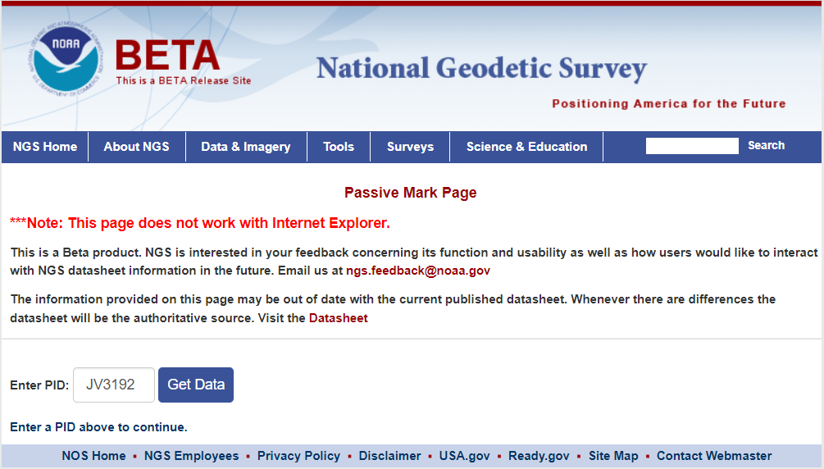
Beta Passive Marks page
Easier to read
Includes geospatial information
A preview of the future data delivery system
https://beta.ngs.noaa.gov/datasheets/passive-marks/index.html
Notes:
Show DE9524, a mark near Springfield

Slide 33
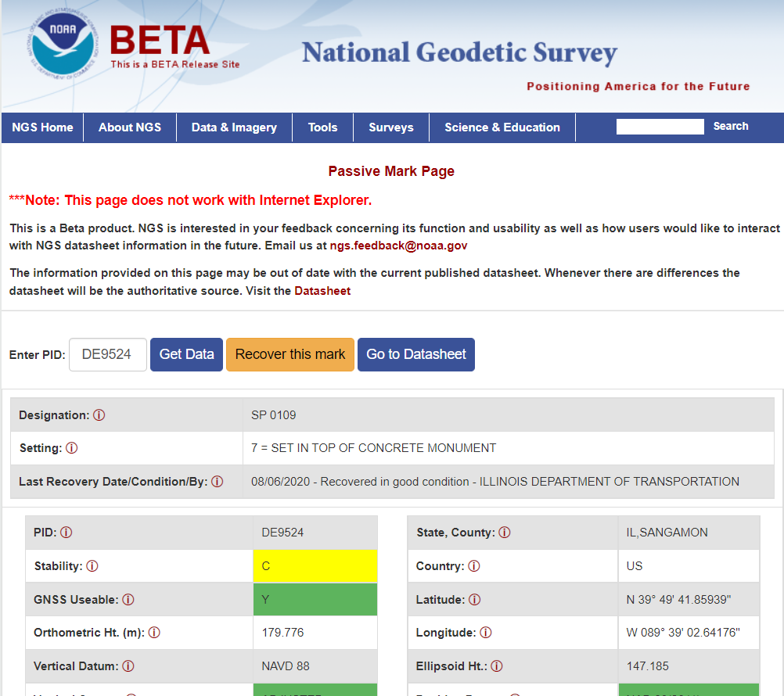
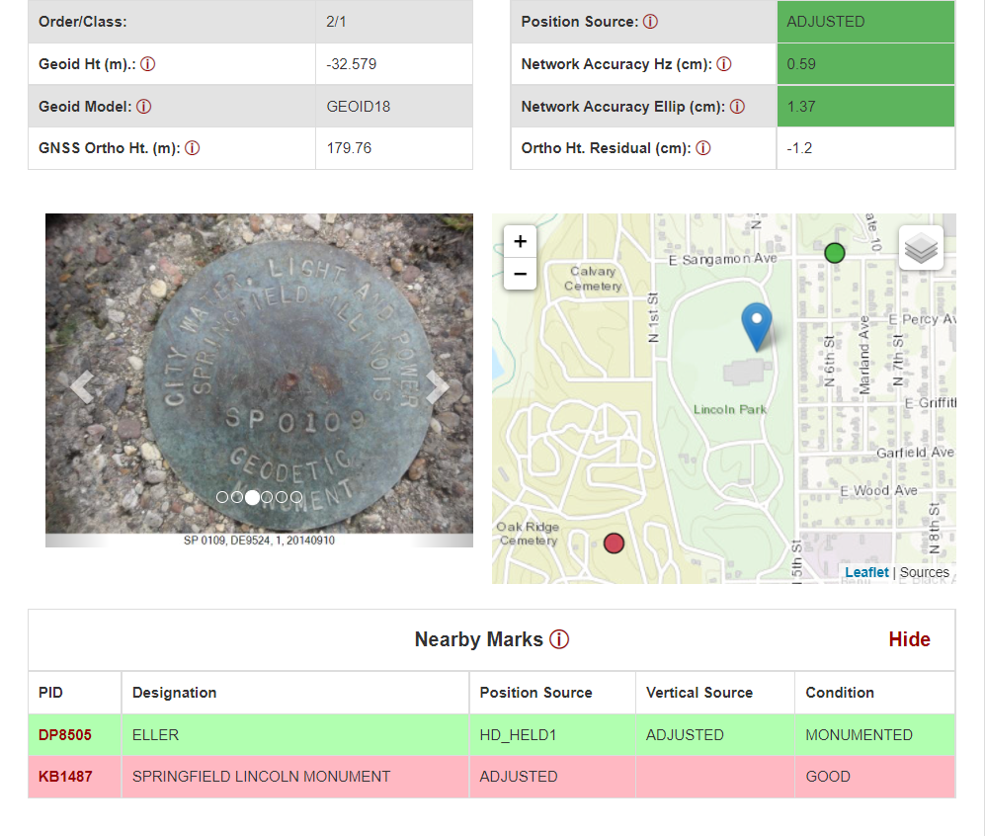
Beta Passive Marks page

Slide 34
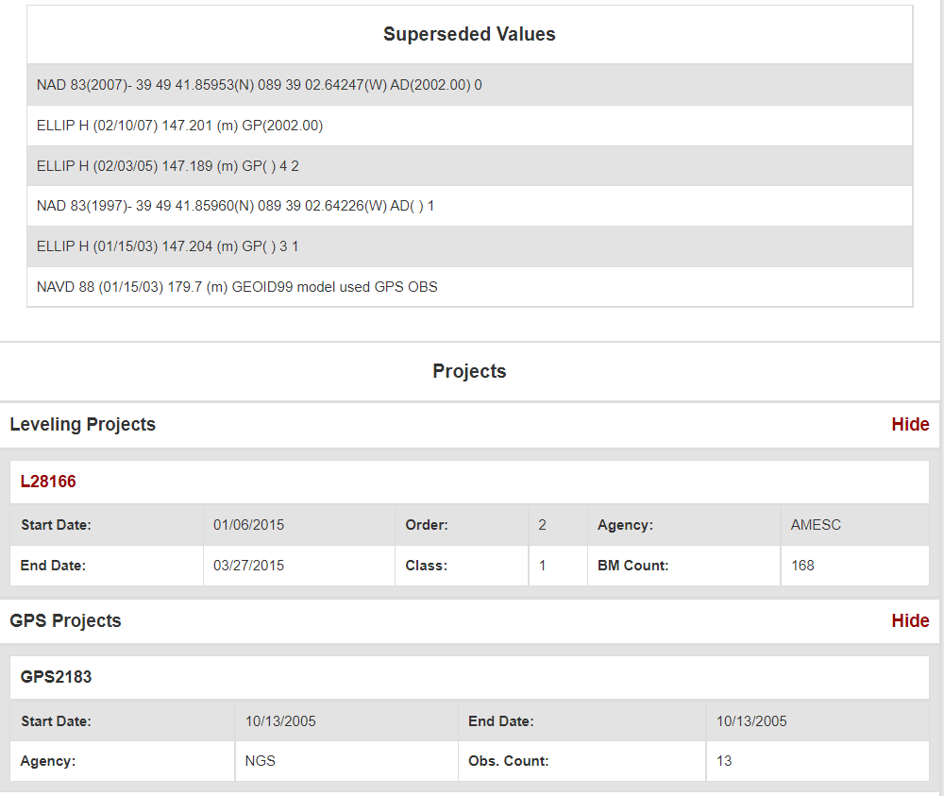
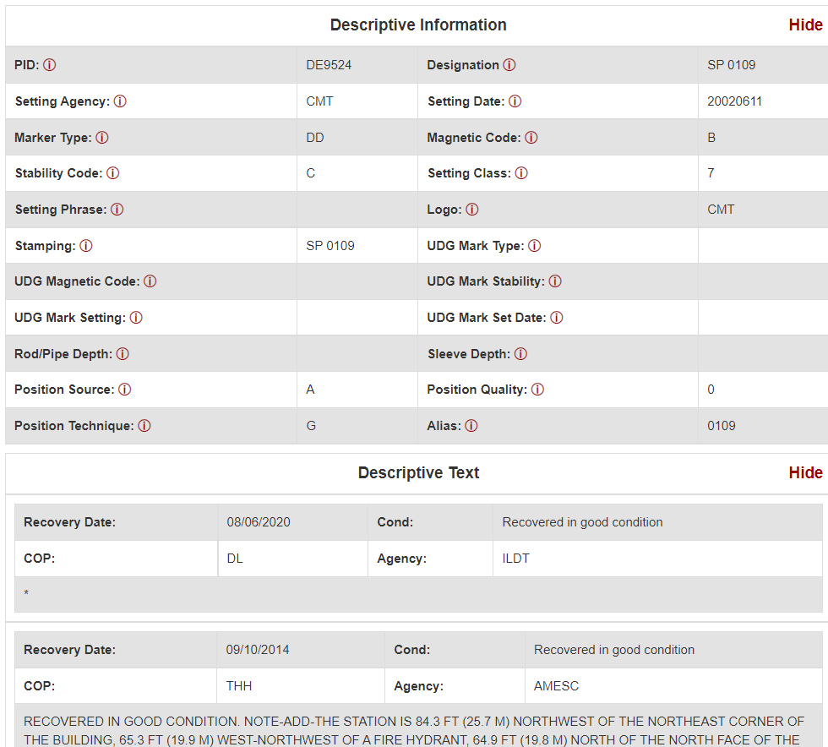
Beta Passive Marks page

Slide 35
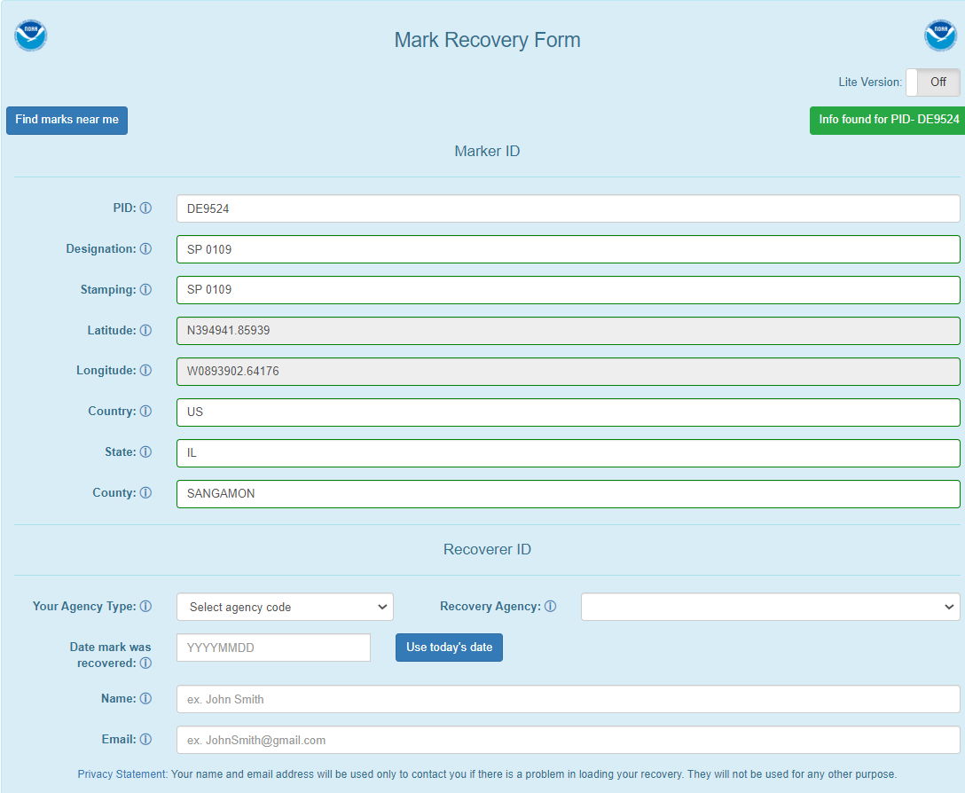
Easy to use mark recovery tool
https://geodesy.noaa.gov/cgi-bin/mark_recovery_form.prl

Slide 36
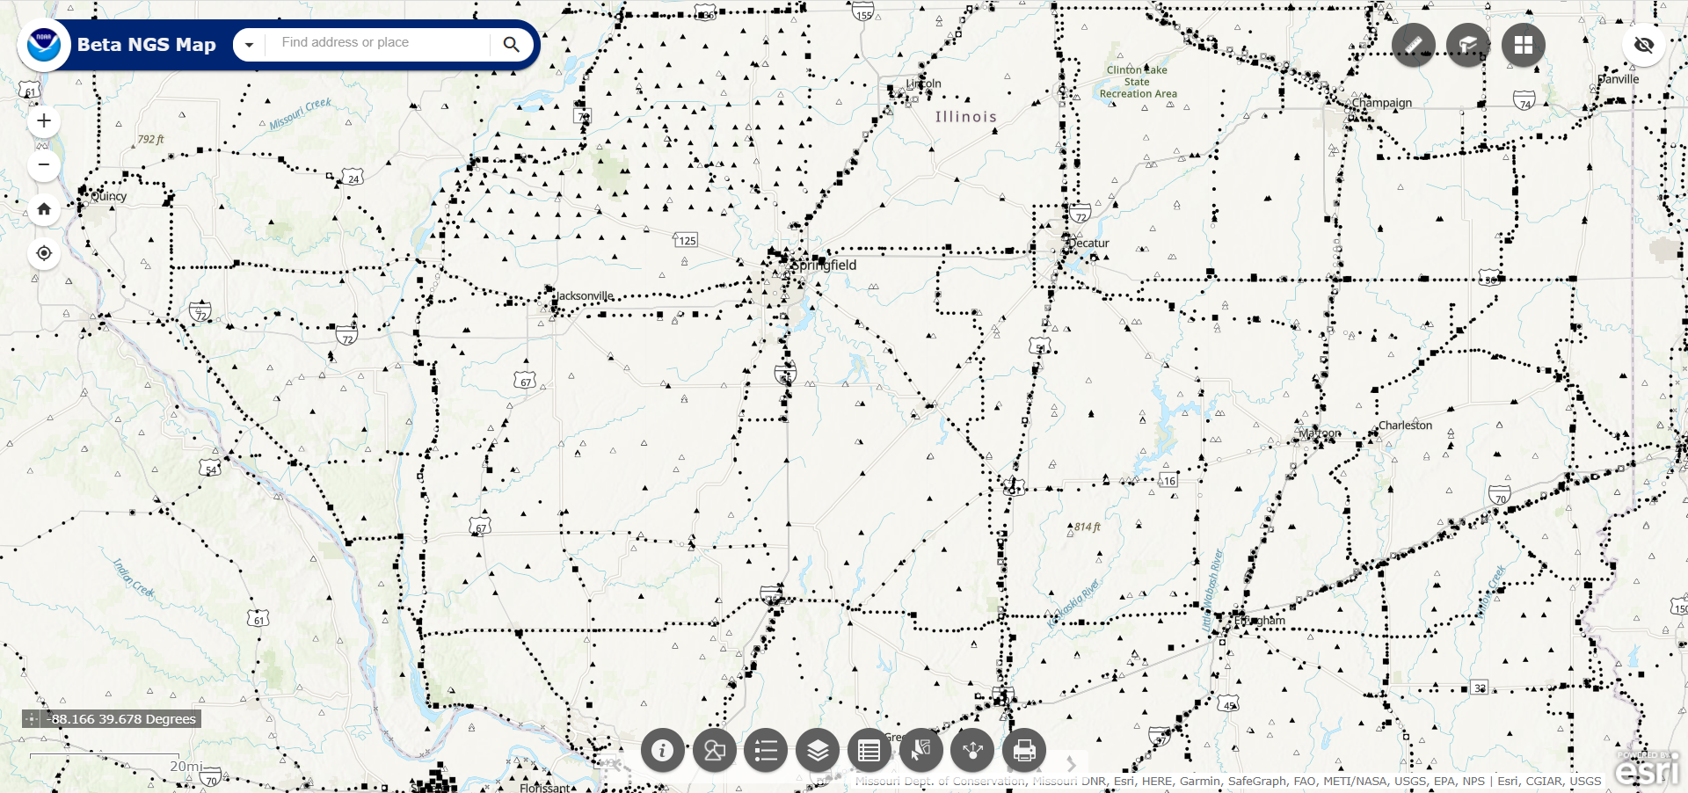
NGS Map
https://geodesy.noaa.gov/datasheets/ngs_map/

Slide 37
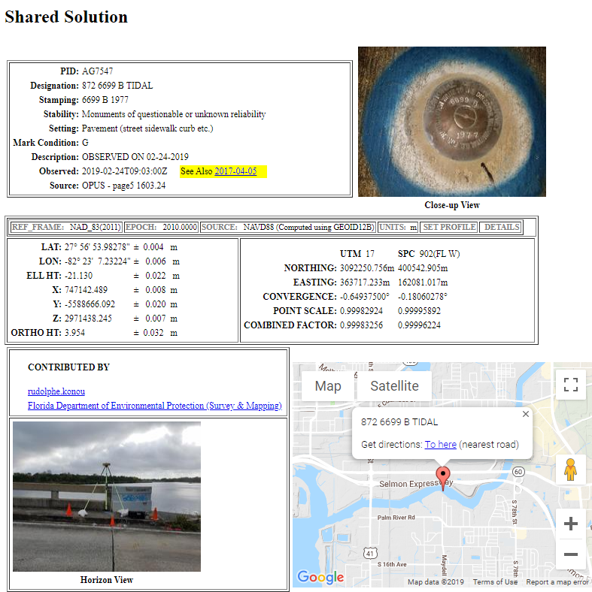
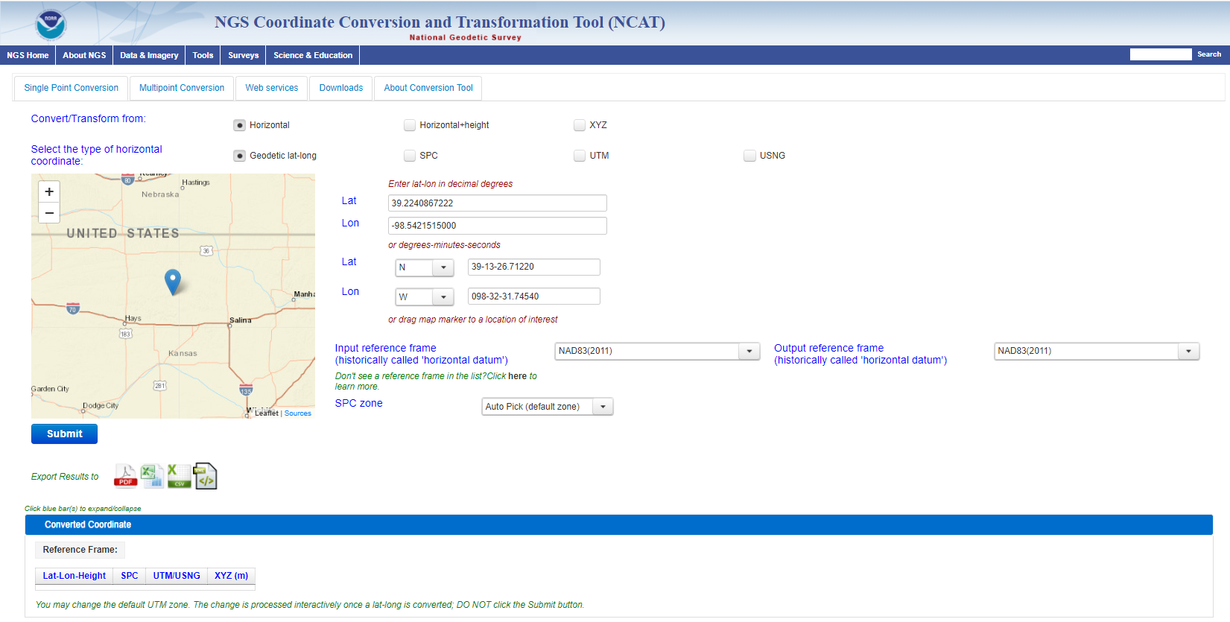
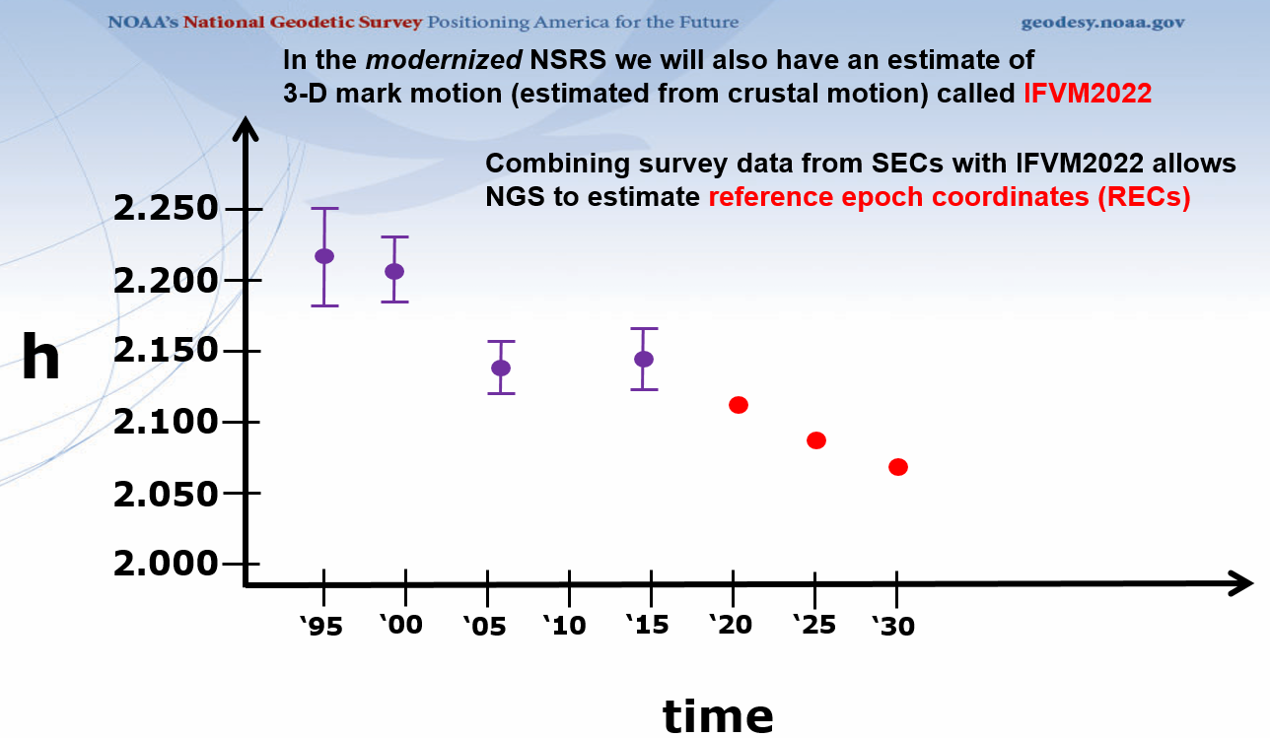
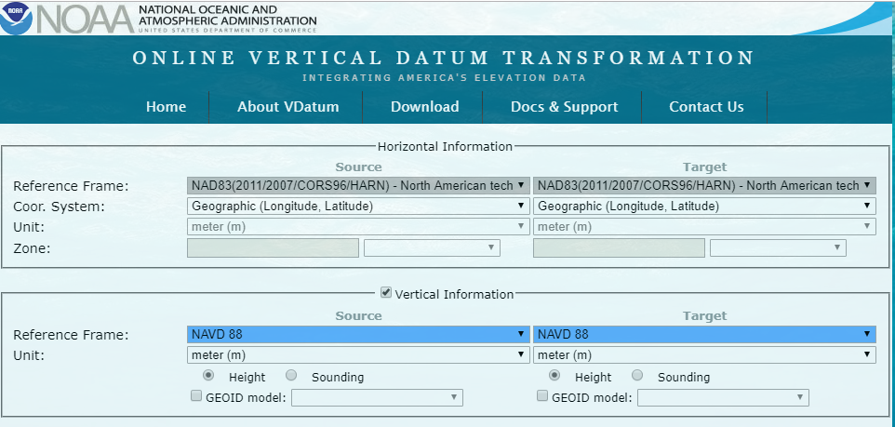
GPS on Bench Marks - What & Why?
GPS on Bench Marks is about preparing the country and our communities to take full advantage of the benefits of the Modernized NSRS, by collecting new GPS observations on bench marks with published NAVD 88 heights.
Primary GPSonBM Campaign Benefits:
2020.0 Reference Epoch Coordinates (REC’s)
Data for NAVD 88 – NAPGD2022 Transformation Tools
Build time series of observations in areas of motion
Added benefits:
Evaluate gravimetric geoid models
Check your RTN results
Update and maintain passive control marks
Identify marks suspected of movement
Notes:
NGS’ GPSonBM program is now requesting data to build the models that NCAT and VDatum will use to transform geospatial data from existing datums to the Modernized National Spatial Reference System.
These are the benefits that we derive that other countries could derive as well. The processes, tools, workflow, and technical specifications that we have developed can be applied in other places. We are keeping in house the definition of the NSRS, outsourcing the observations to realize the frames
Went back to marks that were set before that are no longer accessible or gpsable – so this provides ongoing maintenance. Marks were set open fields and now are developments – road widening (Chicago grew)
revisit Geodetic infrastructure regularly for maintenance

Slide 38
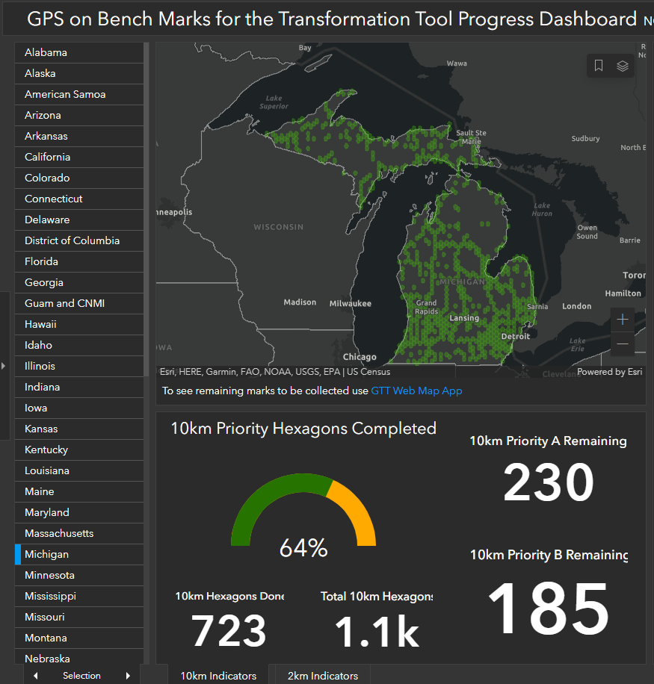
GPS on Bench Marks
Deadline extended to September 30, 2023
Can contribute OPUS Share solutions
Or Bluebooked solutions using the BETA version of OPUS Projects 5.1
This includes real-time observations uploaded in the new GVX vector exchange file format.
https://geodesy.noaa.gov/GPSonBM/
Notes:
Q: What is the deadline to submit GPSonBM for the Transformation Tool?
A: September 30, 2023– so that observations can be used to create 2020.0 Reference Epoch Coordinates (See Blueprint 3 -Working in the Modernized NSRS)
Q: Can we submit previous observations?
A: Yes! Observations made within the past 3 years may be submitted if you have the required metadata and pictures.
Q: What do we do if we can’t find the priority mark or if it not observable with GPS?
A: 1) Submit a Mark Recovery with the new Mark Recovery Form.
2) Find and observe an secondary mark listed in the hexagon layer on the web map.
Q: Can we submit offset observations for marks that are not GPS-able?
A: Not for now, unless you follow the NGS Mark Reset Procedures. In the future, OPUS 6.0 will enable you to process and adjust GPS, leveling, and total station observations together, and submit them to NGS.
Q: Can we submit less than 4 hours of data?
A: Yes, but only by using OPUS Projects to Bluebook the data.
Q: Can we submit RTK observations?
A: YES! The recently released BETA version of OPUS Projects 5.1 enables processing of Hybrid Survey Networks that include both static and real-time observations uploaded in the new GVX vector exchange file format.

Slide 39

Save the Date! NGS day at FIG 2023
NGS will present a full day’s worth of content at the 2023 FIG Working Week in Orlando, FL on May 31, 2023
https://fig.net/fig2023/
https://geodesy.noaa.gov/datums/newdatums/fig-2023.shtml

Slide 40
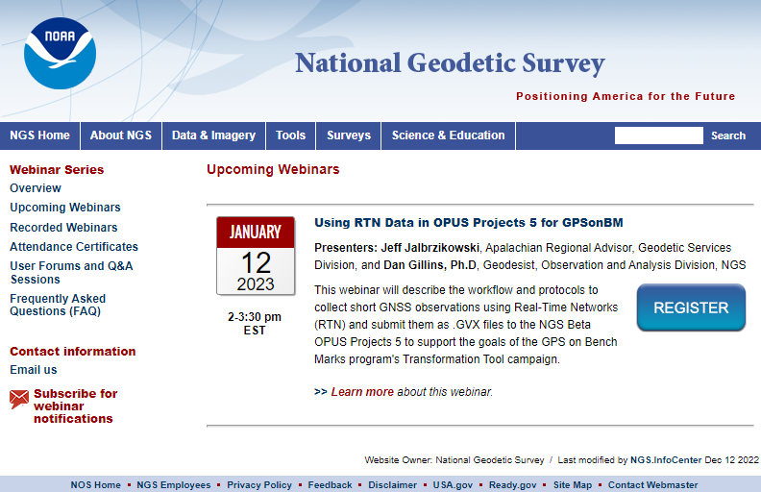
NGS Webinar Series
Monthly webinars highlight geodesy and coastal mapping programs, products, and research
Each webinar features an NGS employee delving into a topic of interest, and generally includes a moderated question and answer session
Registration is free and video recordings are made available for later viewing
Certificates of attendance are available
https://geodesy.noaa.gov/web/science_edu/webinar_series/

Slide 41
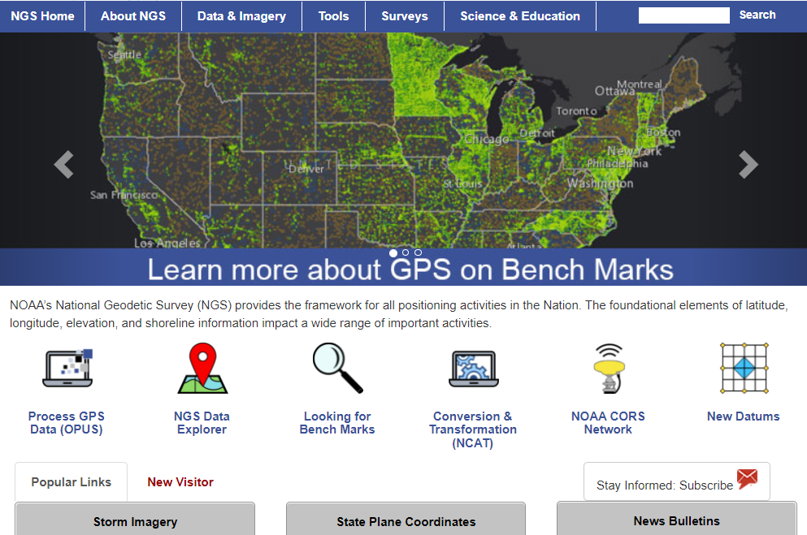
https://geodesy.noaa.gov/
Notes:
Monthly webinar series
All webinars are recorded and available online
Online lessons
Video library
Publication library
NSRS Modernization News

Slide 42
Thank You!
Jacob M. Heck, Ph.D., P.S.
Great Lakes Regional Geodetic Advisor (MI, IN, IL, WI)
U.S. National Geodetic Survey, NOAA
jacob.heck@noaa.gov
c/o NOAA Great Lakes Environmental Research Laboratory
4840 S. State Road
Ann Arbor, MI 48108
For more information, visit https://geodesy.noaa.gov

