Slide 1

The State Plane Coordinate System of 2022
South Carolina Coordinate System
NATRF2022 State Projection
2025 SCSPLS Convention and Technical Conference
February 28, 2025
Charlie Geoghegan
NGS Mid-Atlantic Regional Advisor

Slide 2
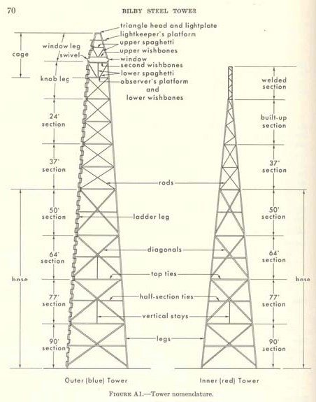
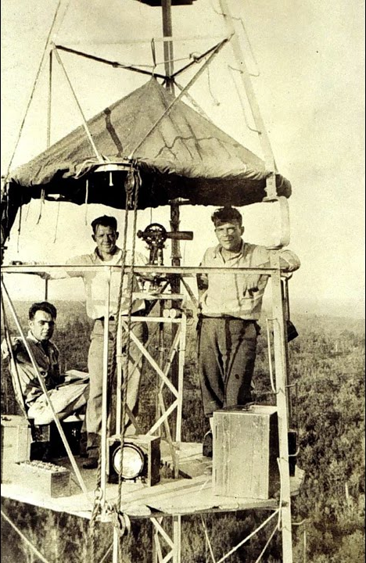

Back in the Day…
Notes:
Spartanburg, Greenville, Walterboro, Summerville

Slide 3




Organizational Structure
Notes:
-We are the Federal Government’s oldest scientific agency.
-part of the Executive Branch
-I know it can seem kind of strange that NGS is part of the NOS, but the origins of NGS lie with the C&GS.
-we are a “Program Office” of the NOS
Survey of the Coast – 1807
Coast Survey – 1836
Coast and Geodetic Survey – 1878
NGS since 1970

Slide 4





We’re not USGS, we’re NGS
≠
Notes:
-as you can read my slide, I like to point that out because over my years at NGS I’ve seen and heard this misunderstanding quite a bit
-don’t worry! it doesn’t offend us! and we do work closely with USGS, but we are separate agencies within totally different departments of the federal government

Slide 5
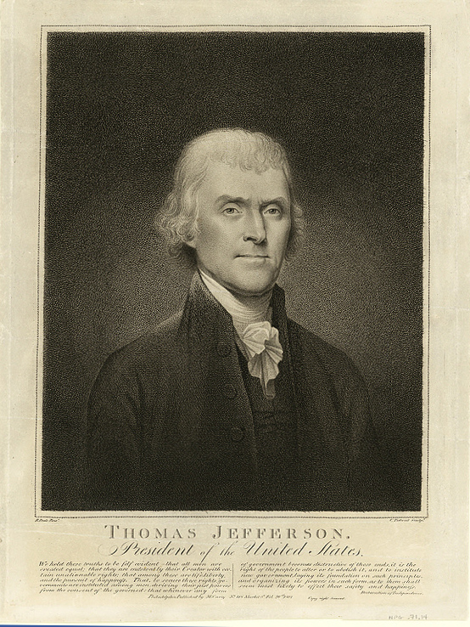
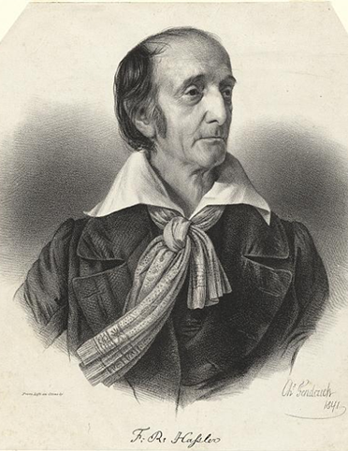



NOAA and NGS
Our Nation’s First Civilian Science Agency
1807
Thomas Jefferson
Survey of the Coast
1811
Ferdinand Hassler
Superintendent
1836
U.S. Coast
Survey
1878
U.S. Coast and
Geodetic Survey
1970
NOAA is established
Notes:
NGS has been around a long time. For more than 200 years, NGS and its predecessor agencies have collaborated with public and private organizations to establish reference stations at precisely determined locations.
We began on a mission established by Thomas Jefferson in 1807 to conduct a “Survey of the Coast” (as the United States Coast Survey).
(Pictured are Thomas Jefferson and Ferdinand Hassler, the first Superintendent of the Coast Survey). We were renamed the U.S. Coast and Geodetic Survey in 1878. NOAA was established in 1970.
Traditionally, precise positioning locations have been identified by setting a survey mark—usually a brass, bronze, or aluminum disk. Locations might also be identified by a deeply driven rod, or a prominent object, such as a water tower or church spire.

Slide 6
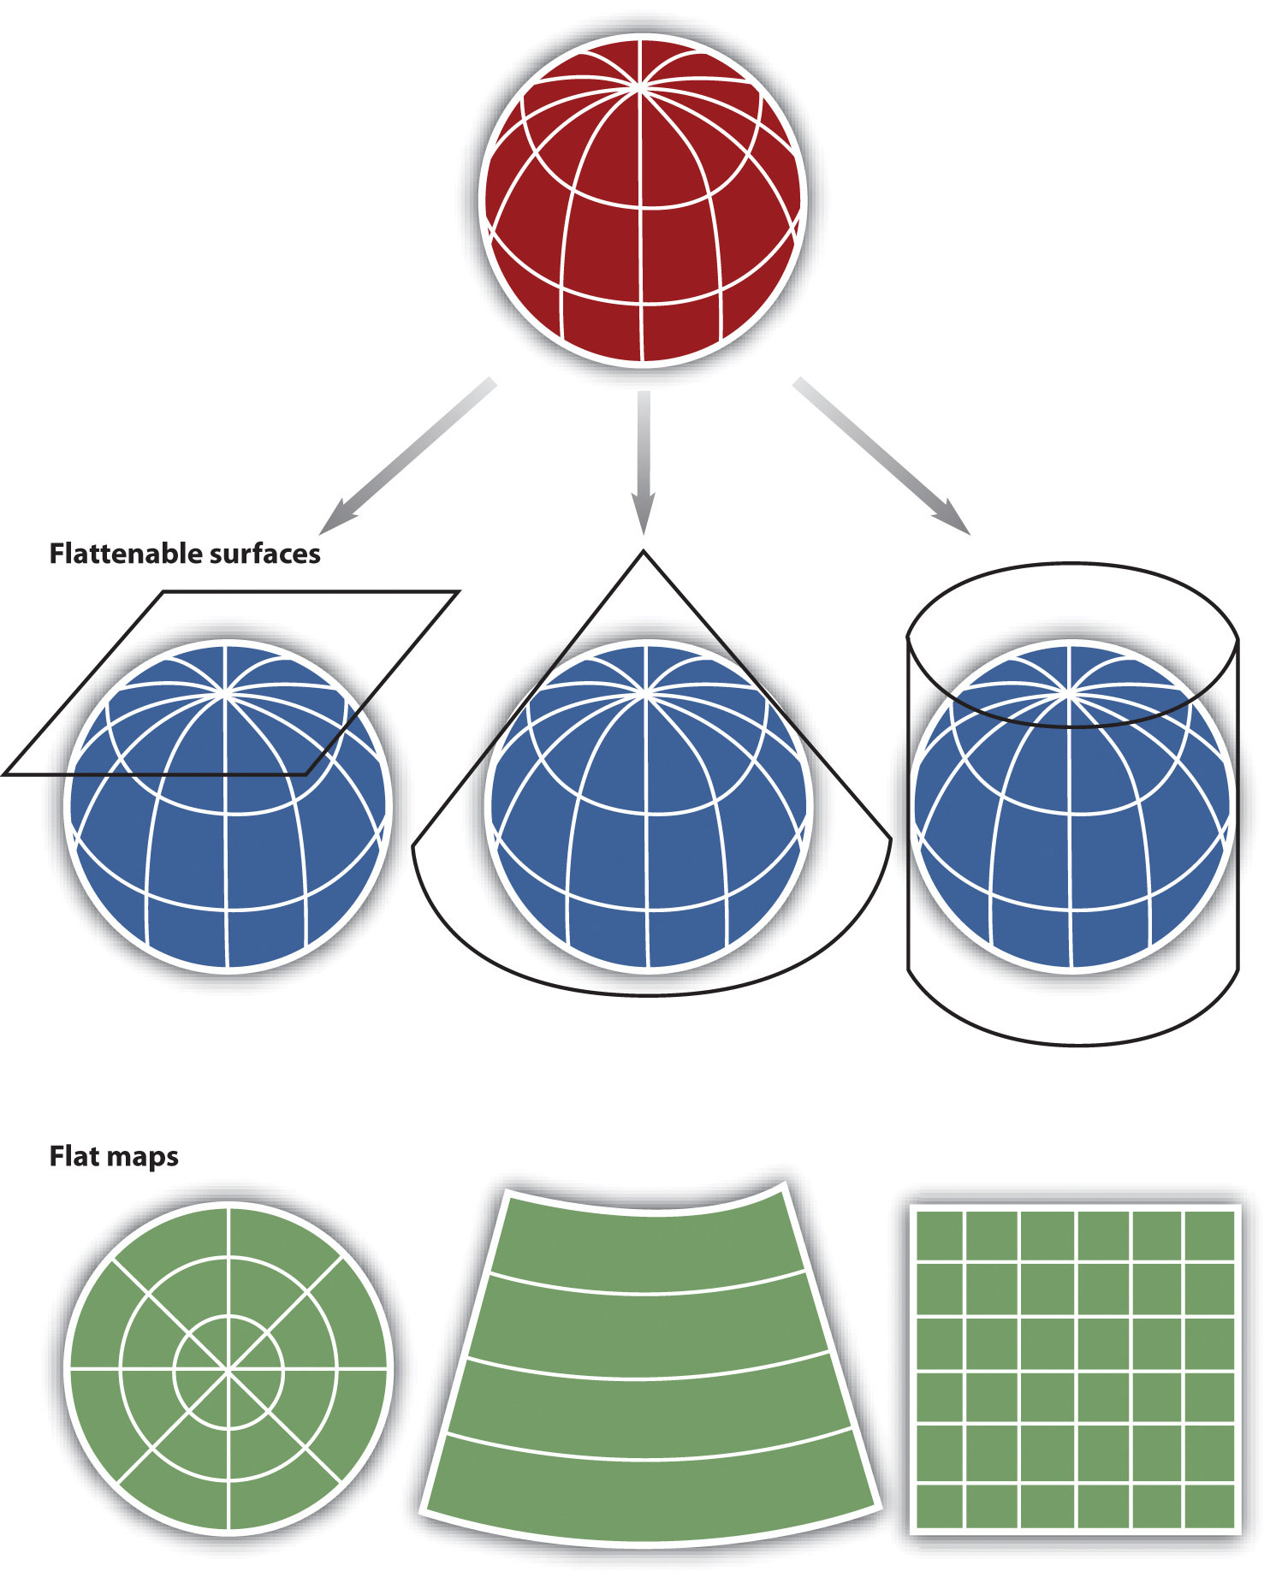
Today’s Topics
NGS’s Geospatial Role
Plane Coordinate Projections
SC Coordinate System
  NAD83 (2011) epoch 2010.00
  NATRF2022 epoch 2020.00
State Plane Coordinate System of 2022
  NGS Tools and Access to SPCS2022

Slide 7
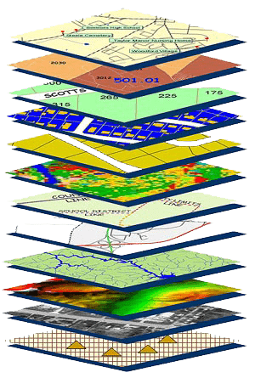
NGS Mission
To define, maintain and provide access to the National Spatial Reference System (NSRS) to meet our Nation’s economic, social, and environmental needs.
NSRS
Notes:
NGS develops and maintains the National Spatial Reference System, a national coordinate system that provides the foundation for transportation, navigation, land record systems, mapping and charting efforts, and a multitude of scientific and engineering applications
CLICK
You’ve all seen this or some similar graphic I’m sure. That bottom layer… that’s our baby, the NSRS.

Slide 8

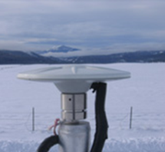




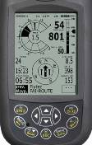





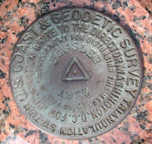
NGS Provides the Geodetic Infrastructure Critical to Our Geospatial Economy through the NSRS
Aviation
The “P” in PNT
CORS
Satellite
Operations
Surveying
and Mapping
Disaster Response
Precision Agriculture
Personal
Navigation
Navigation
Oil Exploration
Fishing and Boating
Trucking and Shipping
Survey Marks
Notes:
For more information see 2019 Report: Scaling the Heights: Socio-Economic Study of the NGS Gravity Program
NGS-Gravity-Program-Socio-Economic-Report.pdf (noaa.gov)
Study Values NGS Gravity Program at $4.2 to $13.3 Billion over Ten Years
Friday, November 1, 2019
A new study estimates the value of the NGS Gravity Program to be between $4.2 and $13.3 billion over ten years, with a middle scenario of $8.7 billion. The socio-economic study was conducted for NGS by ARCBridge Consulting of Herndon, Virginia. The NGS Gravity Program uses information about the gravity field to provide more accurate elevation data (or "heights") for the United States. The improved heights will result from a new vertical height reference system created from the Gravity Program's GRAV-D Project (Gravity for the Redefinition of the American Vertical Datum), which lets surveyors and scientists employ GPS to determine more precise and accurate elevations than currently possible, in less time and with less effort.

Slide 9
National Spatial Reference System
A common and consistent geospatial framework to meet the economic, social, and environmental positioning needs of our Nation.
Foundational elements include:
Latitude
Longitude
Height
Gravity
Shoreline Position
…how these change over time
Horizontal Datums | Vertical Datums
Horizontal Datums | Vertical Datums
NAD83 | NAVD88
NAD27 | NGVD29
Elevation
Great Lakes Datums | Geoid Models
Great Lakes Datums | Geoid Models
IGLD85 | GEOID18
IGLD55 | GEOID12B
Notes:
The primary mission of NGS is, “to define, maintain, and provide access to the NSRS to meet our nations economic, social, and environmental needs”.
NSRS is a consistent geospatial framework, common to all Federal agencies and other users
NSRS supports informed decision-making for mapping and charting, navigation, flood risk determination, transportation, land management, and more
Elements of NSRS include (but are not limited to): latitude, longitude, elevation, gravity, shoreline position + their changes over time …other elements include scale, earth orientation parameters and others
The vertical component of the NSRS currently utilizes the North American Vertical Datum of 1988 (NAVD88)

Slide 10
NGS Mission
To define, maintain and provide access to the
National Spatial Reference System (NSRS)
access… ? = traditionally → marks/disks/landmarks
= modern and future → NOAA CORS Network (NCN)
More on tools and access later…

Slide 11
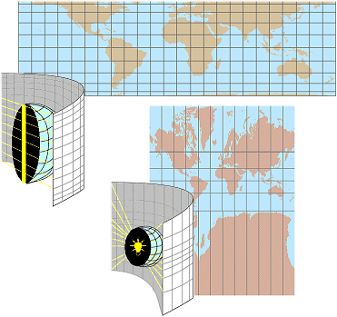
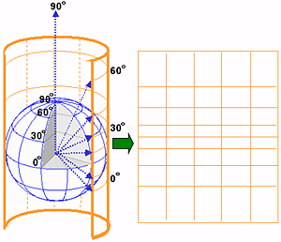
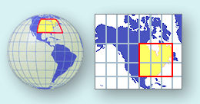
Plane Coordinate Projections
A map projection is a method by which we translate a sphere or globe into a two-dimensional representation.
The term “map projection” comes from the concept of projecting a light source through the earth’s surface onto a two-dimensional surface (a map).

Slide 12
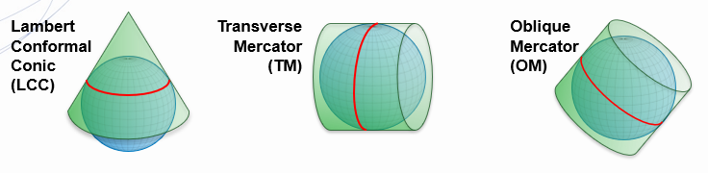
Three Common Projections

Slide 13

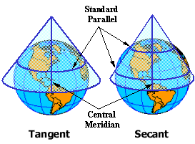
Lambert Conical Conformal (LCC)
The Lambert Conformal Conic projection was developed by Johann Lambert around 1772
A conic projection preserves shape (but not area), the projection wasn't appreciated for nearly a century after its invention.
One of the best projections for middle latitudes with an east–west orientation.
Can use a single latitude line as its point of contact (a tangent line), or the cone can intersect the earth's surface along two lines, called secants
Along the line or lines there is no distortion, but distortion does occur as the distance north or south increases.

Slide 14
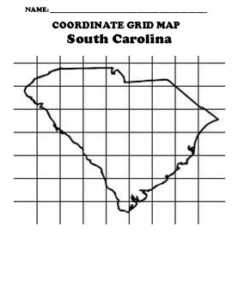
The SC Coordinate System
The official legislated coordinate system for the state
Currently projected from NAD83’s latest realization, (2011) epoch 2010.00
Will be projected from NATRF2022 epoch 2020.00 when officially recognized by the Federal Geodetic Control Subcommittee (FGCS)
Code of Laws, Title 27, Chapter 2, §27-2-10 to §27-2-110

Slide 15

SC Code, Chapter 2 of Title 27
The SPSC83, established by NGS, “may be cited as the South Carolina Coordinate System Act.“
The official legislated coordinate system for the state
Single zone
International foot: 1 inch = 2.54 cm exactly or 1 foot = 0.3048 m exactly
Reliance on description based on coordinate system not required.

Slide 16
Greenville County Boundary (excerpts)
Stone marked "S.C. 1815" on one side and "N.C. Sept. 15" on the other side at N 1,225,788.54 and E 1,636,650.35 [North American Datum 1983-86 (NAD 83-86)]
… a point at N 1,193,615.00 and E 1,635,730.00 (NAD 83-86)
… a point at N 1,155,409.00 and E 1,634,410.00 (NAD 83-86)
… a point at N 1,133,159.00 and E 1,633,701.00 (NAD 83-86)
… a point at N 1,131,240.00 and E 1,633,595.00 (NAD 83-86)
… a point at N 1,128,573.00 and E 1,633,500.00 (NAD 83-86)
… a point at N 1,102,217.00 and E 1,632,108.00 (NAD 83-86)

Slide 17
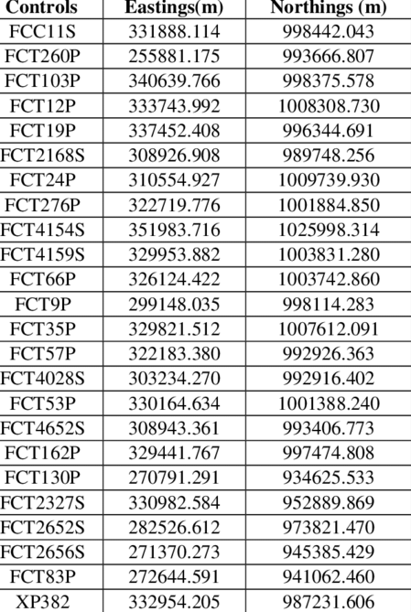
SC Standards of Practice
pp6 (11) Coordinate Description: A description of lands in which the angle points or other points in the boundary are each referred to by grid coordinates on the South Carolina State Plane Coordinate System (current Datum) or similar coordinate system.

Slide 18
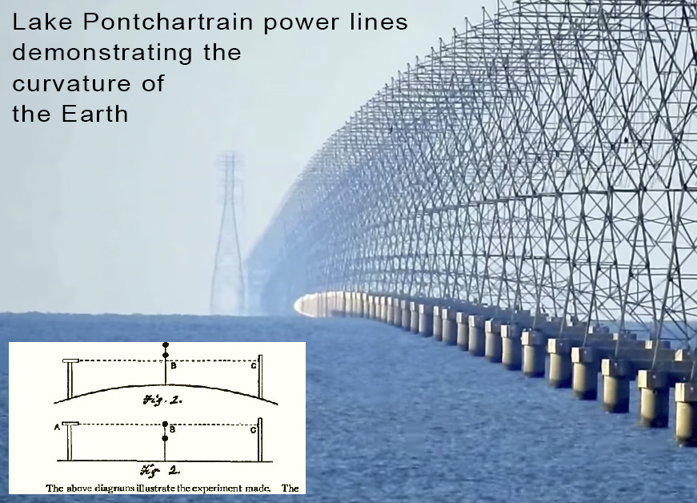
SC Standards of Practice for Geodetic Surveys
pp7(19) Geodetic Survey: areas and points affected by… the curvature of the earth
  must be connected to the coordinate realization of the North American Datum 1983 or other recognized datum.
  shall conform to the Federal Geographic Data Committee’s Geospatial Positioning Accuracy Standards, Part 2: Standards for Geodetic Networks in their most current publication.

Slide 19
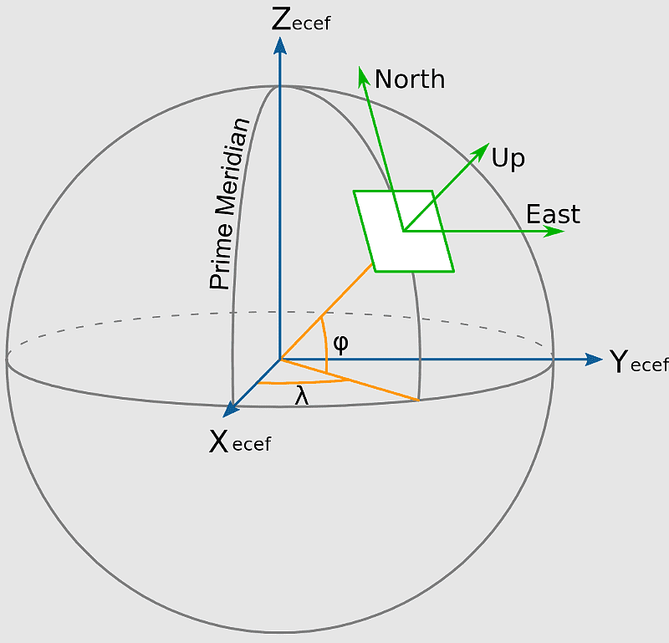
SC Standards of Practice
pp7(20) Recognized geodetic datums:
  North American Datum 1983 (NAD83)
  North American Vertical Datum 1988 (NAVD88)
or later accepted datum if applicable.
SCSoP open for NATRF2022/SPCS2022?

Slide 20
SC Standards of Practice
pp7 (21) State Plane Coordinate System:
The official coordinate system for surveying purposes in South Carolina is the South Carolina State Plane Coordinate System
single zone Lambert Polyconic Projection designated by the National Geodetic Survey as Zone 3900.
For the purpose of the South Carolina State Plane Coordinate System, the foot is the International Foot with one inch being exactly 2.54 centimeters. To convert metric coordinates to international feet, multiply by 3.280839895.
Because 1 iFt = 0.3048 m exactly: meters divided by 0.3048 = iFt
iFt x 0.3048 = meters (exactly)

Slide 21
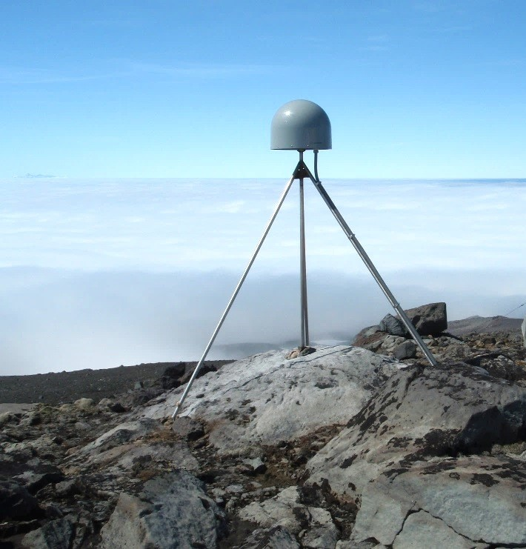
SC Standards of Practice
pp8, (36) Rover: The name given to a GNSS receiver located over an unknown survey point whose coordinates are to be determined or checked against known geodetic control.
(37) Static GNSS Survey: A geodetic survey that uses multiple survey grade satellite receivers
At least one receiver must be on known geodetic control.
Consider NCN station and/or SCRTN station
Braced CORS Monument

Slide 22
SC Standards of Practice
pp13, (3) Coordinate values:
  South Carolina State Plane Coordinate System or
  Geographic Positions based on the National Coordinate System.
Horizontal coordinate values should be in:
  the North American Datum of 1983 (NAD 83) 2007 or
  the most current datum published by the National Geodetic Survey (NGS).
Vertical coordinate values should be in:
  the North American Vertical Datum of 1988 (NAVD 88) or
  the most current datum published by the National Geodetic Survey (NGS).
Identify any local coordinate system used AND its relationship to the National Coordinate System.
Use meters or international foot

Slide 23
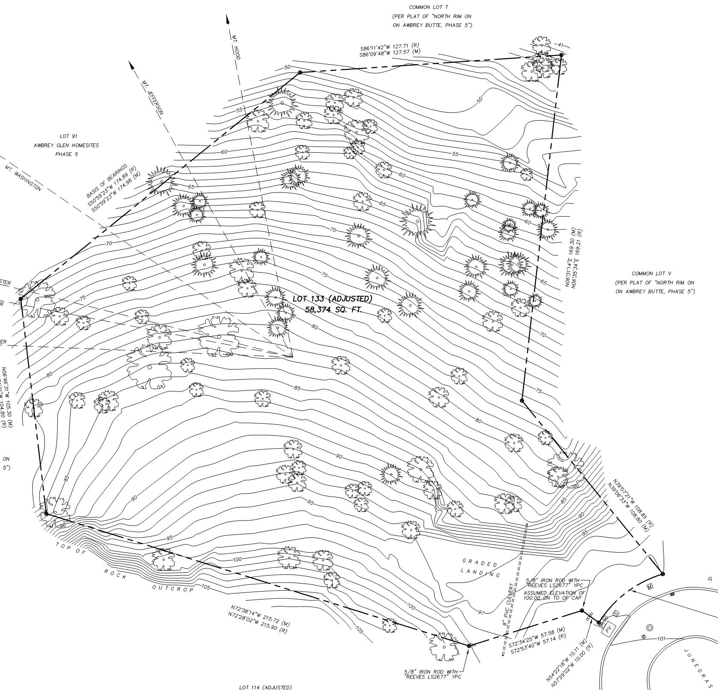
SC Standards of Practice
(5) Ground control for topographic and planimetric mapping projects shall be in South Carolina State Plane Coordinate System grid coordinates, NAD83/2007, and distances in International feet or meters.
A minimum of one permanent project vertical control point shall be shown.

Slide 24
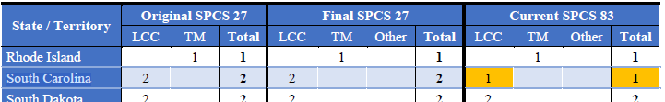
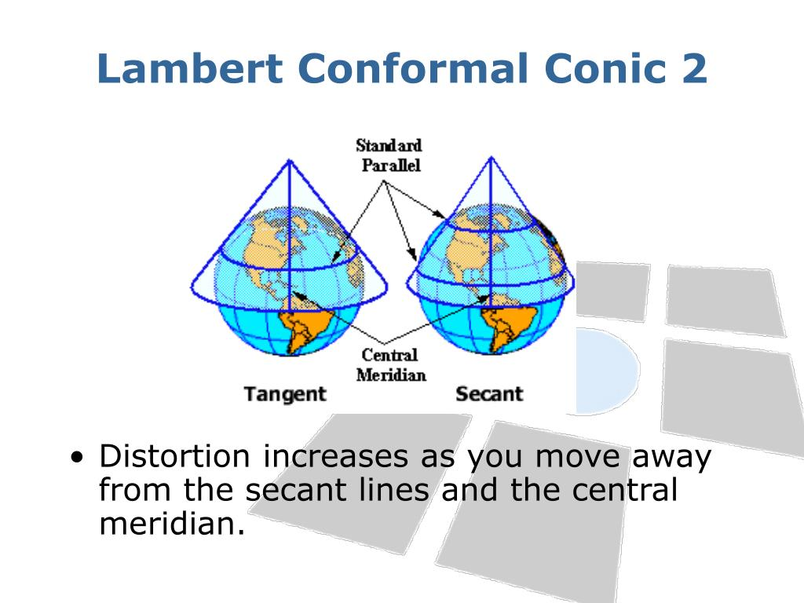
Keeping What Works
South Carolina will continue historical use of the Lambert Conformal Conical Projection
Two departures from SPCS27, adoption of a single zone system and the International Foot, will remain in future systems

Slide 25
SPCS27 vs. SPCS83
Grid origins were changed by significant amounts for all U.S. zones to ensure projected coordinates differed substantially from SPCS 27.
Exception: decreased false easting by exactly 4 feet (1.219 meter) in South Carolina (due to treating SPCS 27 grid origin value of 2,000,000 U.S. survey feet as international feet, and then converting to meters).
The difference between 2,000,000 U.S. Survey Feet and 2,000,000 International Feet is 4’ or 1.219 meters
2,000,000 iFt is exactly 609,600 meters, the value adopted by SPSC83

Slide 26
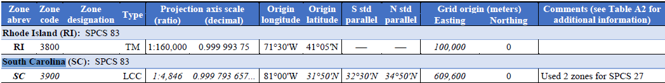
SPCS83 Defining Parameters
Two zones used for SPCS 27 combined into single zone for SPCS 83. False easting is exact metric conversion from 2,000,000 international feet = 1,999,996 sFt (exact), which differs from SPCS 27 false easting of 2,000,000 sFt by only 4 feet (exact).

Slide 27
Defining Parameters for SPCS27 and 83

Slide 28
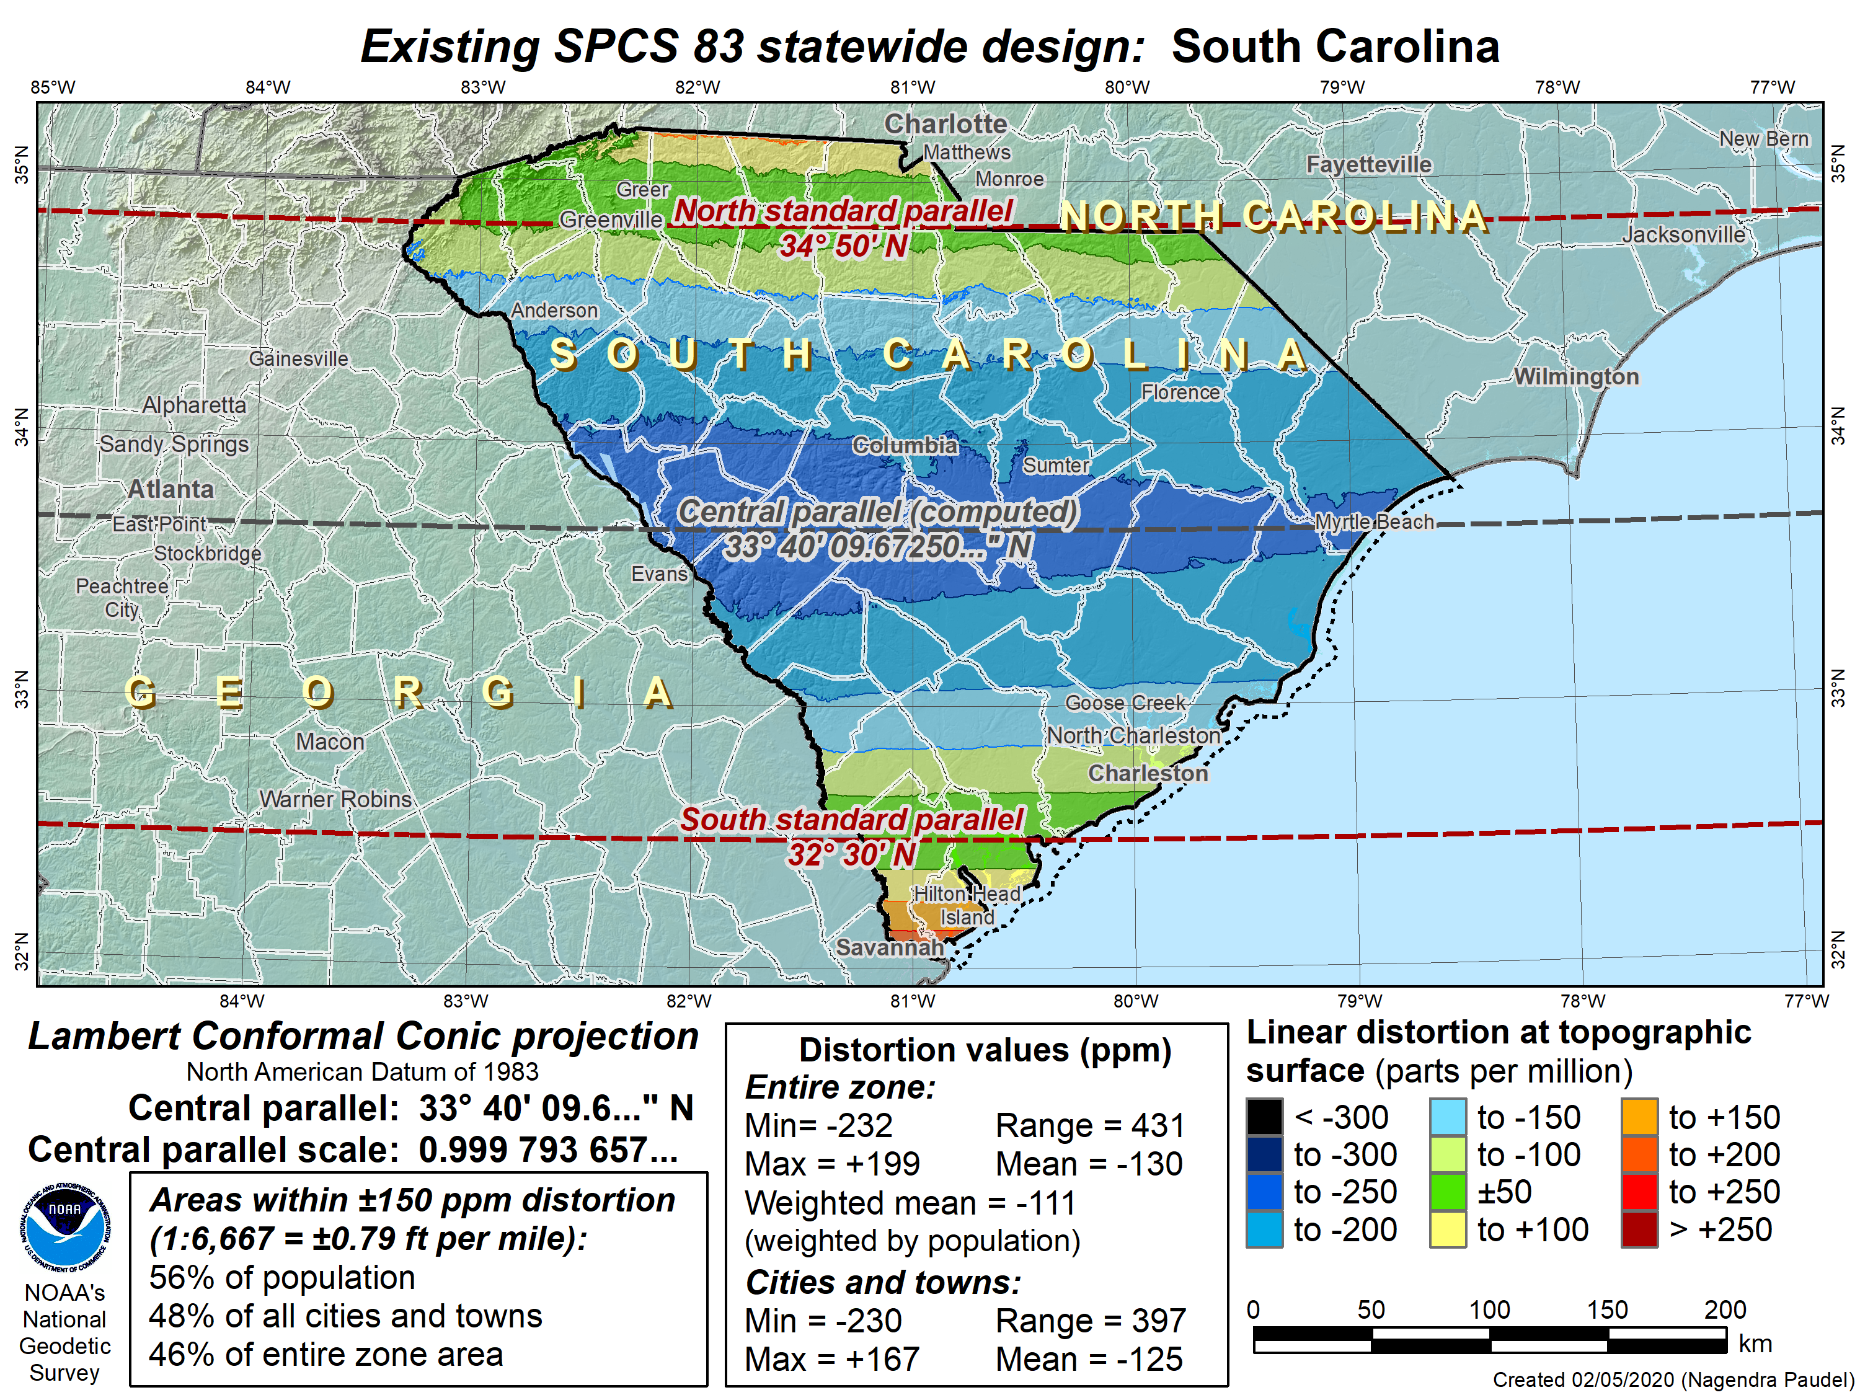

Slide 29
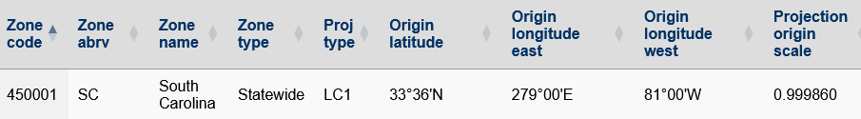
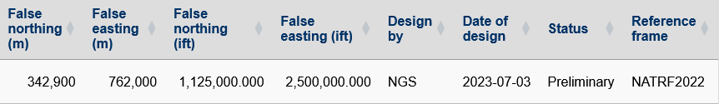

Slide 30
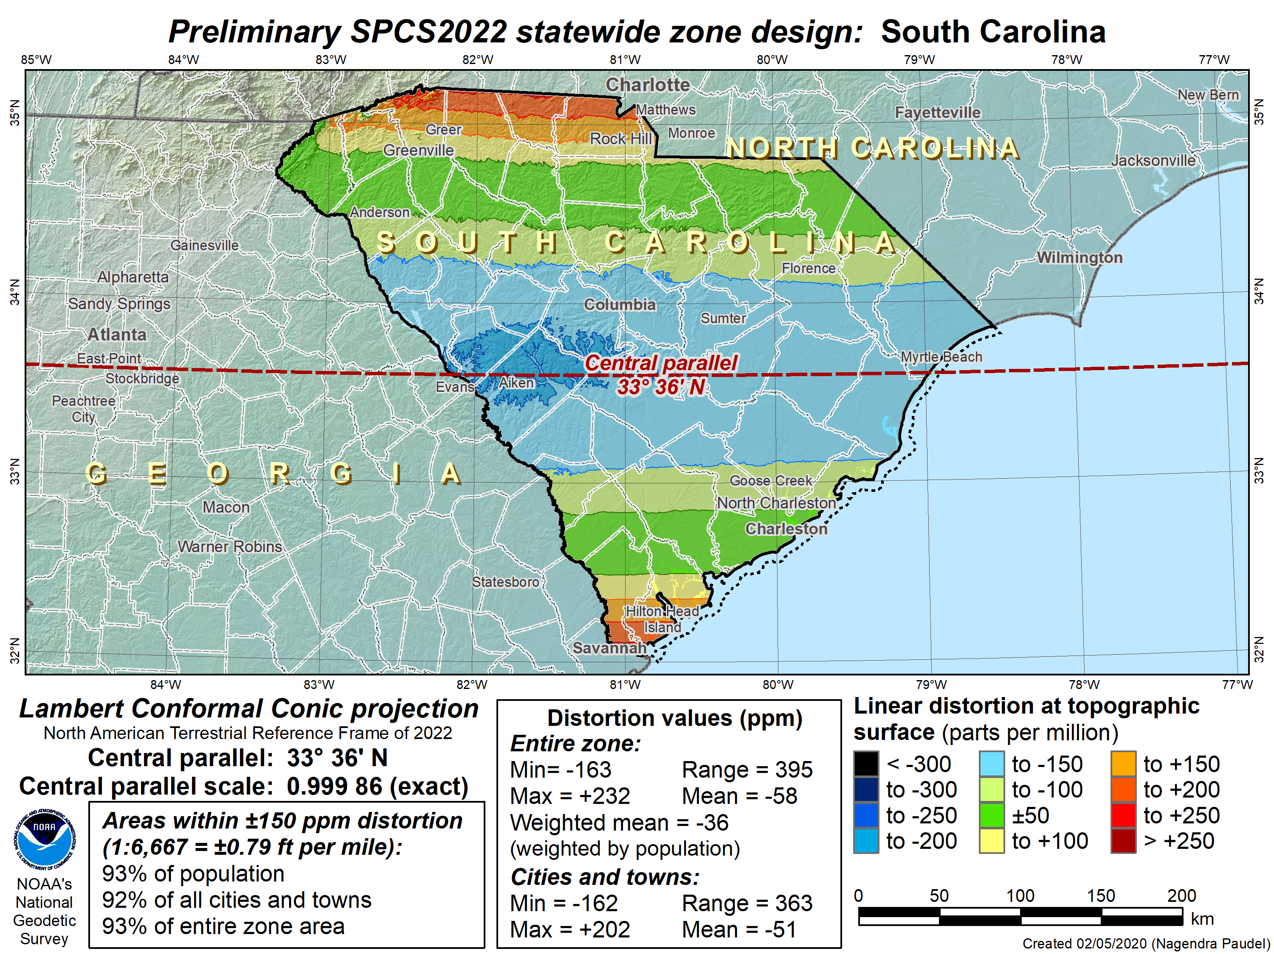

Slide 31
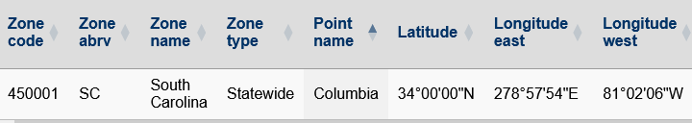

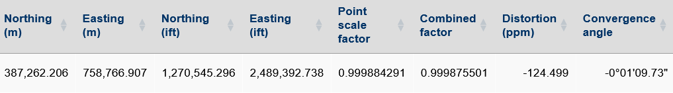
SPCS2022
SPCS2022 Example Coordinates and Distortion Values - Alpha Release - Last Updated 6/26/2024

Slide 32
Distortion Maps: SPCS83 vs SPCS2022

Slide 33
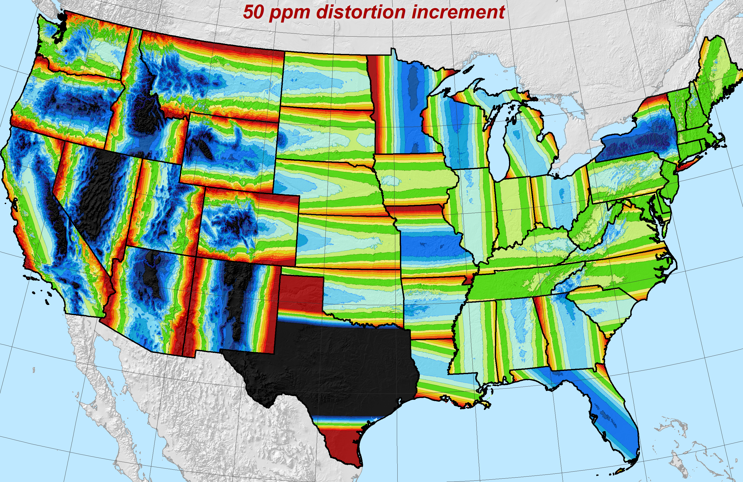
The State Plane Coordinate System of 2022

Slide 34
NSRS Access
The NSRS terrestrial reference frame (TRF), a.k.a. the horizontal datum, is currently and will continue to be defined by the NOAA CORS Network.
  The current official national TRF is NAD83 (2011) with a reference epoch date (REC) of 2010.00
  When NAD83 is replaced, the new TRF will be the North America Terrestrial Reference Frame of 2022 (NATRF2022).

Slide 35
What “Access” to the NSRS Will Mean
What will stay the same?
  The NSRS will remain as “geodetic control” for you to “access”
    Geospatial information and metadata about various points will still be available
    Passive control will continue to exist but…
      Gone are the days of getting “the coordinate” on a point from a “datasheet”
Notes:
What will stay the same?
The NSRS will remain as “geodetic control” for you to “access”
Geospatial information and metadata about various points will still be available
And passive control will exist…
But gone are the days of getting “the coordinate” on a point from a “datasheet”

Slide 36
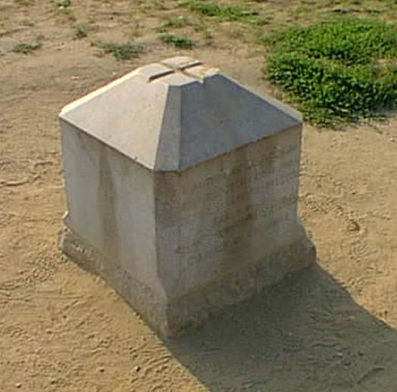
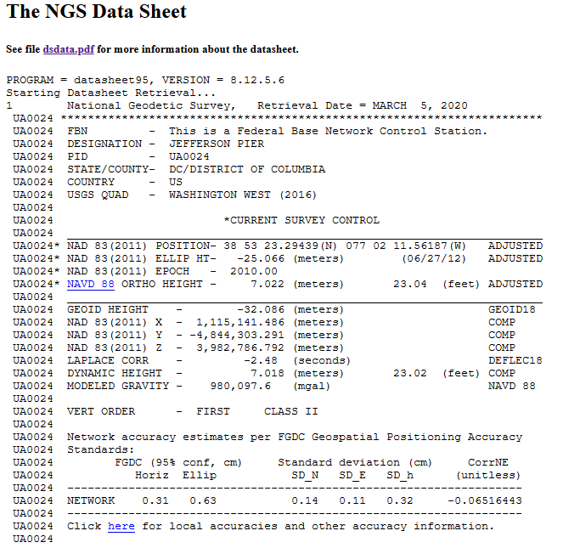
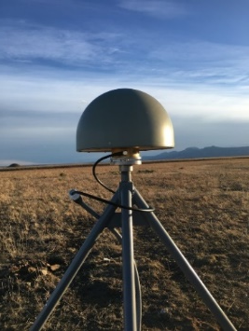
What “Access” to the NSRS Means
Until 1980, NGS offered “passive control” (Infrequently observed marks)
  And one definitive coordinate set for each one of about 1.6 M marks
More recently, NGS provides data and coordinate functions with NOAA CORS Network
  2000+ stations currently, most were not installed by NGS
  And one definitive coordinate function for each one
  And the software to determine coordinates from your GNSS data (OPUS)
Notes:
So, what does ACCESS mean?
Until 1980, NGS offered “passive control”* (meaning * Infrequently observed marks)
And one definitive coordinate set for each one of about 1.6 M marks
More recently, NGS provides data and coordinate functions with NOAA CORS Network
(most of which were not installed by NGS)
And one definitive coordinate function for each one
And the software (PAGES / OPUS) to differentially position your GPS receiver to each station
2000+ stations currently

Slide 37
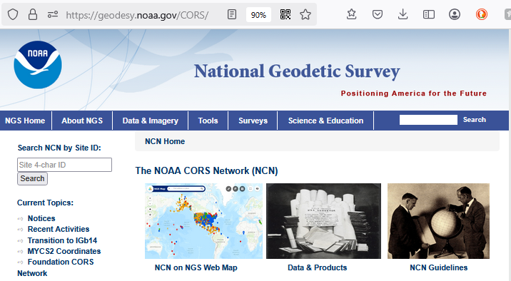

NCN Access to the NSRS
geodesy.noaa.gov/CORS/

Slide 38
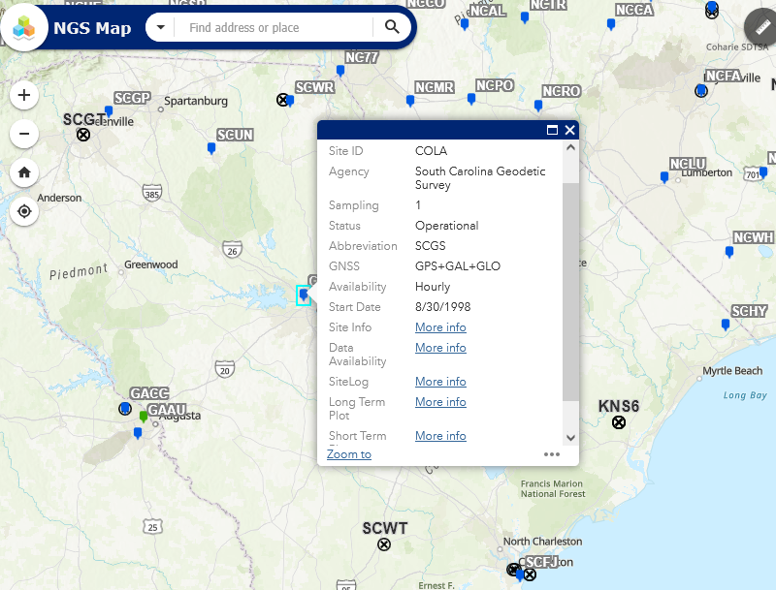

NGS CORS Map
NGS CORS Map

Slide 39
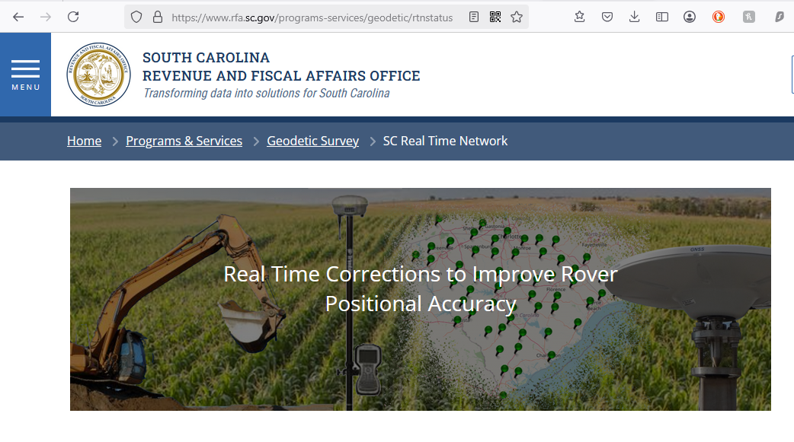


SCRTN Aligned to the NSRS
rfa.sc.gov/programs-services/geodetic/rtnstatus

Slide 40
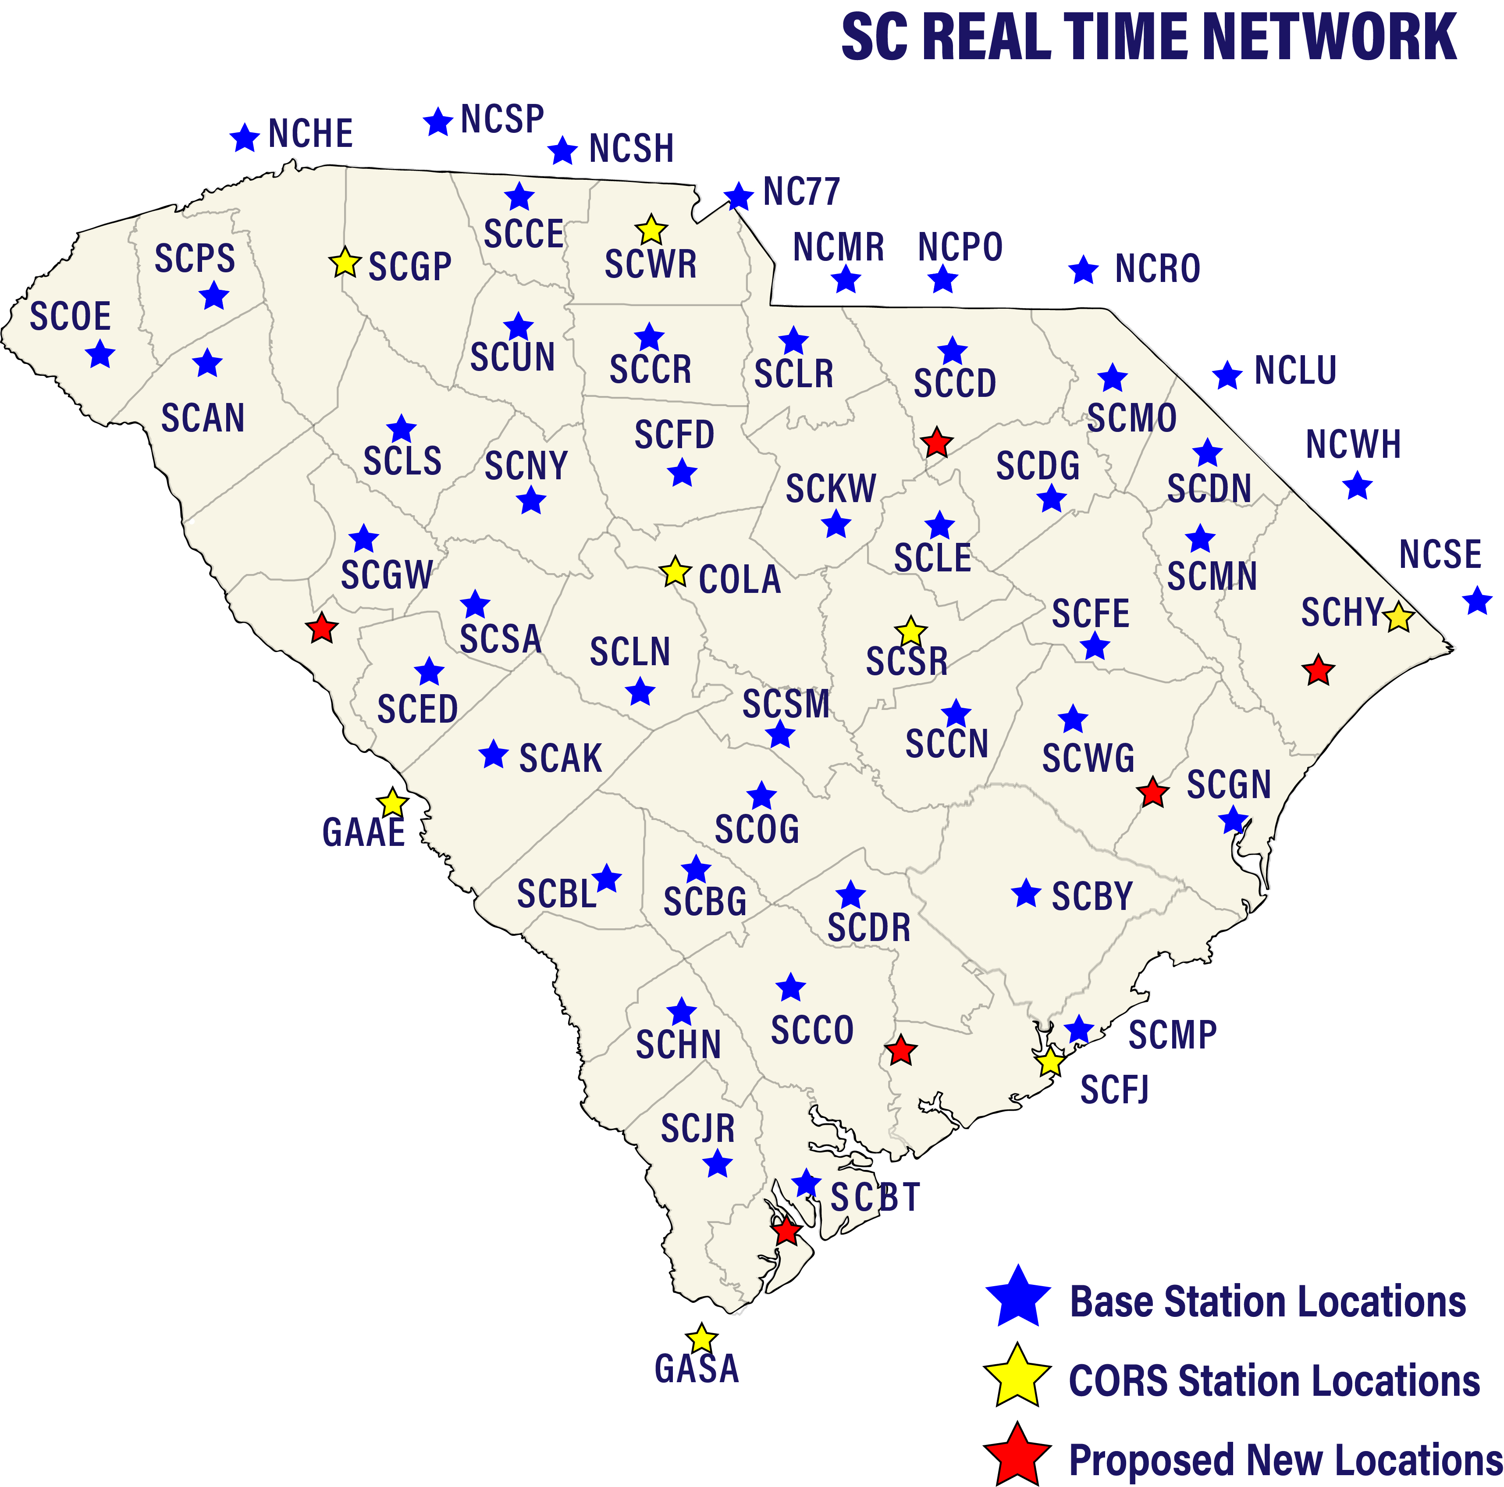

Slide 41
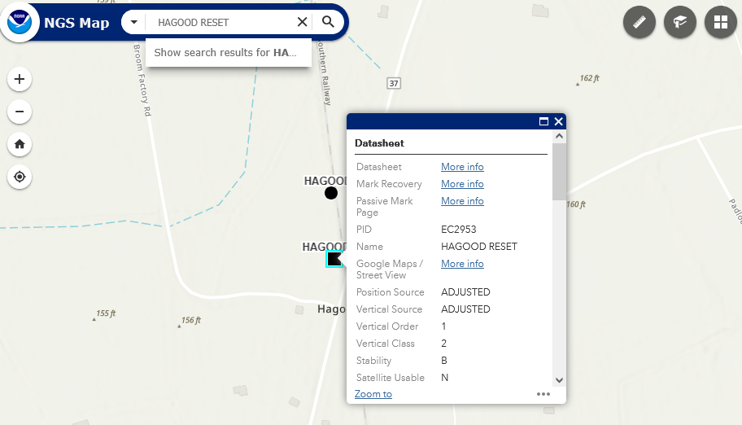

NGS Map
NGS Map

Slide 42
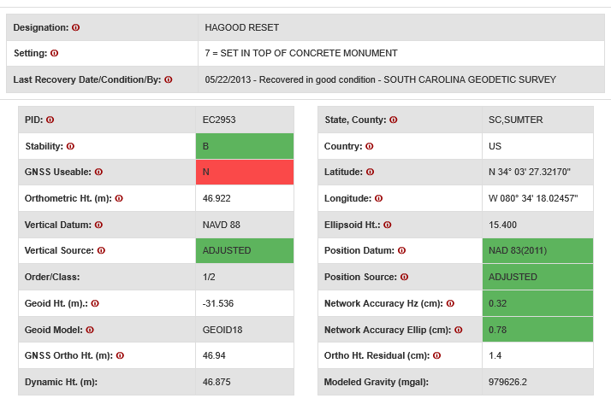

Passive Mark Page
Passive Mark Page

Slide 43
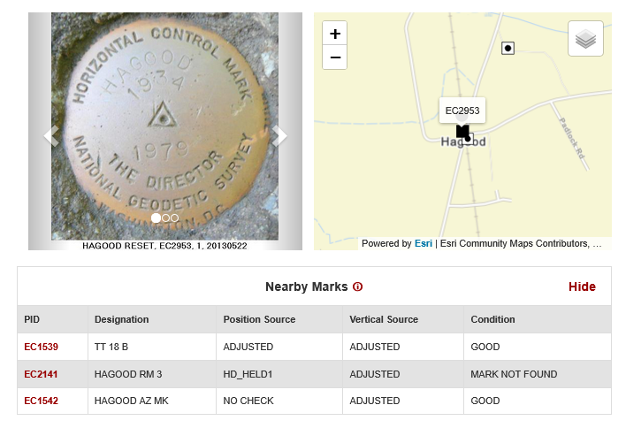
(cont) Passive Mark Page

Slide 44
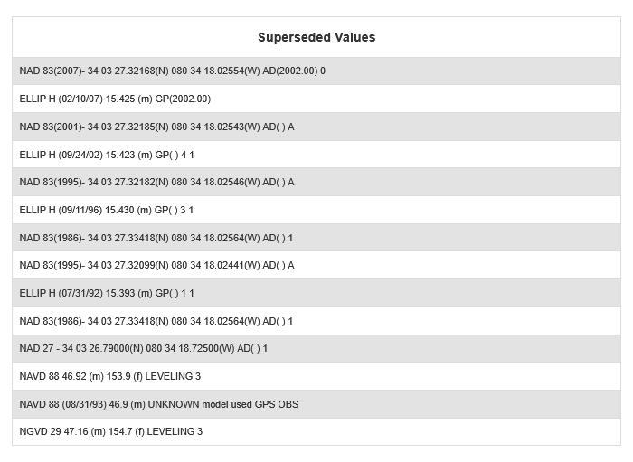
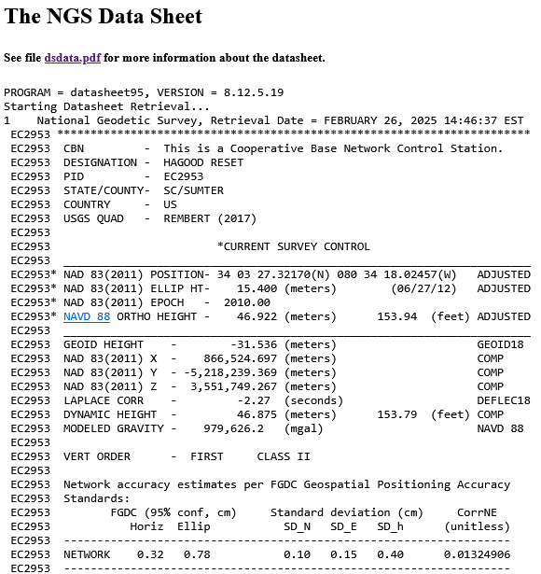
(cont) Passive Mark Page

Slide 45
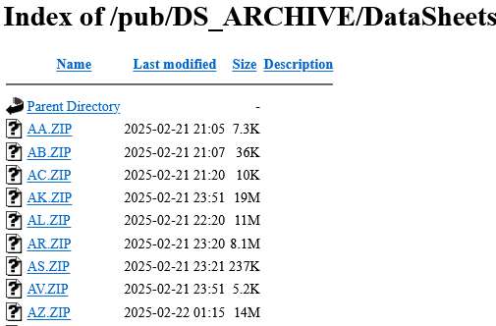
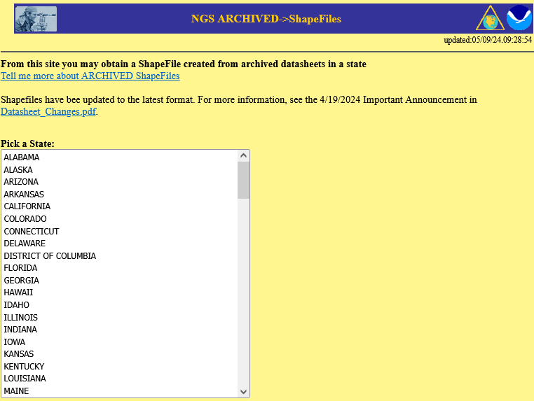


NGS Archived Control and ShapeFiles
Archived by state each month:
Control (DataSheets) ShapeFiles

Slide 46
Existent control -> 2022 Coordinates
Resurvey: Return to the field and collect new observations, relying upon geodetic control that has coordinates in the new datum
Readjust: Using existing observations, re-compute new coordinates based upon geodetic control (CORS) that has been defined in the new datum
Transform: Take finished products which have coordinates in the old datum and use transformation software to estimate coordinates in the new datum

Slide 47

Conversion and Transformation Tools
NGS Coordinate Conversion and Transformation Tool (NCAT)
NAD83(2011)
NAD83(NSRS2007), a.k.a. …(2007)
NAD83(FBN), early 2000s
NAD83(HARN), 1995 in SC
NAD83(1986)
NAD27
USSD U.S. Standard Datum
Vertical Datum Transformation (Vdatum)
NAD83(2011)
NAD83(1986)
NAD 1927, a.k.a. NAD27
NAD83(NSRS2007), a.k.a. …(2007)
NAD83(1992) ~ NAD83(HARN)
Various realizations of ITRF, IGS and WGS

Slide 48
SUPERSEDED Horizontal and Geometric Datum(s)
US Standard Datum (USSD) 1901 MEADES RANCH Clarke 1866
North American Datum (NAD) 1913 MEADES RANCH Clarke 1866
NAD27 1927 MEADES RANCH Clarke 1866
NAD83 (1986) 1986 Ellipsoid GRS80**
NAD83 (HARN) 199x* Ellipsoid GRS80**
NAD83 (NSRS2007) 2007 Ellipsoid GRS80**
*Different states began using the High Accuracy Reference Network or HARN realization of NAD 83 in different years. HARN for SC is 1995
** Geodetic Reference System of 1980

Slide 49



Conversion and Transformation Tools
NGS Coordinate Conversion and Transformation Tool
(NCAT) ALPHA NCAT
Vertical Datum Transformation
(VDatum)
Current version of NCAT
ALPHA version of NCAT
Current version of VDatum

Slide 50
Datums, Realizations and Reference Epoch
NAD83(2011) epoch 2010.00

Slide 51
Datums, Realizations and Reference Epoch
NAD83(2011) epoch 2010.00
H. Datum
Realization/Adjustment
Reference Epoch

Slide 52
HAGOOD RESET, Superseded Coordinates
NAD83(2011) 34 03 27.32170 080 34 18.02457 AD(2010.00) 0
NAD83(2007) 34 03 27.32168 080 34 18.02554 AD(2002.00) 0
NAD83(2001) 34 03 27.32185 080 34 18.02543 AD( ) A
NAD83(1995) 34 03 27.32182 080 34 18.02546 AD( ) A
NAD83(1995) 34 03 27.32099 080 34 18.02441 AD( ) A
NAD83(1986) 34 03 27.33418 080 34 18.02564 AD( ) 1
NAD27 34 03 26.79000 080 34 18.72500 AD( ) 1

Slide 53
HAGOOD RESET, Converted* Coordinates (iFt)
Latitude Longitude Northing Easting
NAD83(2011) 34 03 27.32170 080 34 18.02457 809,526.694 2,129,713.782
NAD83(2007) 34 03 27.32168 080 34 18.02554 809,526.692 2,129,713.701
NAD83(2001) 34 03 27.32185 080 34 18.02543 809,526.709 2,129,713.710
NAD83(1995) 34 03 27.32182 080 34 18.02546 809,526.706 2,129,713.707
NAD83(1995) 34 03 27.32099 080 34 18.02441 809,526.622 2,129,713.796
NAD83(1986) 34 03 27.33418 080 34 18.02564 809,527.955 2,129,713.687
NAD27 34 03 26.79000 080 34 18.72500 385080.579 **2,129,676.338**
*NGS Coordinate Conversion and Transformation Tool (NCAT)
**SC NAD27 Plane Coordinate System North Zone, U.S. Survey Foot

Slide 54
HAGOOD RESET, Apparent Shifts in Position
NAD27 385,079.809 2,129,676.338
NAD83(1986) 809,527.955 2,129,713.687
NAD83(1995) 809,526.622 2,129,713.796
NAD83(1995) 809,526.706 2,129,713.707
NAD83(2001) 809,526.709 2,129,713.710
NAD83(2007) 809,526.692 2,129,713.701
NAD83(2011) 809,526.694 2,129,713.782
425,843.09’
1.34’
0.12’
0.00’
0.02’
0.08’
different datums

Slide 55
HAGOOD RESET, Compare to NAD83(2011)
Northing Easting
NAD83(2011) 809,526.694 2,129,713.782
(NAD27 385,079.809 2,129,676.338 424,446.89’)
NAD83(1986) 809,527.955 2,129,713.687 1.26’
NAD83(1995) 809,526.622 2,129,713.796 0.07’
NAD83(1995) 809,526.706 2,129,713.707 0.08’
NAD83(2001) 809,526.709 2,129,713.710 0.07’
NAD83(2007) 809,526.692 2,129,713.701 0.08’

Slide 56
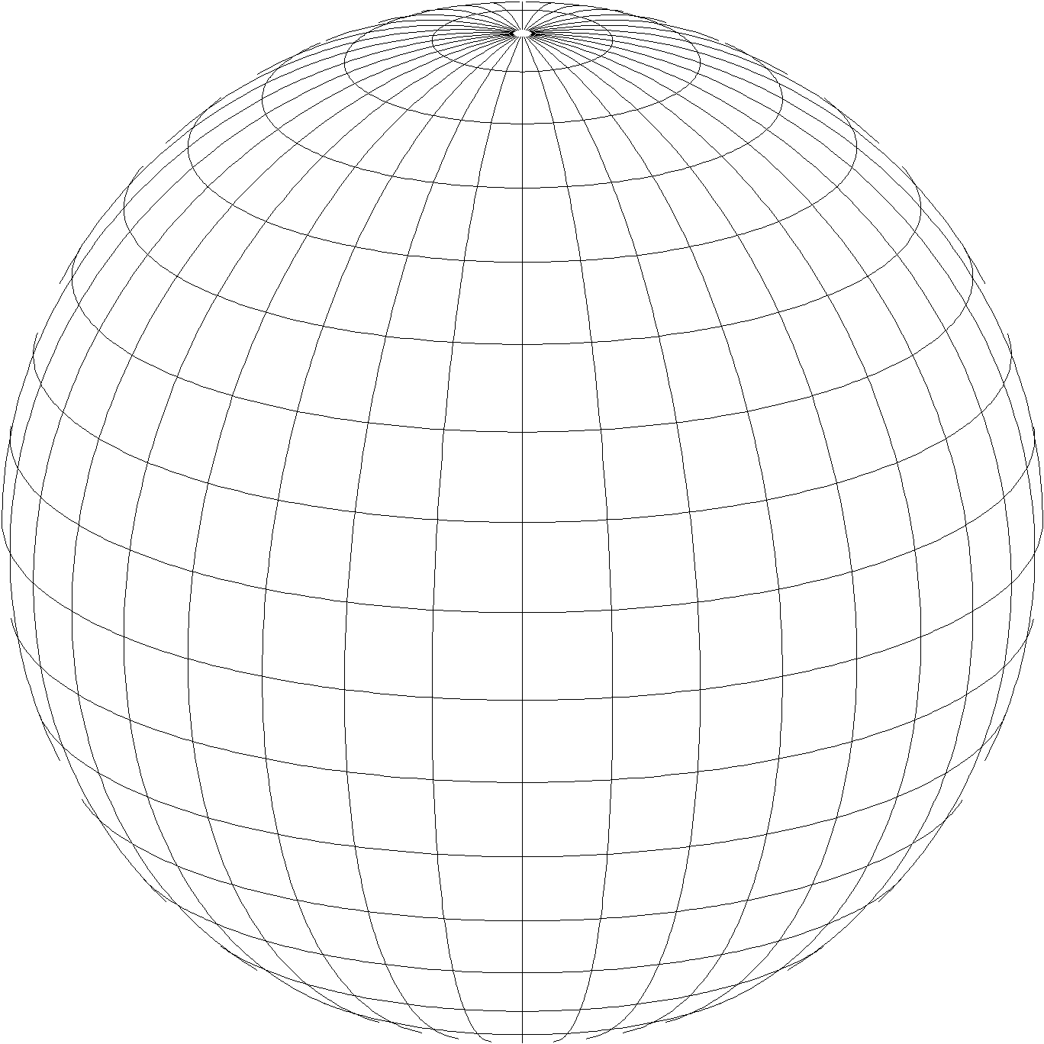
State Plane Coordinate System of 2022 (SPCS2022)
Part of modernizing the National Spatial Reference System (NSRS)
Third generation of State Plane
  First in 1930s (SPCS 27), second in 1980s (SPCS 83)
  Same 3 conformal map projection types
  Same ellipsoid as SPCS 83 (GRS80)
Same as existing State Plane, but different…
  Based on new terrestrial reference frames instead of NAD 83
  More zones, most designed by state stakeholders
  Designed to reduce linear distortion at topographic surface
  (i.e., reduce difference between “grid” and “ground” distances)
Design of all SPCS2022 zones (nearly) done!
Lambert Conformal Conic
Transverse Mercator
Hotine Oblique Mercator

Slide 57
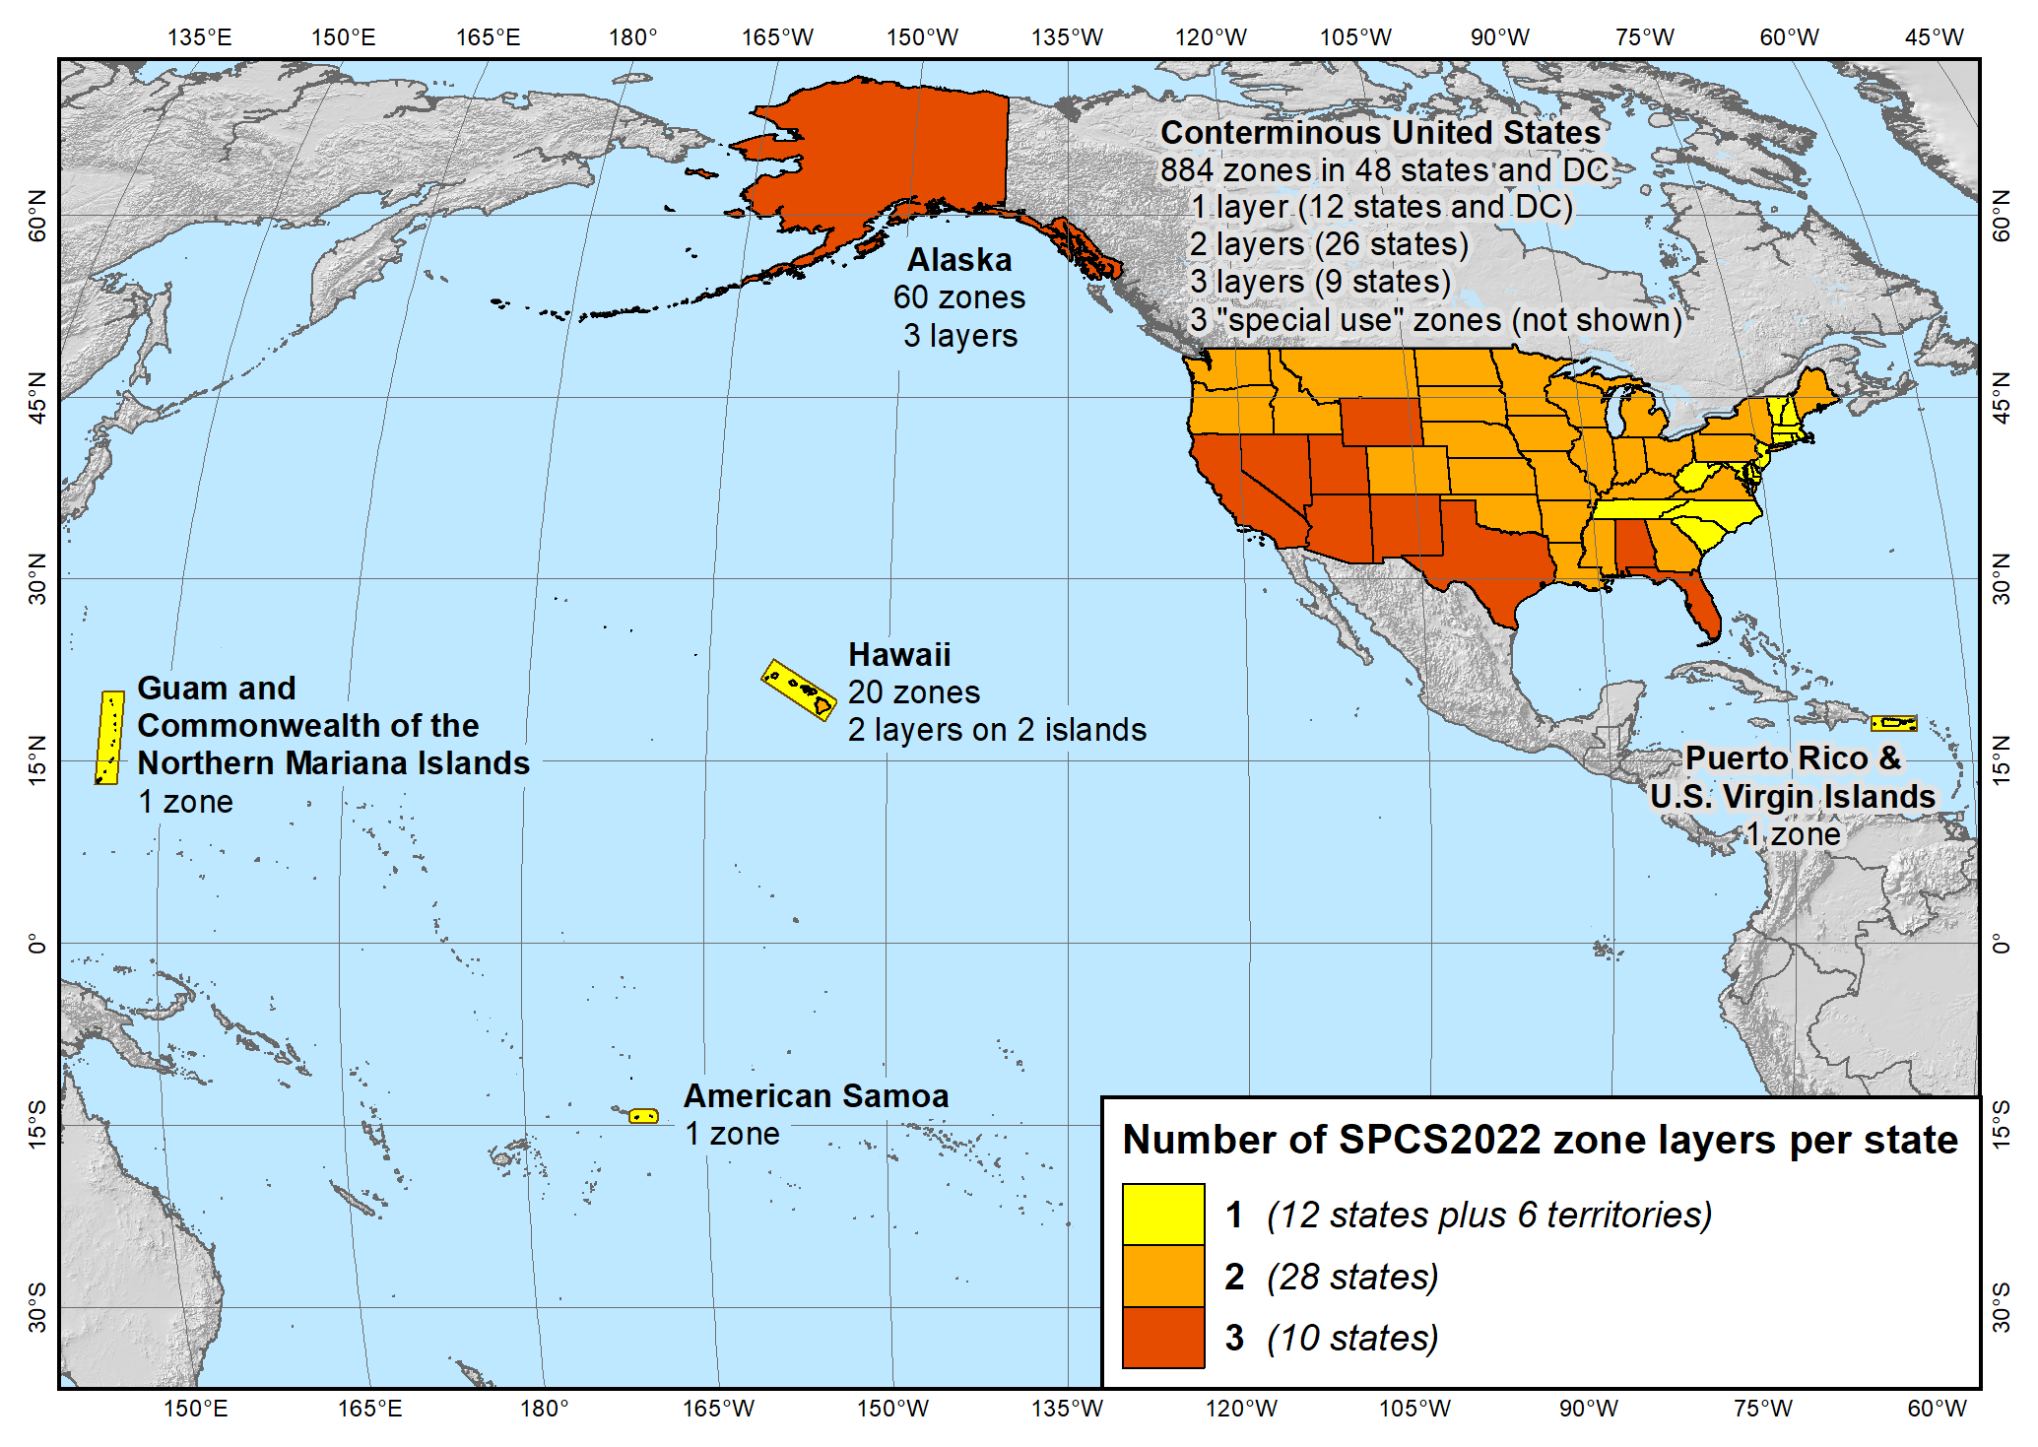
SPCS2022 zone layers
1 layer: 12 states plus 6 territories
2 layers: 28 states
3 layers: 10 states

Slide 58
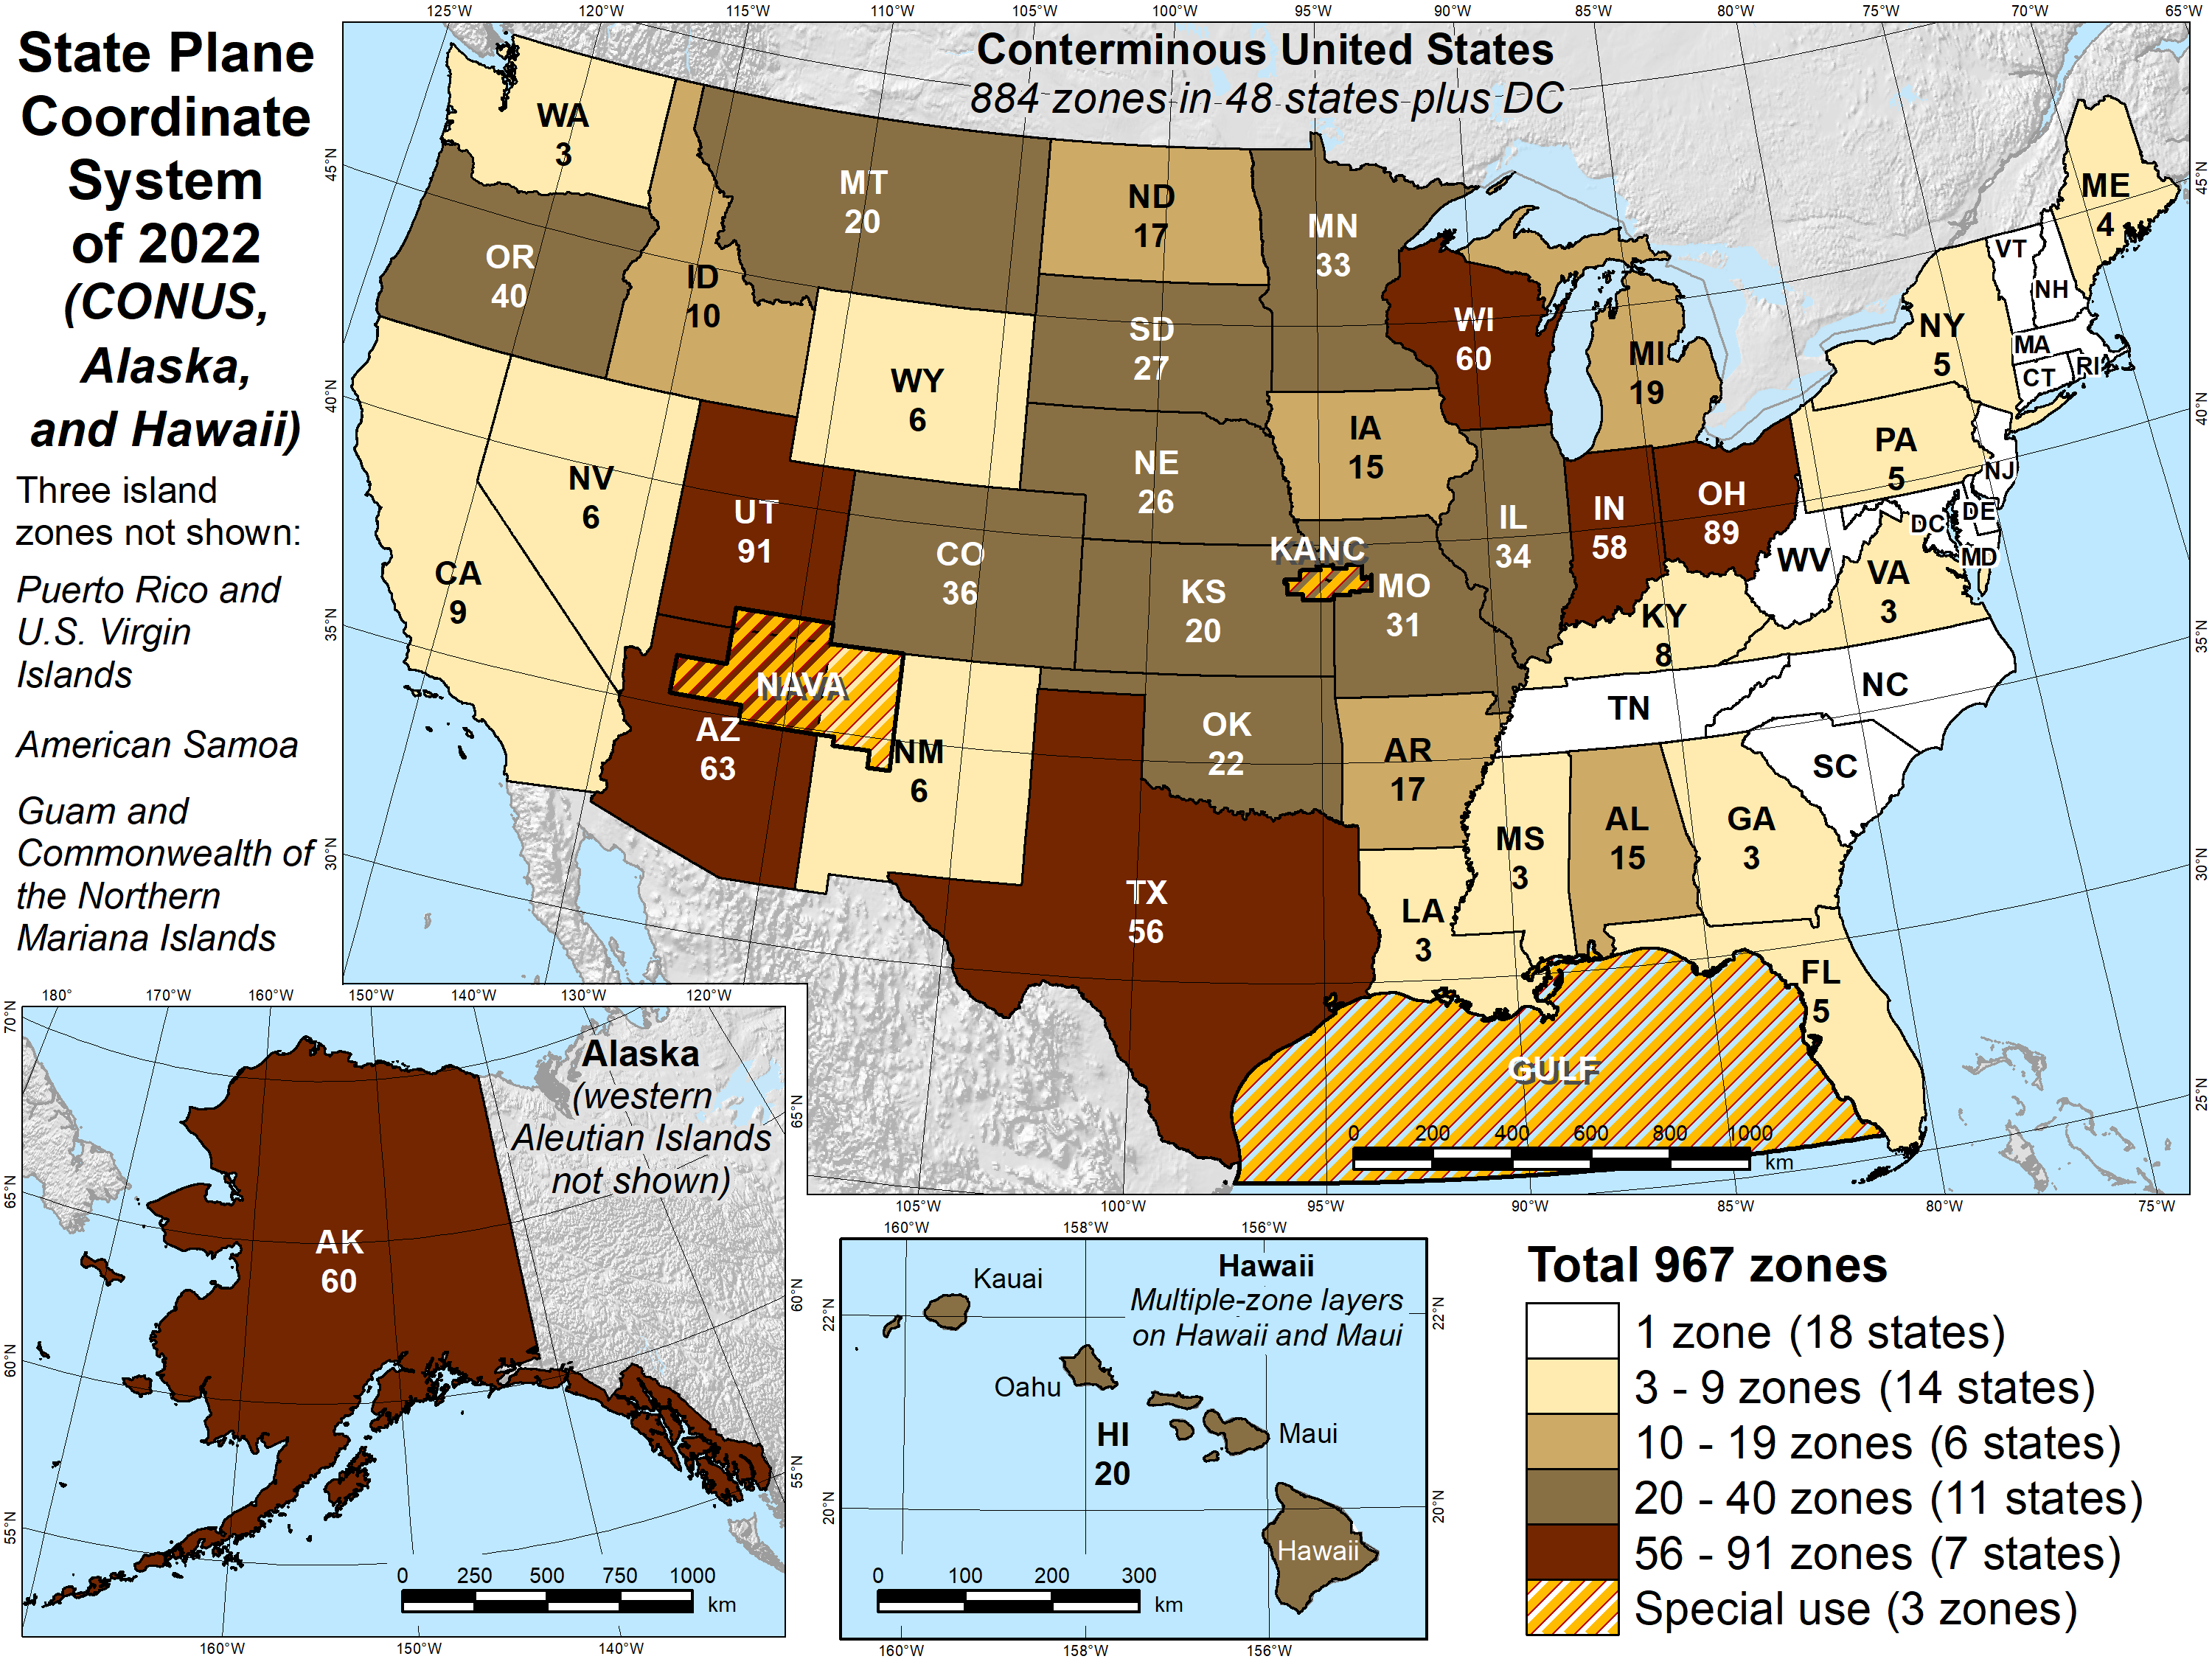
Number of SPCS2022 zones (preliminary)
Designs by NGS
  165 zones
  Includes 54 statewide zones…
  …and 3 “special use” zones
  (in more than one state)
Designs by state stakeholders
  802 zones in 28 states
Total = 967 zones
for 56 states
and territories
Compare to 125
zones in existing
State Plane

Slide 59
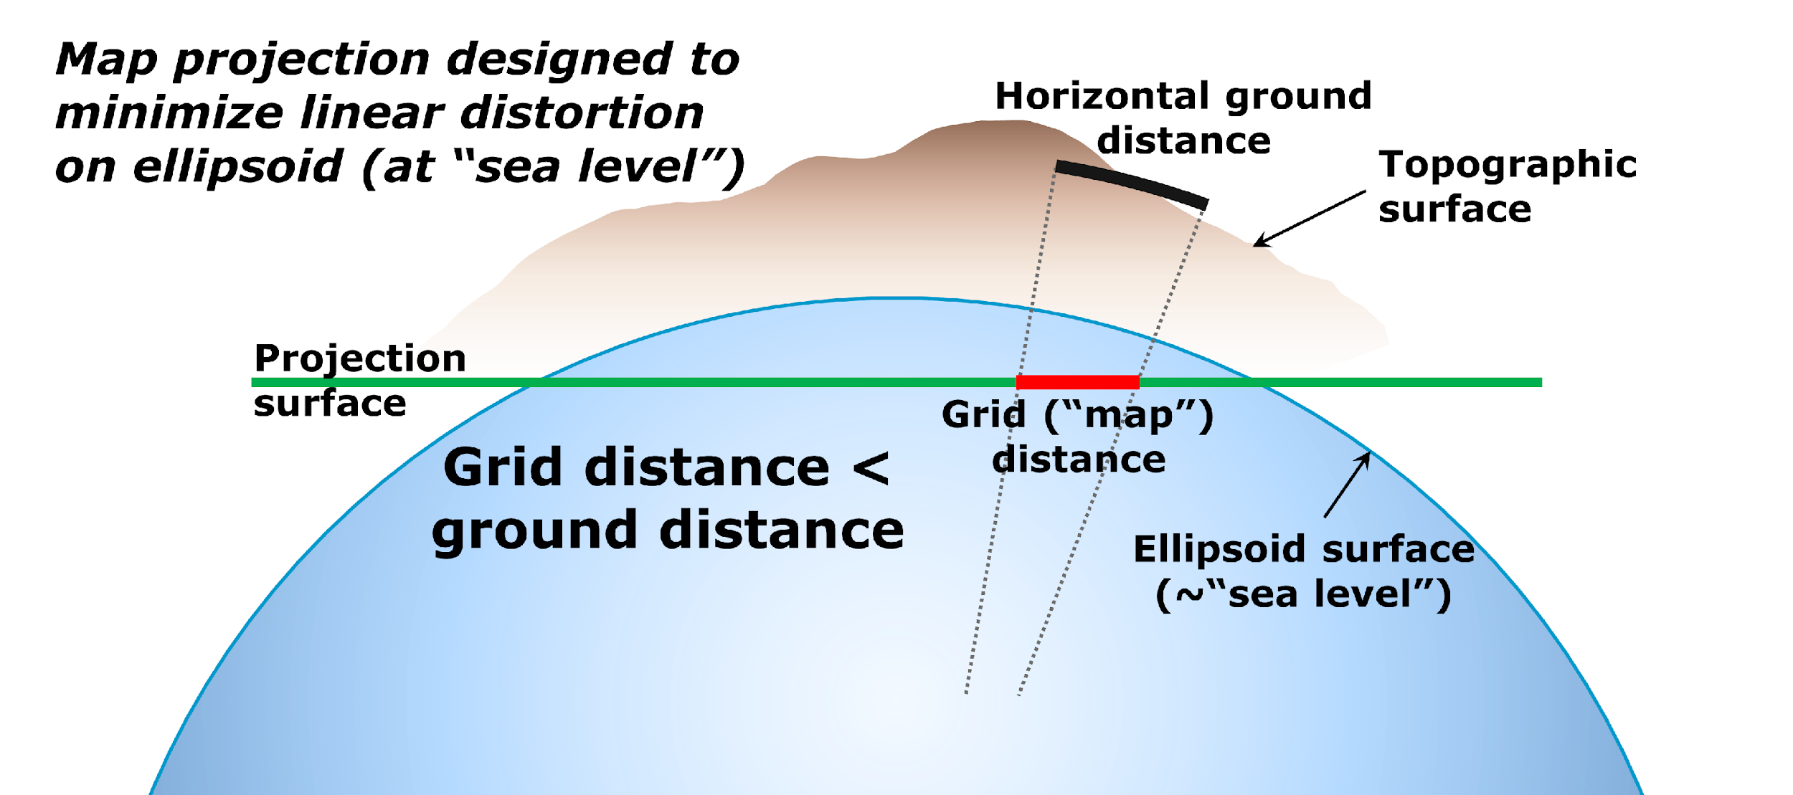
State Plane Coordinate Systems of 1983 and 1927

Slide 60
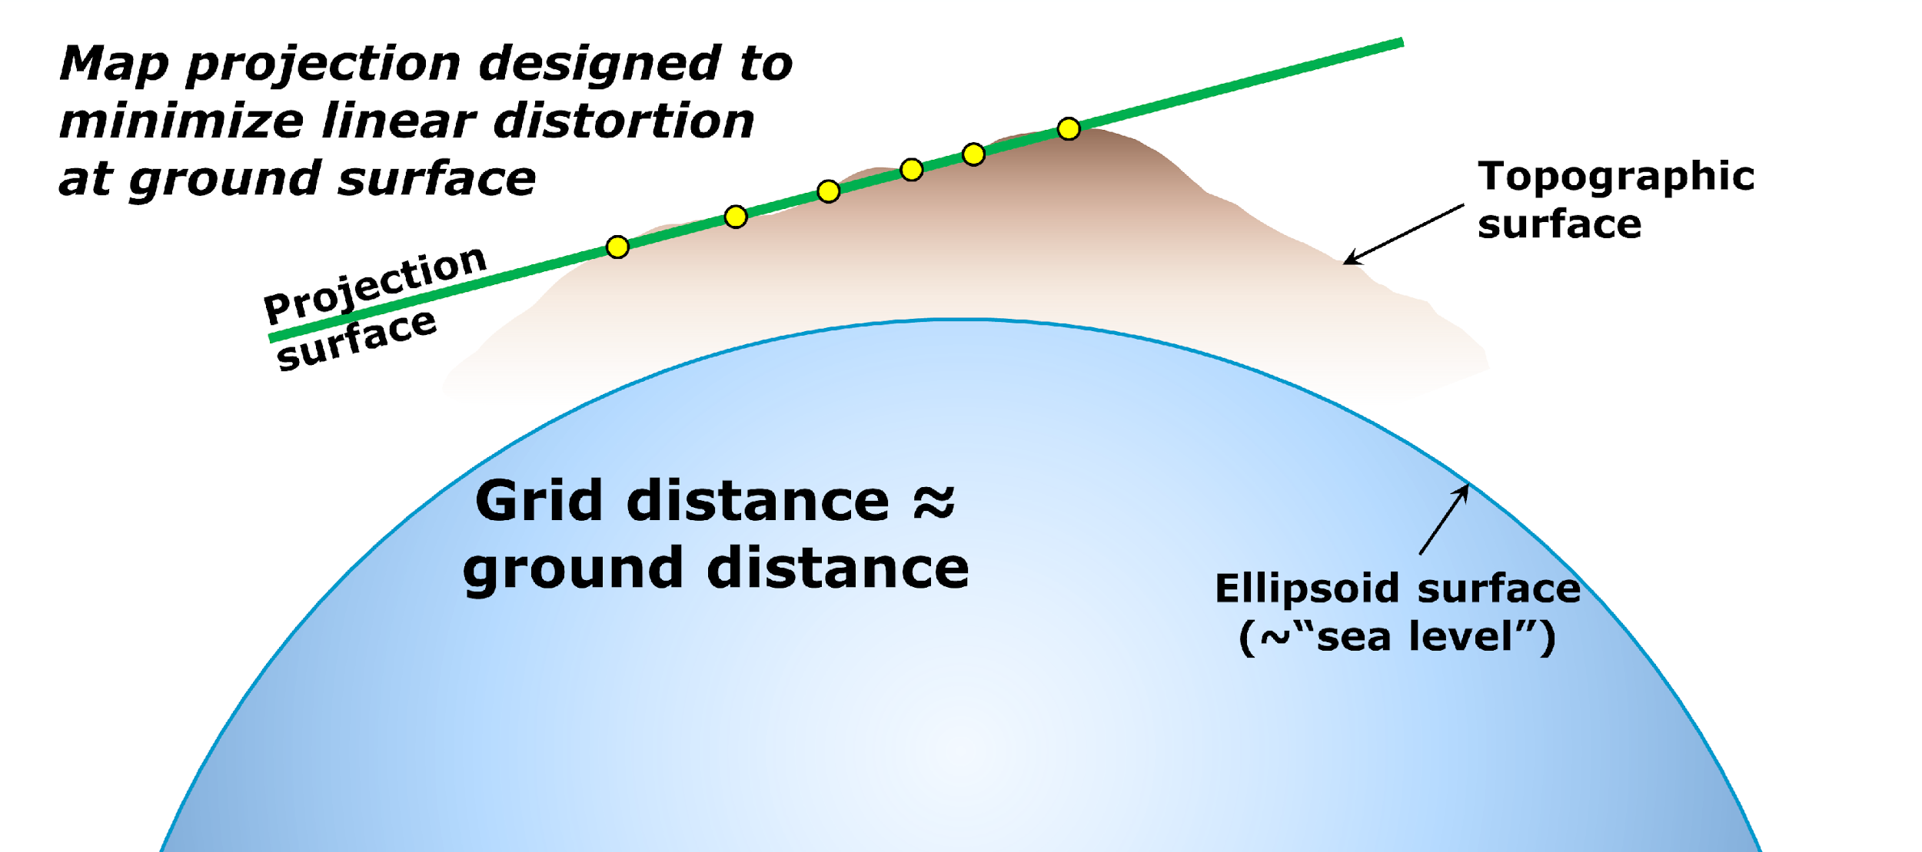
State Plane Coordinate System of 2022

Slide 61
SPCS2022 distortion design philosophy
Linear distortion minimized at topographic surface (not ellipsoid surface)
  Purpose: reduce difference between projected “grid” and actual “ground” distances
  Population distribution also taken into account in NGS designs
What is linear distortion?
  Map projection “scale error” at topographic surface
  Unique (i.e., same in every direction) only for conformal projections
  Given here in parts per million (ppm) = mm of distortion per km
Linear distortion | = | Projected minus actual distance
 |  | Actual distance
= | Combined factor - 1

Slide 62
Linear distortion magnitudes
Parts per million | Centimeters per kilometer | Feet per mile | Dimensionless ratio | Examples
20 ppm | 2 cm/km | 0.11 ft/mile | 1:50,000 | Typical “low distortion projection” limit
50 ppm | 5 cm/km | 0.26 ft/mile | 1:20,000 | Minimum distortion for designs by NGS
100 ppm | 10 cm/km | 0.53 ft/mile | 1:10,000 | Historic State Plane distortion design limit
400 ppm | 40 cm/km | 2.11 ft/mile | 1:2,500 | UTM distortion design limit

Slide 63

Burning questions about NSRS Modernization
When will it be done?
What will it consist of?
What formats will be used?
What will it look like?
Products on alpha will move to beta starting this year

Slide 64



Alpha products are NOT final products!
https://alpha.ngs.noaa.gov/index.shtml
Preliminary
For illustrative
purposes only
Not authoritative
Under active development
Subject to change without notice
Feedback to: ngs.feedback@noaa.gov

Slide 65
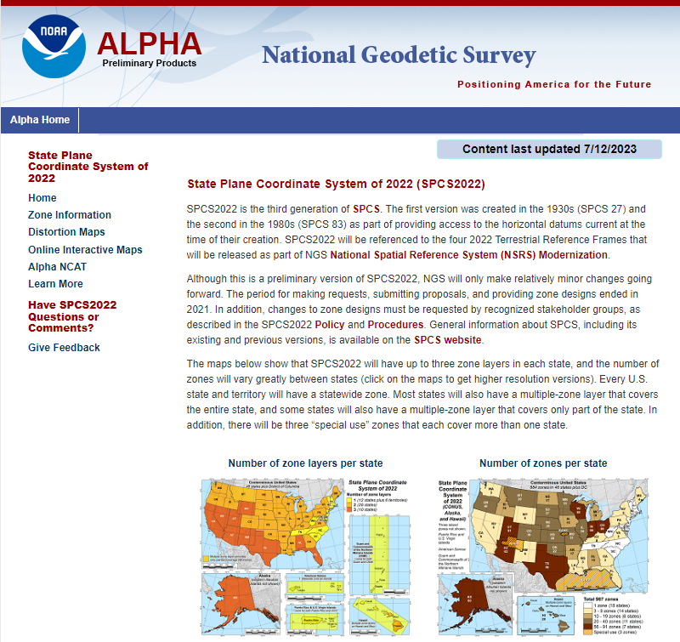

Alpha SPCS2022 Home
https://alpha.ngs.noaa.gov /SPCS/index.shtml
Gives date last updated
Links to other SPCS2022 pages in sidebar:
  Zone information
  Distortion maps
  Online interactive maps (SPCS2022 Experience)
  Alpha NCAT
  Additional information
  Feedback

Slide 66



ArcGIS Online SPCS2022 Experience
Online interactive maps
Shows distortion and gives zone definitions
Being updated now
Accessible on mobile devices

Slide 67




Slide 68
That’s great, but when will SPCS2022 be done?
SPCS2022 included with rollout of Modernized NSRS
  Getting feedback from stakeholders and others NOW
  In process of finalizing designs NOW
Zone designs done and shared with world by late 2024 or early 2025
  Provide definitions directly usable by commercial partners
  Definitions also in EPSG Geodetic Parameter Dataset and ISO Geodetic Registry
Modernized NSRS becomes official in 2026 (after beta)
  SPCS2022 zones can then be added, removed, changed
  Updated Policy and Procedures will describe the process

Slide 69
How Can You Prepare
Stay up to date and check available resources
  Participate in NGS webinars, Geospatial summits, and online training
  Contact NGS Regional Advisor
Metadata is essential
  Improves reliability and accuracy of data
  Increases value and usefulness
Consider whether to transform old data and/or collect new data
  Know your accuracy requirements
69

Slide 70
How Can You Prepare
Require/provide complete metadata for all mapping contracts
    What datum(s)
    How data was collected and processed
Preserve all original observations
    particularly when referenced to ellipsoid (GNSS)

Slide 71
Use Complete Nomenclature
NAD83
NAVD88
MLLW
Notes:
METADATA - you must document the datum you are referencing, but the datum itself is not enough.
Particularly in time leading up to 2022!

Slide 72
Use Complete Nomenclature
NAD83(2011) epoch 2010.00
H. Datum
Realization/Adjustment
Reference Epoch
GNSS-derived orthometric heights
NAVD88 (GRS80, GEOID18)
V. Datum
Reference Ellipsoid
Geoid Model
MLLW(9452210; 1960-78 #2128)
Tidal Datum
NOAA Tide Station
National Tidal Datum Epoch & Published Sheet Number (if available)
Notes:
Note: exact content and format may vary; these general recommendations are specific to projects with a vertical emphasis.
Also keep a record of source/date of survey whenever possible, even before 2022.
Start now: Also keep a record of source/date of survey whenever possible, even before 2022.

Slide 73


Where to learn more…
geodesy.noaa.gov
Thank you!

