Slide 1
Turning the Page on PAGES: NGS's Next Generation Multi-GNSS Software
Bryan Stressler
NGS 2019 Geospatial Summit
May 6th-7th, 2019

Slide 2
PAGES
Backend software currently used for:
OPUS
Orbit Production
CORS Monitoring
GPS-only L1/L2
Operational for 20+ years
New NGS staff
New and modernized GNSS constellations
IGS is moving towards multi-GNSS
NGS needs new, extensible software capable of multi-GNSS processing

Slide 3
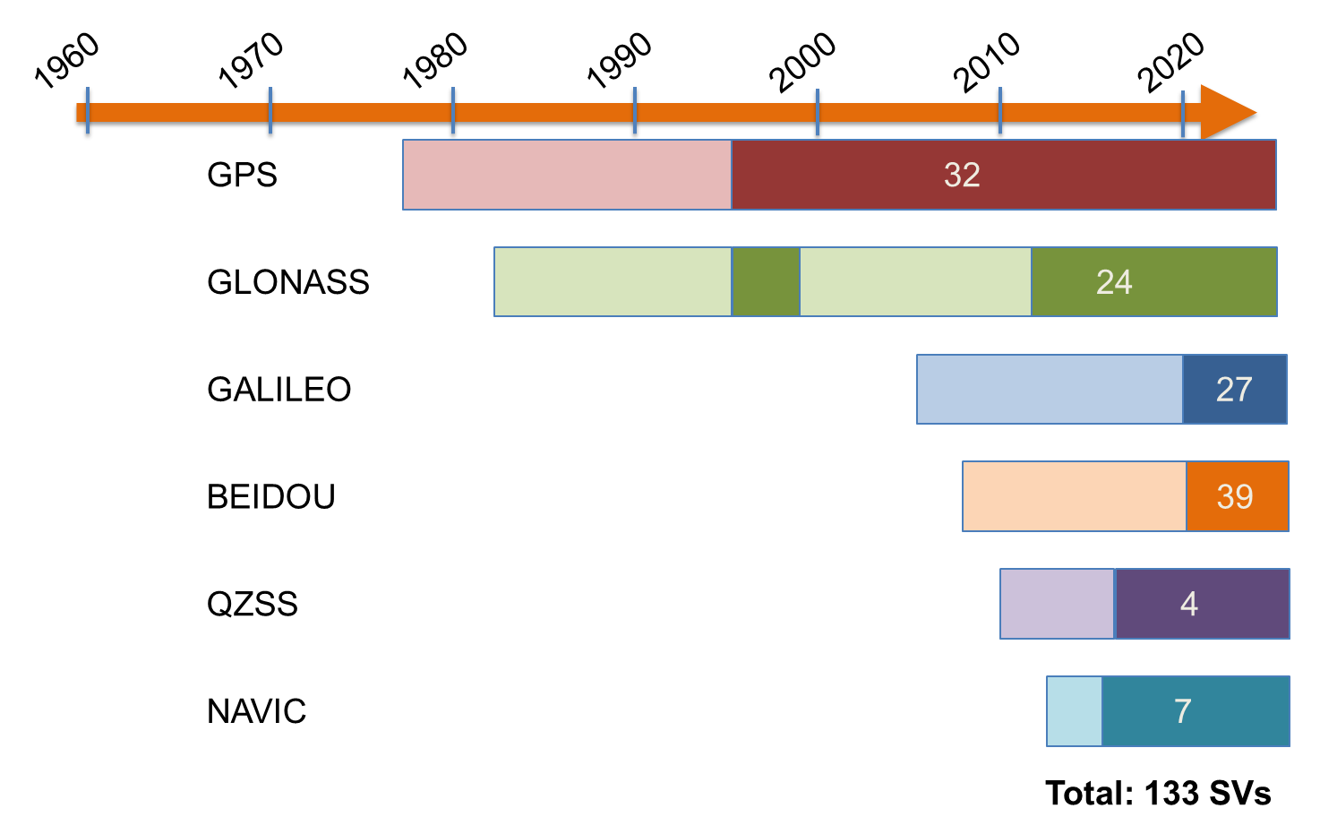
GNSS Timeline

Slide 4
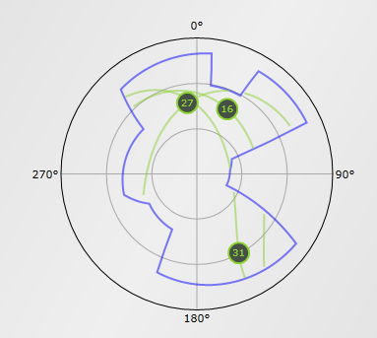
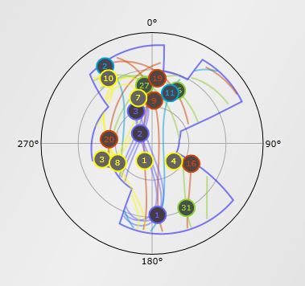
Multi-GNSS Positioning
Multi-GNSS can dramatically improve positioning in non-ideal surveying conditions
Modern signals, triple frequency observations
Many more satellites in view
GNSS sky plots with an obstruction diagram.
Left: GPS-only- a positioning solution cannot be obtained.
Right: Multi-GNSS- 18 satellites!
http://www.gnssplanningonline.com

Slide 5
Looking Forward
What we’re doing:
Building a suite of multi-GNSS capable software to replace PAGES
Modern programming/scripting languages (C++, Python)
Research pertaining to new GNSS constellations and processing strategies
Baseline processing
Orbit production
Planned deployment: June 2021

