Slide 1
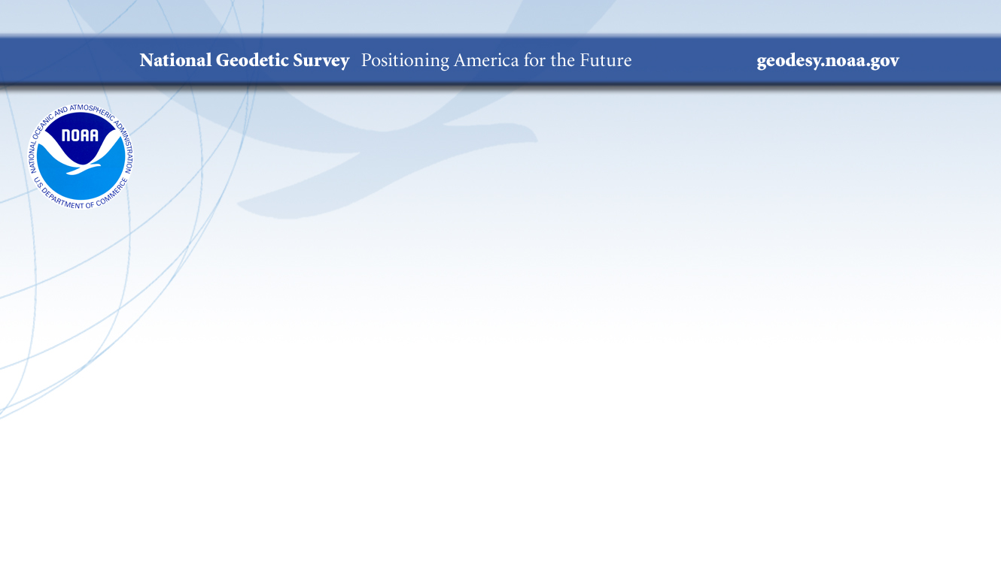

Vertical Datums
June 03, 2024
Dan Martin
Northeast Regional Geodetic Advisor
ME, NH, VT, MA, CT, RI, NY, NJ
Dan.martin@noaa.gov
240-676-4762

Slide 2

Outline – Asked to discuss…
Datums (basic understanding)
Where do old datums come from (e.g. NAD 83)? (basic understanding)
Geoid (basic understanding)
Where do MSL, MLLW, etc come from for a given tide gauge? (basic understanding)
What will the post 2025 system be, compared to what we do now (basic understanding)
Will anything change post 2025
How do we convert from existing tide gauges to elevations in DEMs (more detail)
How can we start using the post 2025 system?

Slide 3
National Spatial Reference System
(NSRS)
NGS Mission: To define, maintain & provide access to the National Spatial Reference System (NSRS) to meet our Nation’s economic, social & environmental needs
Consistent National Coordinate System
Latitude/Northing
Longitude/Easting
Height
Scale
Gravity
Orientation
& how these values change with time

Slide 4
What is a Datum?
"A set of constants specifying the coordinate system used for geodetic control, i.e., for calculating the coordinates of points on the Earth."
"The datum, as defined above, together with the coordinate system and the set of all points and lines whose coordinates, lengths, and directions have been determined by measurement or calculation."
NGS has used the first definition for NAD83

Slide 5
Geodetic Datums
  HORIZONTAL
  2 D (Latitude and Longitude) (e.g. NAD 27, NAD 83 (1986))
  VERTICAL
  1 D (Orthometric Height) (e.g. NGVD 29, NAVD 88, Local Tidal)
  GEOMETRIC
  3 D (Latitude, Longitude and Ellipsoid Height)
  Fixed and Stable - Coordinates seldom change
  (e.g. NAD 83 (1996), NAD 83 (2007), NAD 83 (CORS96) NAD 83 (2011))
  also
  4 D (Latitude, Longitude, Ellipsoid Height, Velocities) Coordinates change with time
  (e.g. ITRF00, ITRF08)

Slide 6
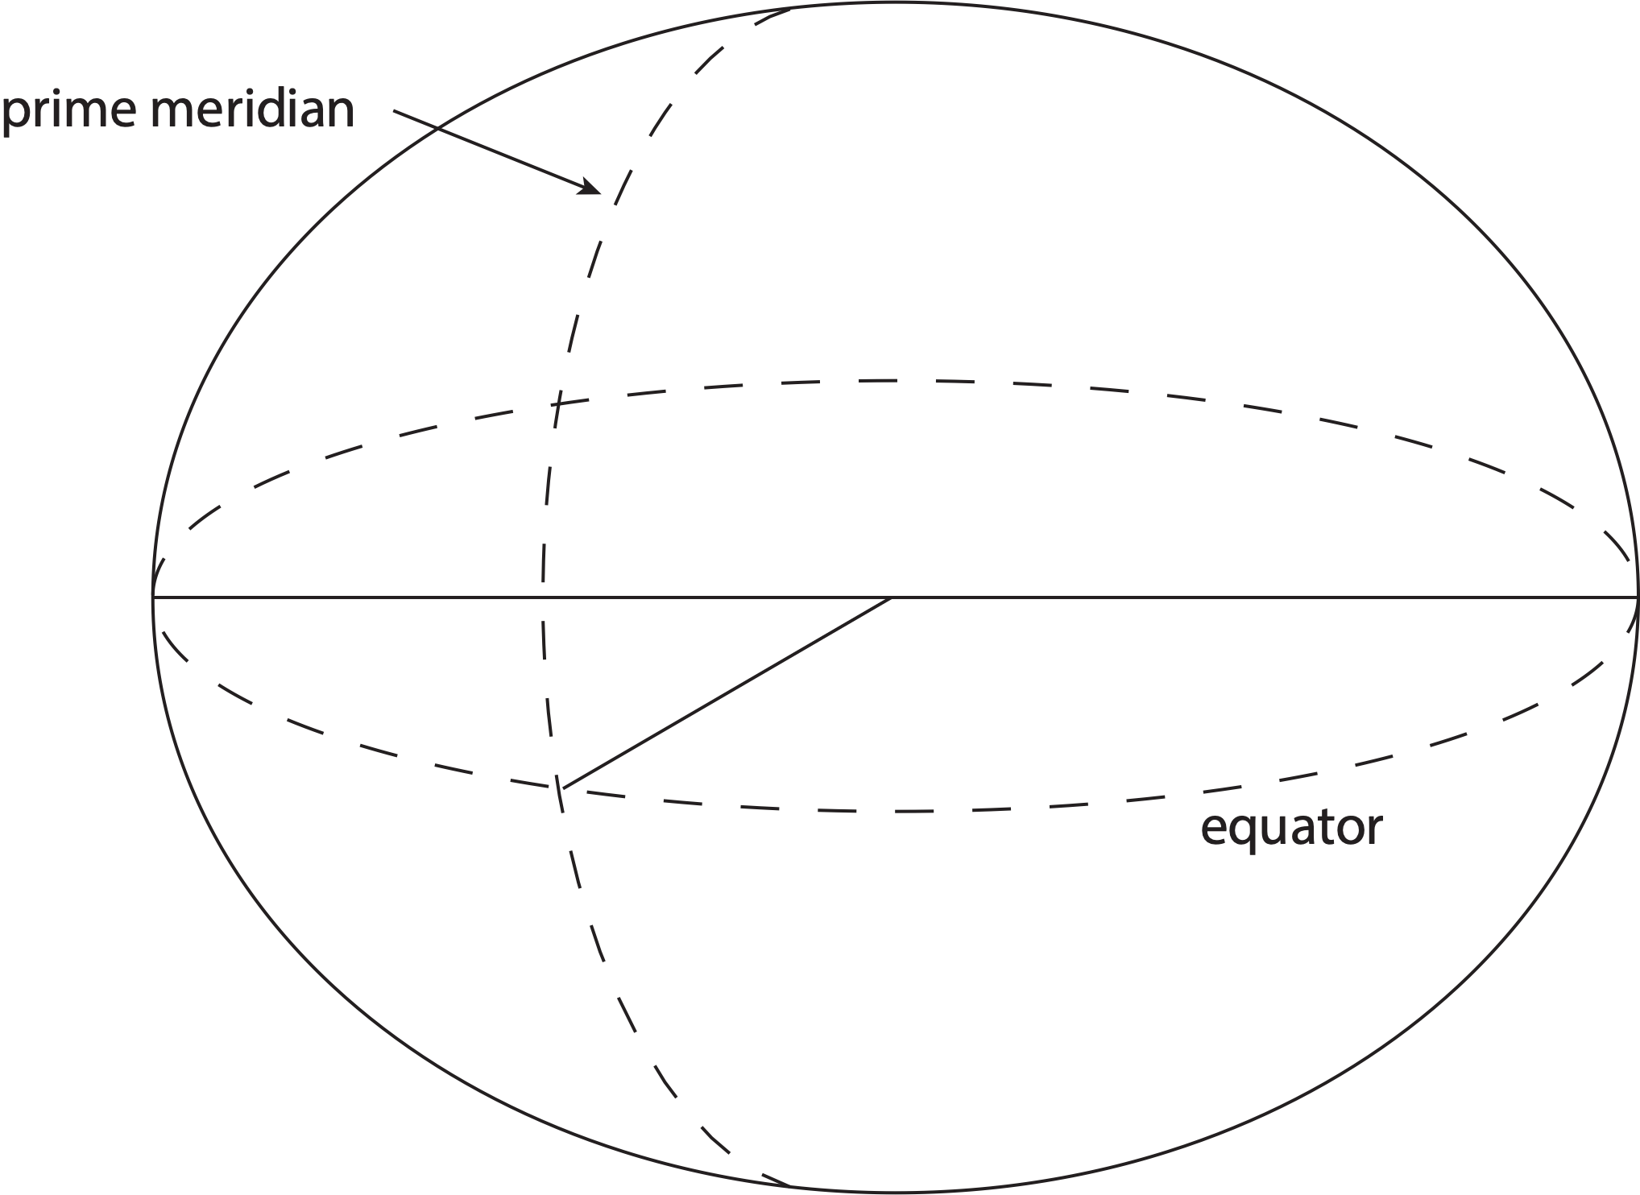
Traditional horizontal geodetic datums
Positions of points on Earth’s surface are reduced to the surface of a reference ellipsoid

Slide 7
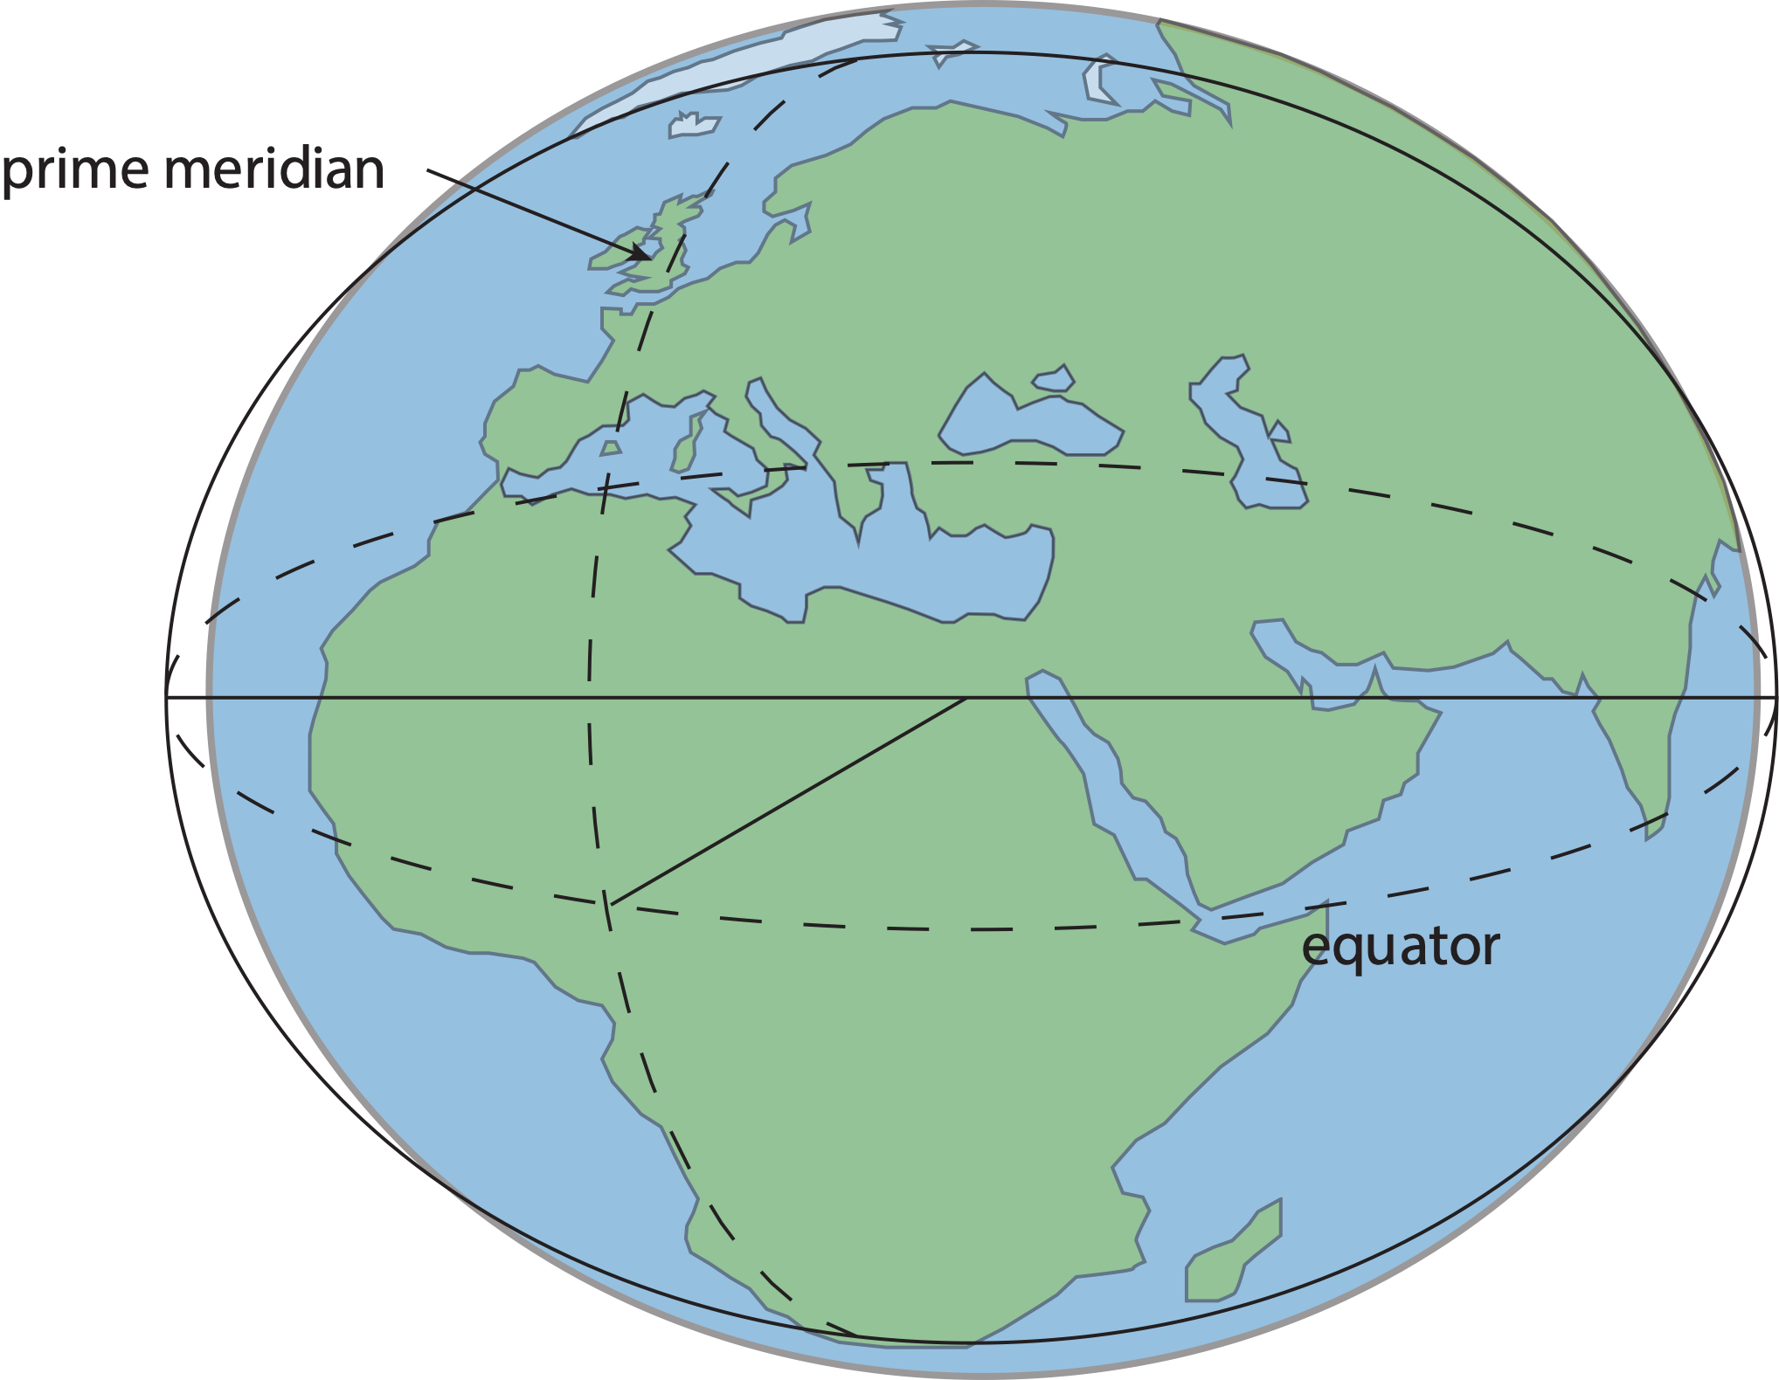
Traditional horizontal geodetic datums
Positions of points on Earth’s surface are reduced to the surface of a reference ellipsoid
The reference ellipsoid matches the shape of the Earth roughly, but not exactly

Slide 8
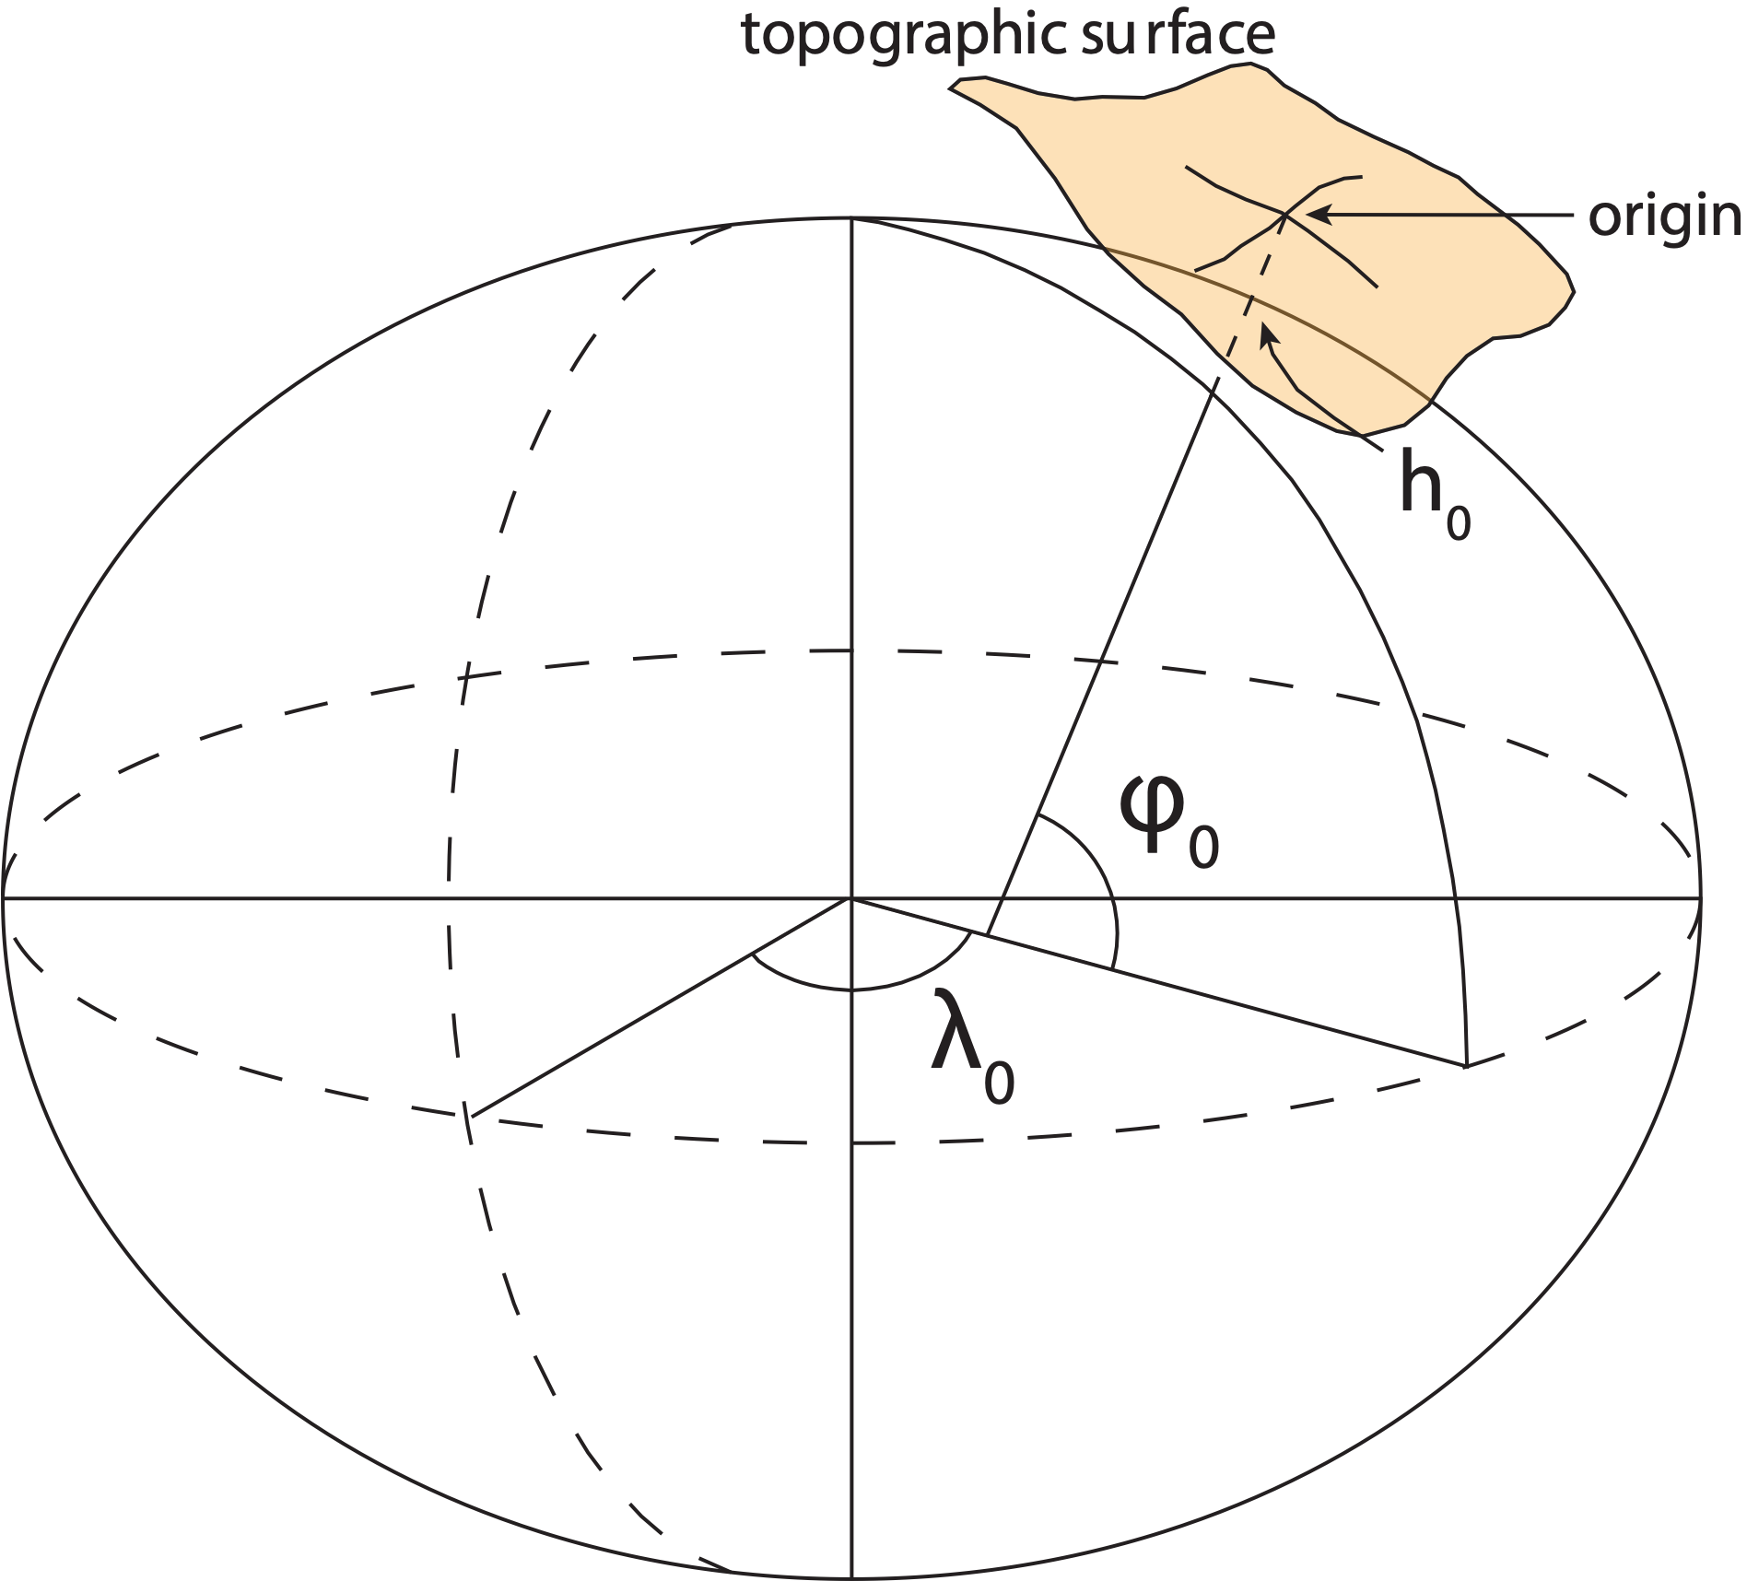
Traditional horizontal geodetic datums
Positions of points on Earth’s surface are reduced to the surface of a reference ellipsoid
The reference ellipsoid roughly matches the shape of the Earth
A reference point is selected as the origin, all other positions are given with respect to that point

Slide 9
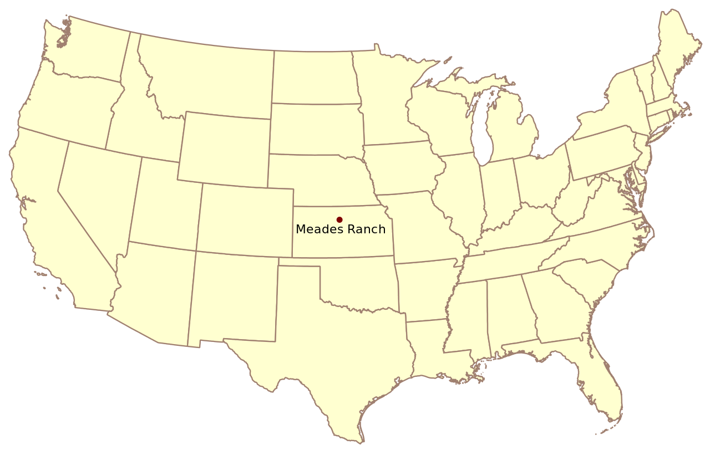
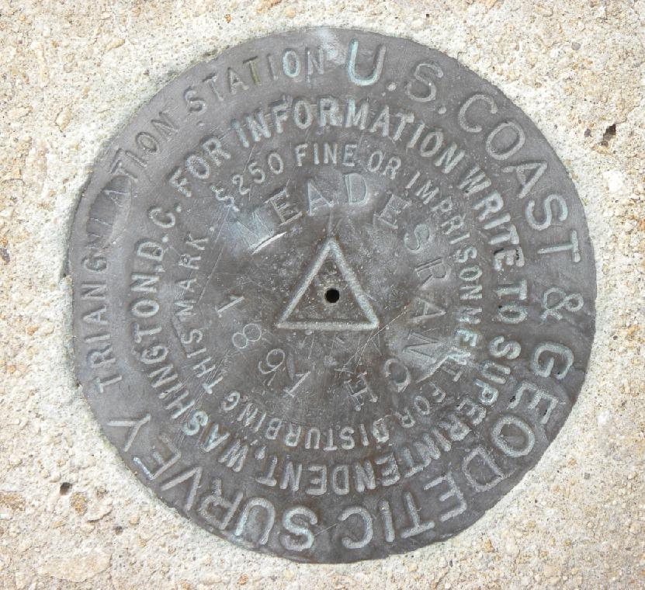
Traditional horizontal geodetic datums
North American Datum of 1927 (NAD27)

Slide 10

Traditional horizontal geodetic datums
North American Datum of 1927 (NAD27)

Slide 11

Traditional horizontal geodetic datums
North American Datum of 1927 (NAD27)

Slide 12

Traditional horizontal geodetic datums
North American Datum of 1927 (NAD27)

Slide 13
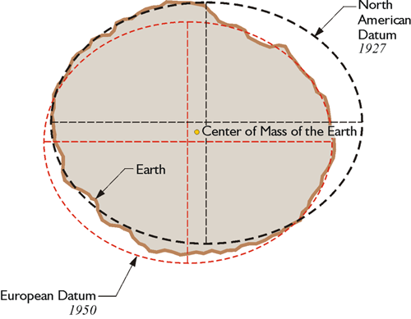
Traditional geodetic datums
Drawbacks of using this approach:
The reference ellipsoid is optimized for the region; it is not suitable for global positioning
The center of the reference ellipsoid does not coincide with the location of the center of mass of the Earth
Neighboring countries may use different datums which can cause unnecessary complications when dealing with points of interest in border regions
This method is static – dynamic process are unaccounted for
https://www.e-education.psu.edu/geog862/node/1797

Slide 14
Introducing global reference frames

Slide 15
Reference system:
A set of prescriptions and conventions together with the modeling required to define at any time a triad of coordinate axes¹
ITRS
International Terrestrial
Reference System
Reference frame:
ITRF
International Terrestrial
Reference Frame
Realizes the system by means of coordinates of definite points that are accessible directly by occupation or observation¹
¹Springer Handbook of Global Navigation Satellite Systems, Ch. 2, p. 34

Slide 16

International Terrestrial
Reference System (ITRS)
Defined and maintained by the International Earth Rotation and Reference System Service (IERS)
Defines conventions for:
  Origin (Where is the zero point?)
  Scale (What is the measure of length?)
  Orientation (How are the axes oriented in space?)
https://www.iers.org/IERS/EN/Home/home_node.html

Slide 17
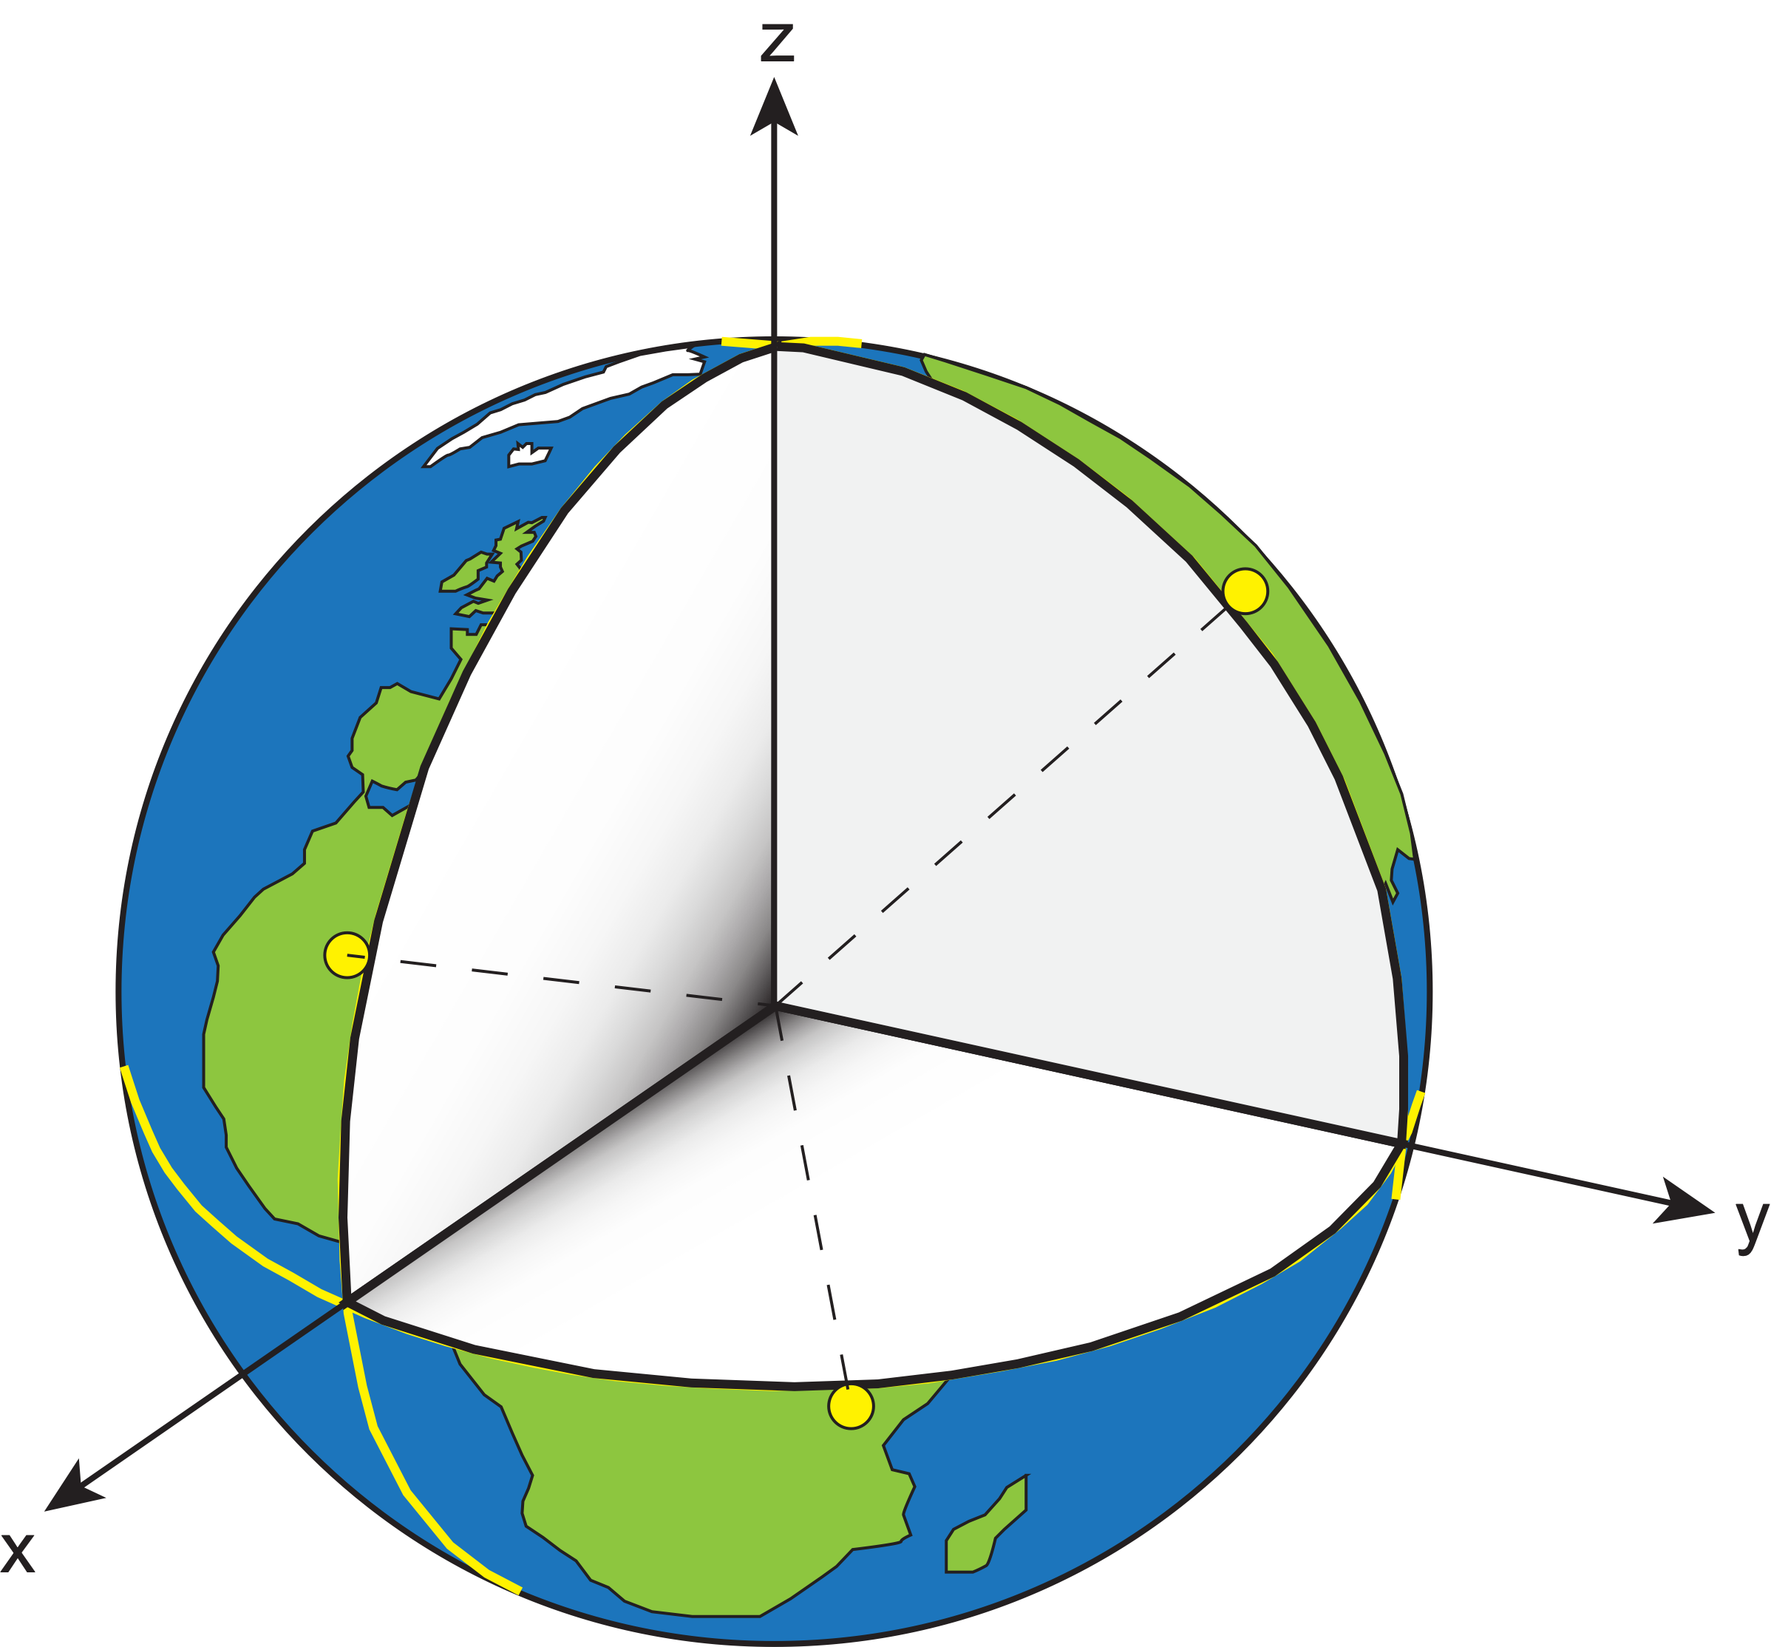
International Terrestrial Reference Frame (ITRF)
“Realization” of the idealized reference system occurs when coordinates are assigned to physical points in a self-consistent manner that honors the rules of the reference system.

Slide 18
Horizontal Datums/Coordinates…What do we (you) use in your work?
NAD 27
NAD 83 (Lat-Lon) SPC
  Which one???
    NAD 83 (1986)
    NAD 83 (19xx) - HARN
    NAD 83 (1996) - FBN
    NAD 83 CORS96(2002)
    NAD 83 (NSRS2007)
    NAD 83 (2011) epoch 2010.00
WGS 84
  Which one???
    WGS 84 (1987), (G730), (G873), (G1150), (G1674), (G1762), (G2139), (G2238), (G2296)
ITRFxx (epoch xxxx)
IGSxx (epoch xxxx)

Slide 19
Simplified Concept of NAD 83 vs. ITRF2020
h₈₃
h₂₀₂₀
Earth’s
Surface
ITRF2020
Origin
2.2 meters
NAD 83
Identically shaped ellipsoids (GRS-80)
a = 6,378,137.000 meters (semi-major axis)
1/f = 298.25722210088 (flattening)
Origin
Notes:
ITRF (International Terrestrial Reference Frame) just has an origin; take NAD83 shaped ellipsoid centered at the ITRF origin to derive ITRF97 ellipsoid heights.
Ellipsoid heights NAD83 vs. ITRF97 - Defined origins are best estimate of the center of mass; NAD83 is not geocentric. Move origin; move ellipsoid surface as illustrated.
Ellipsoid height differences reflect the non-geocentricity of NAD83.

Slide 20

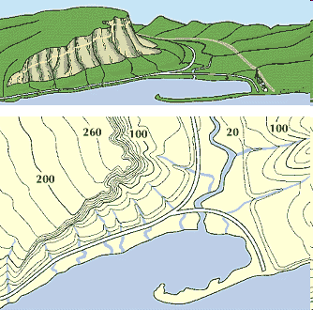
What is a Vertical Datum?
Strictly speaking, a vertical datum is a surface representing zero elevation
Traditionally, a vertical datum is a system for the determination of heights above a zero elevation surface
Vertical datum comprised of:
  Its definition: Parameters and other descriptors
  Its realization: Its physical method of accessibility
"topographic map." Online Art.
Britannica Student Encyclopædia.
17 Dec. 2008
<http://student.britannica.com/ebi/art-53199>

Slide 21
History of vertical datums in the USA
Pre-National Geodetic Vertical Datum of 1929 (NGVD 29)
  The first geodetic leveling project in the United States was surveyed by the Coast Survey from 1856 to 1857.
  Transcontinental leveling commenced from Hagerstown, MD in 1877.
  General Adjustments of leveling data yielded datums in 1900, 1903, 1907, and 1912. (Sometimes referenced as the Sandy Hook Datum)
  NGS does not offer a utility which transforms from these older datums into newer ones (though some users still work in them!)
Notes:
According to Dave Doyle, the USACE still maintains data relative to the 1912 4th General Adjustment!

Slide 22
History of Vertical Datums in the USA
NGVD 29
  National Geodetic Vertical Datum of 1929
  Original name: “Sea Level Datum of 1929”
  “Zero height” held fixed at 26 tide gauges
    Not all on the same tidal datum epoch (~ 19 yrs)
  Did not account for Local Mean Sea Level variations from the geoid
    Thus, not truly a “geoid based” datum

Slide 23
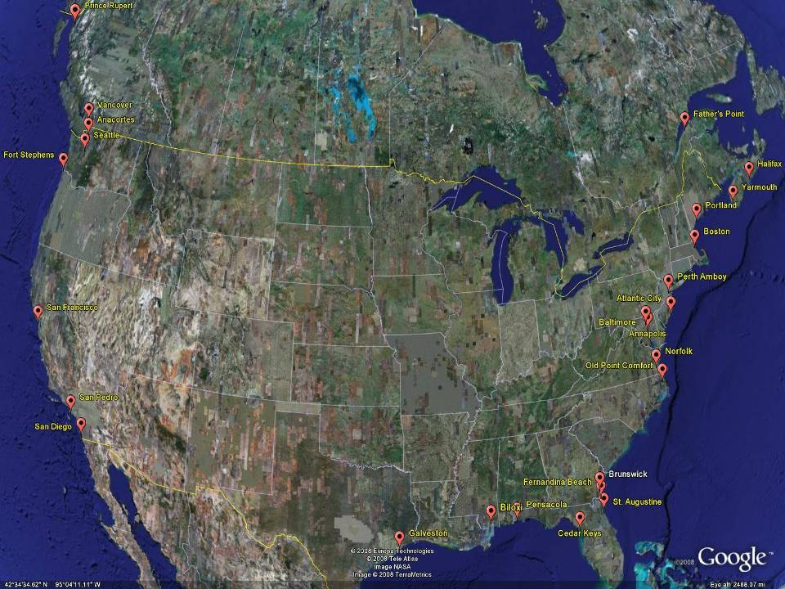
NGVD29
The National Geodetic Vertical Datum of 1929 is referenced to 26 tide gauges in the US and Canada
Notes:
It turns out that MSL is a close approximation to another surface, defined by gravity, called the geoid, which is the true zero surface for measuring elevations. Because we cannot directly see the geoid surface, we cannot actually measure the heights above or below the geoid surface. We must infer where this surface is by making gravity measurements and by modeling it mathematically. For practical purposes, we assume that at the coastline the geoid and the MSL surfaces are essentially the same. Nevertheless, as we move inland we measure heights relative to the zero height at the coast, which in effect means relative to MSL.
Definition: NGVD29 – The National Geodetic Vertical Datum of 1929…
The Sea Level Datum of 1929 was the vertical control datum established for vertical control surveying in the United States of America by the General Adjustment of 1929. The datum was used to measure elevation or altitude above, and depression or depth below, mean sea level (MSL).
Mean sea level was measured at 26 tide gauges: 21 in the United States and 5 in Canada. The datum was defined by the observed heights of mean sea level at the 26 tide gauges and by the set of elevations of all bench marks resulting from the adjustment. The adjustment required a total of 66,315 miles (106,724 km) of leveling with 246 closed circuits and 25 circuits at sea level.
Since the Sea Level Datum of 1929 was a hybrid model, it was not a pure model of mean sea level, the geoid, or any other equipotential surface. Therefore, it was renamed the National Geodetic Vertical Datum of 1929 (NGVD 29) in 1973. The NGVD 29 was subsequently replaced by the North American Vertical Datum of 1988 (NAVD 88) based upon the General Adjustment of the North American Datum of 1988.

Slide 24
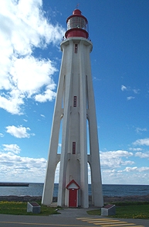
Current Vertical Datum in the USA
NAVD 88: North American Vertical Datum of 1988
Definition: The surface of equal gravity potential to which orthometric heights shall refer in North America*, and which is 6.271 meters (along the plumb line) below the geodetic mark at “Father Point/Rimouski” (NGSIDB PID TY5255).
Realization: Over 500,000 geodetic marks across North America with published Helmert orthometric heights, most of which were originally computed from a minimally constrained adjustment of leveling and gravity data, holding the geopotential value at “Father Point/Rimouski” fixed.
Father Point Lighthouse, Quebec
*Not adopted in Canada
Notes:
By fixing the geopotential value at the origin point, it was possible to ensure that the origins of IGLD 85 and NAVD 88 aligned.
*It should be pointed out that while the datum was defined in such a way as to be usable on the North American continent, it was never actually adopted in Canada. It can be used there, but it’s not their official civilian datum.
Note that the designation of the vertical control point at Father Point is “1250 G=NAVD 88 DATUM POINT” for PID# TY5255 and is not available from the publicly accessible NGSIDB.

Slide 25
History of Vertical Datums in the USA
NAVD 88
  North American Vertical Datum of 1988
  One height held fixed at “Father Point” (Rimouski, Canada)
  …height chosen was to minimize 1929/1988 differences on USGS topo maps in the eastern U.S.
  Thus, the “zero height surface” of NAVD 88 wasn’t chosen for its closeness to the geoid (but it was close…few decimeters)…… More on that later

Slide 26
History of Vertical Datums in the USA
NAVD 88 (continued)
  Use of one fixed height removed local sea level variation problem of NGVD 29
  Use of one fixed height did open the possibility of unconstrained cross-continent error build up
  But the H=0 surface of NAVD 88 was supposed to be parallel to the geoid…(close again)

Slide 27
What is “The Geoid”?
The equipotential surface of the Earth’s gravity field which best fits, in a least squares sense, global mean sea level

Slide 28
Geoid
Geopotential
surfaces
Ellipsoid
surface
Gravity vector
(aka “plumbline”),
pointing “up”
The relationships between the ellipsoid surface (solid red), various geopotential surfaces (dashed blue), and the geoid (solid blue). The geoid exists approximately at mean sea level (MSL). Not shown is the actual surface of the earth, which coincides with MSL but is generally above the geoid.
Notes:
Looking at a side view of the irregular shaped Earth and the relationships between surfaces of equal potential (equipotential or geopotential surfaces), perpendicular to the attraction of gravity at that point. Note these geopotential surfaces are not geometrically parallel due to the variations in the earth’s irregular gravity field. Also, the geopotential surfaces converge (become closer together) at the poles due in large part to Earth’s rotation.
As you run levels across theses surfaces the equipment is plumbed per the attraction of gravity at that point. Our assumption is that our horizontal field of view can be corrected for a nice consistent Earth curvature when in fact a correction for conditions affecting us at a particular point must be accounted for.
Running levels north and south require more correction for the convergence of the geopotential surfaces than when running levels east and west.
The red oval illustrates the reference ellipsoid for our space based coordinate system and, though a close approximation of the size and shape of the Earth, is an entire, unrelated reference surface when determining GPS-derived ellipsoid heights.

Slide 29
The ellipsoid, the geoid, and you
Deflection of the vertical
You are here
Earth surface
Ellipsoid height, h
Orthometric height, H
Alaska
Mean
sea level
Geoid height, N_{G}
Ellipsoid
Geoid
h ≈ H + N_{G}
h = H + N_{G}
Note: Geoid height is negative everywhere in the coterminous US
(but it is positive in most of Alaska)

Slide 30
Types of Geoid Models?
Gravimetric (or Gravity) Geoid Height Models
  Defined by gravity data crossing the geoid
  Refined by terrain models (DEM’s)
  Scientific and engineering applications (today)
  Will be the type used for Geoid2022
Composite (or Hybrid) Geoid Height Models
  Gravimetric geoid defines most regions
  Warped to fit available GPSBM control data, e.g., NAVD88
  Defined by legislated ellipsoid (NAD 83) and local vertical datum (NAVD 88, PRVD02, etc.)
  May be statutory for some surveying & mapping applications

Slide 31
Which Geoid for Which NAD 83?
NAD 83(2011)
NAD 83(2007)
NAD 83(1996) & CORS96
Geoid12A/12B
Geoid18
Geoid09
Geoid06 (AK only)
Geoid03
Geoid99
Geoid96

Slide 32
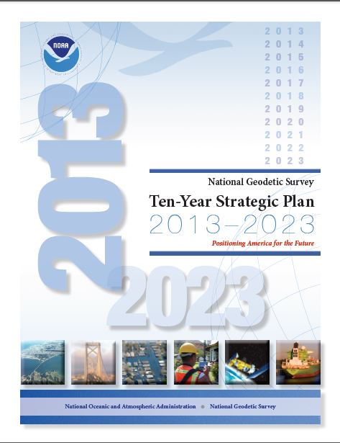
The National Geodetic Survey 10 year plan
Mission, Vision and Strategy
2008 – 2018, 2013-2023
http://www.ngs.noaa.gov/INFO/NGS10yearplan.pdf
Official NGS policy as of Jan 9, 2008
  Modernized agency
  Attention to accuracy
  Attention to time-changes
  Improved products and services
  Integration with other fed missions
2022 Targets:
  NAD 83 and NAVD 88 re-defined
  Cm-accuracy access to all coordinates
  Customer-focused agency
  Global scientific leadership
X
2025-2026
Notes:
Realization and unification of NAD83 in Canada and the U.S. via the ITRF.
http://www.geod.nrcan.gc.ca > Geodetic Survey Division > Publications > Papers

Slide 33
Names
The Old:
NAD 83(2011)
NAD 83(PA11)
NAD 83(MA11)
The New:
The North American Terrestrial Reference Frame of 2022
(NATRF2022)
The Caribbean Terrestrial Reference Frame of 2022
(CATRF2022)
The Pacific Terrestrial Reference Frame of 2022
(PATRF2022)
The Mariana Terrestrial Reference Frame of 2022
(MATRF2022)

Slide 34
Names
  The Old:
  NAVD 88
  PRVD 02
  VIVD09
  ASVD02
  NMVD03
  GUVD04
  IGLD 85
  IGSN71
  GEOID12B
  DEFLEC12B
Orthometric
Heights
one vertical datum
pole-to-equator
  The New:
  The North American-Pacific Geopotential Datum of 2022 (NAPGD2022)
  - Will include GEOID2022
Normal
Orthometric
Heights
Dynamic
Heights
Gravity
Geoid
Undulations
Deflections of
the Vertical

Slide 35
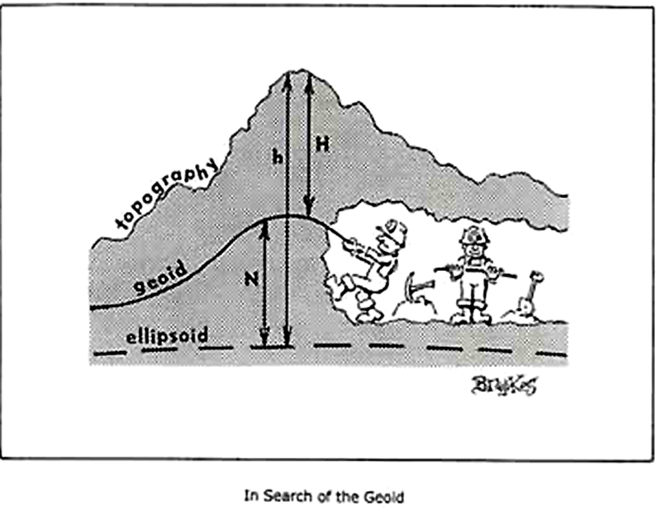

Slide 36
Where is the Geoid, i.e., “0.000”?
BLUF - U.S. and Canada agreed to adopt the common value of 62,636,856.00 m²/s² to serve as the common geoid. EGM08 uses 62,636,854.25 m²s-²
The most fundamental aspect of any geopotential datum is the selection of the geopotential value (W0) to serve as the geoid, which is the best approximation of global mean sea level.
The value of 62,636,856.0 m² s-² (Burša et al., 1999) was adopted by the International Astronomical Association (IAU), the International Earth Rotation and Reference Systems Service (IERS) and the Bureau International des Poids et Mesures (BIPM).
NGS decided to determine the best value from comparisons at tide gauges around North America (Roman and Li, 2020). This will tie more closely to the mission of the National Ocean Service inside of NOAA and provide enhancements to products such as VDatum and the Sea Level Rise viewer
It will also better serve the American public by making a more explicit link between the ocean surface and places on land in the form of relative sea level (e.g., how high is my house above the next storm surge or King tide?)
Removal of estimated Mean Ocean Dynamic Topography (MODT) values at nearly 200 tide gauges in the U.S. and Canada determined residual values that averaged out to the value adopted by the IAU and the IERS. This test was completed by NGS for the U.S. and also by the Canadian Geodetic Survey, and both agencies agreed on the results. Therefore, the U.S. and Canada agreed to adopt the common value of 62,636,856.00 m²/s² to serve as the common geoid.

Slide 37
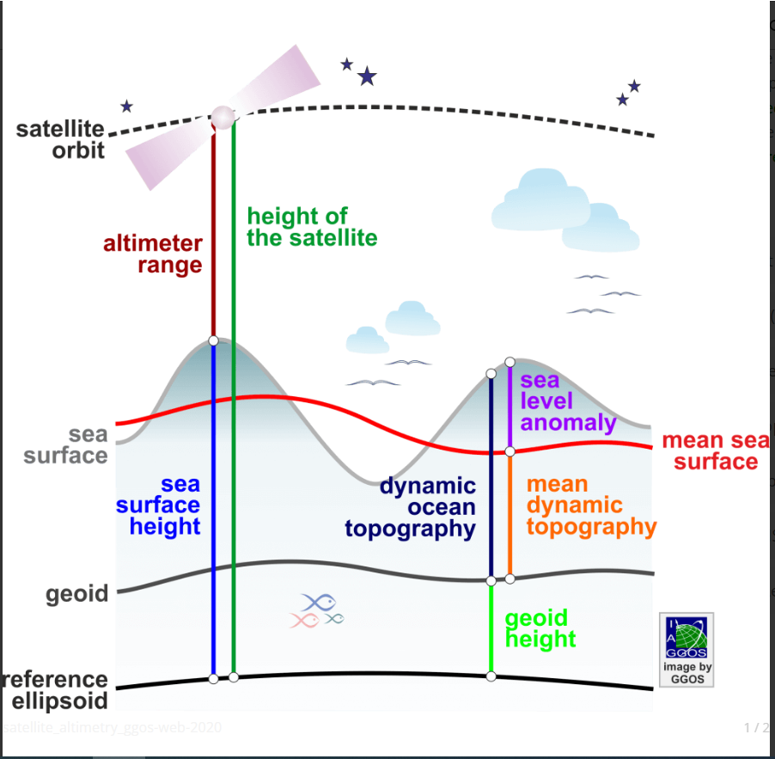
Measurements for Ocean Models

Slide 38
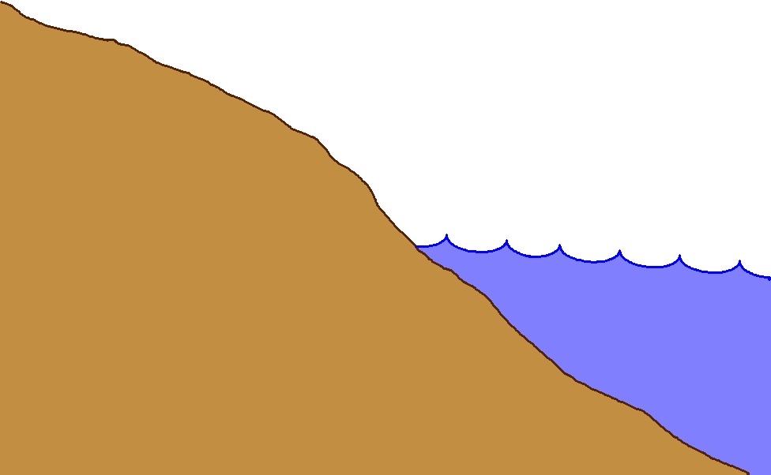
Gravity measurements help answer two big questions…
How “high above
‘sea level’ ” am I?
(FEMA, USACE,
Surveying and
Mapping)
How large are
hydrodynamic processes?
(Coast Survey, CSC,
CZM)
Earth’s
Surface
ITRF or WGS84 and EGM08
Geoid
≠
Coast
Ocean
Surface
Ellipsoid
NAD 83 and Geoid 18
From
Gravity
From
GPS
From
Satellite Altimetry

Slide 39
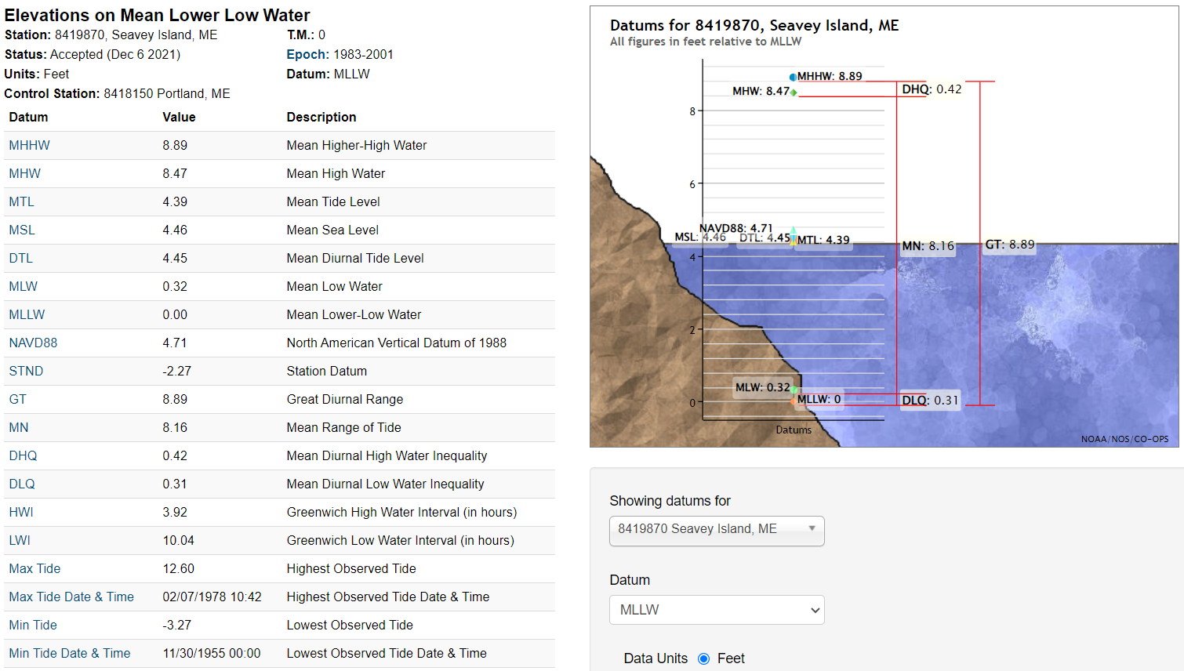
Local Tidal Datums
Datums computed based on daily (sometimes hourly) observations taken during the 18.6 year Tidal Epoch listed
Full Datum Definitions at CO-OPS Website

Slide 40
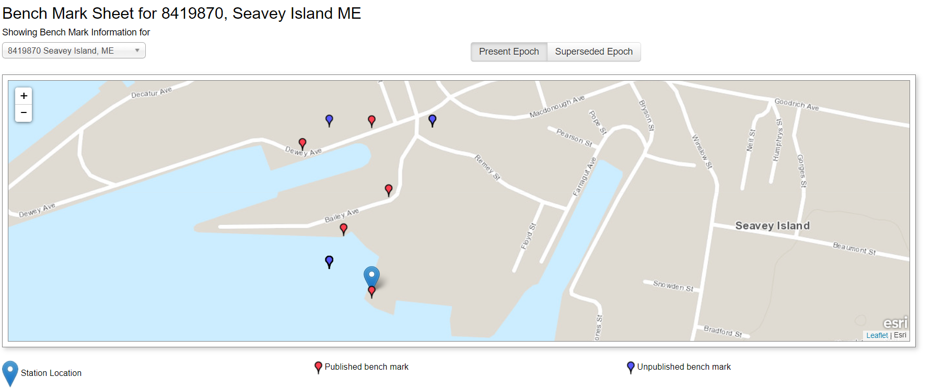
Tied to Stable NAVD88 BM’s

Slide 41
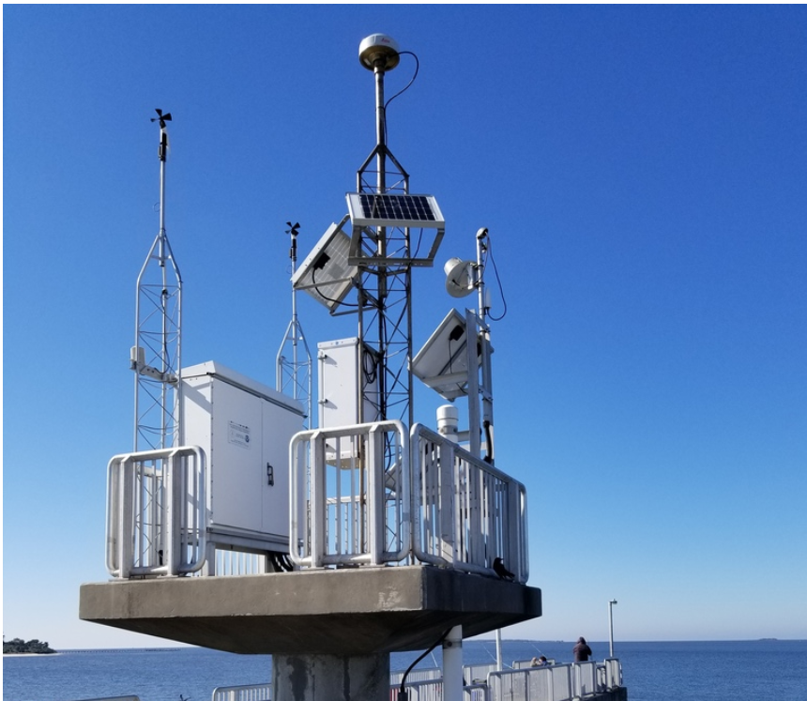
Sometimes a Direct Tie to ITRF and NAD 83 via NOAA National CORS (NCN)

Slide 42
Working with Tidal and Geodetic Datums
Direct conversion/transformation through known measured difference NAVD 88 or NAD 83 ⬅➔ Local Tidal (very local to gauge)
VDATUM
  provides transformation and interpolation between gauge locations: https://www.ngs.noaa.gov/INFO/facts/vdatum.shtml
  Supports file conversion (.txt, .las/laz, .shp)

Slide 43
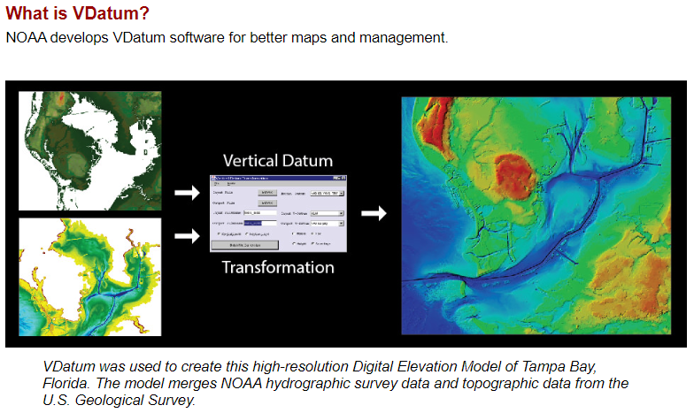

Slide 44
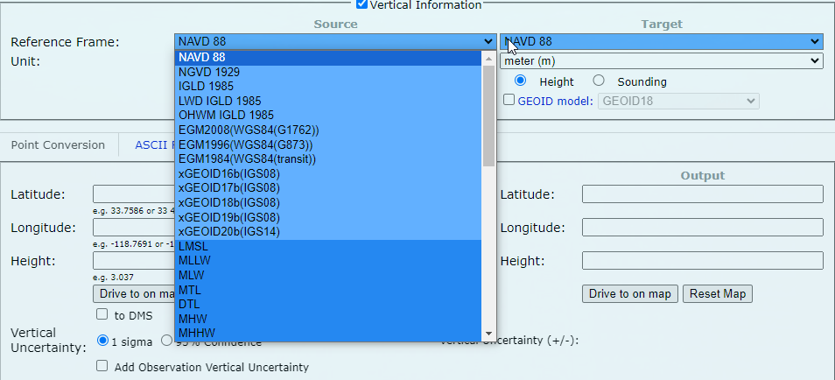
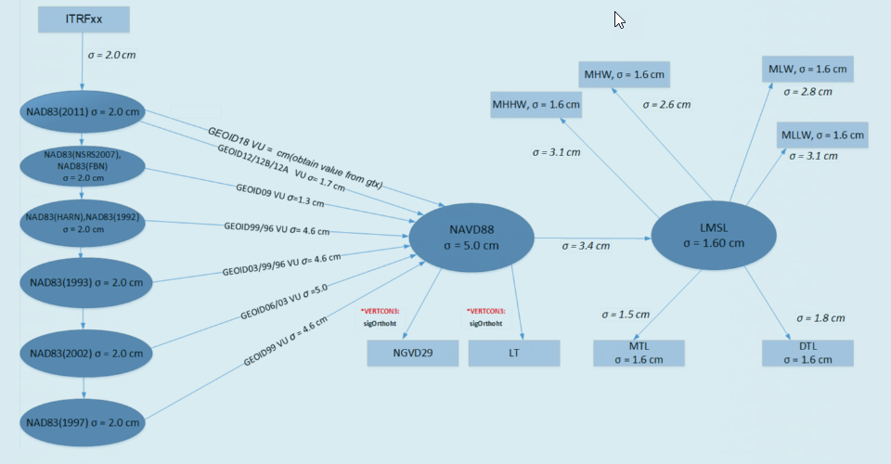
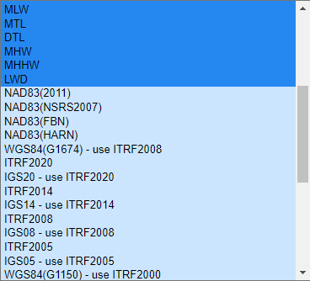
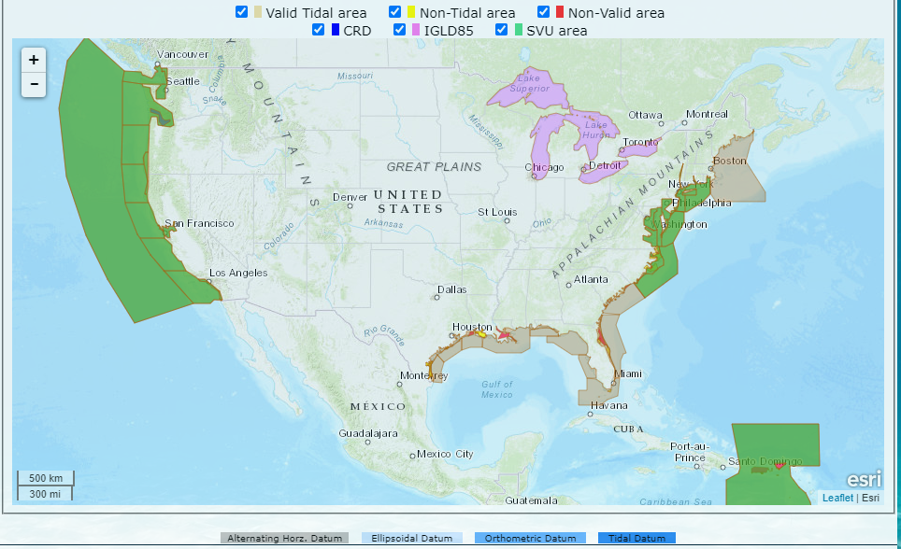
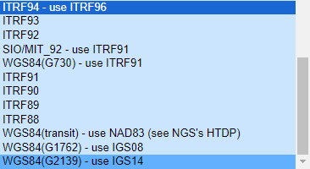

Slide 45
Today vs Future
Geometric frame aligned to ITRF
Geometric and Geopotential datums integrated
Geopotential datum fundamentally based on H=h-N, not on benchmarks/leveling
Dynamic (tracking changes in all dimensions)

Slide 46
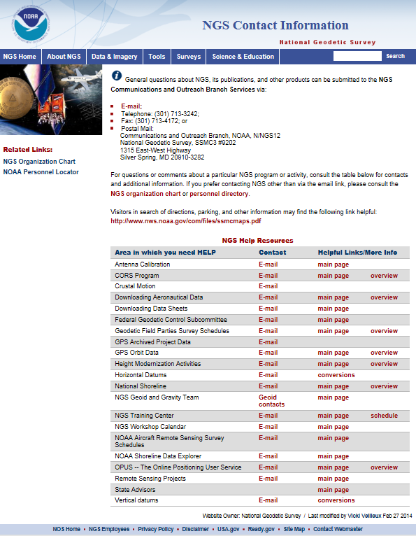
How can you prepare (generally)?
Watch for upcoming NGS status conferences/reports/webinars, News, New Products, etc…
  https://geodesy.noaa.gov/INFO/subscribe.shtml
New Datums Pages
  https://geodesy.noaa.gov/datums/newdatums/index.shtml
  https://alpha.ngs.noaa.gov/index.shtml
Understand the impact of changing positions and heights for your community, company or agency
Communicate your issues directly to NGS
  NGS Info Center
  State /Regional Geodetic Advisor
  http://www.ngs.noaa.gov/ADVISORS/AdvisorsIndex.shtml

Slide 47
How to Prepare
Metadata is essential
    Improves reliability and accuracy of data
    Increases value and usefulness
Transform and collect data in current datums
    NAD 83 (2011), NAVD 88
Do an inventory of your data
Do you have documents, manuals, contracts, etc…that include language re: datums?
Do you have clients, subcontractors, in-house staff other than survey that need to be educated about the new datums?
Store Data…not just coordinates!

Slide 48
Thank You!
Questions?
Presentation will be available at:
https://www.ngs.noaa.gov/web/science_edu/presentations_library/
Dan Martin
Northeast Regional Geodetic Advisor
ME, NH, VT, MA, CT, RI, NY, NJ
Dan.martin@noaa.gov
240-676-4762

