Slide 1
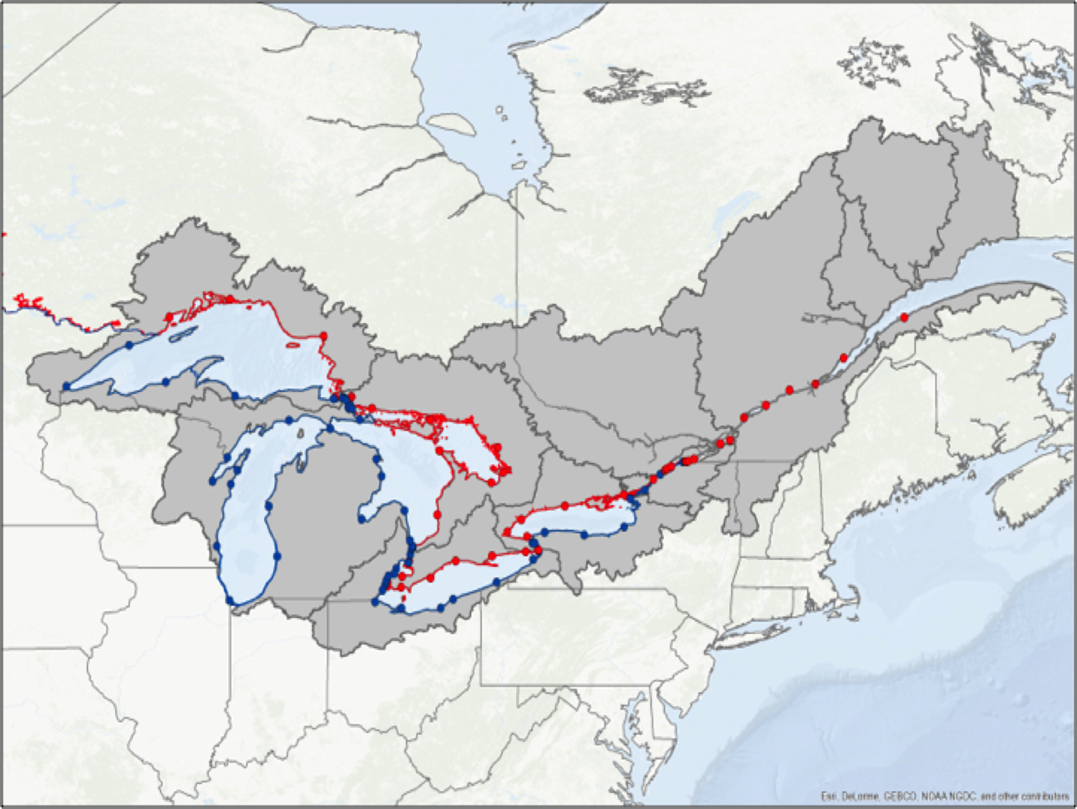


Defining a New
International Great Lakes Datum
Coordinating Committee on Great Lakes
Basic Hydraulic and Hydrologic Data
Laura Rear McLaughlin¹, Terese Herron²
¹Center for Operational Oceanographic Products and Services, NOAA
²Canadian Hydrographic Service, Fisheries and Oceans Canada
On Behalf of the Vertical Control – Water Levels Subcommittee
Coordinating Committee on Great Lakes Basic Hydraulic and Hydrologic Data
NGS Webinar Series
Virtual
July 15, 2021

Slide 2
What is IGLD?
IGLD = International Great Lakes Datum
A common height reference system (vertical datum) to measure and relate water levels
The official vertical datum reference for water level measurements and navigation products throughout the Great Lakes, their connecting channels and the upper St. Lawrence River
Required for the unified, internationally coordinated collection, compilation and use of data for hydraulics, hydrology & water level management

Slide 3
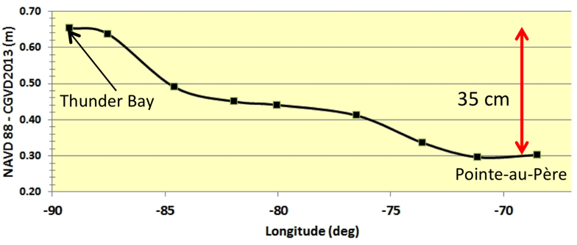
Why a New IGLD?
Two previous realizations of IGLD
  Leveling-based datums
  With respect to MSL at Pointe-au-Père, QC
  IGLD (1955)
  IGLD (1985) – current – based on NAVD88
Need to periodically update IGLD due to vertical crustal motion (glacial isostatic adjustment)
IGLD (1985) also
contaminated by
systematic error in
leveling
IGLD(1985) Systematic Error (m)
Longitude (deg)

Slide 4
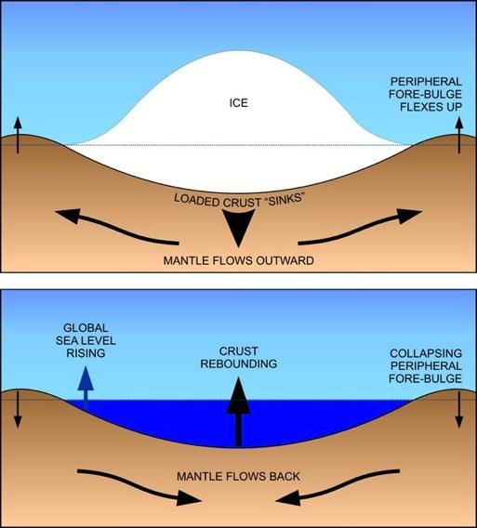
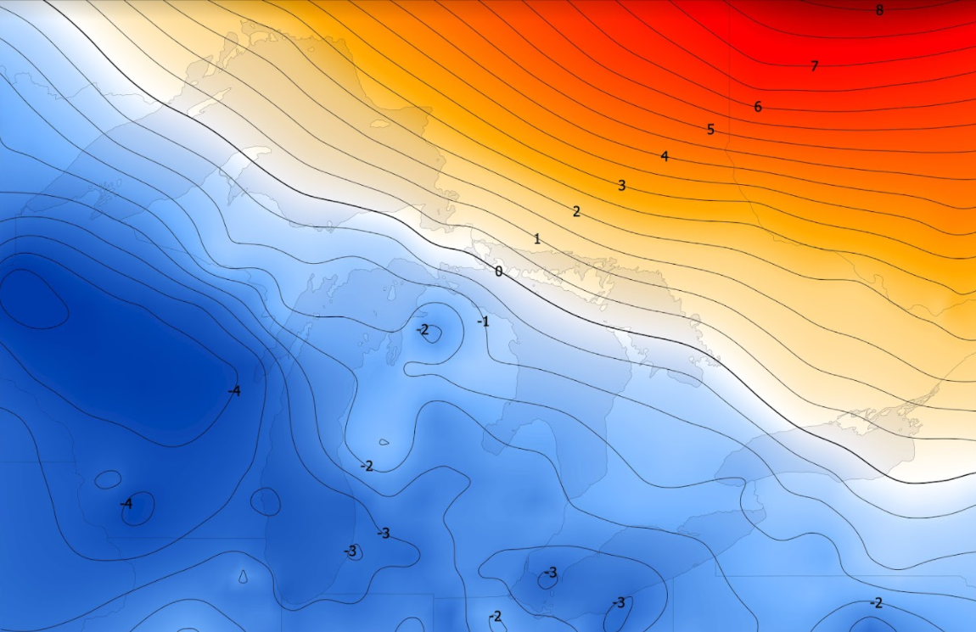
Glacial Isostatic Adjustment (GIA)
Uplifting in north, subsiding in south
Overall tilting ~7 mm/yr (21 cm over 30 yr)
Need to update IGLD every 25-30 yr – overdue!
Contour map of vertical velocities in mm/year based on data from the Canadian Geodetic Survey. Contour interval: 0.5 mm/year)
Process of glacial isostatic adjustment

Slide 5
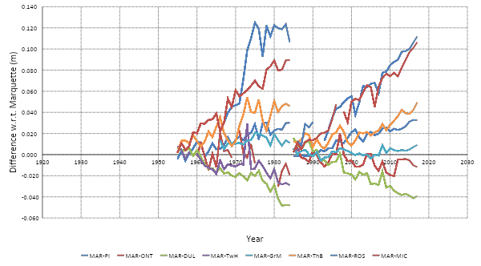
Effect of GIA Tilting on Water Levels
Yearly Average Difference in Lake Superior Water Levels
Marquette vs Other Gauges
IGLD (1955)
IGLD (1985)

Slide 6
Attributes Defining an IGLD
Reference Zero
Reference Surface (Equipotential Surface)
Dynamic Heights
Reference Epoch

Slide 7
Reference Zero
Reference datum for heights – zero height
  Usually mean sea level (MSL) over decades
  Represented by a geopotential value (W₀)
Different realizations of MSL for IGLD
  IGLD (1955) used MSL at Pointe-au-Père, QC
  IGLD (1985) used MSL at both Pointe-au-Père & Rimouski
New IGLD (2020)
  CC adopted same W₀ adopted for new North American – Pacific Geopotential Datum of 2022 (NAPGD2022)
  Represents MSL around coasts of North America
  Also adopted by Canadian Vertical Datum of 2013
  31 cm above IGLD (1985)

Slide 8
Reference Surface
Reference surface is an equipotential surface to which all heights are referenced
Extension of the reference zero inland – surface of zero ht
IGLD (1955) & (1985) used geodetic leveling to indirectly define the reference surface
  Too time consuming & cost prohibitive
  Datum accessible only where leveling exists (bench marks)
  IGLD (1985) contaminated by systematic errors
New IGLD (2020) will be based on NAPGD2022
  Same N.A. geoid as a continuous reference surface
  Available everywhere in North America
  Consistent & accurate at cm-level

Slide 9
Dynamic Heights
Heights are fundamentally based on the geopotential difference between a point and the reference surface (geoid)
  Geopotential difference constant along an equipotential surface (e.g., undisturbed lake)
Orthometric heights (H)
  Geopotential difference / mean gravity along plumbline
  Physical distance from reference surface to point
  Gravity of equipotential surface not constant over large areas
  H is NOT constant along an equipotential surface (lake)
Dynamic heights (H^{d})
  Geopotential difference / constant value of normal gravity at 45°
  Scaled version of geopotential difference
  Similar magnitude as orthometric heights
  H^{d} is constant along an equipotential surface (lake)
  Required for water management & power generation

Slide 10
Dynamic vs Orthometric Heights
H^{D}₁
H^{D}₁ = H^{D}₂
Lake Superior
H^{D}₂
Lake Michigan-
Huron
H₁
H₁ ≠ H₂
H₂
Lake Ontario
Reference surface
(geoid)
H₀ = H^{D}₀ = 0
South
North
Dynamic heights (H^{D}₁ & H^{D}₂) on equipotential surface (lake) are same
Orthometric heights (H₁ & H₂) are physical distances from ref. surface – not the same because of convergence of equipotential surfaces (due to flattening of Earth at the poles)
Notes:
DON’T SPEND MUCH TIME ON THIS SLIDE. JUST READ THE BULLETS TO SAVE TIME.

Slide 11
Reference Epoch
Epoch is a point in time to which data are referenced
Mean water levels defined over a 7-year observation period using summer months (June-September)
  IGLD (2020) using 2017-2023
  Central reference epoch = 2020
  Mean levels used for evaluating lake topography & validation of seasonal gauge observations
Heights will be referenced to the 2020 epoch
  To ensure compatibility of heights measured at different epochs
  Velocity model will account for crustal motion

Slide 12
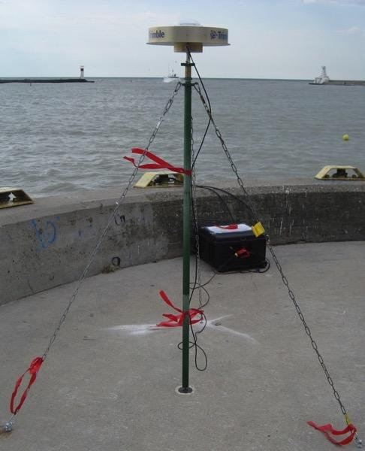
Key Activity – GNSS Surveys
Need to determine heights of water level stations in the new geoid-based IGLD (2020)
GNSS survey campaign will be required at all water level stations in 2020→2021→2022 (ref. epoch)
  Permanent, seasonal, Seaway &
  hydro stations
Using standardized binational
guidelines
Other campaigns at permanent
gauges
  1997, 2005, 2010, 2015 & 2022 &2027
  Used to improve vertical velocity model
Typical GNSS Setup

Slide 13
Key Activity - Seasonal Gauging
To determine lake topography (a.k.a. hydraulic correctors) due to, e.g.
  River discharge
  Prevailing winds
  Variations in water temperature
Too few permanent gauges
  Need to densify network with seasonal gauges (see next slide)
  Each installed for a single summer
  Spread over several years
Ensuring binational consistency & linking of observations
All gauges will be included in 2020 GNSS campaign
Notes:
THIS IS CHS WORK SO YOU SHOULD CHECK THIS SLIDE AND REVISE AS YOU SEE FIT. FLIP TO THE MAP ON THE FOLLOW SLIDE ONLY TO SHOW THE DENSIFICATION OF THE GAUGE NETWORK PROVIDED BY THE SEASONAL ONES. THEN SKIP THE MAP WHEN FINISHED THIS SLIDE. THAT SHOULD SAVE YOU SOME TIME AS YOU MIGHT BE RUNNING OUT OF TIME AS THIS POINT.

Slide 14
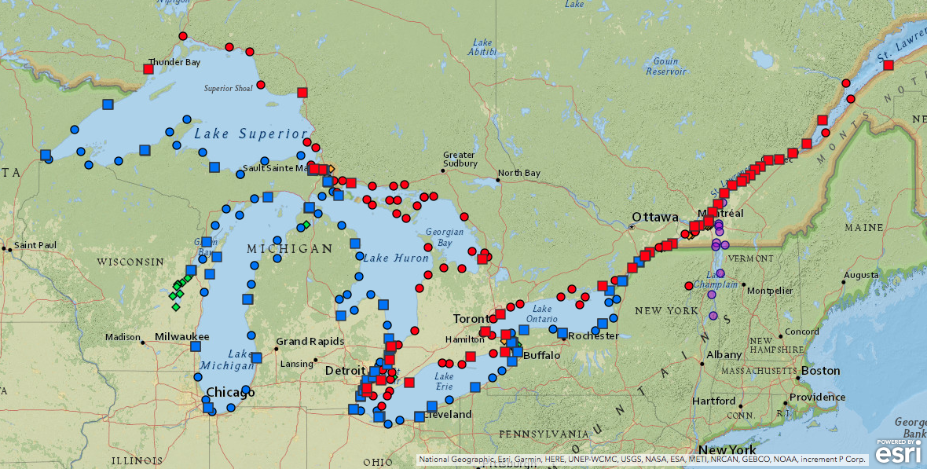
Seasonal Gauges
52 Canadian permanent
68 Canadian seasonal
55 American permanent
54 American seasonal
Notes:
SKIP THIS SLIDE IF RUNNING OUT OF TIME

Slide 15
Additional Activities/Issues
Transformations between datums
  Needed to update existing products to new datum
Low water datum
  Defines chart datum for safe navigation
  Needs to be defined w.r.t. new IGLD
Outreach
  Identify and inform those impacted by a new IGLD so they can understand and prepare
Future issues; many changes required including water management rules/accounting, legal shoreline use/planning, chart updates, models, etc.

Slide 16
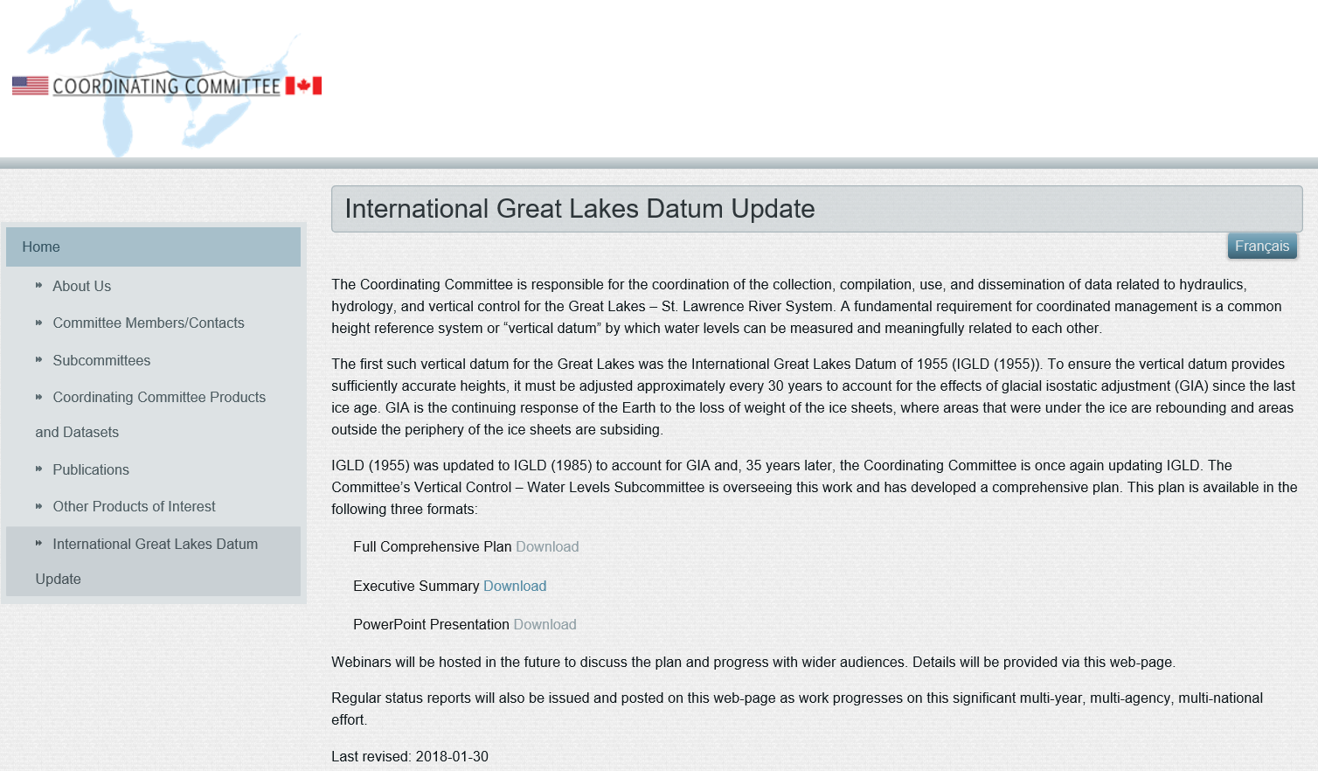
For Further Information
http://GreatLakesCC.org/

