Slide 1
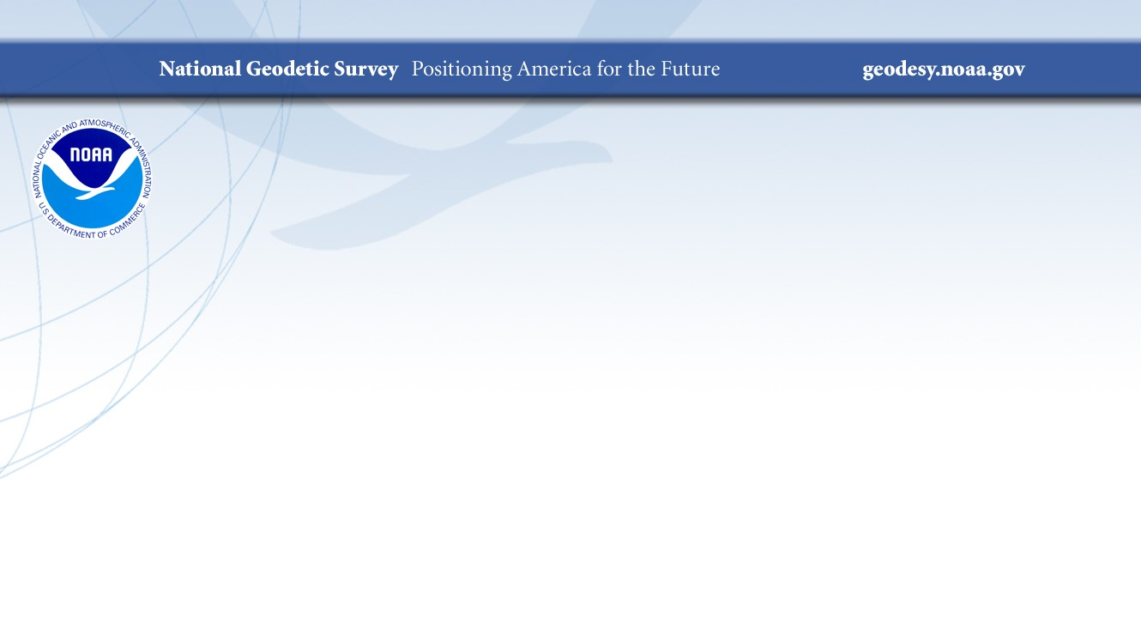
Vertical Datums: An Overview & Planned Updates
Notes:
12 – 15 minutes
Presenters: Jacob Heck, Laura Rear McLaughlin, Terese Herron, Michael Michalski
Vertical datums provide reference for determining elevations. In the next few years, NGS, CO-OPS, and partner agencies in Canada, are updating three vertical datums:
the North American Vertical Datum of 1988 (NAVD 88),
the geodetic vertical datum that will be replaced by the North American-Pacific Geopotential Datum of 2022 (NAPGD2022);
the International Great Lakes Datum (IGLD) used to reference water levels in the Great Lakes and connecting channels; and
the National Tidal Datum Epoch (NTDE) used to reference water levels along the U.S. Ocean Coastline.
This webinar gives an overview of these datums and the changes that are coming.
*Technical Content Rating: Beginner - No prior knowledge of this topic is necessary.

Slide 2
The North American Vertical Datum of 1988
(NAVD 88)
The vertical control datum of the National Spatial Reference System (NSRS)
Notes:
The North American Vertical Datum of 1988 (NAVD 88) is the vertical control datum established in 1991 by the minimum-constraint adjustment of the Canadian-Mexican-United States leveling observations. It held fixed the height of the primary tidal bench mark, referenced to the new International Great Lakes Datum of 1985 local mean sea level height value, at Father Point/Rimouski, Quebec, Canada. Additional tidal bench mark elevations were not used due to the demonstrated variations in sea surface topography, i.e., the fact that mean sea level is not the same equipotential surface at all tidal bench marks.
North American Vertical Datum of 1988 (NAVD 88) consists of a leveling network on the North American Continent, ranging from Alaska, through Canada, across the United States, affixed to a single origin point on the continent.
In 1993 NAVD 88 was affirmed as the official vertical datum in the National Spatial Reference System (NSRS) for the Conterminous United States and Alaska (see Federal Register Notice (FRN)). Although many papers on NAVD 88 exist, no single document serves as the official defining document for that datum. Detailed information about NAVD 88 is available here.

Slide 3
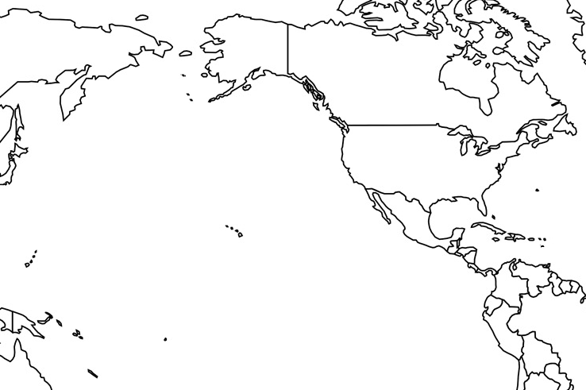
Vertical Datums of the NSRS
St. Paul I.
- None -
St. Lawrence I.
- None -
St. Matthew I.
- None -
Alaska
NGVD 29
NAVD 88
St. George I.
- None -
CONUS
NGVD 29
NAVD 88
Hawaii
- None -
CNMI
NMVD 03
Puerto Rico
PRVD 09
U.S. Virgin Islands
VIVD 09
American Samoa
ASVD 02
Guam
GVD 63
GUVD 04
Notes:
NAVD 88 is just one of several vertical datums in the NSRS
Some places have no official geodetic datums

Slide 4
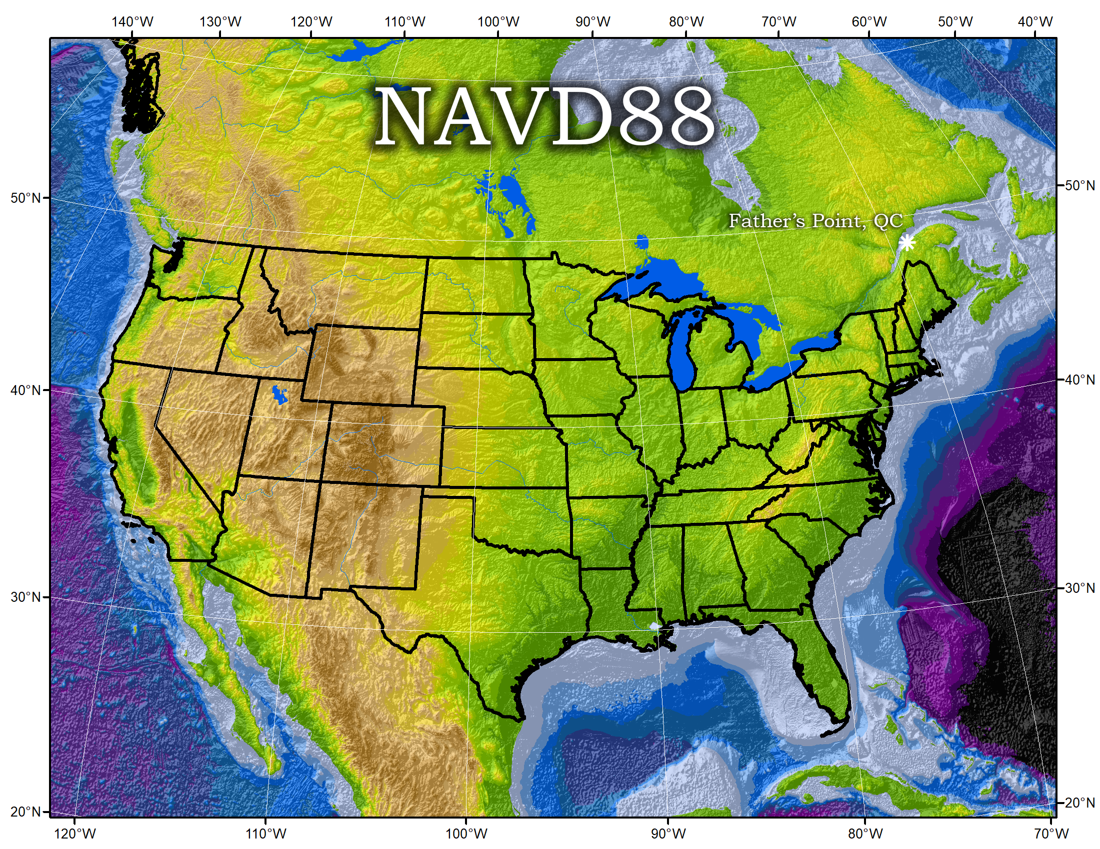
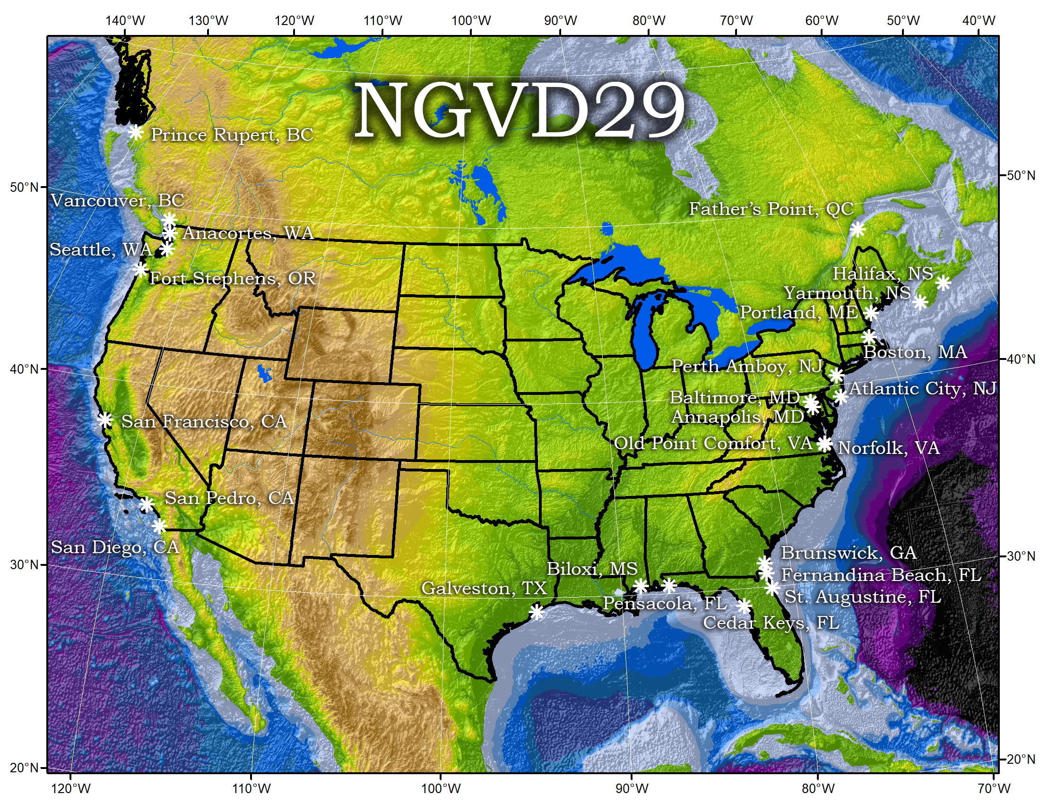
Notes:
NGVD 29: 26 Tide gauges in North America
NAVD 88: Father Point in Rimouski, Canada

Slide 5
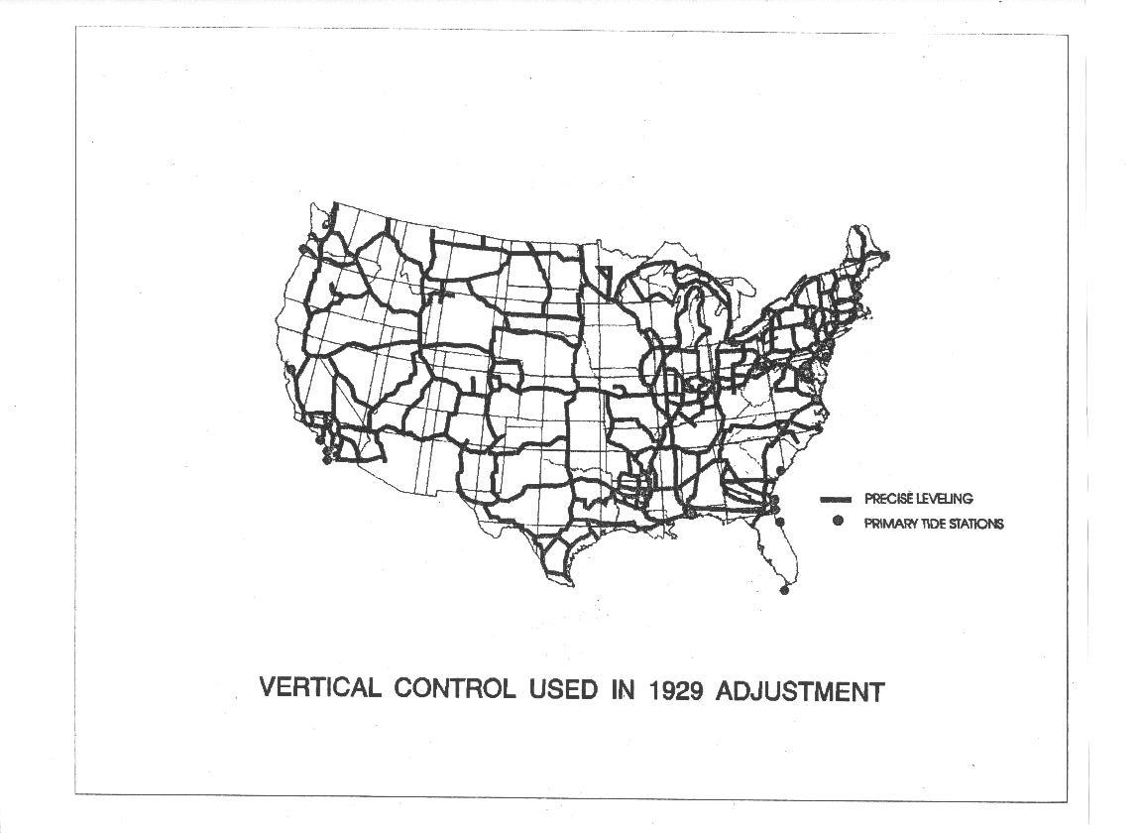
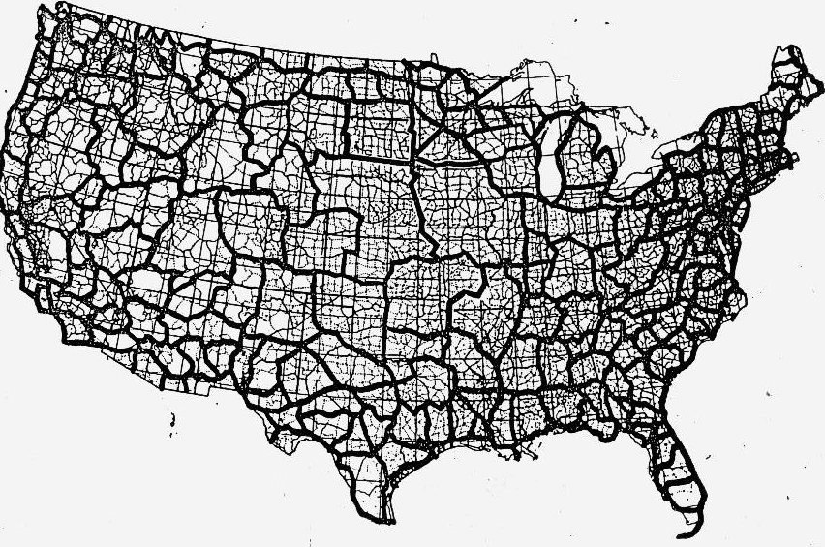
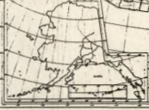
NGVD 29
NAVD 88
Notes:
NGVD29 on left
NAVD88 on the right
Both are realized by leveling. Leveling data collected by crews walking across the country was adjusted to produce these datums.

Slide 6
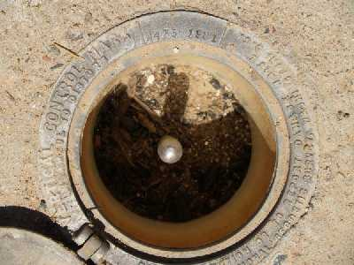
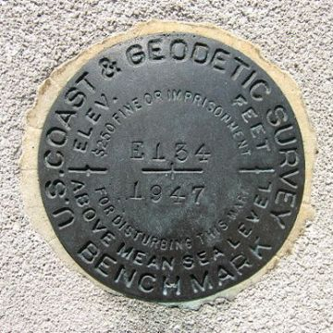
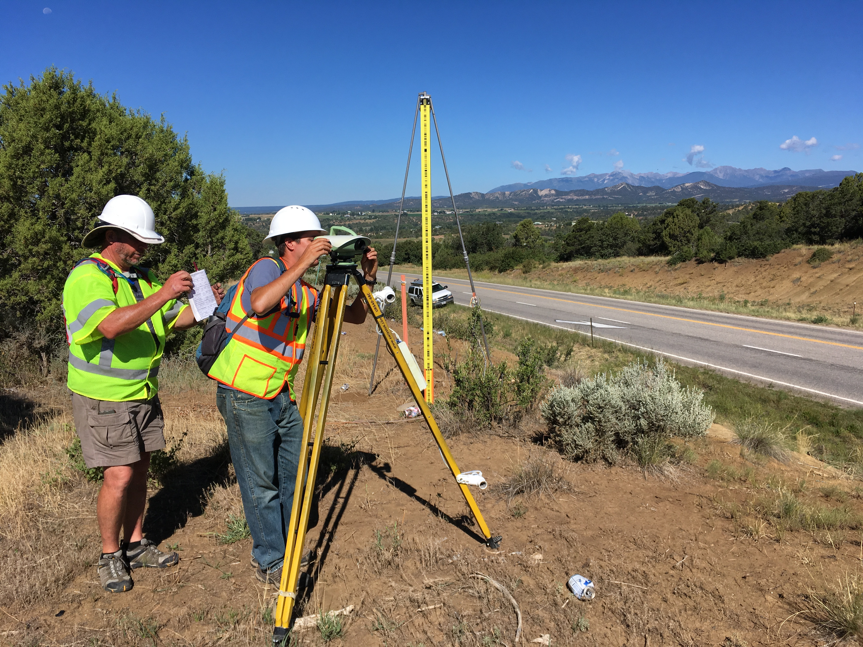
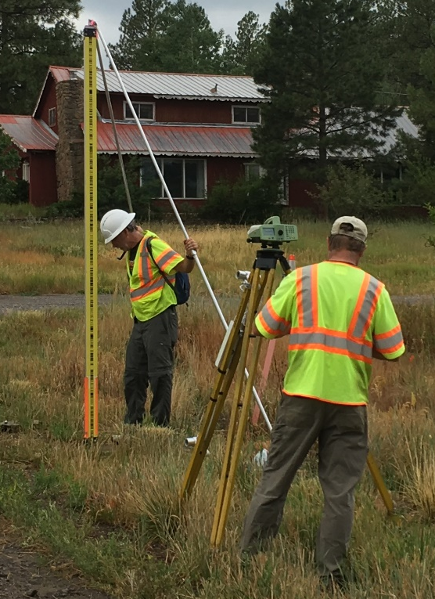
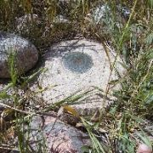
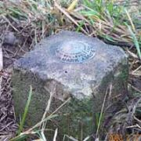
Notes:
NAVD 88 is accessed through leveling off of marks with NAVD 88 heights on them.
Those heights were determined by leveling crews.

Slide 7
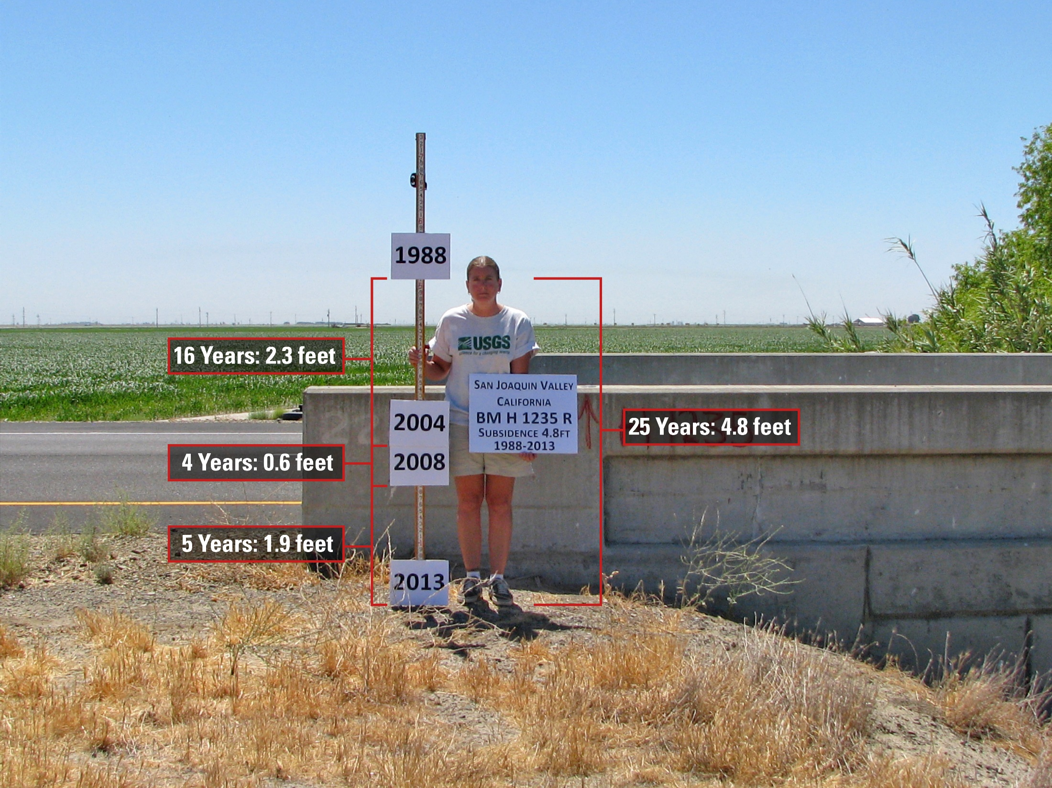
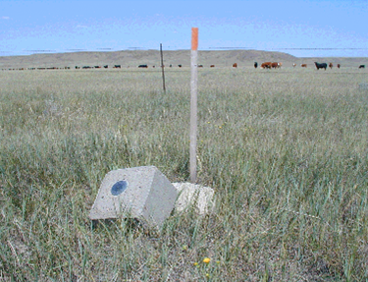
Subsidence
Destruction
Notes:
NAVD 88 has limitations, including that it assumes that the heights stay the same over time, which in reality they don’t. This photo shows subsidence in California’s Central Valley.
Marks are susceptible to destruction and damage as well

Slide 8
The North American - Pacific Geopotential Datum of 2022
(NAPGD2022)
The vertical control datum of the Modernized National Spatial Reference System
Notes:
NAVD 88 is going away once the new geopotential datum is ready. It will be defined by a geoid model and accessible through GNSS/GPS

Slide 9
Replacing NAVD 88
  The Old:
  NAVD 88
  PRVD 02
  VIVD09
  ASVD02
  NMVD03
  GUVD04
  The New:
  The North American-Pacific
  Geopotential Datum of 2022
  (NAPGD2022)
Orthometric
Heights
Normal
Orthometric
Heights
Notes:
Currently the NSRS consists of a variety of vertical datums. NAVD88 is an orthometric heights datum in the continental United States.
All these listed datums and supporting products will be replaced by the North American-Pacific Geopotential Datum of 2022 (NAPGD2022), the geoid model GEOID2022.

Slide 10
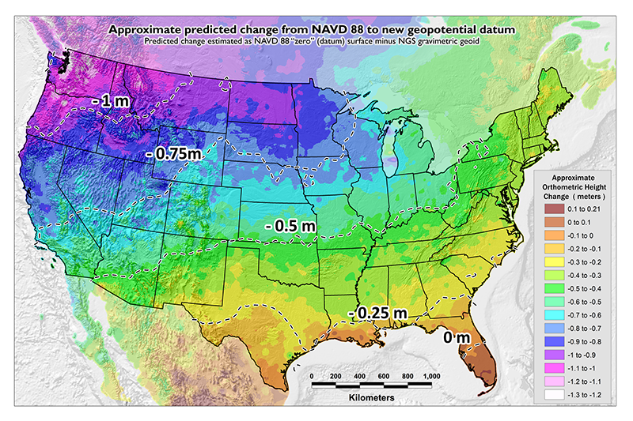
NAVD 88 (epoch ?) to
NAPGD2022 Epoch 2020.00 (estimate)
Notes:
NAVD 88 has a tilt to it. Leveling is susceptible to systematic errors that build up over large distances.

Slide 11
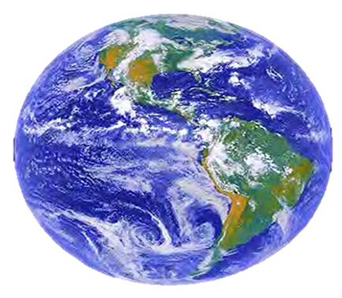
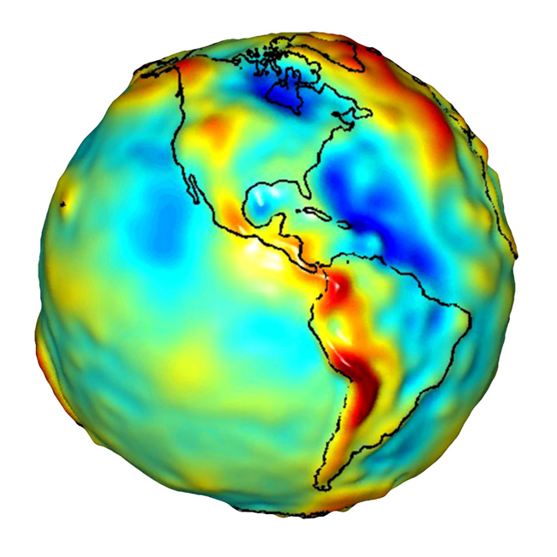
GRS80 ellipsoid
Geoid
Notes:
NAPGD2022 will be accessed differently than NAVD 88 is. First, let me explain what is what.
Start with the Earth. The Earth isn’t flat, but it’s more than just a sphere.
We first approximate it as an ellipsoid, which is a sphere that’s been squashed a little bit. The ellipsoid that we use is called GRS 80. With GPS we can measure a height above the ellipsoid.
A better approximation is a geoid, a surface that closely matches sea level. A geoid is what’s called an equipotential surface. As you move through the The height above the geoid is called an orthometric height. Leveling gives orthometric height differences. These are more significant than ellipsoidal heights since ellipsoidal heights don’t tell anything about which way water flows.

Slide 12
Understanding “Geo-Potential”
h
The resting water has “potential” energy just by being high up on this cliff.
Energy = mgh
That potential energy can turn into real (kinetic) energy by falling.
Energy = ½ mv² (= mgh)
Think of the Earth as creating a “gravity field” that masses experience. I’ve drawn potential “field lines”
Potential = gh
Gravity x Height is “Geopotential”. This is what water “feels”.
Notes:
Credit: Derek van Westrum
The geoid is the equipotential surface that we choose to be the reference surface.

Slide 13
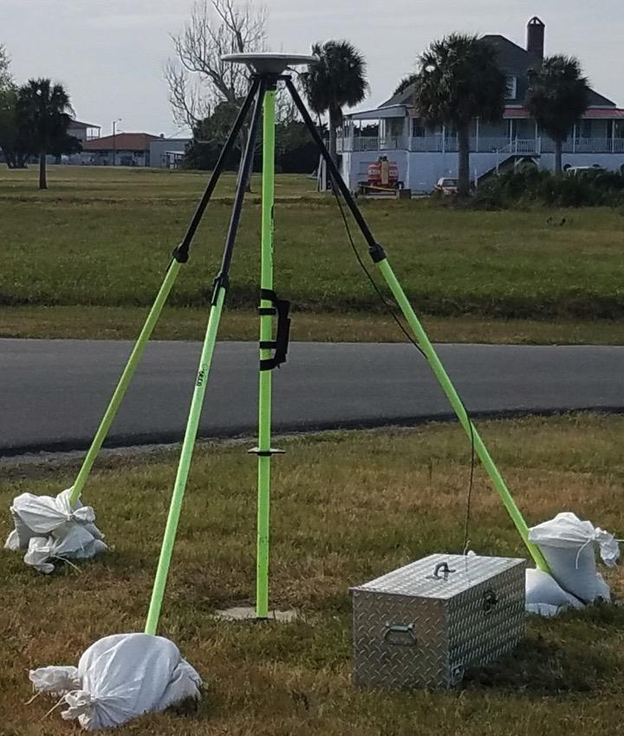
Earth’s
Surface
h
ITRF
origin
GRS80
ellipsoid
Notes:
Back to that ellipsoid, when you measure with GPS, you get coordinates in a reference frame, like the International Terrestrial Reference Frame. Those coordinates can be converted to latitude, longitude, and an ellipsoidal height relative to the reference ellipsoid, which are geometric quantities.

Slide 14
The Geoid, and Heights
h
= H
+ N
h: ellipsoidal height
H: orthometric height
N: geoid undulation
Topography
h
H
The geoid
N
A chosen
ellipsoid
Notes:
We work on the topography, at the surface of the earth
Then we have the geoid
Then we have the ellipsoid
Little h comes from GPS/GNSS and is the perpendicular distance from the ellipsoid surface
Big H is the useful value that we want, the distance above the geoid
The geoid undulation N comes from the geoid model, if you measure with GPS and subtract the geoid undulation, then you get the orthometric height

Slide 15
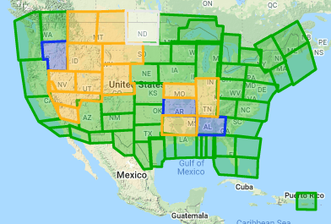

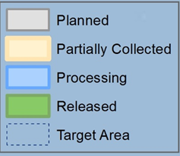
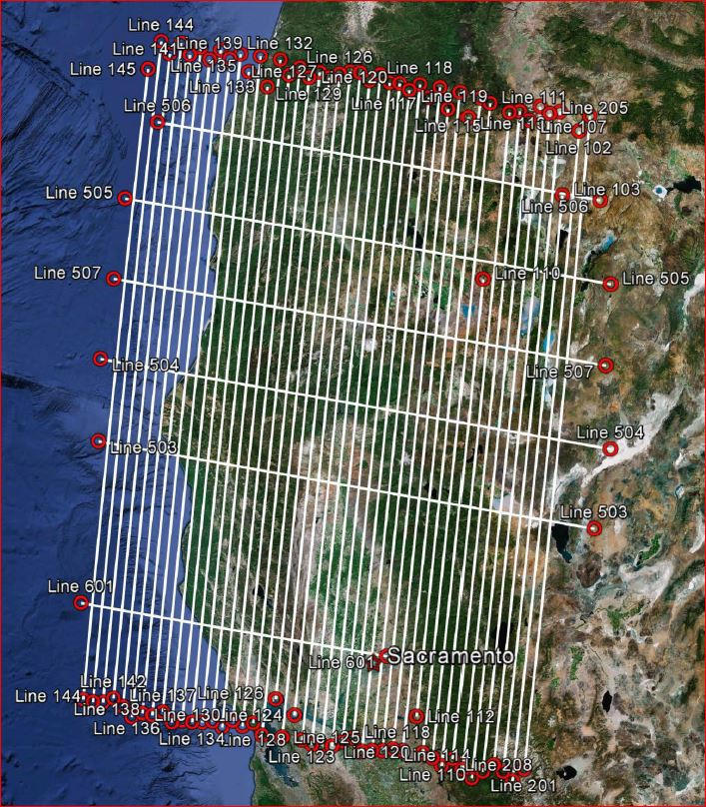
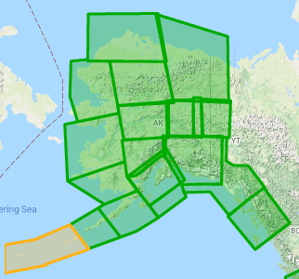
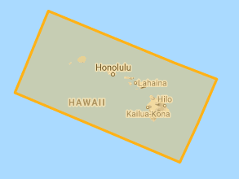
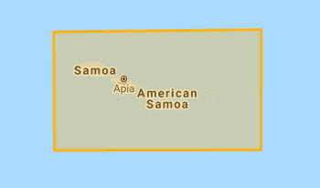
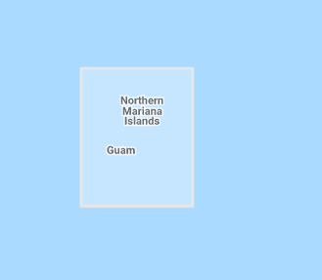
Gravity for the Redefinition of the American Vertical Datum (GRAV-D)
10 km data lines
70 km cross lines
20,000 ft altitude
230 kt flight speed
Alaska
Hawaii
American Samoa
Guam & CNMI
Notes:
To get the geoid height, that capital N, we need to make a geoid model. To do that, we need gravity information across the country. Since 2008 we have been flying airborne gravity as part of the GRAV-D program across the country.

Slide 16
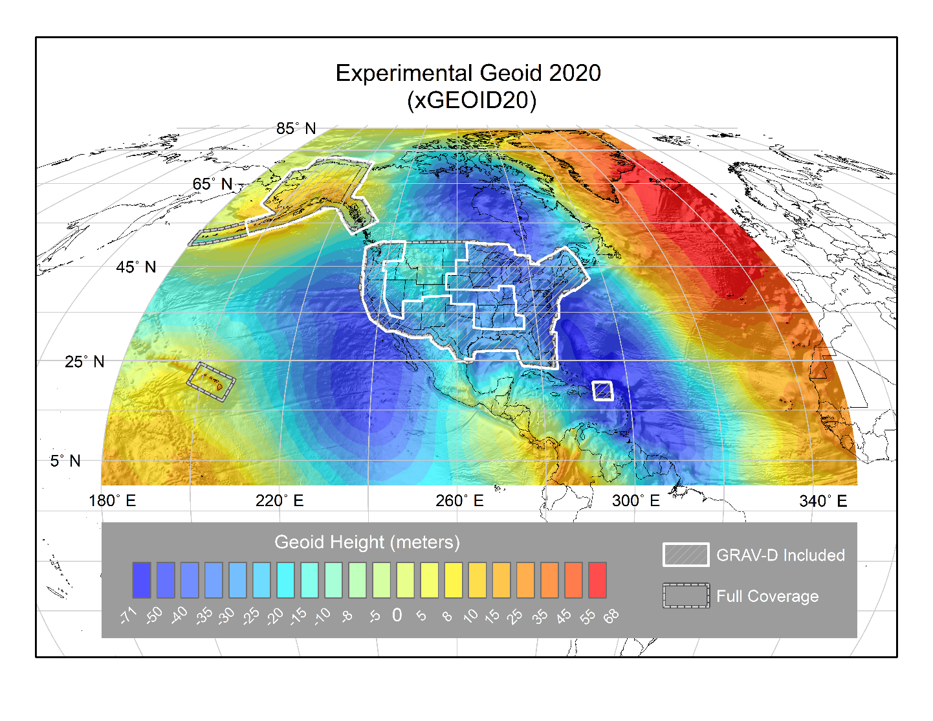
Notes:
The geoid model looks something like this.

Slide 17
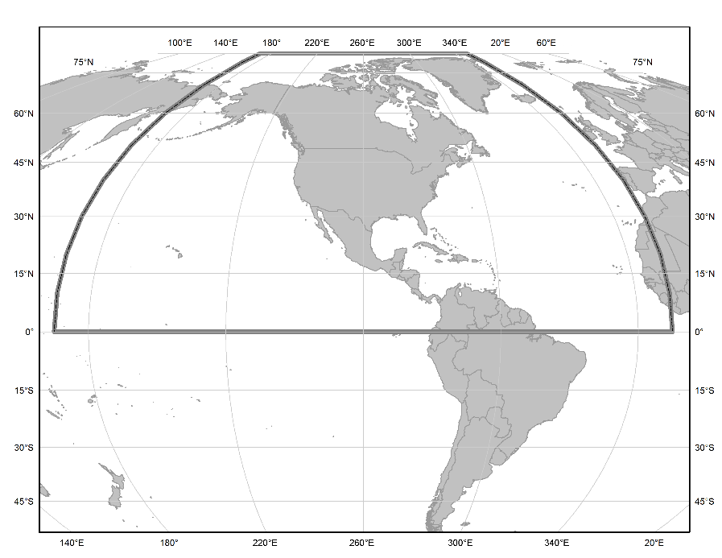
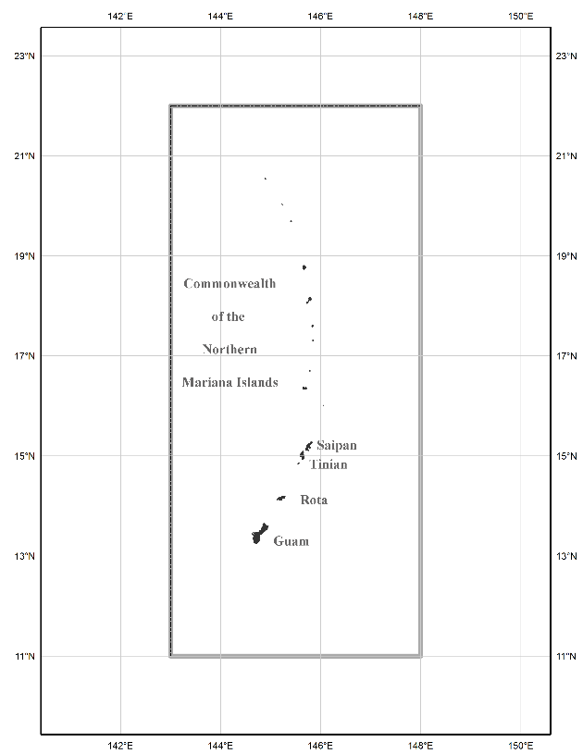
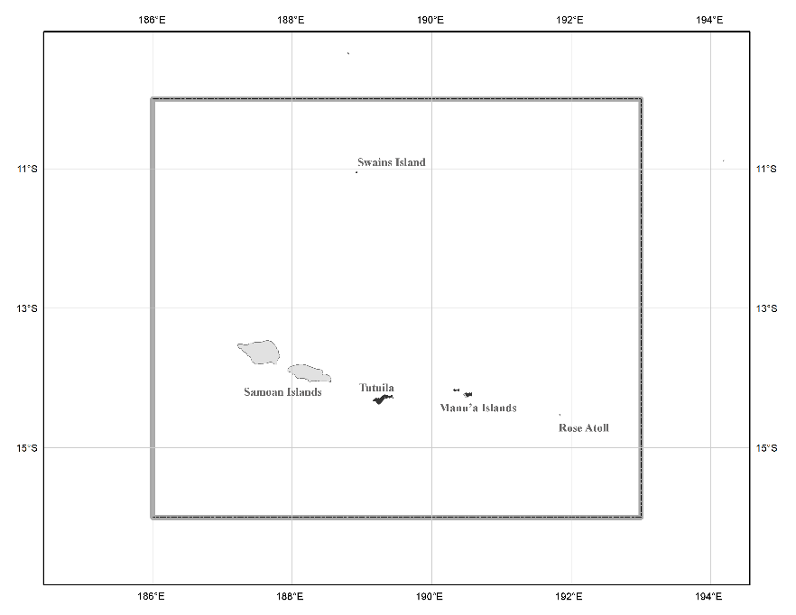
Three Gridded Regions
“North American region”
¼ of the Earth
“American Samoa region”
“Guam/CNMI region”
Notes:
Here are the Three Gridded Regions in NAPGD2022 which, though global, will have high-resolution components only available in these three regions. NAVD 88 only covers the continental United States. NAPGD2022 will allow for consistent height determination across all of these territories.

Slide 18
Next up: IGLD

